Slide 1
Improvement Suggestions to the Procedure for Product Acceptance
Peter Miu (EUMETSAT)
CMA, CNES, EUMETSAT, ISRO, IMD, JMA, KMA, NASA, NIST, NOAA, ROSHYDROMET, USGS, WMO

Slide 2
What’s this all About?
Essentially, the GSICS Procedure for Product Acceptance (GPPA) is the process for GSICS product developers to their GSICS products “approved”.
The GPPA consists of up to four phases and this is documented in the GSICS Procedure for Product Acceptance Version 2.1 (Document Number: GSICS_GCC_GPPA_V02.1.
The four phases are:
Submission
Demonstration
Pre-operational
Operational

Slide 3
So what’s the Problem?
The GPPA is “complicated”, Document GSICS_GCC_GPPA_V02.1 is 6 pages.
Yes its only 6 pages, doesn’t sound complicated to me...well the process of submission, review and authorisation across the International GPRC partners requires coordination, tracking and action resolution.
No one is doing this full time, there are currently no periodic meetings to discuss the existing GSICS products.
It seems that there is a problem as there are currently no operational GSICS products.

Slide 4
How can we fix this? (1)
Simplify the procedure by (note, general principle, to be tailored for each phase):
Simple GPPA webpage to submit proposed documentation and the product(s).
Documentation can be uploaded to a ‘free cloud’ site, somewhere where it can be referenced using a URL.
Products can be uploaded to a GSICS collaboration server such that its contents can be visualised.
Submissions can be brought together in an overview webpage identifying the phase.
A doodle (or equivalent) “Make a Choice” webpage can be create to record reviewer’s recommendation and comments for the submission.
The overview webpage, product link from the GSICS collaboration server and the doodle “Make a Choice” webpage can be sent to reviewers for processing.
Simplify the authorisation of a phase by:
For all phases other than the Operational, each GPRC reviewer makes a “pass” or “fail” recommendation in the a doodle “Make a Choice” page. A hard deadline time limit is set with periodic reminders and if the reviewer do not respond, the product is passed and a summary webpage with the reviewer result is issued.
For the Operational phase, same doodle “Make a Choice” page with the additional of one member of the executive panel to needs to authorise the operational status.

Slide 5
How can we fix this? (2)
If disagreement arise between reviewers for the operational phase, a GSICS Product Validation Review Board (GPVRB) shall be held to discuss the issue(s). This should be chaired by a member of the executive panel and the final decision is made by him/her.
Summary of the tools to automate the steps:
Doodle (or equivalent) for recording the reviews of the product phases.
GSICS collaboration servers used to access these products.
“Free Cloud” site e.g. Google Docs to store documentation submitted.
Simply web pages to bring the information together for access by reviewers.
Development needed:
Web page authoring for bring information together.
Automated or manual organisation of the submitted contents into the tools.
THREDDS configuration update.
Doodle “Make a Choice” page creation.

Slide 6
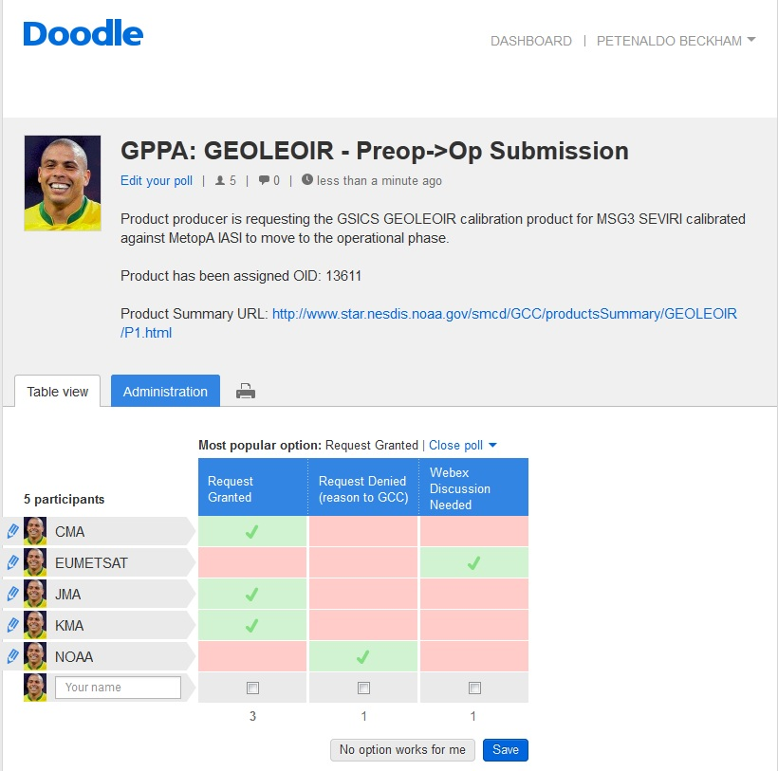
GPPA Doodle Mock-up
http://doodle.com/yzfvzd8h8ttgf8g5#table

Slide 7
Summary of who does what?
Overall Coordination: GCC
Submission Organisation: GCC
Web pages Development: GPRC GDWG Member
Product Access via a Collaboration Server: CMA / EUM / NOAA
Doodle “Make a Choice” web pages: GPRC GRWG Reviewer
Reviewing the submissions: GPRC GRWG Reviewer
Authorising a GSICS product: GPRC GRWG Reviewer + Executive Panel

Slide 8
End of Presentation: Thank you for your attention
WMO GSICS Portal
http://gsics.wmo.int
GSICS Coordination Centre - http://www.star.nesdis.noaa.gov/smcd/GCC/index.php
GSICS Product Catalog - http://www.star.nesdis.noaa.gov/smcd/GCC/ProductCatalog.php
EUMETSAT’s Data and Management Server
http://gsics.eumetsat.int

Slide 9
Lets Continue to Achieve Results !
GSICS achievements have been through International Partners working together.
We need to continue this through a sense of urgency to commit to common agreed goals.
Taking a lead to develop a common agreed goal does not mean you are totally responsible for work.
Seeking support is expected through the gsics-dev googlegroups mailing list or a dedicated WebEx teleconference.
Just to re-literate GSICS achievements are a Result of International Partners working together!

