Slide 1
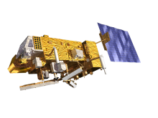
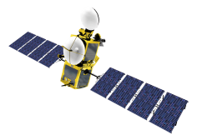
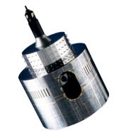
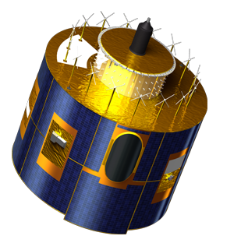
EUMETSAT GSICS Processing and Research Centre Report
Tim Hewison, Sébastien Wagner, Peter Miu, Rob Roebeling, Ken Holmlund, Bartolomeo Viticchiè, Viju John, Anne O’Carroll
EUMETSAT

Slide 2
Overview
Personnel Changes
Satellite Status
Status of outstanding GSICS actions on EUMETSAT
EUMETSAT GSICS Data and Products Server Status
Instrument Calibration Event Logs
Development of GSICS Products at EUMETSAT – summary only
GEO-LEO IR Products for current Meteosat using IASI
LEO-LEO IR Products AVHRR-IASI
GEO Solar-band Channels for current Meteosat – DCC & Lunar
Re-calibration of Meteosat archive data

Slide 3
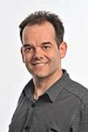
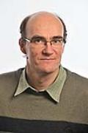
EUMETSAT GSICS Personnel Changes
Executive Panel
Ken Holmlund – replaces Jo Schmetz
Data Working Group
Simon Elliot – joins Formats Expert
Peter Miu – Everything Expert
Research Working Group
Tim Hewison – Chair and IR
Sébastien Wagner – Vis/NIR
Rob Roebeling – Archive Re-Cal
Rose Munro – UV Sub-Group
Joerg Ackermann – Microwave Sub-Group
Supported by:
Bartolomeo Viticchiè – Lunar Cal
Viju John – Meteosat-HIRS
Anne O’Carroll – AVHRR-IASI
Point of Contact for Operational Matters:
Harald Rothfuss

Slide 4
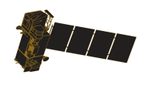
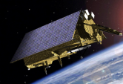
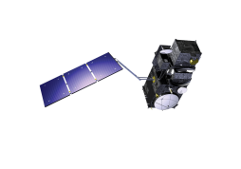
EUMETSAT commitment to long term continuity...
YEAR...
03
04
05
06
07
08
09
10
11
12
13
14
15
16
17
18
19
20
21
22
23
24
25
26
27
28
29
30
31
32
33
34
35
36
37
38
39
40
METEOSAT SECOND GENERATION
METEOSAT-8
METEOSAT-9
MSG-3/METEOSAT-10
MSG-4/METEOSAT-11*
METEOSAT THIRD GENERATION
MTG-I-1 : IMAGERY
Mandatory Programmes
MTG-S-1: SOUNDING
MTG-I-2: IMAGERY
MTG-I-3: IMAGERY
EUMETSAT POLAR SYSTEM (EPS)
MTG-S-2: SOUNDING
METOP-A
MTG-I-4: IMAGERY
METOP-B
METOP-C
EPS-SECOND GENERATION (EPS-SG)
METOP-SG: SOUNDING AND IMAGERY
METOP-SG: MICROWAVE IMAGERY
Optional Programmes
JASON
JASON-2
JASON-3
SENTINEL 6 (JASON-CS)
Third Party Programmes
COPERNICUS
SENTINEL-3
SENTINEL-4 ON MTG-S
SENTINEL-5 ON EPS-SG
YEAR...
03
04
05
06
07
08
09
10
11
12
13
14
15
16
17
18
19
20
21
22
23
24
25
26
27
28
29
30
31
32
33
34
35
36
37
38
39
40

Slide 5
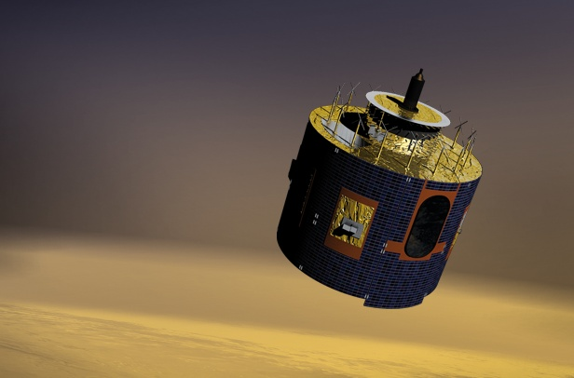
Geostationary satellites
Meteosat Second Generation (MSG)
4 geostationary weather satellites, operations at least until 2018 (MTG)
Full disk imagery: Imaging European weather, every 15 minutes with 12 spectral bands (currently Meteosat-10)
Rapid Scan Service (RSS) every 5 minutes (currently Meteosat-9): detection of rapid, local development of convective systems
Data collection for environmental monitoring

Slide 6
EUMETSAT’s geostationary satellite coverage
60 N
Meteosat-10 (0° Longitude)
Meteosat-9 (9.5° E) (RSS)
Meteosat-8 (3.5 ° E) (Back-up)
0
Meteosat-7 (57.5° E)
80
60 S
160
140
120
100
80
60
40
20
0
20
40
60
100
120
140
160
180

Slide 7
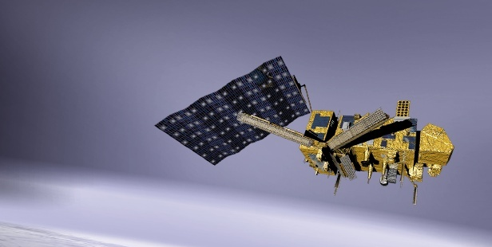
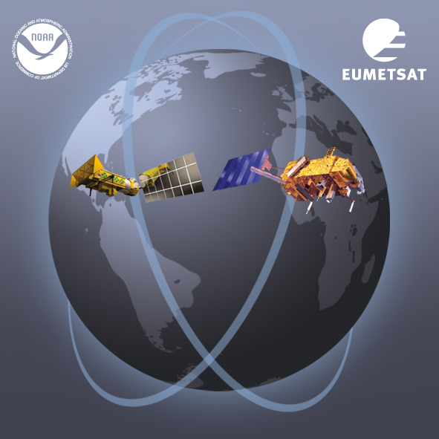
Current Polar-orbiting satellites: EUMETSAT Polar System
Dual operation of Metop-A and Metop-B
Metop-A launched in 2006: 21:30 Asc
Metop-B launched in 2012: +48 min
Metop-B prime satellite since April 2013
Metop-C launch planned for 2018
Part of Initial Joint Polar System shared with NOAA
Missions and Payload
Imagery (VIS, IR), sounding (IR, MW, UV, GPS occultation), radar (ASCAT)
direct broadcasting and data collection capabilities
Applications
Numerical Weather Prediction and Nowcasting at high latitudes
Marine meteorology and oceanography
Air quality, atmospheric chemistry

Slide 8
Status of Outstanding Actions on EUMETSAT
Action Ref | Description | Assigned to |  | Due Date | State
GWG_13.27 | EUMETSAT and CNES to liaise to exchange lunar observation data and report in March 2014. | Tim Hewison |  | 01 Mar 2014 | Closed
GWG_13.30 | All GPRCs to provide GCC with links to the official SRFs for all instruments for which GSICS Products are being developed for publication on GCC website. | All |  | 01 Jul 2014 | Done for SEVIRI
Several | Actions related to Instrument Events Logs will be reported by Rob
GRWG06_17 | Find out time overlaps between geostationary satellites (commissioning and operational periods), find out about the availability of such data and publish this information on the GSICIS Wiki |  | All | 01 Dec 2011 | Underway at EUMETSAT
EP-12.05 | Each GPRC to consider implementing the near real time distribution of both the operational calibration information and the corrected calibration information, as part of the L1 data formats |  | All GRPCs | 01 Sep 2012 | Done - now in L1.5 HDR
GRWG07_07 | Investigate use of IASI observations for creating spectral band conversions for broad-band instruments and consider respective requirements; report back to GRWG |  | EUMETSAT (T. Hewison) | 01 Dec 2012 | Report Thurs pm
GWM-14.10.1 | Tim Hewison to circulate a proposed list of variables for the GEO-LEO hyperspectral IR case in time for discussion at the next annual GRWG meeting. (scoring to select reference) |  | Chair (T. Hewison) | 24 Mar 2014 | Closed Email 2014-03-12

Slide 9
Status of Outstanding Actions on EUMETSAT – cont.
Action Ref | Description | Assigned to | Due Date | State
GRWG05_08 | Investigate the possibility to supply GEO data over desert sites to the SADE database | EUMETSAT | 01 Mar 2011 | Late
GWG_13.12 | NOAA & EUMETSAT to analyse GEO-GEO difference after applying the GEO-LEO correction to quantify the diurnal calibration uncertainty before promotion to Operational status. | EUMETSAT | 01 Sep 2014 | Done See Thurs am
GWG_13.14 | EUMETSAT to propose solution based on modification of plotting tool and server structure and content to allow this daily results to be displayed. | Tim Hewison | 01 Sep 2013 | Late
GWG_13.16 | Tim Hewison to draft example of netCDF file incorporating the delta correction to convert from MetopB/IASI to MetopA/IASI and distribute to GRWG+GDWG. | Tim Hewison | 01 Mar 2014 | Done See Thurs am
GWG_13.37 | EUMETSAT (lead) + GDWG members to work with EUMETSAT to use their bias plotting tool for GPRC product monitoring plots. | Tim Hewison | 01 Mar 2014 | Late

Slide 10
Status of Outstanding Actions on EUMETSAT – cont.
Action Ref | Description | Assigned to | Due Date | State
GWG_13.44 | EUMETSAT to add the link to the WMO GSICS portal to the GSICS logo. | Tim Hewison | 01 Mar 2014 | Closed. Not possible!
GWG_13.45 | EUMETSAT to add the links to other GPRC websites. | Tim Hewison | 01 Mar 2014 | Closed.
GWG_13.46 | EUMETSAT to add the link to the GSICS product catalog. | Tim Hewison | 01 Mar 2014 | Closed.
GWG_13.47 | EUMETSAT to add the link to the GCC home page. | Tim Hewison | 01 Mar 2014 | Closed.

Slide 11
Calibration Event Logging System
DWG -Talk Wednesday PM
Report on progress done at CGMS 40 and 41
Proposed next steps, in collaboration with international partners:
Establishing a list of standard Event Type Names in the CGMS context;
Define a simple and robust data model (through an extended test pilot)
Propose a unified calibration events logging approach.
Report on the progress
➔ Work on defining high level requirements (user / database / accessibility) + liaising with GRDWG / GPRCs / agencies
GSICS | WGII/3 | 41.21 | GSICS to take on calibration event monitoring activities following the recent work on calibration event monitoring. Such information should be included in the next update of the WMO OSCAR database.
CGMS space agencies | WGII/3 | 41.22 | CGMS agencies to provide working papers on current and future capabilities for calibration monitoring and event logs – CGMS-42.
Concept:
Log all events impacting radiometric and geometric data quality:
❶ Platform level ❷ Satellite level ❸ Data processing level
Use common Standards and Procedures across missions and instruments;
Allow for portability across space agencies;
Comprise a database historic events;
Allow users to access and visualize the events database.

Slide 12
GSICS Data and Products Server Status
The Server is Operational since March 2009.
Comparable source data set from MFG, MSG and MetOp are uploaded daily to the server. These data set are used by EUMETSAT and CMA.
JMA is uploading daily its intermediate data sets for their GEO-LEO-IR GSICS products.
Both EUMETSAT and JMA have been uploading daily their GEO-LEO-IR GSICS products.
The products are in demonstration and pre-operational status for some time. We need to determine what to do next with these products.
NOAA has a GSICS Data and Products server, its role in the GSICS collaboration server network will be discussed in the GDWG meeting.
CMA is preparing a GSICS Data and Products server. This will also be discussed in the GDWG meeting.
The GSICS Product Plotting Tools has been completed for the GEO-LEO-IR GSICS products. It is ready for deployment for use by the user community for any operational GEO-LEO-IR products.

Slide 13
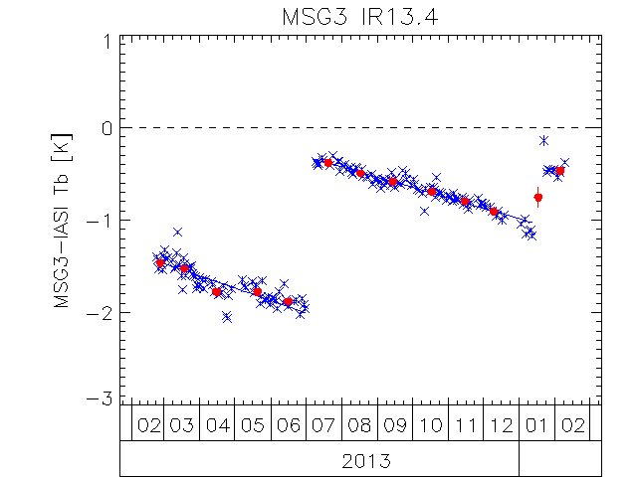
GSICS Products Development – GEO-LEO IR hyperspectral
DWG –Talk Thursday AM
Re-Analysis & Near-Real-Time Corrections for Meteosat/SEVIRI-Metop/IASI
Routine generation of Pre-Op products for Meteosat-10/SEVIRI and Metop-A/IASI
Now injecting alternative calibration coefficients -> L1.5 HDR
Routine generation of Demo products for Meteosat-8, -9, -10/SEVIRI and Metop-A,-B/IASI
GEO-GEO comparisons over diurnal cycle
In development – (Talk 4e)
Delta Correction to migrate MetopB/IASI ➔ MetopA/IASI
In development – (Talk 4g)
Example of EUMETSAT’s Bias Monitoring of Meteosat-9 for GSICS
Time series of standard bias in infrared channels of Meteosat-10/SEVIRI relative to Metop-B/IASI, expressed in brightness temperature [K].
These comparisons used to generate inter-calibration corrections.
Allow monitoring of instrument anomalies.
The trend lines show steady degradation of the 13.4 μm channel’s calibration and sudden recoveries, following the spacecraft decontamination procedures.
Validated model of how the ice contamination.
Other channels (not shown) have small, stable biases.

Slide 14
GSICS Products Development – GEO-LEO IR broadband
DWG –Talk Thursday PM
In support of Reprocessing of Meteosat archive for FCDR
Re-calibration of WV & IR channels using HIRS
Support to SCOPE-CM IOGEO project
Meteosat/MVIRI-Metop/HIRS
Spectral Band Adjustment in development
Characterisation of calibration drift
Use of Aqua/AIRS as transfer reference
LEO-LEO IR
MetopA/HIRS-MetopA/IASI
Characterisation of calibration drift
More reported on Day 4 pm

Slide 15
GSICS Products Development – Lunar calibration
RWG -Talk Wednesday PM
ACHIEVEMENTS
Flexible and robust extraction tool in place for the GEOs imagers
Unique archive of lunar observations from GEOs available
Applications: instrument monitoring + characterization
To secure operations, implemented independent version of the ROLO model
Extremely accurate drift estimate (uncertainty: ~0.02% yr⁻¹ for LRES, ~0.05% yr⁻¹ for HRVIS)
All SEVIRI well within specification for long-term drift
Lunar calibration can be used to monitor the vicarious calibration
OPEN ISSUES:
Phase-angle dependence of the ROLO model
Original ROLO spectral sampling
FUTURE:
Keep consolidating in-house expertise and provide support to present and future programs and to climate activities.
More GSICS related ➔ Initiate a project for transferring MODIS calibration to the GEOs using the Moon as transfer target

Slide 16
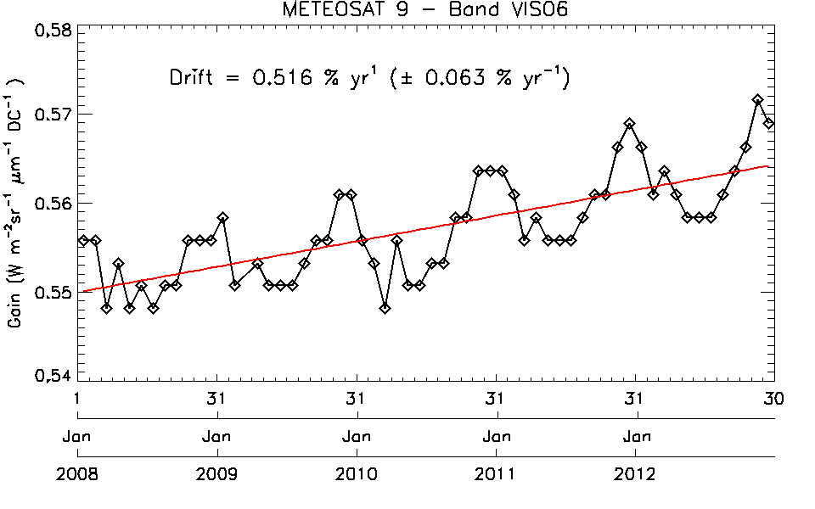
GSICS Products Development – DCC
RWG -Talk Wednesday AM
ACHIEVEMENTS
Implementation COMPLETED
Decoupled processing of MODIS and SEVIRI to derive gains COMPLETED
Uncertainty analysis to associate an uncertainty estimate to the derived gain ON-GOING
Definition of a GSICS product content+ Formatting to GSICS standards in NetCDF ON-GOING
Implementation of the DCC algorithm for Met-07 ON-GOING
PLANNED WORK FOR 2014
Establish a reference value for MODIS radiance
Uncertainty analysis to be continued
Operational implementation of the DCC extraction for MSGs
Generation of a GSICS product (demo) for Met-9
Support to SCOPE-CM ➔ corrections for Met-7,8,9 and 10)
Integration of the DCC results in a VIS/NIR calibration monitoring tool (➔ towards consolidated GSICS corrections)

Slide 17
Enhancing monitoring capabilities Towards consolidated GSICS corrections?
SSCC
DCCs
Relative scale
Moon
Example of the VIS06 band on MSG2/SEVIRI.
Development of Multi-Mission Integrated Calibration Monitoring System

Slide 18
EUMETSAT GSICS Products Development Timeline
Planned activities
?

Slide 19
Summary
Calibration is key to ensuring EUMETSAT achieves its objectives:
1. To establish, maintain and exploit European systems of operational meteorological satellites
2. To contribute to the operational monitoring of the climate & the detection of global climatic changes
3. Furthermore, other environment monitoring issues are considered when interactions with the atmosphere or the ocean are involved
EUMETSAT continues to develop new calibration capabilities
For real-time operations
Support of climate reanalysis
Support to future programs (MTG + EPS/SG) + third party programs (S3)
In international cooperation, including:
Global Space-based Inter-Calibration System
CEOS WGCV

Slide 20
Thank you

Slide 21
Inter-Calibration
Inter-Calibration Corrections
Developed within GSICS
GEO-LEO IR
Collocated observation (SNO)
Meteosat/SEVIRI-Metop/IASI
Pre-Operational
Including Uncertainty Analysis
Bias Monitoring
Used to support commissioning
Analysis of ice contamination
Developing Delta Correction to migrate references
GEO-LEO VIS
Pseudo-Invariant Targets
In Development
for Meteosat/SEVIRI– Aqua/MODIS:
Deep Convective Cloud
Lunar
Example of EUMETSAT’s Bias Monitoring of Meteosat-9 for GSICS
Time series of standard bias in infrared channels of Meteosat-10/SEVIRI relative to Metop-B/IASI, expressed in brightness temperature [K].
These comparisons used to generate inter-calibration corrections.
Allow monitoring of instrument anomalies.
The trend lines show steady degradation of the 13.4 μm channel’s calibration and sudden recoveries, following the spacecraft decontamination procedures.
Validated model of how the ice contamination.
Other channels (not shown) have small, stable biases.

Slide 22
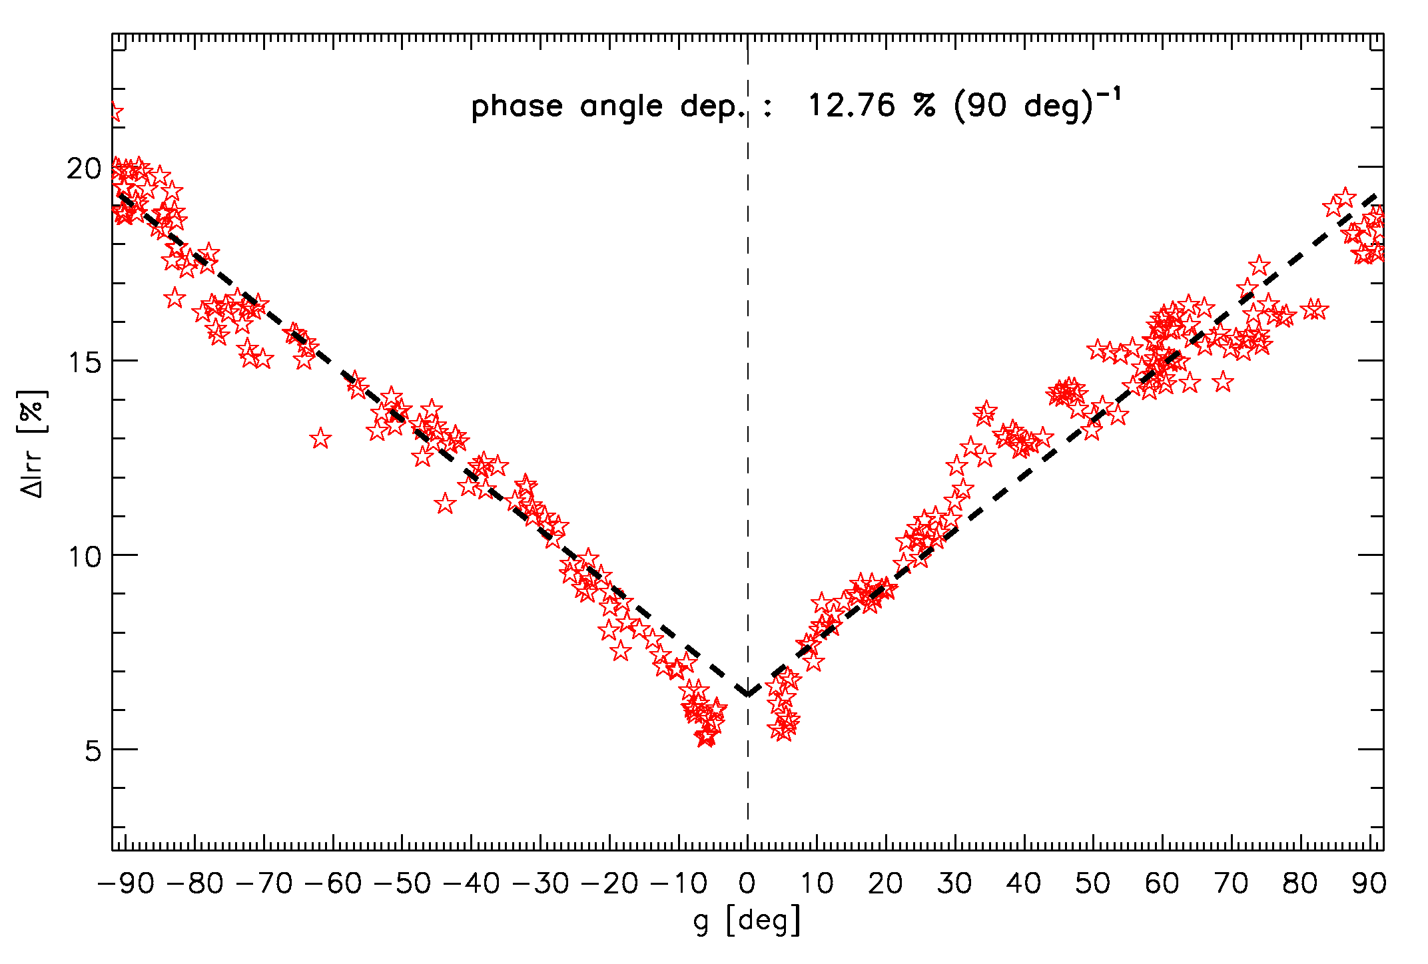
Lunar calibration – EUMETSAT achievements
Developed automatic lunar imagery extraction tool
Extensive and unique archive of lunar images acquired by Meteosat-7, -8, -9 and -10
(for SEVIRI only, about 1030 images at low resolution and about 170 for HRVIS).
EUMETSAT implementation of USGS ROLO model
(fully validated and tested with USGS)
➔ Enhanced monitoring and inter-calibration capabilities for reflective solar bands.
Through collaboration with USGS and CNES
phase angle dependence was identified
Issue for GEO imagers
(no choice on illumination)
should be corrected
VIS06
VIS08
NIR16
Example SEVIRI Imagettes Extracted for Lunar Calibration
ΔIrradiance vs. g for the MSG2/NIR1.6 channel

Slide 23
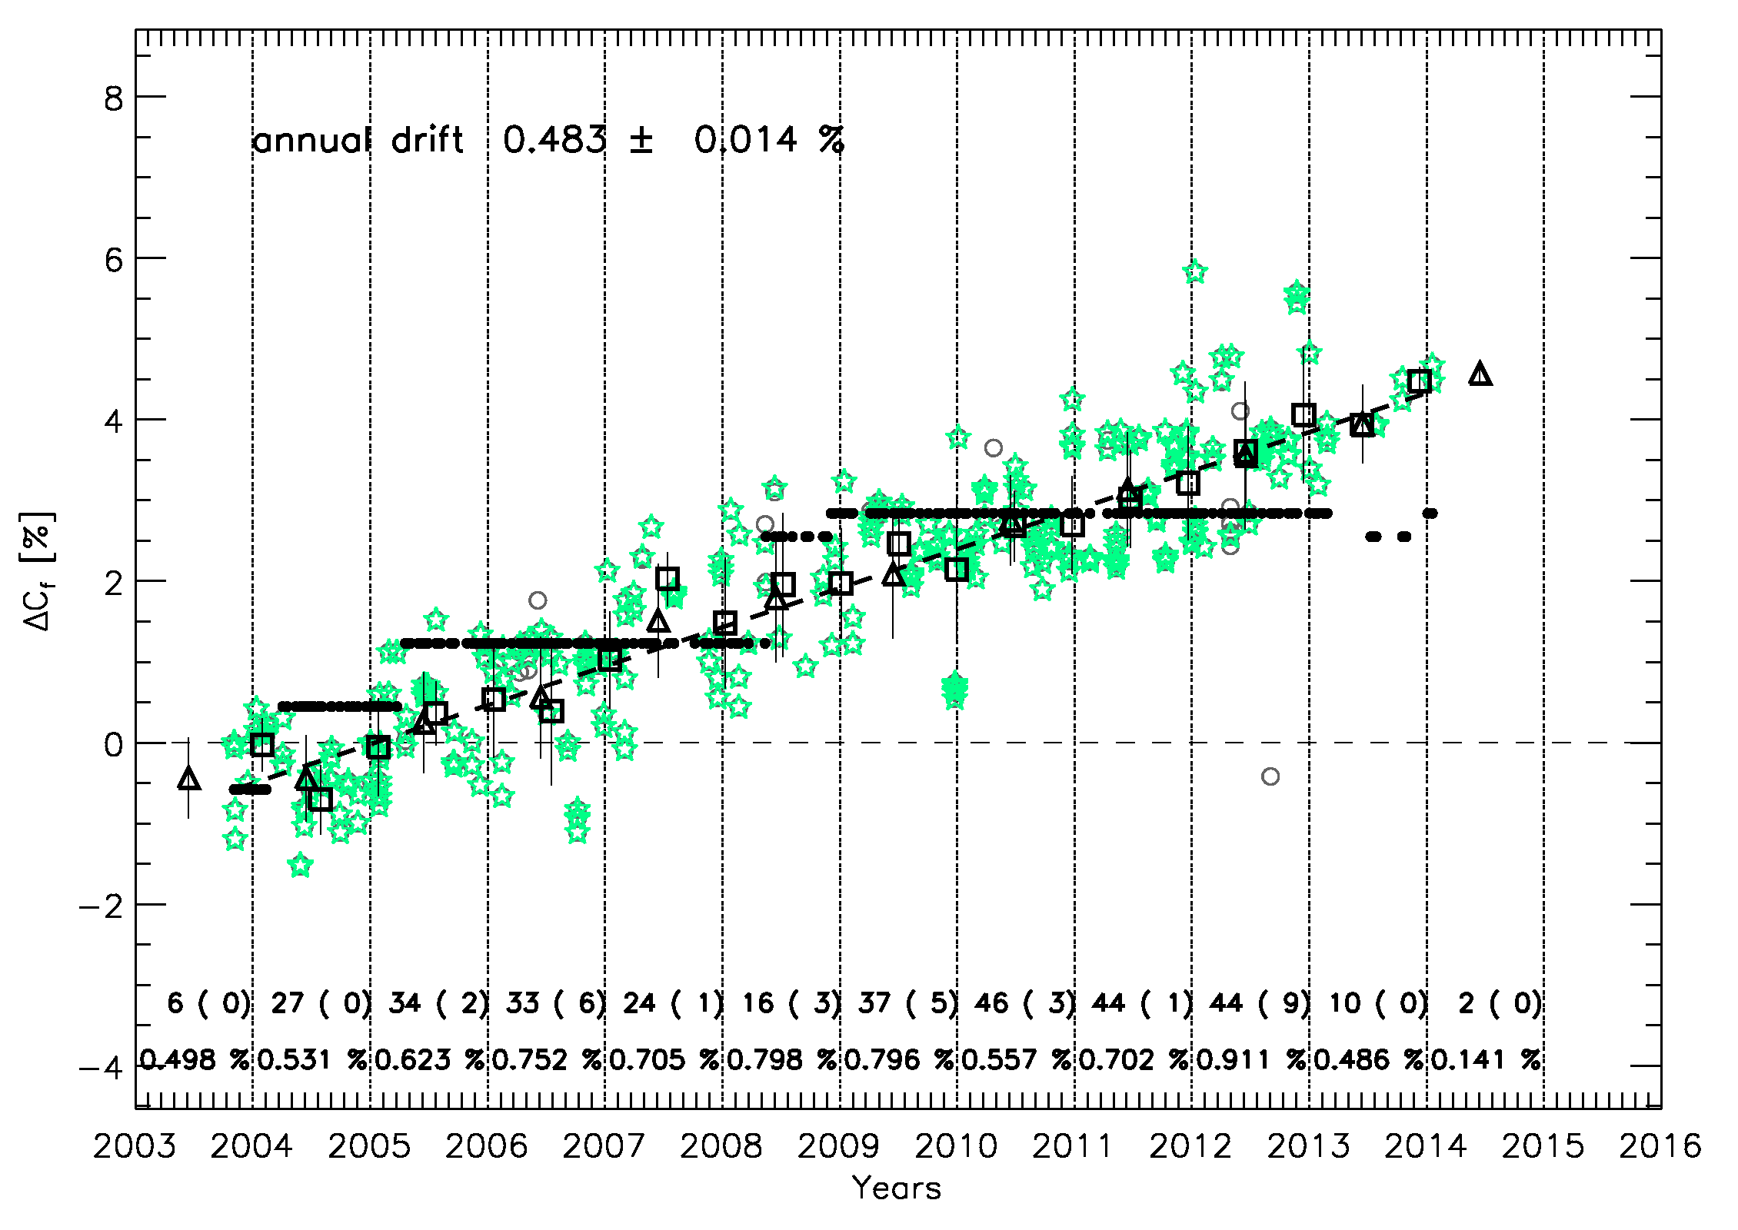
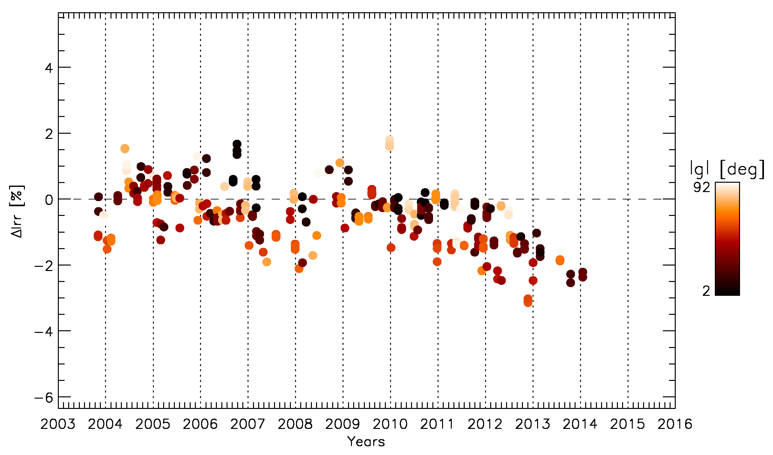
Lunar calibration – EUMETSAT achievements
Bias in irradiance = monitoring of the combined system instrument/calibration
Gain on ROLO scale = monitoring of the instrument drift
Combining analysis = powerful monitoring tool
BUT phase angle dependence should be characterized and removed
 | VIS0.6 | VIS0.8 | NIR1.6 | HRVIS
Meteosat-8 | 0.483 ± 0.014 (0.3583 ± 0.228) | 0.444 ± 0.013 (0.3673 ± 0.193) | -0.013 ± 0.018 (0.031 ± 0.180) | 0.493 ± 0.059 (0.398 ± 0.222)
Meteosat-9 | 0.475 ± 0.022 (0.359 ± 0.255) | 0.468 ± 0.020 (0.467 ± 0.249) | 0.033 ± 0.025 (-0.051 ± 0.220) | 0.550 ± 0.062 (0.510 ± 0.285)
Meteosat-10 | -0.841 ± 0.293 (-0.590 ± 2.756) | -0.665 ± 0.203 (-0.318 ± 2.990) | -0.365 ± 0.634 (0.128 ± 2.222) | N.A. (-0.653 ± 2.752)
Annual Average Rate of Calibration Gain Drift
Bold = Moon results. In small italic = SSCC drift from all available runs.
All SEVIRI within specifications for long-term drift

Slide 24
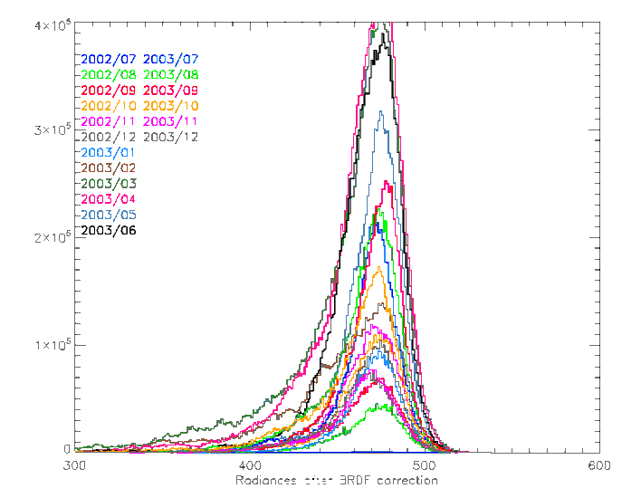
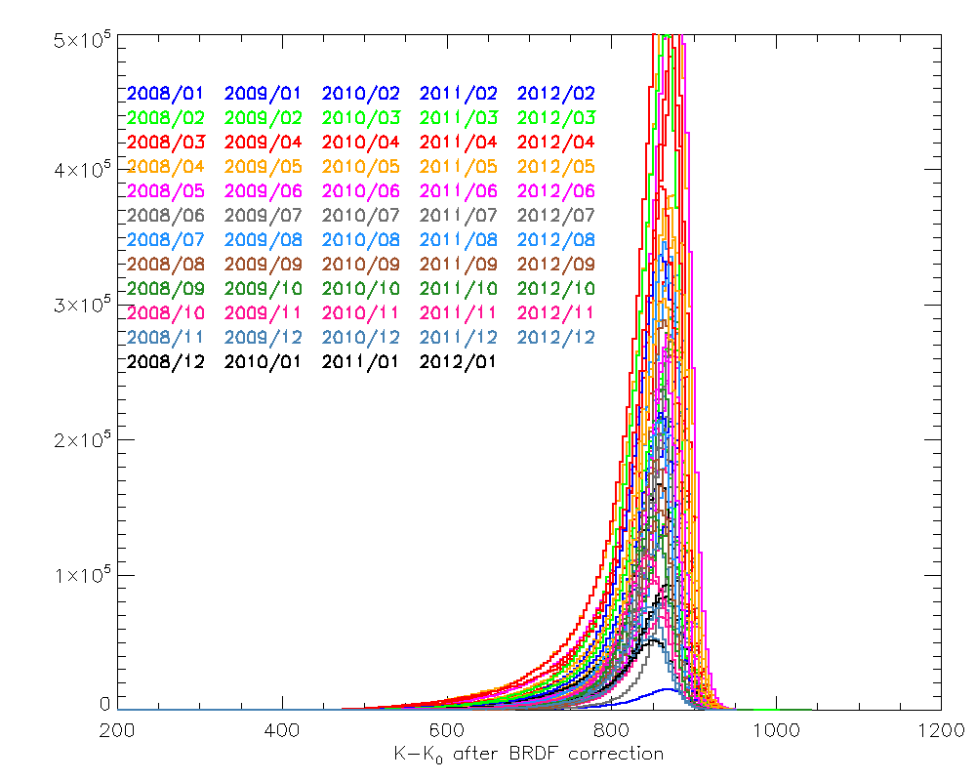
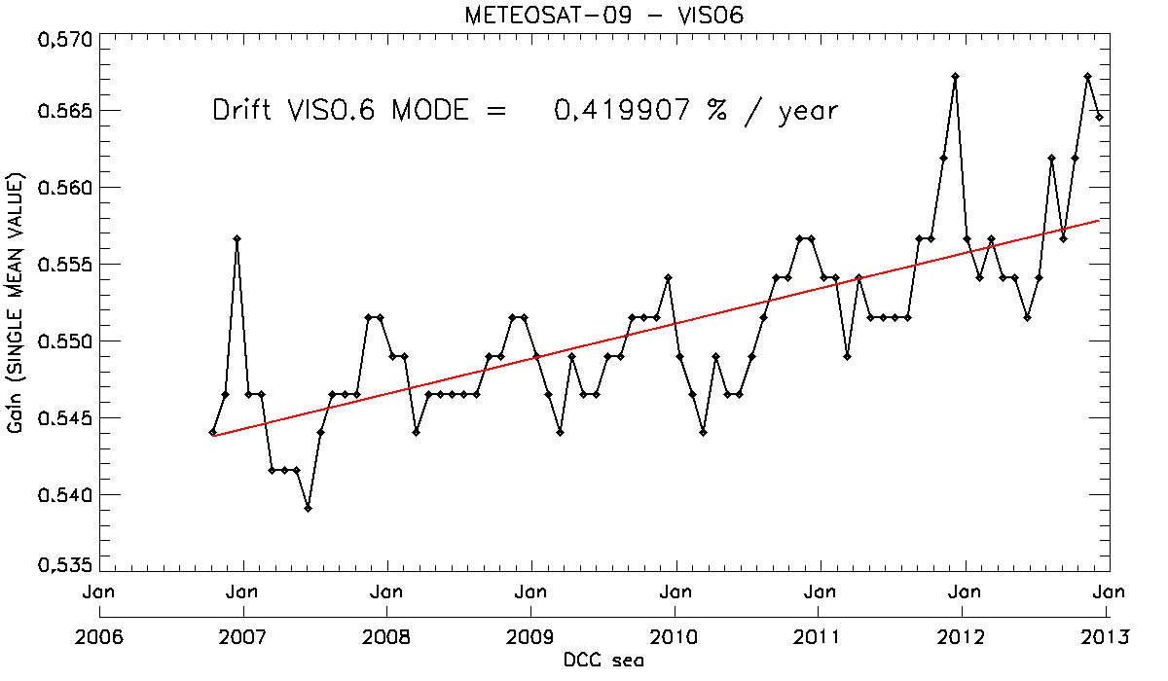
GSICS - Inter-calibration with MODIS – DCC
Deep Convective Clouds
inter-calibration transfer targets
No need for simultaneous observations (DCC stability over time)
Inter-calibration between all GEOs possible due to DCC global distribution (common calibration reference)
Implementation of the GSICS ATBD https://gsics.nesdis.noaa.gov/pub/Development/AtbdCentral/GSICS_ATBD_DCC_NASA_2011_09.pdf
After BRDF correction to overhead sun
Example of gain derived for Meteosat-9 VIS0.6
Monthly PDFs of DCC reference radiances (MODIS Aqua)
Monthly PDFs of DCC target counts (geostationary satellites [Meteosat])

Slide 25
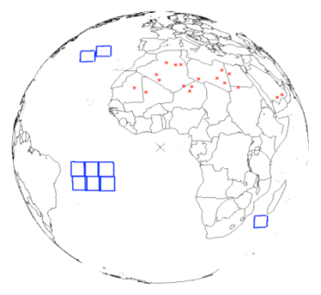
Vicarious Calibration
SEVIRI Solar Channel Calibration System
Uses Pseudo Invariant Targets: Desert Targets Open Ocean Targets (Rayleigh Scattering)
Operational Calibration:
Meteosat VIS/NIR channels “SSCC”
Pseudo-Invariant Targets +RTM:
Desert Targets in Sahara/Arabia
Rayleigh Scattering over clear ocean (for validation)
Deep Convective Cloud (currently inactive)
In Development:
Lunar Calibration
Based on ROLO model,
Implemented at EUMETSAT
Validated against USGS version
For all VIS/NIR Channels
Meteosat/SEVIRI and MVIRI
Applicable to other instruments
Deep Convective Cloud
Through GSICS
Integrated Calibration/Monitoring System
VIS06
VIS08
NIR16
Example SEVIRI Imagettes Extracted for Lunar Calibration

Slide 26
Status of Event Logging Actions on EUMETSAT
Joint07_05 Reports on what events can be made available from a legal point of view – All GPRCs (led by Roebeling)
Rob/Sebastien: Send mail to the space agencies asking their opinion
Joint07_09 Check and provide comments to provide shortlist of instrument events to be logged – All GPRCs
Rob/Sebastien: Send mail to space agencies including a memo with the list we compiled based on earlier inventories. Take the table from the CGMS paper as starting point
Joint07_10 Propose an event logging procedure including standard – EUMETSAT (R. Roebeling + P. Miu)
This needs to wait. Following the outcome of CGMS-41, where it was advised to move the event logging activity to GSICS we need to rethink and rediscuss how to proceed. As a first step best to get existing event logging systems in the OSCAR database. As a second step, to harmonize the naming conventions used. As a third step, to harmonize the procedures.
Joint07_11 propose a web based interface for event logging for GSICS - Main.EUMETSAT(Roebleing+Miu)
This needs to wait. As indicated before, we will follow the advice to link existing systems to OSCAR
EP-12.22 GDWG and EUMETSAT/CDWG to define a controlled vocabulary for instruments events - Main/GDWG+EUMETSAT.CDWG
Rob/Sebastien: Send mail to space agencies including a memo with the list we compiled based on earlier inventories. Take the table from the CGMS paper as starting point
GWG_13.9 Rob Roebeling to consider using this high level concept to illustrate how the event logging WG could start with a simple concept acceptable for all space agencies.
Rob/Sebastien: To prepare a memo outlining a high level concept. To iterate internally. To iterate between space agencies. This can come later. At the GRWG we can present our ideas for a concept.

Slide 27
Status of Event Logging Actions on EUMETSAT
GWG_13.54 NOAA and EUMETSAT to work together to produce examples of events in XML format. – ManikBali PeterMiu
EUMETSAT to discuss with NOAA at the GDWG how to proceed now Aleksandar has left NOAA.
GWG_13.55 All GPRC to provide examples of the events applicable to their instruments. Support NOAA and EUMETSAT work on the common list of event types - GPRC
Rob/Sebastien: Send mail to space agencies including a memo with the list we compiled based on earlier inventories. Take the table from the CGMS paper as starting point

