Slide 1
KMA GPRC Report
2014 GSICS Annual Meeting (24-28 Mar 2014) @Darmstadt
- Current Status and Future Plan of KMA -
Minjin CHOI
Dohyeong KIM, Ho-Seung LEE, Hye-Sook LEE, Tae-Hyeong OH
National Meteorological Satellite Center
Korea Meteorological Administration

Slide 2
CURRENT STATUS OF KMA
Visible channel
Operate vicarious calibration system combined desert/ocean/cloud targets
keep studying the moon targets for vicarious calibration
providing time series of slope and intercept
Infrared channel
Operate GSICS GEO-LEO Inter-calibration system
use of two kinds of LEO sensors (MI/COMS & IASI/MetOp-A and MI/COMS & AIRS/Aqua)
providing time series of mean biases for TBs
Display in website
Display the method and results of GSICS activities in NMSC homepage
Re-Calibration
Test an effect of GSICS correction on COMS Level 2 products

Slide 3
VISIBLE CHANNEL (1/2)
check the change of slope calculated from scatter plot of 4 targets
slope is obtained everyday using data for 30 days ago.
a scatter plot for 30 days data
get a slope/intercept
trend of slope for long period
2011.04 – 2013.12
Ocean
Desert
Water Cloud
DCC
COMS Observed reflectance
RTM Simulated reflectance

Slide 4
VISIBLE CHANNEL (2/2)
period: 2011.04 – 2013.12
degradation: 5.59% (2.10%/year) from 4 targets on the Earth
3.47% (1.22%/year) from the moon targets
monthly ratio
from moon targets
slope = -0.102
degradation = 3.47%
daily slope
from 4 targets
slope = -0.172
degradation = 5.59%
In spite of relatively short analysis period,
COMS MI visible sensor seems to be maintain its response sensitivity.

Slide 5
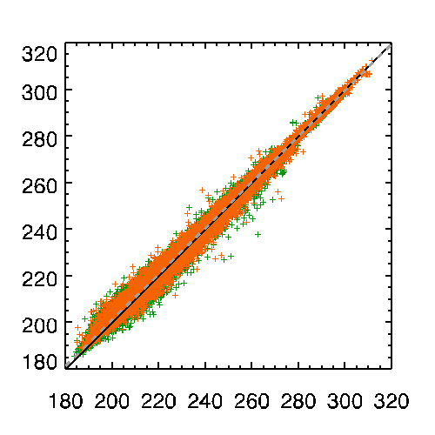
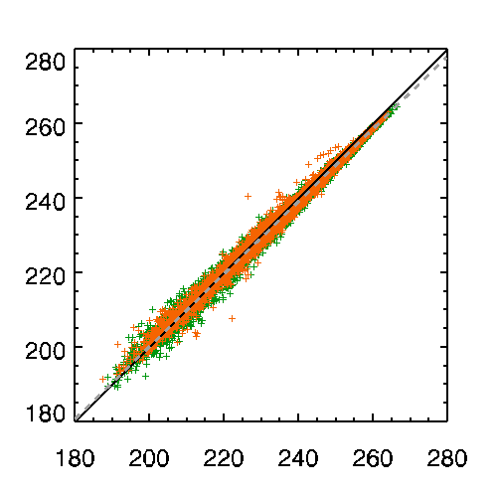
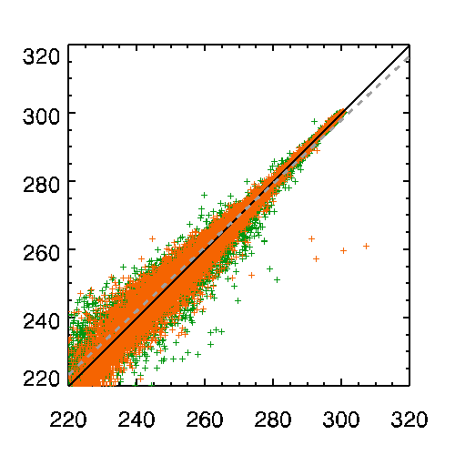
INFRARED CHANNEL (1/3)
check the TB bias for each IR channels using both IASI and AIRS
period: 2011.04 – 2013.12
AIRS IASI
more positive except for IR4
IR1 (10.8μm)
IR2 (12.0μm)
 |  | BOTH | IASI | AIRS
IR1 | Number | 127948 | 47072 | 80876
 | Bias | 0.2468 | 0.2906 | 0.2212
 | RMSE | 1.5455 | 1.5546 | 1.5402
IR2 | Number | 133908 | 49332 | 84576
 | Bias | 0.2171 | 0.2213 | 0.2146
 | RMSE | 1.4138 | 1.4237 | 1.4079
IR3 (WV) | Number | 66436 | 23775 | 42661
 | Bias | -0.9108 | -0.7471 | -1.002
 | RMSE | 1.2263 | 1.0888 | 1.2965
IR4 (SWIR) | Number | 55038 | 24530 | 30508
 | Bias | 0.1083 | 0.0215 | 0.1780
 | RMSE | 2.8551 | 2.4973 | 3.113
LEO TB (K)
mean bias 0.2468
RMSE 1.5455
mean bias 0.2171
RMSE 1.4138
WV (6.75μm)
SWIR (3.75μm)
LEO TB (K)
mean bias -0.9108
RMSE 1.2263
mean bias 0.1083
RMSE 2.8551
COMS TB (K)
COMS TB (K)

Slide 6
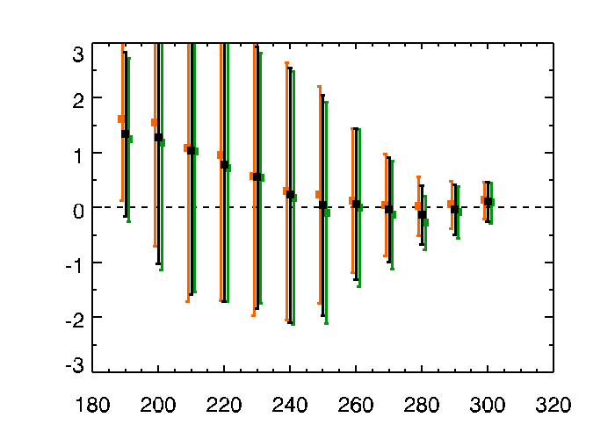
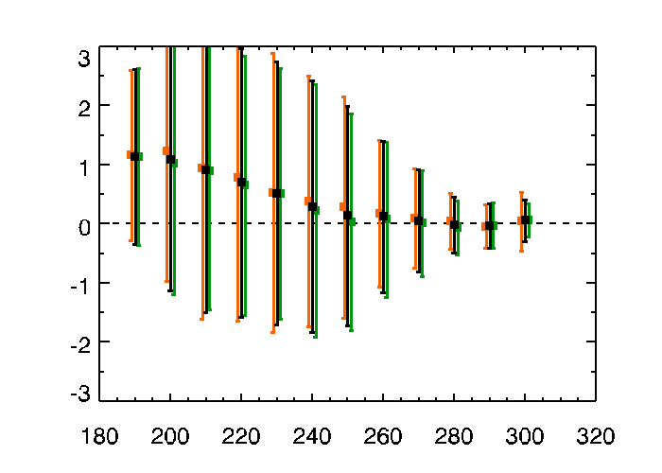
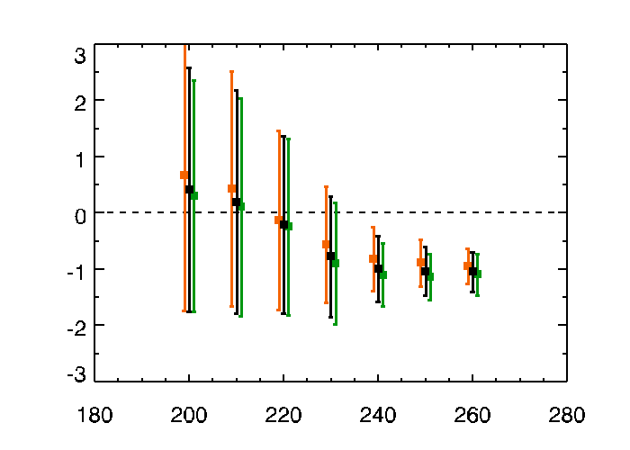
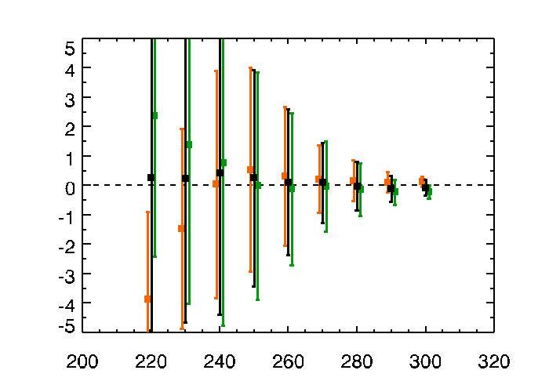
INFRARED CHANNEL (2/3)
trend of TB bias for COMS IR TBs
period: 2011.04 – 2013.12
AIRS IASI BOTH
IR1
IR2
TB Bias (K)
mean bias 0.2468
RMSE 1.5455
mean bias 0.2171
RMSE 1.4138
different signs
for cold temperature
large negative bias for warm temperature
WV
SWIR
TB Bias (K)
mean bias -0.9108
RMSE 1.2263
mean bias 0.1083
RMSE 2.8551
COMS TB (K)
COMS TB (K)

Slide 7
INFRARED CHANNEL (3/3)
monthly variation of TB bias and RMSE
period: 2011.04 – 2013.12
AIRS IASI BOTH
TB Bias (COMS-LEO)
TB RMSE
(K)
(K)
mean Bias 0.2468
IR1
mean RMSE 1.5455
mean Bias 0.2171
IR2
mean RMSE 1.4138
mean Bias -0.9108
WV
mean RMSE 1.2263
SWIR
mean Bias 0.1083
mean RMSE 2.8551

Slide 8
WEB DISPLAY
http://gsics.wmo.int/
directly linked!

Slide 9
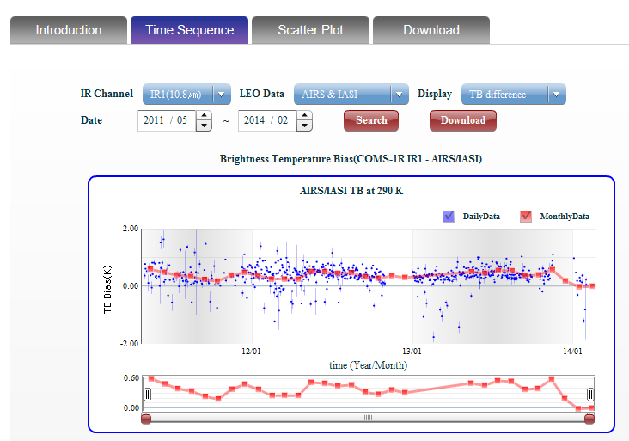
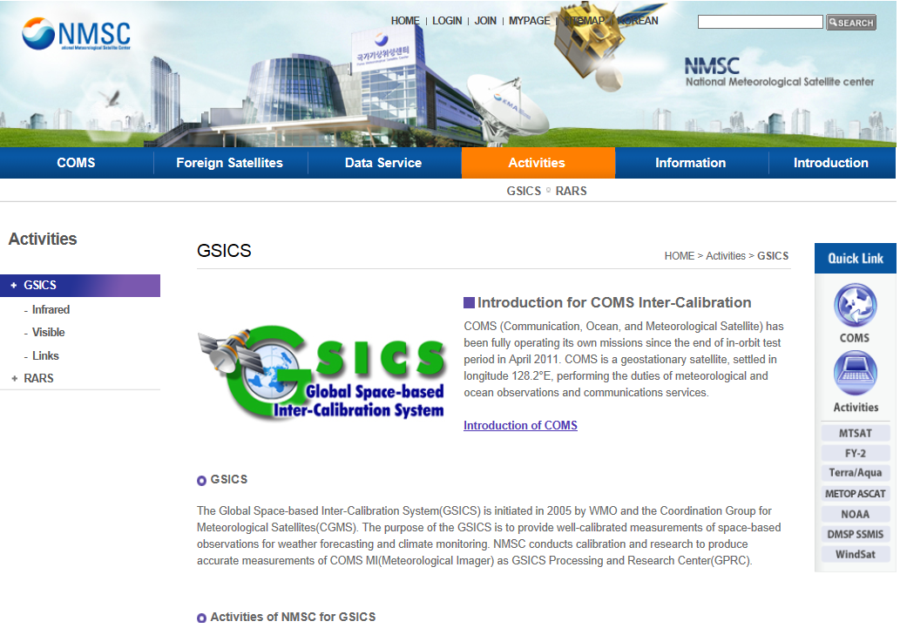
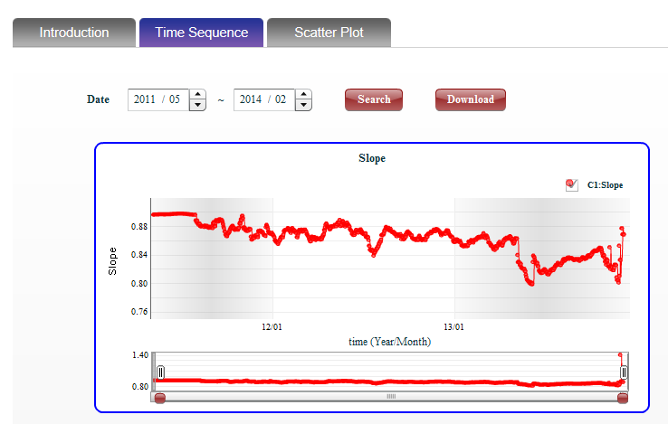
WEB DISPLAY
Infrared
Visible
2013, completely construct
web presenting system
(IR and VIS)
http://nmsc.kma.go.kr/html/homepage/en/gsics/gsicsMain.do

Slide 10
RE-CALIBRATION (1/3) : Concept
To investigate an effect of GSICS calibration coefficient on Level2 products
Test product: Sea Surface Temperature (SST), Solar insolation(INS)
Validation data: buoy around East Asia, pyranometer ground observation of KMA
Period:2012-2013 for SST, 2013 for INS
COMS
Level 1B
TB Reflectance
processing & Validation
raw data
correction
GSICS coefficients
SST
(IR1, IR2)
with buoy
WHAT
EFFECT ?
INS
(VIS)
with
pyranometer

Slide 11
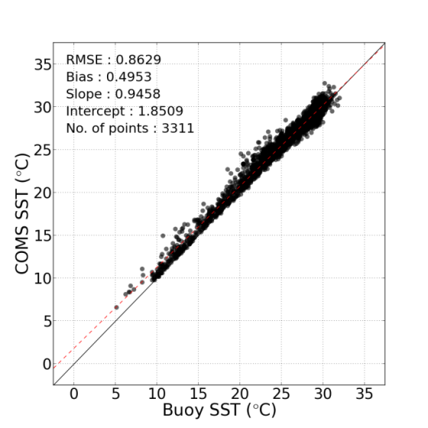
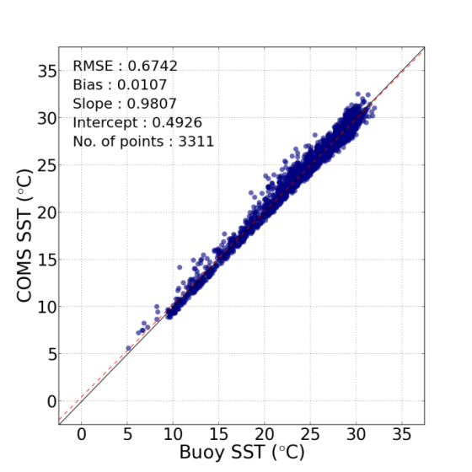
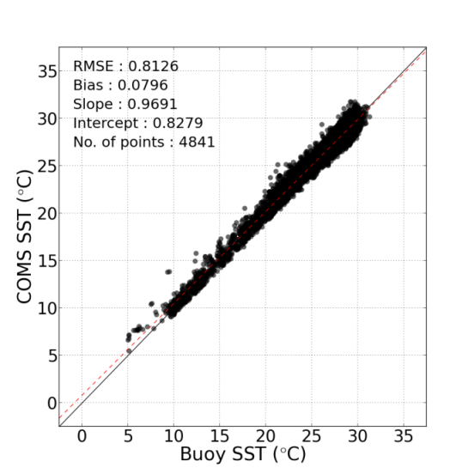
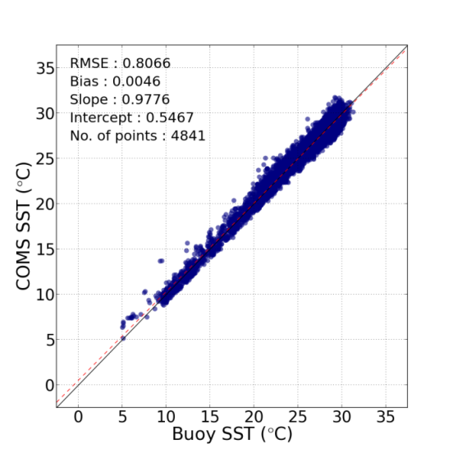
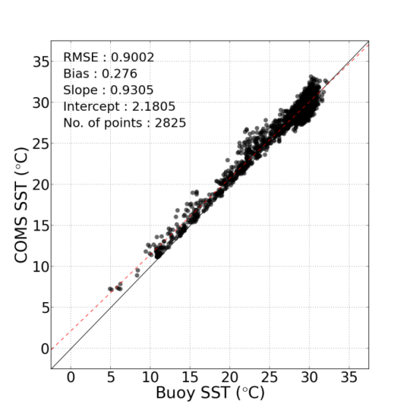
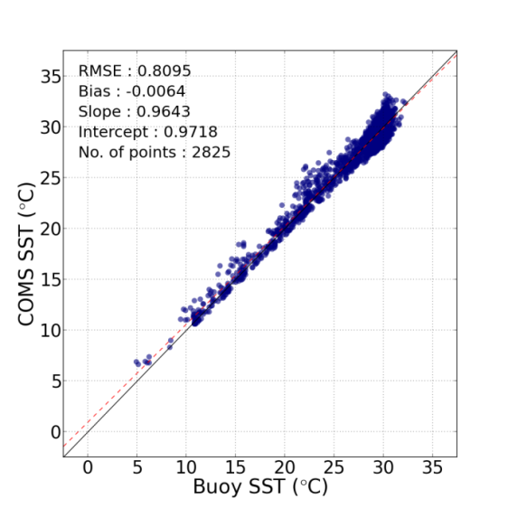
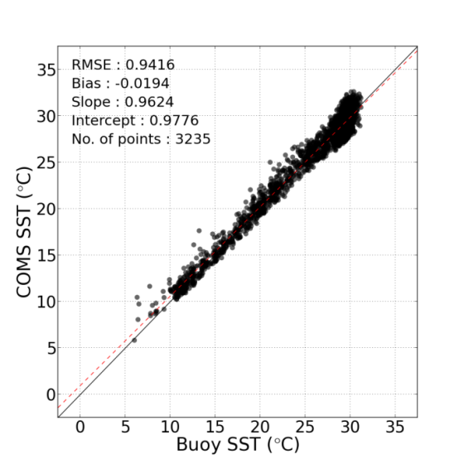
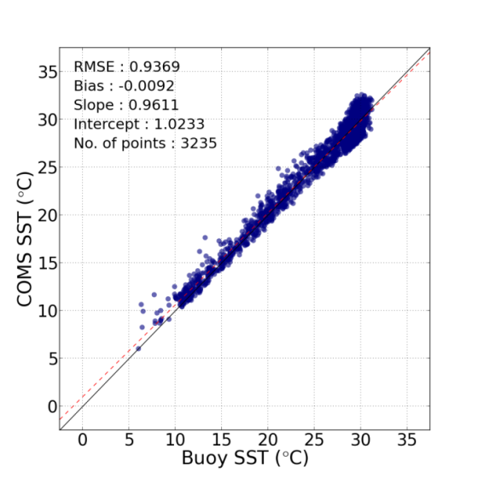
RE-CALIBRATION (2/3): results of SST
Comparison of recalibrated SST with observed buoy SST
$$MCSST=C_{0}+C_{1}∙{IR}_{11㎛}+C_{2}∙({IR}_{11㎛}−{IR}_{12㎛}){+C}_{3}∙({IR}_{11㎛}−{IR}_{12㎛})∙(\sec{(θ)}−1)$$
daytime
nighttime
Before
After
Before
After
2012
RMSE 0.86 K
0.67 K
0.81 K
0.81 K
Bias 0.50 K
0.01 K
0.08 K
0.01 K
2013
RMSE 0.90 K
0.81 K
0.94 K
0.94 K
Bias 0.28 K
0.01 K
-0.02 K
-0.01 K

Slide 12
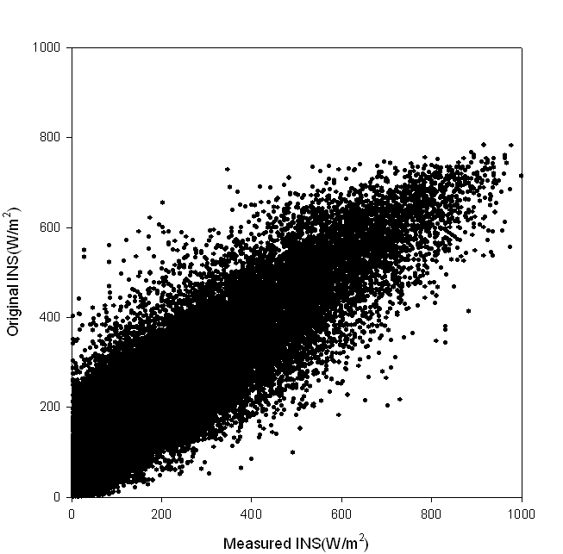
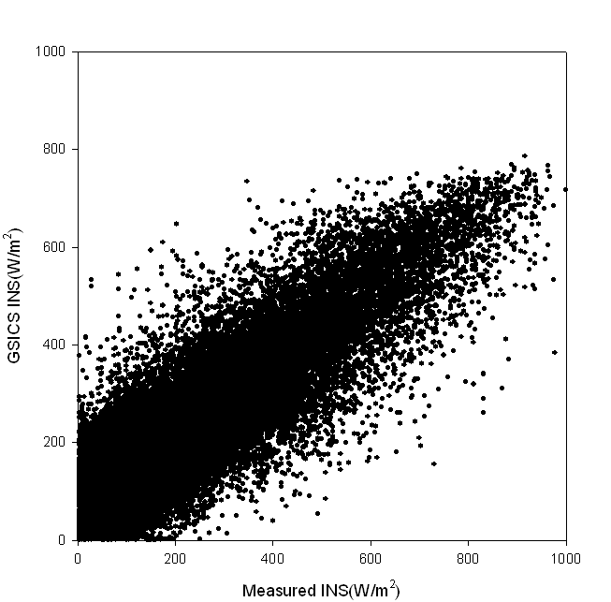
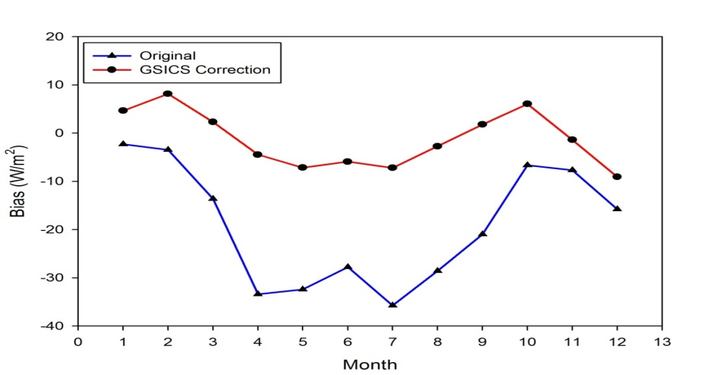
RE-CALIBRATION (3/3): results of INS
COMS INS Algorithm
$${S_{T}}^{′}=S_{T}×CF$$
CF: Cloud Factor $f(VIS, SZA)$
$$S_{T}=S_{I}+S_{R}+S_{A}$$
S_{T} : Total solar insolation on ground
S_{I} : Direct solar insolation
S_{R} : Solar insolation by Rayleigh scattering
S_{A} : Solar insolation by Aerosol scattering
cloudy
All sky INS
Cloud Mask
effect
clear
Clear INS
Comparison of recalibrated INS with observed pyranometer INS
All Sky
 | Before |  | After
 | RMSE | Bias | RMSE | Bias
All sky | 95.832 | 12.163 | 95.772 | 2.523
cloudy | 91.182 | 21.979 | 89.677 | 2.102
partially | 104.96 | 5.308 | 106.1 | -1.016
Before
After
2013
improve
in summer season !

Slide 13
FUTURE PLAN OF KMA
Infrared Channel
To construct another GSICS operation system (COMS vs. IASI/MetOp-B)
To further study for large bias of COMS WV channel
To compare double difference with LEOs (AIRS, IASI)
To investigate diurnal variation of COMS calibration
Visible Channel
To improve vicarious calibration method for moon target.
To refine the operating vicarious system for 4 targets on the Earth
GSICS Webpage
To keep displaying regular results of GSICS activities like now
RE-Calibration
To try to test an effect on Clear Sky Radiance

Slide 14
Thank you☺ Any questions or comments for us?
Notes:
Thank you for listening this talk.

Slide 15
Back-up Slides

Slide 16
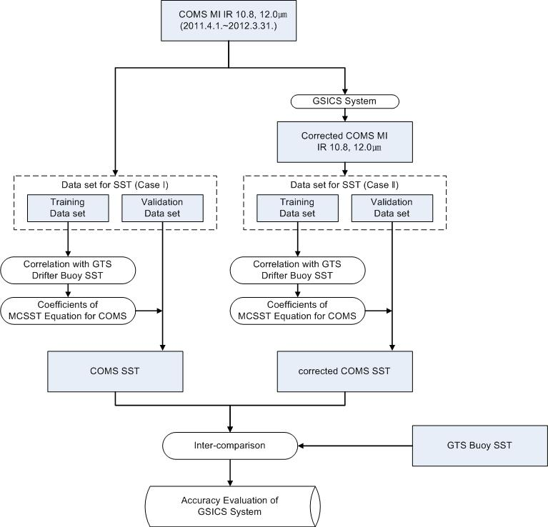
Re-calibration method for SST

Slide 17
Coefficients (for 2012)
How to recalibrate COMS SST using GSICS IR calibration coefficient
IR
IR’
Used Data
COMS/MI Level 1B data
Period: 2011.04. ~ 2012.03.
Equation: Y_{λ} = aX_{λ} + b
GSICS IR Calibration Coefficient
 | a | b
IR1 (10.8㎛) | 1.008 | -2.439
IR2 (12.0㎛) | 1.007 | -1.350
IR3 (6.8㎛) | 1.022 | -5.552
IR4 (3.8㎛) | 1.000 | 0.232
X_{λ} : COMS TBB before calibration
Y_{λ} : COMS TBB after calibration
a, b : calibration coefficient
λ : wavelength
SST
SST’
MCSST = C1∙T_{11㎛} + C2∙(T_{11㎛}-T_{12㎛}) + C3∙(T_{11㎛}-T_{12㎛}) ∙(sec(θ)-1) + C4
 | Day Time |  | Night Time
 | C | C’ | C | C’
c1 | 0.985098 | 0.984 | 0.975640 | 0.979
c2 | 2.338343 | 2.547 | 2.496965 | 2.415
c3 | 0.545135 | 0.413 | 0.353631 | 0.484
c4 | -0.321399 | 0.964 | -0.031189 | 2.040

Slide 18
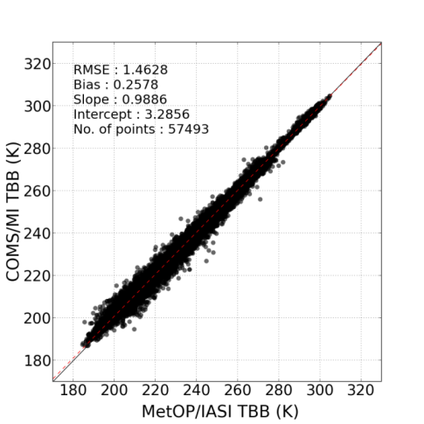
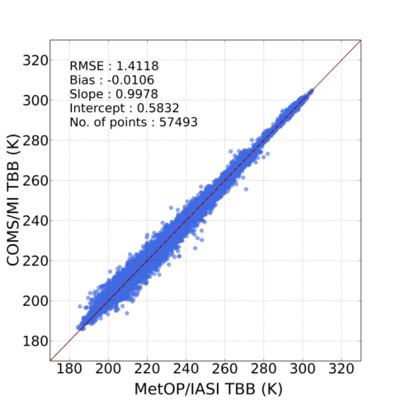
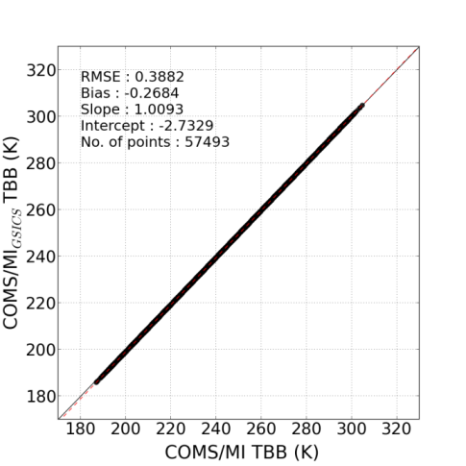
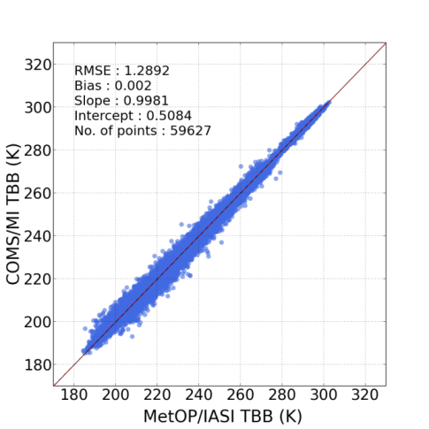
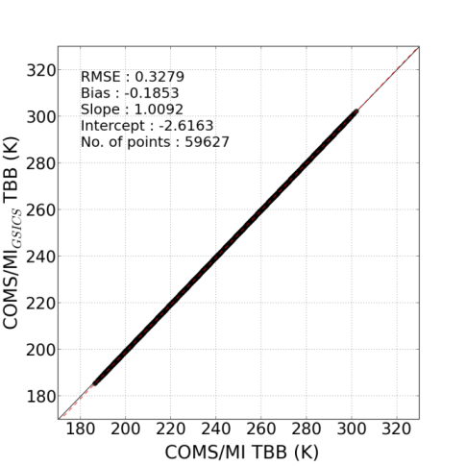
Correction effect
IR1
IR2
Channel |  | 2012 before | 2013 before | 2012 after | 2013 after
IR1 channel (10.8 ㎛) | RMSE (K) | 1.3796 | 1.4628 | 1.3079 | 1.4118
 | Bias (K) | 0.3926 | 0.2578 | 0.0913 | -0.0106
 | Slope | 0.9902 | 0.9886 | 0.9981 | 0.9978
 | Intercept | 3.0185 | 3.2856 | 0.0637 | 0.5832
IR2 channel (12.0 ㎛) | RMSE (K) | 1.3185 | 1.3307 | 1.2284 | 1.2892
 | Bias (K) | -0.4485 | 0.1873 | 0.0661 | 0.002
 | Slope | 0.9913 | 0.989 | 0.9983 | 0.9981
 | Intercept | 1.8687 | 3.0963 | 0.5318 | 0.5084

Slide 19
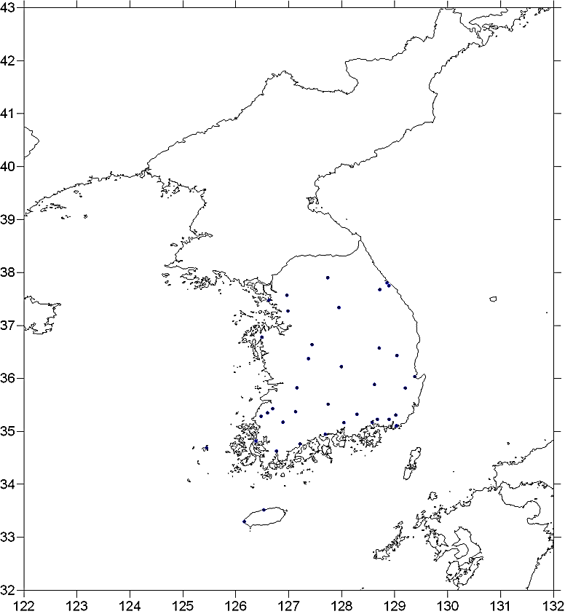
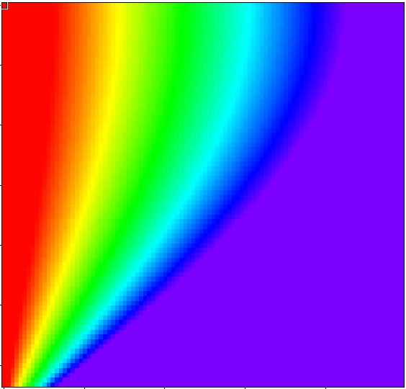
Re-calibration for INS
domain: 30-40°N, 120-130°E, 37 of points
period: 2012.4~2013.3
validation data: AWS INS data in South Korea
GSICS correction coefficient
a : 0.864972 (slope)
b : 0.024749 (intercept)
Cloud Factor (0 to 1 range)
Solar Zenith Angle
VIS Reflectance

Slide 20
2013 May DCC web-meeting (R. Bhatt)

Slide 21
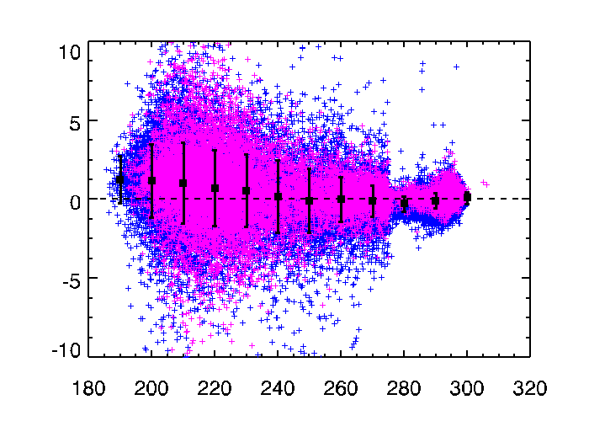
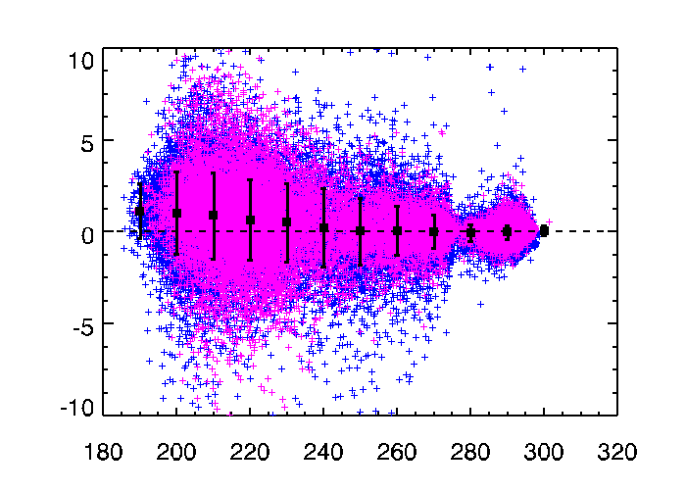
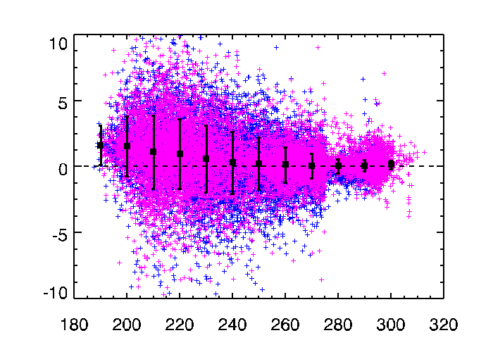
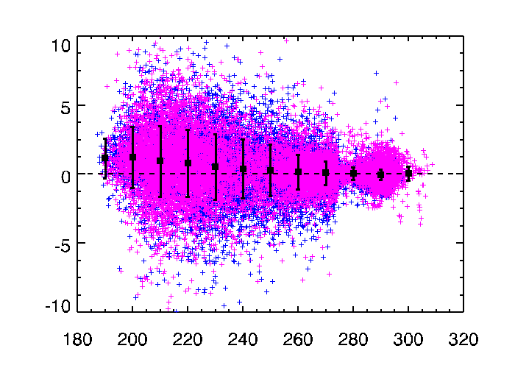
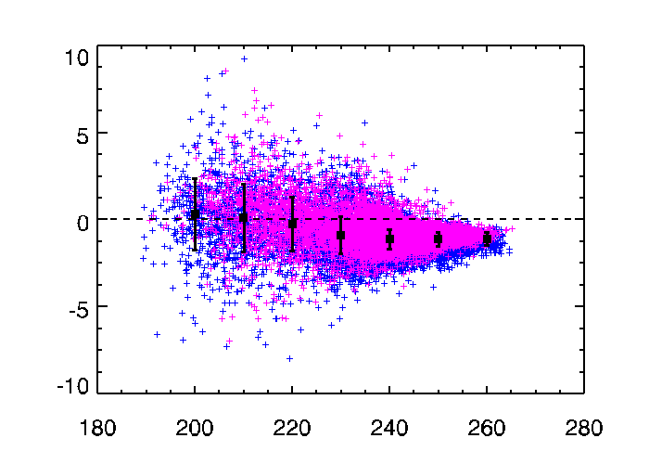
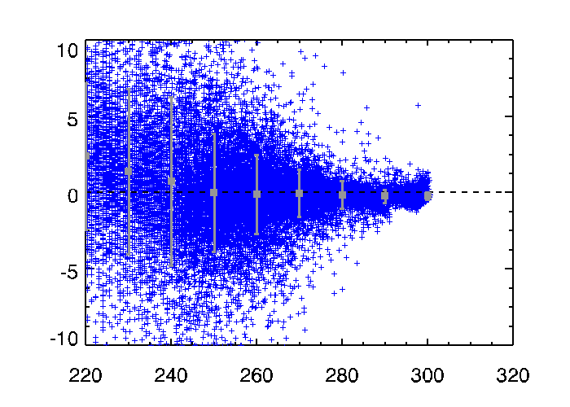
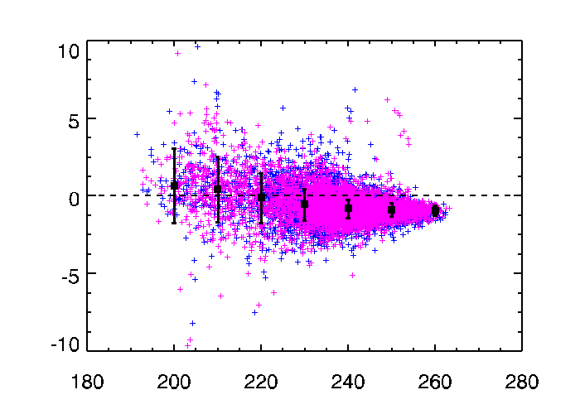
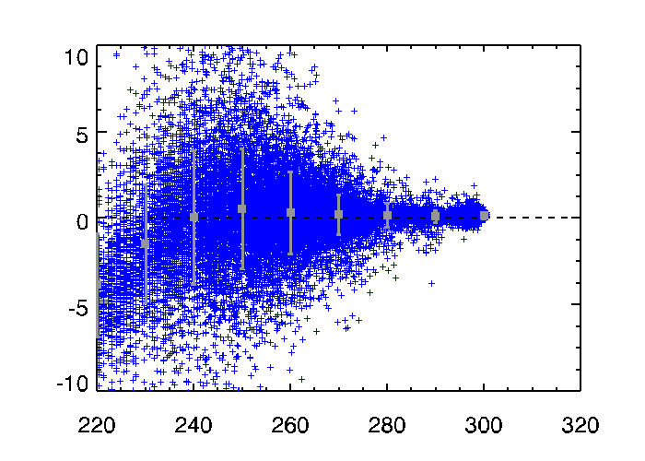
day/night TB bais scatter plot
day (magenta) / night (blue)
period: 2011.04 – 2013.12
Using AIRS data
Using IASI data
IR1 (10.8μm)
IR2 (12.0μm)
IR1 (10.8μm)
IR2 (12.0μm)
day: mean bias 0.4042
night: mean bias 0.0911
day: mean bias 0.2488
night: mean bias 0.1876
day: mean bias 0.3909
night: mean bias 0.2052
day: mean bias 0.2555
night: mean bias 0.1886
WV (6.75μm)
SWIR (3.75μm)
WV (6.75μm)
SWIR (3.75μm)
day: mean bias -0.7731
night: mean bias -1.1688
night: mean bias 0.178
day: mean bias -0.7322
night: mean bias -0.7615
night: mean bias 0.0215

Slide 22
the number of collocation pixels
period: 2011.04 – 2013.12
sum of IASI and AIRS collocation pixels
monthly values
IR1 IR2 IR3 IR4

