Slide 1
NOAA/NESDIS/STAR GOES/GOES-R Integrated Cal/Val System (ICVS) Long-Term Monitoring (LTM) Development
Fangfang Yu, Fuzhong Weng, Xiangqian Wu, and Ninghai Sun
Satellite Meteorology and Climatology Division
Center for Satellite Applications and Research
National Environmental Satellite, Data and Information Service

Slide 2
NOAA/NESDIS/STAR ICVS LTM
LEO (NPP/JPSS, NOAA/Metop …)
GEO(GOES/GOES-R)
S-NPP: ATMS/CrIS/VIIRS/OMPS
NOAA/Metop: AVHRR/HIRS/AMSU/MHS
DMSP …
GOES : Imager/Sounder
Spacecraft, space weather instruments
GOES-R: ABI (after launch) … under development

Slide 3
GOES/GOES-R ICVS Objectives
Provide instrument scientists with calibration healthy status
Provide users with information of radiance quality for product generation.
Users’ Request in the 2013 Users Workshop: Satellite operational anomaly alerting system for the GOES-R series
Facilitate communication of instrument anomalies amongst instrument engineers, calibration scientists and user community.

Slide 4
Web-based System…
Focus on long-term monitoring of real-time on-orbit instrument performance and sensor data quality
Weather instrument Monitoring
(evolved from GOES IPM system)
Spacecraft performance monitoring
Space weather instrument performance monitoring
Telemetry
Calibration Coefficients
Detector Noise
Radiance Quality (GSICS)
Upgrading
Under development

Slide 5
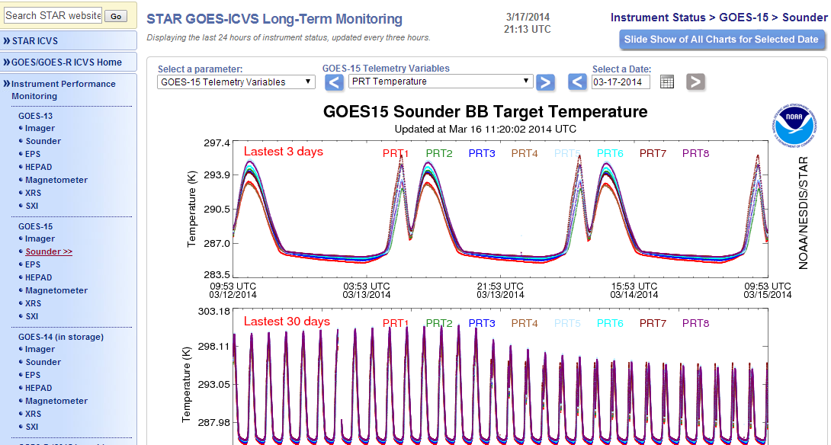
GOES Imager/Sounder ICVS Monitoring
Imager and Sounder ICVS monitoring currently available at: http://www.star.nesdis.noaa.gov/icvs/

Slide 6
GOES ICVS Daily Data Processing Flowchart
Near Real-time L1B data
Data Subset
Calibration related dataset
Imager monitoring
Sounder monitoring
Extract the individual Imager parameter and calculate the statistics
Extract individual Sounder parameter and calculate the statistics
BB
SPLK
TELE
CAL
BB
SPLK
TELE
CAL
Noise
Noise
Plotting and Report
Plotting and Report

Slide 7
Current GOES ICVS LTM Parameters
Satellite | Instrument | Calibration Related Telemetry Parameters | Calibration Target Signals | IR Calibration Coefficients | Detector Noise
GOES-13 | Imager | 14 | 4x5channels (2-8 det/chan) | 2x4 channels (2 det/chan) | 2x5chan (2-8 det/chan)
 | Sounder | 16 | 2x19channels (4 det/chan) | 2x19 channels (4 det/chan) | 2x19 channels (4 det/chan)
GOES-15 | Imager | 14 | 4x5 channels (2-8 det/chan) | 2x4 channels (2 det/chan) | 2x5 channels (2-8 detectors)
 | Sounder | 16 | 2x19 channels (4 det/chan) | 2x18 channels (4 det/chan) | 2x19 channels (4 det/chan)

Slide 8
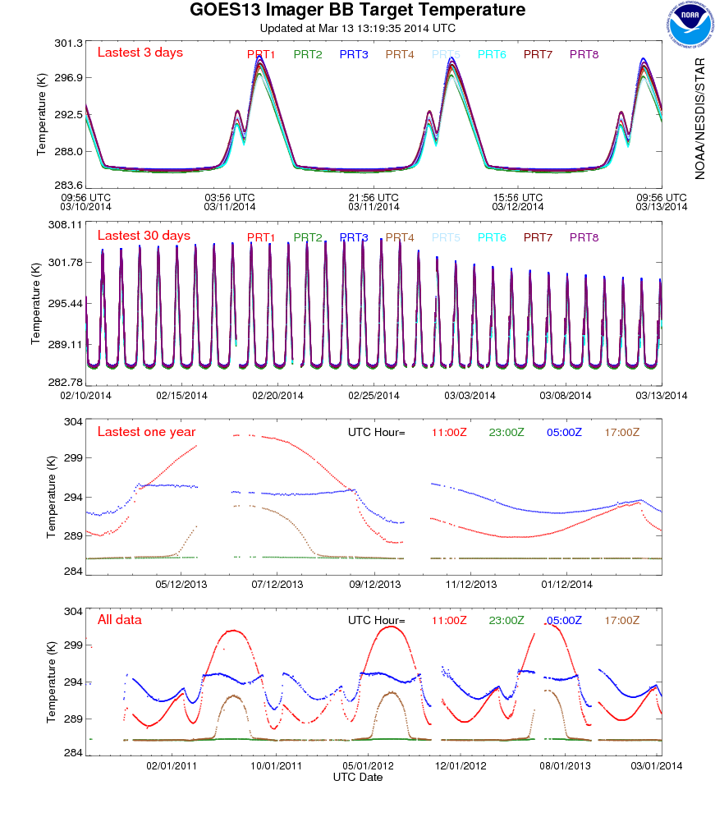
Multiple panels for a variety of temporal scales
Diurnal variation for different PRT detectors
Inhomogeneous heating of BB
midnight heating and the latency
Seasonal Variation
strongest after-midnight heating around the summer solstice
Long-term trending
more apparent at certain time

Slide 9
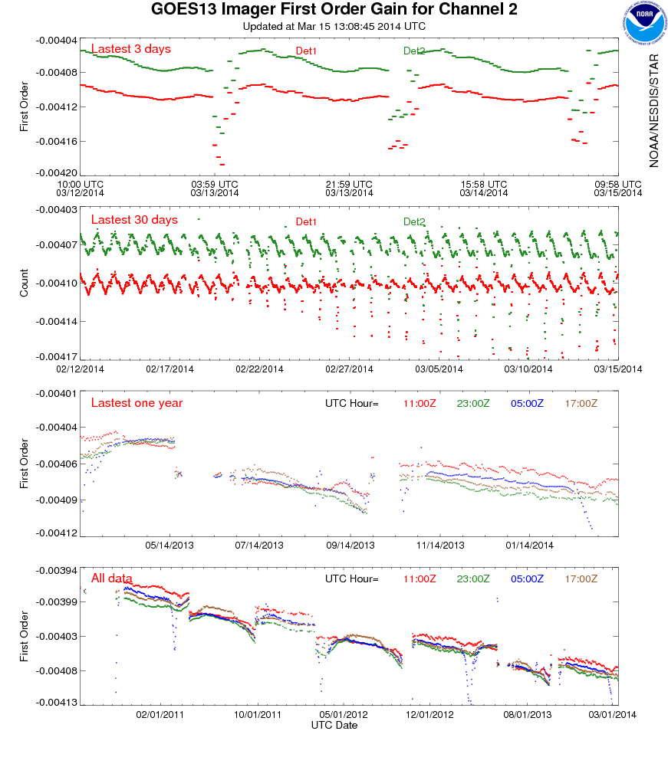
Nominal calibration coefficients
diurnal variation
Erroneous Midnight calibration coefficients
Seasonal variation
erroneous midnight calibration coefficients increase as approaching summer
jump with patch temperature switch
Long-term trending
- Increasing absolute coefficients values as sensor degrades

Slide 10
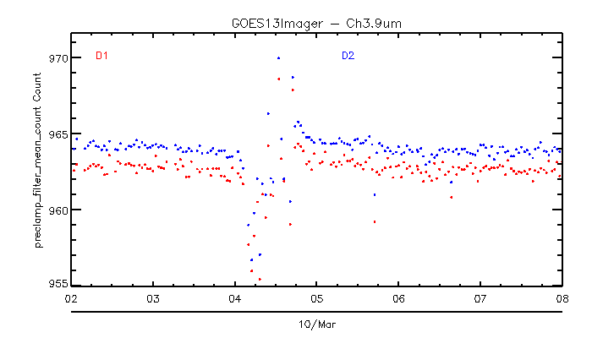
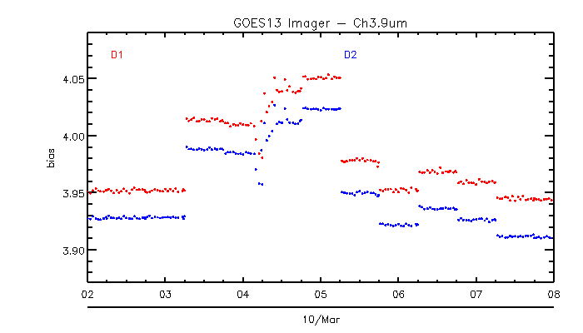
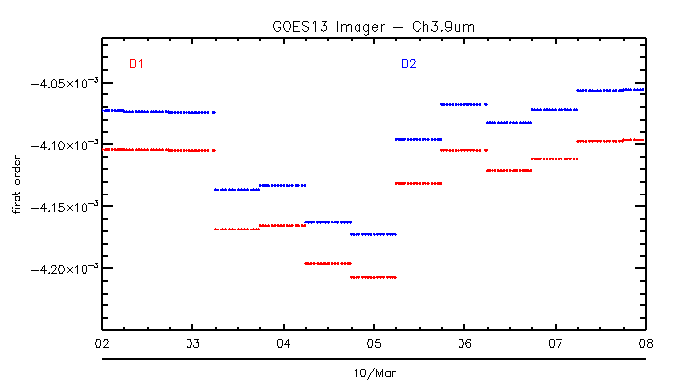
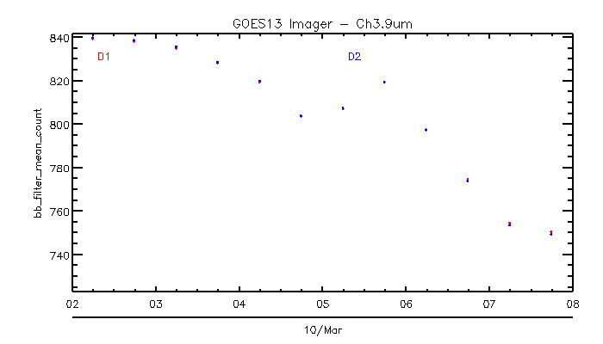
Clamp pos
MBCC slopes cause jumps here
Due to contaminated splk

Slide 11
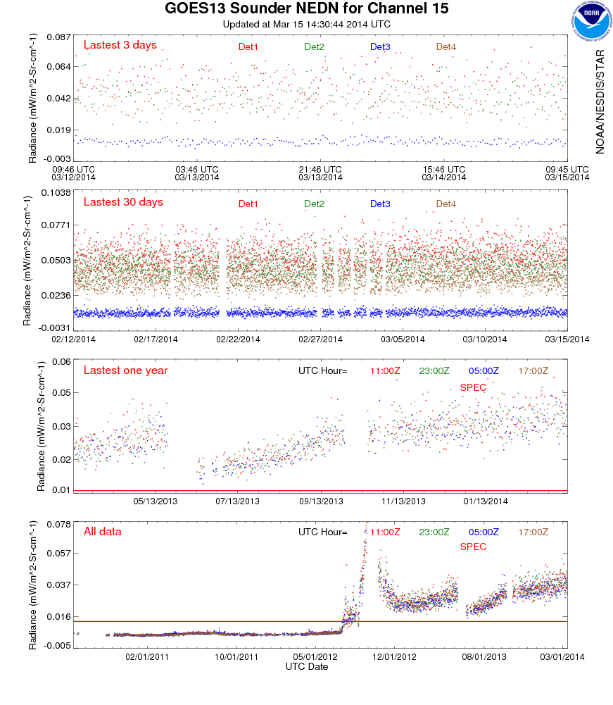
Data outage 05/22/2013- 06/06/2013
Data outage 05/22/2013- 06/06/2013
Noise jumped suddenly in early July 2012
Data outage from 09/12/2012-10/18/2012 , outgassing for Sounder

Slide 12
Examples of using GOES ICVS (GOES IPM) to investigate the root causes of calibration anomalies

Slide 13
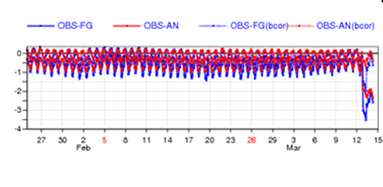
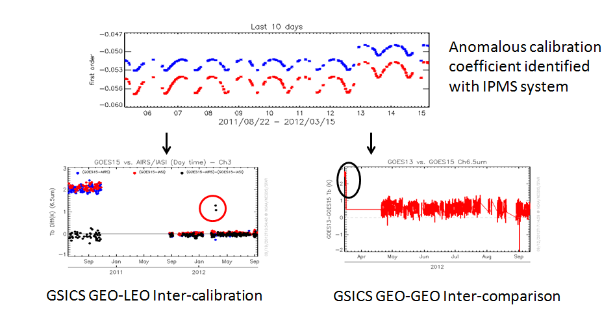
GOES-15 Imager Calibration Anomaly in March 2012
First revealed by ECMWF monitoring of T_{b}
Immediately identified with GOES-IPM monitoring from the change of calibration coefficients. Results of GOES-IPM system helped instrument engineers focus on investigating the final root cause in the ground system – change of SPS version
Evaluated with the GSICS GEO-LEO and GEO-GEO bias monitoring
Wu et al. 2012
Notes:
http://cimss.ssec.wisc.edu/goes/blog/archives/9995

Slide 14
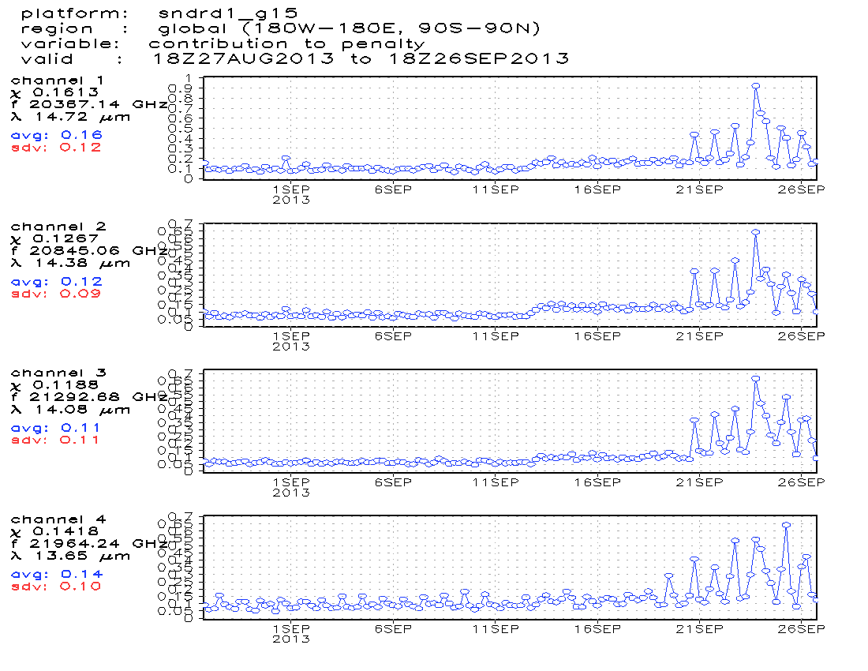
GOES-15 SNDR Ch 1-5 Anomaly in EMC GDAS Operational Monitoring …
http://www.emc.ncep.noaa.gov/gmb/gdas/radiance/esafford/wopr/index.html

Slide 15
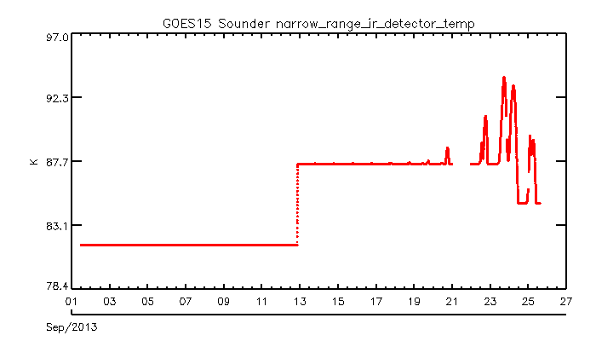
GOES-15 SNDR Ch 1-5 Anomaly in EMC GDAS Operational Monitoring …

Slide 16
Conclusions and Path Forward
A very powerful tool
Instrument performance health monitoring
Diagnose the anomalies
Address the users questions or concerns on the calibration changes
Evaluate/verify the instrument performance
post-launch test period
recovery period right after instrument gets re-activated.
Continue to evolve the GOES ICVS for GOES-R ABI monitoring purpose
Implement and enrich the data quality monitoring
Inter-calibration/inter-comparison
Implement and improve the calibration alert notification function
Provide flexible customized datasets for analysis

