Slide 1
Implementation of DCC at JMA and comparison with RTM
Meteorological Satellite Center of JMA
Keita Hosaka

Slide 2
Contents
Implementation for JMA Systems
Results
Comparison with RT simulation
Summary

Slide 3
Contents
Introduction
Comparison of DCC selection between NASA and JMA
Results of JMA processing frameworks
Threshold dependency
PDF stability
Summary and future plan

Slide 4
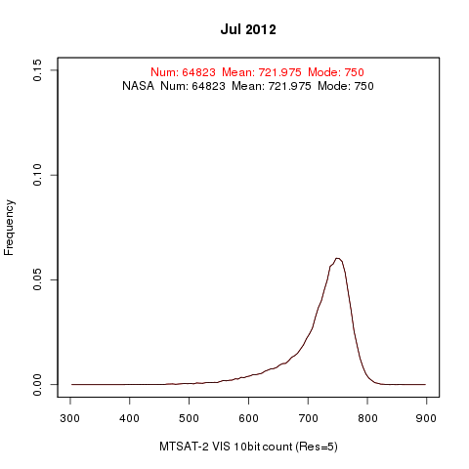
Introduction
First time for JMA to apply NASA’s algorithm to MTSAT-2/Imager
a
Deep gratitude to NASA for providing DCC verification package!
a
At first, we checked the package and got good results ⇒
JMA
Histograms are
completely overlapped!

Slide 5
NASA DCC method for MTSAT-2/Imager
DCC selection thresholds: same as Doelling et al. (2013) except for homogeneity check for MODIS
Doelling et al., 2013: The Characterization of Deep Convective Clouds as an Invariant Calibration Target and as a Visible Calibration Technique. IEEE TGRS , 51, 1147-1159.
5km sub-sampled MODIS L1B (MYD02SSH) are used in this analysis instead of the nominal data (MYD021KM)
DCC domain:
20° S < latitude < 20° N
125° E < longitude < 165° E
SBAF (Spectral Band Adjustment Factor): 0.9376
From web meeting 2012/10
Presentation by R. Bhatt at the DCC Part I web meeting

Slide 6
JMA processing sequences
Download MODIS Data from CLASS
Make working environment
MYD02SSH
MTSAT-2
HRIT
Collect Data
Real-time Comparison
*Don’t use cremate data
DCC Selection
Roughly → Accurately
Archive Data
Future Plan in Demonstration Phase
Archive Statistic Data
Monthly/
Rolling Average
Put Products to EUMETSAT Server

Slide 7
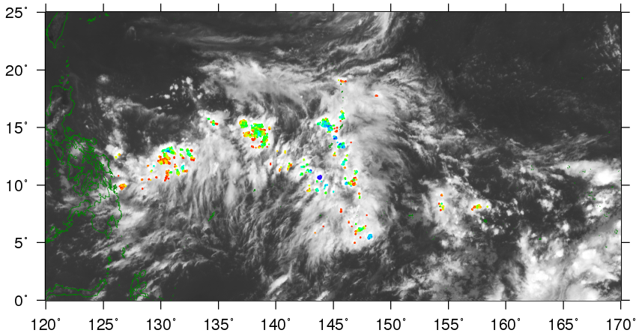
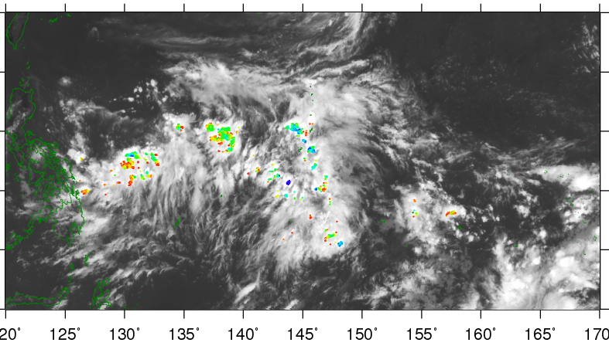
Comparison of DCC selection between NASA and JMA
Thresholds of JMA processing framework:
- Same values in NASA’s DCC verification data document (latitudinal range: N20[deg] ～ S20[deg])
Similar results, but some differences are found because of:
- Data coverage (latitudinal range of the package: -16[deg] < lat < 16[deg])
MTSAT-2 DCC detection at 04UTC 1 July 2012
JMA’s own processing program
NASA DCC verification package
MTSAT-2 11μm channel TB [K]
MTSAT-2 11μm channel TB [K]

Slide 8
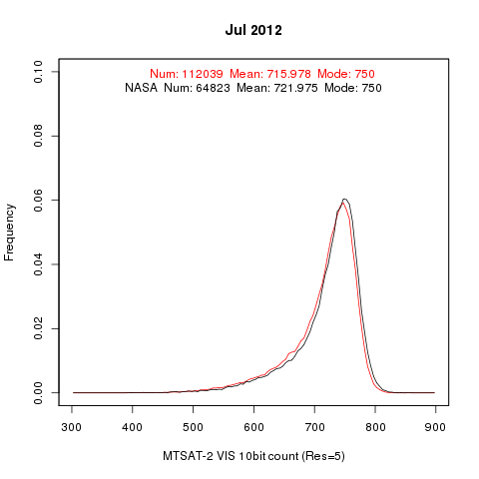
Monthly Histogram Comparison
latitudinal range: N20[deg] ～ S20[deg]
Our results:
- About twice as many DCC pixels
- Mode: almost the same
- Mean: slightly lower
a
a
Angular corrected DN/radiances by Hu DCC BRDF are used in this presentation

Slide 9
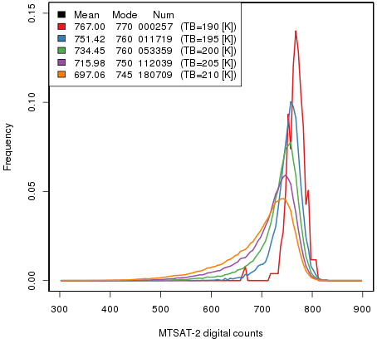
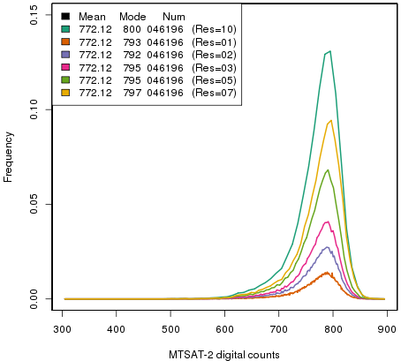
TB threshold for DCC detection and PDF bin size
(Probability Density Function)
Parameters described in the ATBD (TB threshold:205K, Bin size:5) are reasonable
In this study, recommended parameters by NASA are used
MTSAT-2 visible channel PDF of angular corrected DCC on July 2012
TB threshold
Bin size

Slide 10
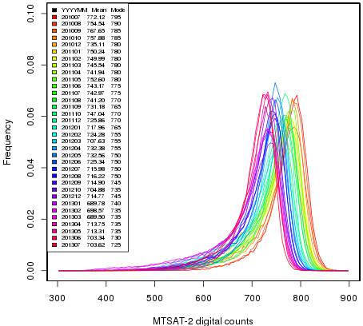
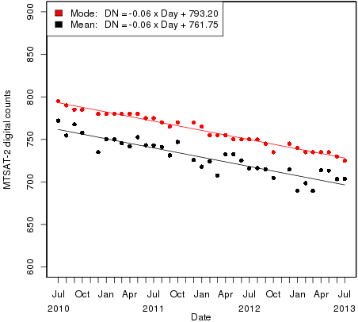
MTSAT-2/Imager PDF variation with time
(Probability Density Function)
Consistent results with the ATBD or those of other GEO satellites
Seasonal variation (mode is more stable than mean)
Small sample size or NO observation from October to December every year, due to MTSAT’s ground system maintenance
Monthly PDFs
mode
mean
Time series of mode and mean of DCC pixels

Slide 11
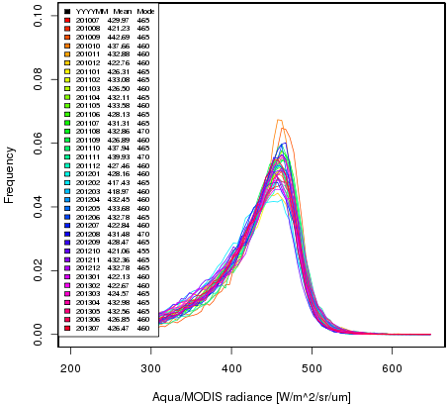
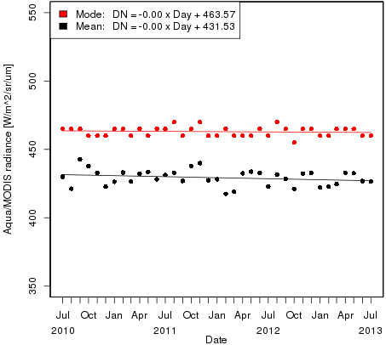
Aqua/MODIS PDF Stability
Same as the RT simulation
Input: 5km sub-sampled data (MYD02SSH, Collection 5)
- IR/VIS spatial homogeneity checks are not applied.
Thresholds for DCC detection: almost same as those for MTSAT-2/Imager
Consistent results with Doelling et al. (2013)
Monthly PDFs
mode
mean
Time series of mode and mean of DCC pixels
Doelling et al., 2013: The Characterization of Deep Convective Clouds as an Invariant Calibration Target and as a Visible Calibration Technique. IEEE TGRS , 51, 1147-1159.

Slide 12
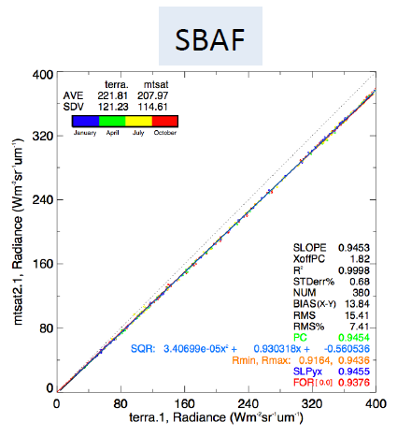
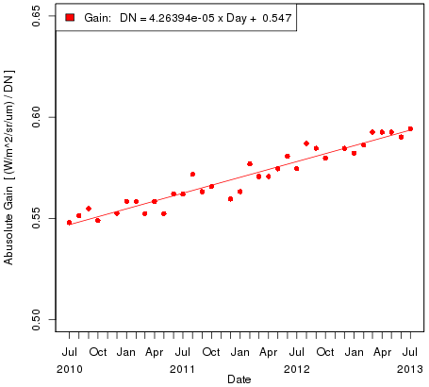
Monthly Gain
Presentation by D. Doelling at the web meeting @ 2012/10
SBAF for MTSAT-2: 0.9376 (Described in Dave’s presentation in October 2012 GSICS web meeting)
a
Need to compare with the results based on our RT simulation method ⇒
a

Slide 13
Summary and future plans
Summary
Implementation of NASA’s DCC method to MTSAT-2/Imager
Preliminary results: good agreement with the ATBD
Issue of MODIS data archive at JMA: difficult to archive nominal Aqua/MODIS data (MYD021KM) due to our disk space and downloading speed
Needs to consider proper thresholds for homogeneity check using 5km sub-sampled data (MOD02SSH)
Future plans
Investigate the impact of BRDF and SBAF on the calibration results
Comparison of the results using nominal Aqua/MODIS data and those using 5km sub-sampled data
Comparison of the results with those based on RT simulation method
Uncertainty evaluation
Creation of netCDF intermediate data which contain selected DCC pixels for replication (and GSICS Correction netCDF)

Slide 14
Contents
NASA DCC method for MTSAT-2
Vicarious calibration using RT simulation
Comparison of gain between NASA DCC method and RT simulation method
Summary / toward demonstration phase

Slide 15
Results of Real-Time DCC method
Good agreements with the ATBD or those of other GEO satellites
Seasonal variation (mode is more stable than mean)
Time series of mode and mean of DCC pixels
mode
mode
mean
mean
MTSAT-2/Imager
Aqua/MODIS

Slide 16
Data Correcting Span for the Demonstration Phase Product
Monthly Mean
Moving Average 30 Days
Data loss mainly due to maintenances of the antenna

Slide 17
Reanalysis: MODIS 3-year Average

Slide 18
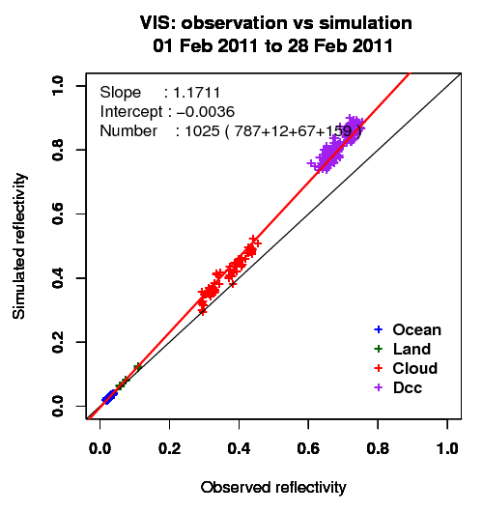
Vicarious calibration using RT simulation
Method: Comparison of observed and simulated radiance for some targets (collaboration research with the University of Tokyo)
Target: Wide range of radiances
Cloud-free ocean / land, liquid water cloud, and DCC
Radiative transfer calculation:
RSTAR (Nakajima and Tanaka [1986,1988])
Input data: Independent from GEO data
JMA Re-Analysis atmos. profiles (JRA-25/JCDAS)
Aerosol/Cloud optical thickness retrieved from MODIS L1B (MYD02SSH)
MODIS BRDF (MCD43C2) for land target
Aura/OMI total column ozone, …
Result of MTSAT-2 in Feb. 2011
Simulated reflectivity
Observed reflectivity

Slide 19
Target selection for the RT simulation
Spatially uniform scene
Small standard deviation of digital counts in a target area
Geometrical condition
Solar/satellite zenith angle < 60°
Exclude data around sun-glint area
Ice crystal shape for DCC simulation: Hexagonal column (Yang et al. 2000)
To minimize the uncertainty, cloud with large optical thickness are used.
Thresholds used in the target selection for MTSAT-2/Imager
 | Ocean | Land | Liquid cloud | DCC
Standard deviation of digital counts (5x5km mean) | < 6 | < 3 | < 12 | < 15
Optical thickness Aerosol for sea and land Cloud for cloud and DCC | < 0.3 | < 0.3 | > 10 & < 40 | > 150
TBB of 10.8um ch. | >273K | > 273K | > 273K | < 205K

Slide 20
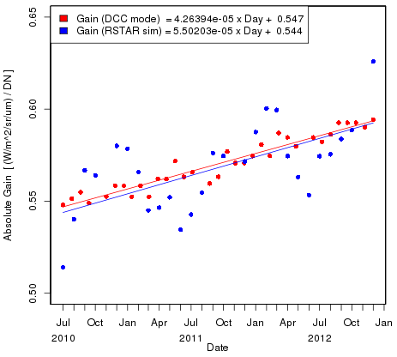
Comparison of gain between NASA DCC method and RT simulation method
Time series of monthly visible channel gain
Gains by RSTAR simulation are derived from direct comparisons between observation and RT simulation
Similar trends, but large variance (seasonal variation) in results of the vicarious method
NASA DCC method
Vicarious method using RT simulation

Slide 21
Properties of RT Simulation & It’s Statistics
In the statistics of RT simulation, the offset of liner regression is variable.
But if we change offset to 0, the regression slopes may change little. Because there are cloud-free oceans in low levels of both reflectivities.
We tried to use only DCC target in RT simulation, but results have larger variance.
Because there are one group which has the comparable levels and large variance.
There are same problems in retrievals of cloud ices in DCC. For the optical depths of DCC, we use nearly fixed values, in contrast with optical depths of water cloud which are retrieved from MODIS data.
Notes:
explain

Slide 22
Summary / Toward demonstration phase
Summary
Implementation of NASA’s DCC method to MTSAT-2/Imager
we used real-time comparison for estimating the gains.
Comparison of NASA DCC method with vicarious method on RT simulation
Similar gain trend
Need to improve vicarious method
Toward demonstration phase
MODIS DCC selection / data archiving
Difficult to get/archive nominal Aqua/MODIS data (MYD021KM) due to downloading speed. Alternatively, we used 5km sub-sampled data.
Very useful if NASA creates the DCC-selected data (e.g., MTSAT-IASI/AIRS IR collocation NetCDF data on EUMETSAT THREDDS server).
GSICS product (NetCDF) format
What attributes/variables should be contained?
Application for Himawari-8/AHI for the AHI operational phase (starting at 2015/Apr.~2016/Mar.).

Slide 23
Thanks for your attentions!

Slide 24
AHI VIS/NIR Calibration Strategy

