Slide 1
NOAA Operational Implementation of DCC Correction
Fangfang Yu and Xiangqian Wu
NOAA/NESDIS/STAR

Slide 2
Outlines
Operational implementation
Routine daily DCC pixel identification for GOES-13 and GOES-15 since Dec. 2011
Issue of GOES-13 DCC reflectance in 2013 and possible resolving option
Sensitivity analyses
Mode vs. median reflectance
BRDF model: CNES, Hu, and CNES
Proposed DCC correction parameters in netCDF file

Slide 3
DCC Correction
DCC pixel identification
Routine DCC pixel identification for GOES-13 and GOES-15 since late December 2011
Absolute reference reflectance
Long-term or monthly reference reflectance
MODIS vs. VIIRS
DCC reflectance
Mode vs. median
BRDF model
Hu, CERES, CNES PLODER, MODIS and BJ Sohn models
Trending of monitored instrument degradation
Polynomial function
Correction coefficients and the uncertainty variables in the netCDF

Slide 4
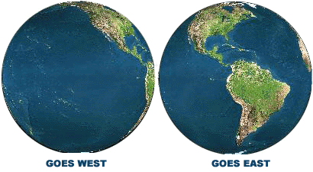
DCC Pixel Identification
GOES-15
GOES-13
Routinely archive the daily DCC pixels from the near real-time data server since late December 2011
All the routine earth scan frames within the DCC temporal and spatial domains
Identified with community- agreed DCC identification criteria
Image from: http://noaasis.noaa.gov/NOAASIS/ml/genlsatl.html

Slide 5
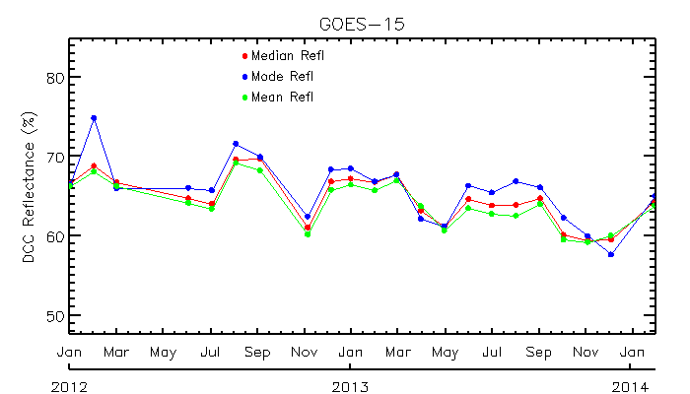
GOES-15, Hu’s ADM Correction

Slide 6
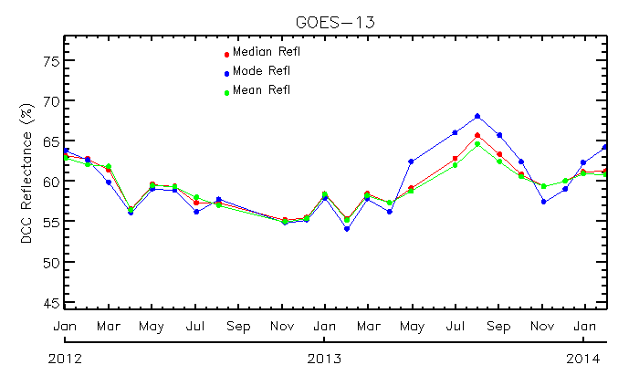
GOES-13, Hu’s ADM Correction
Anomaly on Sept 12, 2013
Data outage: Sept. 12, 2013 – Oct. 18, 2013
Anomaly on May 22, 2013
Data outage: May 22, 2013- Jun 6, 2013

Slide 7
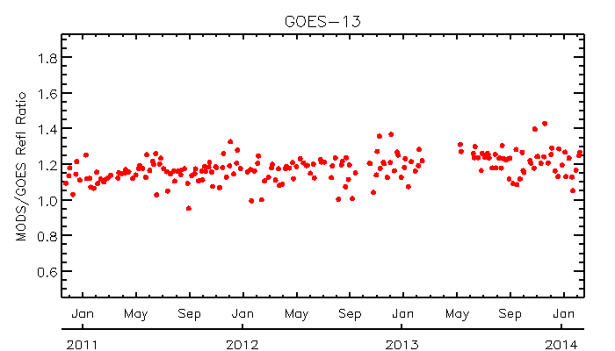
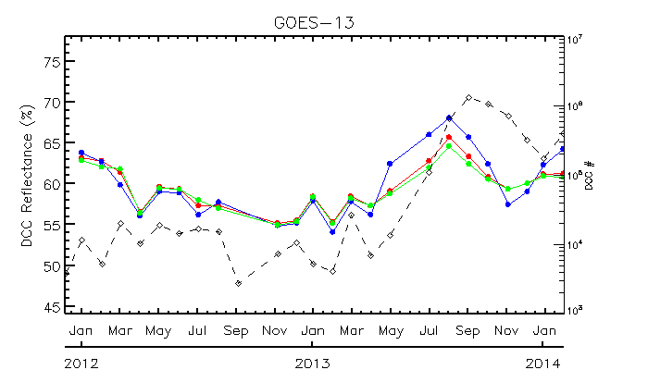
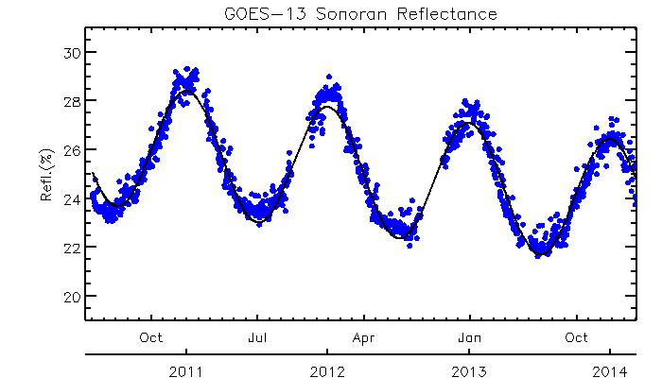
Comparisons with Results of other methods
Ratio between the Terra/MODIS and GOES collocated cloud pixels (ray-matching)
GOES DCC Reflectance
Time-series of Sonoran TOA reflectance (desert target)
No apparent change of GOES-13 degradation trending was observed in 2003 from the ray-matching and desert methods

Slide 8
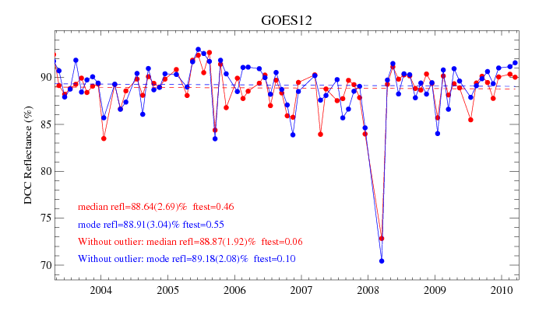
Time-series of Monthly DCC Reflectance
GOES-12 was GOES-East
Monthly Aqua MODIS C6 DCC reflectance
No significant long-term trending
Apparent Annual variation
Root causes to the variation are unknown yet
Land/ocean surface?

Slide 9
Possible solution – Determination of the reference reflectance
Semi-annual/annual variation in DCC reflectance
Climate (water vapor, precipitation, radiation, etc) variation in tropics has semi-variation that can often be stronger than annual cycle
Continent viewed by GOES-East (GOES-13) may complicate this situation
Long-term mean reflectance
May result in relatively large uncertainty, especially in the first several years of operation.
Monthly reference reflectance
Allows for the seasonal variation
How to handle the months with insufficient DCC pixels? Use the long-term value?

Slide 10
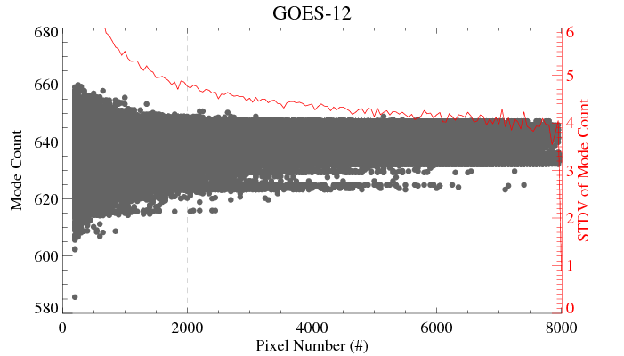
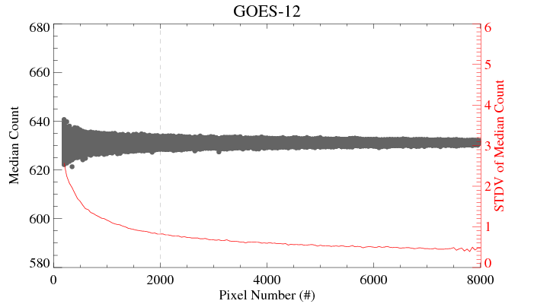
Minimum pixels for a robust DCC reflectance
Mode Reflectance
Median reflectance
Both methods need at least thousands of DCC pixels for a robust result
Less variation with median reflectance

Slide 11
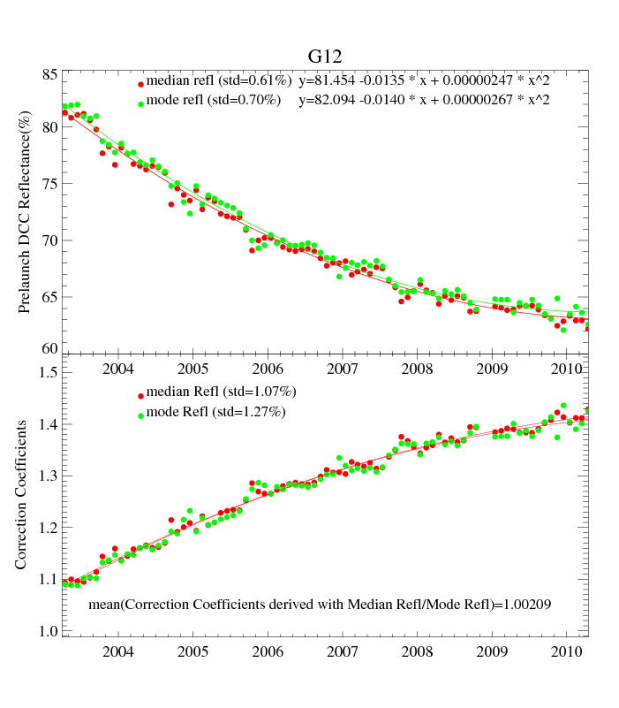
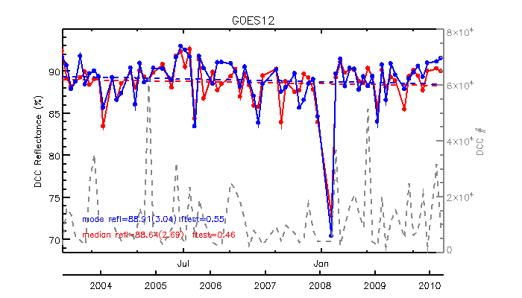
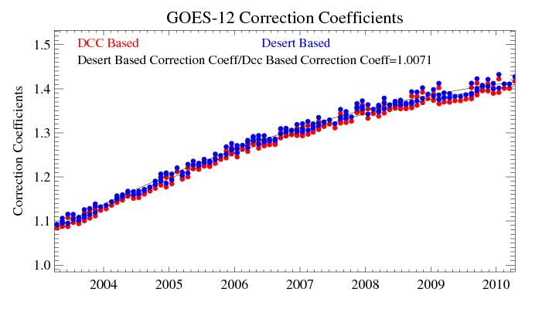
Mode vs. Median Reflectance
Less variations with median values in the time-series of DCC reflectance
The bias between the median and mode reflectance is less than 0.4% (0.21% for GOES-12, 0.34% for MODIS data)
Calibration coefficient difference between median DCC and desert method is less than 1%

Slide 12
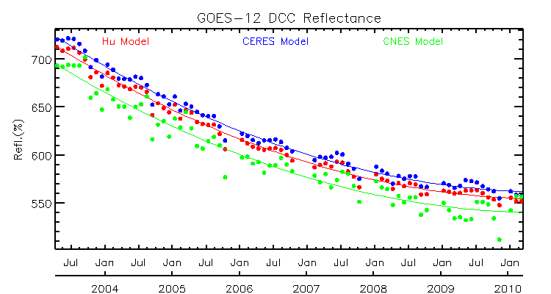
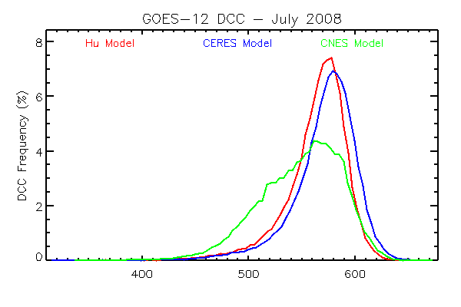
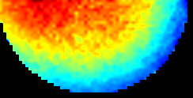
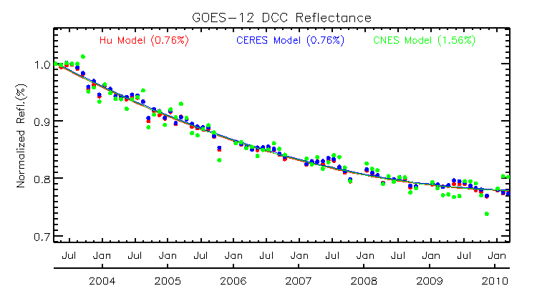
BRDF Models
CNES BRDF model Band 670nm solar range =30-40º
Hu, CERES, and CNES models
Different angular resolutions
CNES: 10 (szn) x2 (vzn) x ~2(raz) degrees (6 x 31 x 61 grid)
CERES: 10 (szn) x 10*(vzn)x10(raz)
Hu: 10 (szn) x 10*(vzn)x10(raz)
CNES model, probably due to its high angular resolution, has relatively large variation
Impact of the long-term trending is very small (<0.3%)
 | Hu | CERES | CNES
Bias, using Hu’s model result as the reference | - | 0.27% | 0.11%

Slide 13
Correction Coefficients
Re-analysis product
Linear correction
Polynomial fitting for GOES Imager visible
Near real-time product
Latency for a reliable DCC product
D. Doeling et al. 2014: Aqua Collection 6 and VIIRS Land PEATE 0.65 channel DCC calibration results.

Slide 14
Variables in the correction product netCDF file
Monthly correction
Global attributes
Band information (satellite and instrument names, central wavelength etc)
Reference instrument information
DCC Data duration
Application validity period
SBAF and the standard error (SCIAMACHY-derived)
Solar constant uncertainty
Trending function equation
….
Variables
Reference reflectance and uncertainty
Fitting coefficients and uncertainty
Correction coefficients and combined uncertainty
BRDF model uncertainty
…..

Slide 15
Conclusions
In addition to slight seasonal variation, DCC reflectance over the GOES-East position seems to have some annual reflectance variation in certain years.
Determination of reference reflectance
Affect the calibration latency for the near real-time product
While median reflectance can result in slightly lower standard error than mode reflectance, the resulted correction coefficients between these methods is very small (<0.4%)
Median reflectance is recommended
Impact on the degradation fitting (systematic error) is very small
Three BRDF models were tested.
Different standard error
Impacts on the degradation fitting (systematic error) are very small (<0.3%) with long-term re-analysis data

