Slide 1
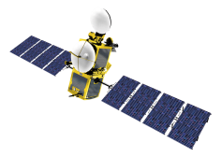
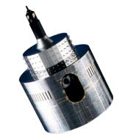
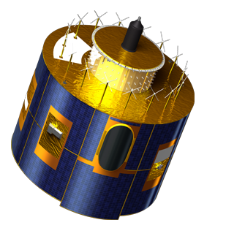
EUMETSAT implementation of the DCC algorithm
Sébastien Wagner
Notes:
EUM/STG-SWG/36/14/VWG/15

Slide 2
Implementation and processing: a summary... 1/2
ATBD is implemented (prototype)
Uncertainty analysis still missing
Data processing:
Meteosat Second Generation:
Meteosat-09: data extracted and processed from 10/2006 till 12/2012 for VIS06 and VIS08.
Data from Rapid Scan Service? ➔ Need to be tested BUT low confidence in data availability (5 degree only [lower limit = 15deg N], mostly above desert)
Met-8 and -10: can be processed but needs SBAF + thresholds from NASA.
MODIS data processed (same algorithm) from 01/2003 till 08/2004. 2002, end 2004, 2005 and 2006 still missing.
Meteosat First Generation ➔ implementation of Met-7 on its way
➔ See previous presentations at Web Meetings (all available on the WIKI)

Slide 3
Implementation and processing: a summary... 2/2
For further analysis + uncertainty analysis:
Extraction of the land/sea mask
PDFs are build-up after a first coarse extraction ➔ intermediate datasets without homogeneity checks.
➔ See previous presentations at Web Meetings (last one in January 2014)
In preparation ➔ automation of the extraction (intermediate dataset) on our operational system for all current GEOs
Step 1 = instrument monitoring
Step 2 = generation of GSICS corrections

Slide 4
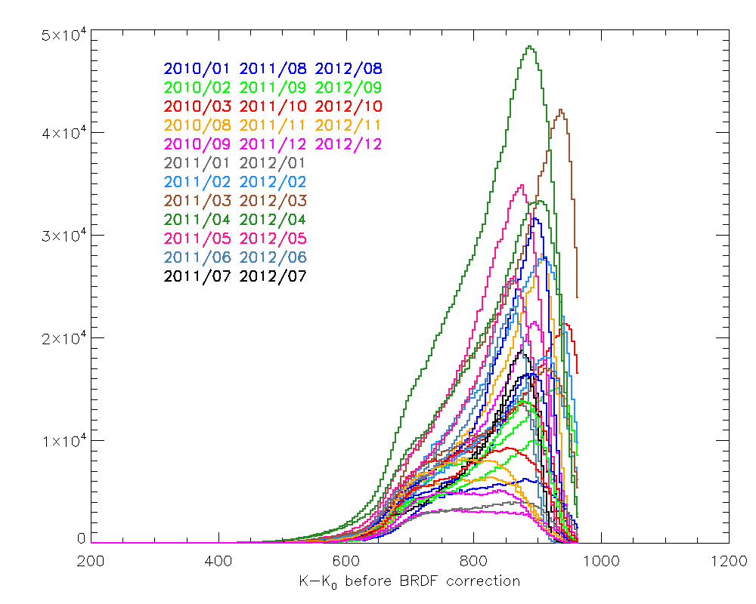
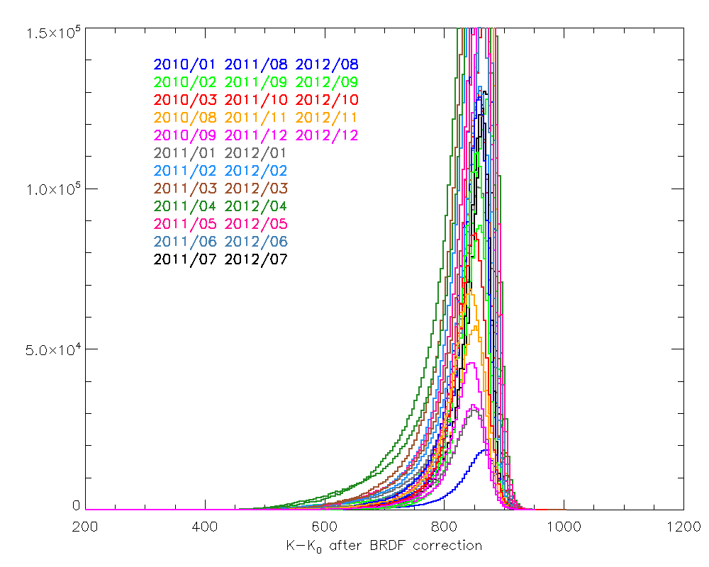
Effects of the saturation for Met-9 VIS0.6
saturation

Slide 5
Effects of the saturation
Potential shift in the mode value due to the reshuffling
Saturation in MET-09 counts
BRDF correction
Effect on the gain?
Saturation removed taking out the last bin
BRDF correction

Slide 6
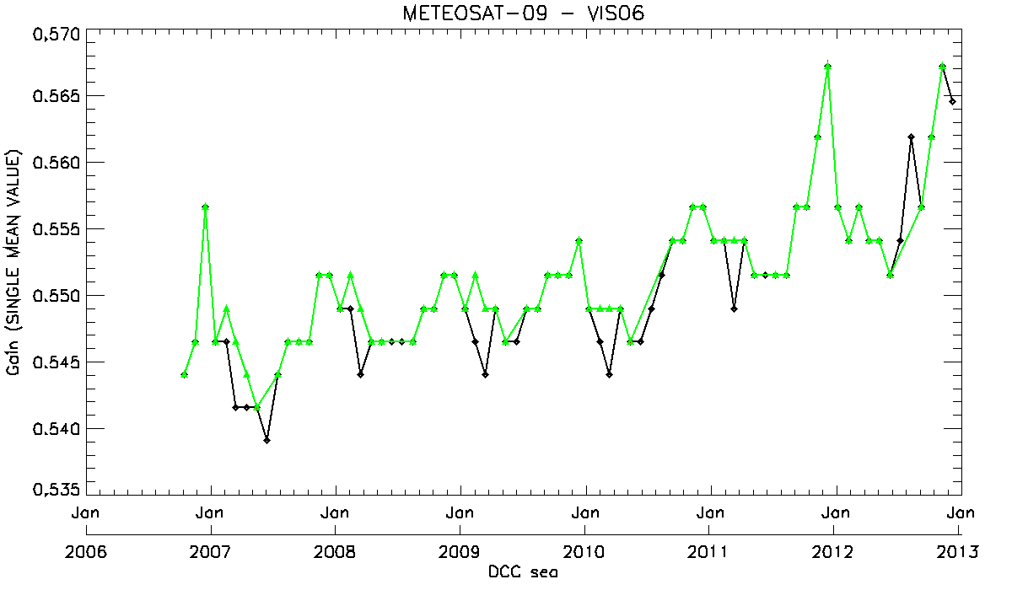
Effects of the saturation for Met-9 VIS0.6
With saturation
Without saturation
Effect on the gain
(DCC above sea only)

Slide 7
What is a GSICS DCC product?
Is a product a yearly-derived drift derived from a linear drift?
Is it a monthly-cumulated drift derived from a linear fit?
Is a product a monthly window moving from month to month?
Can it be a daily moving window of N days as for IR products (NRTC + RAC)?
Questions raise as we observe seasonality, at least with SEVIRI

Slide 8
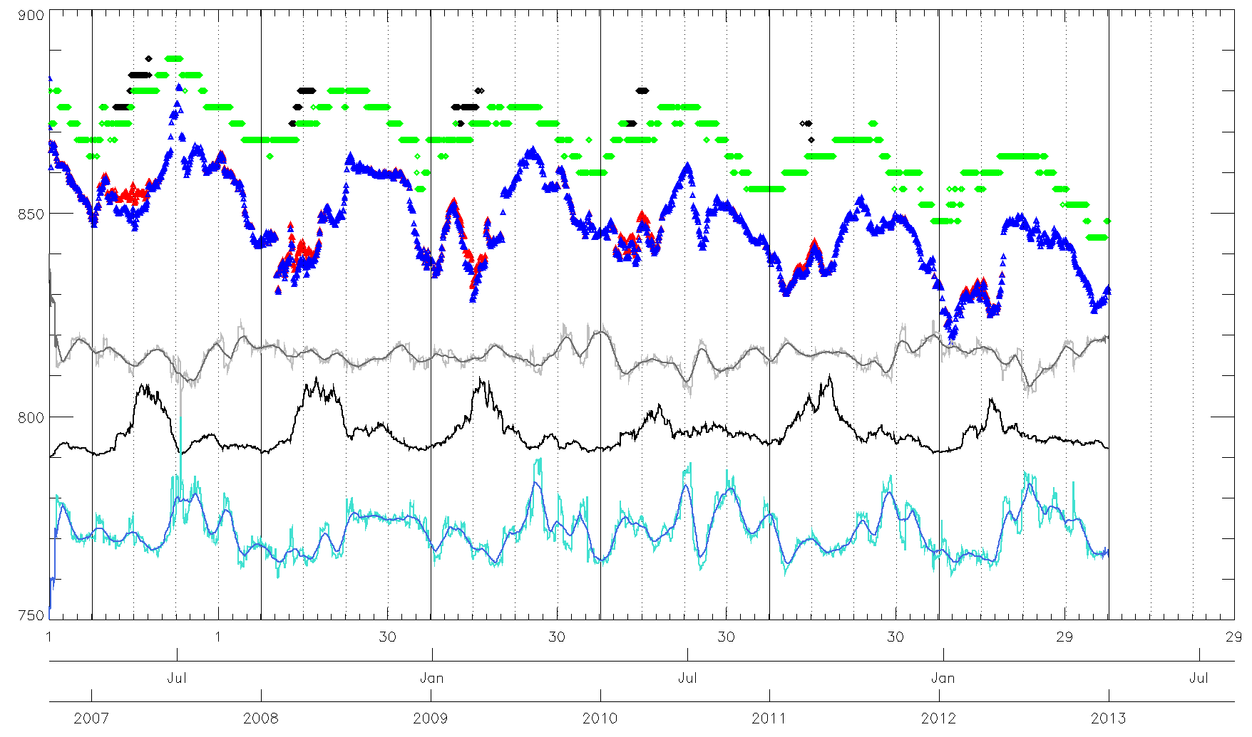
Effect of the saturation MET-9/VIS0.6
MODE
SKEWNESS + smoothed over 30 days
MODE – No saturation
Number of DCCs
MEAN
K-K0
MEAN – No saturation
KURTOSIS + smoothed over 30 days

Slide 9
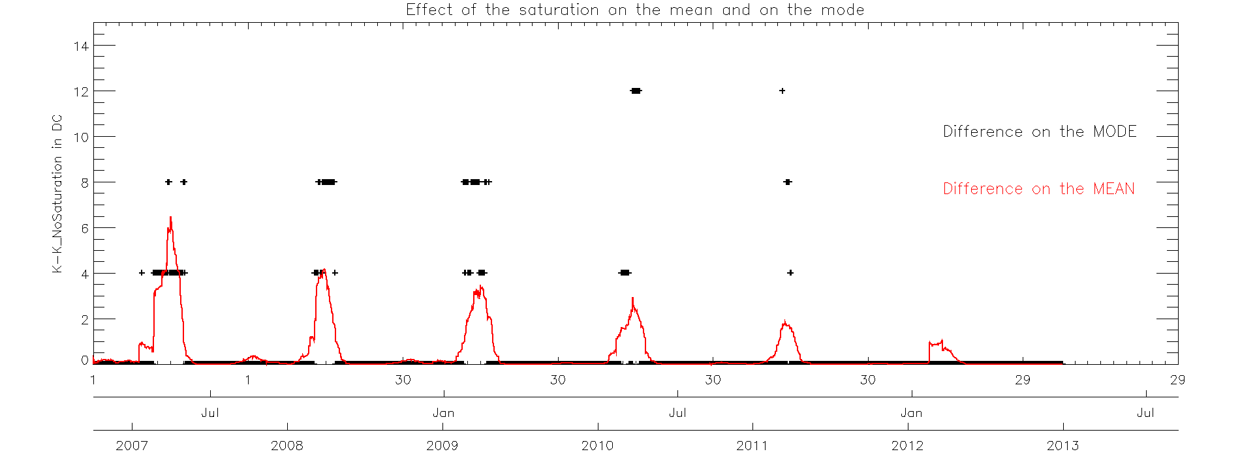
Effect of the saturation MET-9/VIS0.6
Effects of saturation decreases with time ➔ Instrument degradation helps us!

Slide 10
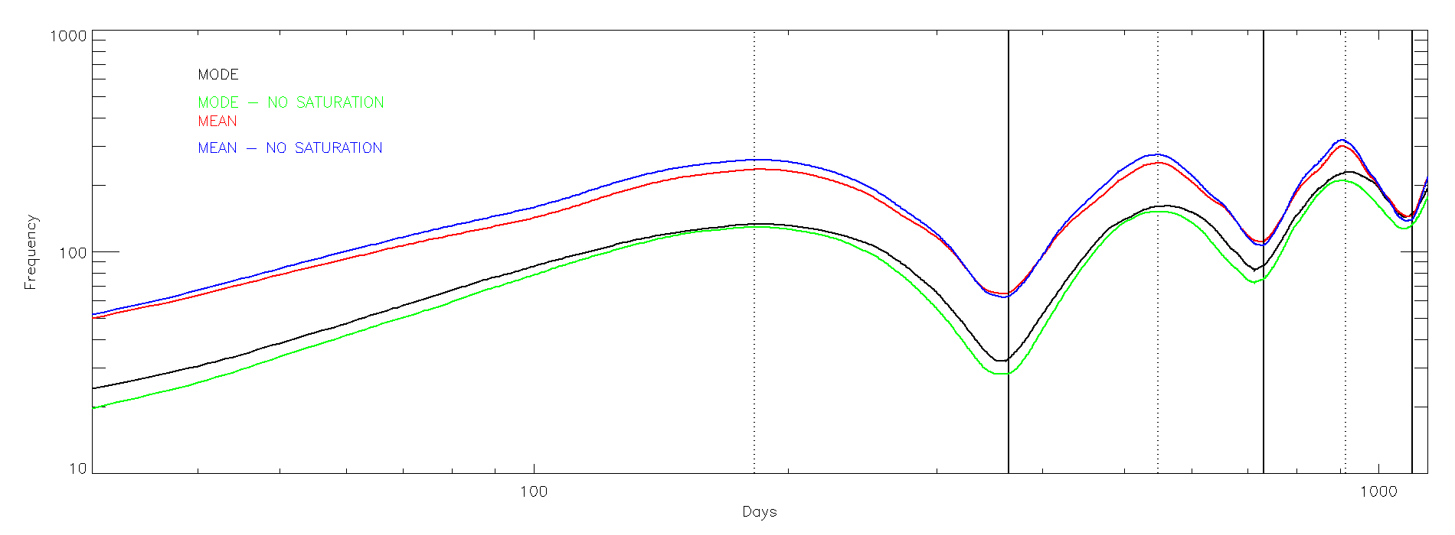
Variogram analysis of the time series
Variogram
30 days (interval used for the NRT product)
 | Mode | Mean | Mode (no saturation) | Mean (no saturation)
Drift Stability | 0.1538 | 0.1110 | 0.1374 | 0.1046

Slide 11
Drift, offset and uncertainty for various products
 | Mean | Mode | Mean (No saturation) | Mode (No saturation)
NRT D-30 | A = -0.4168% yr⁻¹ B = 858.85 DC Err = 0.011 | A = -0.4365% yr⁻¹ B = 880.26 DC Err = 0.008 | A = -0.3999% yr⁻¹ B = 857.93 DC Err = 0.016 | A = -0.4148% yr⁻¹ B = 879.03 DC Err = 0.008
NRT D-15 | A = -0.4199% yr⁻¹ B = 859.06 DC Err = 0.012 | A = -0.4389% yr⁻¹ B = 879.83 DC Err = 0.009 | A = -0.4041% yr⁻¹ B = 858.20 DC Err = 0.013 | A = -0.4197% yr⁻¹ B = 878.70 DC Err = 0.008
NRT D-30 (sea only) | A = -0.3837% yr⁻¹ B = 858.96 DC Err = 0.027 | A = -0.3952% yr⁻¹ B = 879.78 DC Err = 0.026 | A = -0.3601% yr⁻¹ B = 857.67 DC Err = 0.027 | A = -0.3779% yr⁻¹ B = 878.50 DC Err = 0.025
RAC 15+D-15 | A = -0.4310% yr⁻¹ B = 860.39 DC Err = 0.012 | A = -0.4480% yr⁻¹ B = 881.47 DC Err = 0.008 | A = -0.4068% yr⁻¹ B = 859.08 DC Err = 0.013 | A = -0.4298% yr⁻¹ B = 880.16 DC Err = 0.007
Yearly drift (bold = lunar calibration; between bracket = SSCC)
 | VIS0.6 | VIS0.8 | NIR1.6 | HRVIS
Meteosat-9 | 0.475 ± 0.022 (0.359 ± 0.255) | 0.468 ± 0.020 (0.467 ± 0.249) | 0.033 ± 0.025 (-0.051 ± 0.220) | 0.550 ± 0.062 (0.510 ± 0.285)
MOON + SSCC

