Slide 1
2014 GSICS Annual Meeting (24-28 Mar 2014) @Darmstadt
COMS
visible channel calibration
- issue for moon target -
Minjin CHOI
Dohyeong KIM(dohyeong@gmail.com), Ho-Seung LEE, Hye-Sook LEE, Tae-Hyeong OH
National Meteorological Satellite Center
Korea Meteorological Administration

Slide 2
CONTENTS
COMS visible channel calibration systems in KMA
Vicarious calibration by using targets on the Earth
- Data
- Results
Vicarious calibration by using the moon
- Data
- Methods
- Results
Summary & Issues

Slide 3
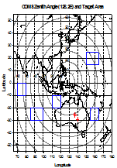
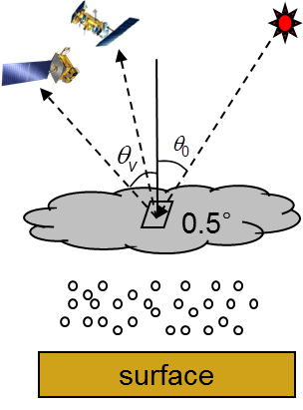
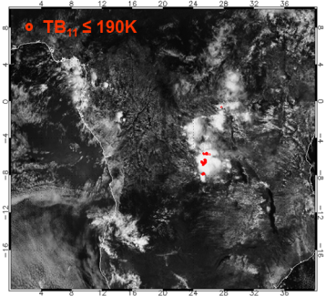
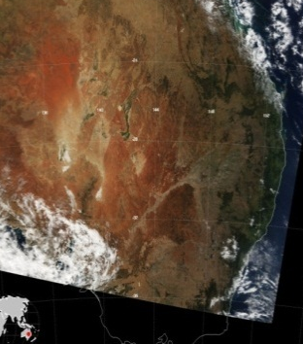
using target on Earth: Data
Period | Apr. 2011 to Dec. 2013
Targets | Ocean | Desert | Water cloud (WC) | Deep convective cloud (DCC)
Obs. | - Pacific Ocean - Indian Ocean | - Simpson Desert in Australia | - Over ocean regions - Overcast clouds | - Overshooting clouds
selection criteria | - No cloud - No sunglint - MODIS AOT at 500nm(<0.1) - Wind speed < 7m/s | - 11 fixed location | - COT ≥ 5 - CTT ≥ 273K (for water cloud) - CTT ≤227K (for ice cloud) | TB_{10.8} ≤ 190K Homogeneity checks

Slide 4
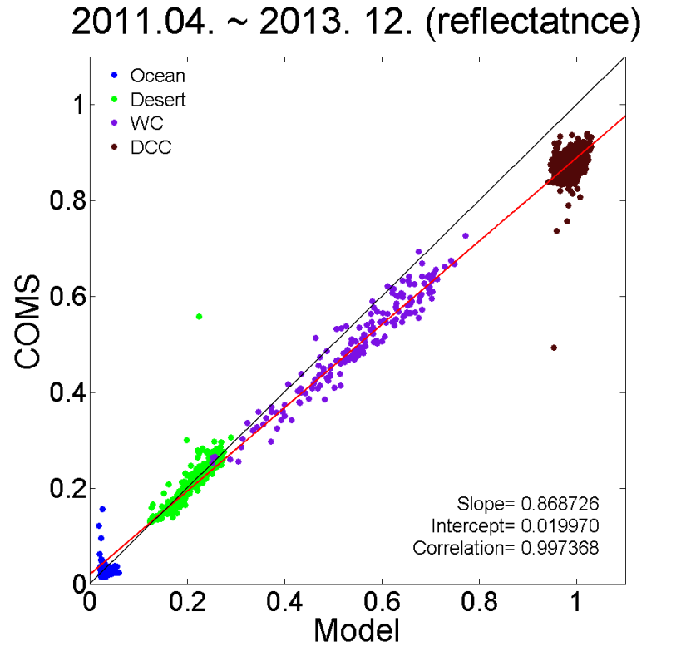
using target on Earth: Results
a scatter plot for 30 days data
get a slope/intercept
trend of slope for long period
Scatter plot
by using ocean/desert/WC/DCC
Time series of slopes and intercepts
Ocean
Desert
WC
DCC
DCC
COMS Observed reflectance
WC
The degradation is about 5.59%(1.97%/year) from Apr.2011 to Dec. 2013.
Desert
Ocean
RTM Simulated reflectance
for all data until now
- slope= 0.868 (about 87%)
- intercept= 0.020

Slide 5
Visible Channel Calibration by using the moon

Slide 6
Data & Method (1/2)
DATA
Period : Feb. 2011 ~ Dec. 2013
Lunar observation data
COMS MI has observed the moon twice a month since February 2011.
Position data of the sun, the moon and COMS
ECEF coordinates are converted to Selenographic coordinates.
Instrument Irradiance
Extraction of a global view of the moon from the observation data (rectangle)
Convert the radiance(R) COMS observed into irradiance(I).
Where $N_{p}$ is the total number of pixels in the lunar disk image.
$R_{p}$ is an individual radiance measurement (i.e. pixel) on the Moon($W/{(m}^{2}∙sr∙μm)$).
$Ω$ is the solid angle of a pixel ($sr$), corresponding to one visible detector, i.e. $28 μrad$.

Slide 7
Data & Method (2/2)
ROLO irradiance model
KMA use ROLO lunar model of USGS for lunar calibration of COMS MI.
I_{ROLO} is calculated using COMS SRF.
where: $ϕ(λ)$ is the detector spectral response(no unit)
$I(λ)=A_{λ}×E_{sun}(λ)×Ω_{M}/π$
$E_{sun}(λ)$ is the solar spectral irradiance($W/{(m}^{2}∙μm))$.
$Ω_{M}$ is the solid angle of the moon at standard distance($=6.4236×{10}^{−5} steradian)$
$A_{λ}$ is the disk-equivalent reflectance(albedo)
Final Value for comparison: RATIO ={observed irradiance} / {simulated irradiance}
Input data of ROLO
Absolute phase angle
Selenographic longitude of the sun
Selenographic longitude of COMS
Selenographic latitude of COMS
ROLO
Lunar Irradiance Model
Version 311g
Hugh H. K. and Thomas C. S., 2005: The spectral irradiance of the moon, the astronomical journal, 129, 2887-2901.

Slide 8
Results: Degradation
Degradation from February 2011 to December 2013
The degradation is about 3.47%(1.22%/year) for the moon target from Feb.2011 to Dec. 2013 (for 35 months).
Standard deviation of bias between performance and regression line is 1.664% (relatively large).

Slide 9
Effect of input data (1/2)
The range of input variables for COMS
VARIABLES | RANGE | CHARACTERISTICS
Absolute phase angle | 0 to 90 (deg) | The largest effect on ROLO irradiances
Longitude of the Sun | -180 to 180 (deg) | Related to Phase angle
Longitude of COMS | -15 to 15 (deg) | less impact on ROLO irradiance
Latitude of COMS | -10 to 10 (deg) | less impact on ROLO irradiance
Simulated ROLO irradiance and phase angle
phase angle and Sun longitude
ROLO irradiance
Phase angle(degree)
Phase angle(degree)
2012.06.
Time(2012.06.)
Sun longitude(degree)
Simulated ROLO irradiance and Satellite latitude
Simulated ROLO irradiance and Satellite longitude

Slide 10
Effect of input data (2/2)
Relations of satellite position and the Ratios (observed/simulated)
The satellite latitudes are inversely proportional to the ratios.
The satellite longitudes are proportional to the ratios.

Slide 11
Get the question!
The right two figures show that there are no relations between the ratios and phase angles, sun longitudes.
Total 68 cases
The left scatter plot show that some libration effect to ratios are exist in these 68 cases.
⇒ The effect of moon libration is needed to be reconsidered !
How to reconsider it ?

Slide 12
Summary & Issues
The visible calibration by using ocean, desert, water cloud and deep convective cloud
The observed values are reaching about 86.9% of simulated values from April 2011 to December 2013 (for 35 months).
The degradation is about 5.59%(1.97%/year).
by Moon target
In 68 cases of COMS lunar observation
The selenographic satellite latitude and longitude are having relations with the results of ratios (observed/ROLO).
The satellite latitudes are inversely proportional to the ratios.
The satellite longitudes are proportional to the ratios.
We think that it is associated with an effect of moon libration. How do we consider it? or other causes?

Slide 13
Thank you ☺

Slide 14
Back-up Slides

Slide 15
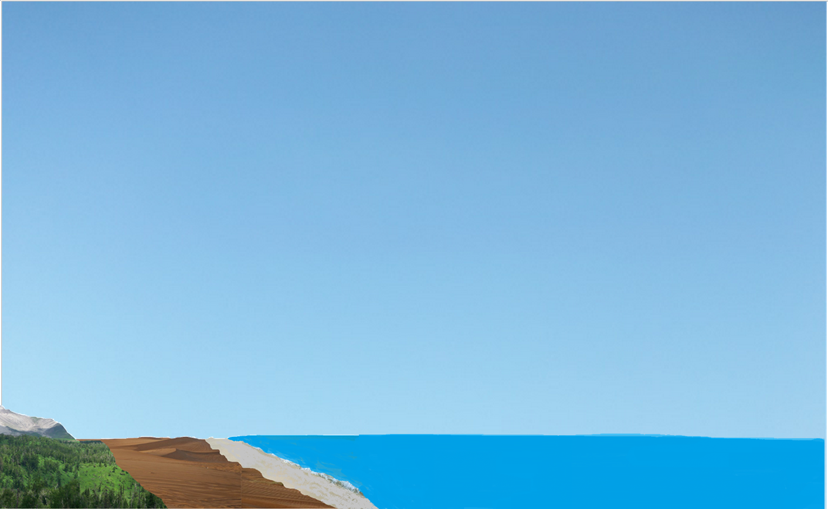
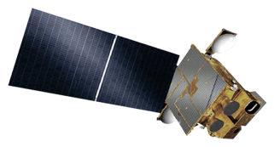
Method (Ocean)
Area
Longitude: 70°E~165°E
Latitude: 30°S~25°N
Observation
Model
RTM(6S)
Ocean BRDF
TPW(NCEP)
O₃(OMI)
Cloud
Target selection is done
MODIS AOT at 550nm (<0.1)
Wind speed < 7m/s
Sun-glint
Desert
Ocean
Pigment
concentration
Notes:
This is the method with ocean.
The ocean targets are chosen in between longitude 70 degrees east to 165 degrees east and latitude 30 degrees south to 25 degrees north.
The clear ocean targets are selected by following conditions, no cloud, no glint, less than 0.1 Aerosol Optical Thickness and less than 7 meter per second wind speed.
Addition to these condition, the Pigment concentration is also considered.
When suitable ocean targets are selected, The Model calculate the simulated values.
The RTM model utilized in ocean calibration is 6S.
As input data, ocean BRDF, Total Precipitable Water, Total volume of Ozone and parameters in condition properties for choosing targets are used.

Slide 16
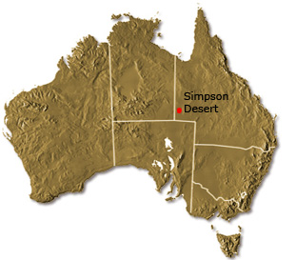
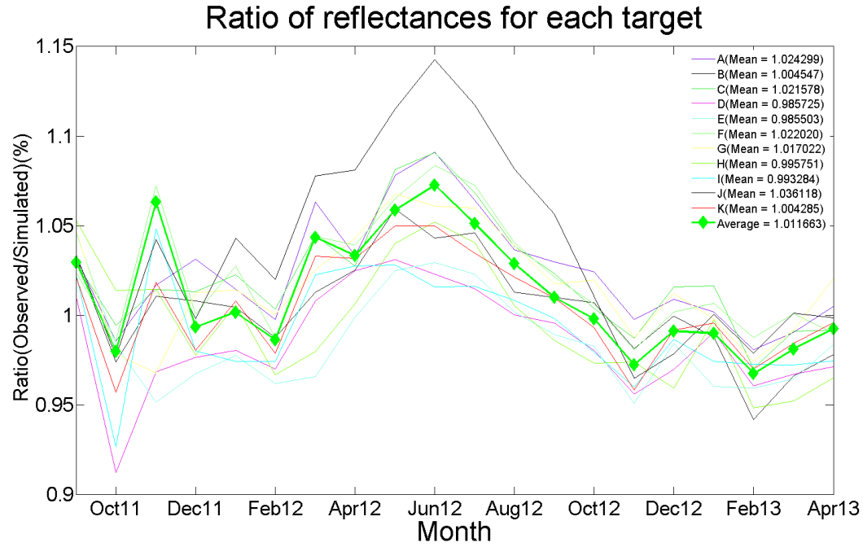
Method (Desert)
Observation
Model
11 targets of Simpson desert
RTM(6S)
TPW(NCEP)
O₃(OMI)
MODIS BRDF Parameter(2004~2006)
- Selection of Bright surface
- Temporal stable surface
- Spatial stable surface
AOT = 0.1
Surface
- Spectral BRDF(2.5nm)
Target selection is done
11 targets of Simpson desert in Australia
Desert
Chun, H. W., & Sohn, B. J., 2006: Calibration for the solar channel using MODIS-derived BRDF parameters over Australian desert targets. Target, 4(6), 8.
Notes:
This is the method with desert.
We use 11 fixed targets of Simpson desert in Australia
These targets were chosen by land analysis through the MODIS BRDF data generated from 2004 to 2006.
The model of desert is 6S like the ocean model.
Spectral BRDF with 2.5nm interval obtained from MODIS BRDF and ASTER spectral albedo is utilized as 6S input data.
Additionally, like the ocean case, AOT. NCEP TPW and OMI ozone data are also utilized as input data for model. But AOT is assumed to be 0.1 following the results considered with the state of Atmosphere in these areas.

Slide 17
Method (Water Cloud))
Observation
Model
RTM(SBDART)
Ocean BRDF
Tropical profile
Particle size (MODIS)
Altitude (MODIS)
Target selection is done
COT ≥ 5
CTT ≥ 273 K (Water cloud)
≤ 227 K (Ice cloud)
Water cloud
Over ocean regions
Ocean
Ham S. H. 2006: Improvement of cloud's spectral reflection simulation using MODIS cloud products. 12th Conference on Atmospheric Radiation.
Notes:
For detection of cloud target, we considered COT and CTT of clouds over ocean region.
Thresholds of WC are followings.
COT is more than 5 and CTT is more than 273K or less than 227K
AS RTM model, SBDART is used, which model is cloud related model.
RTM inputs are followings.
Since the targets are chosen over ocean region between latitude 30 degrees south to 30 degrees north, ocean BRDF and Tropical profile are used as input for model.
Particle size, Altitude data from MODIS data, COT and CTT are also used for model.

Slide 18
Method (Deep Convective Cloud)
Observation
Model
RTM(SBDART)
Ocean BRDF
Tropical profile
COT =200
Particle size = 20
Target selection is done
TB_{10.8} ≤ 190K (COMS 10.8-µm band)
Homogeneity checks
15km
DCC
1km
Ocean
Sohn, B-J., Seung-Hee Ham, Ping Yang, 2009: Possibility of the Visible-Channel Calibration Using Deep Convective Clouds Overshooting the TTL. J. Appl. Meteor. Climatol., 48, 2271?2283.
Notes:
This is method for DCC
Even though MODIS cloud products data are used for selecting the targets in WC methods, In the case of DCC, targets are selected by using COMS MI IR1 10.8 micrometer channel data.
To select clouds overshooting tropopause layer 1km to 15km, the Brightness Temperature of target from IR1 channel should be less than 190K.
And to exclude the boundary pixels of clouds, homogeneity checks are performed.
SBDART is also used for model of DCC like the water cloud case.
Ocean BRDF and Tropical profile, COT and Particle size are also input of the model. But, COT and Particle size are assumed to be 200 and 20 following the results of analysis of DCC characteristics.

Slide 19
phase angle
sun longitude
satellite longitude
satellite latitude

