Slide 1
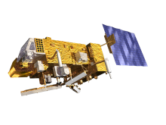
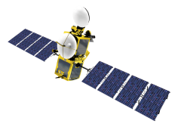
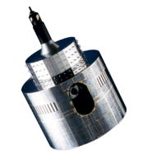
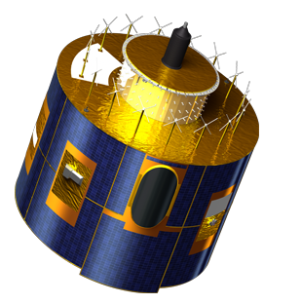
Lunar calibration at eumetsat: open questions
Viticchiè, B., Wagner S., Hewison, T. (EUMETSAT)
& Takahashi, M. (JMA)
Acknowledgment: Tom Stone & Sophie Lacherade

Slide 2
Current status
Multi-mission calibration tool (currently working on MET7, 8, 9, 10, and MTSAT2) → easy plug-in of new instruments.
Results for MET8, 9, and 10 now consolidated (Sebastien’s presentation) → operating routine analyses on a monthly-basis.
Analysis of MET7/VIS data:
122 observations available in the time period 1999 – 2003 (currently extracting 1998, 2004, 2005).
Collaboration with Flight Dynamics to derive the position of the satellite for the analysis.
Currently working on the consolidation of the result/approach.
Analysis of MTSAT2/VIS data:
100 observations available in the time period 2010 – 2014.
Currently working on the consolidation of the result/approach.

Slide 3
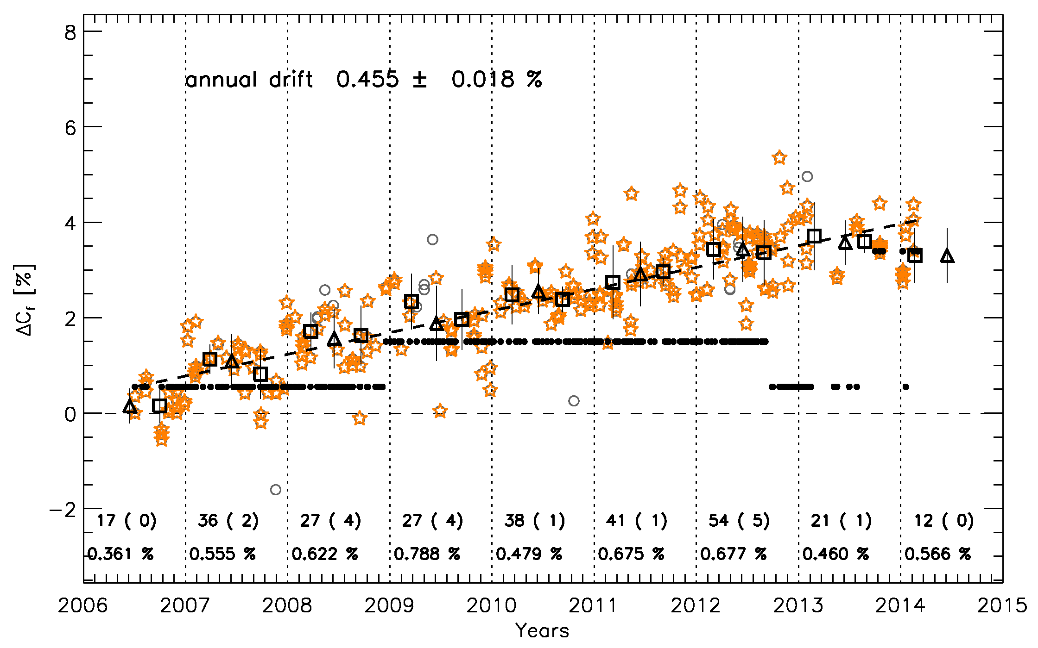
MET9/VIS08 example

Slide 4
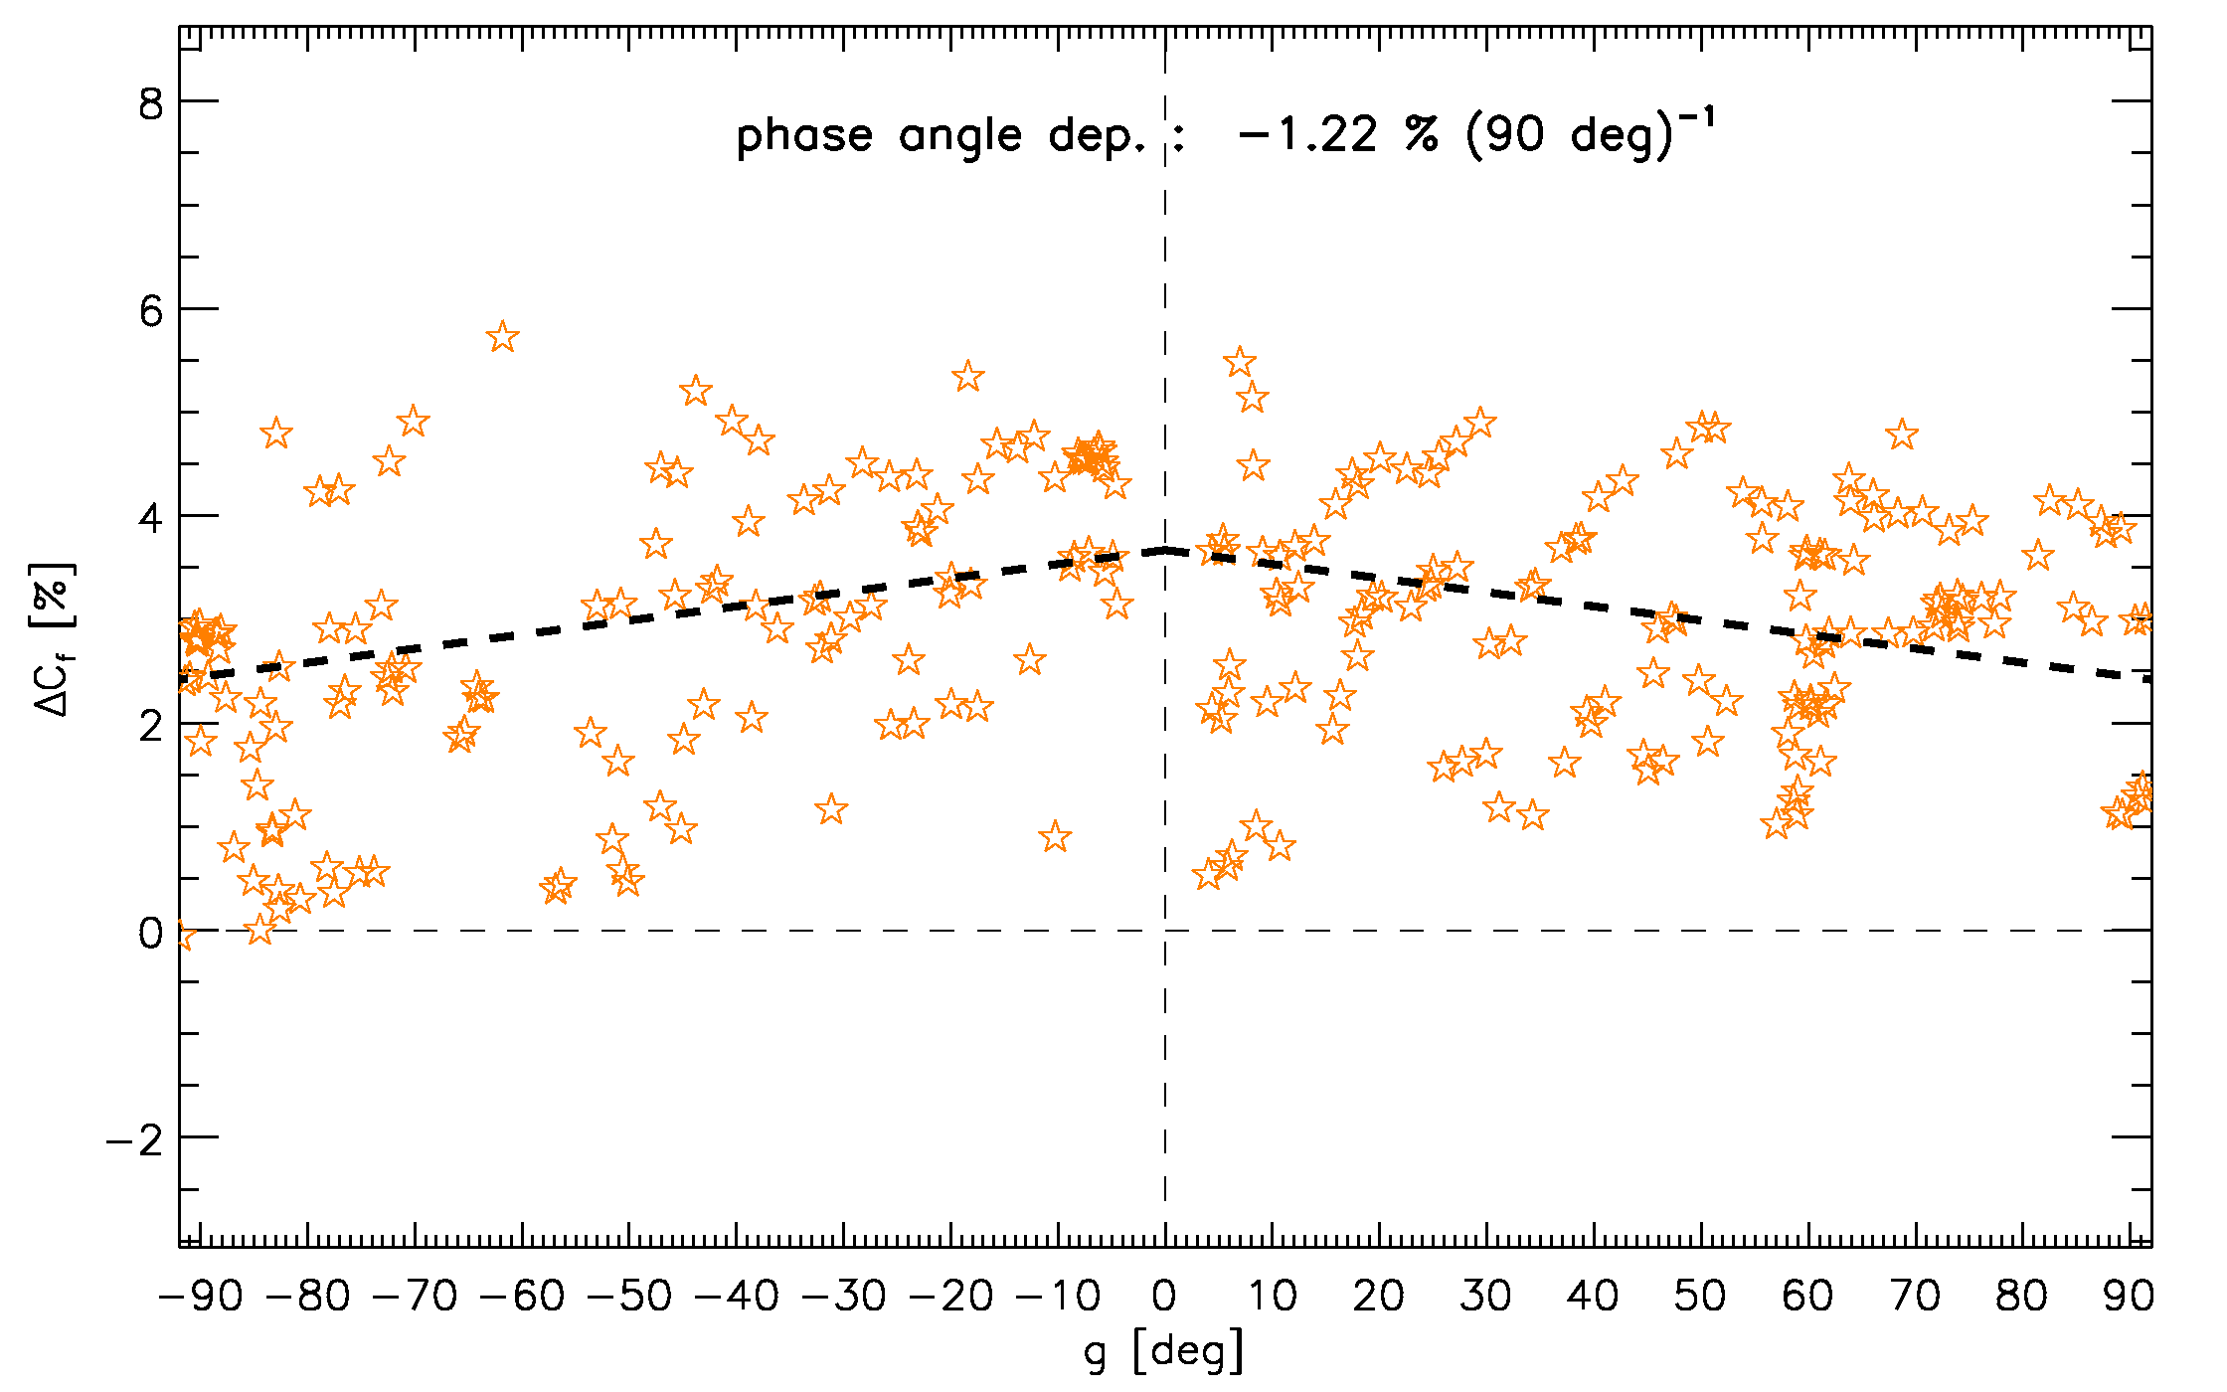
MET9/VIS08 example

Slide 5
MET9/VIS08 example
Drift measurement after correcting for the phase-angle dependence:
Phase-angle dependence -1.22 % over 90 deg (when modelled with a linear function)
Accuracy ≈ 10⁻² % on the annual drift measurement after correcting for the phase-angle dependence!

Slide 6
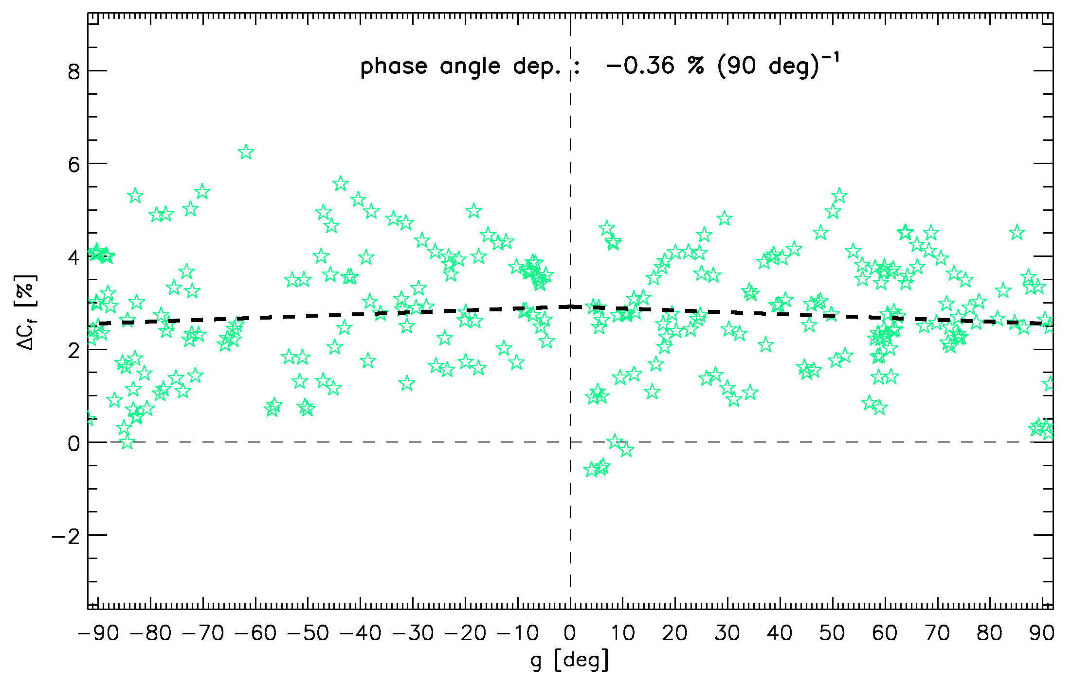
Phase-angle dependence for MET9
MET9/ | VIS06 | VIS08 | NIR16 | HRVIS
ΔC_{f} | -0.36 %
ΔIrr

Slide 7
Phase-angle dependence for MET9
MET9/ | VIS06 | VIS08 | NIR16 | HRVIS
ΔC_{f} | -0.36 % | -1.22 %
ΔIrr

Slide 8
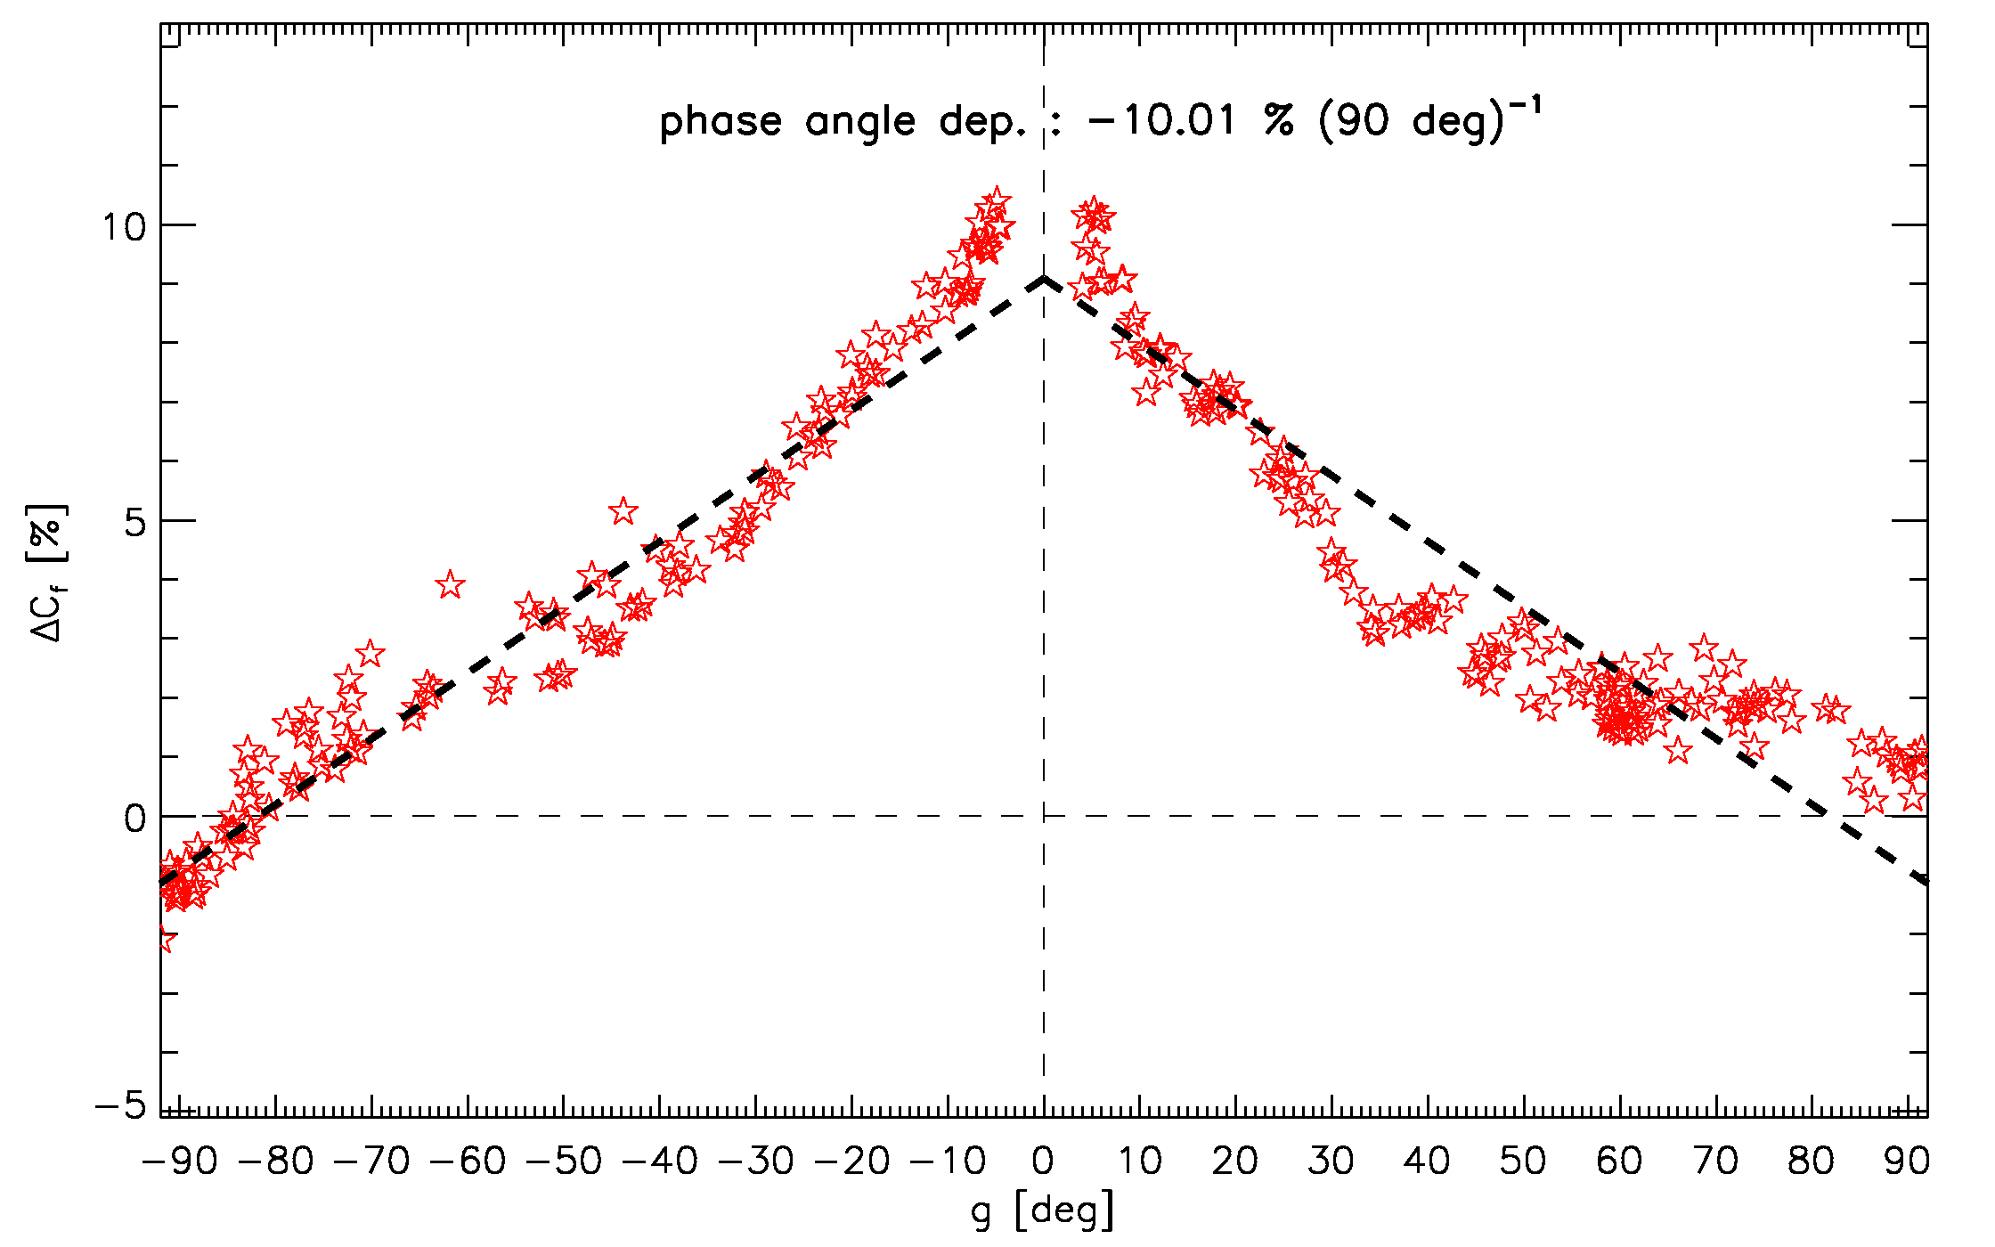
Phase-angle dependence for MET9
MET9/ | VIS06 | VIS08 | NIR16 | HRVIS
ΔC_{f} | -0.36 % | -1.22 % | -10.01 %
ΔIrr

Slide 9
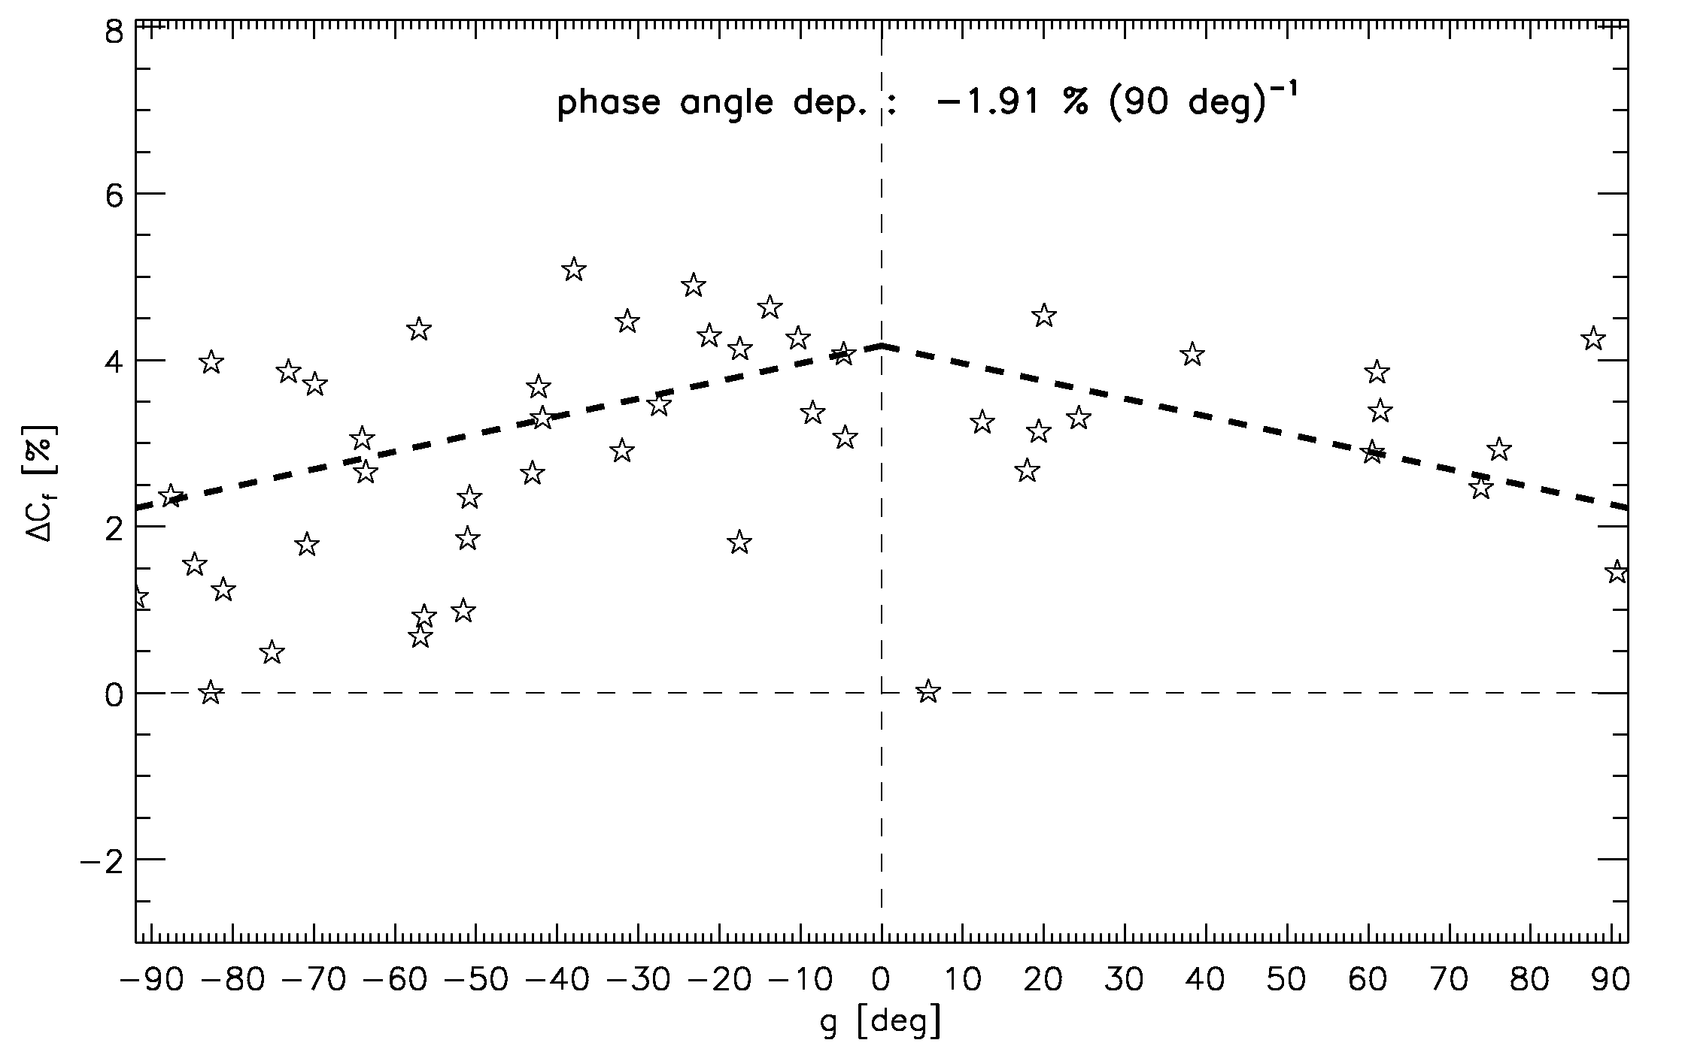
Phase-angle dependence for MET9
MET9/ | VIS06 | VIS08 | NIR16 | HRVIS
ΔC_{f} | -0.36 % | -1.22 % | -10.01 % | -1.91 %
ΔIrr

Slide 10
Phase-angle dependence for MET9
MET9/ | VIS06 | VIS08 | NIR16 | HRVIS
ΔC_{f} | -0.36 % | -1.22 % | -10.01 % | -1.91 %
ΔIrr | -0.04 % | 1.64 % | 12.78 % | 7.92 %

Slide 11
Phase-angle dependence for MET9 and MET8
MET9/ | VIS06 | VIS08 | NIR16 | HRVIS
ΔC_{f} | -0.36 % | -1.22 % | -10.01 % | -1.91 %
ΔIrr | -0.04 % | 1.64 % | 12.78 % | 7.92 %
GOOD
CONSISTENCY
BETWEEN
MET8 AND MET9
MET8/ | VIS06 | VIS08 | NIR16 | HRVIS
ΔC_{f} | -0.09 % | -1.90 % | -9.45 % | -0.79 %
ΔIrr | -0.04 % | 1.32 % | 12.66 % | 5.13 %

Slide 12
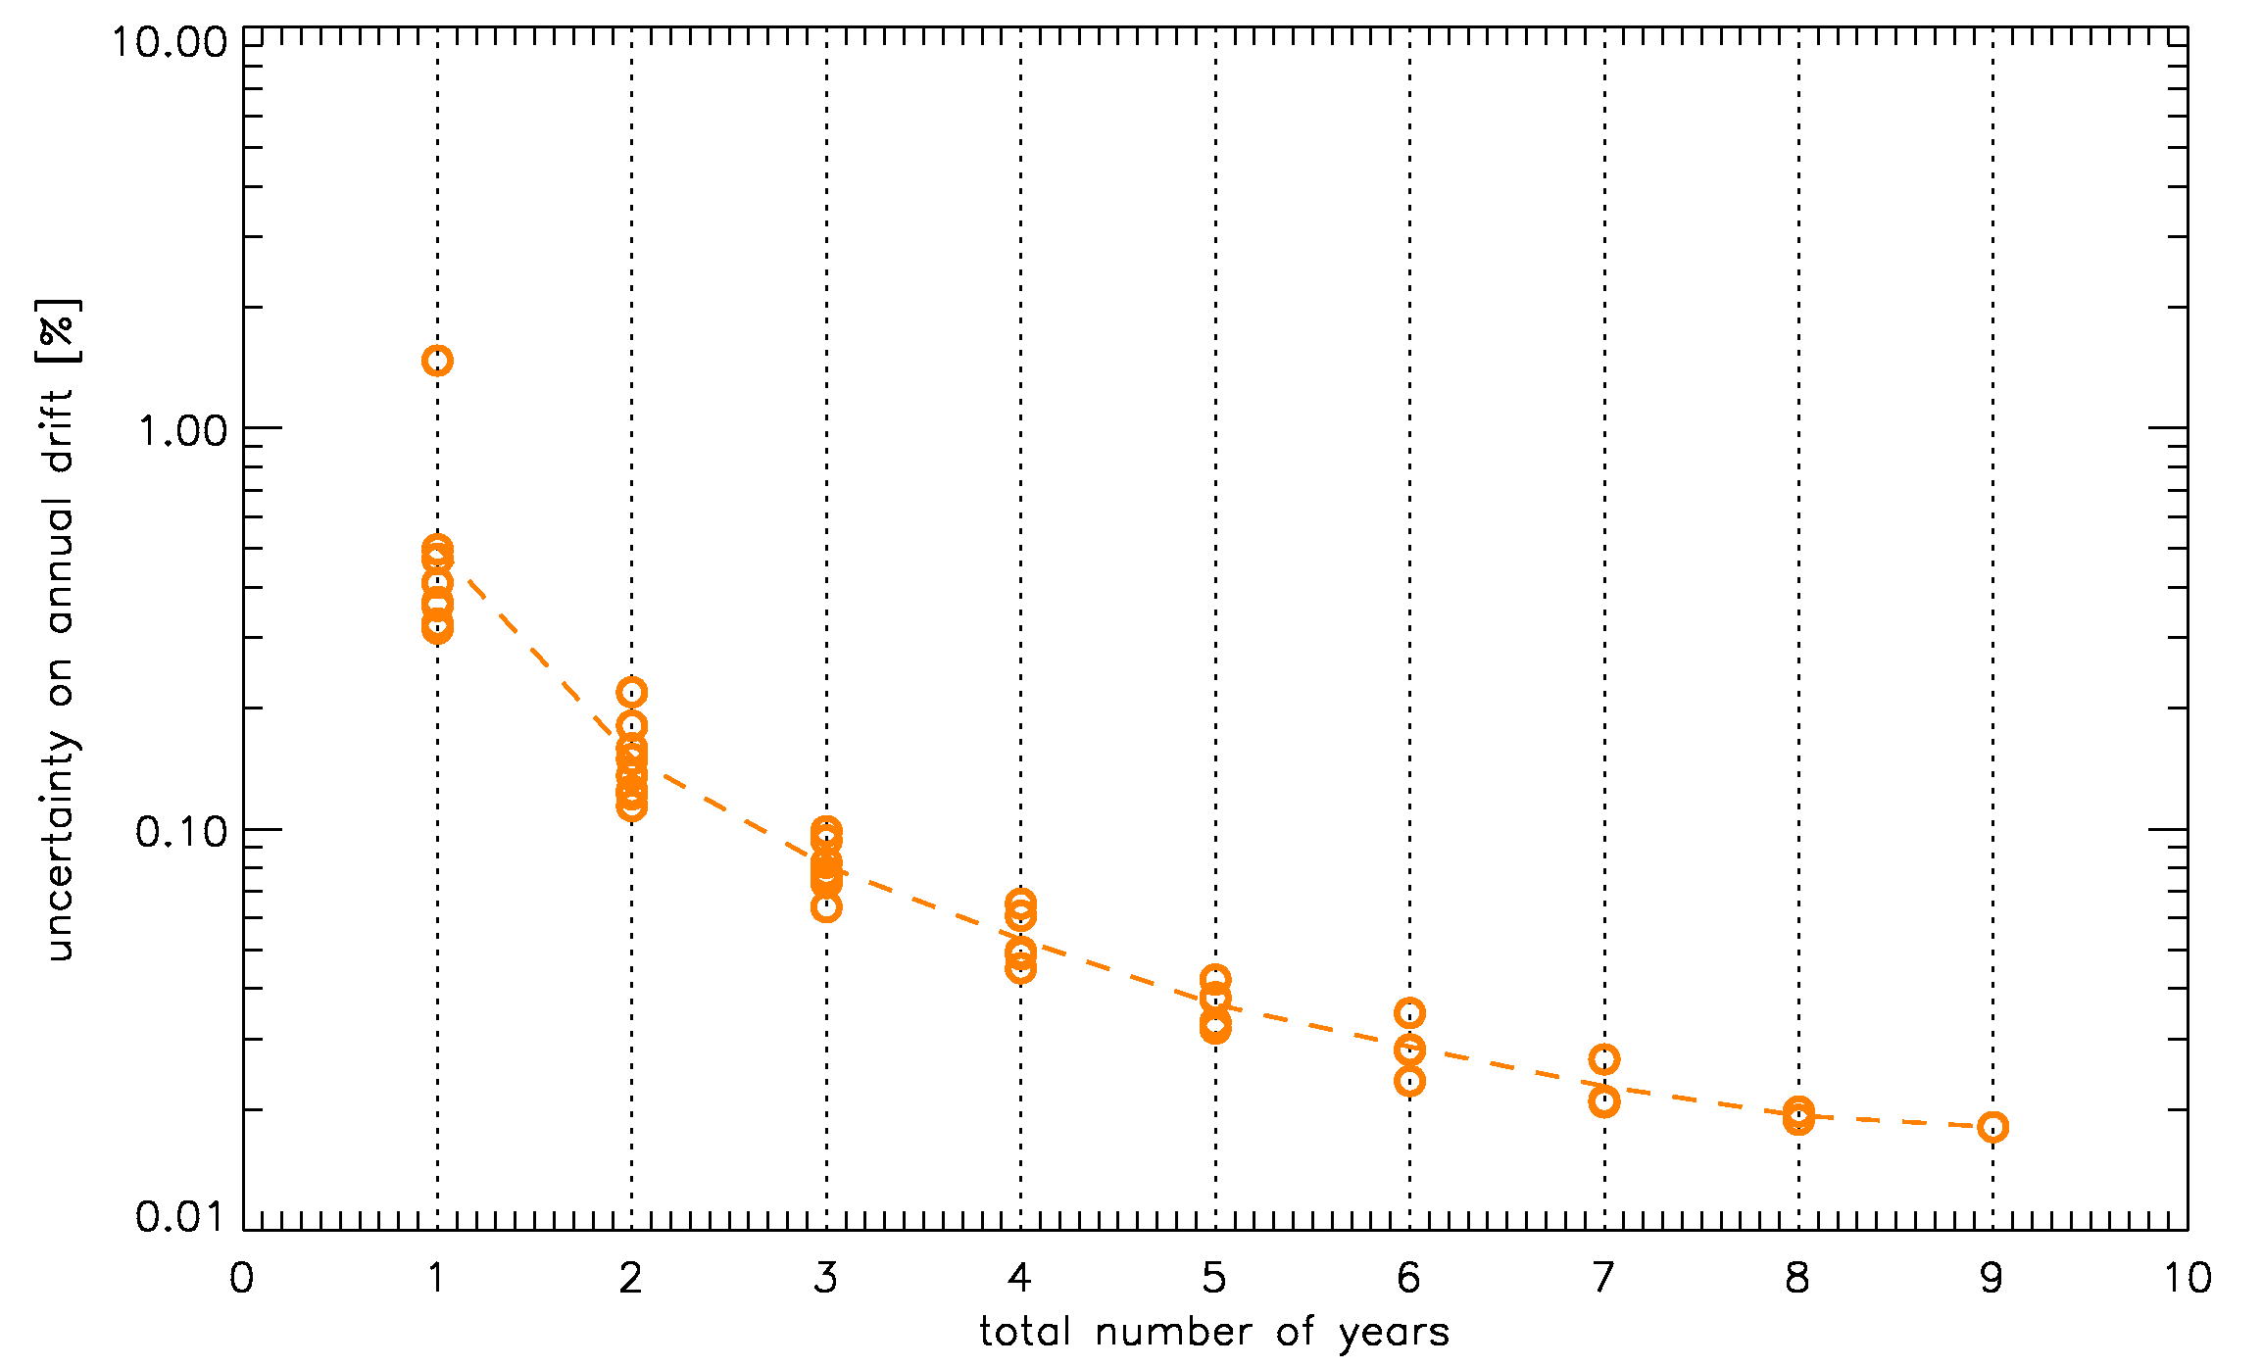
Accuracy on the drift measurement: MET9/VIS08
0.018 %

Slide 13
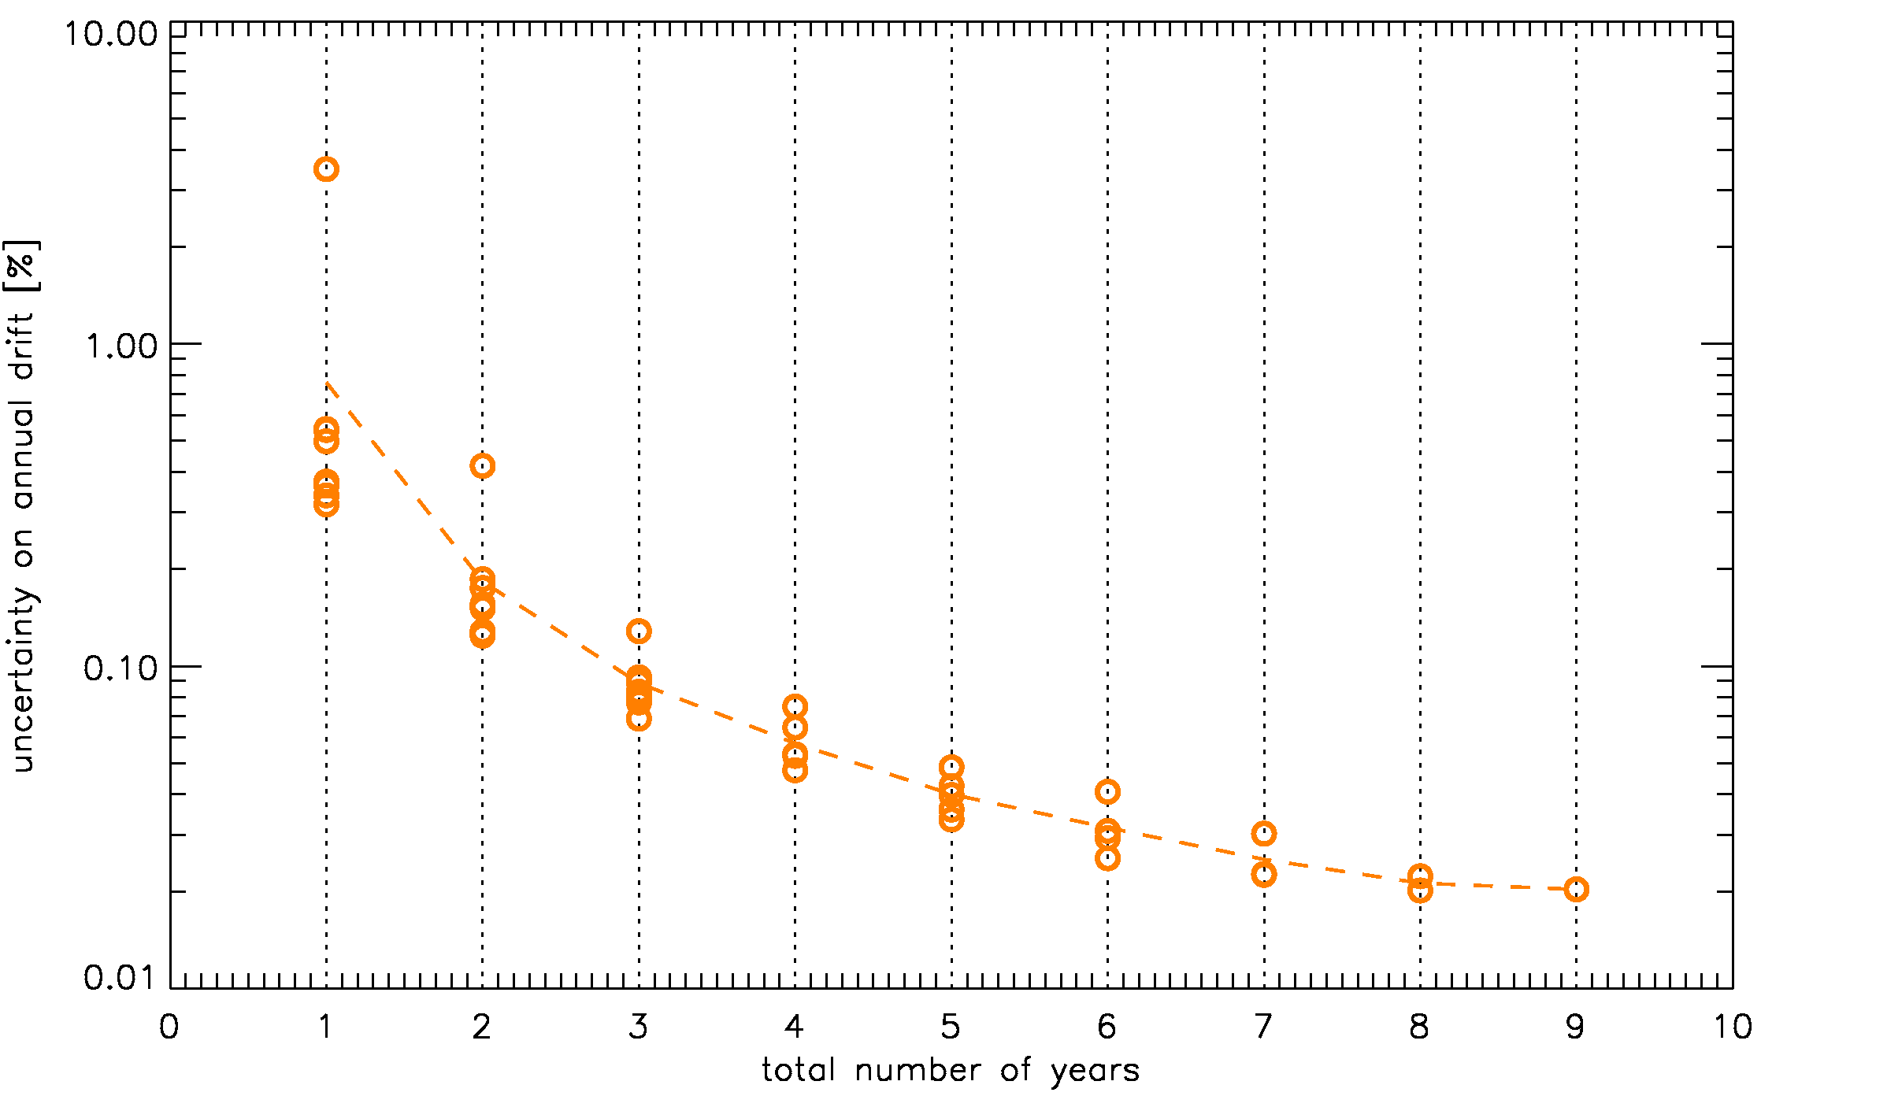
Accuracy on the drift measurement: MET9/VIS08
No phase-angle dependence
correction (1.22% (90 deg)⁻¹ )

Slide 14
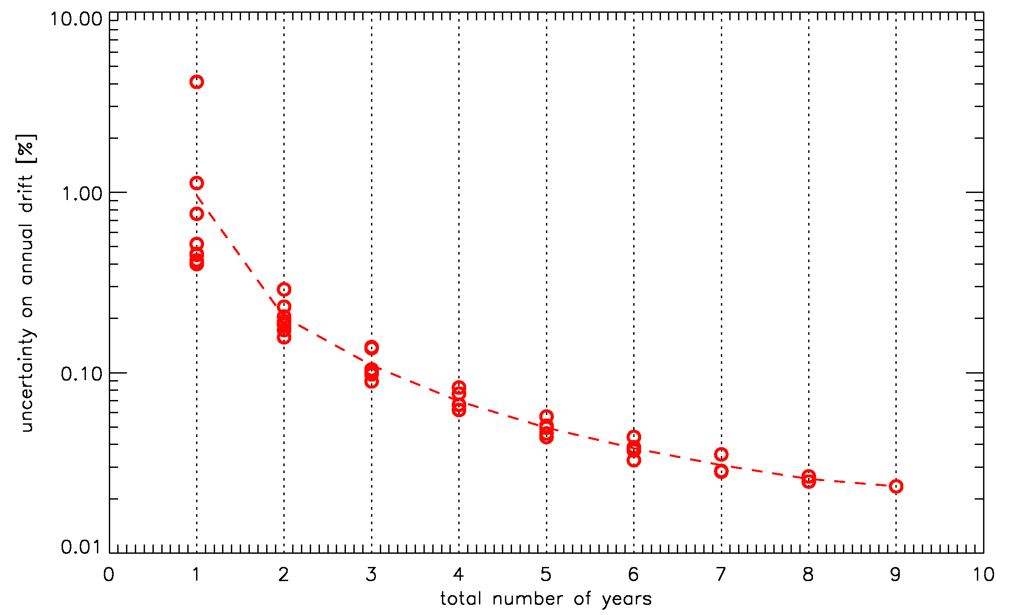
Accuracy on the drift measurement: MET9/NIR16

Slide 15
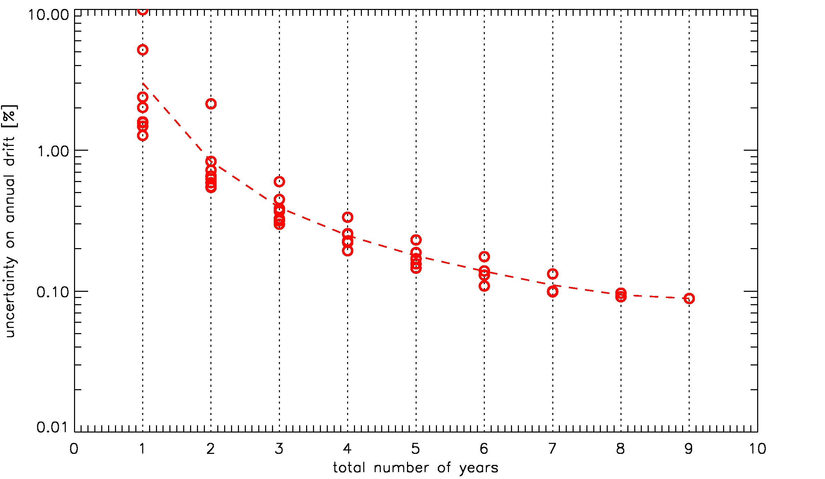
Accuracy on the drift measurement: MET9/NIR16
No phase-angle dependence
Correction (10.01% (90 deg⁾⁻¹ )
IMPORTANT IMPACT ON THE DRIFT MEASUREMENT

Slide 16
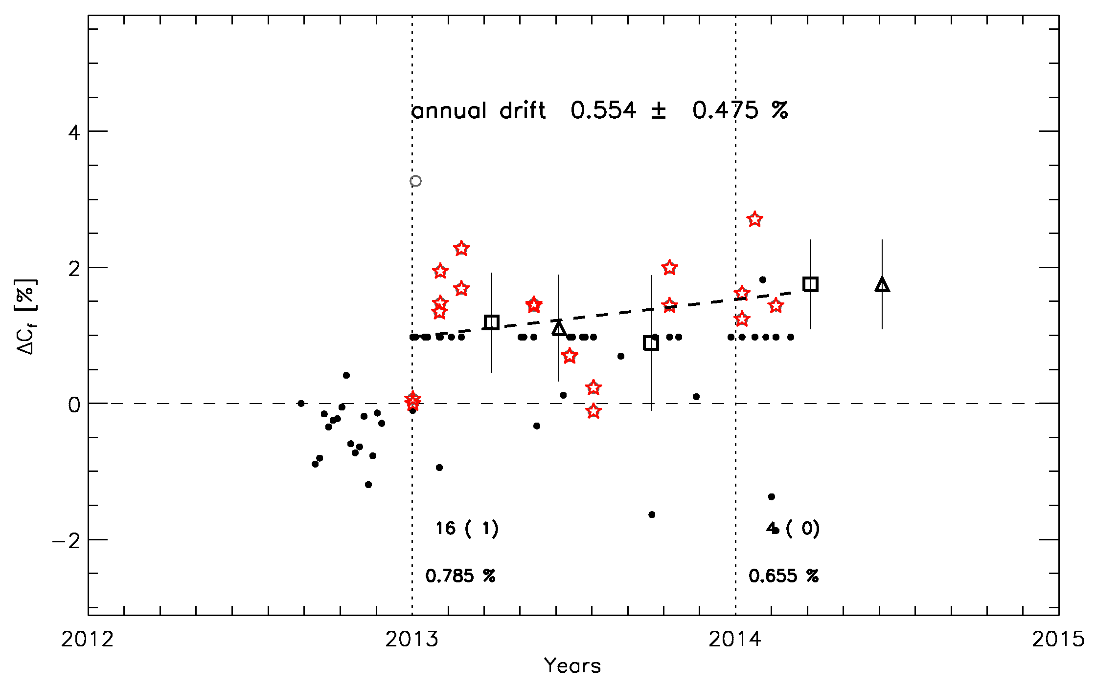
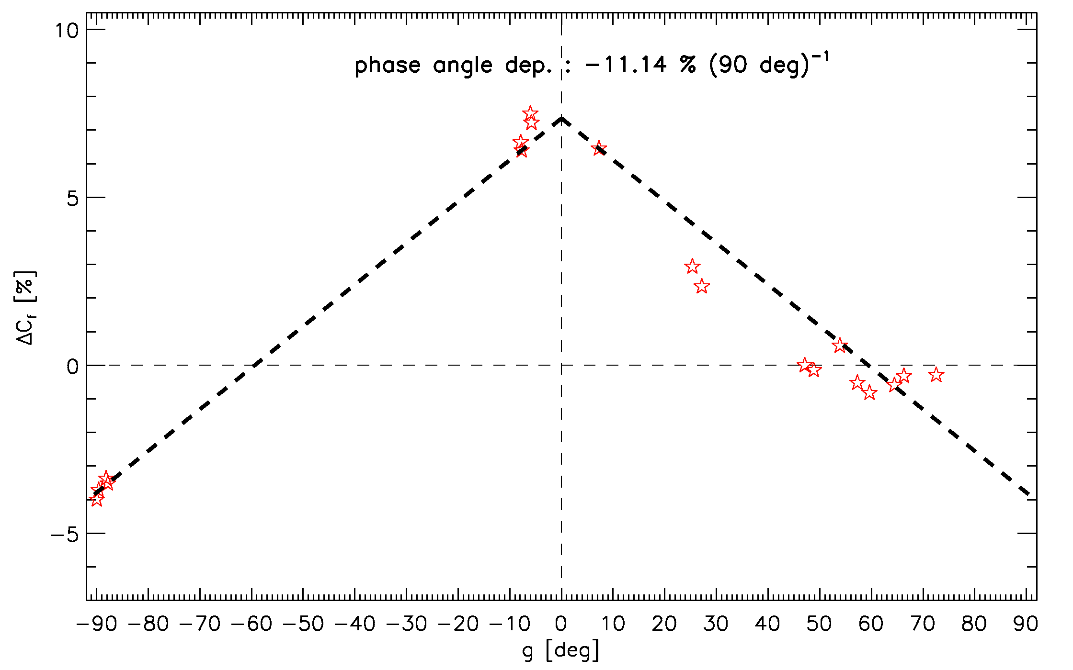
MSG3/NIR16 example
The measurement of the phase-angle dependence depends on the number of available observations and on the phase-angle values of the observations

Slide 17
MSG3/NIR16 example
nine observations covering 90 deg
The measurement of the phase-angle dependence depends on the number of available observations and on the phase-angle values of the observations

Slide 18
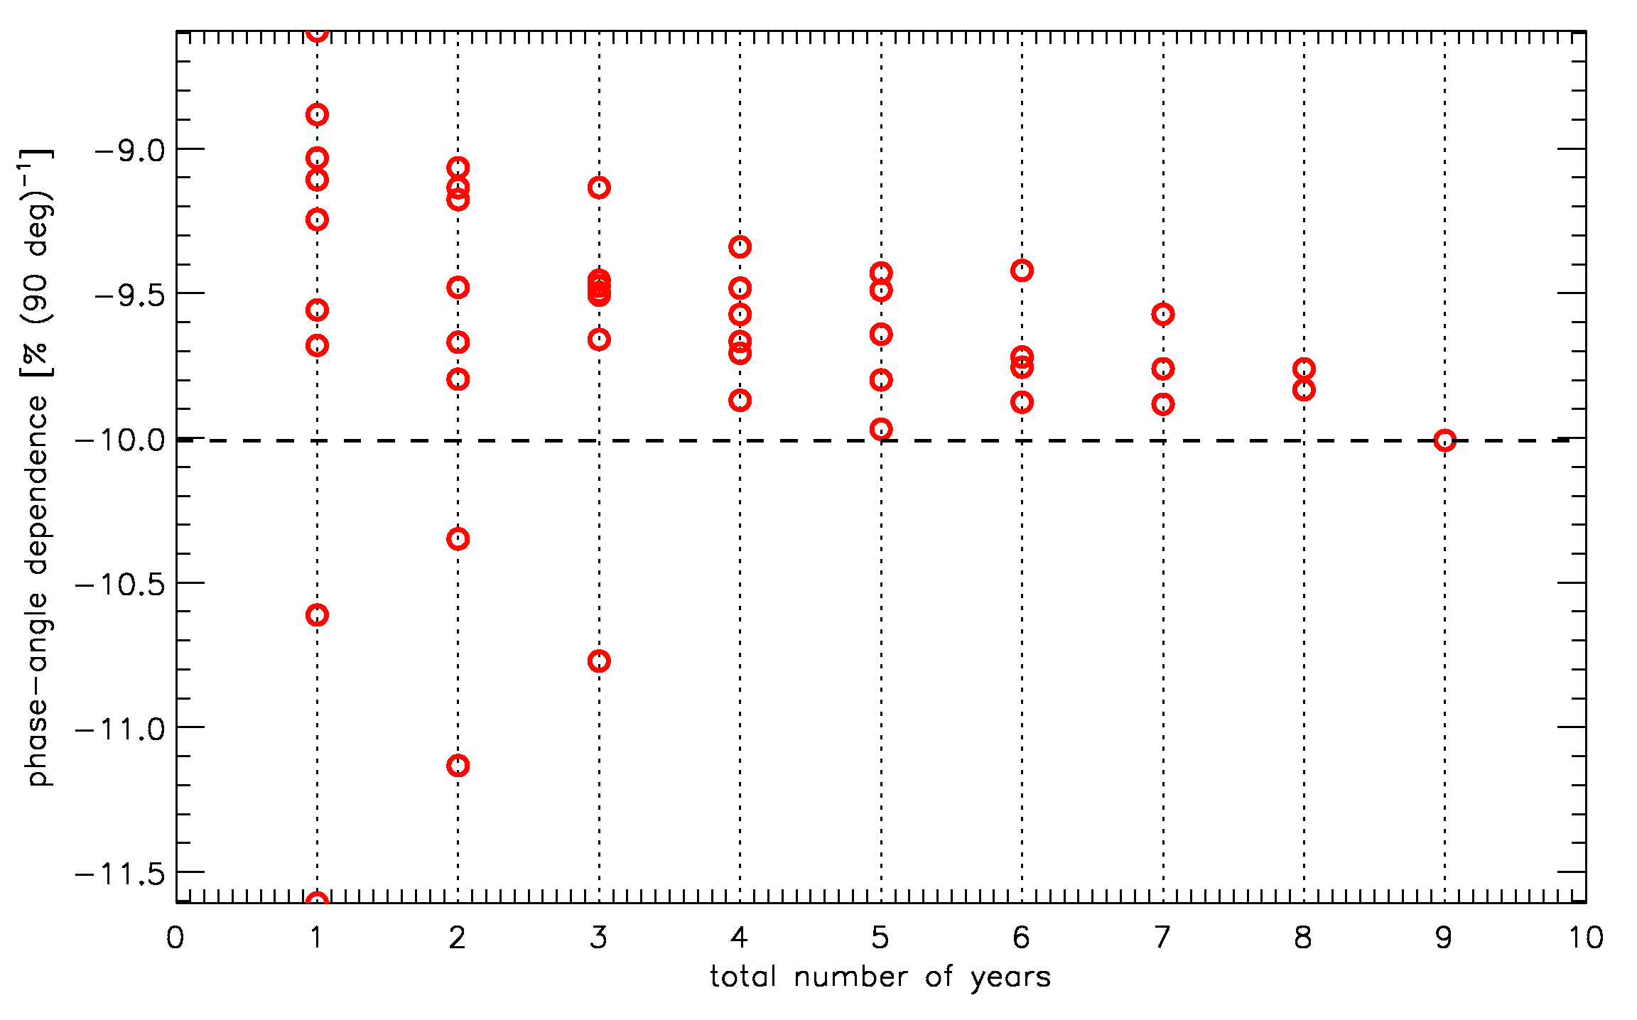
MSG3/NIR16 example
MET9/NIR16
nine observations covering 90 deg
when measured/modelled over few years (with few data) the results vary a lot
The measurement of the phase-angle dependence depends on the number of available observations and on the phase-angle values of the observations

Slide 19
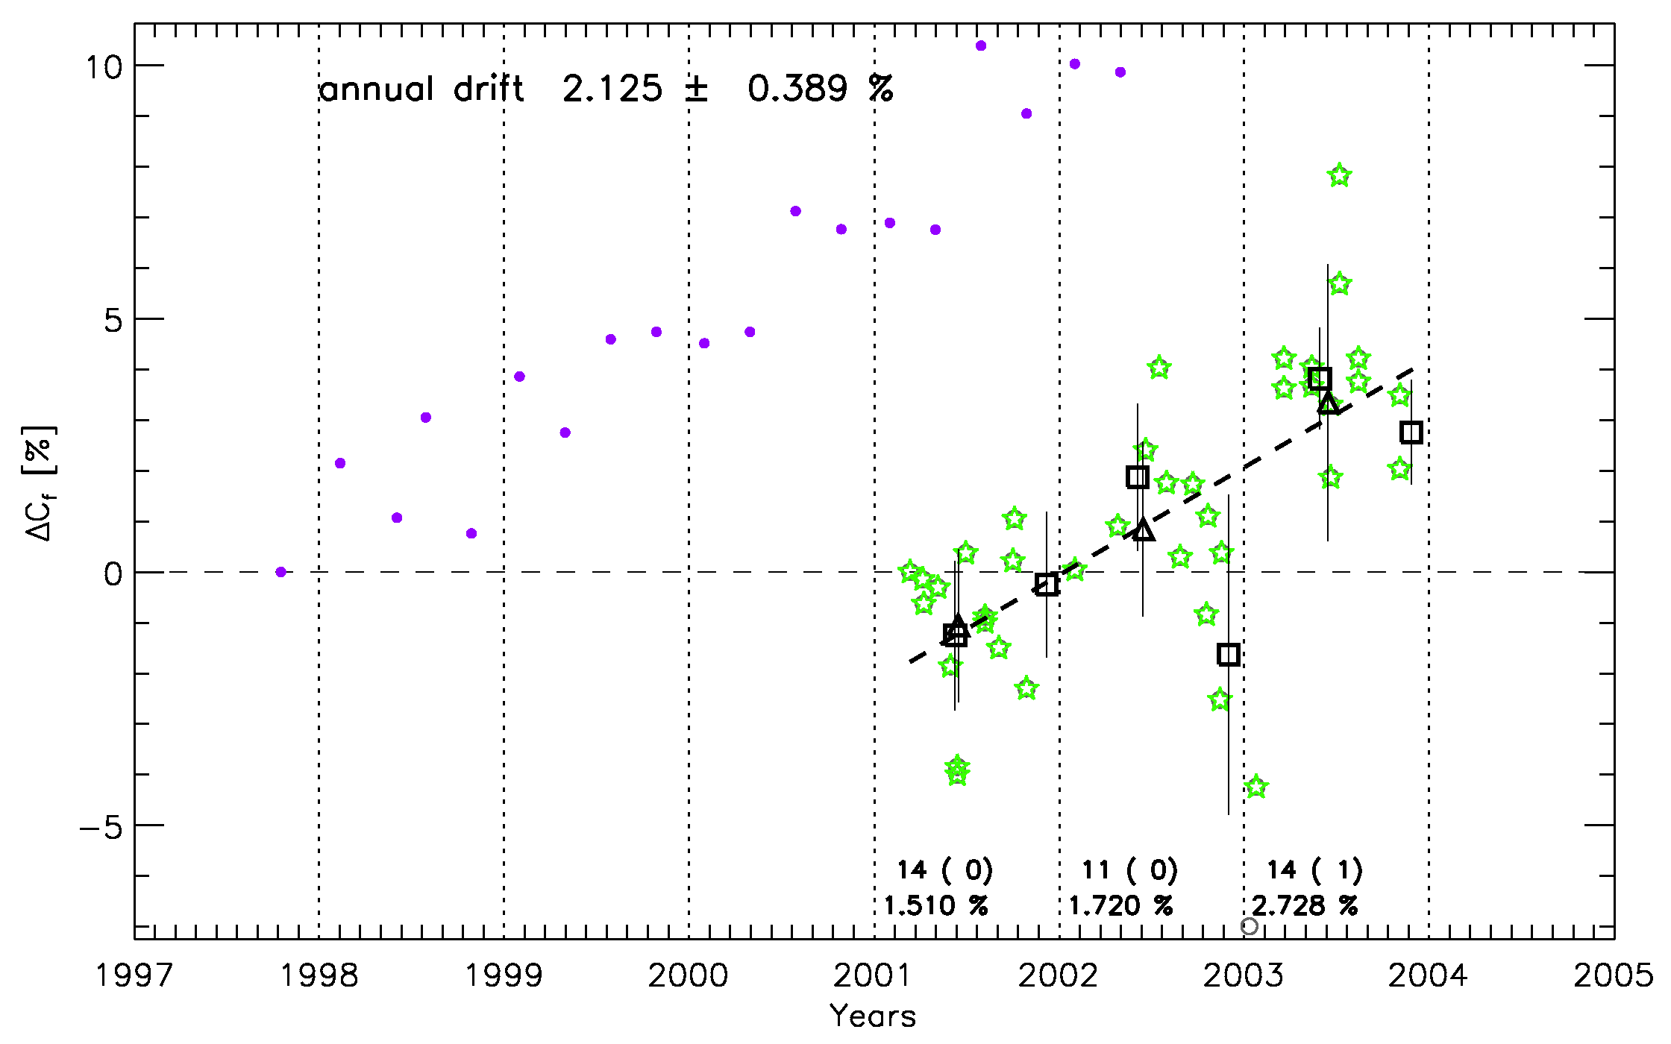
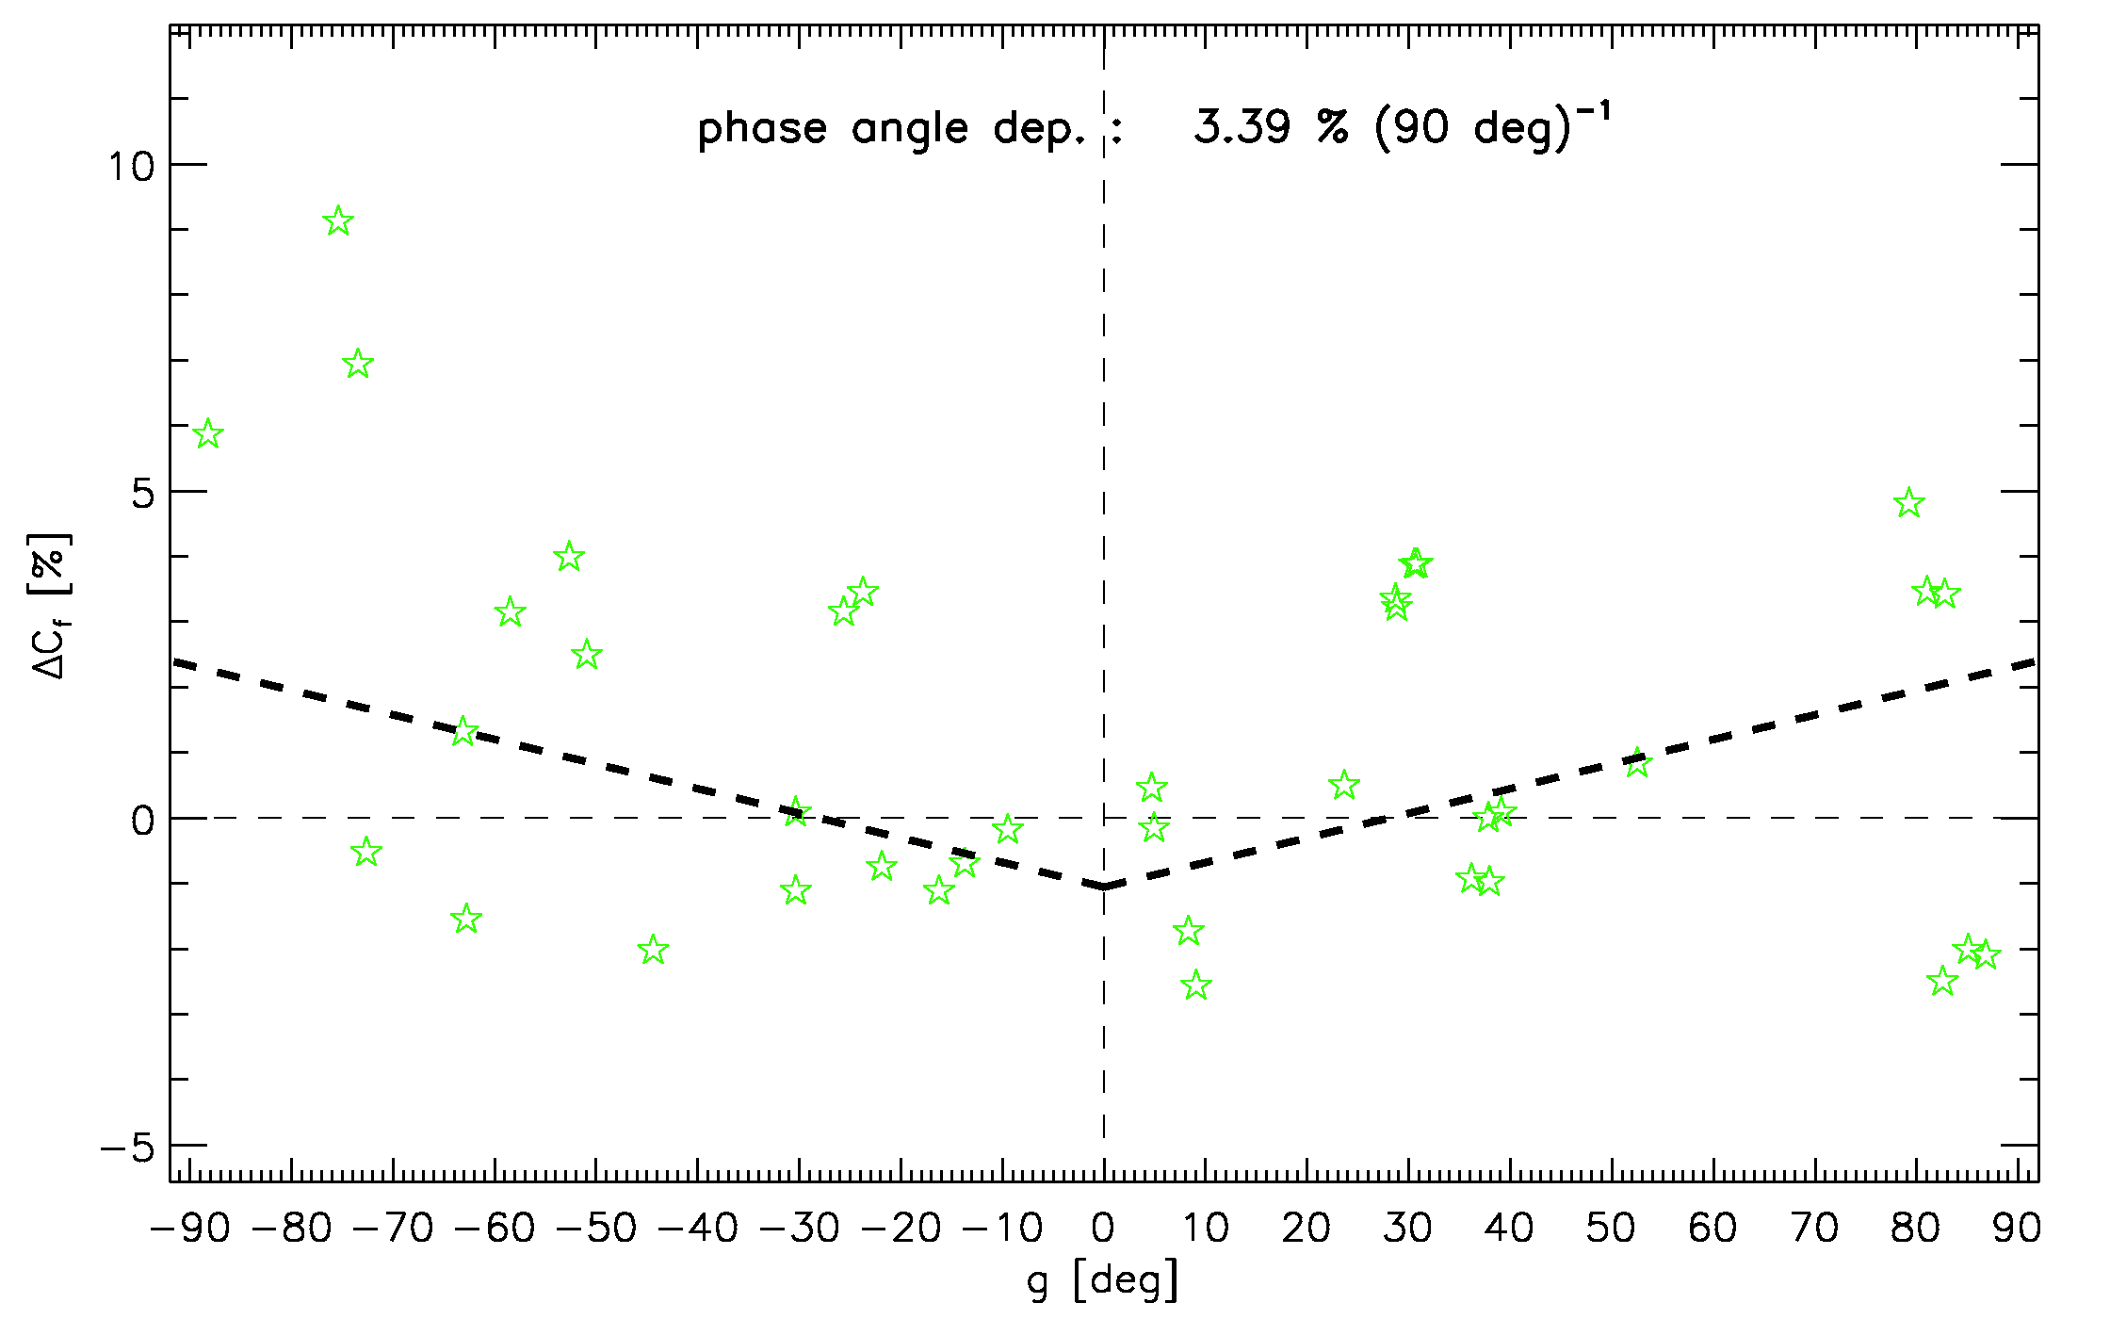
MET7/VIS example – PRELIMINARY
For MET7/VIS a phase-angle dependence of 3.39 % (90 deg)⁻¹ between 2001 and 2004; more data will be analysed → 1997 – present (goal)
The current drift measurement is in line with the SSCC drift measurement (purple dots)

Slide 20
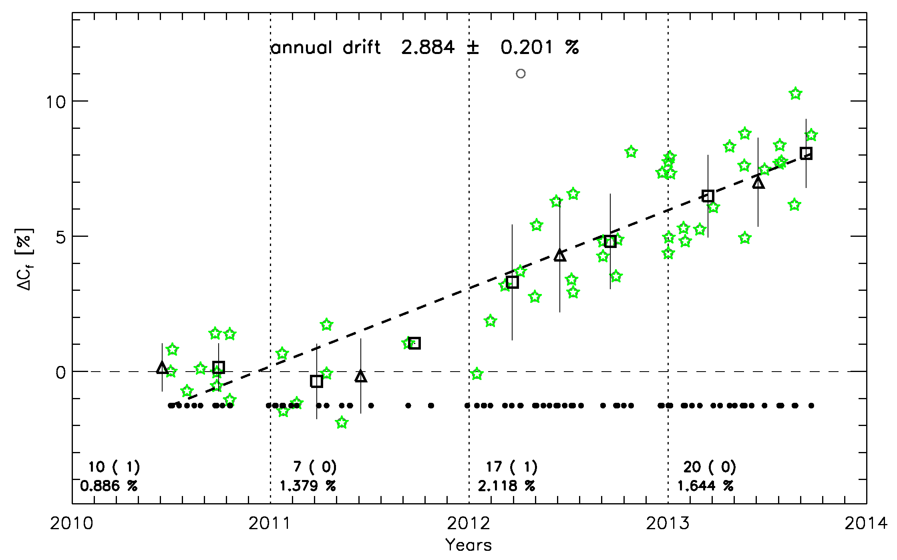
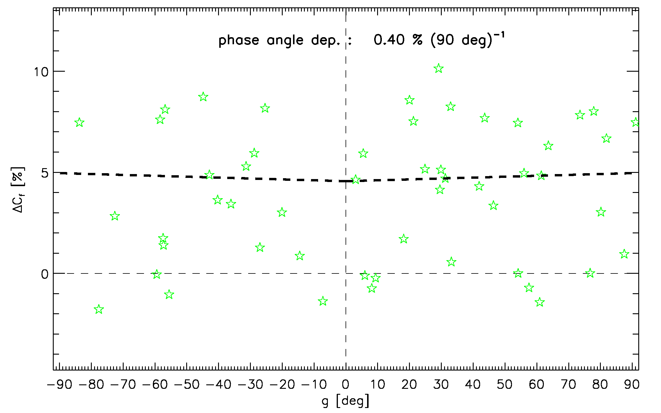
MTSAT2/VIS example – PRELIMINARY
For MTSAT2/VIS a phase-angle dependence of 0.4 % (90 deg)⁻¹ between 2010 and 2014
The annual drift measured with both vicarious RTM and NASA DCC is of about 4% per year.
IMPORTANT: we’ve investigated the effect of the oversampling factor on the results of the calibration.

Slide 21
Summary
Consolidating the results from the lunar calibration = understanding the phase-angle dependence
Open issues:
Phase-angle dependence:
How to model it: linear for MSGs, but clearly not linear for PLEIADES,
Understanding the phase-angle dependence in ΔIrr and ΔC_{f},
NIR16 - Tom suggestion: check for non-linearity in case of very large phase-angle dependence.
Spectral dependence:
Central wavelength,
SRF extension (e.g., shall MSG/HRVIS, MET7/VIS, and MTSAT2/VIS behave in a similar way?), and
from the activity with Tom we’ve found that the phase-angle dependence changes with the way the reflectance spectra are handled in the calibration process.

Slide 22
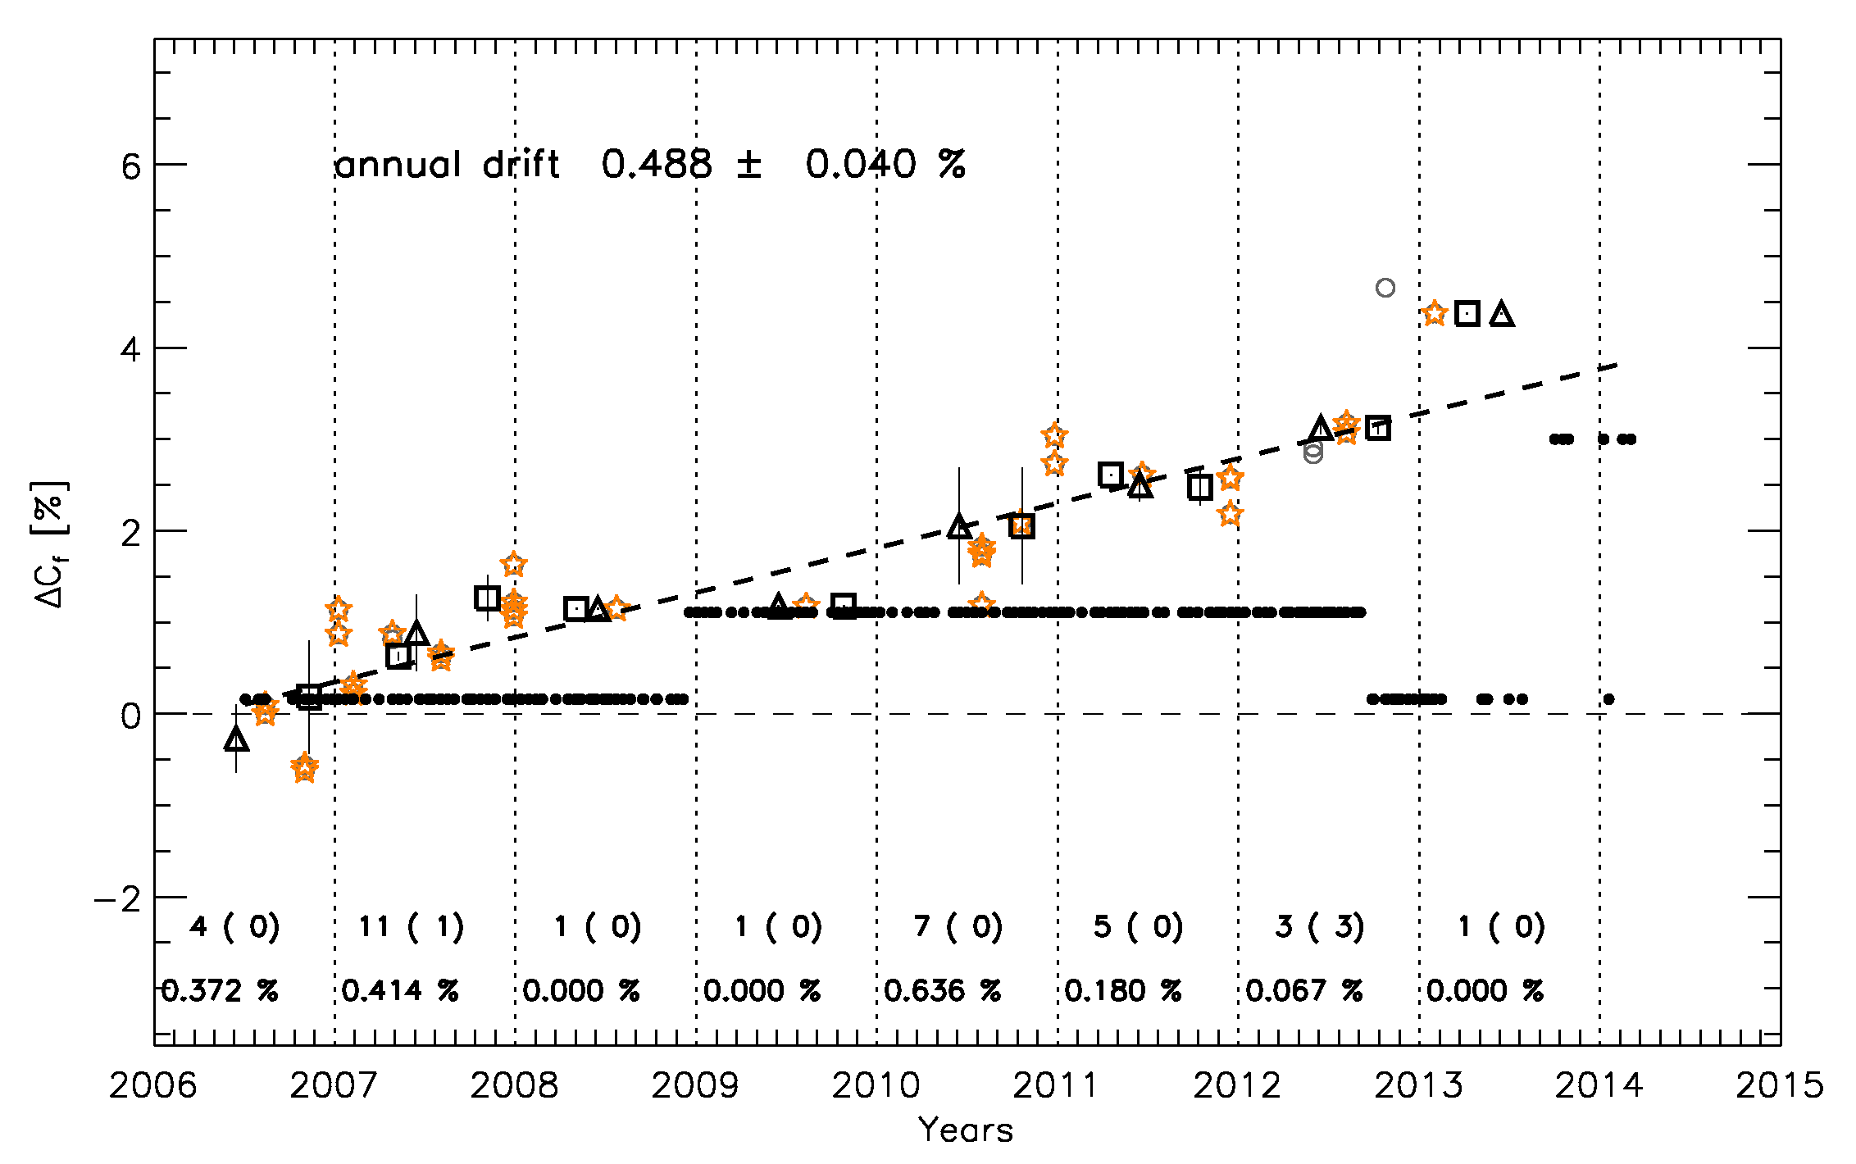
MSG2/VIS08 with phase angle between 52 deg and 62 deg

