Slide 1
FY-3/MERSI degradation monitoring using Pseudo Invariant Calibration Sites
Wang Ling, Hu Xiuqing, Chen Lin
National Satellite Meteorology Center, China Meteorological Administration (NSMC/CMA)

Slide 2
Outline
Data & Method
Application to FY-3A/MERSI
Application to FY-3C/MERSI
Conclusions

Slide 3


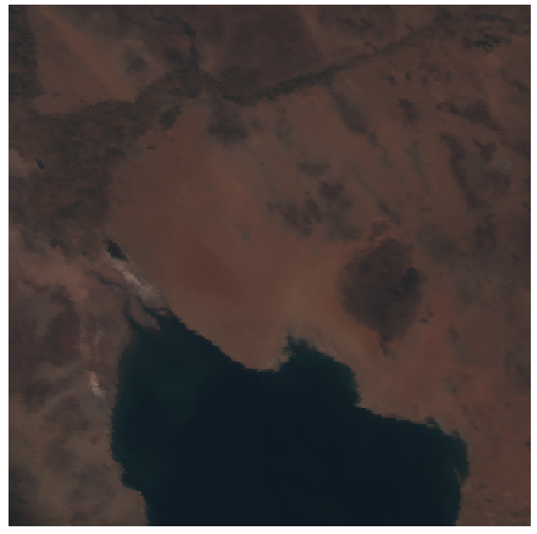
Data & Method
Satellite data
  FY-3A/ MERSI: VNIR, 05/27/2008-12/31/2013, ~6 years
  FY-3C/ MERSI: VNIR, 09/23/2013-03/18/2014, ~6 months
Desert PICS used here
Libya1
Arabia2
Sonora
2009-06-14 09:46, FY-3A/MERSI
2009-06-01 07:09, FY-3A/MERSI
2009-06-20 17:59, FY-3A/MERSI

Slide 4
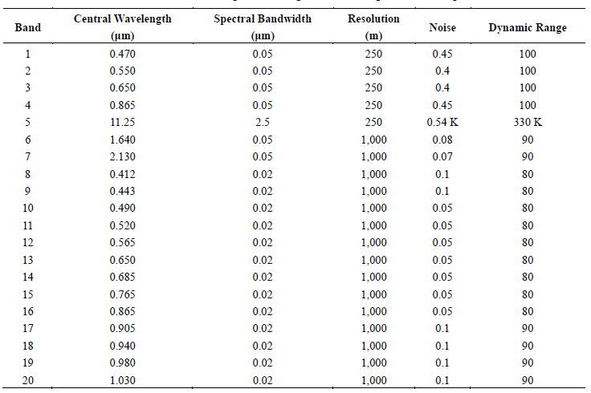
MERSI spectral band specifications

Slide 5

Method
TOA Reflectance calculation
  ROI (Region of Interest): 15*15 pixels
Data selection
  Cloud screening: Spatial homogeneity (CV<0.1) & Temporal consistency (ρ- ρ_{15 neighbors} <2.0 std_{15 neighbors} )
  Angular dependency control: SZA<60°& VZA<20°
Degradation Assessment
  Exponential regression model is used.
$$ρtoa= (a∙DN+b)∙d^{2}/\cos\left(θ_{s}\right)$$
a,b: calibration coefficient; θs: solar zenith angle; d: Earth-Sun distance in astronomical units
Y=Aexp(-kd)
Notes:
FY-3A digital number (DN) data are first converted to TOA reflectance by using pre-launch calibration coefficient
local outliers in the time series can be detected by comparing them with data values from local neighbors.
Local mean values are computed using 15 temporally neighboring data points, and data points deviated from the local mean by more than a 2.0 standard deviation are considered contaminated data points
Exponential regression model is used for assessing sensor degradation.

Slide 6
Variability of time series before and after observation geometry control
Var: A measure of the dispersion of the measurements
SAZ<60, VZA<20
Notes:
红-近红外波段（3-4；13-16）Var较小，原始的Var<0.1
水汽吸收通道（17-19）Var最大,短波长蓝波段Var次之，原始的Var在0.2附近
Water vapor absorption channel, followed by the blue channel

Slide 7
Application to FY-3A/MERSI
470 nm

Slide 8
Application to FY-3A/MERSI
410 nm

Slide 9
Application to FY-3A/MERSI
940 nm

Slide 10
Application to FY-3A/MERSI
865 nm

Slide 11
Application to FY-3A/MERSI
Results from three sites agrees well and the STD <1.5% for most of the bands.
The B8(410 nm) exhibits the highest degradation rates.
The degradations of blue-green bands are slight larger; the R-IR (except for B17-B20) are relative stable.

Slide 12
Comparison with DCC results
The desert approach produces larger results than the DCC approach.
The differences in degradation rates are generally less than 4% during the 6 years.

Slide 13
Application to FY-3C/MERSI
2013.09-2014.03
Most of the reflective solar bands (except for B8) do not show severe degradation during the early period of operation (<3%).
The STD (1~2%) is slight larger compared with the trending results (~3%).
Notes:
As influenced by water vapor absorption, the trending results of band 17-18 are not reliable during such a short period of 6 months. Hence, we did not show the results here for these three band.

Slide 14
410 nm
685 nm
865 nm

Slide 15
Conclusions
Selection of the measurements with SZA< 60°& VZA< 20°is appropriate to reduce angular dependence of time serious.
The degradation results for FY-3A/MERSI derived from desert monitoring are consistent with DCC approach. The differences are within 4%, except for bands 2, 11, 16, 18 and 19.
Most of the RSBs (except for B8) of FY-3C/MERSI are stable during the early period of operation.
More effect is needed to remove the seasonal oscillation caused by atmospheric variation to produce more precise and reliable results.

Slide 16
Thank you for your attention!

