Slide 1
An Integrated Vicarious Calibration Method to Improve the GOES Imager Radiometric Calibration Accuracy
Fangfang Yu¹ and Xiangqian Wu²
1: ERT, Inc@NOAA/NESDIS/STAR
2: NOAA/NESDIS/STAR
2014 GSICS Annual Meeting, Darmstadt, Germany

Slide 2
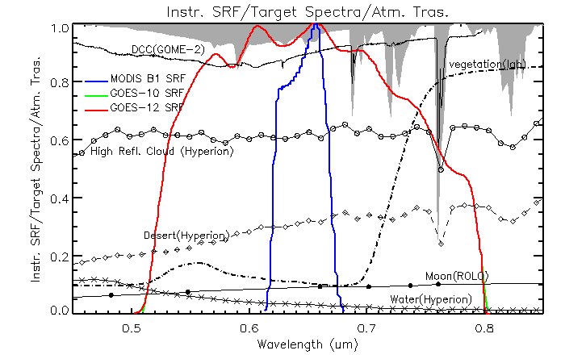
Outline
GOES Imager vicarious calibration methods
Desert based method
Deep Convective Cloud (DCC)
Ray-matching
Lunar calibration
Star calibration
Integrated method
relative calibration
absolute calibration
Conclusions

Slide 3
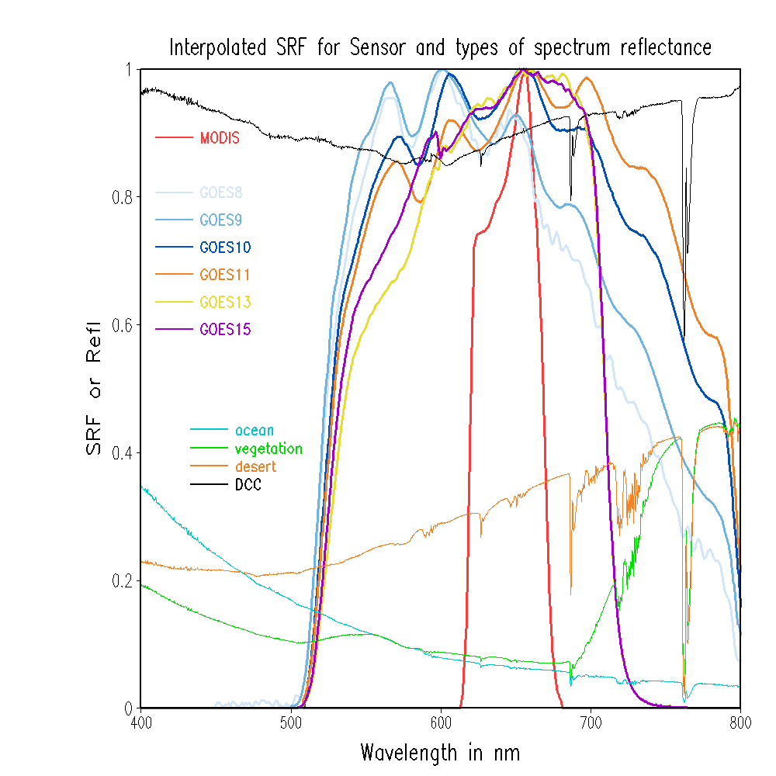
GOES Imager Visible Vicarious Calibration Methods
Reference targets:
Sonoran desert
Deep Convective Cloud (DCC)
Aqua MODIS – collocated cloud pixels
Moon
Stars
GOES-10 (GOES-West, 135W) and GOES-12 (GOES-East, 75W) as examples
Earth surface targets,
Absolute calibration
Direct sensor inter-calibration,
absolute calibration
Extra-terrestrial objects, relative calibration

Slide 4
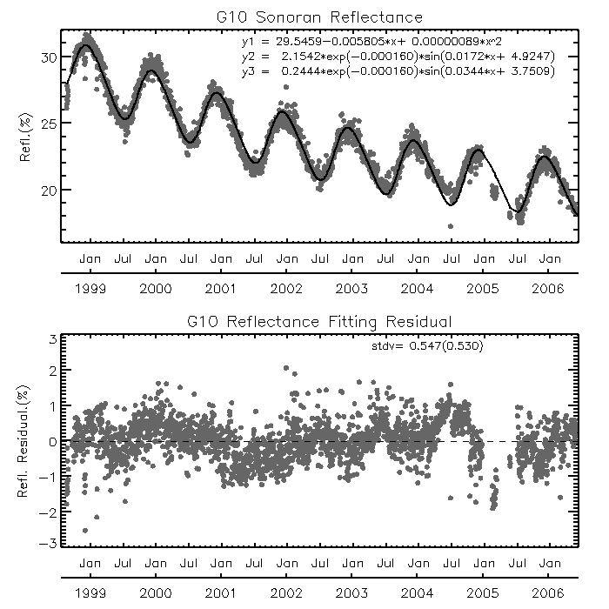
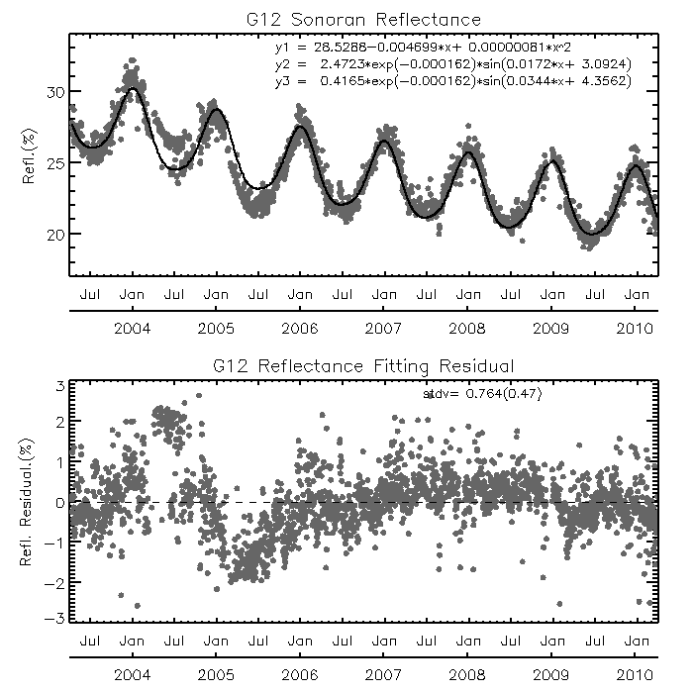
Sonoran Desert
Trending of clear pixel pre-launch reflectance
Removal of contaminated pixels is important to reduce the uncertainty
BRDF and seasonal atmospheric variations are simulated with two sine terms
Periodic deviations (e.g. ENSO events)
Transfer the GOES calibration to Aqua MODIS standard for absolute calibration
BRDF correction of different solar zenith angle and relative azimuth angle between GEO and LEO measurements
Hyperion data for the spectral correction

Slide 5
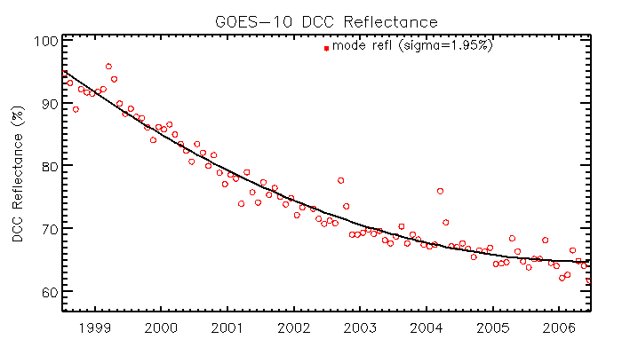
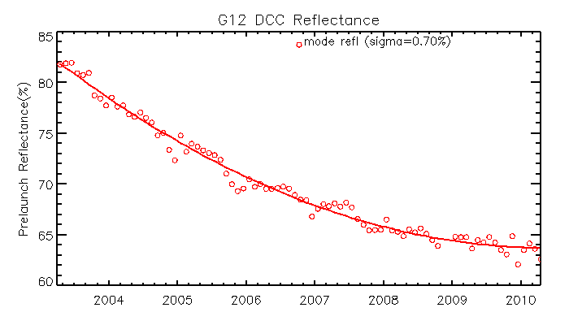
Deep Convective Cloud
Stable, spectrally flat, high reflectance and common to all the satellites
Trending of DCC
Seasonality
Occasional insufficient DCC pixels may lead to large deviation
GOES-West
GOES-East

Slide 6
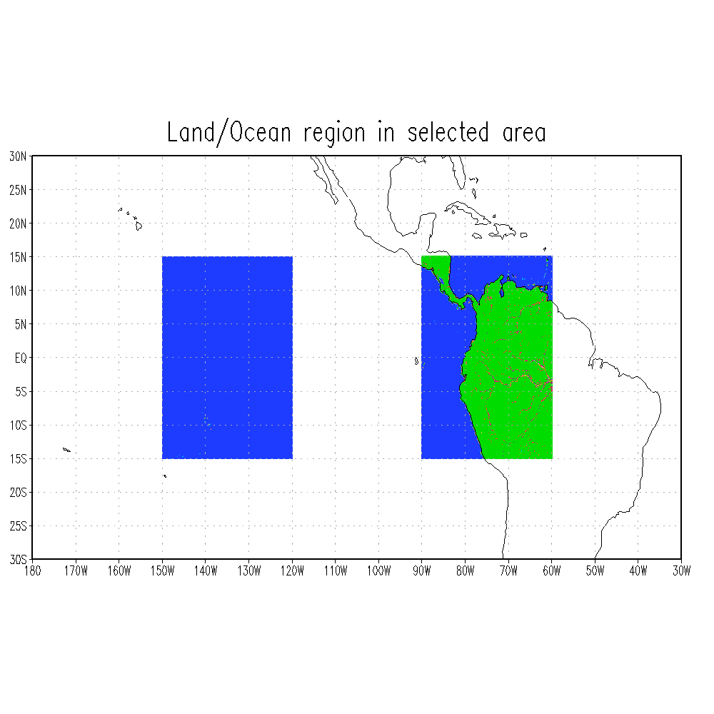
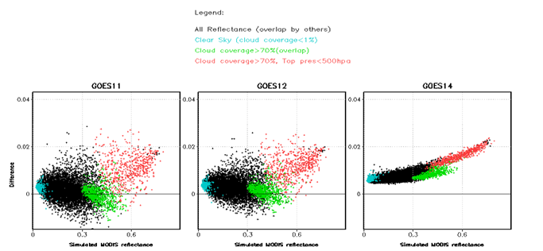
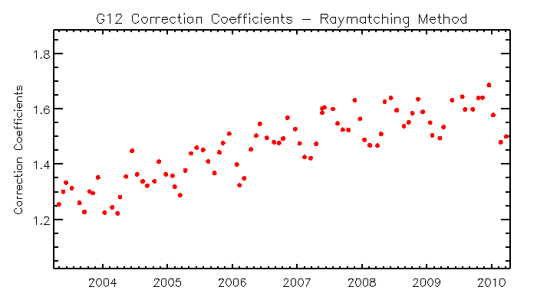
Ray-matching
Direct inter-comparison
Collocations at sub-satellite regions: nadir lat/lon ±8º
Large uncertainty of spectral correction for GOES-12
GOES-West
GOES-East
Wu et al. IGARSS 2011

Slide 7
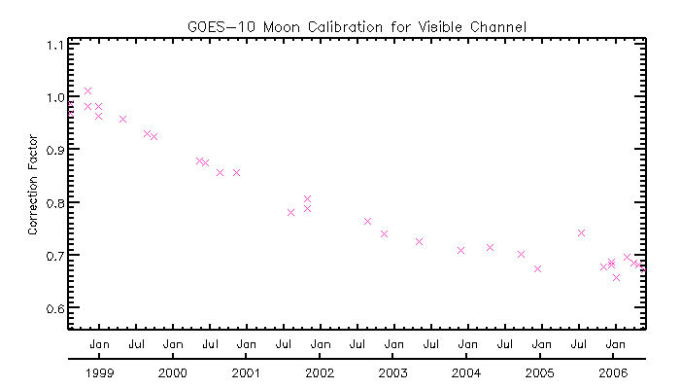
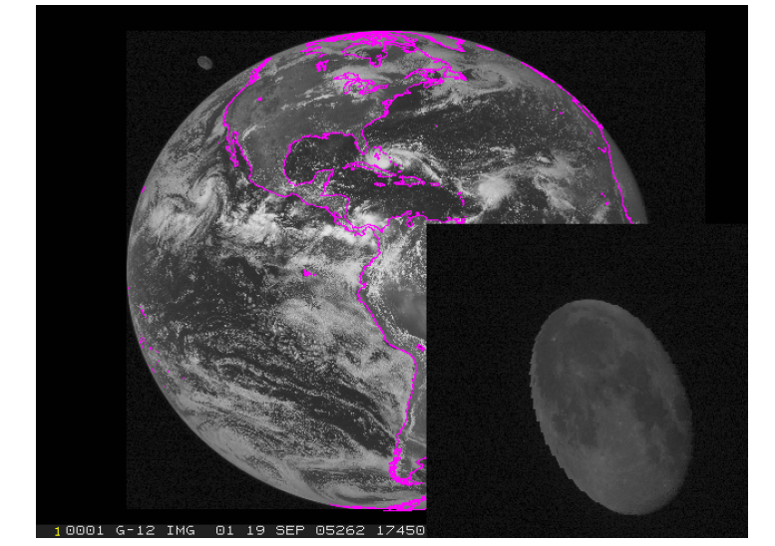
Lunar Calibration
Extremely stable, slight spectral variation at different phase angles
Relative Calibration available with comparison to the USGS ROLO model

Slide 8
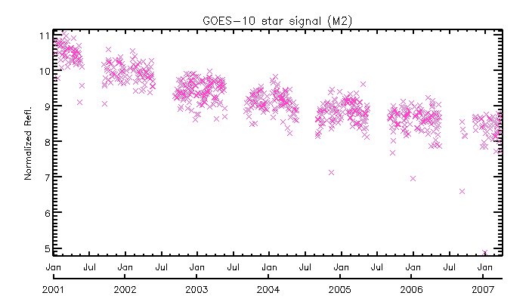
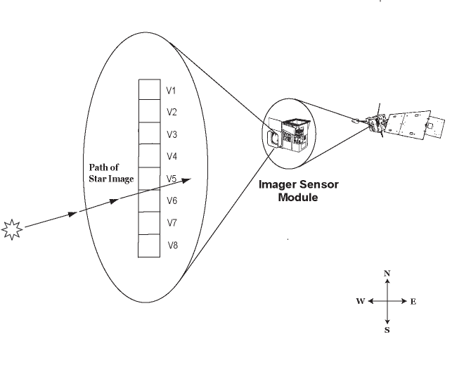
Star Calibration
Extremely stable
A variety of bright stars.
Subject to instrument diurnal/seasonal sensor optical variation
Each star has observation gap in a year
Relative calibration

Slide 9
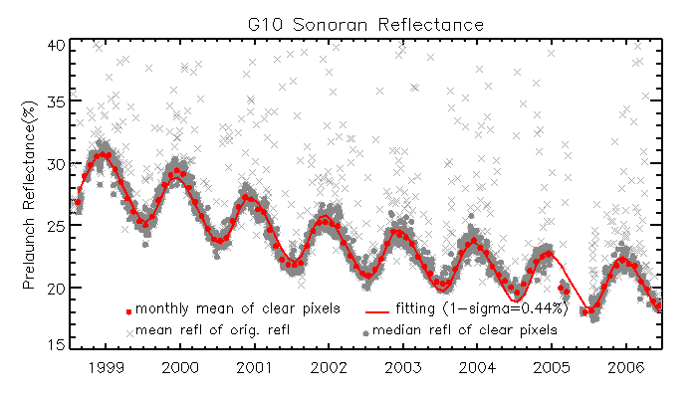
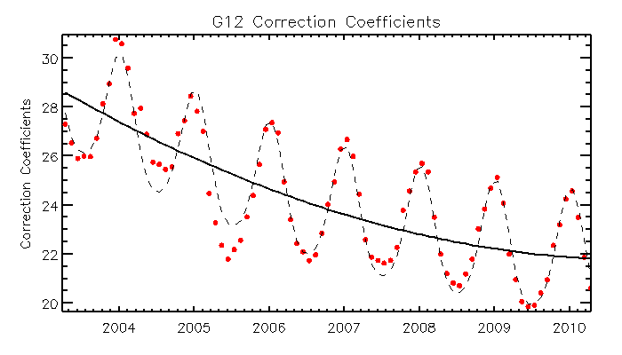
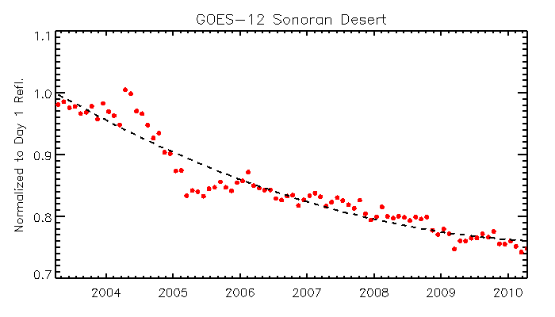
Normalization of the Pre-launch Reflectance
Removal of contaminated pixels
Monthly average reflectance
Trending fitting
Normalized to the estimated Day1 reflectance

Slide 10
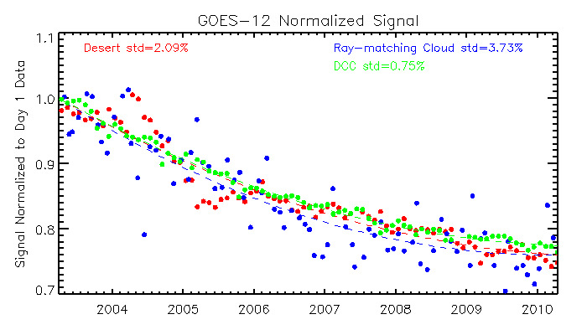
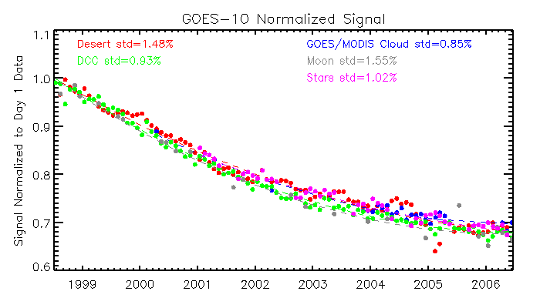
Combined Vicarious Calibrations
Comparable relative calibration accuracy
Similar degradation patterns over different reference targets indicate that the impact of spectral response function variation, if any, is small and possibly negligible on the pre-launch calibration reflectance

Slide 11
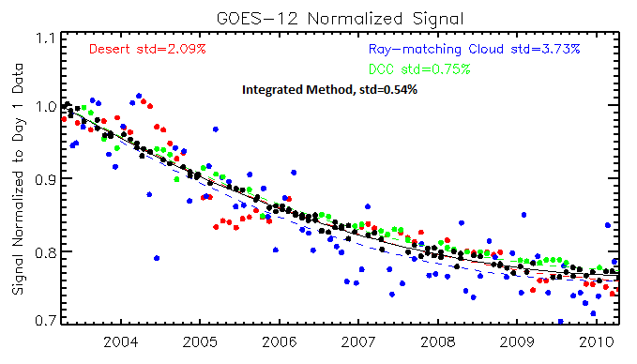
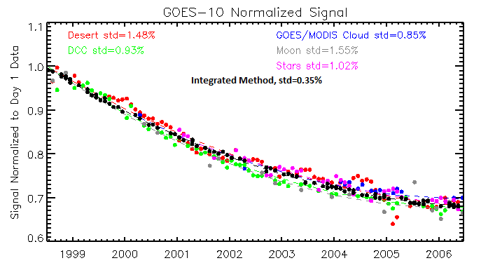
Integrated Vicarious Calibration
Where is the truth of sensor degradation?
The truth should have higher possibility of observations where results of most methods converge
Recursive filtering to remove the observations away from the “truth” - the fitting curve

Slide 12
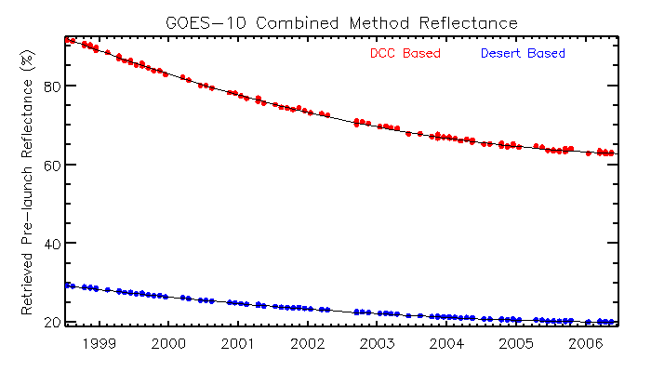
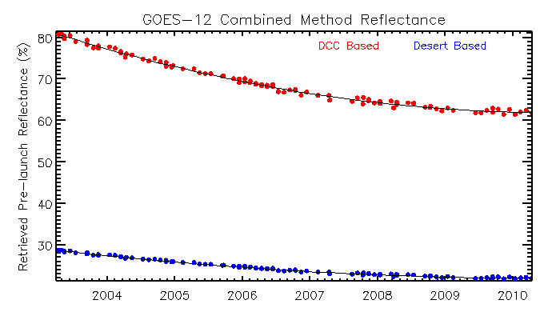
From Relative to Absolute Calibration
Use of desert and DCC methods as example to calculate the absolute calibration correction coefficients
Re-construct the pre-launch reflectance from the integrated calibration result.

Slide 13
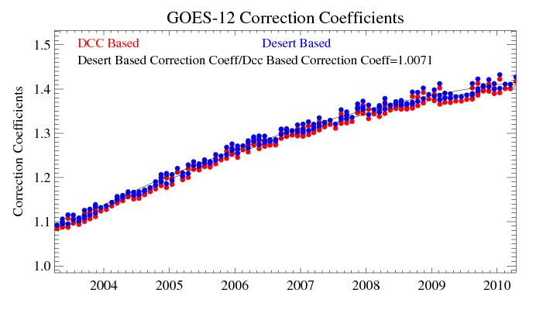
Absolute Calibration Correction
Sonoran Desert:
DCC :
The systematic difference between desert and DCC method is less than 1%

Slide 14
Conclusions
The integrated algorithm is able to increase the relative calibration accuracy
It can be used to evaluate the absolute calibration difference between different vicarious methods
Other integrated method should be explored
Reference refl.
instr. Refl.

