Slide 1
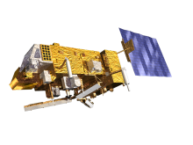
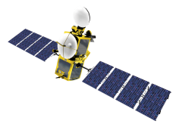
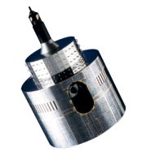
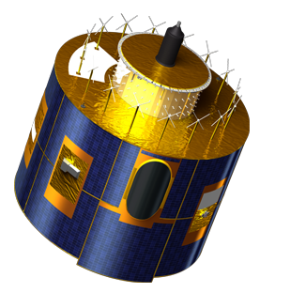
GEO-GEO products –
diurnal variations
Tim Hewison
EUMETSAT

Slide 2
Overview
Modify ATBD for GEO-LEO hyperspectral IR inter-calibration:
Same geometric alignment criteria: Δsecθ < 0.01
Same Time difference Δt < 300 s (usually 0)
But compare individual pixel:pixel
Faster! But no averaging
Pre-compute selected blocks of pixels
Rule of thumb: for maxsec=0.01
lonmin=(a.ssnom+b.ssnom)/2-maxsec*4500./abs(a.ssnom-b.ssnom)/2
lonmax=(a.ssnom+b.ssnom)/2+maxsec*4500./abs(a.ssnom-b.ssnom)/2
Faster
Assumes relative positions don’t change significantly over 24hr!
Use unweighted linear regression

Slide 3
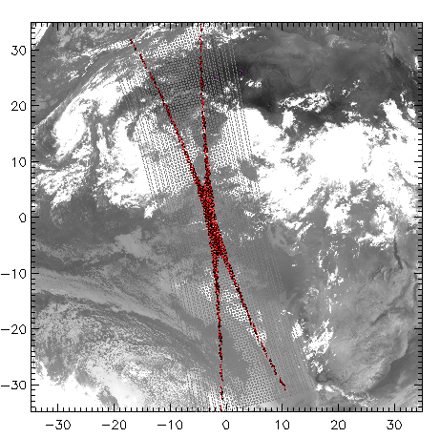
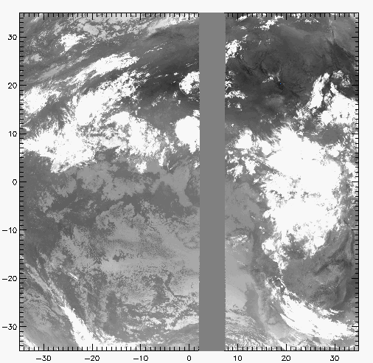
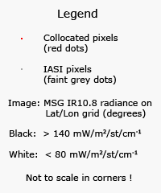
GEO-GEO Geo(metry) - Collocation Criteria
Simultaneous near-Nadir Overpasses
ΔLat<35° ΔLon<35° Δt< 5 min Δsecθ < 0.01
MSG2-IASI and MSG1-IASI
MSG2-MSG1
Restricted to ~tropics
~1000 collocations/orbit/night
Restricted to strip 4.9° wide
Can extend to cover 24hr
Example Image of Meteosat-9 10.8μm Channel Red points show collocated MSG-IASI pixels
Example Image of Meteosat-9 10.8μm Channel Grey area shows collocated MSG2-MSG1 pixels

Slide 4
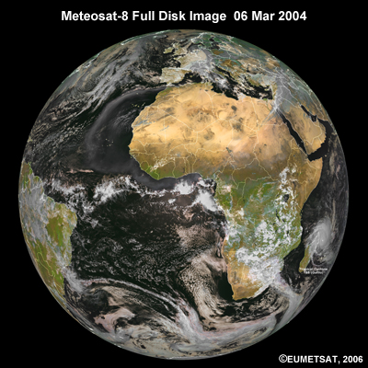
Overlap between 0.0°E and 9.5°E
9.5°E and 0.0°E
Collocations follow narrow strip
Centred on 4.95°E
Rule of Thumb:
Δlon<4.96°

Slide 5
Overlap between 0.0°E and 9.5°E in RSS
9.5°E and 0.0°E
Collocations follow narrow strip
Centred on 4.95°E
Rule of Thumb:
Δlon<4.96°

Slide 6
Overlap between 0.0°E and 3.4°E
3.4°E and 0.0°E
Collocations follow narrow strip
Centred on 1.7°E
Rule of Thumb:
Δlon<14.26°

Slide 7
Overlap between 0.0°E and 3.4°E – in RSS
3.4°E and 0.0°E
Collocations follow narrow strip
Centred on 1.7°E
Rule of Thumb:
Δlon<14.26°

Slide 8
Spectral Band Adjustment Factors
Broadband IR comparison:
No spectral convolution
Need Spectral Band Adjustment Factor
For GEO-GEO inter-calibration products
Can neglect for relative differences in time series

Slide 9
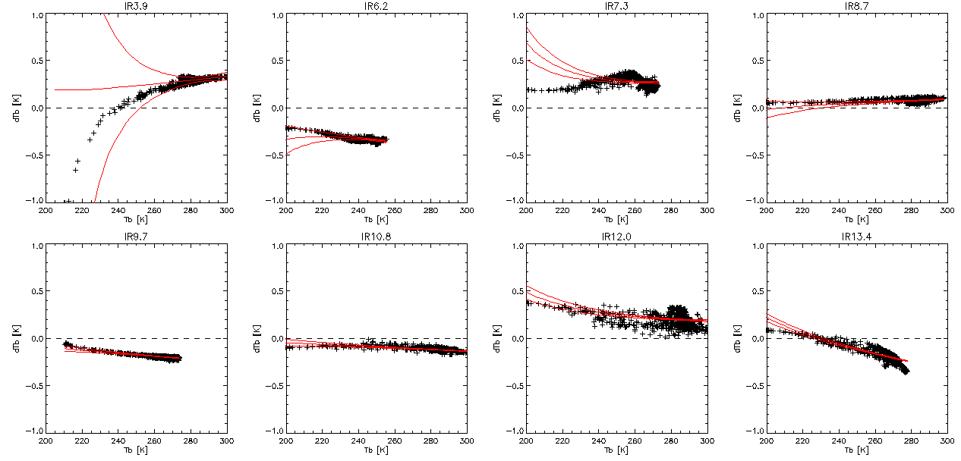
Spectral Conversion Using IASI Obs
Meteosat-8 and -9 have different Spectral Response Functions (SRFs)
Take representative radiance spectra observed by IASI (cloudy + clear)
Convolve with SRFs of MSG1 and MSG2
Synthetic radiances
Compare by linear regression
Function to convert L_{MSG1} to L_{MSG2}
Need to include this function when comparing (MSG2-MSG1) with (MSG2-IASI)-(MSG1-IASI)
Meteosat9-8 Brightness Temperature Differences from synthetic radiances calculated from IASI obs.
Red lines show quadratic fit with 1-σ uncertainty. Typical differences ~0.2K, correctable with rms~0.03K (except IR3.9, because of non-linear radiance-Tb). This is not the limiting factor in these 3-way comparisons.

Slide 10
2014-03-01 MSG3-MSG1 Tb Diffs for Standard Scenes
Blue/Green = Mean Tb-Tbref (RHS)
Black = ΔT_{STD}(MSG3-MSG1) (LHS)
Red = Mean (T_{MSG3}-T_{MSG1}) (LHS)

Slide 11
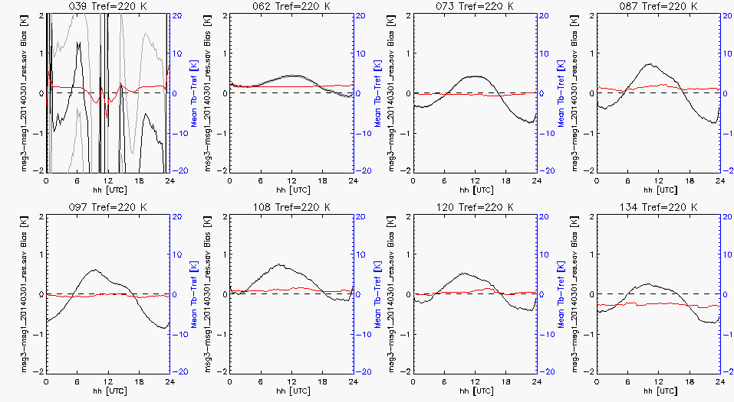
2014-03-01 MSG3-MSG1 Tb Diffs for Cold Scene (220K)
Blue/Green = Mean Tb-Tbref (RHS)
Black = ΔT_{STD}(MSG3-MSG1) (LHS)
Red = Mean (T_{MSG3}-T_{MSG1}) (LHS)

Slide 12
Mean Variance over 24h Periods in 2014-02/03
Mean diurnal SD over ~1 month data
Limited Validity of statistics:
Outside eclipse season
Will update in eclipse season
Nominal BB Calibration Views
Will update for experimental intervals
Show GEO-GEO cal differences
Assume each vary independently!
>Theoretical Uncertainty
~Day-to-day variability
Need to update guidance to users
Just in ReadMe files?
MSG3-MSG1 Channel | Mean SD for T_{STD}[K] | Mean SD Tb=220K
IR3.9 | 0.212 | 3.24
IR6.2 | 0.052 | 0.27
IR7.3 | 0.039 | 0.35
IR8.7 | 0.052 | 0.42
IR9.7 | 0.038 | 0.44
IR10.8 | 0.040 | 0.41
IR12.0 | 0.050 | 0.36
IR13.4 | 0.052 | 0.33
Total Uncertainty (k=1) from Uncertainty Analysis ~0.01K
Total Uncertainty (k=1) from Uncertainty Analysis ~0.7K for IR3.9 ~0.2K for IR10.8

