Slide 1
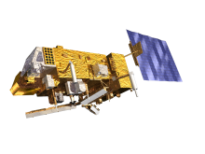
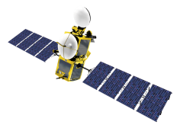
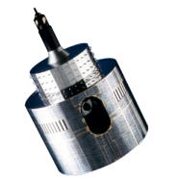
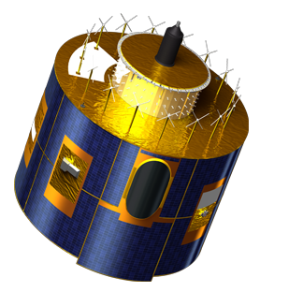
GEO-LEO IR products –
Delta Correction format for embedding in netCDF GSICS Corrections
Tim Hewison
EUMETSAT

Slide 2
Recap of Previous Decisions
Delta Corrections should be generated
To allow users to transfer calibration to common reference
Based on Double Differences (Mon-Ref1)-(Mon-Ref2)
Delta Corrections are specific to each monitored instrument
Delta Corrections are not GSICS Products in their own right
Delta Corrections should be embedded in GSICS Corrections
in netCDF format

Slide 3
Implementation of Delta Correction
Reference-1
Monitored Instrument
Reference-2
GSICS Correction Mon➔1
GSICS Correction Mon➔2
Derived by GSICS
Mon➔1
Applied by User
Integrated into GSICS Correction
Delta Correction 2➔1

Slide 4
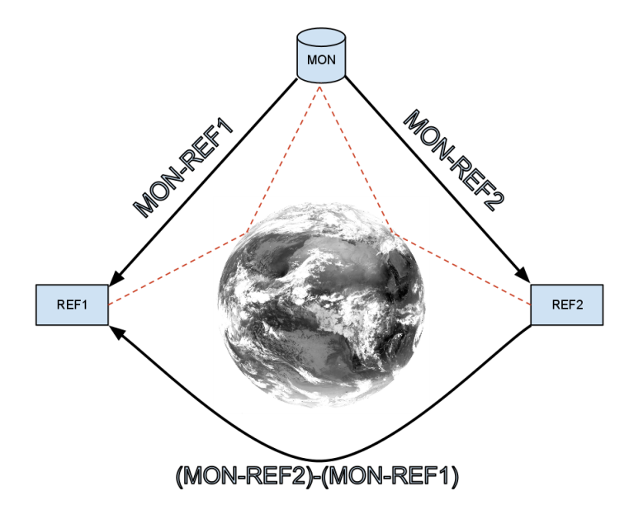
GEO as Transfer Radiometer
Direct Comparison may not be possible
GEOs can be collocated with every LEO overpass
Use as transfer standard
But define Delta Corrections in GEO channel space
Errors from Spectral Band Adjustment tend to cancel out
Wang et al [2011] compared direct SNO method with LEO-GEO-LEO method:
Broad consistency
Mean differences of <0.1K
L. Wang, M. Goldberg, X. Wu, C. Cao, R. A. Iacovazzi Jr, F. Yu, and Y. Li, "Consistency assessment of Atmospheric Infrared Sounder and Infrared Atmospheric Sounding Interferometer radiances: Double differences versus simultaneous nadir overpasses," JGR, vol. 116, no. 11, 2011.
Schematic diagram showing how double differencing against a third sensor as an intermediate transfer reference can be used to inter-calibrate two instruments without requiring direct comparison of their observations. Dashed red lines show collocated observations from pairs of instruments. Black arrows show calibration transfers.

Slide 5
Meteosat-10/SEVIRI as Transfer
Direct Comparison Metop-B & -A impossible
Orbits are 50min/180° out of phase
Meteosat-10/SEVIRI can be collocated with overpasses of both Metop’s
Use as transfer standard
Define Delta Corrections in SEVIRI channel space
Strictly Meteosat-10/SEVIRI
But SRF Differences expected to have negligible impact
Meteosat-10/SEVIRI
(Met10/SEVIRI-MetopA/IASI)
(Met10/SEVIRI-MetopB/IASI)
Metop-A/IASI
Metop-B/IASI
(Met10/SEVIRI-MetopB/IASI)-(Met10/SEVIRI-MetopA/IASI)
Schematic diagram showing how double differencing against a third sensor as an intermediate transfer reference can be used to inter-calibrate two instruments without requiring direct comparison of their observations. Dashed red lines show collocated observations from pairs of instruments. Black arrows show calibration transfers.

Slide 6
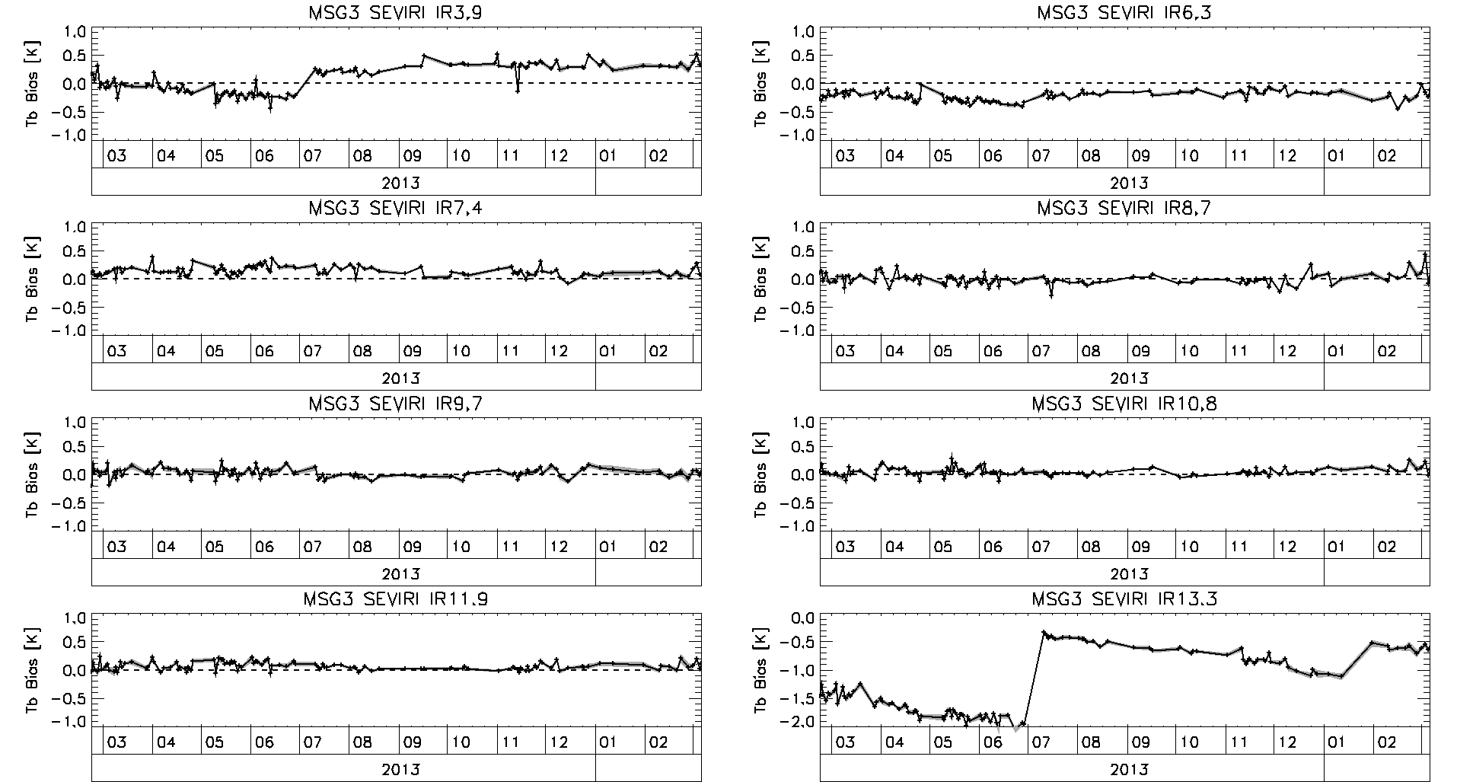
Time Series of Standard Biases – Updated! Full year (Met10/SEVIRI-MetopA/IASI)
^ Decontaminations ^
Unsmoothed Daily Results 3-sigma filter
– not necessarily same days!
^ Decontaminations ^

Slide 7
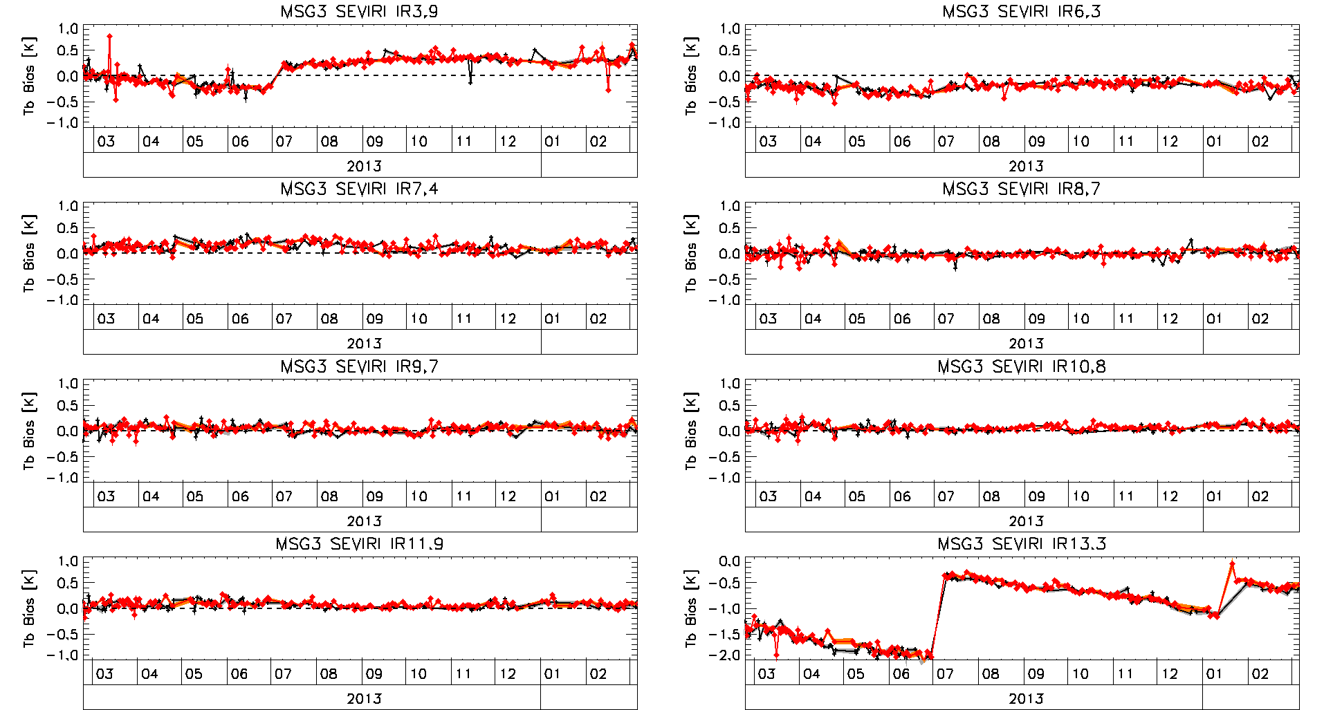
Time Series of Standard Biases – Updated! Full year (Met10/SEVIRI-MetopB/IASI) & (Met10/SEVIRI-MetopA/IASI)
Unsmoothed Daily Results 3-sigma filter
– not necessarily same days!

Slide 8
Statistics of Double Difference – Full year (Met10/SEVIRI-MetopB/IASI)-(Met10/SEVIRI-MetopA/IASI)
Meteosat-10/ SEVIRI Channel | Mean Difference of Standard Biases [K] | Std Error of Difference of Standard Biases [K]
IR3.9 | +0.078 | 0.021
IR6.2 | +0.014 | 0.011
IR7.3 | -0.018 | 0.011
IR8.7 | -0.007 | 0.011
IR9.7 | -0.022 | 0.010
IR10.8 | -0.015 | 0.008
IR12.0 | -0.015 | 0.009
IR13.4 | -0.034 | 0.046
Biases for standard scene radiances (clear sky)
From Daily GSICS Corrections
12 months’ Metop-B/IASI data
Double differences are v. small (Mean Abs Diff = 0.025K)
Only statistically significant at 95% level for IR3.9
due to decontamination step
Good News!
But still need delta correction!
With uncertainties!
Total Uncertainty (k=1)¹ ~0.01K
¹ T. J. Hewison: “An Evaluation of the Uncertainty of the GSICS SEVIRI-IASI Inter-Calibration Products", IEEE Trans. Geosci. Remote Sens., vol. 51, no. 3, Mar. 2013

Slide 9
Statistics of Double Difference – Full year (Met10/SEVIRI-MetopB/IASI)-(Met10/SEVIRI-MetopA/IASI)
Meteosat-10/ SEVIRI Channel | Mean Difference of Standard Biases [K] | Std Error of Difference of Standard Biases [K]
IR3.9 | +0.21 | 0.63
IR6.2 | +0.01 | 0.03
IR7.3 | -0.13 | 0.08
IR8.7 | -0.05 | 0.18
IR9.7 | -0.02 | 0.08
IR10.8 | +0.00 | 0.12
IR12.0 | -0.09 | 0.11
IR13.4 | -0.04 | 0.10
Biases for cold cloud radiances (220K)
From Daily GSICS Corrections
12 months’ Metop-B/IASI data
Double differences are v. small (Mean Abs Diff = 0.068K)
Not statistically significant
Compared with Uncertainties
More Good News!
Total Uncertainty (k=1)¹ ~0.7K for IR3.9 ~0.2K for IR10.8
¹ T. J. Hewison: “An Evaluation of the Uncertainty of the GSICS SEVIRI-IASI Inter-Calibration Products", IEEE Trans. Geosci. Remote Sens., vol. 51, no. 3, Mar. 2013

Slide 10
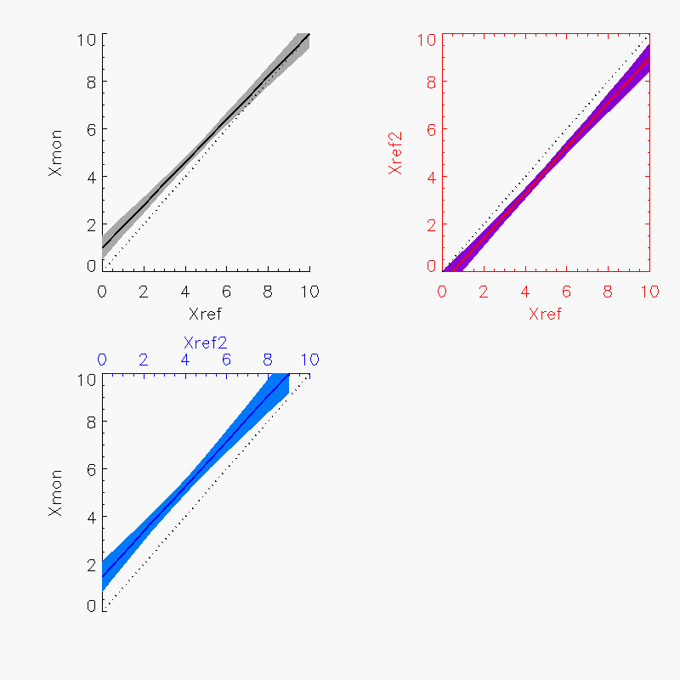
Formulating the Delta Correction
GSICS Correction
=> Double Difference:

Slide 11
Uncertainty of Delta Correction
Propagate uncertainties from GSICS Corrections
But co-covariances unknown
Collocations not collocated!
Could assume zero
= Uncorrelated GSICS corrections
Check assumption: Compare
Estimated “theoretical” uncertainties from error propagation
with observed variance of DD time series (unsmoothed daily results)
Because no trend in Double Differences (DD)
Thanks to Masaya for spotting typo in J!

Slide 12
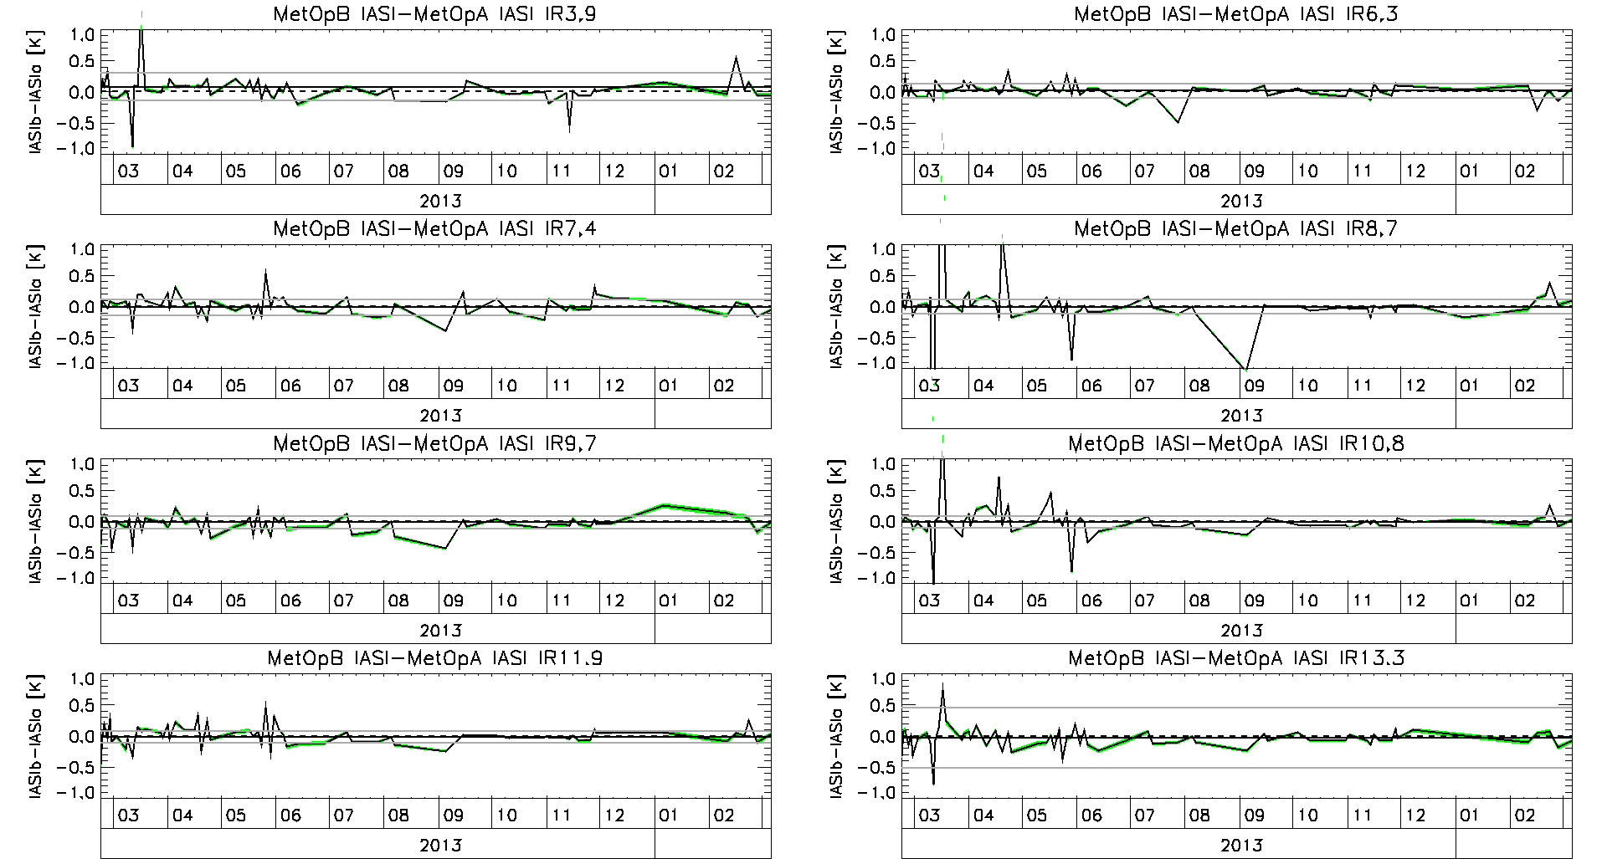
Time Series of Double Differences (Met10/SEVIRI-MetopB/IASI)-(Met10/SEVIRI-MetopA/IASI)
No Significant Trend in DD for Tb=std or 220K, 290K,...
No Significant Trend in DD for slope or offset
Unsmoothed Daily Results – only selecting matched days!

Slide 13
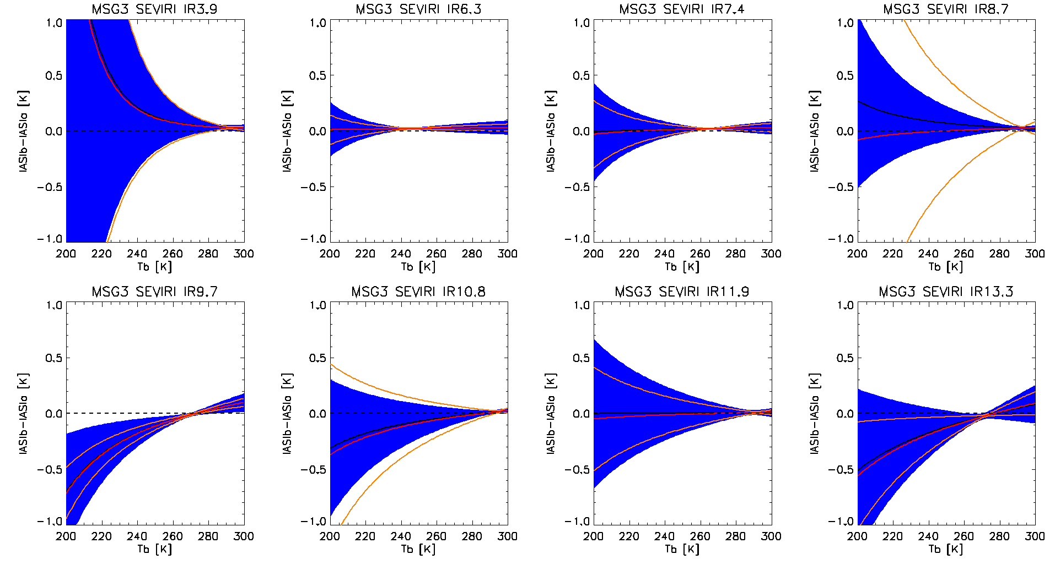
Uncertainties from Theory & Time Series Double Difference coefficients applied to range of scene Tbs
Most Channels – No significant difference over range of Tbs
Theoretical Uncertainty match time series statistics q. well
Black line: Bias Implied from mean of SD coefficients time series
Blue shading: ±k=1 uncertainty from theory, assuming co-covariances=0
Red line: Bias implied from mean of DD coefficients time series
Orange curves: ±k=1 uncertainty from variances of DD coefficients time series

Slide 14
What happens after Metop-A?
Delta Correction
Time
Monitor IASIb-a DD
during overlap period
Calculate trend
and uncertainty
Extrapolate trend?
Only if significant?
Dangerous!
Extrapolate uncertainty
Using variogram analysis
Need >2 years overlap

Slide 15
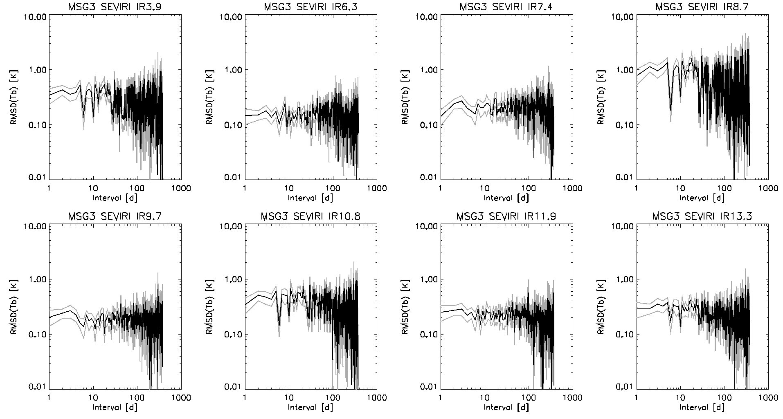
Variogram of Double Differences

Slide 16
Analyse Stability using Variograms
Create stochastic model of calibration drifts
Using Temporal Variogram:
No significant drift over 0.5yr
Longer periods?
Fit (2γ_{t})^{1/2} and t to predict range of future drifts
See Met7-IASI for example...
?
Temporal variogram [(2γ_{t})^{1/2}] calculated as RMS difference of DD Standard Biases

Slide 17
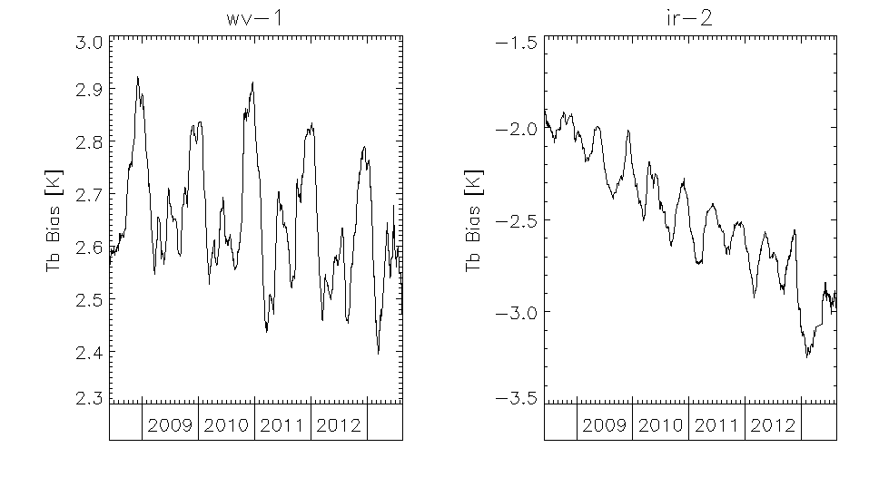
Time Series of Meteosat7/MVIRI Bias wrt IASI
Meteosat7/MVIRI “WV” and “IR”
GSICS Re-Analysis Correction
Evaluated Standard Bias for Standard Scene radiance
Expressed as Tb
5 year long time series
WV: strong yearly cycle
IR: twice-yearly cycle
+ long-term drift
(ice contamination?)
Time Series of Standard Biases for “WV” and “IR” channels of Meteosat7/MVIRI calculated with reference to Metop-A/IASI.

Slide 18
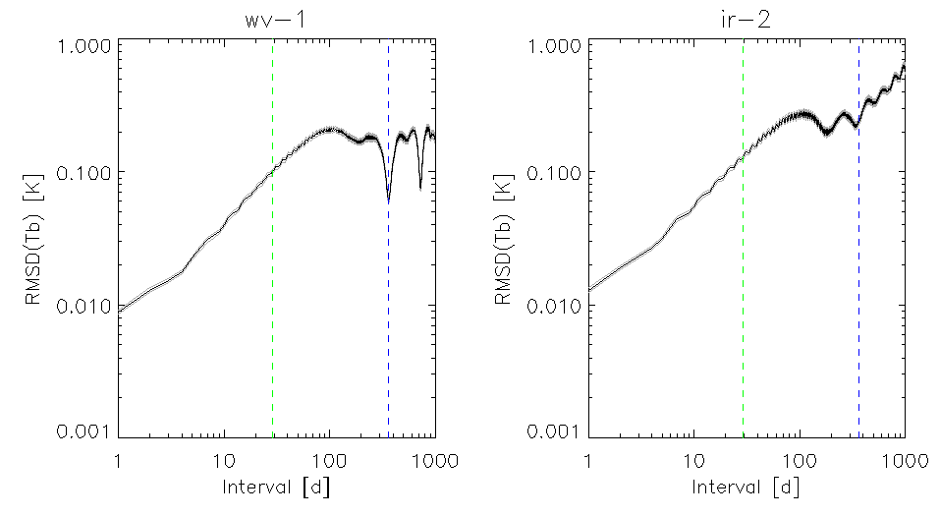
Variograms for Meteosat-7/MVIRI “WV” and “IR”
“WV” and “IR” channels of Meteosat/MVIRI
Variograms increase with time interval 1-29d
Averaging period used in GSICS Correction
“WV” Minimum at Δt=1yr:
(2γ_{t})^{1/2}=65±4 mK
“IR” Minimum at Δt=1yr:
(2γ_{t})^{1/2}=187±12 mK
Higher “nugget values”
More collocation noise
Higher “sill values”
Faster calibration drift
See poster for details
6-Month Cycles
Annual Cycles
Low Pass Filter
Low Pass Filter
Long-term Drift
Long-term Drift
Temporal variograms [(2γ_{t})^{1/2}] calculated as RMS differences in Standard Biases for “WV” and “IR” channels of Meteosat-7/MVIRI calculated with reference to Metop-A/IASI. Vertical lines show periods of 29d and 1yr.

Slide 19
Conclusions
GSICS Correction: Inter-calibrate Meteosat/SEVIRI to Metop/IASI
Metop-A/IASI stable reference instrument since 2007
Metop-B/IASI launched in 2012 in anti-Metop-A orbit!
Developed Double Differencing method to compare IASI-A and –B
Consistent Calibration (Mean Abs Diff = 0.03K for warm scenes)
Stable Calibration (SD of DD= 0.03K for warm scenes)
Developed Delta Corrections
To convert inter-calibration against one reference to be consistent with another
Track relative calibration drift during overlap period w/ uncertainty
Extrapolate drift and uncertainty outside overlap period
Provides traceability link for Climate Data Records

Slide 20
Practical Implementation
Generate NRTC & RAC independently using Metop-A/IASI and Metop-B/IASI
Create a process to read these and generate Delta Corrections
(Mon-Ref1)-(Mon-Ref2) & (Mon-Ref2)-(Mon-Ref1)
Assuming zero co-covariances
Append these into netCDF files for
NRTC & RAC
(Mon-Ref1) & (Mon-Ref2)

Slide 21
Decisions – Updated during meeting with outcomes in Green
Do we use same Delta Corrections for NRTC & RAC? No!
What smoothing period to use for Delta Corrections?
Same as for NRTC? (e.g. 14d)
Same as for RAC? (e.g. 29d)
As long a period as the double-difference is stable?
Some arbitrary reference period? (e.g. 1yr)
Or multiple integer number of years?
a for NRTC, b for RAC, c/d/e for ARC (TBD)

Slide 22
Decisions, Decisions
What happens when Metop-A/IASI dies?
Just keep the last Delta Corrections?
Define mean Delta Correction over some period?
The whole period of overlap?
Some arbitrary reference period?
Adopt Metop-B/IASI as standard and Define Delta Corrections for IASI-A->B as (b.i) or (b.ii)?
n.b. Need backward compatibility for current IASI-A products
Remove delta-correction when second reference dies.
Revisit question for ARC. Possibly use blended reference.
Do we really need another class of GSICS Product?
To support generation of FCDRs over long time period
To cover multiple monitored and reference instruments
Yes. In the near future.

Slide 23
Decisions, Decisions, Decisions
How to distribute embedded Delta Corrections?
(Mon-Ref2), (Ref2-Ref1) ? – User applies optionally Start with this as simplest option.
(Mon-Ref2), (Mon-Ref2)+(Ref2-Ref1) ? – Allows users to inter-calibration to Ref2 or Ref1 – Still possible to back out Delta Correction if needed
(Mon-Ref2), (Ref2-Ref1), (Mon-Ref2)+(Ref2-Ref1) ? – Everything! (few bytes bigger) Aim to add this option, subject to user feedback on a).
(Mon-Ref2)+(Ref2-Ref1) ? – Already applied – but problematic at end of Ref1?

Slide 24
Mid-term aims
Definition of a merged community reference
For IR inter-calibration
Based on IASI on Metop-A, -B, -C, AIRS, CrIS...
Hyperspectral?
Applicable for archive re-calibration
How?
How to define uncertainties?
When to start?
But first, what are the requirements?

Slide 25
Proposed modification to netCDF for Option 5b)
Blue: Current content for Mon-Ref1 (called “reference_instrument”)
Red: Proposed addition for Mon-Ref2 (called “reference_instrument2”)
Green: Decisions needed – outcomes in bold
Dimensions
chan = 8
chan_strlen = 5
validity = 2
date = UNLIMITED (198 currently)
standard_name = "time"
long_name = "date of evaluation"
units = "seconds since 1970-01-01T00:00:00Z"
calendar = "gregorian"
bounds = "validity_period"

Slide 26
Global Attributes – Part 1
Conventions = "CF-1.6"
Metadata_Conventions = "Unidata Dataset Discovery v1.0"
standard_name_vocabulary = "CF Standard Name Table (Version 19, 22 March 2012)"
project = "Global Space-based Inter-Calibration System "
title = "MSG3+SEVIRI vs MetOpB+IASI GSICS Re-Analysis Correction" Same title? yes
summary = "Coefficients of the GSICS Correction for the infrared channels of a GEOstationary imager using a LEO hyperspectral reference instrument"
institution = "EUMETSAT"
date_created = "2013-08-02T14:02:16Z"
date_modified = "2014-03-12T14:52:30Z"
license = "Calibration information delivered as a GSICS operational product is generated in accordance with GSICS principles and practices.; GSICS operational and demonstration products may be used and redistributed freely. Scientific publications using GSICS operational or demonstration products should however acknowledge both GSICS and the relevant producer organization.; There is no warranty on the data express or implied, including warranties of merchantability and fitness for a particular purpose, or any assumed legal liability for the accuracy, completeness, or usefulness, of this information. The user of the data do so at their own risk."

Slide 27
Global Attributes – Part 2
naming_authority = "int.eumetsat.gsics"
creator_name = "EUMETSAT - European Organisation for the Exploitation of Meteorological Satellites"
creator_email = "ops@eumetsat.int"
creator_url = "http://www.eumetsat.int"
references = "ATBD, Unidata NetCDF, Climate Format Conventions, EUMETSAT IASI 1C Native Format Guide"
history = "2013-08-01T00:00:00Z hypirsno_match_file_nc collocation_criteria=v0.3; 2013-08-01T00:00:00Z hypirsno_collocate v0.3 collocation_criteria=v0.3; 2013-08-01T00:00:00Z hypirsno_convolve v0.1 SRF=v1.95; 2013-08-01T00:00:00Z hypirsno_analyse v0.2 filter=0; 2013-08-02T14:02:16Z hypirsno_output v03.05.00 filter=0 corr=RAC"
processing_level = "demonstration/v03.05.00"
time_coverage_start = "2013-08-01T00:00:00Z"
time_coverage_end = "2014-02-26T24:00:00Z"
geospatial_lat_min = -35.0
geospatial_lat_max = 35.0
geospatial_lon_min = -35.0
geospatial_lon_max = 35.0
geospatial_lat_units = "degrees_north"
geospatial_lon_units = "degrees_east"

Slide 28
Global Attributes – Part 3
id = "W_XX-EUMETSAT-Darmstadt,SATCAL+RAC+GEOLEOIR,MSG3+SEVIRI-MetOpB+IASI_C_EUMG_20130801000000_demo_03.nc" Same filename? yes
wmo_data_category = 30
wmo_international_data_subcategory = 5
local_data_subcategory = 1
keywords = "GSICS, satellites, inter-calibration, etc."
reference_instrument = "MetOpB IASI"
reference_instrument2 = "MetOpA IASI"
monitored_instrument = "MSG3 SEVIRI"
window_period = "P14D"
comment = "Use the RAC with the time closest to the time of interest. Take great caution when applying it at a date where this difference is greater than the window_period."
readMeDocURL = "http://www.eumetsat.int/Home/Main/DataProducts/Calibration/Inter-calibration/"
number_of_times = 198
number_of_validities = 2

Slide 29
Global Attributes – Part 4
planck_function_constant_c1 = 1.19104E-5
planck_function_constant_c1_unit = "mW(cm^-1)^-4 m^-2 sr^-1"
planck_function_constant_c2 = 1.43877
planck_function_constant_c2_unit = "K cm"
radiance_to_brightness_conversion_formula = "tb=((c2 * wnc)/LN(1.+(c1 * wnc^3)/radiance)-beta)/alpha"
brightness_to_radiance_conversion_formula = "radiance=(c1 * wnc^3) / ((EXP(c2 * wnc / (alpha*tb+beta)))-1)"

Slide 30
Variables
char channel_name(chan, chan_strlen)
int number_of_collocations(date, chan)
float central_wavelength(chan)
float std_scene_tb(chan)
float offset(date, chan)
float offset_se(date, chan)
float slope(date, chan)
float slope_se(date, chan)
float covariance(date, chan)
float std_scene_tb_bias(date, chan)
float std_scene_tb_bias_se(date, chan)
byte alert(date)
double validity_period(date, validity)
float wnc(chan)
float alpha(chan)
float beta(chan)
int delta_number_of_collocations(date, chan)
float delta_offset(date, chan)
float delta_se(date, chan)
float delta_slope(date, chan)
float delta_slope_se(date, chan)
float delta_covariance(date, chan)
float delta_std_scene_tb_bias(date, chan)
float delta_std_scene_tb_bias_se(date, chan)
byte delta_alert(date) ?
Assumptions:
Results on same dates from ref & ref2 ?

