Slide 1
Plotting Tool Roll-Out
Special Issue of the IEEE TGRS on “Inter-Calibration of Satellite Instruments”:
Special Issue of the IEEE TGRS on “Inter-Calibration of Satellite Instruments”:
Tim Hewison

Slide 2
Plotting Tool - Status
GSICS bias monitoring plotting tool (by P. Miu)
Still on EUMETSAT Validation Server:
http://vgsics.eumetsat.int/plotter/
Plots time series of bias (as brightness temperatures)
From RAC files on GSICS servers
Calculated using formulae embedded in netCDF files
Example

Slide 3
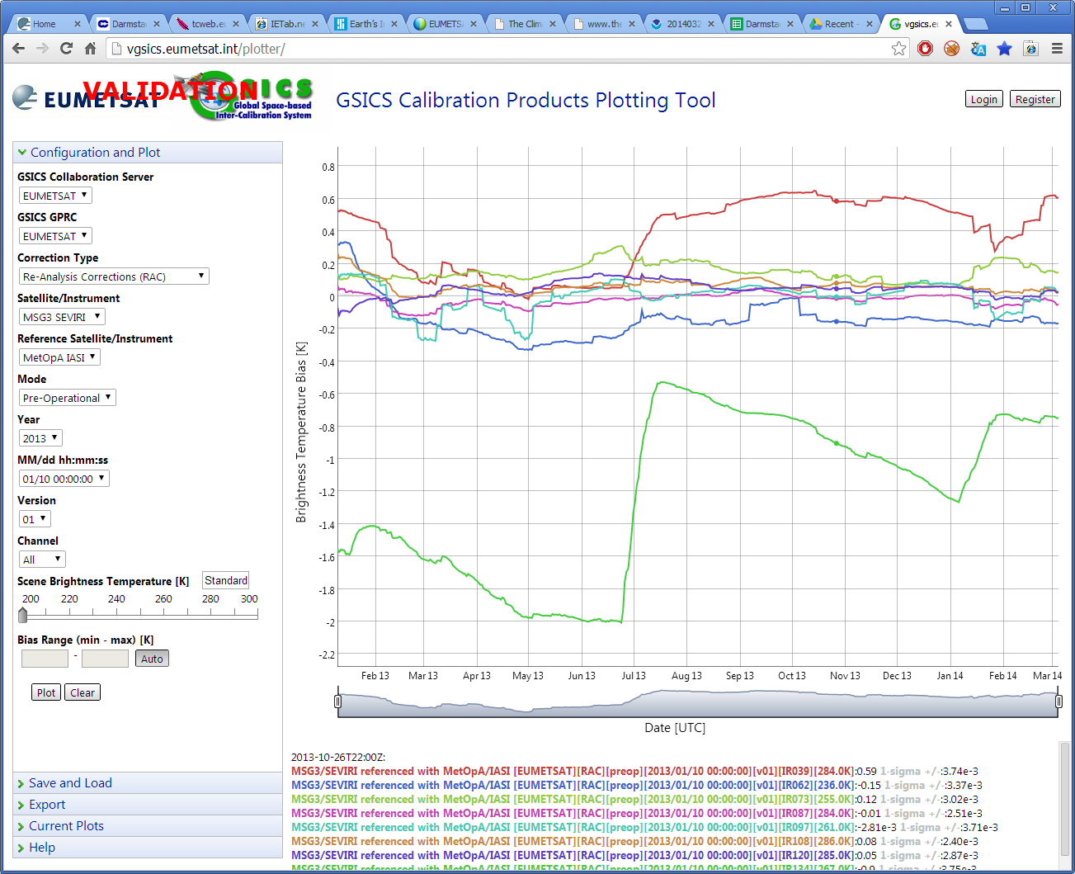

Slide 4
Plotting Tool – Further Development
GWG_13.14 | EUMETSAT to propose solution based on modification of plotting tool and server structure and content to allow this daily results to be displayed. | Tim Hewison | 01 Sep 2013 | Late
Sorry!
Follow up in Web Meeting?
What about NRTC?
Current stored in separate netCDF files valid for each date
Could aggregate?
Is this needed?
Need to define requirements for plotting next GSICS Products
Include conversion all formulae necessary in netCDF files

Slide 5
Anything Else?

