Slide 1
CEOS WGCV Microwave Sensors Subgroup -objectives and activities
Xiaolong DONG
Chair, Microwave Sensors Subgroup
Working Group on Calibration and Validation
Committee on Earth Observation Satellites
(MSSG WGCV CEOS)
CAS Key Laboratory of Microwave Remote Sensing
National Space Science Center, Chinese Academy of Sciences
(MiRS, NSSC, CAS)
Email: dongxiaolong@mirslab.cn
Tel: +86-10-62582841, Fax: +86-10-62528127

Slide 2
OUTLINE
CEOS, WGCV and its Subgroups
Missions and objectives
Recent requirements and challenges
Focuses and progresses
Differences and potential cooperation with GSICS

Slide 3
CEOS
CEOS: Committee on Earth Observation Satellites
Member and associate member: organizations with EO data or major ground capabilities
Mission: CEOS ensures international coordination of civil space-based Earth observation programs and promotes exchange of data to optimize societal benefit and inform decision making for securing a prosperous and sustainable future for humankind.

Slide 4
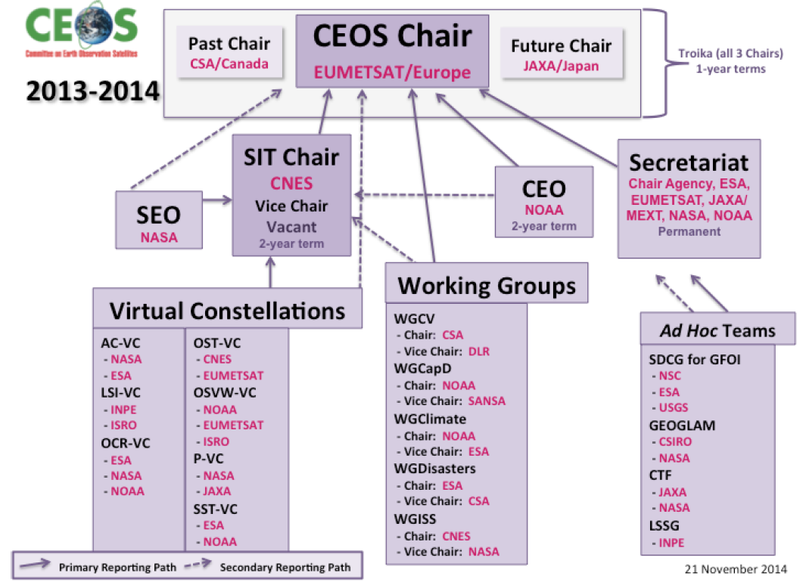
Structure of CEOS (2013-2014)

Slide 5
WGCV
WGCV, Working Group on Calibration and Calibration
Missions: To ensure long-term confidence in the accuracy and quality of Earth Observation data and products
The WGCV provides a forum for the exchange of information calibration and validation, coordination, and cooperative activities.
The WGCV promotes the international exchange of technical information and documentation, joint experiments and the sharing of facilities, expertise and resources.
The WGCV seeks to be the recognized first point of contact for the international user-community as far as calibration and validation is concerned.
The WGCV addresses the need to standardize ways of combining data from different sources to ensure the interoperability required for the effective use of existing and future Earth Observing systems.

Slide 6
WGCV Subgroup (As 2014)
Synthetic Aperture Radar (SAR) Chair: Dr Manfred Zink, DLR
Infrared Visible Optical Sensors (IVOS) Chair: Dr Nigel Fox, NPL
Microwave Sensors (MWS) Chair: Dr. Xiaolong Dong, NSSC, CAS
Terrain Mapping (TMSG) Chair: Prof. Jan-Peter Muller, UCL
Land Product Validation (LPV) Chair: Dr Gabriela Schaepman-Strub, University of Zurich Vice Chair: Dr. Miguel Román, NASA
Atmospheric Composition (ACSG) Chair: Dr Bojan Bojkov, ESA Vice Chair: Dr Jean-Christopher Lambert, IASB/BIRA

Slide 7
Microwave Sensors Subgroup
Missions:
The mission of the Microwave Sensors subgroup is to foster high quality calibration and validation of microwave sensors for remote sensing purposes. These include both active and passive types, airborne and spaceborne sensors.
Objectives
Facilitate international cooperation and co-ordination in microwave sensor calibration / validation activities by sharing information on sensor development and field campaigns.
Promote accurate calibration and validation of microwave sensors, through standardization of terminology and measurement practices.
Provide a forum for discussion of current issues and for exchange of technical information on evolving technologies related to microwave sensor calibration / validation.
Provide calibration/validation support to CEOS virtual constellations and data application groups/communities by coordination of reference sites for both passive and active microwave sensors, and standardization of quality assurance of microwave remote sensing data.

Slide 8
MSSG covers passive and active…
All EO sensors operated in microwave spectrum, except SAR
Works currently focuses on:
Microwave Radiometers (sounders, imagers)
Radar Scatterometers
Radar Altimeters
Other related aspects:
Spaceborne weather radars: Cloud and Precipitation Radars (e.g PR, CPR)
GNSS and GNSS-Reflected signal applications
Ice sounders and GPR

Slide 9
Characteristics of Microwave Sensors
Diversity in types and applications
Low spatial resolutions (km, tens of km, hundreds of km), but generally large swath with prompt global coverage
Atmosphere, ocean, large-scale environmental applications
Data dependent on processing (statistics, sensor parameters, algorithms…)
Importance of process control and quality control

Slide 10
Requirements and Challenges for Cal/Val
Quantitative assimilation in numerical prediction models
Climate and global change applications
Higher requirements, especially for climate and global change applications: sensitivity, accuracy, stability;
Cross-calibration requirements of sensors flown on different spacecrafts and developed by different agencies;
(e.g. ASCAT/METOP of Eumetsat, OSCAT of ISRO, India; SCAT/HY-2 of SOA, China)
No traceable standards available for microwave sensors;
New developed sensors
Polarized radiometers and scatterometers
Interferometric synthetic aperture radiometers
Wide swath and SAR altimeters
…

Slide 11
Climate applications of ocean wind vector
Different sensors (frequency, antennas, scanning…)
Differences in…
Calibration
Processing
Geophysics
Therefore, differences of
L1b products (bias, definitions…)
(P. Lecome, ESRIN/ESA, 2011)
Climate application requirements…
Long-term geophysical parameter with consistency
Cross comparable
Therefore
Standardization of system terminology
Standardization of processing
Cross-cal references

Slide 12
What needs to/can do for microwave sensors…
General considerations
Passive microwave sensors
Active microwave sensors

Slide 13
General considerations
Many groups/organizations (MicroRAD, GSICS, IOVWST,…) had worked on different aspects involving microwave sensors, including Cal/Val, most from aspects of science and applications, WGCV can provide Cal/Val support from sensors by concerned agencies.
MSSG will emphasize on data quality of microwave sensors, by provide a platform for exchange and sharing of prelaunch calibration standards/schemes for different agencies and standardization of prelaunch and post launch calibration of microwave sensors.
Standardization of calibration of passive microwave sensors;
Collecting information of cal/val sites for microwave imagers,
Coordinating microwave data on selected sites for cal/val applications;
Coordinating with other groups and organizations.
Priorities will be on L1b level data, i.e. BT for passive and Sigma 0 for active sensors.

Slide 14
Active microwave sensors
Identify the post-launch cal/val procedures for different type of scatterometers (fixed beam, scanning beam, etc)
Coordinating scatterometer data (C band and Ku band) for potential proposed calibration site (Amazon forest, Antarctic, etc), setup database for cal/val and cross-cal of scatterometer on these sites;
Collecting information of artificial calibration facilities/sites for scatterometers;
Identify information of calibration sites for radar altimeters, collaboration for cross-instrument cal/val;
Identify cross-cal/comparison of PR with other sensors (Alt, etc)

Slide 15
Focuses for active sensors (1)
Scatterometers
Evaluation of L1b (sigma 0);
Prelaunch calibration requirements
Antenna, internal cal, data processing
After launch cal/val
Identify and characterization of extended-area target
Amazon, ocean, ice
Antenna pattern cal
Extended target, ground calibration station and transponders
Rotating and fixed, pencil-beam and fan-beam
After launch cal/val
Cross cal of sigma 0 for sharing wind retrieval models
Ocean wind vector
Soil moisture

Slide 16
Focuses for active sensors (2)
Radar altimeter
Prelaunch calibration
Antenna, transmitted signal, receiver
After launch cal/val
Ground calibration stations
Cross cal/val for application of ALT data from different satellites
Sea level
Significant wave height
Surface wind speed

Slide 17
Cross-calibration of scatterometry 1: requirements and difficulty
Climate data record (CDR) of ocean surface wind (OSW) become important new requirement for scatterometer data, in addition to weather applications;
Consistency of OSW data from different missions requires cross-cal;
L1b data (sigma 0) bias plays essential role;
Difficulties in direct sharing of sigma 0 data (US, China, India) due to data policy;
OSVW VC and MSSG coordinate in international, multilateral frame.

Slide 18
Cross-calibration of scatterometry 2: Progresses and next step work
Coordinate with OSVW VC, IOVWST and agencies to determine areas for x-cal of Ku-band data; (June 2-4, 2014 IOVWST meeting)
Survey of sites for X-cal and val of microwave scatterometry data
Multilateral joint campaigns to avoid data share difficulties (X-cal with Amazon for QSCAT, OSCAT and HY-2 SCAT
Work on standard processing algorithms for x-cal purpose;
X-cal of L1b data and OSW data;
X-cal with global ocean NWP models

Slide 19
Recent progresses
Recent progresses
Collaboration with OSVW VC and IOVWST to formulate MSSG priorities on scatterometer
NSOAS, CNES and ESA cooperation for cal/val of radar altimeter: cross-cal and cal with ocean
Progresses on cal/val of passive microwave atmospheric data with GNSS measurements
Progresses on microwave emission standard

Slide 20
Cross-calibration of altimetry 1: requirements and progresses
Climate and global change research requires long-term data with continuance;
Sea level products related to orbit and algorithms (corrections) and requires x-cal and val
HY-2A altimeter with Jason-1/2 (NSOAS, CNES, ESA), very good encouraging results
Multimission altimetry data validation in the Baltic Sea (NSOAS, DTU Space)

Slide 21
Differences and potential cooperation with GSICS
Differences
WGCV:
better effort based
Techniques and show portal
GSICS:
commitment by operational agencies
Operational service
Potential cooperation
Exchange of information
Technique support
Data provision
Validate

Slide 22
The End!

