Slide 1
The Development of AMSU FCDR’s and TCDR’s for Hydrological Applications
¹Ralph Ferraro (Ralph.R.Ferraro@noaa.gov)
¹Huan Meng, ²Wenze Yang, ²Isaac Moradi
Collaborators: ²Hai-Tien Lee, ¹Tom Smith, ²Jim Beauchamp
¹Satellite Climate Studies Branch, NOAA/NESDIS/STAR/CoRP
²Cooperative Institute for Climate & Satellites, Univ. of MD, College Park
College Park, MD USA

Slide 2
Outline
Motivation
Project Overview and Status
Examples of Corrections Made
  Geolocation, Scan Bias, Intersatellite
Application Examples
Summary and Future Plans

Slide 3
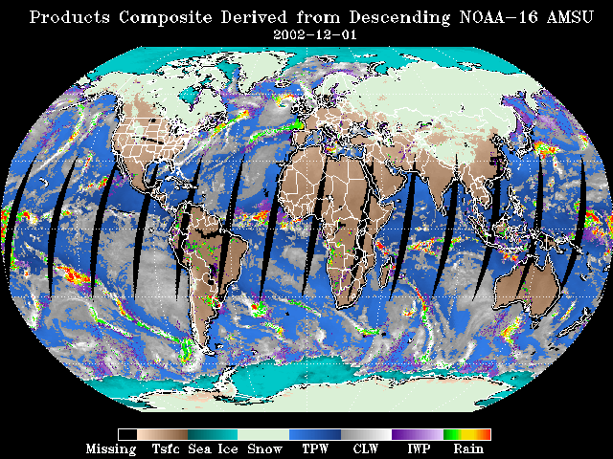
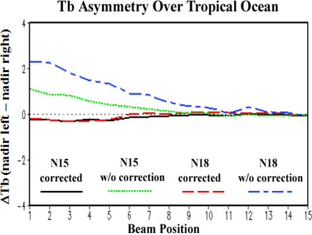
Project Motivation
AMSU was designed for “weather”
  Never planned for climate/time series
  Used primarily for real time applications
    Calibration changes made “forward looking”
    Reprocessing not part of “baseline” operation
N-15 in 1998; 7 satellites to date
AMSU is useful for more than just T(z)/Q(z)
  Window channels >> precip. editing
  TPW and precipitation stand alone L2 products contributing to “blended” time series
    NESDIS bTPW
    NWS CMORPH; NASA TMPA, etc.
Our motivation
  Properly characterize all of the sensors
  Make the time series homogeneous
  Reprocess the Hydrological Products

Slide 4
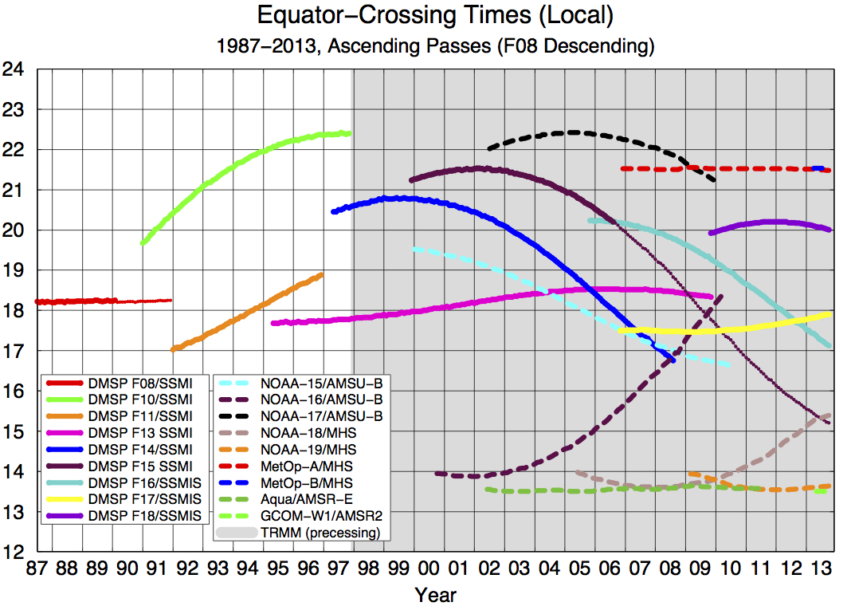
Courtesy of Eric Nelkin
(SSAI; NASA/GSFC)

Slide 5
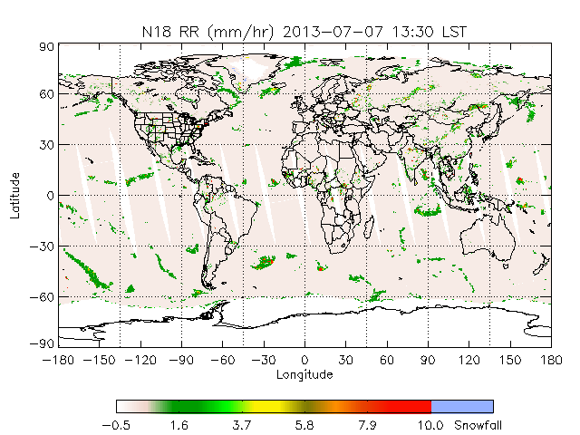
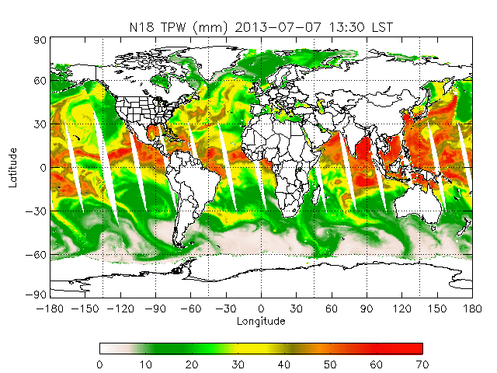
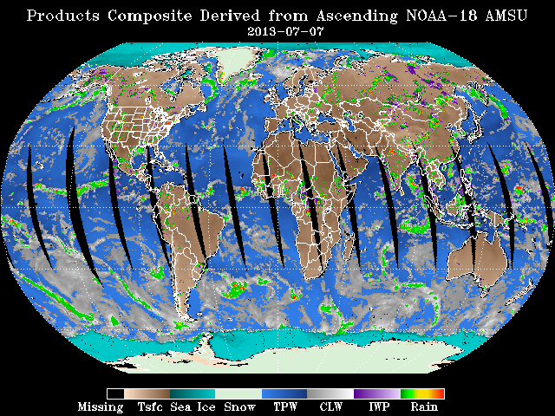
Project Overview
Develop AMSU-A/-B and MHS FCDR’s for “window” & “water vapor” channels
  AMSU-A: 23.8, 31.4, 50.3, 89.0 GHz
  AMSU-B/MHS: 89, 150/157; 183±1, 183±3, 183±7/190 GHz
Develop TCDR’s for hydrological products (12 products)
  Rain rate (and snowfall detection), total precipitable water, cloud liquid water, ice water path, sea ice concentration, snow cover, snow water equivalent, land surface temperature, land surface emissivity 23, 31 and 50 GHz.
Satellites: NOAA-15,16,17,18,19 & MetOp-A
Time period: Years 2000-2010 (depending on launch date)
  We are prepared to extend to current time period…working this out with NCDC right now

Slide 6
Project Status - NOAA AMSU TCDR’s & FCDR’s
Led by H. Meng, R. Ferraro at NESDIS/STAR; I. Moradi and W. Yang (CICS-MD)
Following similar proven calibration, intercalibration practices (MSU/AMSU & SSM/I CDR’s)
  A few more challenges
    AMSU scan geometry
    3 sensor modules
ẞ data sets generated, more versions in progress
  Some remaining issues being worked on
Code, documentation well in progress
  Initial transition activities with NCDC
Satellite | 1998 | 1999 | 2000 | 2001 | 2002 | 2003 | 2004 | 2005 | 2006 | 2007 | 2008 | 2009 | 2010
NOAA-15 | May | X | X | X | X | X | X | X | X | X | X | X | X
NOAA-16 |  |  | Sep | X | X | X | X | X | X | X | X | X | X
NOAA-17 |  |  |  |  | Jun | X | X | X | X | X | X | Dec
NOAA-18 |  |  |  |  |  |  |  | May | X | X | X | X | X
MetOp-A |  |  |  |  |  |  |  |  | Oct | X | X | X | X
NOAA-19 |  |  |  |  |  |  |  |  |  |  |  | Feb | X

Slide 7
Summary of Key Findings
AMSU-A/AMSU-B/MHS can have significant geolocation errors
  Problem can be more severe in a particular satellite or time period
  NOAA-15 AMSU-A2 was the most problematic
AMSU-A/AMSU-B/MHS can have significant cross scan biases
  NOAA-15 AMSU-A and MetOp-A MHS were the most severe
Several AMSU-B sensors show degradation over time
  NOAA-16 AMSU-B channel 5 has the largest degradation
Multiple calibration methods are required to generate CDR’s for AMSU window and water vapor channels (e.g., SNO, vicarious calibration, etc.)
  Bias is often scene temperature and/or polarization dependent
  Warm target contamination caused by orbital drift is one of the most important error sources for inter-satellite calibration

Slide 8
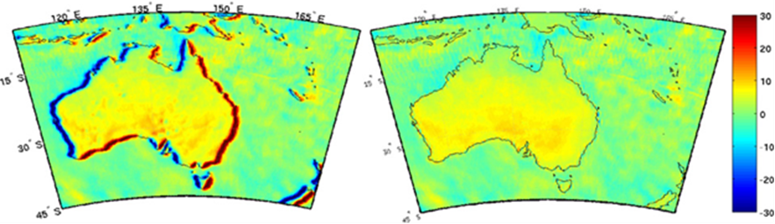
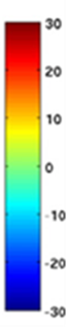
Geolocation
Errors were larger for the earlier NOAA/POES than for current MetOp
  AMSU-A problems greater than AMSU-B or MHS
Empirical model to account for Pitch, Roll, Yaw
  Eliminates Asc-Des differences across coastlines
  LUT applied to L1B data on a daily basis
Moradi, I., H. Meng, R.R. Ferraro, S. Bilanow, 2013: Correcting geolocation errors for microwave instruments aboard NOAA satellites, IEEE Trans. Geosci. Rem. Sens., 51, 3625-3637.

Slide 9
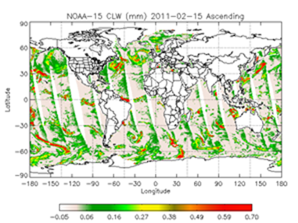
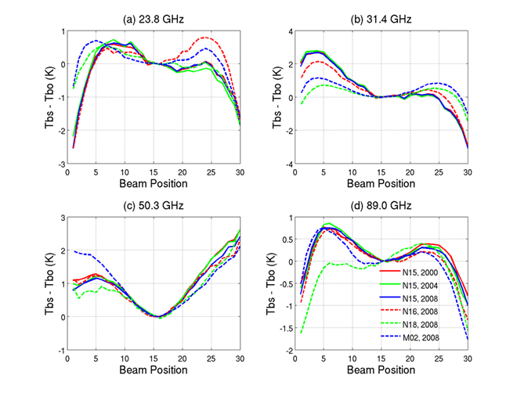
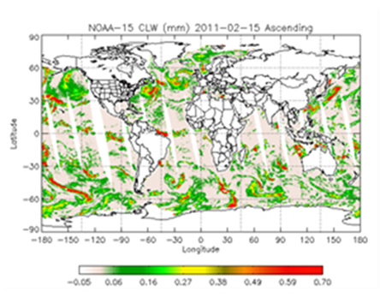
AMSU-A Scan Bias Corrections
AMSU-A suffers from across scan asymmetry
  Pointing accuracy? RFI? Partial beam blockage? Misalignment of polariz. Angle?
Causes biases in retrieved products, depending upon channels used (see CLW)
Corrections developed as function of satellite
  Fairly stable over time
Yang, W., H. Meng, R.R. Ferraro, I. Moradi, C. Devaraj, 2013: Cross-Scan Asymmetry of AMSU-A Window Channels: Characterization, Correction and Verification, IEEE Trans. Geosci. Rem. Sens., 51(3). DOI: 10.1109/TGRS.2012.2211884.

Slide 10
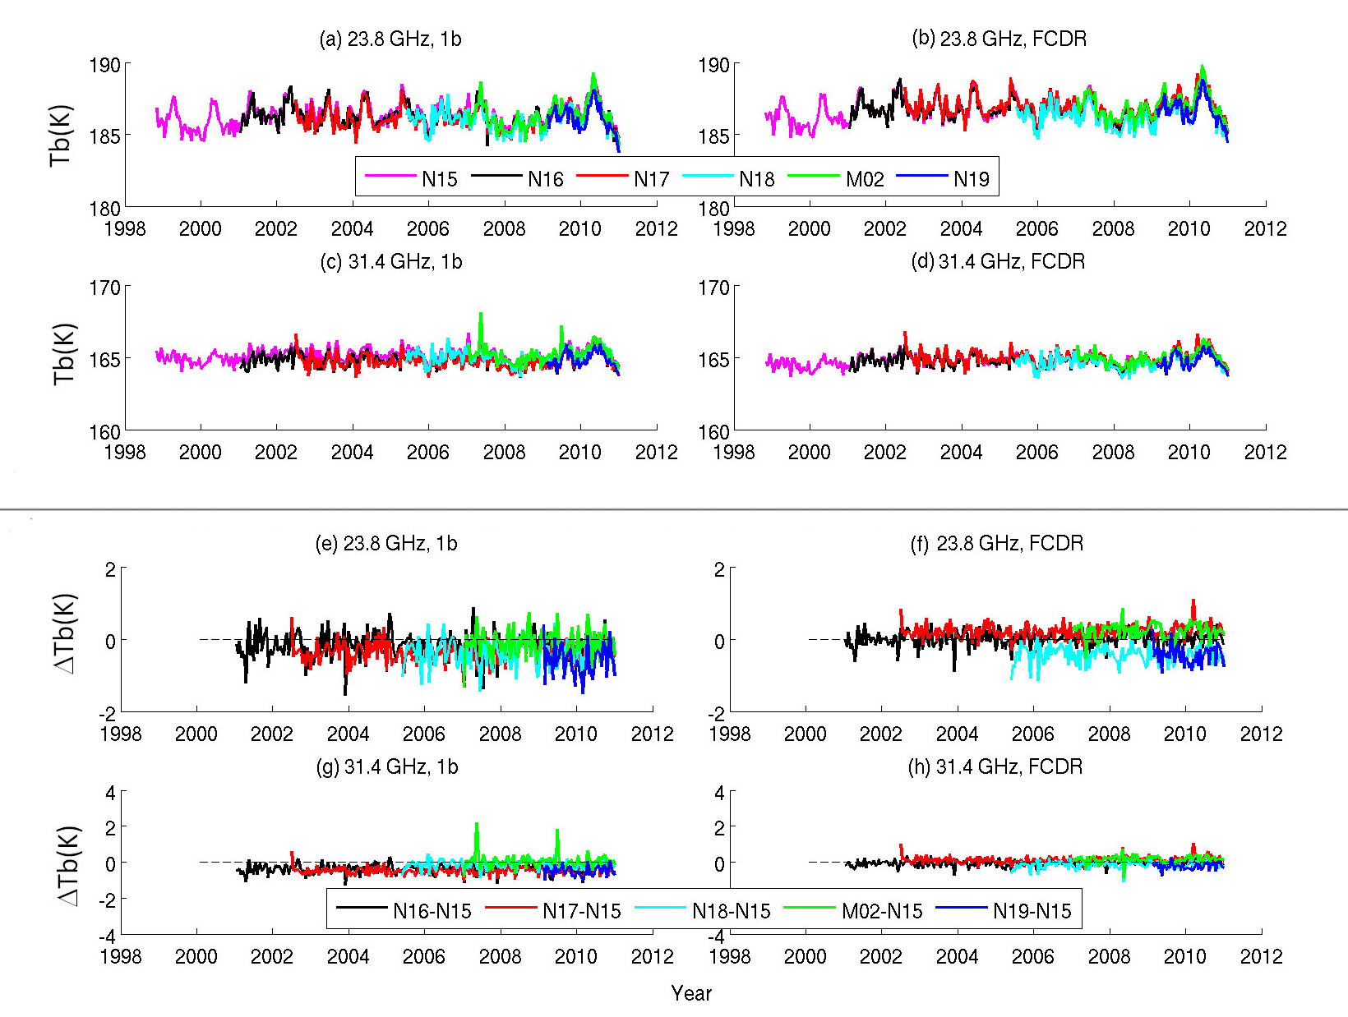
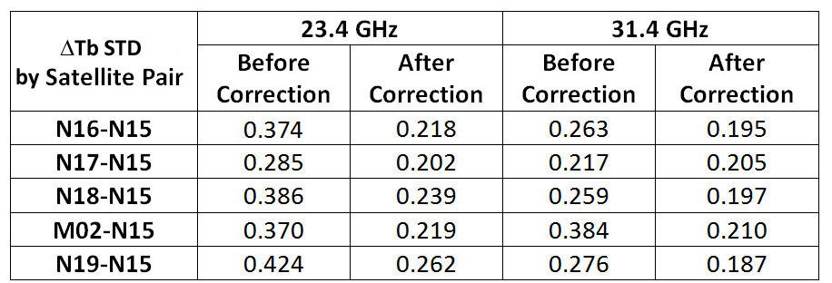
AMSU-A Inter-Calibration - Warm Target Contamination Correction

Slide 11
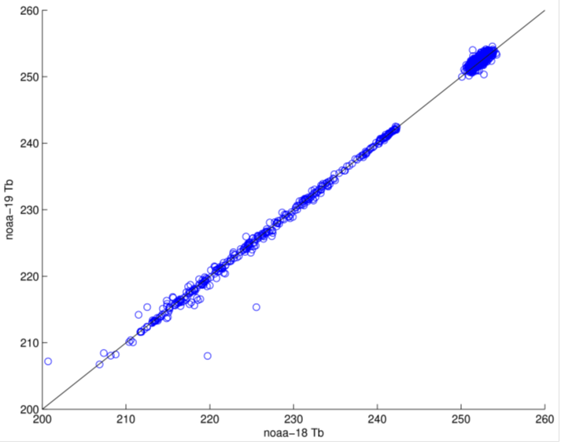
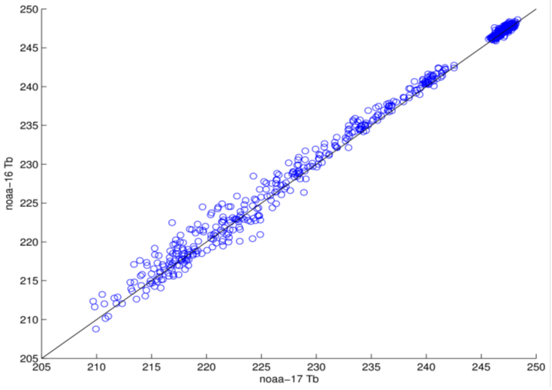
AMSU-B/MHS Intersatellite Corrections
Different approach than AMSU-A since bias characteristics and surface effects different
  183 GHz bands
  89 and 157 GHz
No scan bias corrections employed currently
Empirical corrections based on zonal mean values over warm (tropics) and cold (poles)
  Edit for precip.
  Land/ocean together (for now)
  Smoothing procedure
Averages of CH3 TB over tropics (warm)
and Antarctica (cold) for N15 & N16 vs. N17.

Slide 12
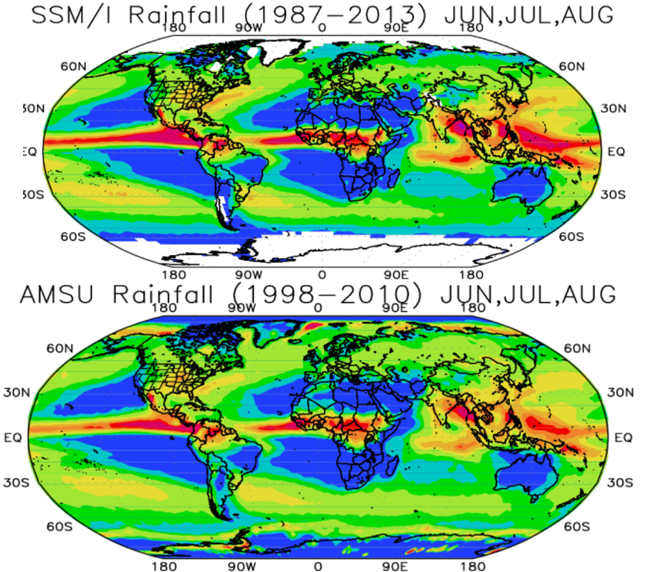
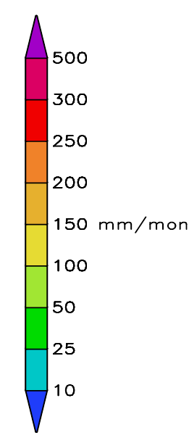
Uses and Applications of the TCDR’s
AMSU CDR’s are geared for use with other similar data sets
  Because time series is only 11 years in length at present, the stand alone TCDR’s do not offer information of long term trends
  The CDR’s are best suited when they are combined with similar CDR’s from other sensors (e.g., SSM/I, AMSR-E, TMI)
Primary “scientific” user would be “blended” product developers and organizations, e.g., for precipitation and other hydrological products:
  WCRP/GEWEX/GPCP
  NASA/TRMM and GPM programs
  NOAA/CMORPH precipitation product

Slide 13
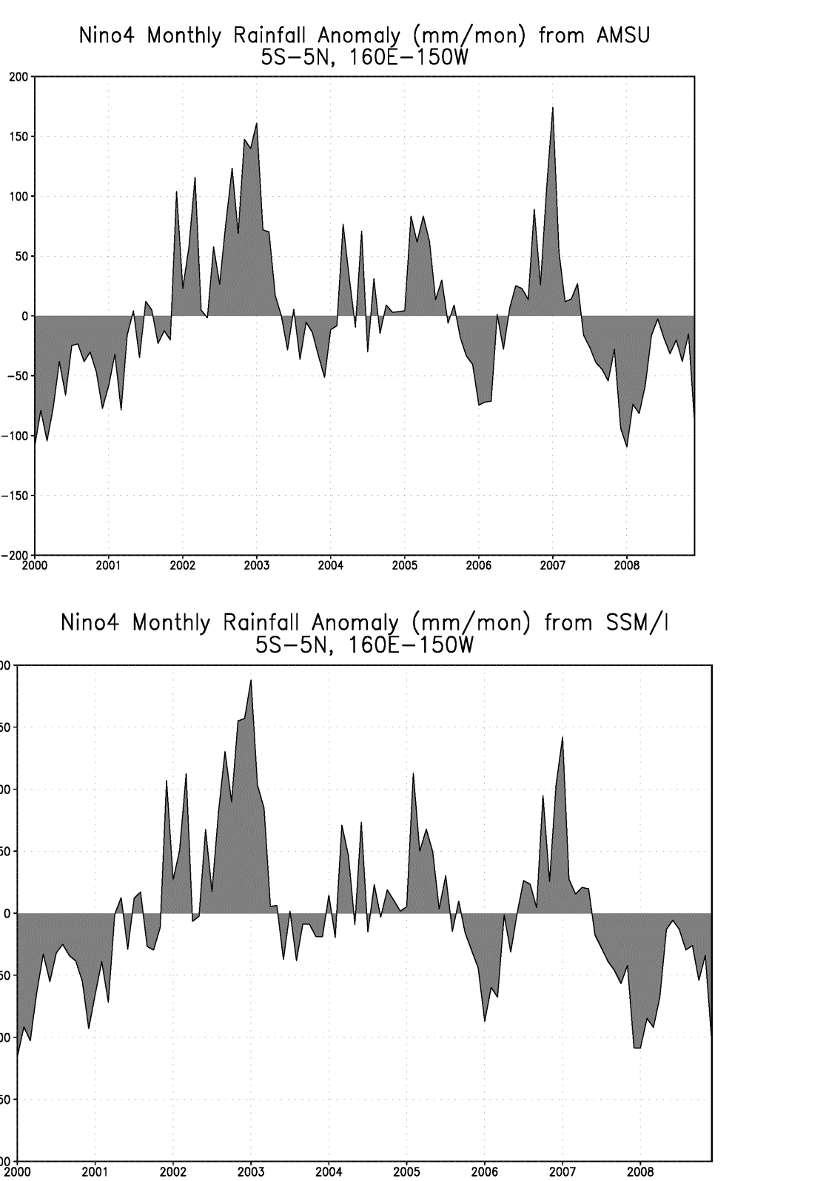
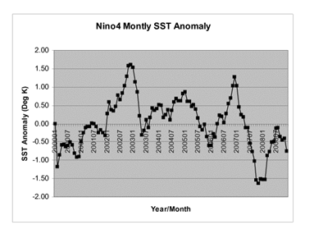
ENSO Comparison
2000-2009

Slide 14
Summary and Future Plans
AMSU-A FCDR’s - V1 data sets being finalized
AMSU-B/MHS – V0 data sets being developed; expect V1 in about 3-4 months
Next planned steps
  Generate AMSU-A TCDR’s
  Generate AMSU-B/MHS TCDR’s
  Work on lingering issues
    Resolve residual biases for specific sensors/channels
    Apply alternate approaches, if needed
  Transition to NCDC
With proper funding
  Extend time series to 2014
  Extend into ATMS
Web sites
  NCDC: http://www.ncdc.noaa.gov/cdr/grants.html
  STAR: http://cics.umd.edu/AMSU-CDR/home.html

