Slide 1
Calibrating raw data of UVN instrumentation –
Lessons learned for a UVN GSICS sub-group on instrument characterisation
Rűdiger Lang, Rose Munro, Antoine Lacan, Christian Retscher, Gabriele Poli, Michael Grzegorski , Andriy Holdak, Rasmus Lindstrot, Ed Trollope

Slide 2
Outline
On-ground and In-flight UVN characterisation
Some examples from the GOME-2 on-ground and in-flight characterisation efforts (and the lessons learned)
Generic recommendation for UVN characterisation from GOME-2 lessons learned: why can’t we go down to 1% or below in the lab?
Summary from the 1st EO workshop on UVN characterisation (ESRIN, June 2013)
Summary and potential work-outline for a GSICS UVN sub-group on instrument characterisation

Slide 3
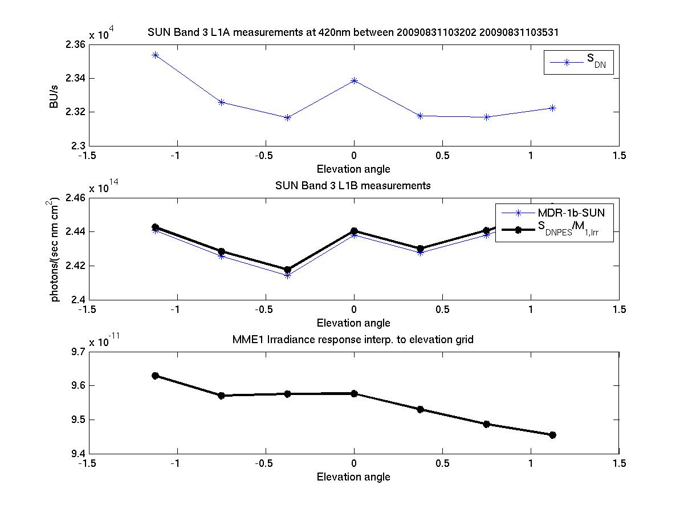
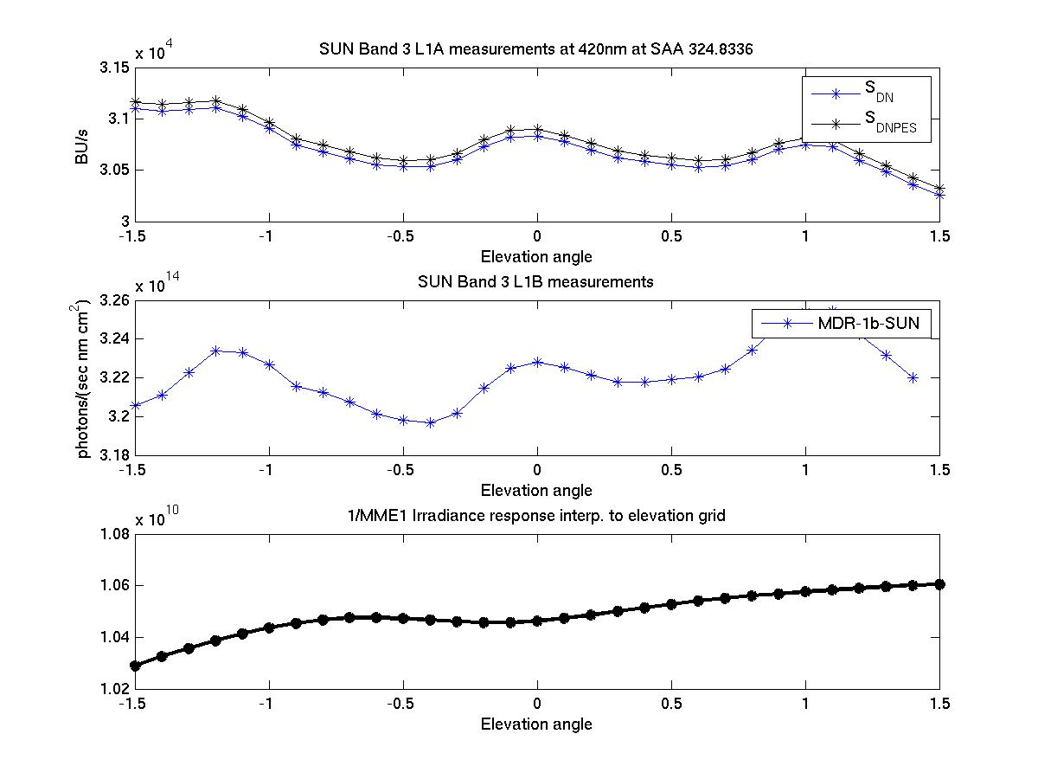
Goniometry: Angular dependence for Solar Measurements (AIRR)
Comparison between current key-data and high res. elevation angle grid
GOME-2 FM3 Metop-A
Band 3 solar signals at 420 nm
GOME-2/Metop-A
raw
calibrated
key-data
Solar Elevation angle
Solar Elevation angle
Key-data – angle resolution
In-flight derived values with increased angular resolution

Slide 4
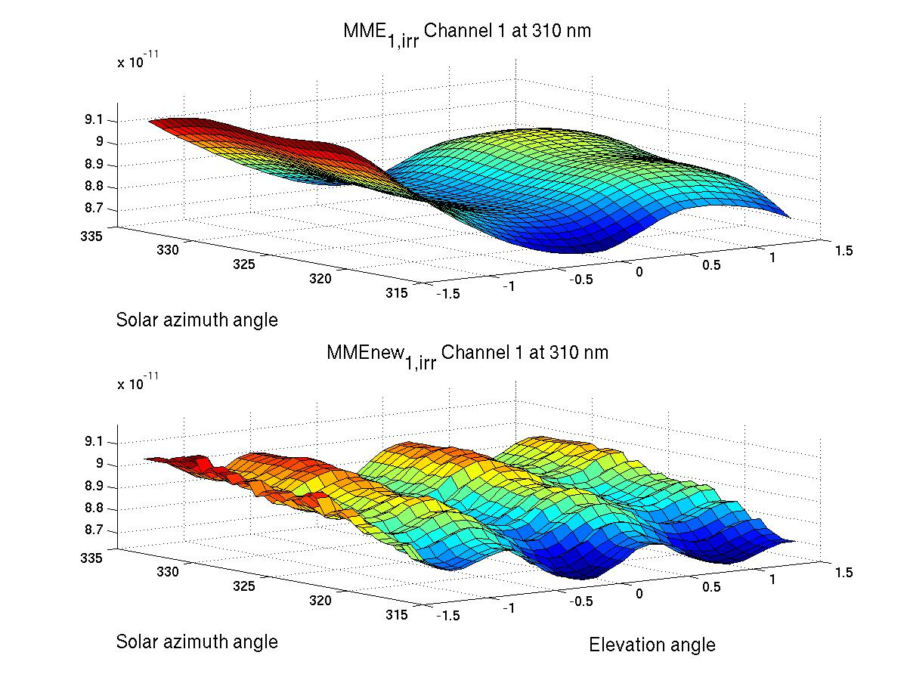
Goniometry: Angular dependence for Solar Measurements (AIRR)
Comparison between current key-data and high res. elevation angle grid
GOME-2 FM3 Metop-A
The Angular dependence of irradiance on the diffuser in elevation and solar azimuth I₀(φ,e) is
difficult to measure on-ground (long-measurement period / in vacuum)
but one can derive it from in-flight data
1 year of in-flight data needed
FM3 on-ground
key-data
In-flight data
Of relevance also for other current and future missions!

Slide 5
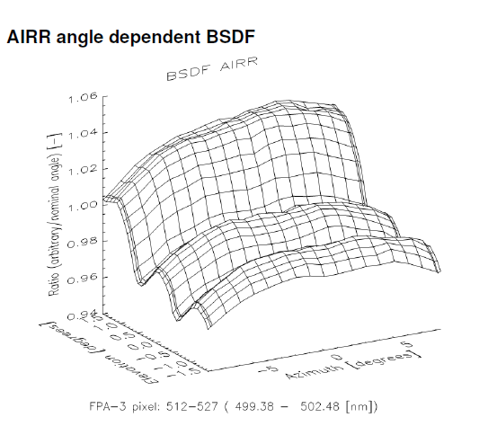
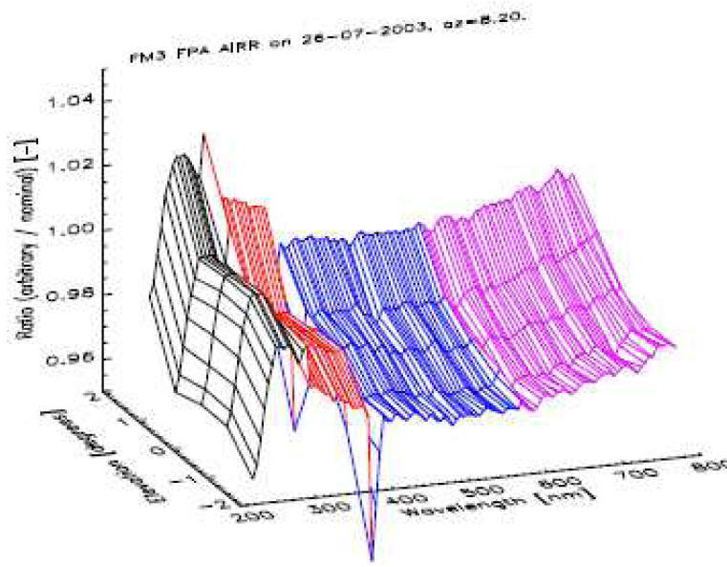
GOME-2 FM3 Metop-A
Goniometry: Improved AIRR measurements for FM-2
TNO FM2 delta calibration campaign (Kenter et al.)
GOME-2 FM2 Metop-B
SAA: 0.5 resolution (317 to 333)
Elevation: 0.1 resolution (-1.5 to 1.5)
Similar to L1-processor angle fine-grid as defined in initialisation file!
FM3 Metop A
Original angular resolution
FM2 Metop B
Higher angular resolution

Slide 6
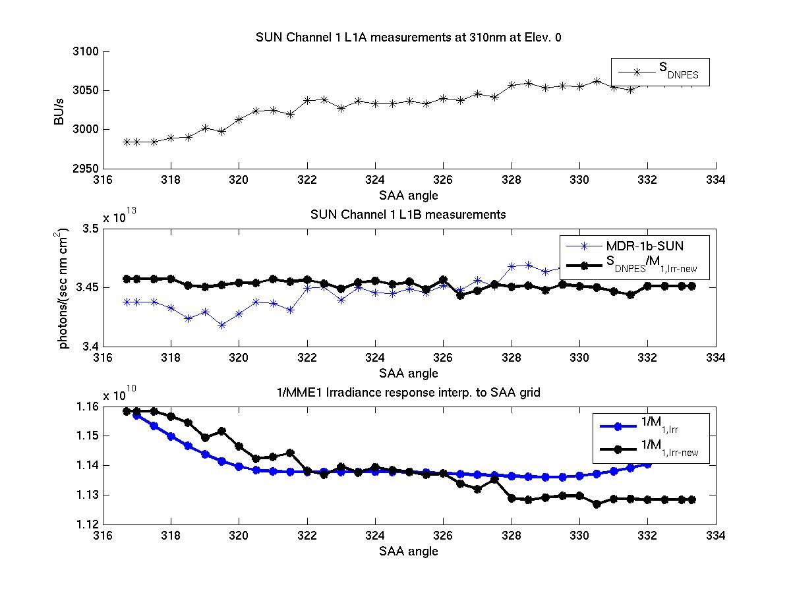
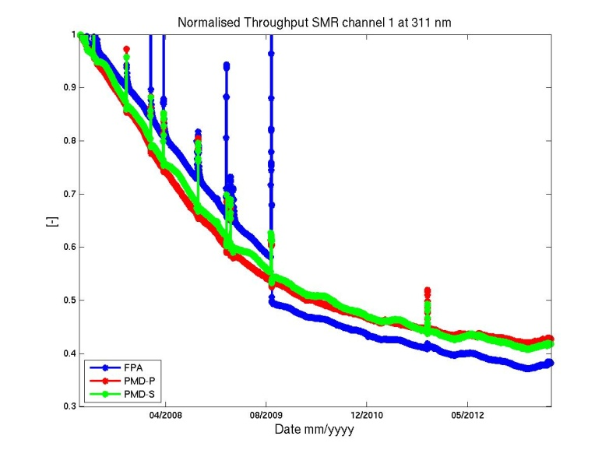
Goniometry: Angular dependence for Solar Measurements (AIRR)
Comparison between current key-data and in-orbit derived data
Angular domain – azimuth angle at 311 nm
GOME-2 FM3 Metop-A
FM3 on-ground key-data
FM3 in-flight data
In-flight data
The Angular dependence of irradiance on the diffuser in elevation and solar azimuth I₀(φ,e) is
difficult to measure on-ground (long-measurement period / in vacuum)...
...and can lead to artefacts in the long-term time-series of reflectances!

Slide 7
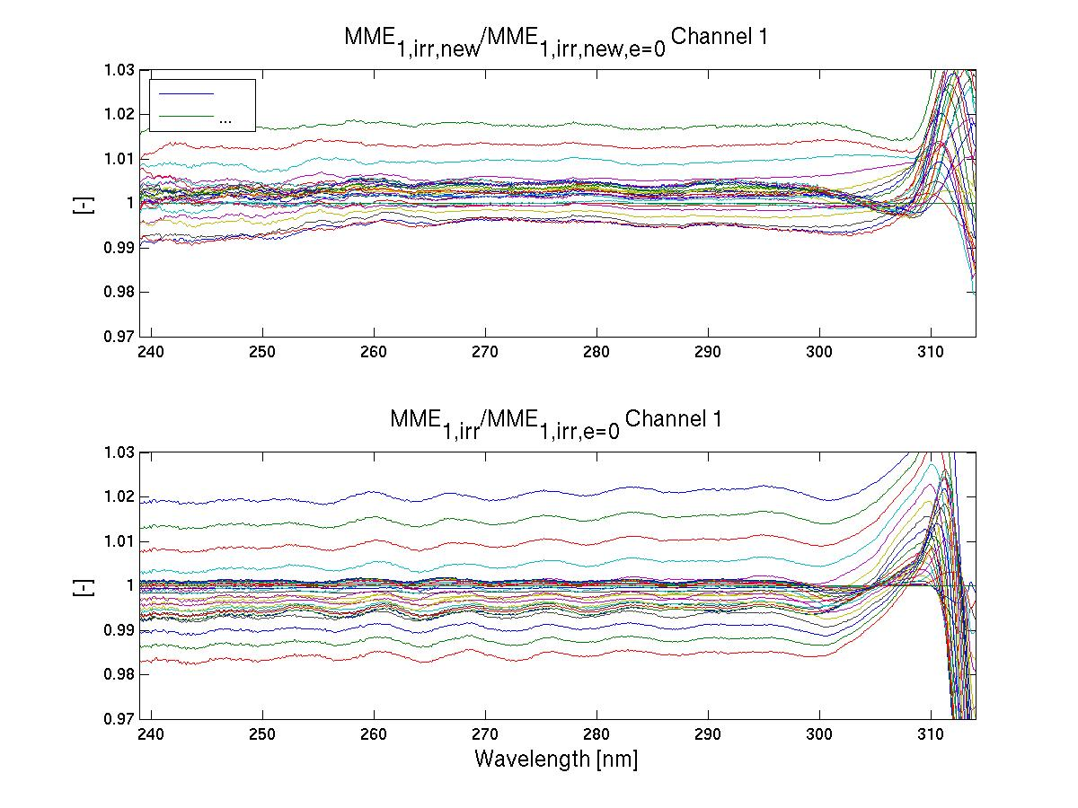
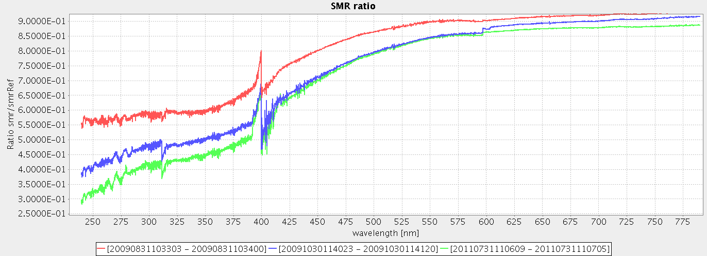
Goniometry: Angular dependence for Solar Measurements (AIRR)
Comparison between current key-data and in-orbit derived data
Spectral domain – Channel 1
GOME-2 FM3 Metop-A
FM3 in-flight data
FM3 on-ground key-data
The Angular dependence of irradiance on the diffuser in elevation and solar azimuth I₀(φ,e) is
difficult to measure on-ground (long-measurement period / in vacuum)...
...and can lead to artefacts in the spectral domain of the solar mean reference measurements!

Slide 8
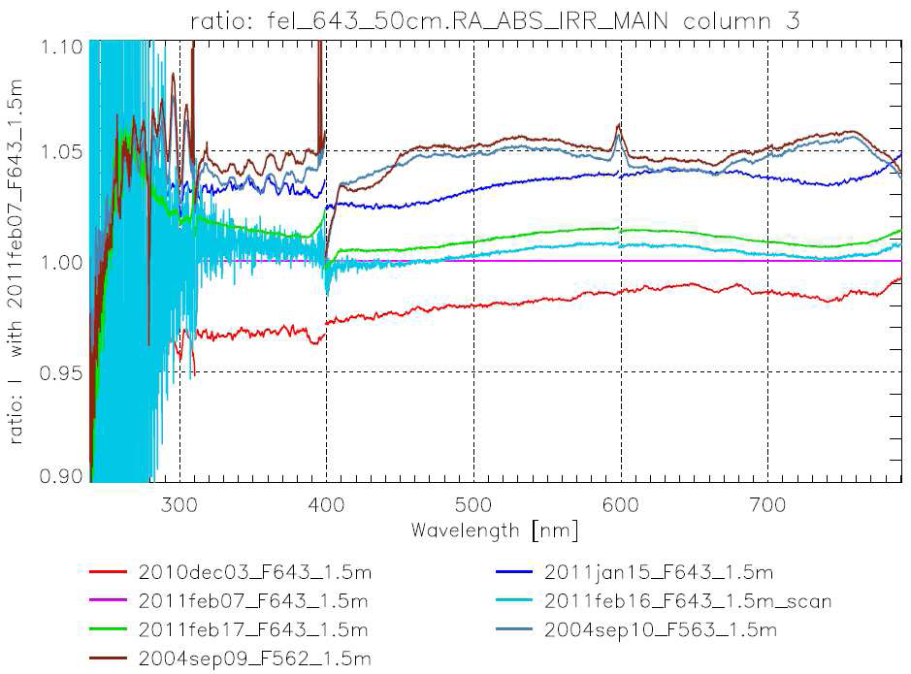
Findings during GOME202-2 Delta Calibration
Radiometric Calibration – On-ground Irradiance response
Irradiance Calibration
Radiometric Calibration Investigations
Same principle setup but measured at different times (i.e. With new realignments)
Large deviations
+/- 4-5% !!!

Slide 9
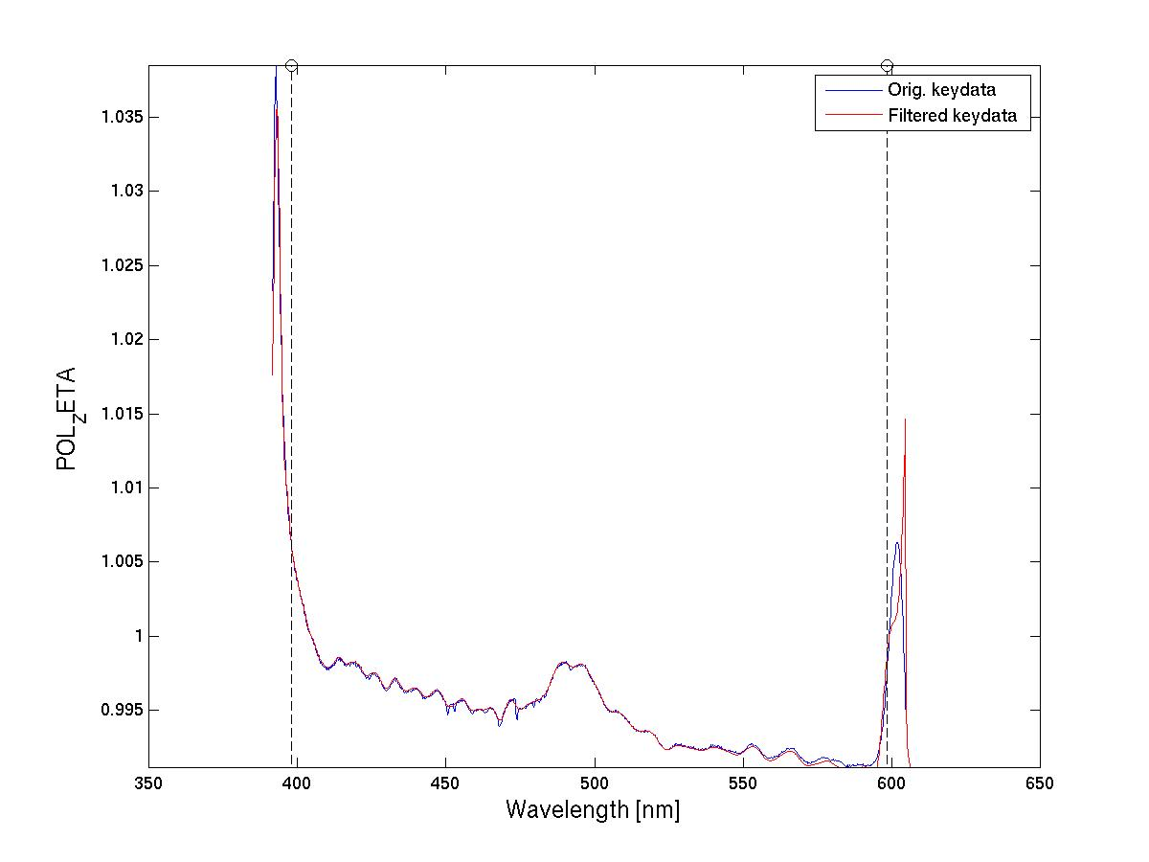
Findings in-orbit after GOME202-2 Delta Calibration
Channel 3: Key-data artifacts
GOME-2 FM2 Metop-B
“Zeta” in channel 3
(pol. Sensitivity for 45 degrees polarised light)
FFT filter removes small scale structure

Slide 10
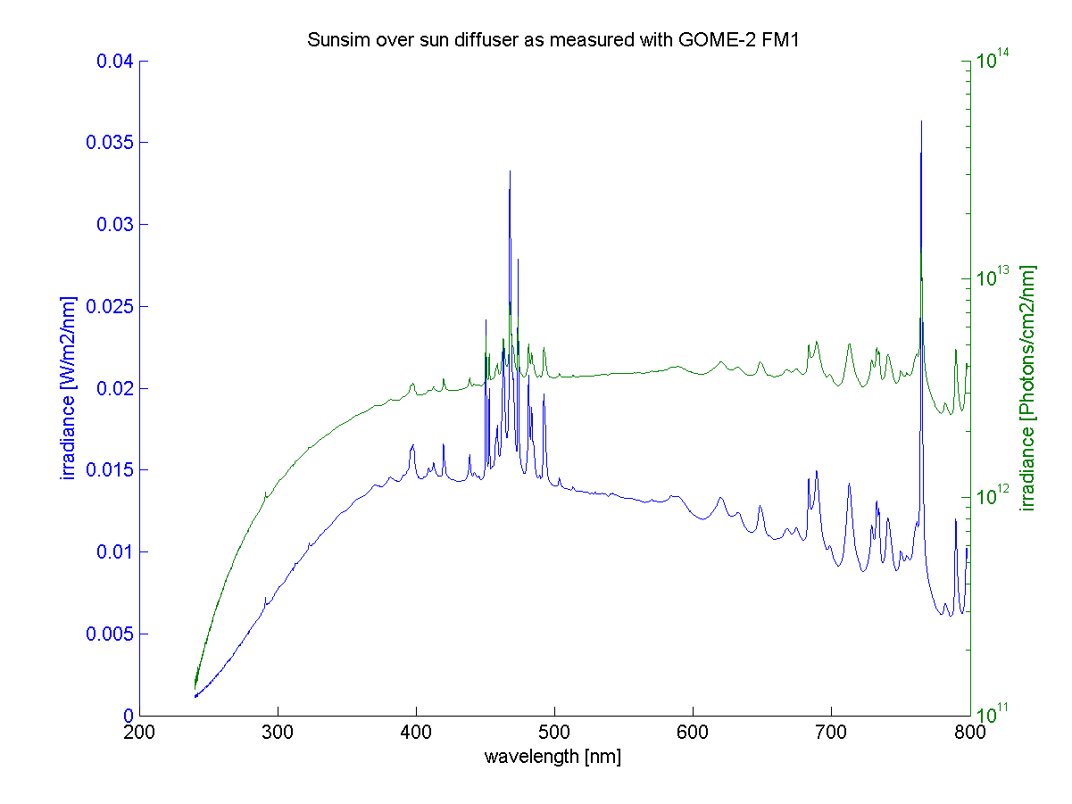
Findings in-orbit after GOME202-2 Delta Calibration
Channel 3: Key-data artifacts – light sources used during calibration
GOME-2 FM2 Metop-B
Origin of small scale structure:
Xe calibration lamp
Residuals are the result of an instability of the lamp during measurement period
(otherwise the spectral structures are divided out)
Courtesy G. Otter, TNO/TPD

Slide 11
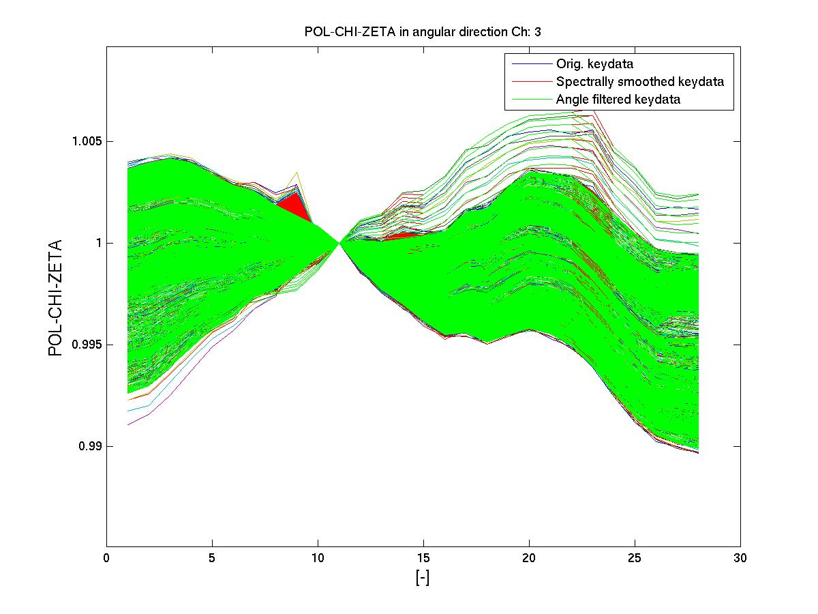
Findings in-orbit after GOME202-2 Delta Calibration
Channel 3: Key-data artifacts – viewing angle direction
GOME-2 FM2 Metop-B
Angular dependence of “Zeta” in channel 3 (Chi for Zeta)
(pol. Sensitivity for 45 degrees polarised light)
Key-data has been corrected in recent updates for FM2 and FM3
(May/June 2013)!

Slide 12
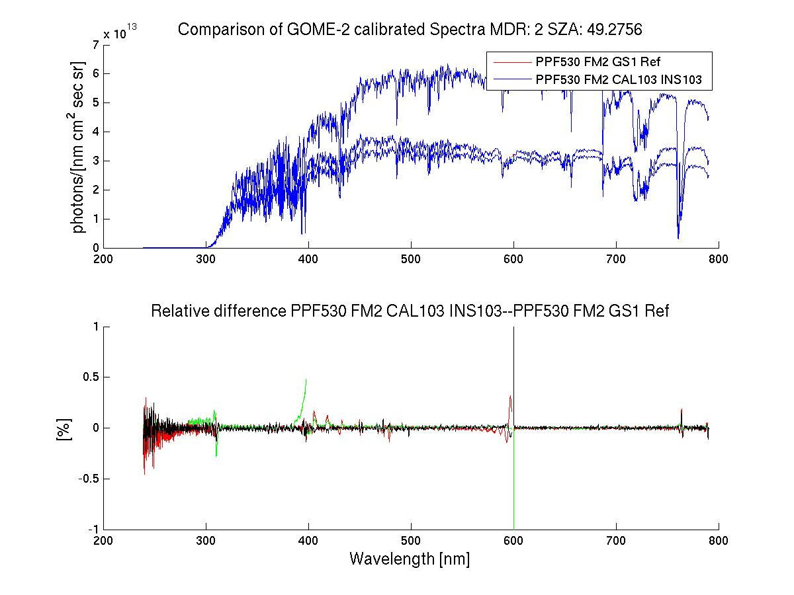
Findings in-orbit after GOME202-2 Delta Calibration
Channel 3: Key-data artifacts – impact on radiances
GOME-2 FM2 Metop-B
Residuals are small but spectrally persistent and varying in viewing angle
Key-data has been corrected in recent updates for FM2 and FM3
(May/June 2013)!

Slide 13
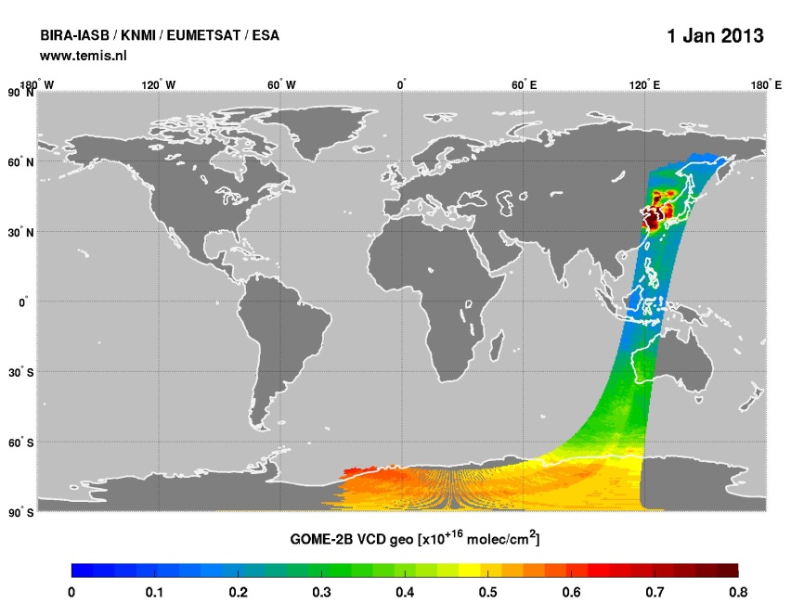

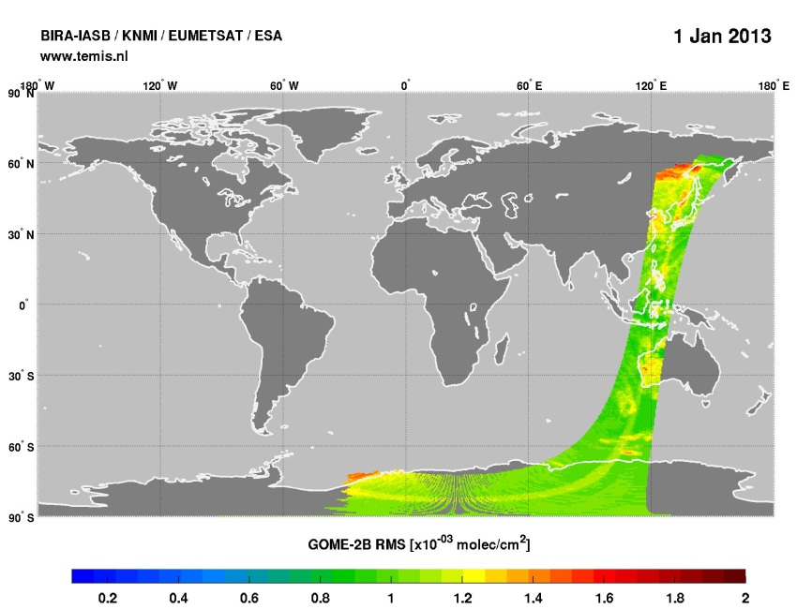
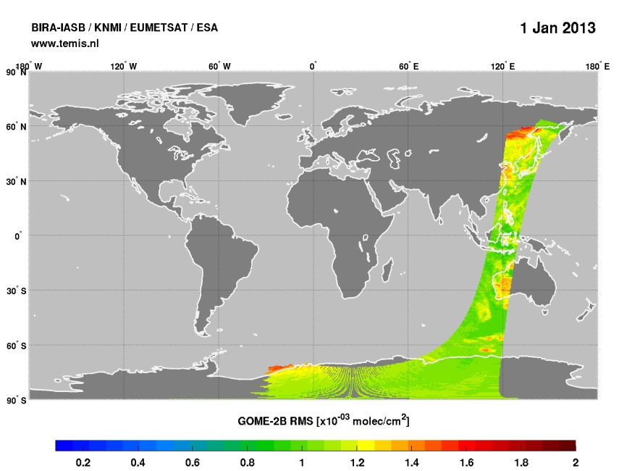
Findings in-orbit after GOME202-2 Delta Calibration
Channel 3: Key-data artifacts – impact on retrievals
GOME-2 FM2 Metop-B
Old key-data
New key-data
Initial retrieval differences observed (preliminary)
TNO2
TNO2
NO2 retrieval:
425 to 497 nm
Courtesy:
I. deSmet, BIRA
RMS
RMS

Slide 14
Metop-A/B GOME-2 Radiometric accuracy and calibration
Earthshine measurement co-location FM2 to FM3 / Co-location criteria
GOME-2 FM3 Metop-A
GOME-2 FM2 Metop-B
Metop-A (M02): FM3
Metop-B (M01): FM2
Co-location criteria:
Area overlap > 80%
Geo. AMF diff < 2%
Relative O₂ A-Band residual (ROR) smaller than empirical threshold
Time difference:
49 min (half an orbit)

Slide 15
Metop-A/B GOME-2 Radiometric accuracy and calibration
Earthshine co-located Metop-A/B measurements – co-locations
GOME-2 FM3 Metop-A
GOME-2 FM2 Metop-B
26th December 2012
10th January 2013

Slide 16
Metop-B / FM2 Radiometric accuracy and calibration
Earthshine measurement co-location to Metop-A / FM3 / Radiances
GOME-2 FM3 Metop-A
GOME-2 FM2 Metop-B
Radiance residuals are dominated by FM3 degradation signature

Slide 17
Metop-A/B GOME-2 Radiometric accuracy and calibration
Earthshine co-located Metop-A/B residuals
Background predominantly from Metop-A degradation
GOME-2 FM3 Metop-A
GOME-2 FM2 Metop-B
Example for an average over multiple FM2/FM3 residuals in reflectivity.
Prelim. Approach:
A linear background is subtracted per channel to account for the difference in reflectivity-degradation and for broad-band differences in the different observed atmospheric paths per instrument.
Looking for the small scale structures per channel

Slide 18
Metop-A/B GOME-2 Radiometric accuracy and calibration
Earthshine co-located Metop-A/B reflectances and residuals
GOME-2 FM3 Metop-A
GOME-2 FM2 Metop-B
Residual in reflectivity
+ Lin. background subtracted per channel
+ 20 pix. moving average smoothing
+ Relative Oxygen-A band Residual (ROR) selection criterium

Slide 19
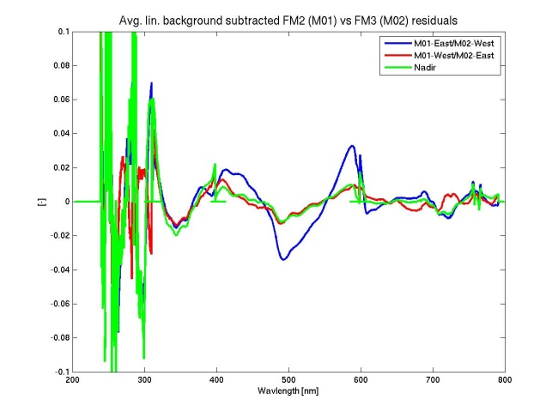
Metop-A/B GOME-2 Radiometric accuracy and calibration
Earthshine co-located Metop-A/B residuals / average background subtracted
GOME-2 FM3 Metop-A
GOME-2 FM2 Metop-B
FM2-East/FM3-West
FM2-West/FM3-East
Nadir
Separation between East/West/Nadir at +- 20 degree viewing-angle

Slide 20
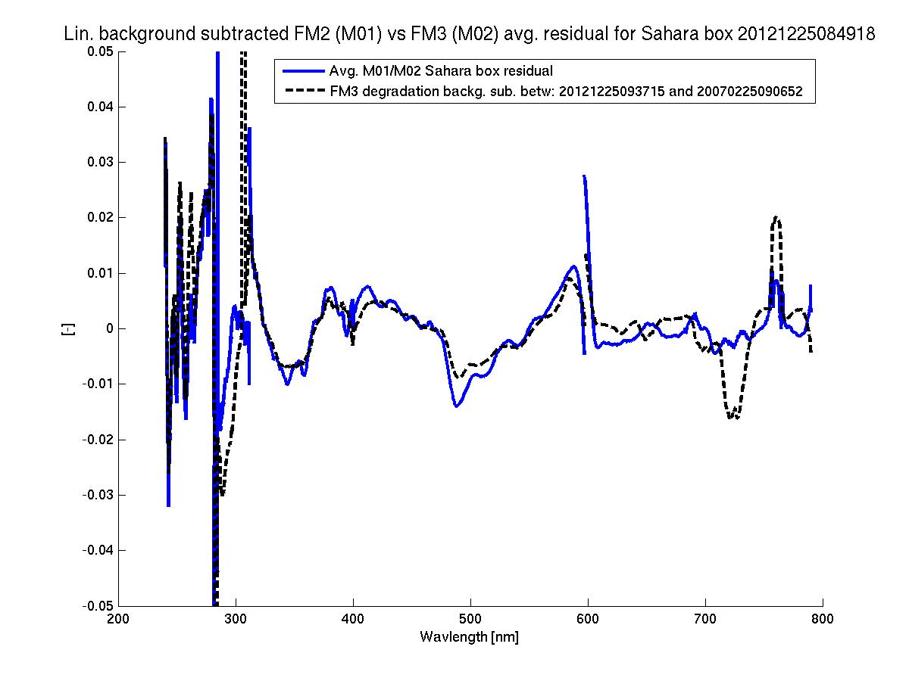
Metop-A/B GOME-2 Radiometric accuracy and calibration
Earthshine co-located Metop-A/B residuals / Background-subtracted
plus degradation residual from Metop-A
GOME-2 FM3 Metop-A
GOME-2 FM2 Metop-B
Background subtracted co-located Metop-A/B residual
Background subtracted temporal degradation residual Metop-A

Slide 21
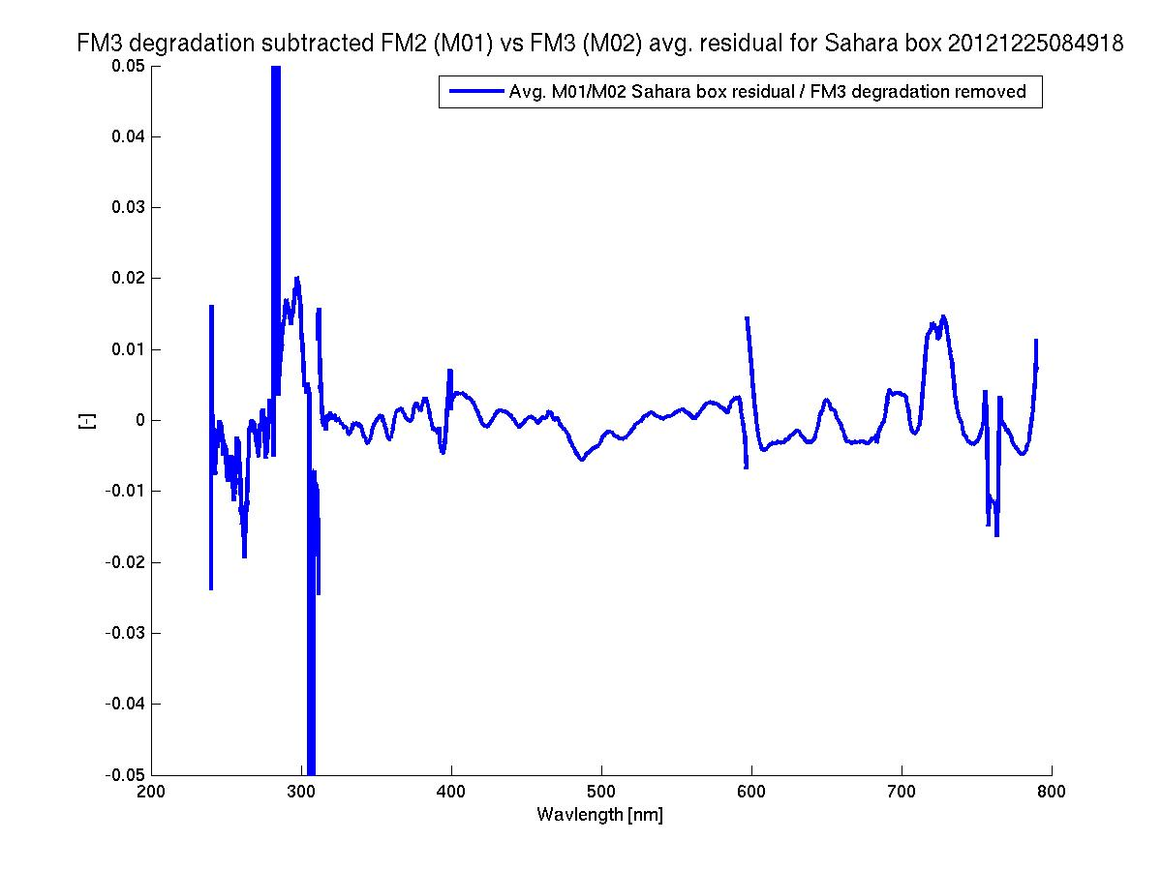
Metop-A/B GOME-2 Radiometric accuracy and calibration
Earthshine co-located Metop-A/B residuals / Background-subtracted
plus degradation residual from Metop-A subtracted
GOME-2 FM3 Metop-A
GOME-2 FM2 Metop-B
Background subtracted co-located Metop-A/B residual
without the temporal degradation contribution of Metop-A

Slide 22
Recommendations for On-Ground Characterization
Time Time Time
Considerations for On-Ground Characterisation Campaign (I)
Time … Time … Time
  Characterisation campaigns should be long enough to allow for measurements to be repeated for consistency checking
  Assess impact of lamp position & alignment errors
  Allow sufficient time for stabilisation

Slide 23
Recommendations for On-Ground Characterization
Environment
Considerations for On-Ground Characterisation Campaign (I)
Environment
  Essential that all characterisation measurements are carried out in thermal vacuum and that the thermal environment including gradients is representative of the in-orbit situation
  Scan-angle dependencies should also be characterized in vacuum

Slide 24
Recommendations for On-Ground Characterization
Procedures I
Considerations for Measurements
Procedures I
  Alignment procedures should be documented and reproducible with photo/video documentation
  Ensure reproducibility of distance measurements
  Close attention should be paid to frames of reference, coordinate systems & angles (e.g. GOME-2 flip of elevation angles diagnosed in orbit)
  All sources should be well commissioned prior to the start of measurement
  Radiometric calibration must be connected to standards e.g. NIST
  All measurements and procedures must be traceable & under configuration control including software versions and documentation of which precise measurement is used in the generation of key data
  Data processing should be automated as far as possible

Slide 25
Recommendations for On-Ground Characterization
Procedures II
Considerations for Measurements
Procedures II
  Check temperature sensitivity in case thermal stability is not as expected
  Ensure sufficient angular discretisation for characterisation of diffuser BSDF
  For slit function characterisation need requirements from the data analysis activity (signal:noise, spectral coverage and sampling, source commissioning requirements etc) before planning the measurements
  Ensure that all required supplementary calibration measurements (e.g. dark signal etc) are taken close to the time of each measurement (GOME-2 monitoring block)
  Ensure sufficient sampling points for straylight characterisation
  Ensure that the slit is overfilled

Slide 26
Recommendations for In-Orbit Calibration
Summary
Considerations for In-Orbit Calibration & Performance Verification
  Consider taking necessary in-orbit calibration measurements adjacent to Sun measurements if possible
  Take dark measurements under the same conditions as measurements
  Much longer measurement time will be needed for e.g. WLS over diffuser as opposed to WLS direct (if used for monitoring diffuser) so it is necessary to ensure this is compatible with lamp lifetime and recommended use
  Take many monitoring and calibration measurements early in instrument life
  Be wary of coatings etc that will require time to stabilise and outgas
  Be aware of any temperature dependencies of output or aging issues in on-baord targets (e.g. LED/WLS).
  …

Slide 27
Recommendations for In-Orbit Calibration
Summary cnt.
  Instrument should typically be stored in a container over pressured using nitrogen
  Regular reactivation is required
  Extreme attention to cleanliness required
  Assess what monitoring measurements can be made during regular re-activation in ambient.
  …

Slide 28
Notes from the 1st EO lessons learned meeting ESRIN
June 2013 – 1/3
From level-2 perspective (Diego Loyola, DLR):
Improvements in fit qualities for direct fitting approaches (as with respect to standard DOAS) with however higher sensitivity to level-1 calibration issues call for inter-calibrated UVN level-1 products
SCIAMACHY/GOME-1 experience (Thijs Krijger, SRON)
Better documentation and availability of all on-ground measurements (also those not used in the “official” data-packs, for recovery or development of in-orbit error or degradation mitigating methods (“dirty mirror” - model).
On-board and on-ground reference sources (N. Fox, NPL)
Demands rigorous instrument model during calibration with all potential error sources known and documented. He suggests to use tuneable lasers for Stray-light.
He claims it is possible to design an on-board reference source to accuracies significantly below 1%, which is very insensitive to the degradation of the reference detector and which in turn would be linked to a different source which does the spectral changes. This approach would be very insensitive to the degradation of the reference detector (Fox et al, Phil. Trans. R. Soc. A 2011 369, 4028-4063).

Slide 29
Notes from the 1st EO lessons learned meeting ESRIN
June 2013 – 2/3
From MERIS/OLCI diffuser and stray-light (Ludovic Bourg, ACRI-ST, Juergen Fischer FU Berlin):
MERIS sees hardly any diffuser degradation (below 4% full lifetime at 400nm).
However much more detailed stray-light model was needed. Final stray-light level correction term is also proportional to the observed brightness with a quadratic factor in pixel space.
The initially provided on-ground (very complex) ray-tracing model correction levels for the instrument stray-light was not sufficient, although it already accounts for a large proportion of the stray-light contribution.
POLDER-3/Parasol experience (Patrice Henry)
A posteriori developed degradation model available.
After correction for degradation they then apply pre-dominantly vicarious calibration methods (“Muscle and Muse” analysis suite including database containing reference data per target).
Achieved accuracies for vicarious calibration are not better than 1%. The latter can only be achieved by combining different methods and sources.

Slide 30
Notes from the 1st EO lessons learned meeting ESRIN
June 2013 - 3/3
From MERIS/OLCI diffuser and stray-light (L. Bourg, ACRI-ST, J. Fischer FU Berlin):
MERIS sees hardly any diffuser degradation (below 4% full lifetime at 400nm).
However much more detailed stray-light model was needed. Final stray-light level correction term is also proportional to the observed brightness with a quadratic factor in pixel space.
The initially provided on-ground (very complex) ray-tracing model correction levels for the instrument stray-light was not sufficient, although it already accounts for a large proportion of the stray-light contribution.
OMI/Sentinel5p (Quintus Kleipool/Marcel Dobber, KNMI)
Not having a scan-mirror is an advantage and the crucial (OMI) mirror is very well hidden inside the instrument.
On-ground calibration has missing angular dependence measurements in vacuum and not enough for operational range of conditions.
Radiation damage has triggered a large increase of dead pixel, increase of dark current, and RTS changes for OMI even though a lot of additional shielding has been added.
WLS on OMI is difficult to use for non-linearity because it is not stable enough

Slide 31
Summary
Best practices for UVN on-ground and in-flight calibration and characterization
On-ground calibration efforts need to be improved at all levels: time, documentation, availability, and accuracy of data and the related error budgets.
Vicarious calibration can complement these efforts but so far accuracy levels below 1% can not be achieved.
Below 1% radiometric accuracy levels are difficult to achieve if achievable at all through on-ground calibration alone. On-board calibration and vicarious calibration methods need to be added.
Huge amount of effort has been invested to compensate for avoidable deficiencies in on-ground characterisation for past or currently flying UVN instrumentation.
Some proposals are on the table to significantly (fundamentally) improve our capabilities for accurate on-ground characterisation (e.g. Fox et al.)
1st EO lessons learned meeting in ESRIN, June 2013 called for detail recommendation on “best practices” for on-ground calibration in-line and supported by the CEOS activities of best-practices for calibration.
Shall and can we support these activities with UVN GSICS activities?

Slide 32
Any suggestions/ideas/comments?

Slide 33
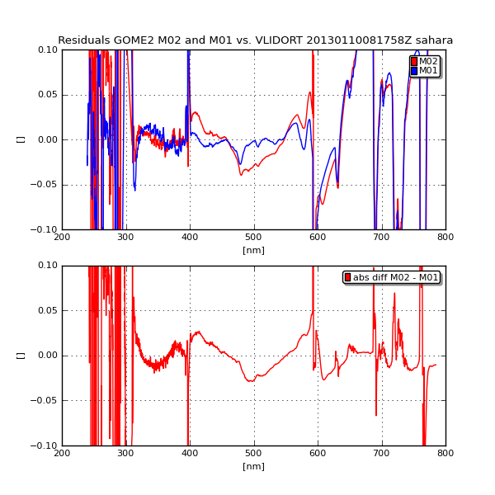
Metop-A/B GOME-2 Radiometric accuracy and calibration
Earthshine co-located Metop-A/B residuals /
Interpretation with forward model – V-LIDORT
GOME-2 FM3 Metop-A
GOME-2 FM2 Metop-B
Left up: Residual Metop-B with V-LIDORT
Residual Metop-A with V-LIDORT
Broad-band structure in M-A channel 3
Small-scale structures in M-B channel 3
Bottom: Residuals between M-A and M-B

