Slide 1
Intercomparison of IASI and CrIS spectra
Bertrand THEODORE and Dorothee COPPENS
Hyperspectral L1 team, EUMETSAT

Slide 2
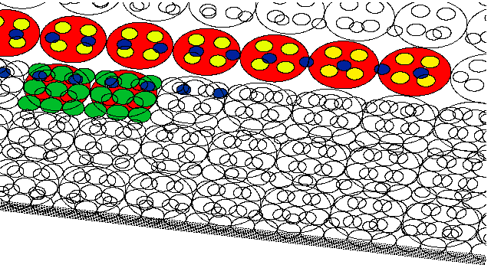
Operational monitoring of IASI products
Comparison with AVHRR
Comparison with HIRS
Inter-comparison IASI-A/IASI-B:
Direct, using grand averages
Double differences
Inter-comparison with CrIS:
Direct, using SNOs
Double differences
IASI
(AMSU-A)
(MHS)
HIRS/4
AVHRR/3

Slide 3
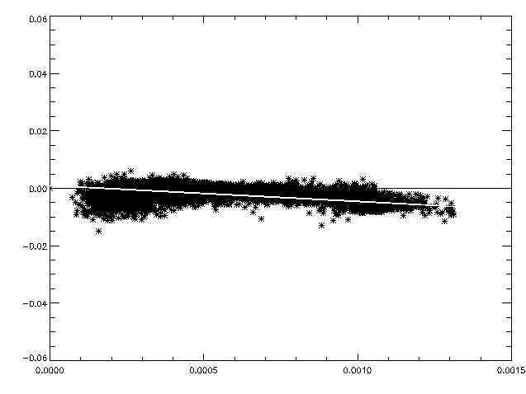
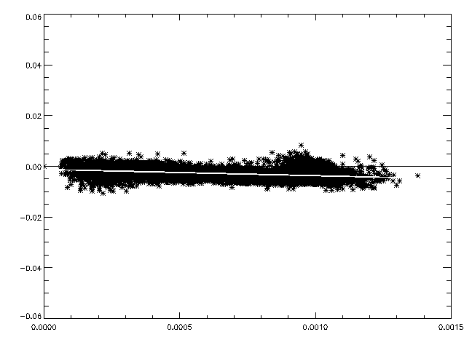
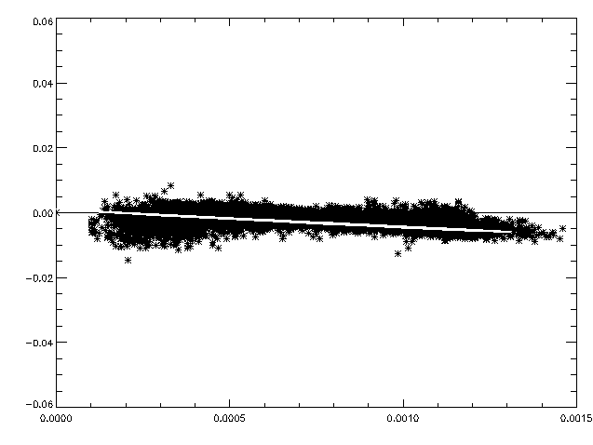
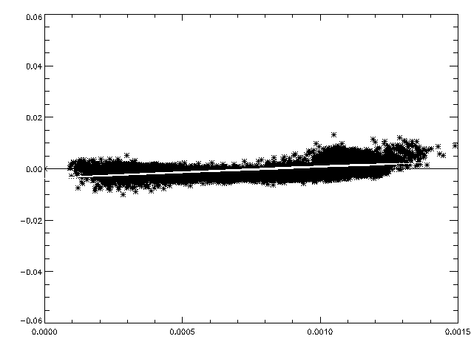
Difference IASI-AVHRR vs. AVHRR
Channel 4
Ch 4 | slope | intercept
M02 | -5.52929 | 0.000977
M01 | -2.50335 | -0.00118
Radiance difference (10-5 W/m2.sr.cm-1)
M02
M01
Channel 5
Ch 5 | Slope | intercept
M02 | -4.89576 | 0.001079
M01 | 4.1248 | -0.003821
Radiance difference (10-5 W/m2.sr.cm-1)
Radiance (W/m2.sr.cm-1)
Radiance (W/m2.sr.cm-1)

Slide 4
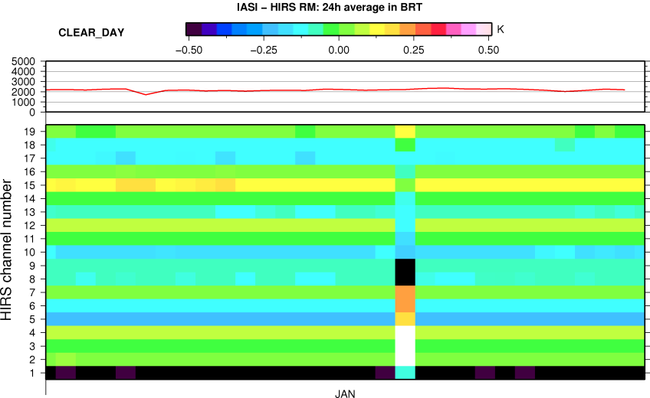
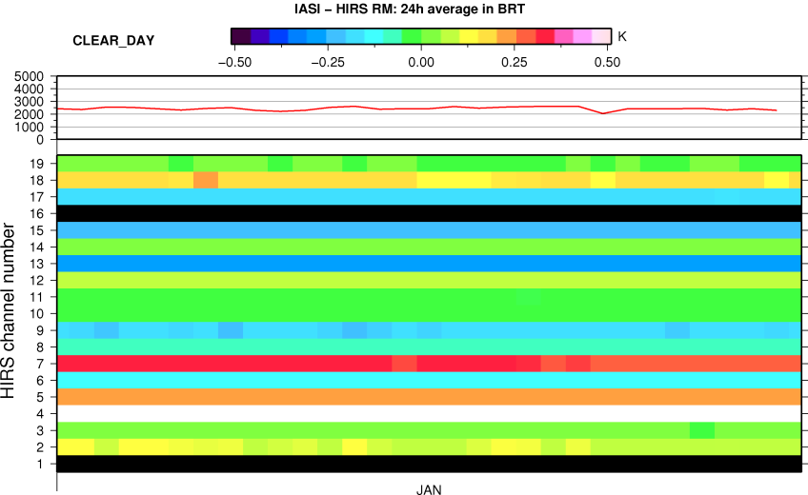
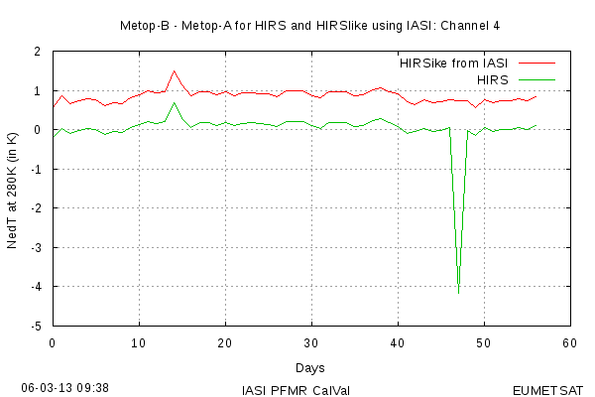
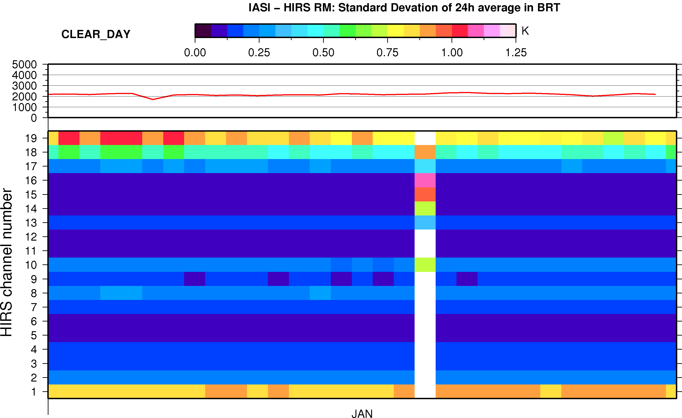
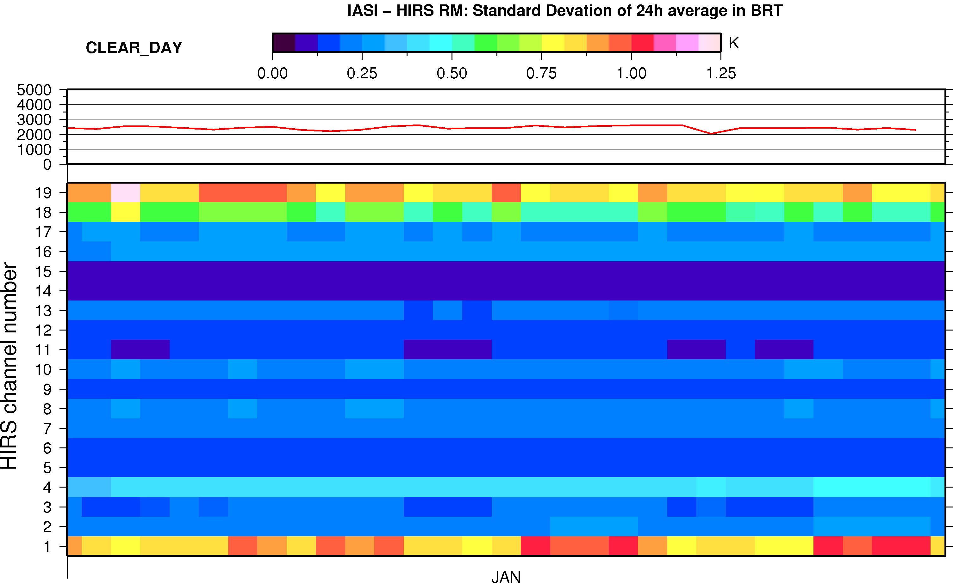
IASI vs. HIRS
<BT>
M02
M01
σ(BT)

Slide 5
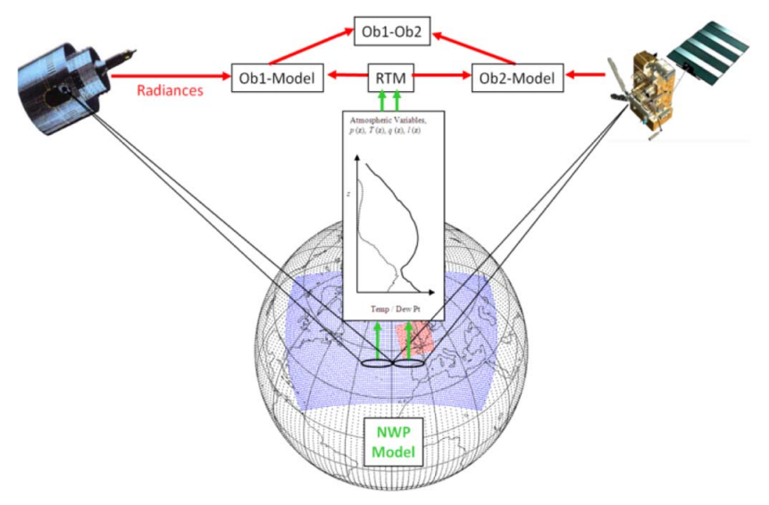
Double-differences IASI-A/IASI-B
Developped for the commisioning of Metop-B and now part of the monthly monitoring
RTM: RTTOV 9.3
T, q and p from ECMWF forecasts
standard profiles of trace gases
Selection of scenes:
night time (sunza >=120 deg.)
No polar regions (abs(lat) <= 60 deg)
Over sea
clear sky
(Plot by Chander et al, 2013)

Slide 6
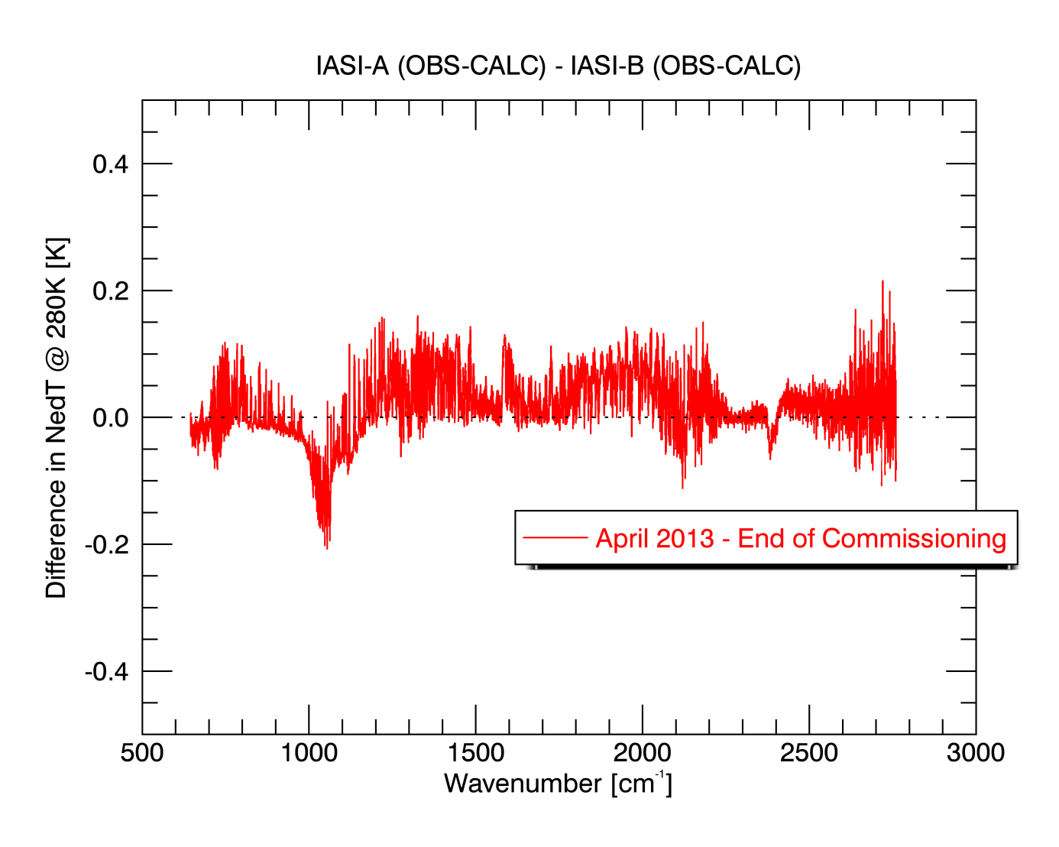
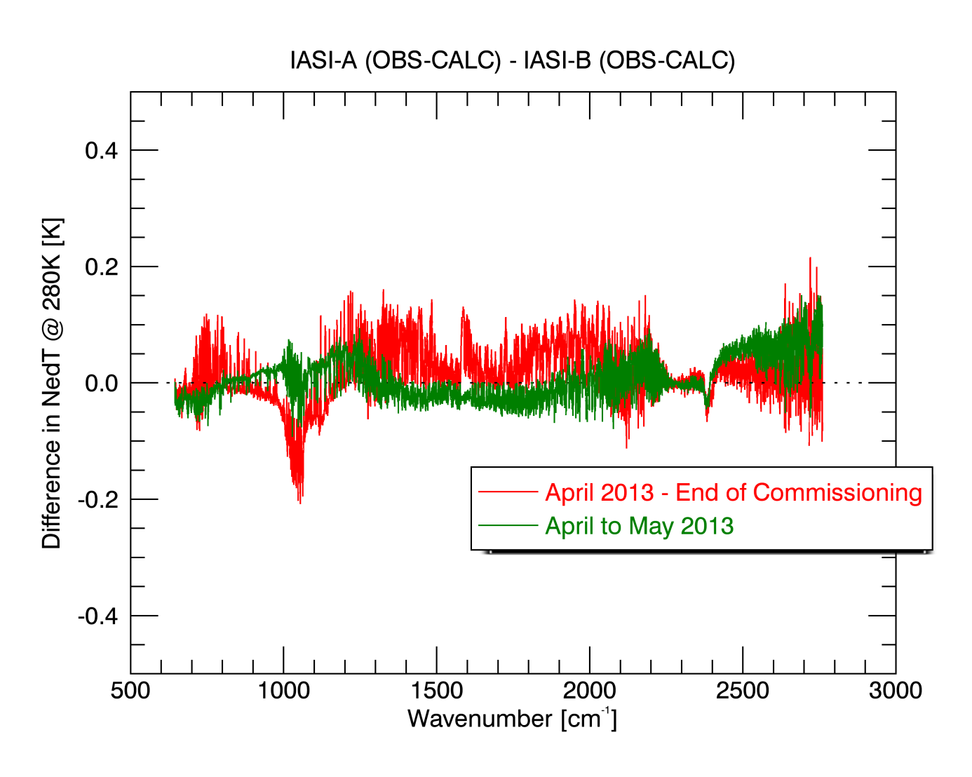
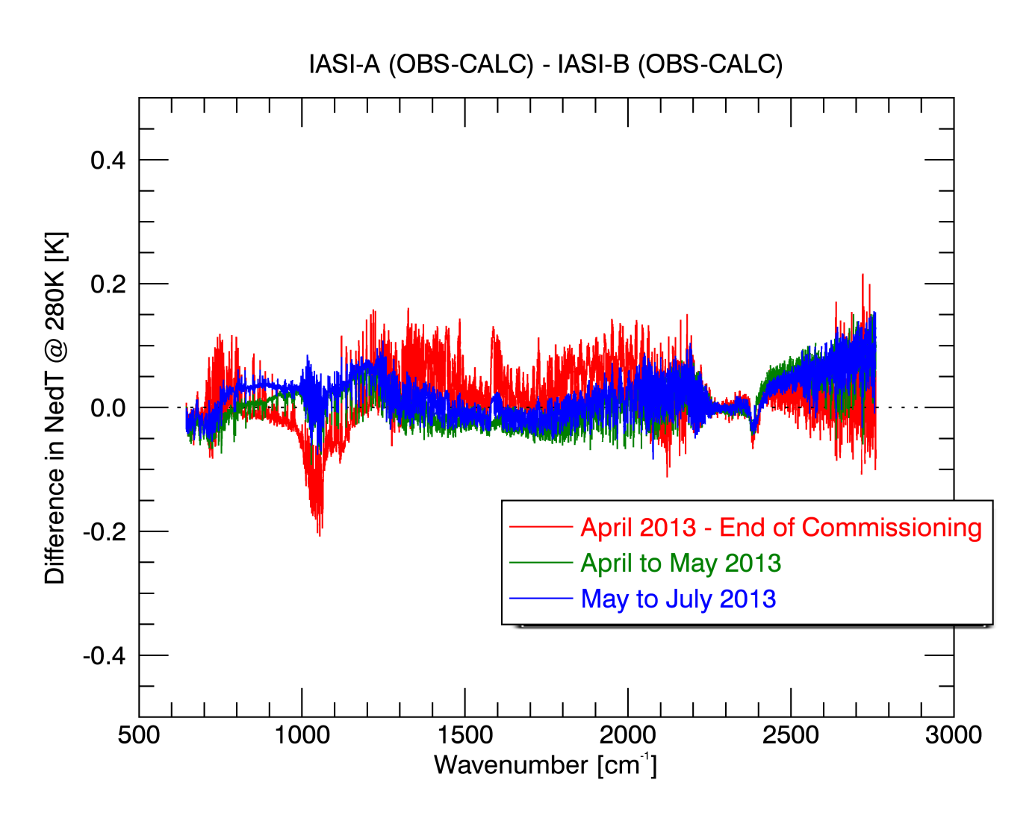
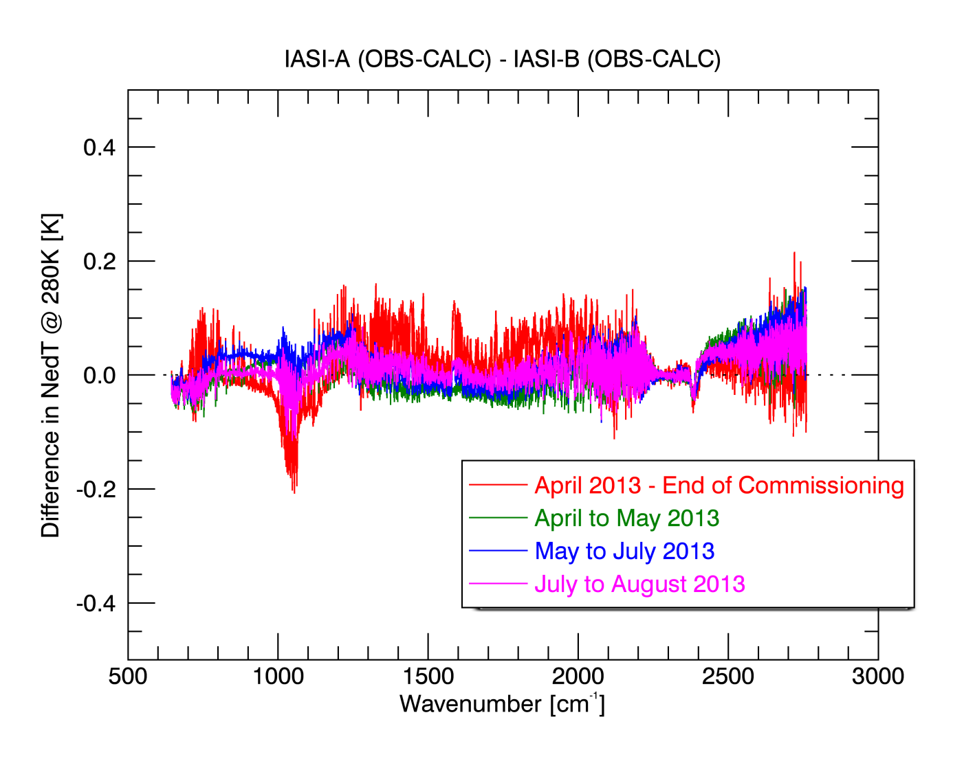
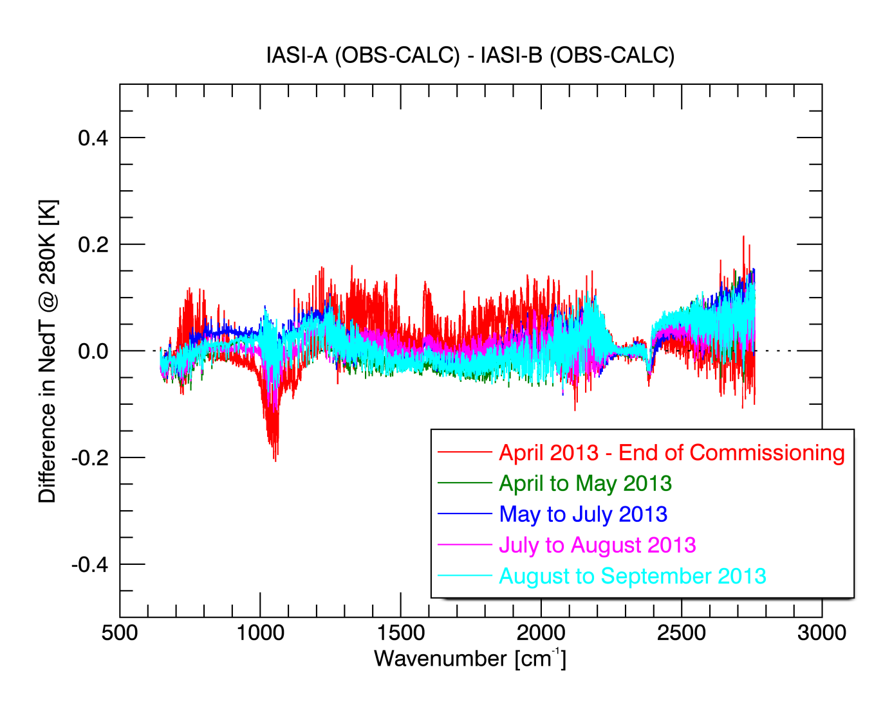
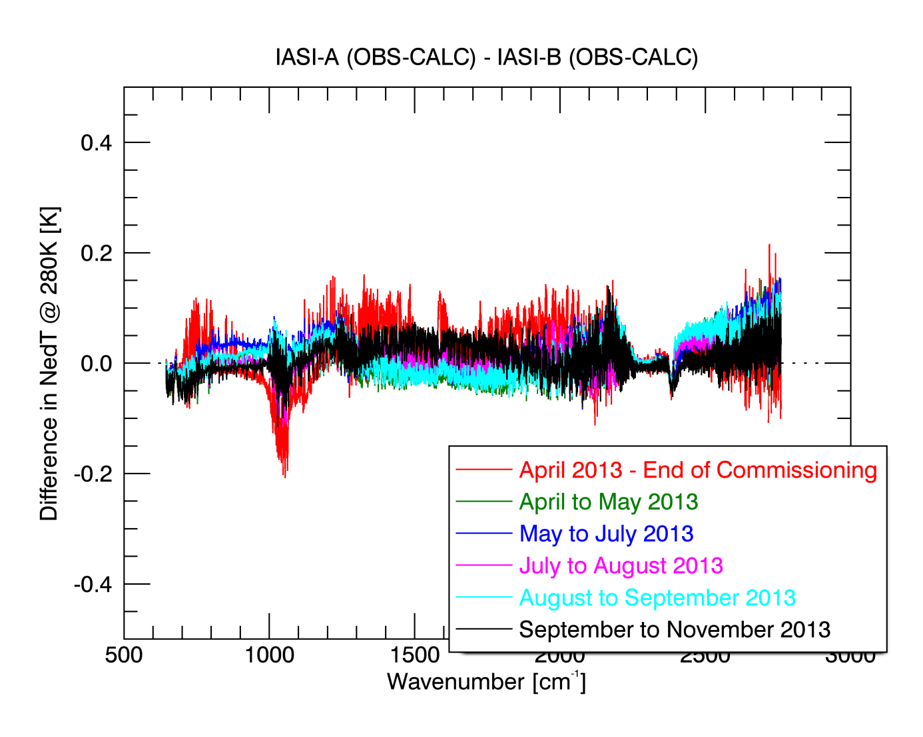
Double-differences IASI-A/IASI-B
On-ground update IASI-A and IASI-B
On-board update IASI-B
No update
On-board update IASI-A
On-ground update IASI-A and IASI-B
Difference always lower than 0.1K NedT => good radiometric consistency

Slide 7
Intercomparison with CrIS: context
Since 31st July 2012, Suomi NPP CrIS SDRs are distributed by
EUMETSAT as “pass through”:
Extract BUFR bulletins
Repack BUFR bulletins
Rename file to WMO GTS standard
Since 12th March 2013, SDRs include cloud data from the VIIRS
instrument i.e. as “pass through” including:
Decode netCDF cloud EDRs
Re-grid and merge with co-located CrIS
Dissemination of 2670 CrIS products / day

Slide 8
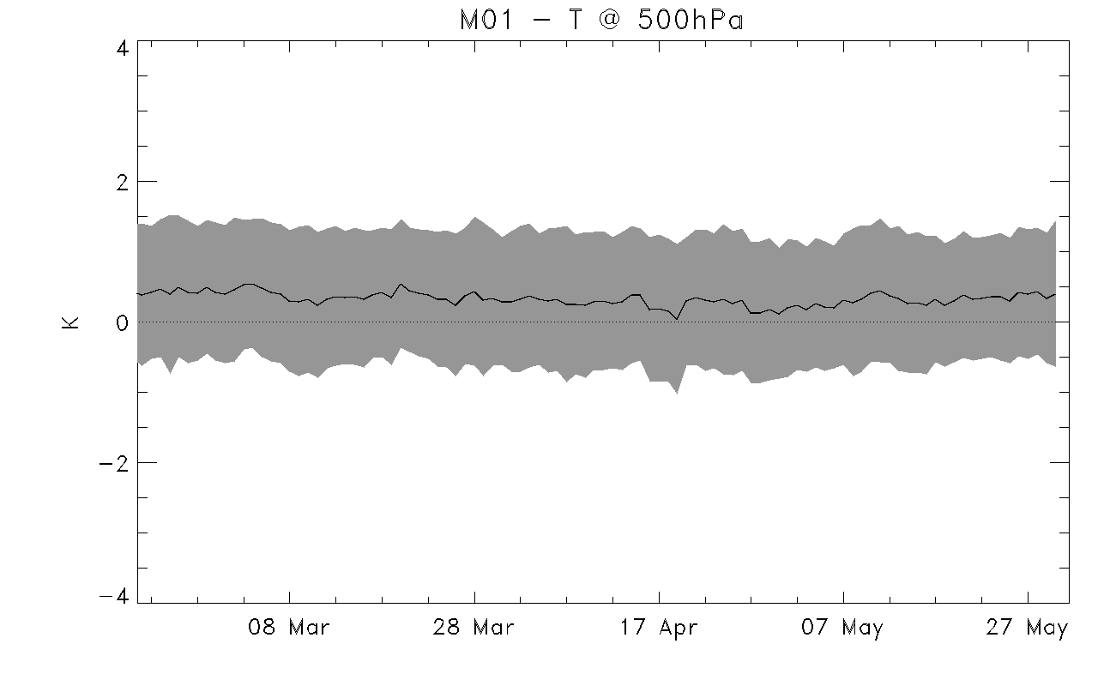
Why Comparing CrIS and IASI ?
CrIS data monitoring
Identify problems in the operational environment related to the products
Assess the quality of the operational products
Global instruments inter-calibration:
Feed-back on other products disseminated by EUMETSAT
New intercalibration using IASI for the GSICS community
Why using IASI ?
IASI on Metop-A has proven to be good reference
Commissioning of IASI-B has shown that it has a
similar quality to IASI-A

Slide 9
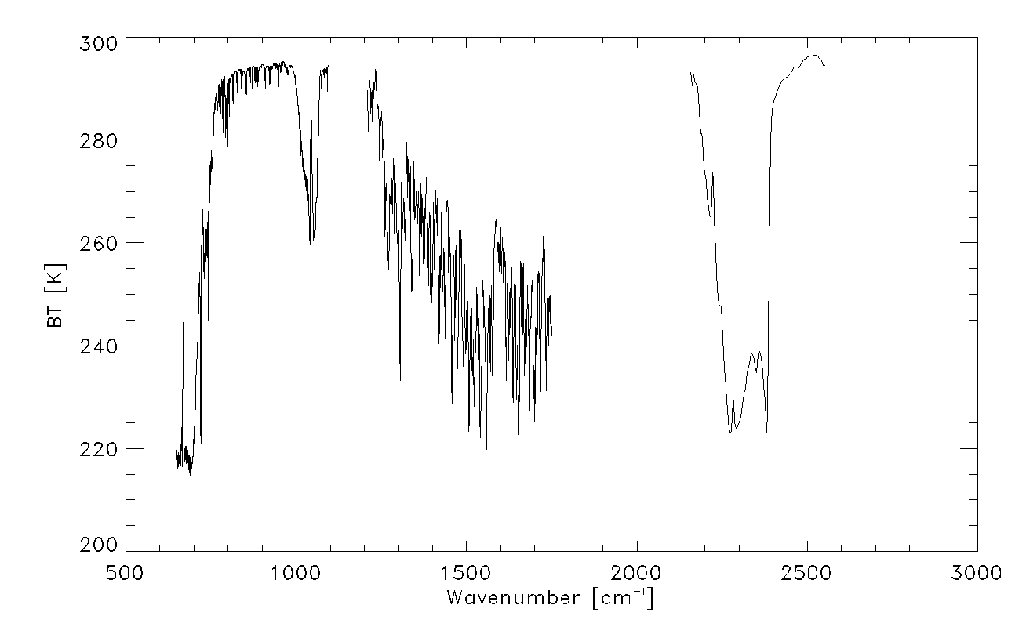
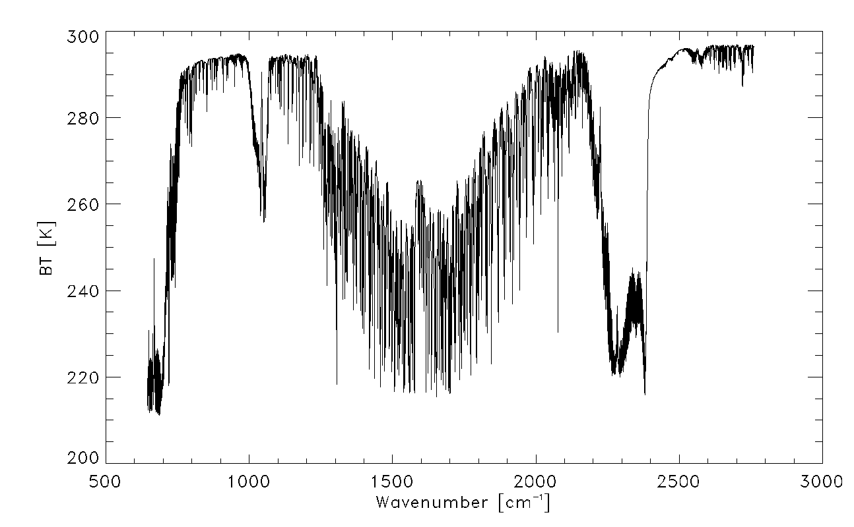
IASI and CrIS
CrIS: three bands with different spectral resolutions
Band | Range (cm-1) | Nb of Chan. | Spectral Resolution (cm-1)
LW | 650-1095 | 713 | 0.625
MW | 1210-1750 | 433 | 1.25
SW | 2155-2550 | 159 | 2.5
IASI: one band with a single spectral resolution
Band | Range (cm-1) | Nb of Chan. | Spectral Resolution (cm-1)
- | 645-2760 | 8461 | 0.25

Slide 10
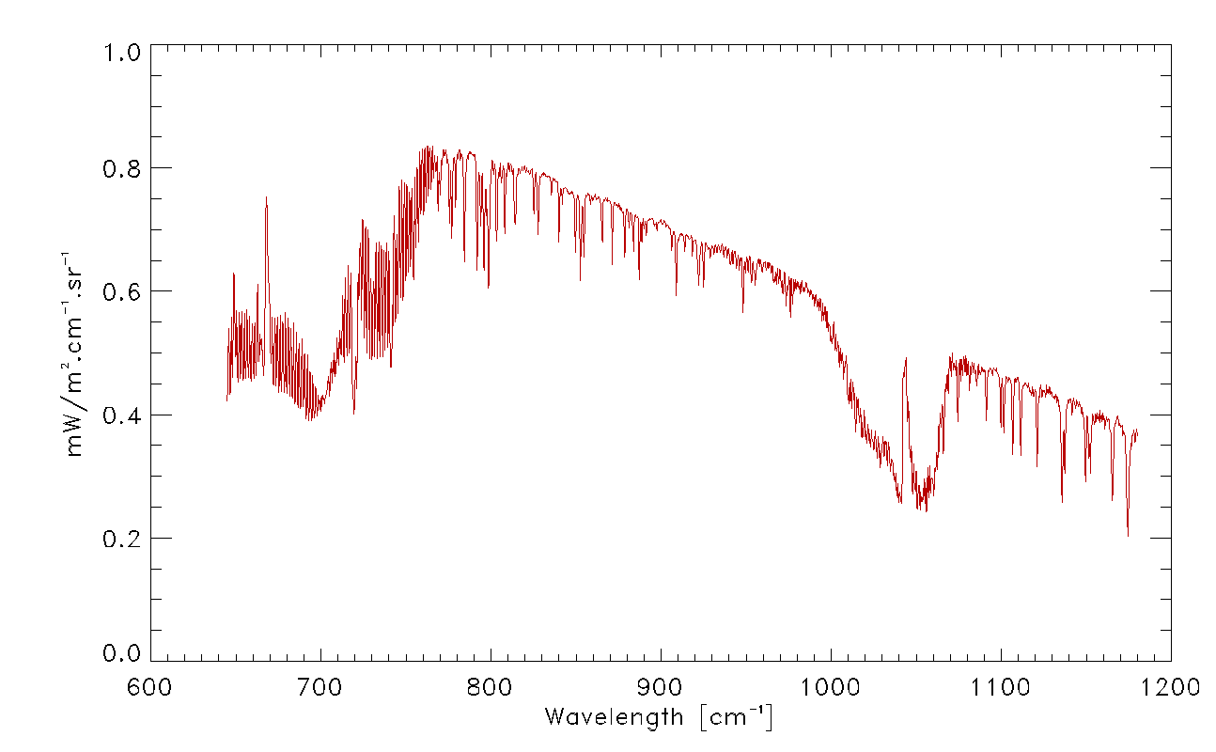
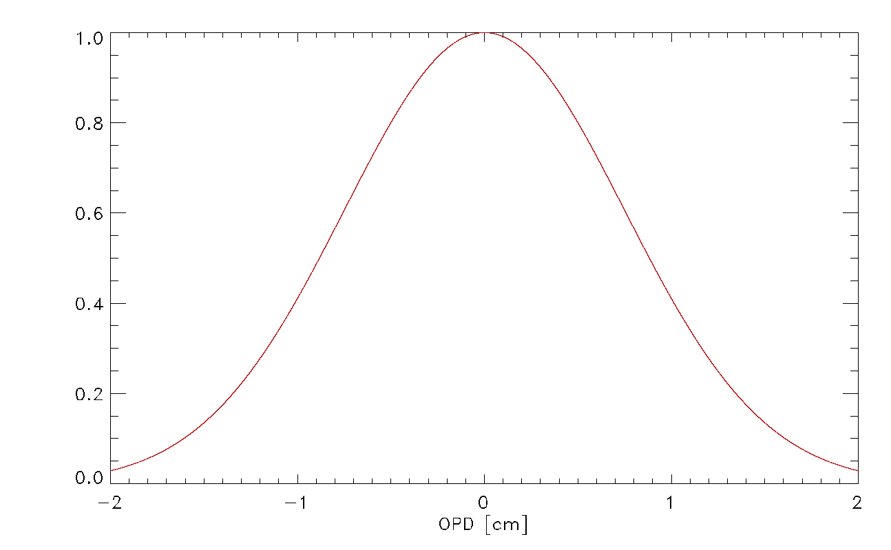
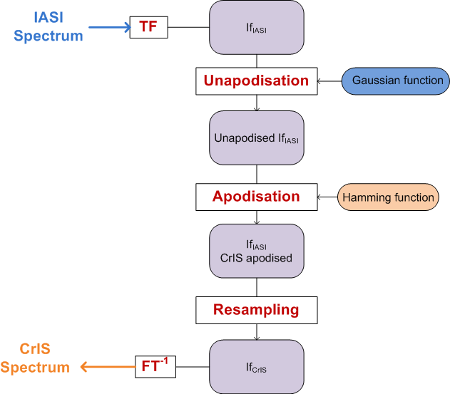
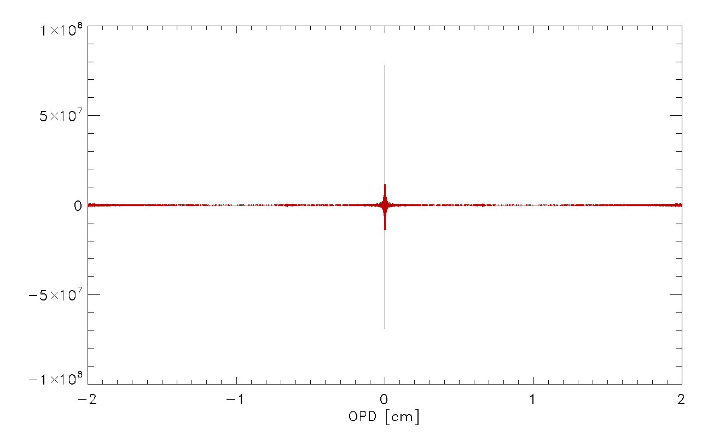
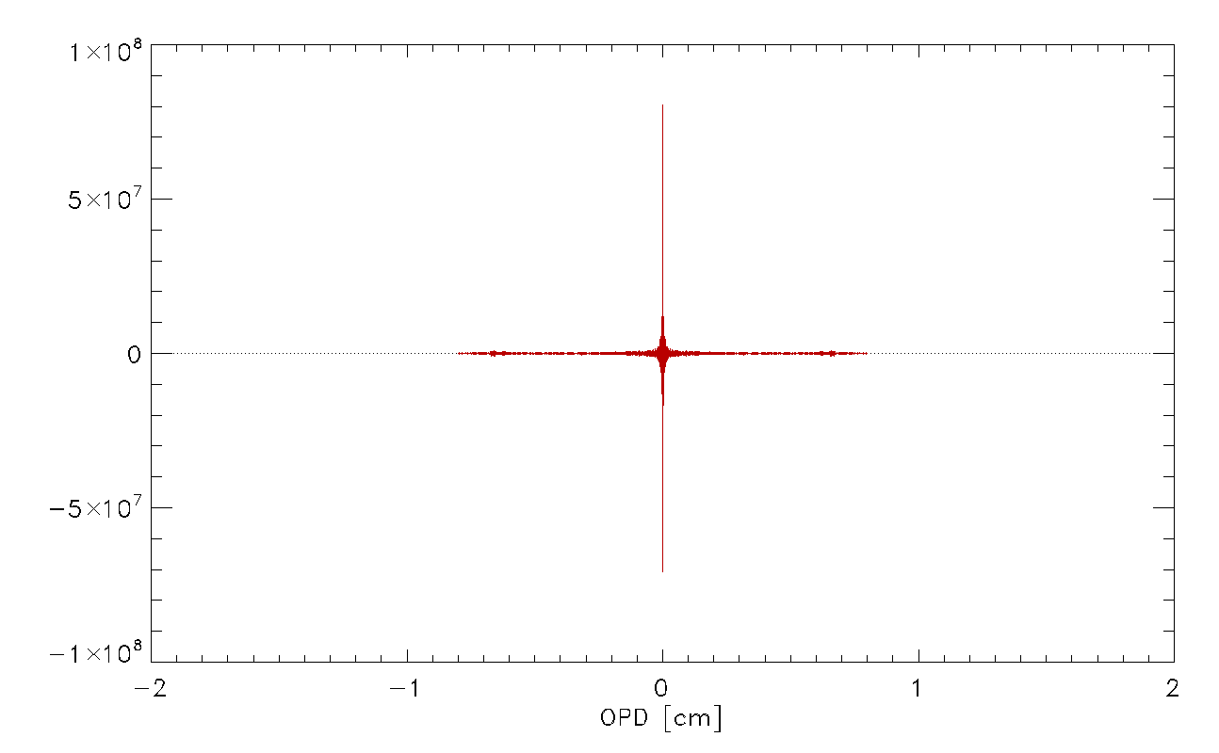
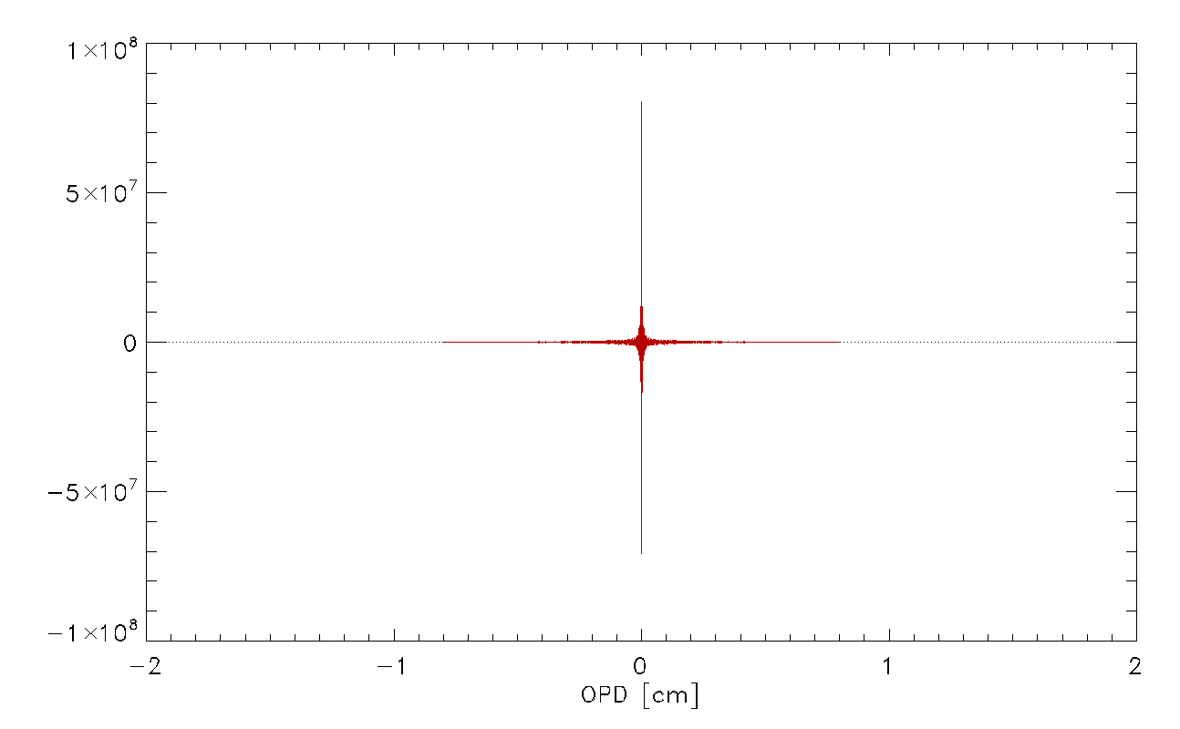
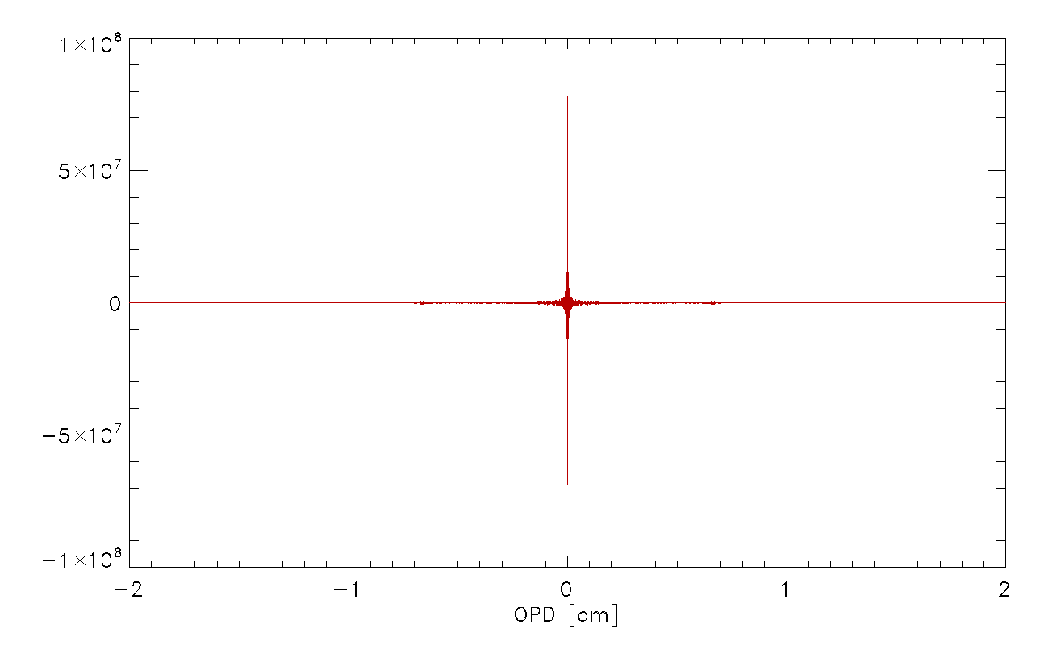
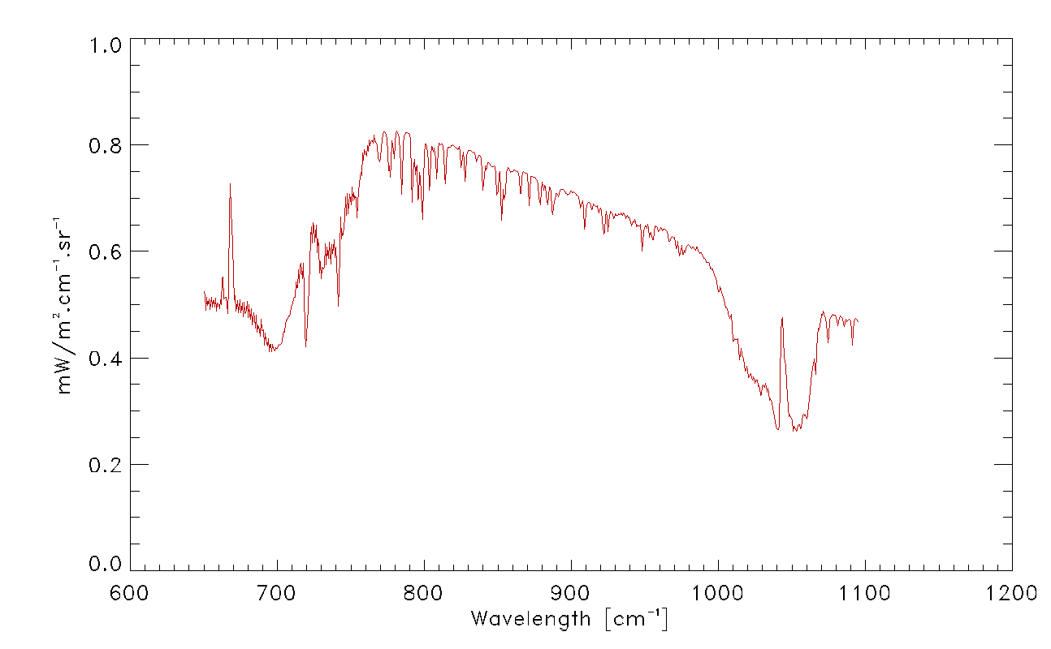
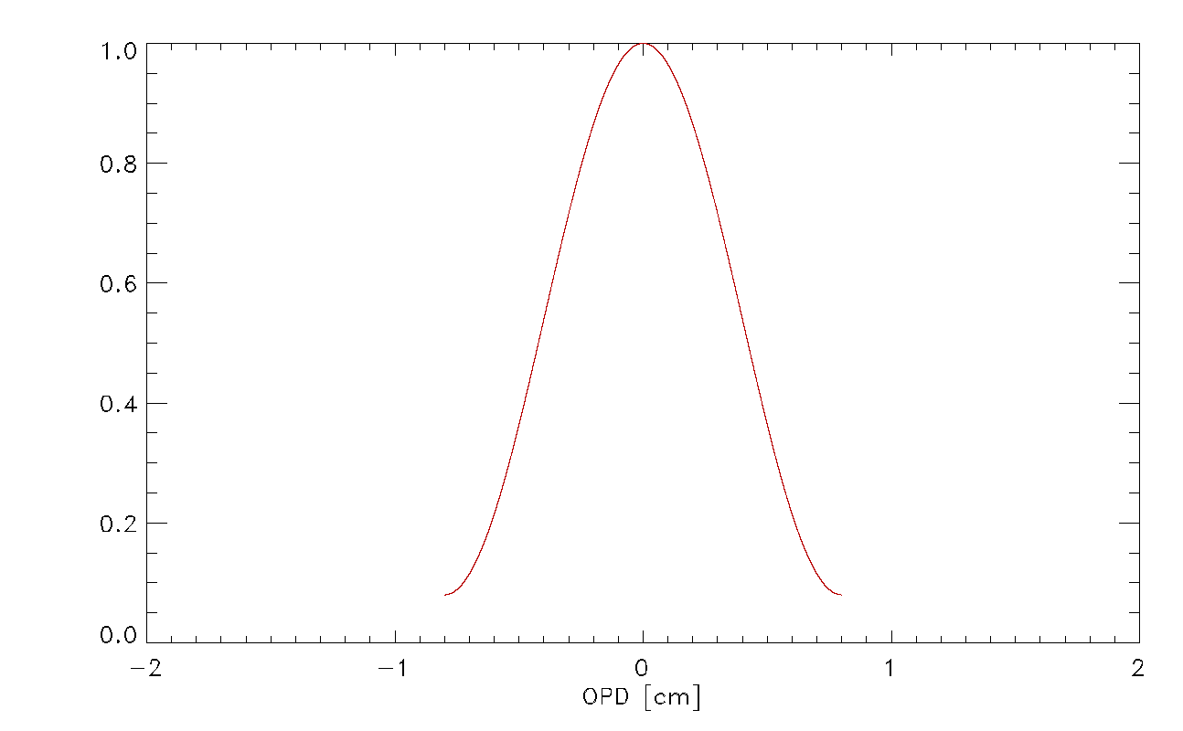
Comparing IASI to CrIS: methodology

Slide 11
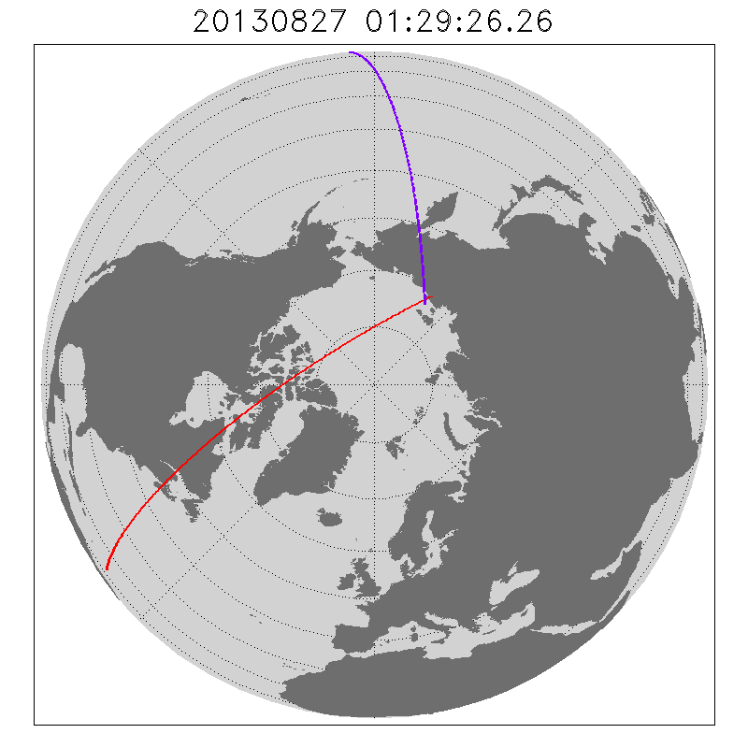
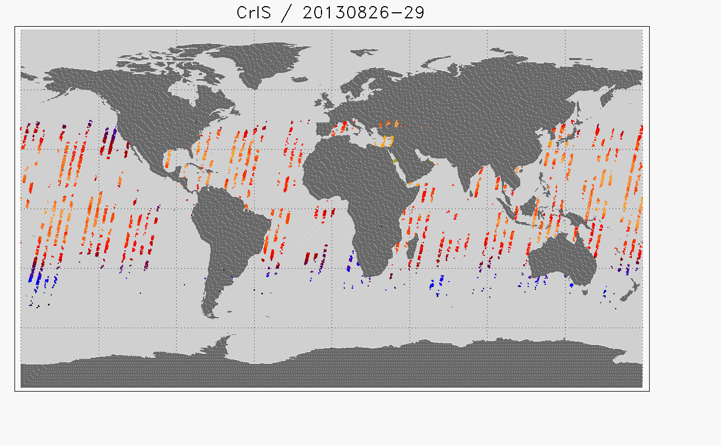
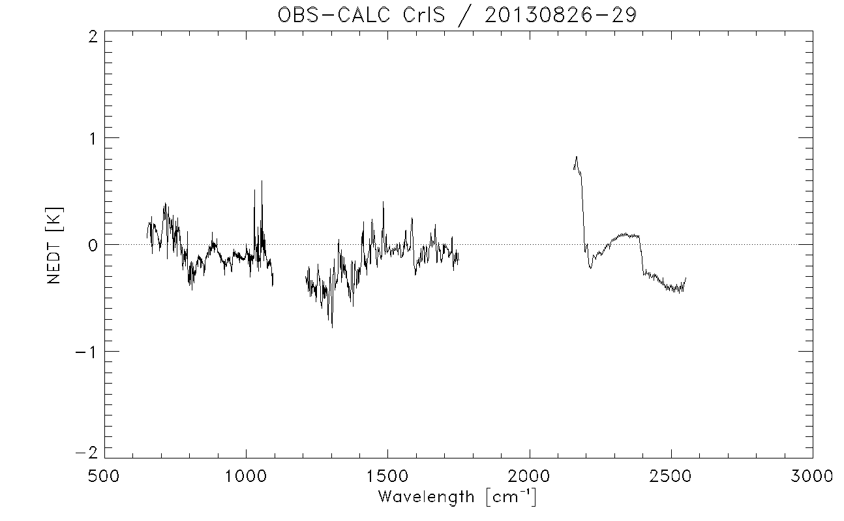
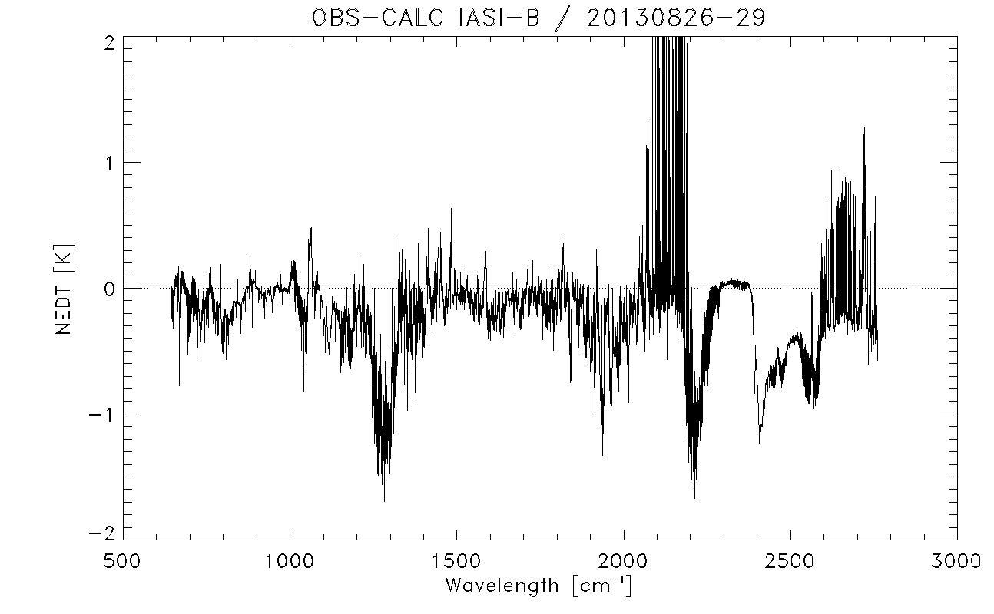
Comparing CrIS and IASI: 2 approaches
SNOs
Comparison of Simultaneous Nadir Observations of
IASI and CrIS
Selection: 2 minutes time difference and 6.5 km
distance difference
Occurrence: every 7 weeks at high latitude (+/- 70 deg)
Double Differences
Comparison of IASI with CrIS through synthetic spectra
Use of ECMWF 3-hourly forecast files
Examination of the double-difference of ECMWF bias:
DD=(RAD_{obs} - RAD_{calc})_{IASI} – (RAD_{obs} – RAD_{calc})_{CrIS}
=>Remove most inaccuracies in both RTM and ECMWF

Slide 12
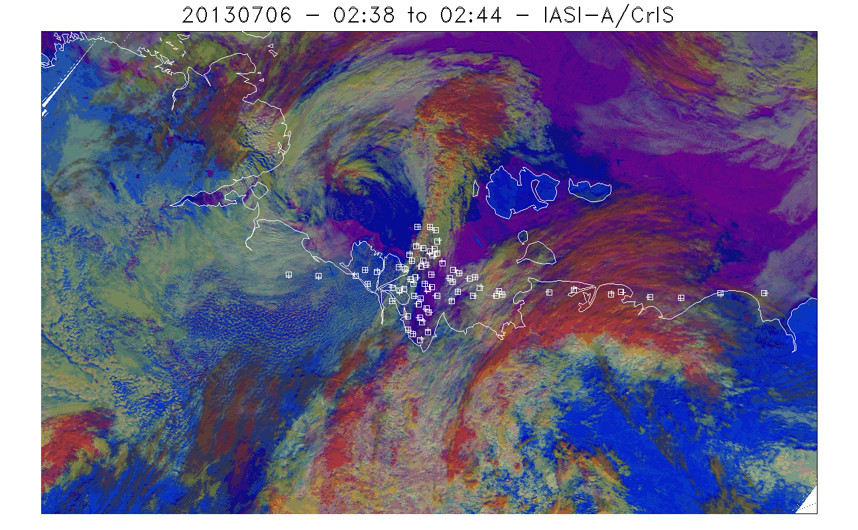
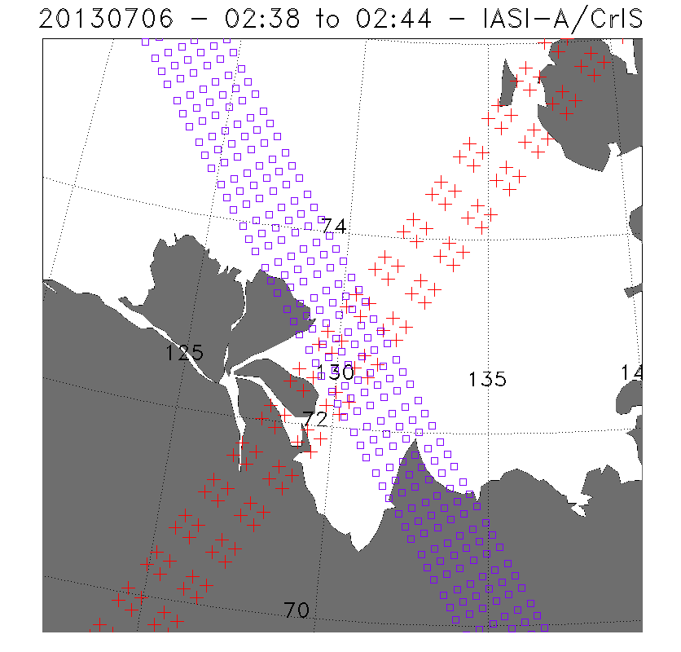
IASI/CrIS SNOs: selection
Pairs are defined
with time and distance
criteria:
2 minutes
6.5 km
Similar satellite
zenith angles:
ABS(cos(a1)/coa(a2)-1)
<=0.01
Homogeneous scenes:
Cloud fraction < 1 %
Or > 99 %

Slide 13
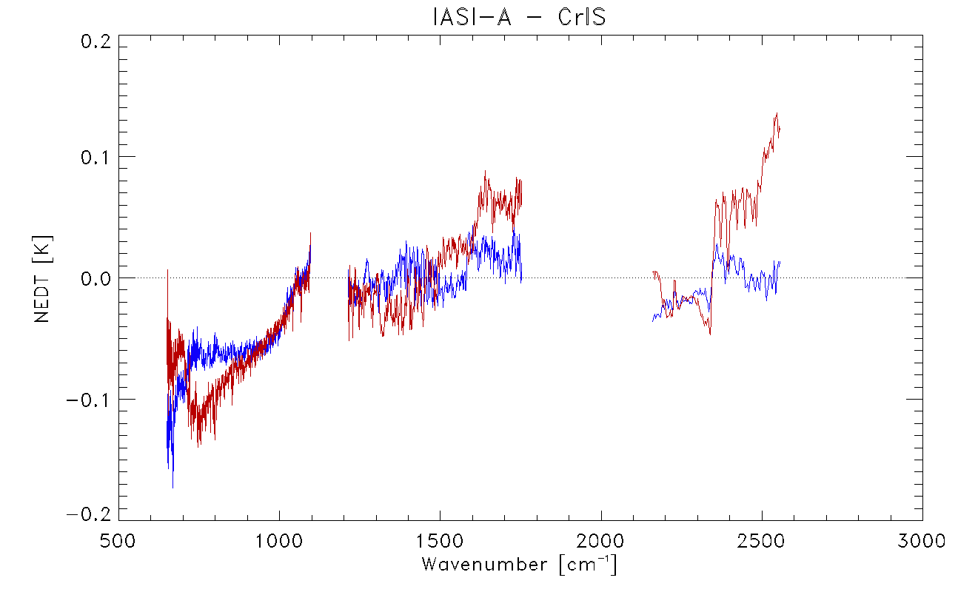
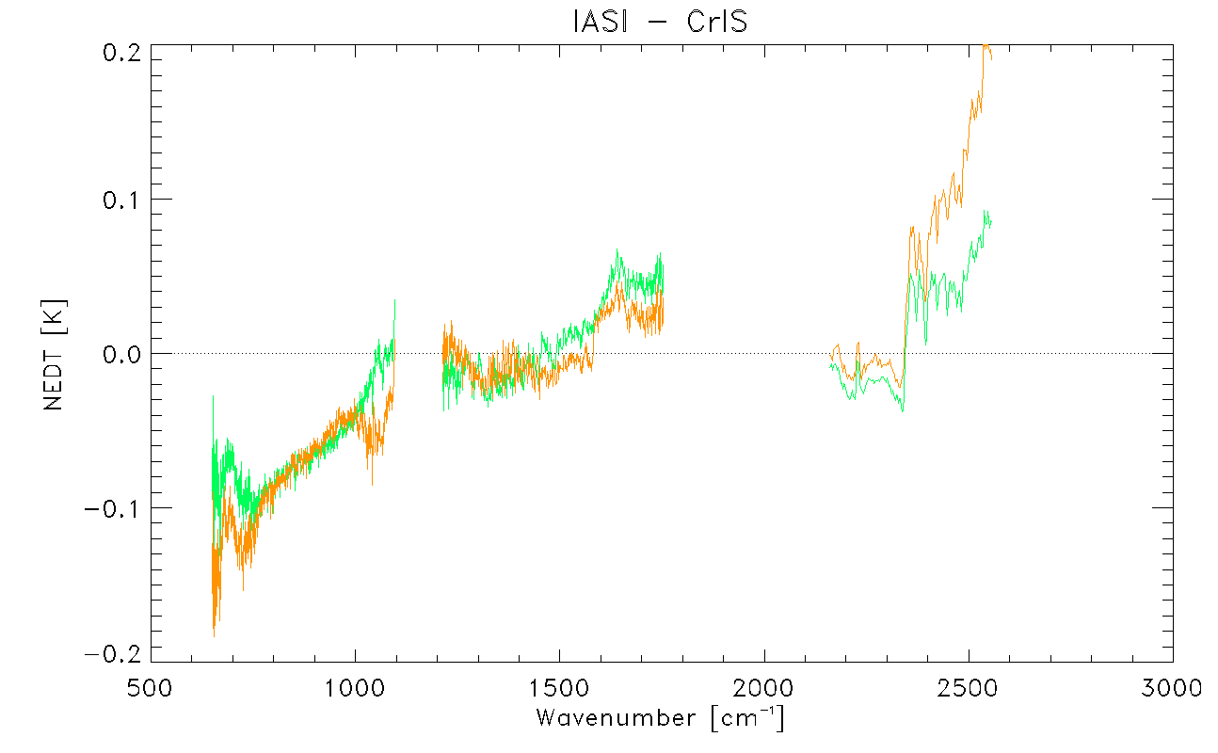
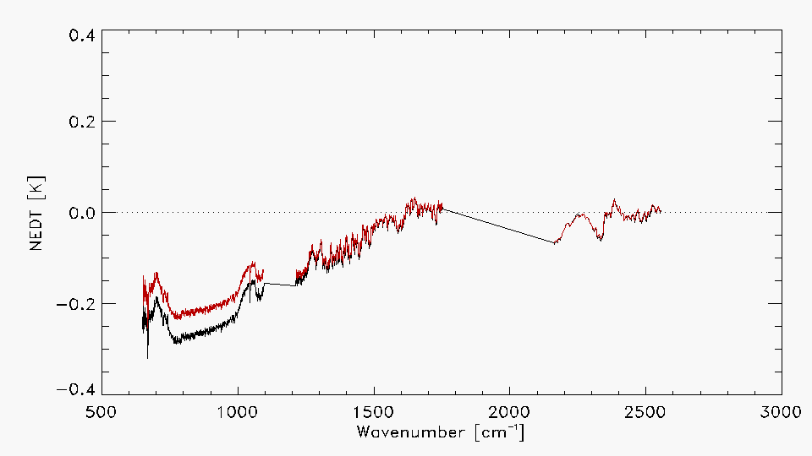
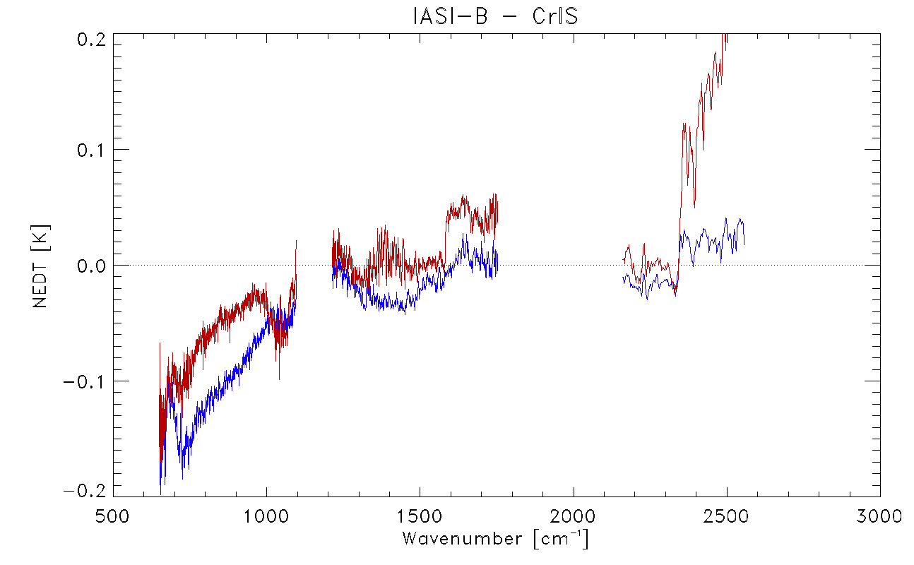
IASI/CrIS SNOs: results
North Pole: 2397 pairs
IASI-B/CrIS: 2619 pairs
South Pole: 1210 pairs
IASI-A/CrIS: 3607 pairs
North Pole: 1528 pairs
CrIS slightly warmer than IASI in band 1
But possibly non-linearity effects in band 1
Very good agreement in band 2 (BT diff. < 0.07 K)
Difficult to conclude in band 3
South Pole: 1091 pairs

Slide 14
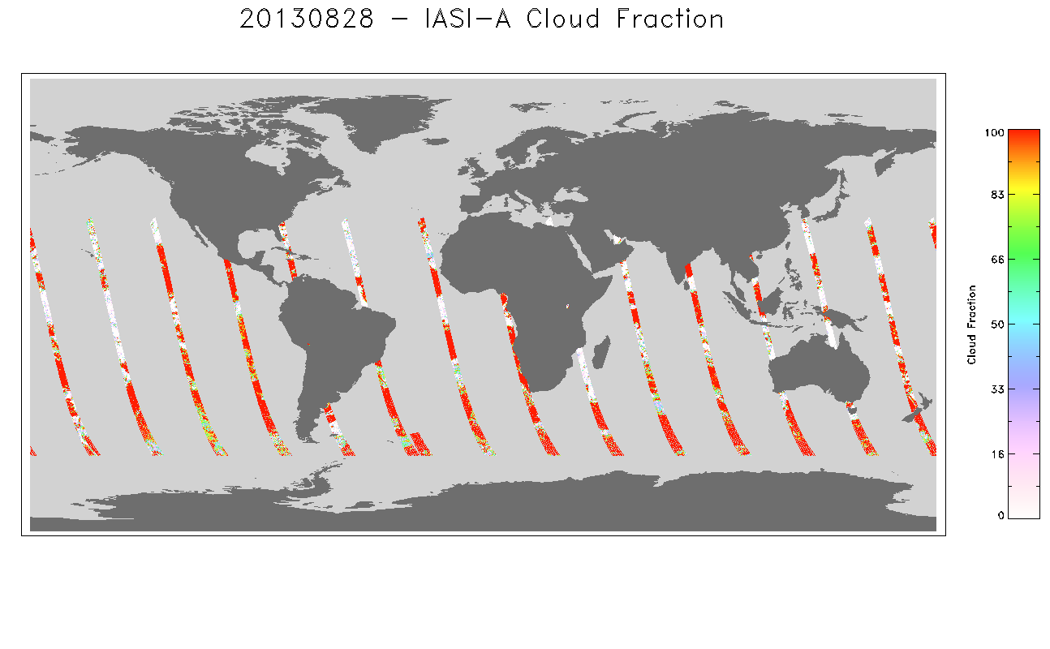
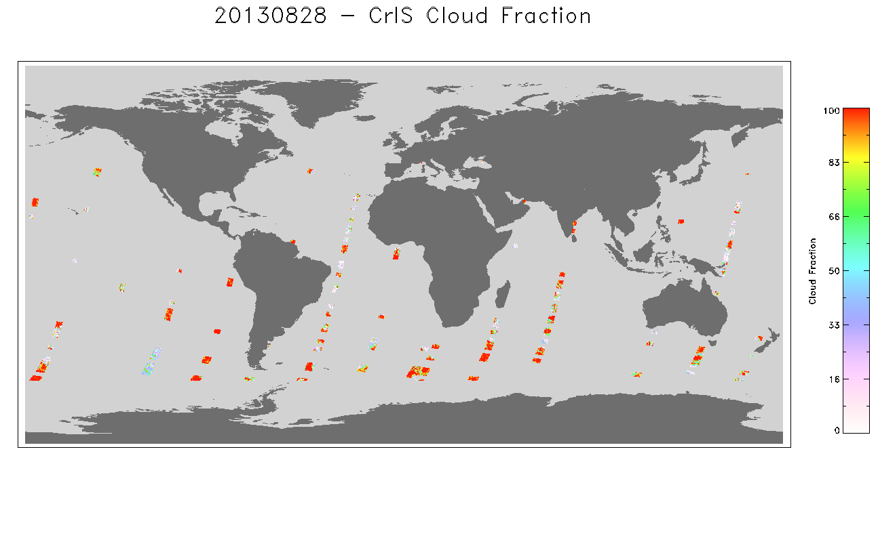
OBS-CALC Double Differences: methodology
RTM: RTTOV 10.2
T, q and p from ECMWF forecasts
standard profiles of trace gases
Selection of scenes:
close to nadir (satza < 10 deg.)
night time (sunza >=120 deg.)
No polar regions (abs(lat) <= 60 deg)
Over sea
clear sky (Cloud fraction in each
product)

Slide 15
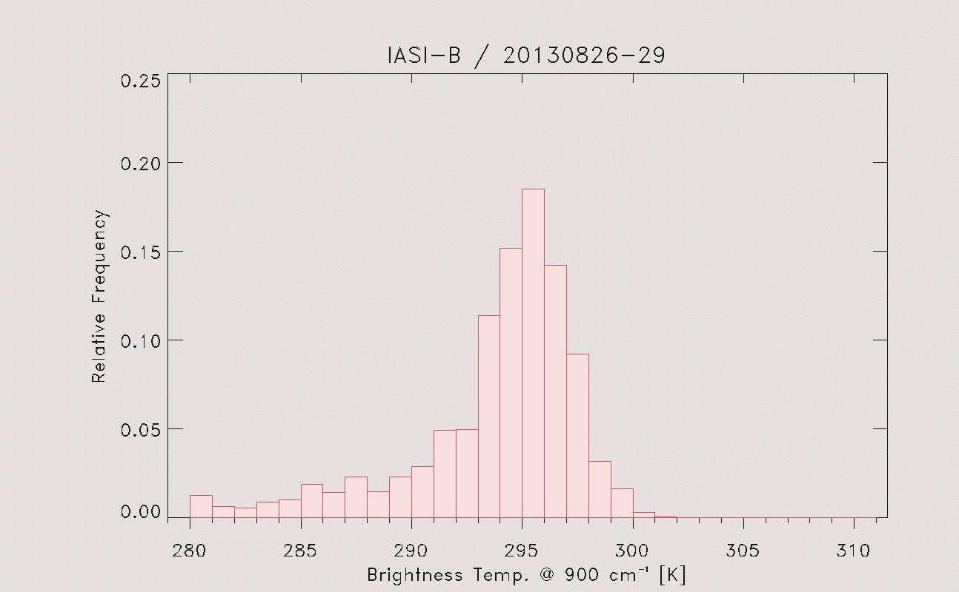
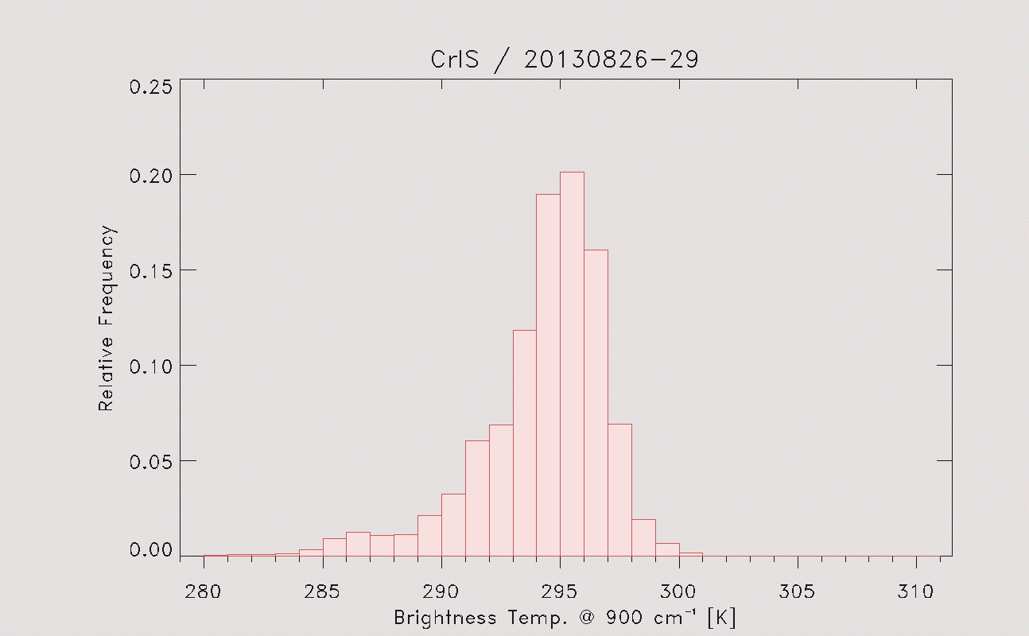
OBS-CALC : selection of clear cases
BT₁₁ >= 280K
BT₁₁ – Tsurf >= 0 K
-3 K < BT₁₁ - BT_{3.9} < 1.5 K
(OBS-CALC)_{BT11} <= 1 K
Same distribution of CrIS and IASI pixels

Slide 16
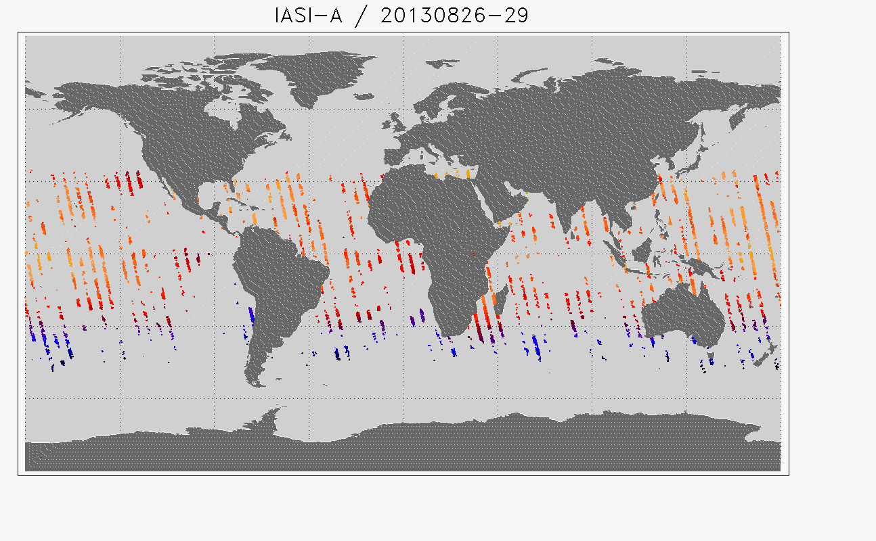
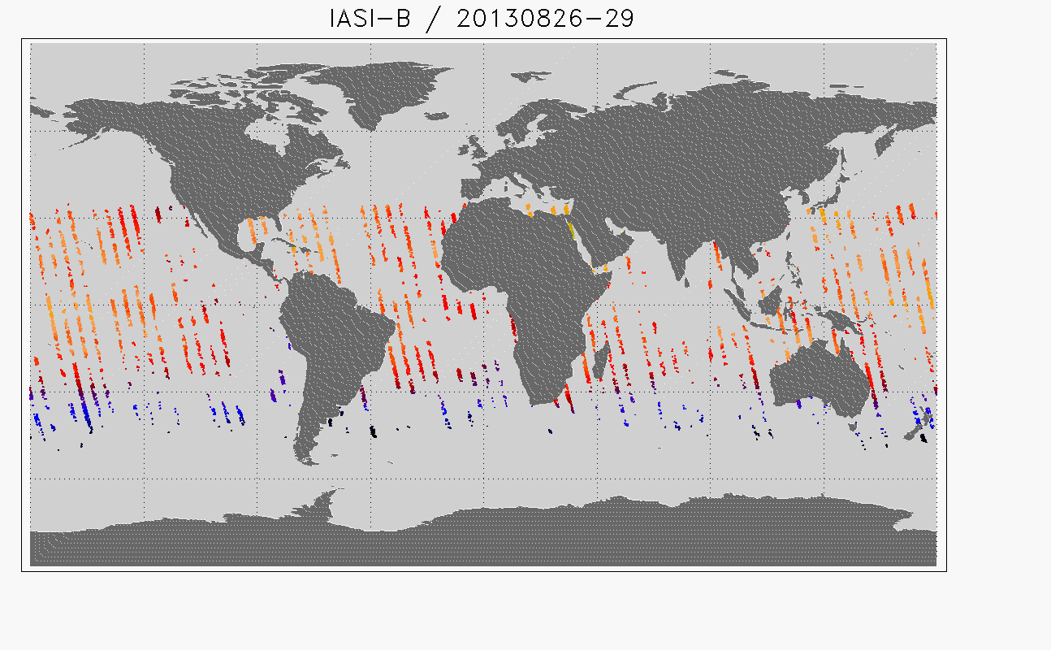
OBS-CALC : selection of clear cases
Geographical distribution
IASI-A: 9799 spectra
CrIS: 18958 spectra
IASI-B 10199 spectra

Slide 17
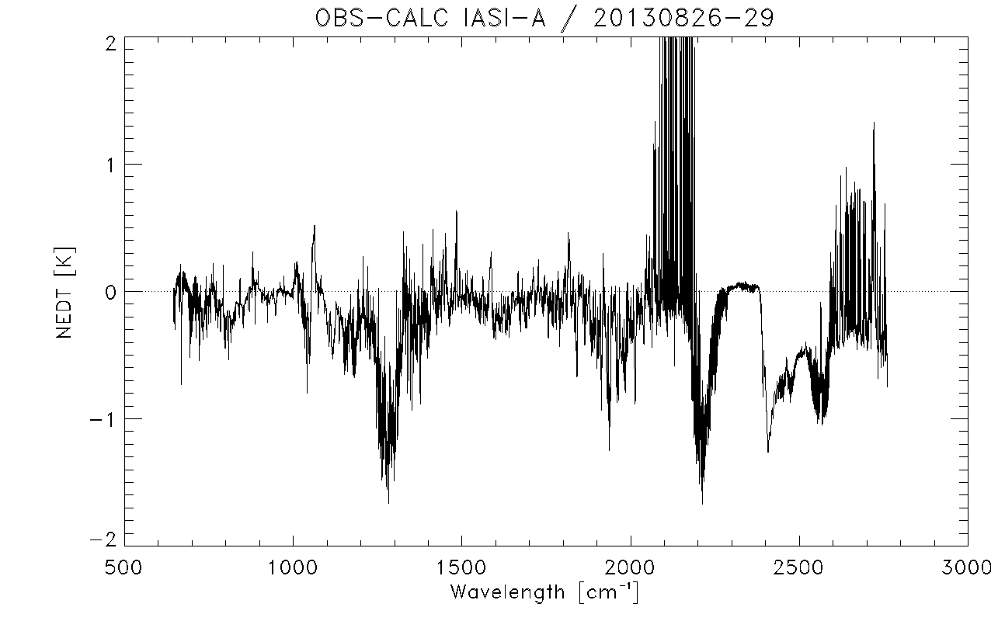
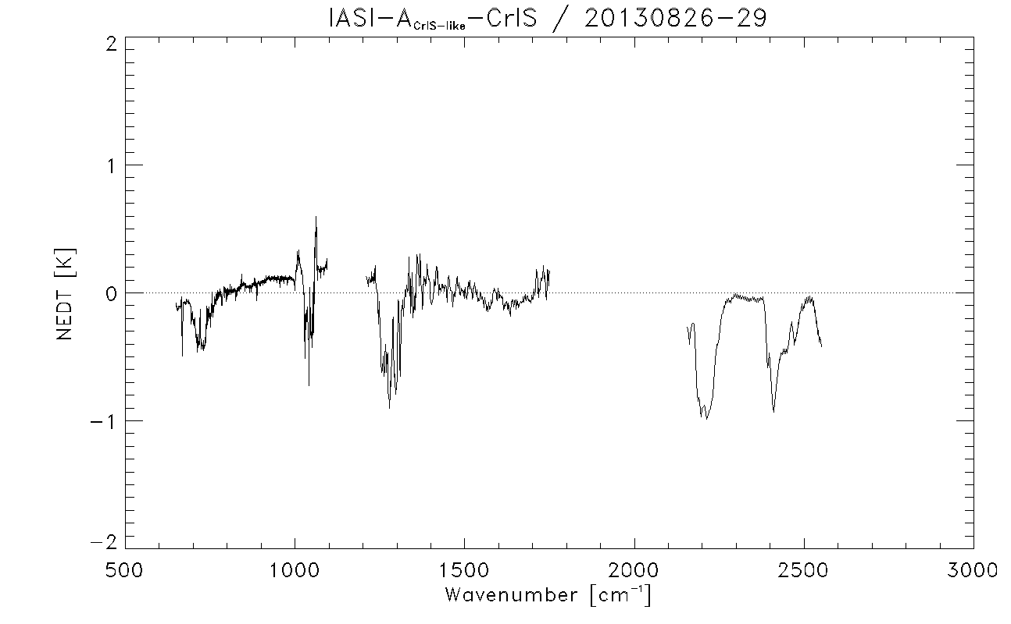
Double differences: results for IASI-A

Slide 18
Double differences: results for IASI-B

Slide 19
Conclusions
Set-up of a tool to compare CrIS and IASI
-> Daily operational monitoring of CrIS products (Obs-Calc)
-> Direct comparison at SNOs for inter-calibration check
Define a good and reliable criteria to select clear cases using
channels differences, not specific to IASI or CrIS.
Shows good radiometric consistency between IASI and CrIS:
Difference at NedT (at 280K) < 0.1 K
Inter-calibration issues:
in band 1: non-linearity correction needed ?
in band 3: to be investigated

Slide 20
Intercomparison of IASI and CrIS spectra
Thank you for your attention !

