Slide 1
Minimising Uncertainty in SBAF - Using AIRS to bridge gap HIRS/2-IASI GSICS meeting, March 2014, Darmstadt, Germany
Viju John, Tim Hewison, Rob Roebeling, Alessio Lattanzio and Jörg Schulz
Notes:
- Change title to more general one.
- Focus can stay on the HIRS work, however, given the character of the workshop an introduction on the VIS/Near-infrared work is also needed.

Slide 2
Spectral Band Conversion Factors - Review
Objective
To develop spectral band conversion factors that minimize the differences between reference and monitored instruments and optimise sampling and fitting methods.
Method
Evaluate for a sounding (~6μm) and a window (~10μm) channel.
Calculate MFG, MSG and HIRS-like IR radiances for a selection of ECMWF profiles (from Chevallier 2001) using RTTOV.
Assess uncertainties for different conditions and fitting methods.

Slide 3
Spectral Band Conversion Factors - Uncertainties different WV instruments
Monitored➔ Reference ⬇ | HIRS/2 NOAA6-14 | HIRS/3 NOAA15-17 | HIRS/4 NOAA18-MetopB | MVIRI Meteosat 1-3 | MVIRI Meteosat 4-7 | SEVIRI Meteosat 8-11
HIRS/2 NOAA6-14 | 0.04 | 1.03 | 1.07 | 0.07 | 0.16 | 0.41
HIRS/3 NOAA15-17 | 0.78 | 0.05 | 0.06 | X | 0.67 | 0.51
HIRS/4 NOAA18-MetopB | 0.84 | 0.06 | 0.03 | X | 0.74 | 0.57
Mean RMSD Tb [K] of Spectral Band Conversion Factors for each class of instrument: WV
Notes:
What are the target accuracies and precisions that we aim at

Slide 4
SNO toolkit for GEO-LEO inter-calibration
We developed a collocation tool to for faster processing of the files:
Observations are mapped on to a common grid (computationally expensive distance calculations between pixels are not needed)
Collocation and post-processing for one image takes only a few seconds (in a traditional distance calculation method this can take up to 1 minute)
Quantified uncertainty associated with use of HIRS/2, HIRS/3 and HIRS/4 as inter-calibration references for WV and IR channels of MFG/MSG:
Negligible for IR in all cases
Significant for WV using HIRS/3, HIRS/4 for MFG/MSG (~1K, see next slides)

Slide 5
SRFs

Slide 6
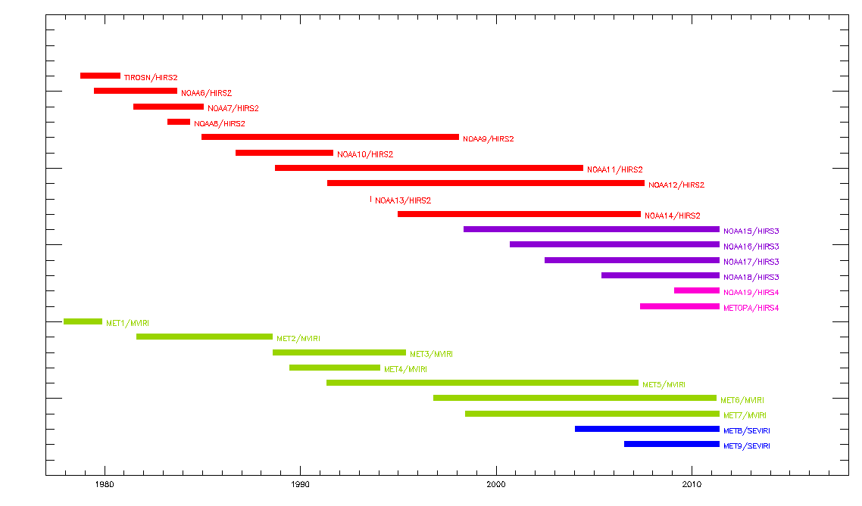
Transferring reference: Double Differencing
Delta
Notes:
More explanation needed
6

Slide 7
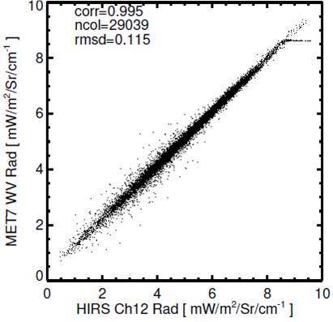
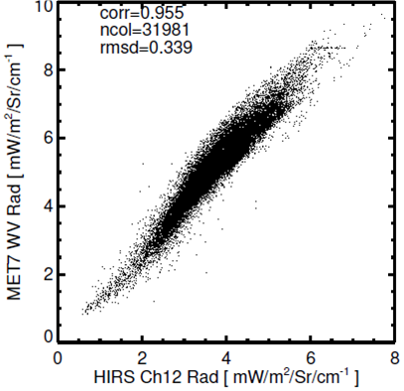
Choosing an inter-calibration reference
We planned to use HIRS/2, HIRS/3, HIRS/4 and IASI to inter-calibrate the MFG and MSG heritage channels (WV and IR)
HIRS/3 and HIRS/4 are not suited as reference. Due to shift and narrowing of spectral response function from HIRS/2 to HIRS/3 and HIRS/4 the Spectral Band Adjustment Factor (SBAF) uncertainty of the WV channel increased from ~0.2 K to ~0.7 K.
To replace HIRS/3 and HIRS/4 we intend to use observations from the NASA hyper spectral instrument: AIRS
We have also tested combination of HIRS channels as reference, but found that more uncertainty is introduced die to this.
Real
HIRS/2
Data
HIRS/2
LARGER!
Real HIRS/3 Data
HIRS/3
The figure shows match–up data for Metosat-7 WV channel with HIRS-2 and HIRS-3 over 0° coverage for January 2003.

Slide 8
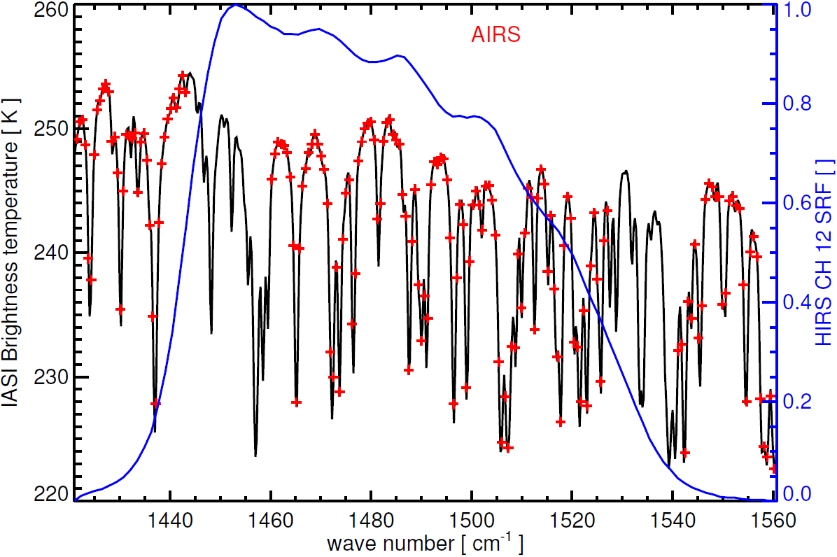
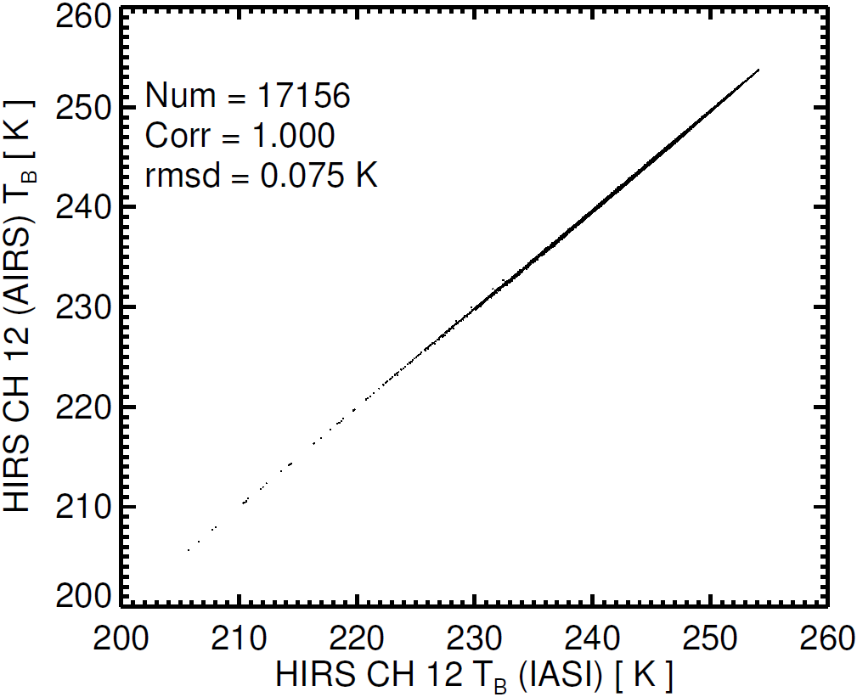
Identified AIRS as a suitable instrument to transfer calibration of HIRS/2 to MetopA/IASI
Hyperspectral sounder: lower uncertainty introduced in Spectral Band Adjustment
AIRS gaps introduce negligible errors
Semi-Synthetic Data
AIRS and IASI spectra with HIRS SRF in blue.
Relationship of HIRS/2 like radiances from IASI and AIRS.
HIRS/2
AIRS
IASI
1980 2002 2006 2014
Availability of reference instruments

Slide 9
Testing HIRS-2 radiances simulated from AIRS
We collocated AIRS with MET7 for January 2003 and converted AIRS spectra to HIRS12 radiances;
RMSD for this is similar to match-up data for HIRS 12 on NOAA14;
This confirms the use of AIRS as a reference instruments for MFG/MSG despite gaps in HIRS12 band;
Larger than semi-synth Comparable to Met7-HIRS/2
HIRS/2
Real
Data
The figure shows match–up data for Metosat-7 WV channel with HIRS-2 radiances simulated from AIRS over 0° coverage for January 2003.
HIRS/3

Slide 10
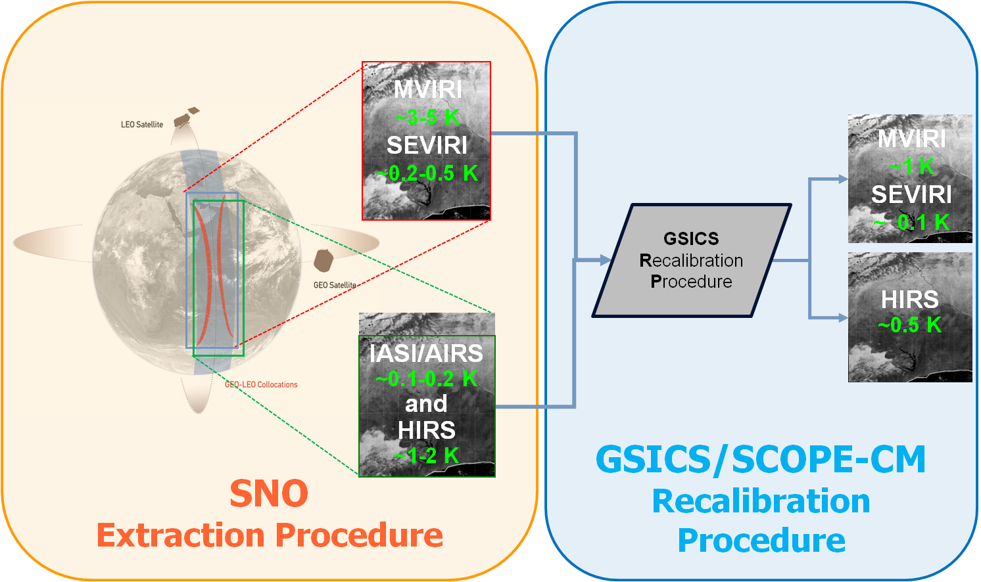
Recalibration procedure

Slide 11
Discussion
What about IR8.7? HIRS/3 Channel?
Based on this work, can we derive generic approaches to:
Selecting a reference instrument?
Defining the SBAF?
Will this be used to generate a new type of GSICS Product?
e.g. Archive Re-Calibration

