Slide 1
GSICS Data Management Working Group: Break Out Session
Manik Bali
NOAA Satellite and Information Service

Slide 2
Introduction
The GDWG supports the activities of GRWG.
Decisions on GSICS data file formats, meta data.
GDWG plays a key role in hosting the GSCICS data on web.
GDWG developed bias monitoring tool.
GDWG also supports progression of products to and within GPPA.

Slide 3
Introduction
To accomplish these goals GDWG needs
Resources.
Capacity Building.

Slide 4
TOPICS
Future Chairing of GDWG.
Maintenance of current GDWG infrastructure.
File naming and DOI number for products.
GDWG status of members.

Slide 5
TOPICS
Taxonomy
NetCDF file content organization of new products.
CF conventions submission; what this involves, and how GSICS can improve and support this process.
Formats and procedure for storing and exchanging satellite instrument event logs.
Revisit GSICS Product Acceptance.
Is Big Data an answer to our questions.

Slide 6
Introduction
Archiving of GSICS intermediate data sets and products.

Slide 7
Future Chairing of GDWG.

Slide 8
Maintenance of current GDWG infrastructure.
Maintenance of Wiki.
Maintenance of GUMS.
Maintenance of Product Catalog.
Plan for 24X7 maintenance.
Help sought from members.

Slide 9
File naming and DOI number for products.
Requires archival in NCDC.
Conflicts with GSICS file naming conventions.
GSICS File naming conventions.
W_US-NESDIS-STAR,SATCAL+NRTC+GEOLEOIR,GOES13+Imager-MetopA+IASI_C_KNES_20140214120000_preop_01.nc
NCDC file naming
NESDIS-STAR_FCDR_MSU_V01R00_N14_D20061001_S0134_E0256.nc

Slide 10
GDWG status of members.
GDWG-CMA
GDWG-JMA
GDWG-KMA

Slide 11
TAXONOMY

Slide 12
NetCDF file content
organization for new products

Slide 13
CF conventions submission; what this involves, and how GSICS can improve and support this process
I just remembered another thing I accomplished: I developed, proposed, and eventually shepherded through the CF convention's acceptance process a bunch of standard names for satellite data variables. Some of the names were inspired and directly relevant to GSICS data. Those names are listed at here.
These came too late for the current GSICS products but I used some of them in the SRF netCDF files I mentioned yesterday
Aleksandar Jelenak

Slide 14
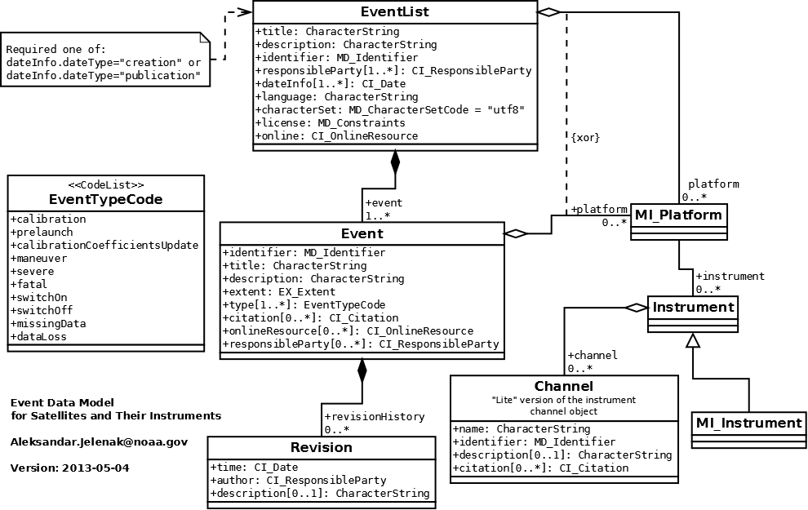
Event Logging Data Model
ICVS has a comprehensive display of event logging

Slide 15
Archiving of GSICS intermediate data sets and products.
Requests from some members to have collocation data.
File formats, names

Slide 16
New organizing of the products on the THREDDS catalog based on proposed taxonomy
Product Catalog has 39 products.
Has search capability.
What are the priorities.

Slide 17
Revisit GSICS Product Acceptance
Present GPPA is time consuming.
Published work is basis for accepting products in Demo phase.
Each subsequent step needs approval of Chairs and EP.
Result is none of the products are in Op phase.

Slide 18
Proposed GPPA
Accept Products upfront (unpublished) on reviewers recommendation.
Reviewers decide if the product is to be included in demo mode into the catalog.
Publication related to product is undertaken. Three key areas the publication should focus on are.
Uniqeness of product.
A uncertainty analysis of product
Use case.
Upon successful publication the product goes back to reviewers.
Upon recommendation product is given operational status.
Anticipated time to become operational 1 -1.5 Yr.

Slide 19
What can we get from BigData?

Slide 20
Thank you

