Slide 1
JMA GDWG Report
Masaya Takahashi
Meteorological Satellite Center / Japan Meteorological Agency
(visiting scientist at EUMETSAT from Mar. 2014 to Feb. 2015)

Slide 2
Contents
Progress of the GDWG activities at JMA (incl. responses to the action items)
JMA GPRC website updates (incl. future plan)
Satellite event log
Change of the GEO-LEO IR RAC data content
Provision of official SRF data to GRWG VIS/NIR sub-group
Collaboration with WIS
Calibration change alerts
Issues to be discussed in the GDWG session
NetCDF metadata checker
Function enhancement of the EUMETSAT bias plotting tool
Summary and future plans

Slide 3
JMA GPRC website updates
http://mscweb.kishou.go.jp/monitoring/calibration.htm
Corrected a link to CMA GPRC
A link to KMA GPRC should be corrected
URI of JMA GPRC will be changed in 2014
We will announce in the near future
Operational calibration information about Himawari-8/AHI will be uploaded/updated in spring/summer 2014
New page describing AHI inter-calibration will be created by the summer 2015

Slide 4
Satellite event log
Logs opened to the public on the JMA sites (monthly report): http://mscweb.kishou.go.jp/operation/opr_report.htm
Operational status changes such as a backup operation by MTSAT-1R http://mscweb.kishou.go.jp/operation/status/mtsat.htm
Maneuvers, orbit elements
Special operation events such as eclipse or solar-interference operation
Logs closed to the public (in the future, it may be opened…)
Operation mode changes (e.g. Full disk mode or Rapid scan mode)
Calibration update Log (e.g. Calibration coefficients)
Sensor quality information (e.g., Decontamination)
Anomalous events (e.g., satellite shutdown, instrument performance)
Logs before 2000 have been archived, but not digitalized
Ready for providing information to be hyper-linked from the WMO OSCAR

Slide 5
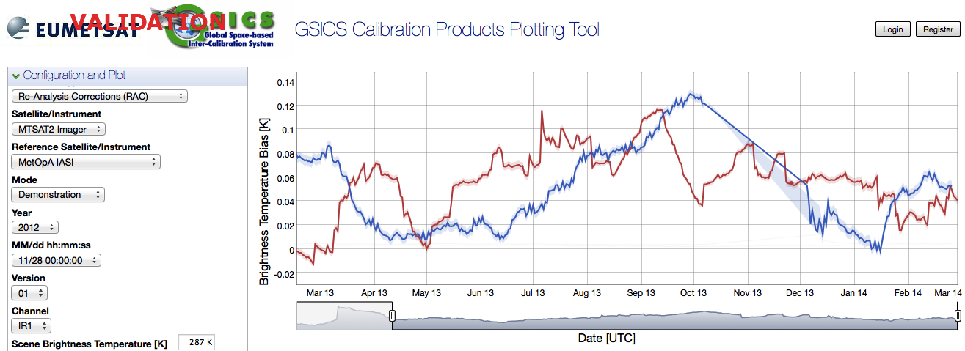
Change of GEO-LEO IR Correction (NetCDF) content
Requirements for the visualization on the bias plotting tool
RAC files are only supported (all information should be contained in one file)
We modified MTSAT-2 vs. AIRS/IASI IR RAC format in July 2013
Easy comparison of GSICS Corrections are realized!
NetCDF metadata checker created by NOAA was so useful for the work!
Time series of 11μm channel TB difference against Metop-A/IASI
on http://vgsics.eumetsat.int/plotter/
MTSAT-2 10.8 um
Meteosat-10 10.8 um
Many thanks for supports and comments of EUMETSAT and NOAA

Slide 6
Collaboration with WIS
1. What was discussed in the 2013 annual meeting?
Cataloging and Discovering GSICS Data
First, make GSICS product catalog discoverable in WIS.
Aleksandar Jelenak (NOAA) reported on the current status. There is the GSICS product
catalog as the central information point about the available GSICS products. It lists a
small set of the most important attributes for each product, such as: algorithm type,
product type, monitored and referenced instrument, data start and end times.
Action: JMA to provide information on what is required to enter metadata on the GSICS
product catalog in the WIS Portal GISC Tokyo.
Task: Produce requirements and implement a tool for scanning GSICS THREDDS
catalogs and build inventory of available data in order to regularly update the
GSICS product catalog.
From the final report of GSICS-EP-14:
http://www.wmo.int/pages/prog/sat/documents/GSICS-GRWG-GDWG-2013_Final-Report.pdf

Slide 7
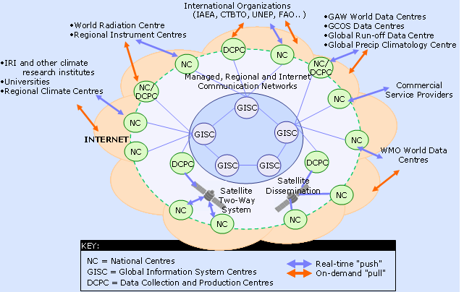
Collaboration with WIS
2. What I reported to Aleksandar in May 2013
“It’s not feasible to add the GSICS product catalog (metadata catalog) into WIS”
(But we will ask details to our colleagues if needed)
“About WIS” on GISC Tokyo: http://www.wis-jma.go.jp/cms/about-wis/

Slide 8
Presentation by Dr. Toyoda (JMA) at the International Workshop “Towards the Successful Implementation of the WMO Information System in Asia” (2010) : http://www.wis-jma.go.jp/cms/help-desk/material/wis-workshop-march-2010/

Slide 9
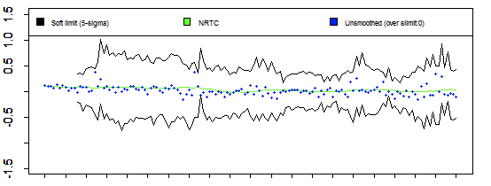
Calibration change alerts
Calibration change alert discussed in the June 2013 web meeting
We have created prototype image using MTSAT-2 vs. IASI NRTC netCDF and reported to gsics-dev
We can operationally create/provide such kinds of data/alerts
Discussion
Who will create figures? Each GPRC? Bias plotting tool? (It’s very useful if email/RSS tools directly linked to the figure)
Prototype of calibration change alert derived from MTSAT-2 vs. IASI NRTC Correction
ΔTB [K]
10.8 [μm]

Slide 10
Contents
Progress of the GDWG activities at JMA (incl. responses to the action items)
JMA GPRC website updates (incl. future plan)
Satellite event log
Change of the GEO-LEO IR RAC data content
Provision of official SRF data to GRWG VIS/NIR sub-group
Collaboration with WIS
Calibration change alerts
Issues to be discussed in the GDWG session
NetCDF metadata checker
Function enhancement of the EUMETSAT bias plotting tool
Summary and future plans

Slide 11
NetCDF metadata checker
Created by Aleksandar, current user: NOAA and JMA (but now we do not use because…)
Bash script: controls the validation
stylesheet: specifically prepared for each GEO-LEO-IR NetCDF
We changed the global attributes in Jul 2013, so the stylesheet Aleksanr provided us is obsolete. But we don’t know how to maintain it…
Requirements (private communication from Aleksandar):
The tool can only run on a UNIX (Mac OS X, Linux, etc.) computer.
Java virtual machine version 1.4 or newer.
Saxon-HE, an open source XSLT/XQuery processor for Java.
Command-line utililty ncdump that comes with the netCDF library. The ncdump utility must be able to produce XML representation (option -x) of a netCDF file's content.
FYI: Other checker available online/offline (CF-Convention compliance checker for netCDF format )
Online: http://cf-pcmdi.llnl.gov/conformance/compliance-checker
Offline (python script): http://pypi.python.org/pypi/cfchecker

Slide 12
Function enhancement of the bias plotting tool
This tool is very useful and convenient for both of users and developers!
For users: monitoring what they want, easy comparison of all satellite’s observation quality
For developers: reduction of costs creating lots of figures, easy detection of the product anomaly by changing data period, monitored temperature, …
Do we support new GSICS products such as GEO-LEO VIS (DCC) and MW FCDR if the GRWG require?
Can we link the calibration alerts to the plotting tool?
E.g., time series of TB biases are visualized when users clicked the hyperlink in the calibration alert email (or RSS feed)
As for current supported products (i.e., GEO-LEO IR), NOAA’s products are not to be integrated (reported by Aleksandar in July 2013 EP meeting).
How’s the progress?
Will CMA THREDDS server also integrate to them?

Slide 13
Summary and future plan
All actions of JMA are closed (except for the correction of a link to KMA)
Satellite event log
Change of the GEO-LEO IR RAC data content
Provision of official SRF data to GRWG VIS/NIR sub-group
Collaboration with WIS
Calibration change alerts
Work plan in 2014
Creation of GEO-LEO VIS (DCC) Correction NetCDF
Preparation of GEO-LEO IR/VIS Correction for Himawari-8/AHI
Updates of JMA GPRC website

Slide 14
Backup Slides

Slide 17
NRT (Near Real Time) distribution with GSICS Information
Action EP-12.05: “Each GPRC to consider implementing the near real time
distribution of both the operational calibration information and the
corrected calibration information, as part of the L1 data formats”
For MTSAT:
Difficult to include it due to big impacts on users
For Himawari-8/-9:
Now under consideration (will be announced in a few month)
Tentative plan of calibration information included in Himawari-8/-9 NRT data
(The information will be valid when GSICS Correction enters Operational-phase)
Correction coefficients against one reference sensor
Window period to be used in a regression
Ancillary information (text block)
Calibration method, reference sensor name, …

