Slide 1
[GSICS GDWG, 2014.03.26]
KMA GDWG Activity Progress Report
Byung-il Lee
bilee01@korea.kr
Satellite Operation Division
National Meteorological Satellite Center

Slide 2
Contents
KMA GSICS
GSICS Data
File Name and Format
Webpage
Introduction for New Website
Plans

Slide 3
KMA GSICS
NMSC Homepage
Data
Display
Four steps
1) Data Collection
COMS, IASI, AIRS, MODIS, OMI
2) Data Processing
Daily, Monthly Process and archiving
3) Data Conversion
NetCDF format conversion
4) Display
GSICS in NMSC Website
Visible and Infrared
Statistics
Module
Image Module
Data
Conversion
Storage
NetCDF
Module
Storage
Data
Process
Cloud
VISCC
Desert
VISCD
Ocean
VISCO
IR
AIRS/IASI
Internal Data Collection
External Data Collection
Data
Collection
COMS Data
MODIS, OMI, AIRS, IASI
NOAA
NASA

Slide 4
GSICS Data
Old Filename
MT1R_20130531_0600_AIRS_060.nc
MT1R_20130531_1100_IASI_1008449763.IASI_xxx_1C_M02_20130531112
958Z_20130531113254Z_N_O_20130531125921Z__20130531130029.nc
New Filename : GSICS standard
pflag_productidentifier_oflag_originator_yyyyMMddhhmmss[_freeformat].type[.compression]
AIRS : W_KR-KMA-NMSC,SATCAL+NRTC+GEOLEOIR,COMS+MI-
Aqua+AIRS_C_RKSL_201305310600.nc
IASI : W_KR-KMA-NMSC,SATCAL+NRTC+GEOLEOIR,COMS+MI_
MetopA+IASI_C_RKSL_201305311100.nc
➔ From April 1, 2011 to present

Slide 5
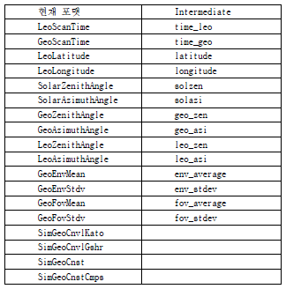
GSICS Data
Colocation data format
Intermediate : Corrected format using GSICS NetCDF format

Slide 6
GSICS Data
Product : On going
Variables | Explain
wnc | monitored instrument channel central wavenumber
beta | radiance to brightness temperature conversion coefficients beta
alpha | radiance to brightness temperature conversion coefficients alpha
a1 | radiance to brightness temperature conversion band correction coefficients offset term
a2 | radiance to brightness temperature conversion band correction coefficients first-order term
a3 | radiance to brightness temperature conversion band correction coefficients second-order term
channel_name | monitored instrument channel identifier
entral_wavelength | monitored instrument channel central wavelength
date | optimal date
validity_period | correction validity period start and end time
slope | correction formula slope
slope_se | standard error of correction formula slope
offset | correction formula offset
offset_se | standard error of correction formula offset
covariance | covariance of correction slope and offset
std_scene_tb | monitored instrument channel brightness temperature of standard scene
std_scene_tb_bias | channel standard scene brightness temperature bias
std_scene_tb_bias_se | std error of channel standard scene brightness temperature bias
number_of_collocations | collocation number for the regression analysis
coll_data_available_flag | collocation data daily available flag
hmg_tb_bias | mean brightness temperature bias over the homogeneous scenes
hmg_tb_bias_se | std error of average of brightness temperature bias at homogeneous scene

Slide 7
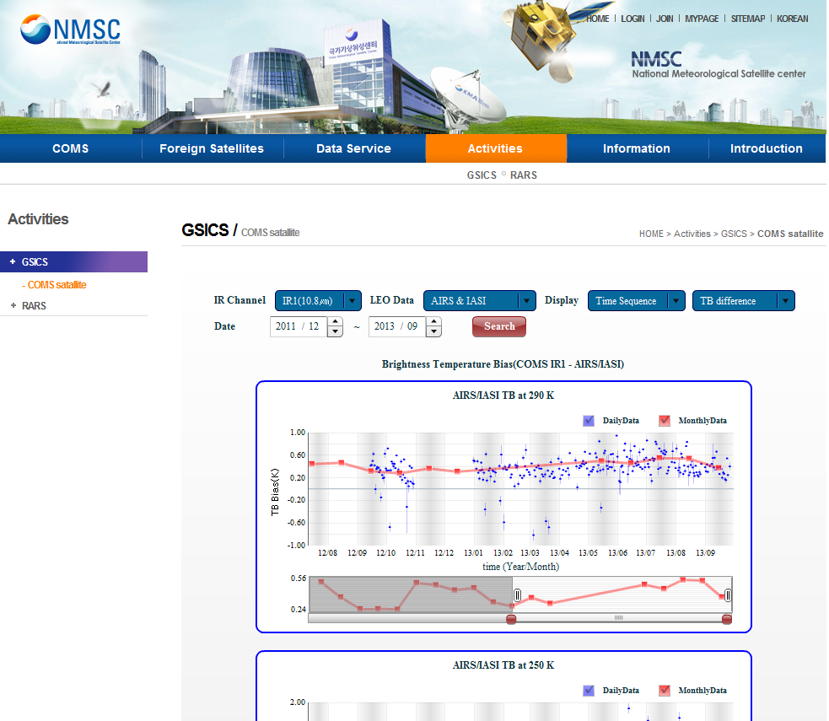
Webpage
KMA GPRC Website
Action: KMA is encouraged to continue developing their GPRC website and take into account the agreed minimum content requirements
Correct GSICS logo linking to the WMO GSICS portal (gsics.wmo.int)
Links to other GPRC websites
Pages with bias monitoring graphs for GPRC products (all if possible)
Links to where the GPRC data can be downloaded (preferably THREDDS data servers)
GPRC website contact information
Links to GPRC official documents (ATBDs, reports, etc.)
The link to the GSICS product catalog.
The link to the GCC home page.

Slide 8
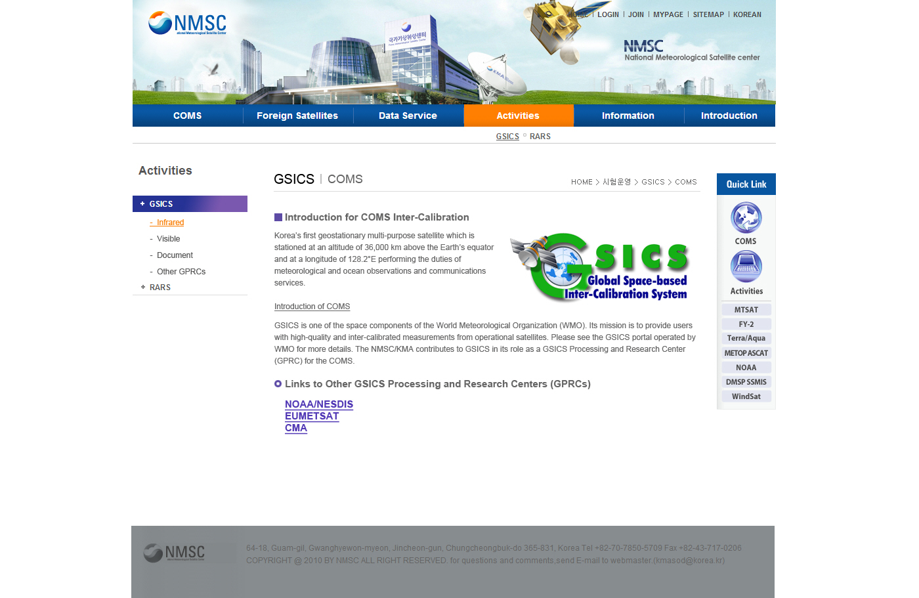
Webpage
Contents
General Information
Infrared
- Algorithm
- Bias monitoring Time sequence graph
- Scatter plot
- Download
Visible
- Algorithm
- Degradation Time sequence graph
- Scatter plot
Document
Other GPRCs Links

Slide 9
Webpage
Introduction for NMSC GSICS Website
http://nmsc.kma.go.kr/html/homepage/en/gsics/gsicsMain.do

Slide 10
Plans
Add the Metop-B IASI
- Inter-calibration with COMS IR
Update Website
- ATBDs, Data download
Data Format and sharing?
- VIS products : Cloud, Desert, Ocean…
- THREDDS?

