Slide 1
Characterizing Diurnal Calibration Variations using Double-Differences
Fangfang Yu

Slide 2
GEO Diurnal Calibration Variations
All the GEO IR instruments experience some diurnal calibration variations
According to Johnson and Weinreb (1996), the causes to the GOES midnight calibration anomalies are attributed to:
Extra radiation reflected by the non-unity emissivity of BB to the detectors, when the instrument is viewing the BB.
Scattered solar radiation contamination at space view
Most pronounced at pre-eclipse and post-eclipse around the equinox.
An empirical midnight calibration correction has been implemented (Weinreb and Han 2003)

Slide 3
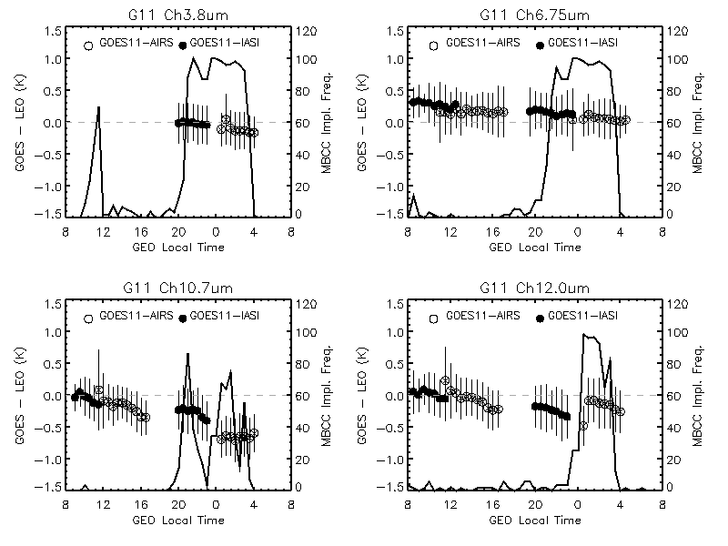
Diurnal Cal. Variation and MBCC Calibration Evaluation
Time dependent Tb bias and the standard deviation (at 30 minute time bin), as well the onset frequency of MBCC application for the winter of 2008.
(Yu et al. 2013)

Slide 4
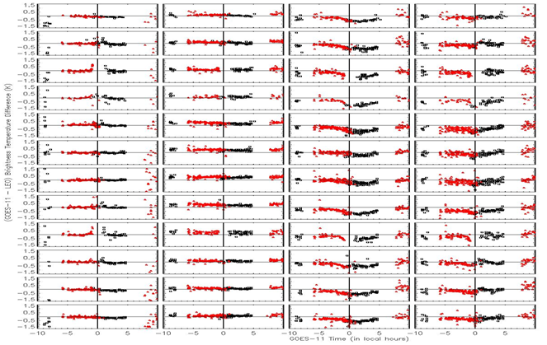
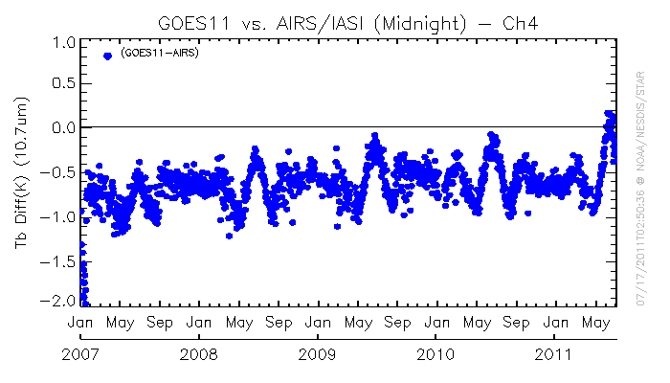
Time-dependent correction during the midnight effect time
Duration and amplitude vary at different IR channel
Depends on the frequency of MBCC application
Change with seasons
Has seasonal long-term trending
Time-series of Tb bias to AIRS at midnight time for GOES-11 Ch4
Evaluation of MBCC performance for each channel and in each month for GOES-11, courtesy of Rama V. R

Slide 5
Diurnal Calibration Variations -1
In Yu et al. (2013), diurnal Tb variation is characterized as: Diurnal Tb Variation = max(Tb_{GEO, daytime} -Tb_{AIRS,daytime}) – min(Tb_{GEO,midnight}-Tb_{AIRS,midnight})
Three months of collocation data are used to ensure enough data for a robust Tb bias at each half-hour time intervals
In the IR product, the correction coefficients are based on monthly collocation
Diurnal Tb Variation = (Tb_{GEO, daytime} -Tb_{AIRS,daytime}) – (Tb_{GEO,midnight}-Tb_{AIRS,midnight})
This method cannot work for shortwave channel (IR3.9µm)
Directional reflectance
May also over-estimate the uncertainty of window channel (10.7µm) in the day-time.
Directional emissivity

Slide 6
Diurnal Calibration Variations - 2
Can we use IASI night-time collocations?
Diurnal Tb Variation = (Tb_{GEO, nighttime} –Tb_{IASI,nightime}) – (Tb_{GEO,midnight}-Tb_{AIRS,midnight})
Need to characterize the IASI-AIRS difference
Double difference
need to know GEO_{t1} -GEO_{t2}
SNO night-time collocations for the SW channels
Extra resource needed
SNO has the cold scene issue
Can we currently assume AIRS-IASI =0 for this channel?

Slide 7
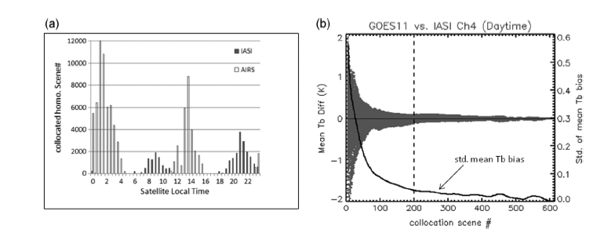
Diurnal Calibration Variations -3
Can we use hourly interval AIRS night-time collocations?
Issues:
Aqua overpasses at 1:30am. As a result, most collocations occur between 00:00-03:00am satellite local time
Need sufficient collocations for robust statistics
May work fine if the non-perfect BB is the main issue for the midnight calibration anomaly: 1-3 hours of midnight
May result in relatively larger uncertainty for the stray-light contamination at pre/post-eclipse seasons: peak at midnight? How about the spinners which have stray-light effect peaks around satellite midnight time?

Slide 8
Diurnal Calibration Variations -4
Since the purpose of diurnal calibration variation and the its uncertainty is mainly for the reference of correction residual (NOAA currently doesn’t plan to provide the midnight correction product), it is proposed that we use AIRS as the reference instrument to characterize the diurnal calibration variation
Night time collocation for SW channel (3.9µm)
Diurnal Tb Variation = (Tb_{GEO, before00Z} –Tb_{AIRS,before00Z}) – (Tb_{GEO,after00Z}-Tb_{AIRS,after00Z})
Diurnal Tb Variation = (Tb_{GEO, night}–Tb_{IASI, night}) – (Tb_{GEO,midnight}-Tb_{AIRS,midnight})
Day/night AIRS collocations for the other IR channels
Diurnal Tb Variation = (Tb_{GEO, daytime} –Tb_{AIRS,daytime}) – (Tb_{GEO,midnight}-Tb_{AIRS,midnight})

Slide 9
Diurnal Calibration Variations -5
In addition to seasonal variations, the diurnal variation may also change (trending) as the instrument ages
Ideally dynamic
Are they really needed in the netCDF file, if it is for the reference of correction residual purpose?
If it is required in the netCDF file, how long (12 months) should we provide the diurnal variations if dynamic data can be guaranteed?
Suggest addressing the diurnal calibration variation and the uncertainty in the product uncertainty analysis document instead of the netCDF file

Slide 10
Parameters in netCDF
Global attributes:
Reference instrument for diurnal calibration variation: Aqua AIRS/Metop-A IASI
Diurnal calibration variation equation: = (Tb_{GEO, nominal} –Tb_{LEO,nominal}) – (Tb_{GEO,midnight}-Tb_{LEO,midnight})
Variables:
std_scene_tb_bias_geo2leo_midnight
long_name: channel standard scene of GEO to LEO brightness temperature bias for midnight period
std_scene_tb_bias_geo2leo_midnight_se
long_name: standard error of midnight channel standard scene of GEO to LEO brightness temperature bias
number_of_collocations_midnight
long_name: collocation number for regression analysis for midnight period
std_scene_tb_bias_geo2leo_nominal
long_name: channel standard scene of GEO to LEO brightness temperature bias for nominal period
std_scene_tb_bias_geo2leo_nominal_se
long_name: standard error of nominal channel standard scene of GEO to LEO brightness temperature bias
number_of_collocations_nominal
long_name: collocation number for regression analysis for nominal period
std_scene_tb_diurnal
long_name: diurnal brightness temperature variation at standard scene radiance
std_scene_tb_diurnal _se
long_name: standard deviation of diurnal brightness temperature variation at standard scene radiance

