Slide 1
Migrating References, Double Differences, Delta Corrections, Archive Re-Calibration, Blending References
Special Issue of the IEEE TGRS on “Inter-Calibration of Satellite Instruments”:
Special Issue of the IEEE TGRS on “Inter-Calibration of Satellite Instruments”:
Tim Hewison
(EUMETSAT) (GRWG Chair)

Slide 2
Intro
Discussion framed in terms of creating delta-corrections
to migrate from IASI-A to –B as Reference,
using double differences
But generically applicable
Even for single difference
Met7-IASIA as example (because it’s bad)
For NRTC & RAC
Thinking ahead to Archive Re-Calibration Corrections

Slide 3
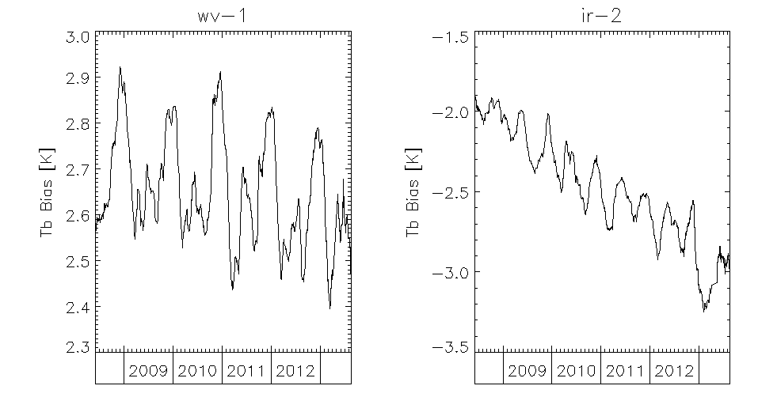
Time Series of Meteosat7/MVIRI Bias wrt IASI
Just an example time series
Meteosat7/MVIRI “WV” and “IR”
GSICS Re-Analysis Correction
Evaluated Standard Bias for Standard Scene radiance
Expressed as Tb
5 year long time series
WV: strong yearly cycle
IR: twice-yearly cycle
+ long-term drift
Time Series of Standard Biases for “WV” and “IR” channels of Meteosat7/MVIRI calculated with reference to Metop-A/IASI.

Slide 4
Characterise Biases in Available Data
In general, time series include: x=f(t)+...
Random Noise – White noise α
Systematic Bias β
Random Drift – 1/f noise
Systematic Drift – linear, polynomial...
Periodic Variations – diurnal/seasonal
Random sporadic outliers – can be filtered

Slide 5
Characterise Biases in Available Data
In general, time series include: x=f(t)+... }
Random Noise – White noise α }
Systematic Bias β } All can
Random Drift – 1/f noise } Change
Systematic Drift – linear, polynomial... }Abruptly
Periodic Variations – diurnal/seasonal }
Random sporadic outliers – can be filtered }
We should characterise biases from available data!
Use this to determine nature of Δ Correction

Slide 6
In case of Jumps in Ref1/2
Any time series parameter can jump
Comparison of Double Differences can identify which time series has jumped
Treat as a discontinuity
Process segments independently
Tie segments together using double-differences
Need to work example

Slide 7
Delta Corrections’ Time Period
At 2014 GRWG meeting:
Agreed to generate Delta Corrections for RACs & NRTCs
Based on double differences over same time periods
But this makes Delta Corrections redundant
Δ=(Mon-Ref1)-(Mon-Ref2)
(Mon-Ref2)+Δ=(Mon-Ref1) – Identical if same period
So users will keep using (Mon-Ref1) until they can’t
Then what?

Slide 8
What happens after Metop-A?
Delta Correction
Time
Monitor IASIb-a DD
during overlap period
Characterise relative bias
and uncertainty
Extrapolate trend?
Only if significant?
Dangerous!
Extrapolate uncertainty
Need >1 year overlap

Slide 9
After Ref1 is gone – 3 Options
Just use most recent ΔRAC?
Does not capture any drift - Extrapolation dangerous!
periodicity e.g. Season cycle
or increased uncertainty - Would be constant in time??
Use whole overlap period?
Could account for drift - in terms of increased uncertainty
Could model periodicity - Risks aliasing different periods
Could model uncertainty as a function of time
Use overlap period of integer number of periods (years)
As 2, but cancels out periodic variations

Slide 10
Schematic Example
First month: ΔTb = -1.90 ± 0.05 K
Time Series of Standard Biases for “IR” channel of Meteosat7/MVIRI calculated with reference to Metop-A/IASI.

Slide 11
Schematic Example
First month: ΔTb = -1.90 ± 0.05 K
First 3 months: ΔTb = -2.00 ± 0.10 K
Time Series of Standard Biases for “IR” channel of Meteosat7/MVIRI calculated with reference to Metop-A/IASI.

Slide 12
Schematic Example
First month: ΔTb = -1.90 ± 0.05 K
First 3 months: ΔTb = -2.00 ± 0.10 K
First 6 months: ΔTb = -2.00 ± 0.05 K
Time Series of Standard Biases for “IR” channel of Meteosat7/MVIRI calculated with reference to Metop-A/IASI.

Slide 13
Schematic Example
First month: ΔTb = -1.90 ± 0.05 K
First 3 months: ΔTb = -2.00 ± 0.10 K
First 6 months: ΔTb = -2.00 ± 0.05 K
First 12 months: ΔTb = -2.05 ± 0.07 K
Time Series of Standard Biases for “IR” channel of Meteosat7/MVIRI calculated with reference to Metop-A/IASI.

Slide 14
Schematic Example
First month: ΔTb = -1.90 ± 0.05 K
First 3 months: ΔTb = -2.00 ± 0.10 K
First 6 months: ΔTb = -2.00 ± 0.05 K
First 12 months: ΔTb = -2.05 ± 0.07 K
First 24 months: ΔTb = -2.15 ± 0.10 K
Time Series of Standard Biases for “IR” channel of Meteosat7/MVIRI calculated with reference to Metop-A/IASI.

Slide 15
Schematic Example
First month: ΔTb = -1.90 ± 0.05 K
First 3 months: ΔTb = -2.00 ± 0.10 K
First 6 months: ΔTb = -2.00 ± 0.05 K
First 12 months: ΔTb = -2.05 ± 0.07 K
First 24 months: ΔTb = -2.15 ± 0.10 K
First 36 months: ΔTb = -2.25 ± 0.15 K
Time Series of Standard Biases for “IR” channel of Meteosat7/MVIRI calculated with reference to Metop-A/IASI.

Slide 16
Schematic Example
First month: ΔTb = -1.90 ± 0.05 K
First 3 months: ΔTb = -2.00 ± 0.10 K
First 6 months: ΔTb = -2.00 ± 0.05 K
First 12 months: ΔTb = -2.05 ± 0.07 K
First 24 months: ΔTb = -2.15 ± 0.10 K
First 36 months: ΔTb = -2.25 ± 0.15 K
First 48 months: ΔTb = -2.35 ± 0.20 K
Time Series of Standard Biases for “IR” channel of Meteosat7/MVIRI calculated with reference to Metop-A/IASI.

Slide 17
Schematic Example
First month: ΔTb = -1.90 ± 0.05 K
First 3 months: ΔTb = -2.00 ± 0.10 K
First 6 months: ΔTb = -2.00 ± 0.05 K
First 12 months: ΔTb = -2.05 ± 0.07 K
First 24 months: ΔTb = -2.15 ± 0.10 K
First 36 months: ΔTb = -2.25 ± 0.15 K
First 48 months: ΔTb = -2.35 ± 0.20 K
First 60 months: ΔTb = -2.50 ± 0.25 K
Time Series of Standard Biases for “IR” channel of Meteosat7/MVIRI calculated with reference to Metop-A/IASI.

Slide 18
Schematic Example
First month: ΔTb = -1.90 ± 0.05 K
First 3 months: ΔTb = -2.00 ± 0.10 K
First 6 months: Cyclic Period ΔTb = -2.00 ± 0.05 K Min Uncert.
First 12 months: ΔTb = -2.05 ± 0.07 K
First 24 months: ΔTb = -2.15 ± 0.10 K Define fn
First 36 months: Increasing ΔTb = -2.25 ± 0.15 K Uncertainty
First 48 months: ΔTb = -2.35 ± 0.20 K
First 60 months: ΔTb = -2.50 ± 0.25 K
Time Series of Standard Biases for “IR” channel of Meteosat7/MVIRI calculated with reference to Metop-A/IASI.

Slide 19
Extrapolate Uncertainty, not Bias
Time Series of Standard Biases for “IR” channel of Meteosat7/MVIRI calculated with reference to Metop-A/IASI.

Slide 20
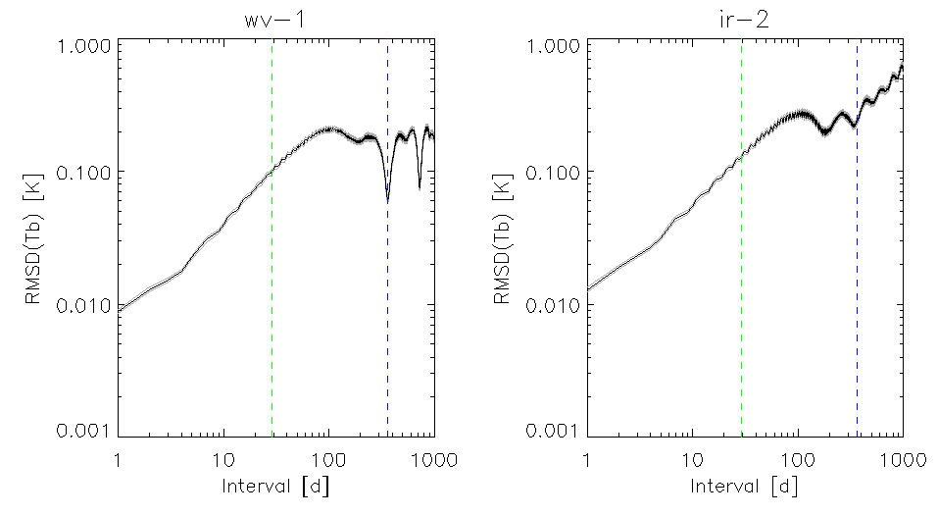
Variograms for Meteosat-7/MVIRI “WV” and “IR”
“WV” and “IR” channels of Meteosat/MVIRI
Variograms increase with time interval 1-29d
Averaging period used in GSICS Correction
“WV” Minimum at Δt=1yr:
(2γ_{t})^{1/2}=65±4 mK
“IR” Minimum at Δt=1yr:
(2γ_{t})^{1/2}=187±12 mK
Higher “nugget values”
More collocation noise
Higher “sill values”
Faster calibration drift
See poster for details
6-Month Cycles
Annual Cycles
Low Pass Filter
Low Pass Filter
Long-term Drift
Long-term Drift
Temporal variograms [(2γ_{t})^{1/2}] calculated as RMS differences in Standard Biases for “WV” and “IR” channels of Meteosat-7/MVIRI calculated with reference to Metop-A/IASI. Vertical lines show periods of 29d and 1yr.

Slide 21
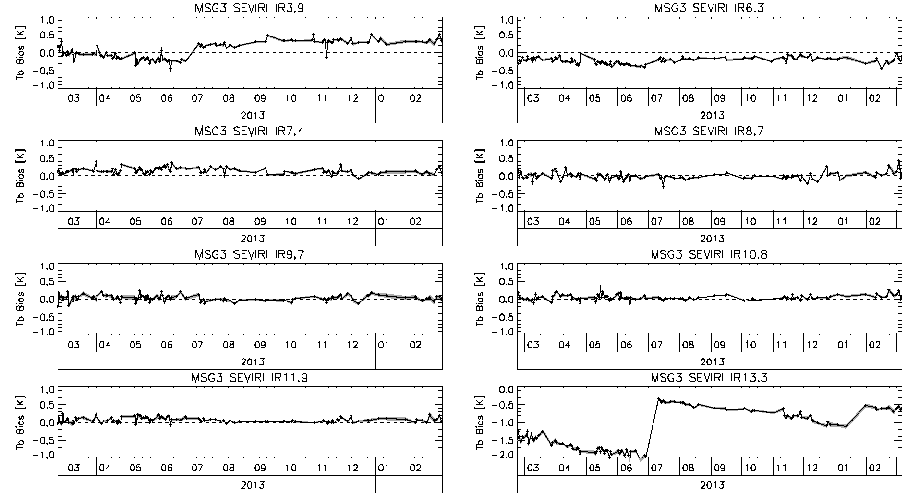
Time Series of Standard Biases – Updated! Full year (Met10/SEVIRI-MetopA/IASI)
^ Decontaminations ^
Unsmoothed Daily Results 3-sigma filter
– not necessarily same days!
^ Decontaminations ^

Slide 22
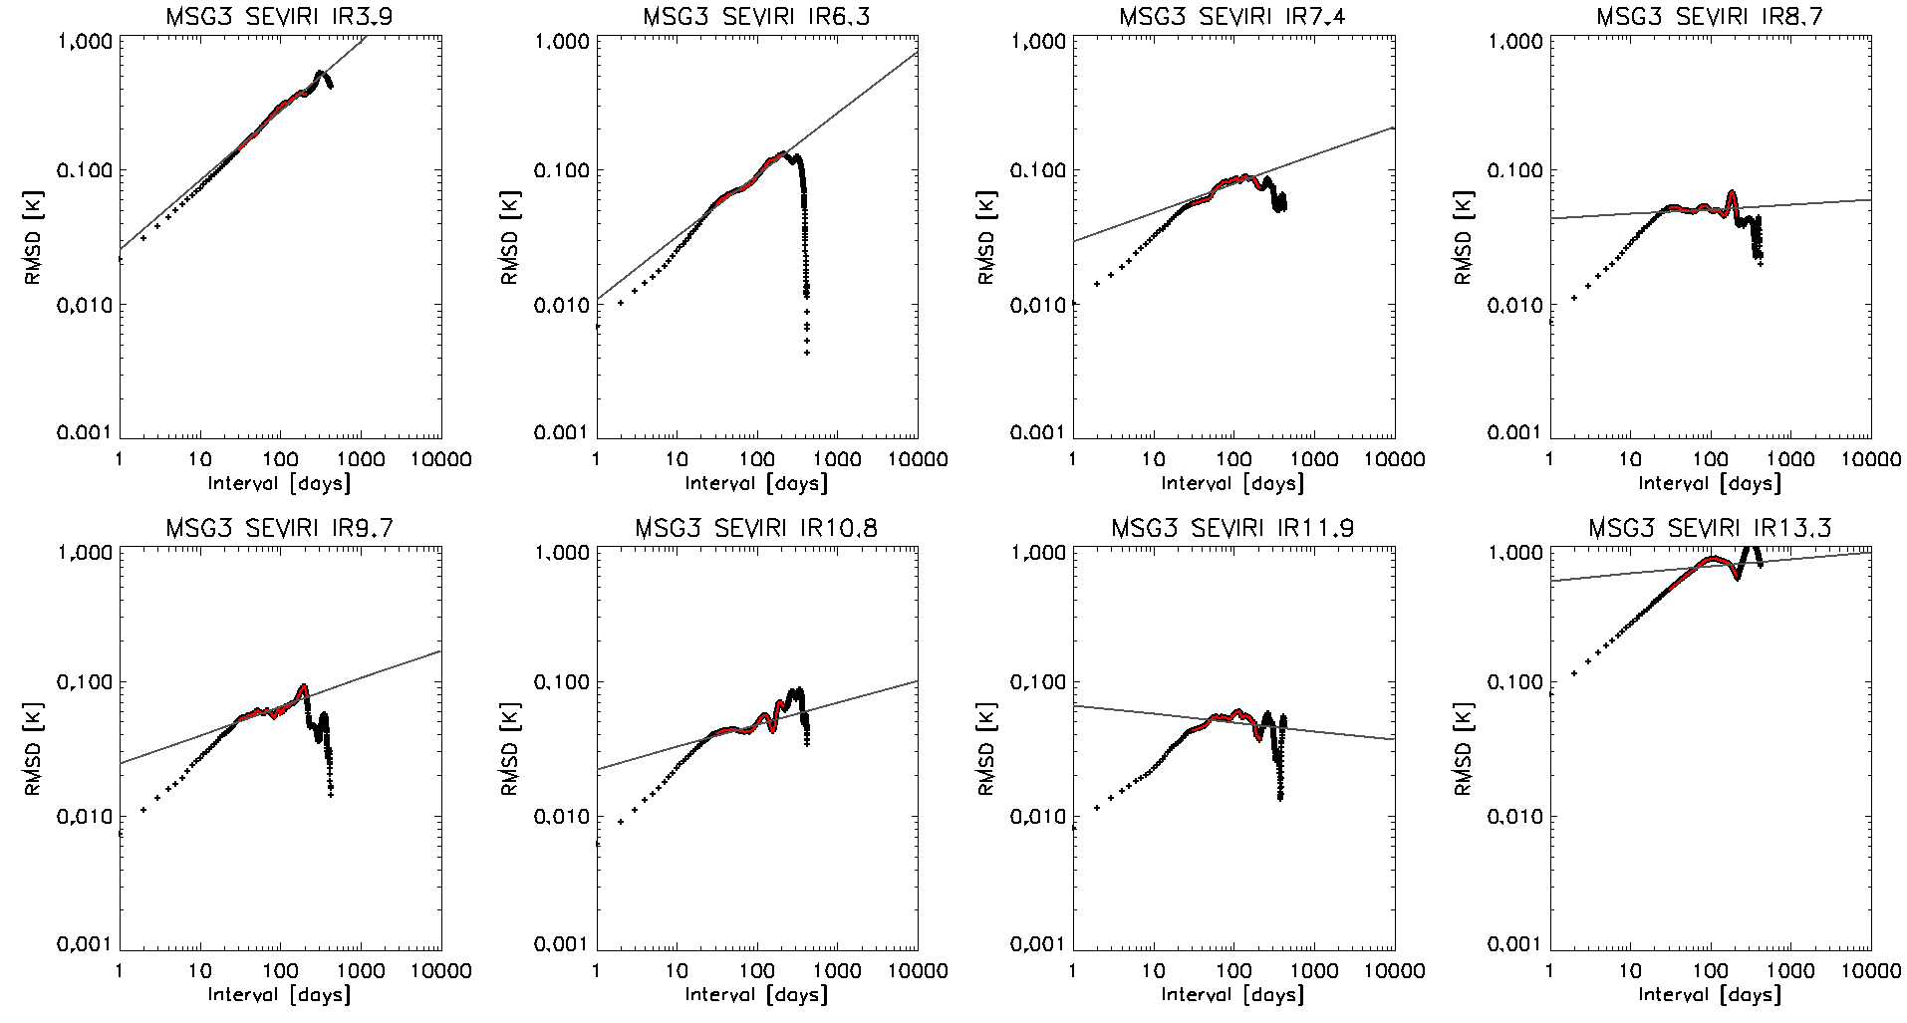
Single-Difference Variograms for (MSG3-IASIB) RACs
Long-timescale minima (Decontaminations)
Long-term Drift
Low Pass Filter

Slide 23
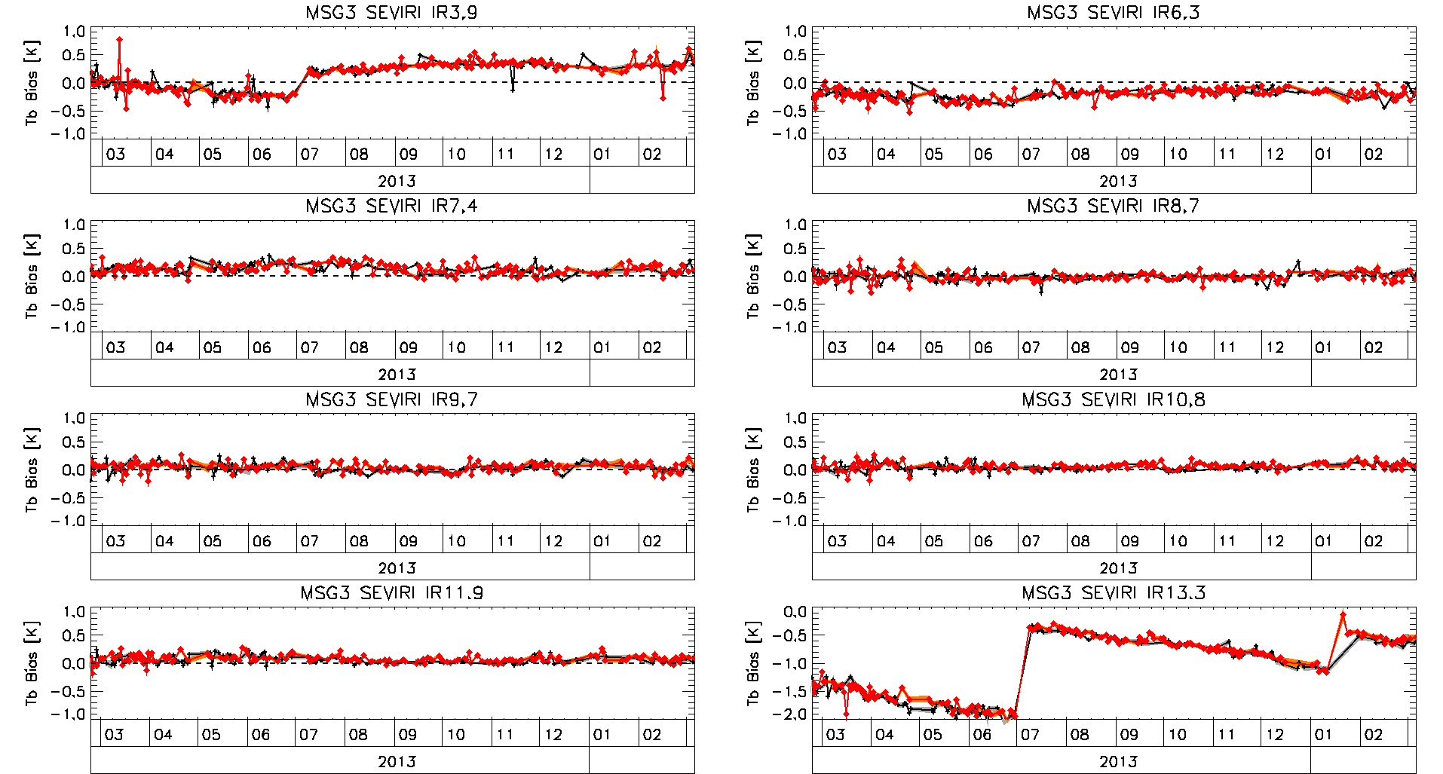
Time Series of Standard Biases – Updated! Full year (Met10/SEVIRI-MetopB/IASI) & (Met10/SEVIRI-MetopA/IASI)
Unsmoothed Daily Results 3-sigma filter
– not necessarily same days!

Slide 24
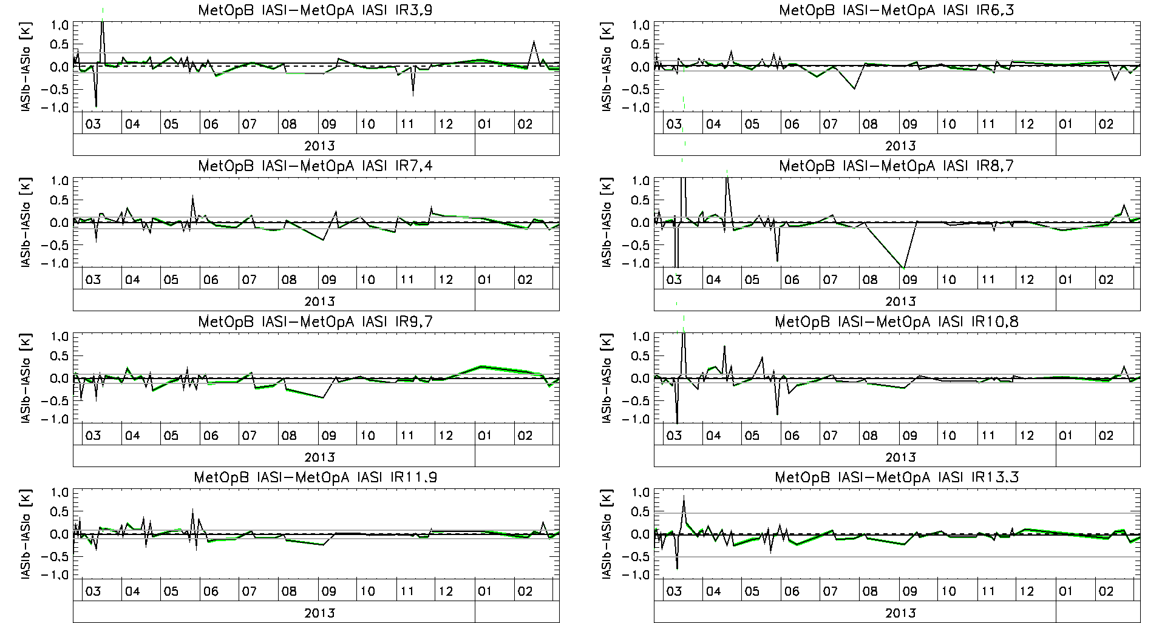
Time Series of Double Differences (Met10/SEVIRI-MetopB/IASI)-(Met10/SEVIRI-MetopA/IASI)
No Significant Trend in DD for Tb=std or 220K, 290K,...
No Significant Trend in DD for slope or offset
Unsmoothed Daily Results – only selecting matched days!

Slide 25
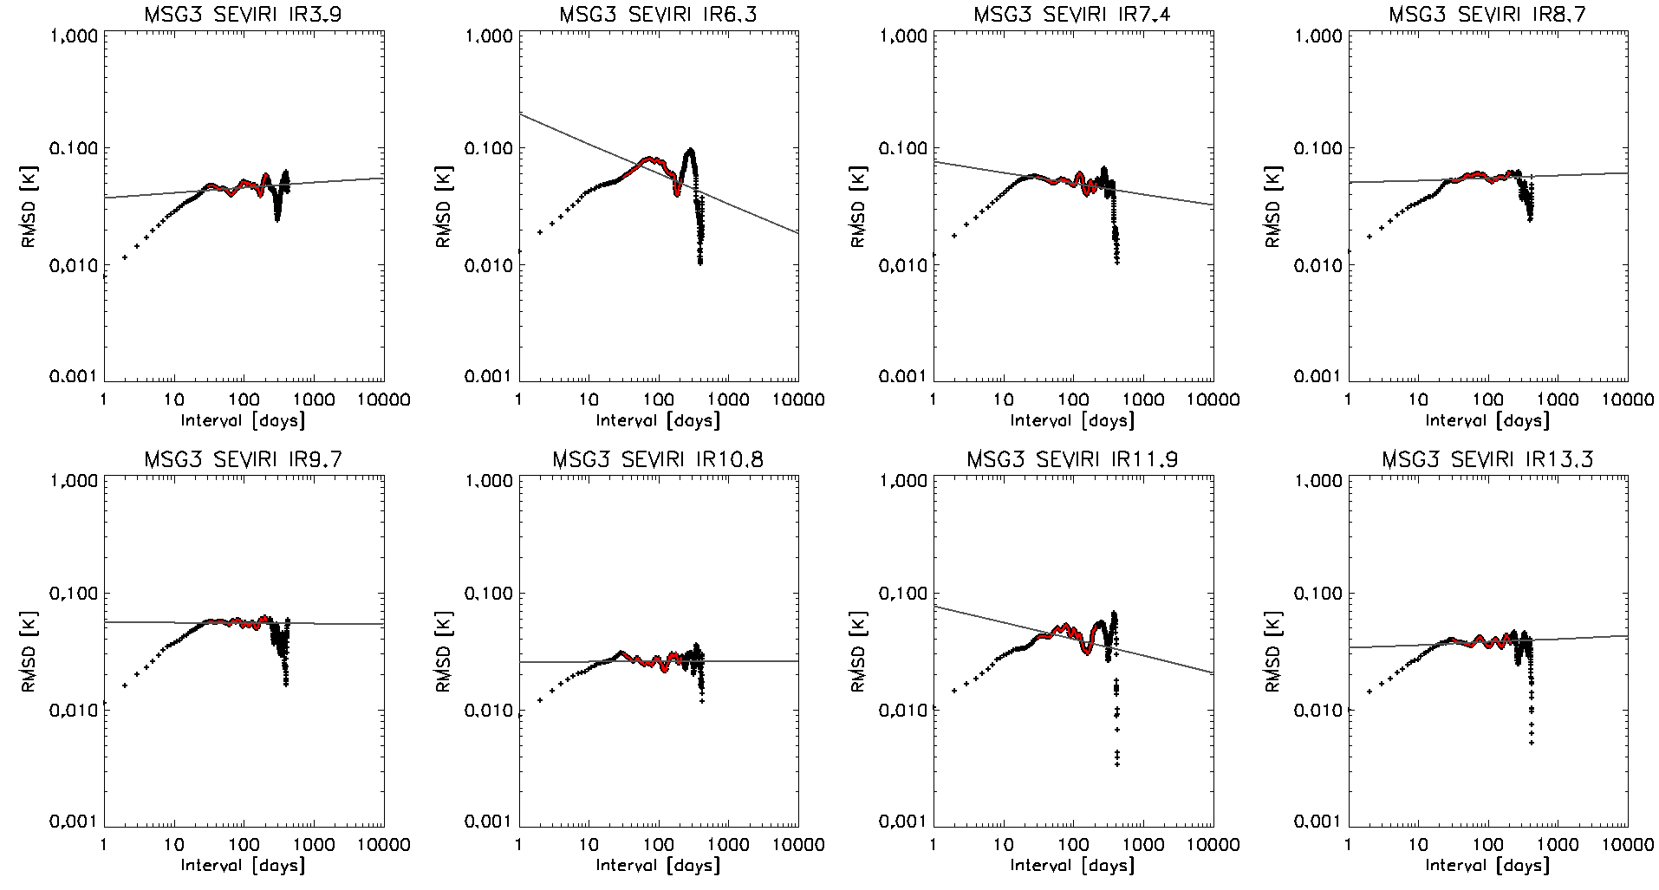
Double-Difference Variograms for (MSG3-IASIB)-(MSG3-IASIA) RACs
Low Pass Filter
No Long-term Drift
No annual cycle

Slide 26
Diurnal Cycles w/ multiple References
Meteosat-9/SEVIRI
Metop-A/IASI
Metop-B/IASI
Aqua/AIRS
S-NPP/CrIS
ΔIASIB-IASIA - Tie 9:30am/pm Time series together }
ΔAIRS-CrIS - Tie 1:00am/pm Time series together }-Combine -> Blended Ref*
ΔAIRS-IASIA - Characterise diurnal cycle }
* Blending could be just ‘averaging’ – susceptible to calibration differences
Or after bias adjustment = traceable to Metop-A/IASI

Slide 27
Blending References
Meteosat-9/SEVIRI
Metop-A/IASI
Metop-B/IASI
Weight
0% 100%
Time
ΔIASIB-IASIA - 50-50 Blend* of References during whole overlap
* Blending could be just ‘averaging’ – susceptible to calibration differences
Or after bias adjustment = traceable to Metop-A/IASI

Slide 28
Blending References
Meteosat-9/SEVIRI
Metop-A/IASI
Metop-B/IASI
Weight
0% 100%
Delay
Time
ΔIASIB-IASIA - 50-50 Blend* of References after initial delay
E.g. 1yr to evaluate Double Differences and develop Delta Correction
* Blending could be just ‘averaging’ – susceptible to calibration differences
Or after bias adjustment = traceable to Metop-A/IASI

Slide 29
Blending References
Meteosat-9/SEVIRI
Metop-A/IASI
Metop-B/IASI
Weight
0% 100%
Delay
Time
ΔIASIB-IASIA - Tapering Blend* of References after initial delay
E.g. 1yr to evaluate Double Differences and develop Delta Correction
* Blending could be just ‘averaging’ – susceptible to calibration differences
Or after bias adjustment = traceable to Metop-A/IASI

Slide 30
Conclusions
Need to generate double differences for all overlap period
Analyse these to characterise reference differences
Should probably not extrapolate trends
But could reconstruct them from multiple references
May not need Delta Corrections until current reference instrument dies
But then Delta Corrections will be needed instantly
For continuity of RACs, NRTCs
To trace them back to previous references
So need to start generating double differences asap
And define Delta Corrections to be ready when needed

Slide 31
Questions
Should we extrapolate periodic cycles?
If we can model/understand them & they are significant
Or use last n whole years
Is it OK to extrapolate uncertainty like this for NRTC/RAC?
For Delta Correction, keeping constant DD bias after Ref1 is dead
Is there any point in generating Delta corrections for current RAC/NRTC using the same smoothing period?
Or should we calc DD over whole overlap period? (or n years?)
Is this concept applicable to other GSICS Products?
DCC, Lunar, ...
Can we make blended reference for Archive Re-Cal/RACs?
With or without bias adjustment?

Slide 32
Urgent Questions
How to characterise diurnal calibration variability?
Do we need to include this in RAC/NRTC netCDF or document it?
How to define Delta Corrections for IASI-B->A?
Just from double difference of RAC & NRTC – same periods (As agreed in 2014 GRWG Meeting) - No added value
Average of all RACs/NRTCs over overlap period? (Correlated)
Average of selected RACs/NRTCs every 29/14d? (Uncorrelated)
Calculate Variograms from RACs/NRTCs over 30d-Nyquist
Recalculate regression from all collocations in overlap period?
Need more data – Any advantages?
As 2, 3 or 4, but for only the most recent n years (avoids aliasing seasonality e.g. from n.5 years)

