Slide 1
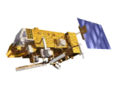
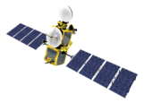
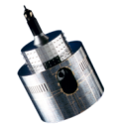
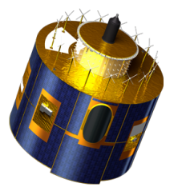
Requirements for an official plotting tool
and Revised Proposal for a GSICS DCC product
Masaya Takahashi (JMA), Sébastien Wagner (EUMETSAT)

Slide 2
Summary
Requirements for an official plotting tool (developed at EUMETSAT)
NOT discussed in the 2014 GSICS annual meeting
Need for GRWG to decide what kinds of plotting we want
Summary of the tool will be introduced today
File naming/contents of GEO-LEO VIS/NIR GSICS product (netCDF)
Discussed in the 2014 GSICS annual meeting
Some modifications after the meeting
Today’s discussion point: file naming (this includes future perspective)
File contents: NOT fixed yet (in particular variables related to the uncertainty)
Templates will be uploaded on the GSICS wiki later
We hope details will be discussed via email...

Slide 3
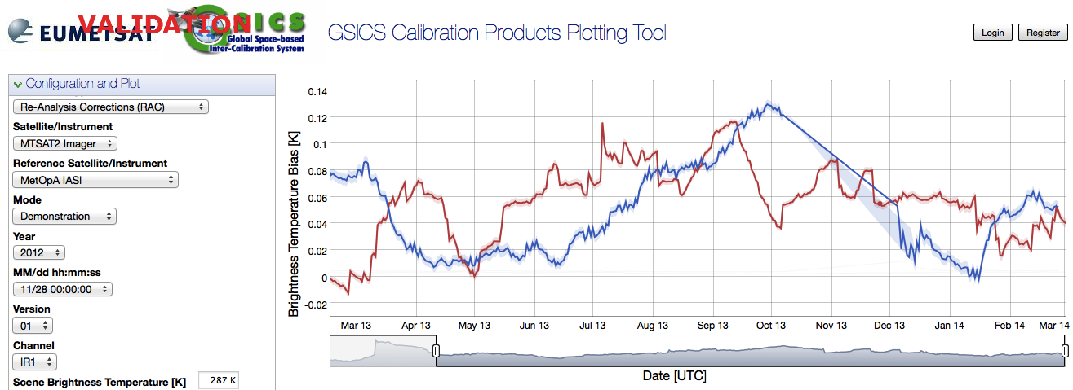
Official GSICS plotting tool http://vgsics.eumetsat.int/plotter/
GPRCs have their own product monitoring/plotting websites
“GSICS Plotting Tool” has been developed at EUMETSAT
Common look and feel (Easy comparison among multiple products)
Dynamical plotting (no need to prepare lots of figures)
Now, only single file is supported (i.e., RAC which contains all time series info.)
Time series of 11μm channel TB difference against Metop-A/IASI
MTSAT-2 10.8 um
Meteosat-10 10.8 um

Slide 4
Requirements for the plotting tool
What kinds of plotting we want?
Possible plots:
DCC statistics timeseries (mean, mode, ...)
Trend analysis (instrument degradation in radiance, reflectance, digital counts,...)
Variogram of DCC statistics (this may be useful for R&D)
... Anything else?
Purpose of the tool should be considered
Primary user of the plotting tool: NOT developers
Low priority to plot details which are useful for GSICS R&D

Slide 5
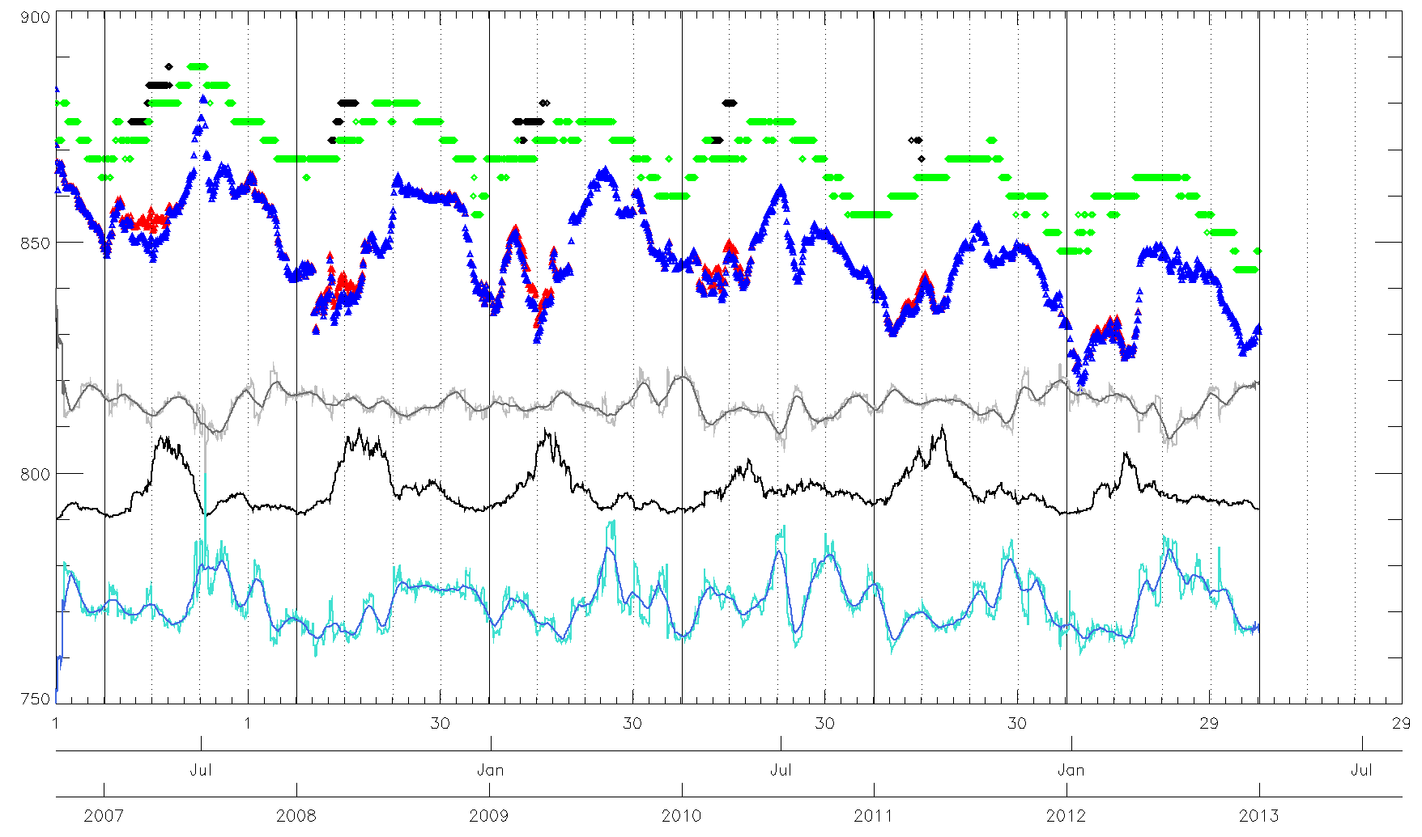
Example of information to display...
MODE
SKEWNESS + smoothed over 30 days
MODE – No saturation
Number of DCCs
MEAN
K-K0
MEAN – No saturation
KURTOSIS + smoothed over 30 days

Slide 6
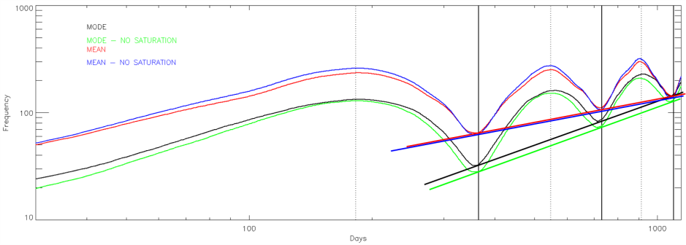
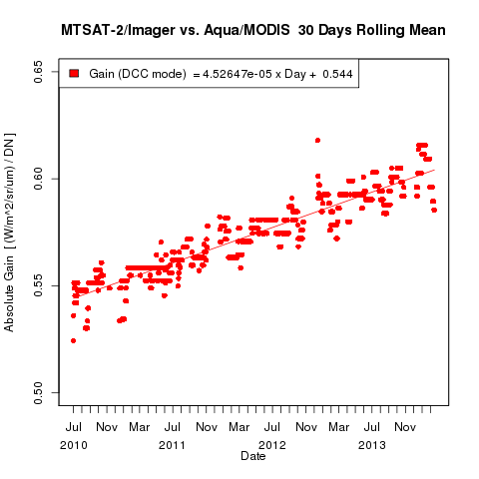
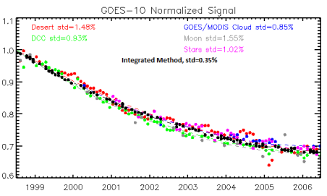
Example of plotting ...
Variogram of DCC statistics
Time series of gain against Aqua/MODIS
Trend analysis
From Fangfang’s presentation at web meeting in Jan. 2014

Slide 7
GSICS file naming and netCDF convention
GSICS file naming convention:
https://gsics.nesdis.noaa.gov/wiki/Development/FilenameConvention
➔ Follows the rules given in the General File Naming Conventions section of the W.M.O. Manual on The Global Telecommunication System
GSICS file naming convention:
https://gsics.nesdis.noaa.gov/wiki/Development/NetcdfConvention
➔ Relies on the following NetCDF conventions:
NetCDF Climate and Forecast Metadata Convention
http://cf-pcmdi.llnl.gov/documents/cf-conventions/latest-cf-conventions-document-1/
NetCDF Attribute Convention for Dataset Directory
http://www.unidata.ucar.edu/software/netcdf-java/formats/DataDiscoveryAttConvention.html

Slide 8
File naming (based on: https://gsics.nesdis.noaa.gov/wiki/Development/FilenameConvention)
Proposal (e.g., Meteosat-10/SEVIRI Re-Analysis Correction):
W_XX-EUMETSAT-Darmstadt,SATCAL+RAC+GEOLEOVISNIR,MSG3+SEVIRI-Aqua+MODIS_C_EUMG_20130601000000_demo_01.nc
GSICS Product Taxonomy:
https://gsics.nesdis.noaa.gov/wiki/Development/ProductTaxonomy
discussion among Tim, Fangfang and Aleksandar in Apr. 2013
Spectral Range, Instrument Class, Principal Methodology, Product Type, ...
Do we agree with this classification?
In the future, do we want to put all VIS/NIR inter-calibration results (e.g., DCC, Moon, Rayleigh Scattering...) into one file?
If GSICS products should be different at each calibration method, we have to think about to add it to the file naming (e.g., ...GEOLEOVISNIR+DCC,MSG2...)
Spectral Range | Acronym | Wavelength Range (µm)
Ultraviolet | UV | below 0.4
Visible | VIS | 0.4 to 0.75
Near-infrared | NIR | 0.75 to 3.0
Infrared | IR | 3.0 to 15.0
Far-infrared | FIR | 15 to 1,000
Microwave | MW | greater than 1,000

Slide 9
netCDF: Global attributes – Part 1
In blue = as in existing IR products.
In red = specific to DCC
In green = comment/question
Conventions = "CF-1.6"
Metadata_Conventions = "Unidata Dataset Discovery v1.0"
standard_name_vocabulary = "CF Standard Name Table (Version 19, 22 March 2012)"
project = "Global Space-based Inter-Calibration System"
title = "MSG3+SEVIRI vs Aqua+MODIS GSICS Re-Analysis Correction”
summary = "Coefficients of the GSICS Correction for the reflective solar bands of a GEOstationary imager using a LEO reference instrument"
institution = "EUMETSAT"
date_created = "2013-08-02T14:02:16Z"
date_modified = "2014-03-12T14:52:30Z"
license = "Calibration information delivered as a GSICS operational product is generated in accordance with GSICS principles and practices.; GSICS operational and demonstration products may be used and redistributed freely. Scientific publications using GSICS operational or demonstration products should however acknowledge both GSICS and the relevant producer organization.; There is no warranty on the data express or implied, including warranties of merchantability and fitness for a particular purpose, or any assumed legal liability for the accuracy, completeness, or usefulness, of this information. The user of the data do so at their own risk."
comment = "Use the RAC with the time closest to the time of interest. Take great caution when applying it at a date where this difference is greater than the window period."

Slide 10
netCDF: Global attributes – Part 2
In blue = as in existing IR products.
In red = specific to DCC
In green = comment/question
naming_authority = "int.eumetsat.gsics"
creator_name = "EUMETSAT - European Organisation for the Exploitation of Meteorological Satellites"
creator_email = "ops@eumetsat.int"
creator_url = "http://www.eumetsat.int"
references = “Aqua MODIS Collection 6 Level 1B“
atbd_doc_url = ATBD URL
atbd_doc_doi = ATBD DOI (or OID)
product_doi = Product DOI (or OID), used in Operational-Phase
history = Info about algorithm version / set-up etc (free content)
processing_level = "demonstration/v03.05.00"
time_coverage_start = "2013-08-01T00:00:00Z"
time_coverage_end = "2014-02-26T24:00:00Z"
geospatial_lat_min = Min_LatGEO
geospatial_lat_max = Max_LatGEO
geospatial_lon_min = Min_LonGEO
geospatial_lon_max = Max_LonGEO
geospatial_lat_units = "degrees_north"
geospatial_lon_units = "degrees_east"
Open Question: what kinds of information is suitable for? Version of dataset, documents? This issue is also related to the other GSICS products.
New proposal from Peter and I. Details will be introduced/discussed in the GDWG web meeting about doi/iod.
Open Question: Actual GEO coverage? Or area where the DCC algorithm is applied (where the method is validated)?

Slide 11
netCDF: Global attributes – Part 3
In blue = as in existing IR products.
In red = specific to DCC
In green = comment/question
id = "W_XX-EUMETSAT-Darmstadt,SATCAL+RAC+GEOLEOVISNIR,MSG3+SEVIRI-AQUA+MODIS_C_EUMG_20130801000000_demo_03.nc”
wmo_data_category = 30
wmo_international_data_subcategory = 4 or 5 “4” for NRTC, “5” for RAC
local_data_subcategory = 3 “1” for GEO-LEO-IR, “2” for LEO-LEO-IR, “3” will be for GEO-LEO-VISNIR
keywords = "GSICS, satellites, inter-calibration, VIS, NIR” (free content)
monitored_instrument = "MSG3 SEVIRI"
reference_instrument = “Aqua MODIS"
monitored_instrument_wmo_code = “(56, 207)"
reference_instrument_wmo_code = “(784, 389)"
window_period = "P30D" Period of 30 days for statistics
dcc_brdf_model = “Hu et al. (2004)”
averaging_method = “mode” “mode” , “mean”, “median”
trend_calculation_formula = “a*date^2+b*date^2+c” fitting function to plot a time series of instrument
degradation. Needed if an official plotting tool
supports this plotting.
Do we need new global attributes about dataset version (e.g., Aqua/MODIS Collection 6)?
From the WMO’s Common Code Tables C-5 and C-8. This was proposed in 2010: https://groups.google.com/forum/#!topic/gsics-dev/FVV68cGgVWU

Slide 12
netCDF: Global attributes – Part 4
In blue = as in existing IR products.
In red = specific to DCC
In green = comment/question
Users can find these information in the ATBD, so it may be redundant for the GSICS products. But we can contain them to the netCDF if we want!
land_sea_mask = “(SEA, SEA, LAND, BOTH)” Flag for filter on land and sea to select dcc pixels
mon_max_ir_tb = 205 Threshold of BT11um for the DCC selection
mon_ir_tb_homogeneity = 2 Standard deviation of 3x3 pixels BT11μm < 1°K
mon_vis_radiance_homogeneity = 0.5 Standard deviation of 3x3 pixels visible radiance < 3%
mon_time_range = “T03:00:00Z/PT3H” Observation time range for DCC selection as UTC
Need to be checked if it follows ISO8601 convection
mon_pdf_increment = “(5, 5, 5, 10)” Increment for the PDF
mon_average_pixel_size = “(2, 2, 2, 6)” Compensating the pixel size
mon_vza_max = “(40, 40, 40, 40)” Threshold of viewing zenith angle [deg]
mon_sza_max = “(40, 40, 40, 40)” Threshold of solar zenith angle [deg]
Should be duplicated for the reference instrument (use global attributes: ref_*)

Slide 13
netCDF: Variable – Part 1
In blue = as in existing IR products.
In red = specific to DCC
In green = attribute: long_name
Variable dimensions:
chan = Number of reflective solar bands (e.g. 4 for SEVIRI)
chan_strlen = 5 (e.g., “VIS06”)
date = 1 for NRT and N for RAC (complete timeseries)
validity = 2 (i.e. for the min and the max)
Variables [dimenison]:
char channel_name [chan]: channel identifier
float central_wavelength [chan]: nominal channel central wavelength
float validity_period [date, validity]: correction validity period start and end time
float sbaf [chan]: spectral band adjustment factor for monitored instrument
Int mon_k0_av [date, chan]: average of deep space count for monitored instrument
float mon_gain [date, chan]: calibration gain with respect to reference instrument
float mon_gain_se [date, chan]: standard error on the gain with respect to reference instrument
monitored instrument (=GEO)

Slide 14
netCDF: Variable – Part 2
In blue = as in existing IR products.
In red = specific to DCC
In green = attribute: long_name
int mon_number_of_targets [date, chan]: number of dcc pixels to calculate correction of monitored instrument
float mon_mode_dc [date, chan]: mode of digital counts for monitored instrument
float mon_mean_dc [date, chan]: mean of ...
float mon_kurtosis_dc [date, chan]: kurtosis of ...
float mon_skewness_dc [date, chan]: skewness of ...
int ref_number_of_targets [date, chan]: number of dcc pixels to calculate correction of reference instrument
float ref_mode_radiance [date, chan]: mode of radiance for reference instrument
float ref_mean_dc [date, chan]: mean of ...
float ref_kurtosis_dc [date, chan]: kurtosis of ...
float ref_skewness_dc [date, chan]: skewness of ...
float mon_sol_irr [chan]: band solar irradiance of monitored instrument
float ref_sol_irr [chan]: band solar irradiance of reference instrument
Necessary if an official plotting tool supports bias plotting regarding reflectance
Open question: what kinds of uncertainties we should include?
Fangfang’s suggestion at the annual meeting:
Uncertainty of reference reflectance, fitting coefficients, Correction coefficients, BRDF model, …

Slide 15
Discussion

