Slide 1
DCC SBAF
DCC web meeting
June 5, 2014

Slide 2
Spectral Band Adjustment Factors
Spectra from each SCIAMACHY scene-appropriate footprint are convolved with imager SRFs
Yields imager-equivalent (pseudo imager) radiances

Slide 3
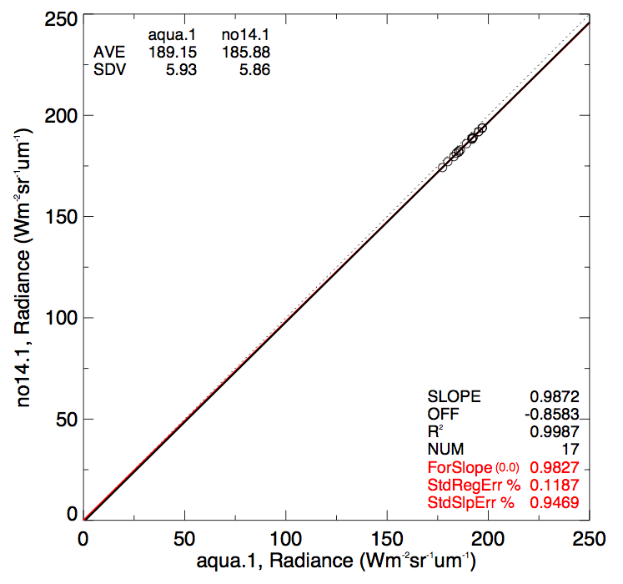
Spectral Band Adjustment Factors
Regression of two pseudo radiances constitutes a Spectral Band Adjustment Factor (SBAF)
Applied to the reference sensor radiance (L_{ref}) to arrive at the predicted target sensor radiance (L_{tar})

Slide 4
Equations
This would be more accurate, than using SCIA rad, since SCIA ratios solar and earth views
Visible band solar constants based on MCST incoming solar, which is what MODIS uses

Slide 5
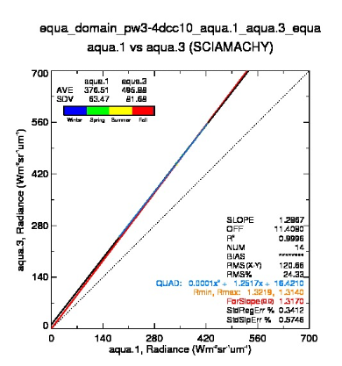
SBAF web site
Earth spectra (SCIAMACHY)
DCC
Desert-Libya-4
Desert-Sonoran
Tropical ocean SNO
NH Polar SNO
Reference (X-axis) SRF
Target (Y-axis) SRF
Units
Radiance
Scaled Radiance
Stratify Pairs by
none
PW
Season
Regression
Force fit
linear
2nd order
• Default
radiance
• Can pick more than one
• Default None
• Dependent on earth spectra selection
Have a plot showing, with a pre-selection from above
The user will see the options and change them
Next page has my vision of what the plot should look like
• too many plots of all combinations,
• too many lines on the plot
• plot title is too confusing

Slide 6
SBAF statistics
SBAF | scaled | radiance | Stderr (%) | SC (MCST) Wm⁻²sr⁻¹µm⁻¹
COMS | 0.9903 | 0.9427 | 0.3 | 480.58
GOES-13 | 0.9921 | 1.038 | 0.1 | 527.75
GOES-15 | 0.9918 | 1.042 | 0.1 | 529.74
Met-7 | 0.9950 | 0.8735 | 0.5 | 446.07
Met-9 | 0.9960 | 1.015 | 0.07 | 516.17
Met-10 | 0.9949 | 1.020 | 0.07 | 518.33
MTSAT-2 | 0.9901 | 0.9398 | 0.3 | 479.33
Aqua-MODIS |  |  |  | 509.34

Slide 7
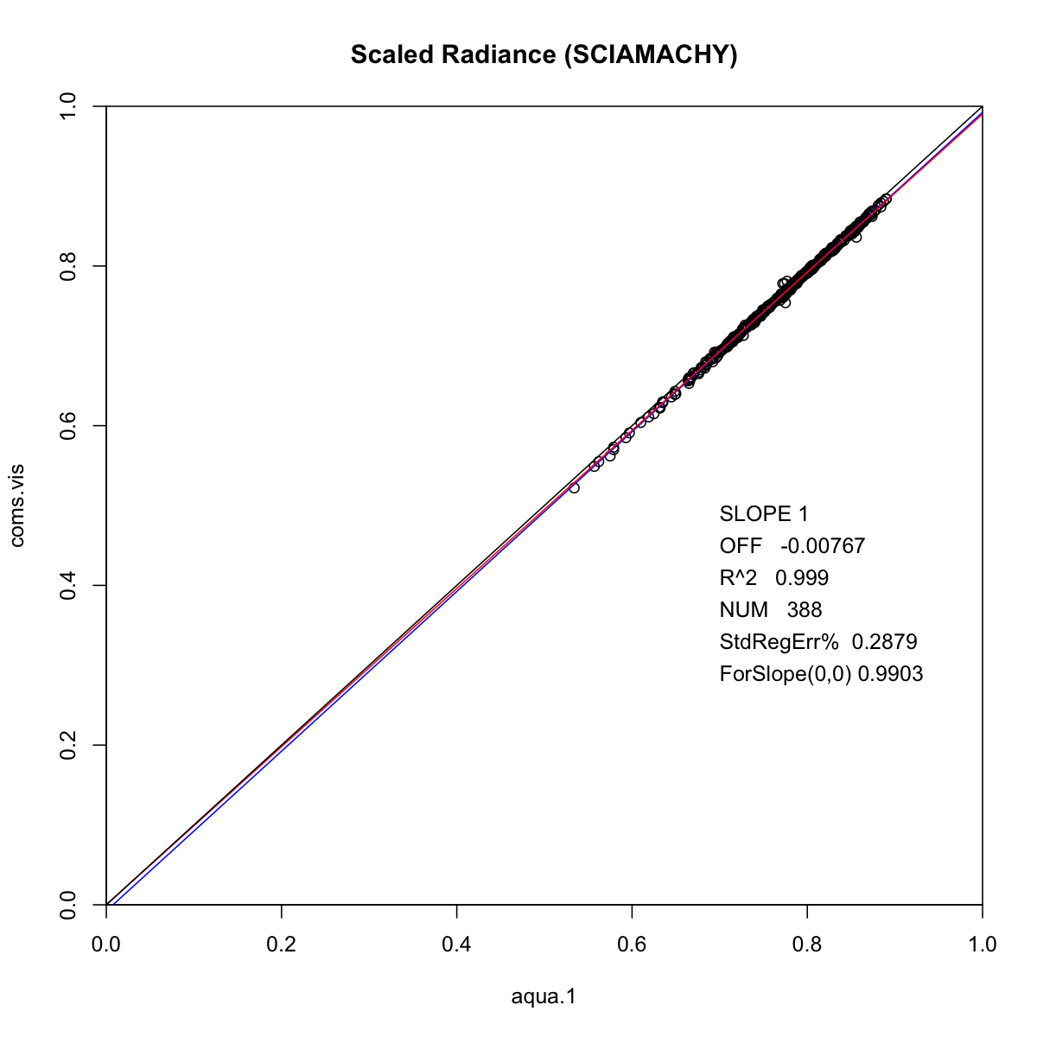
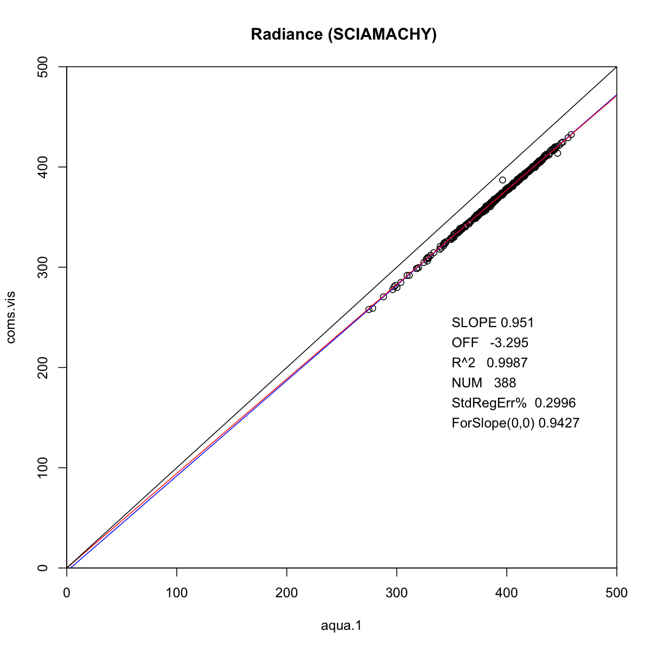
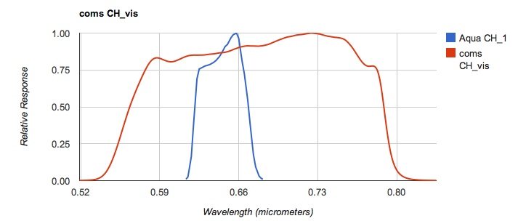
COMS

Slide 8
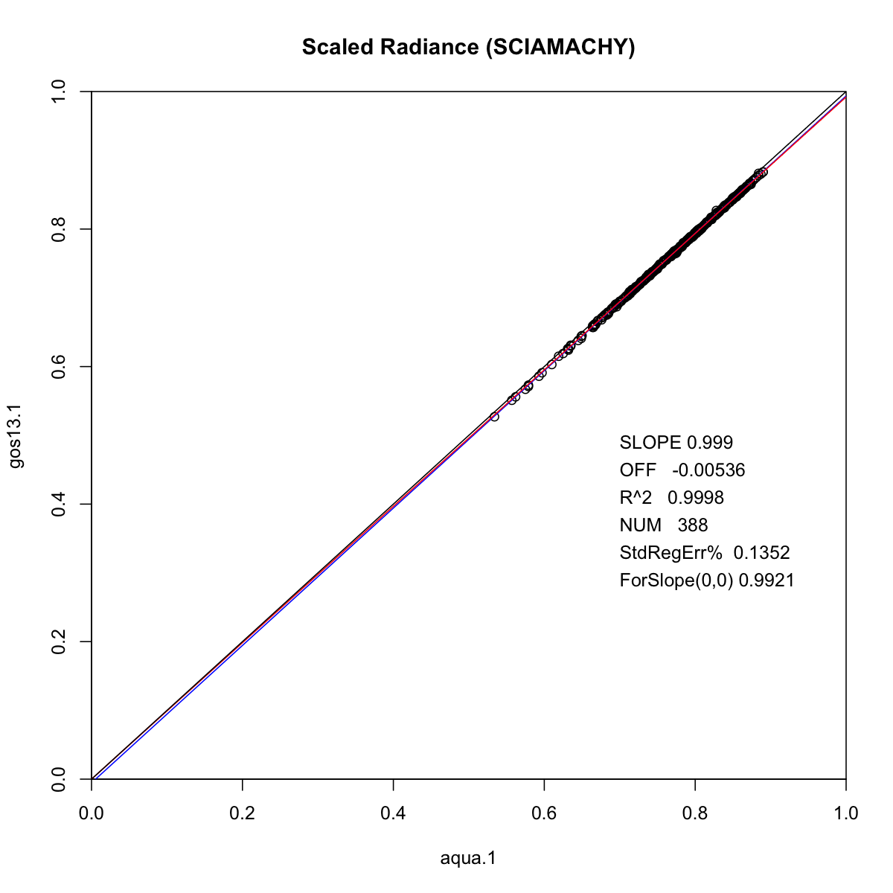
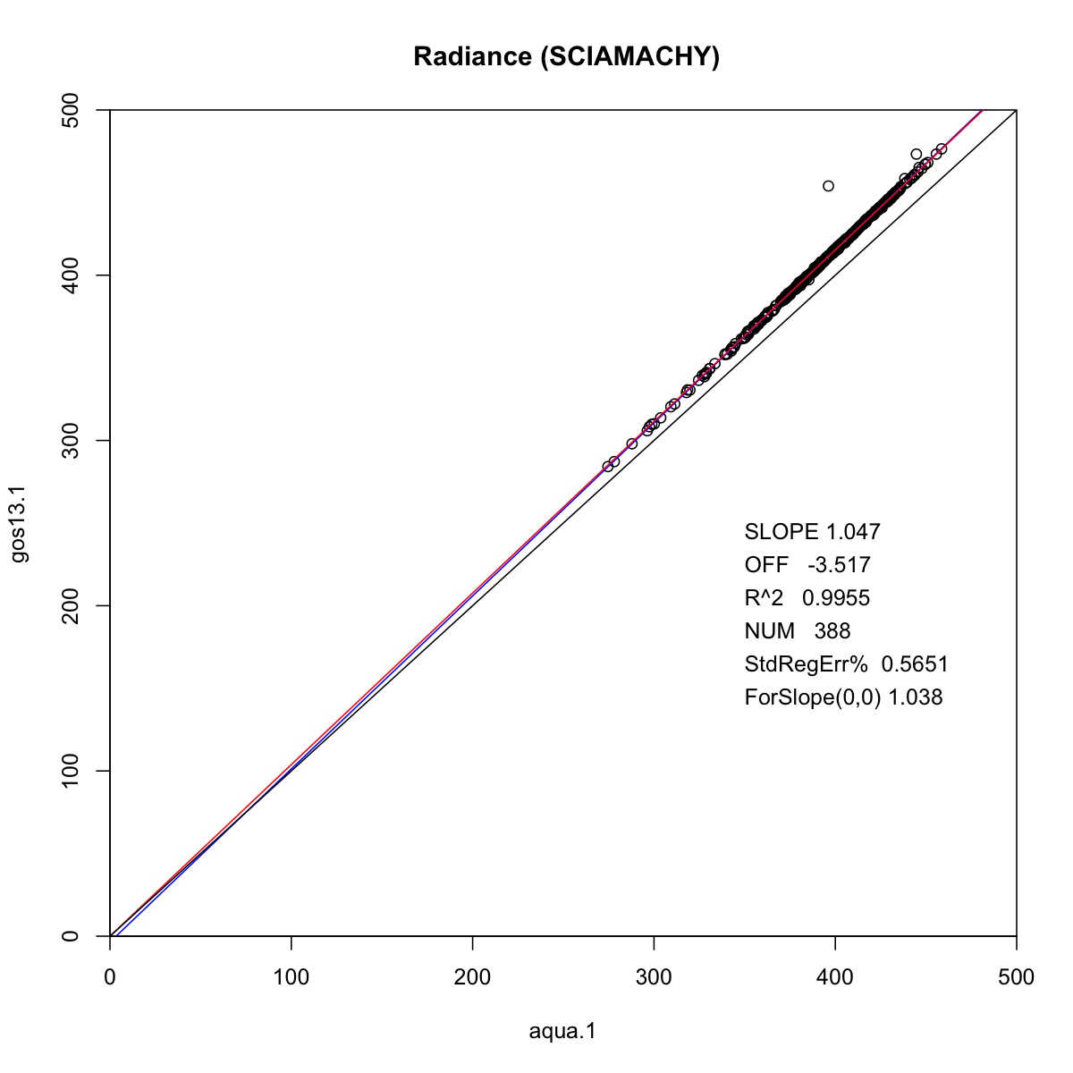
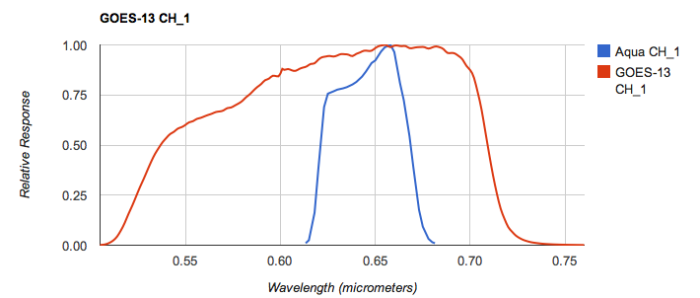
GOES-13

Slide 9
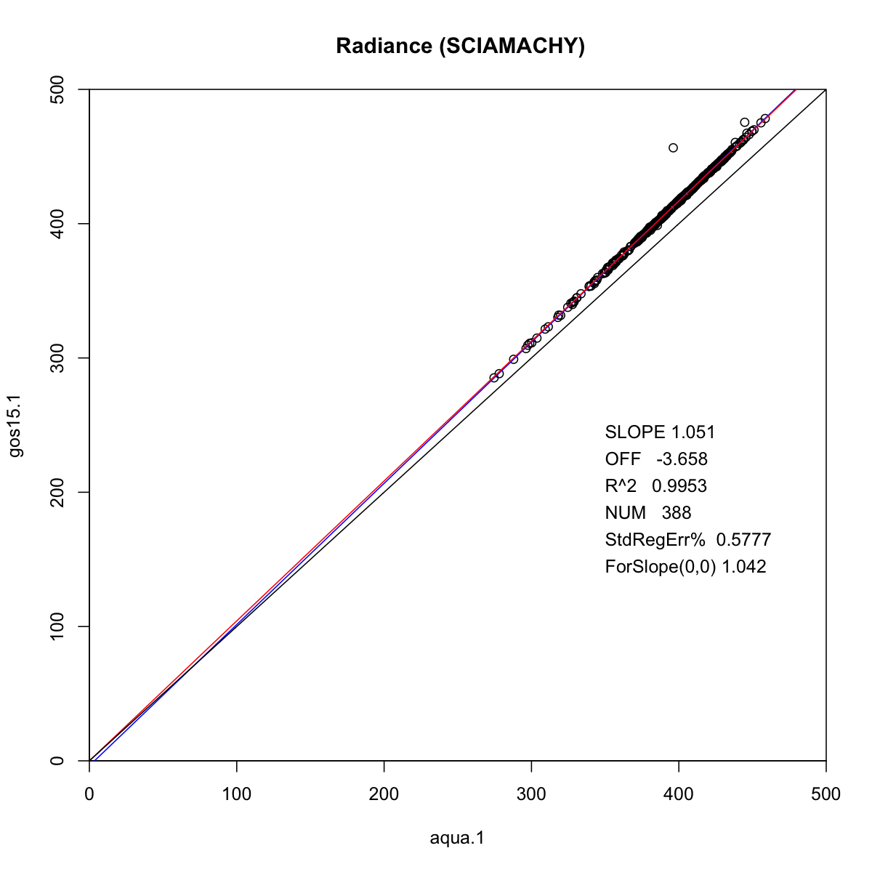
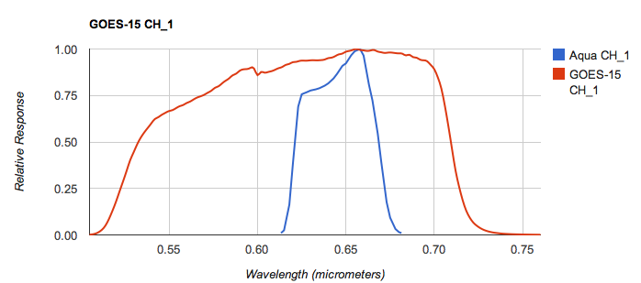
GOES-15

Slide 10
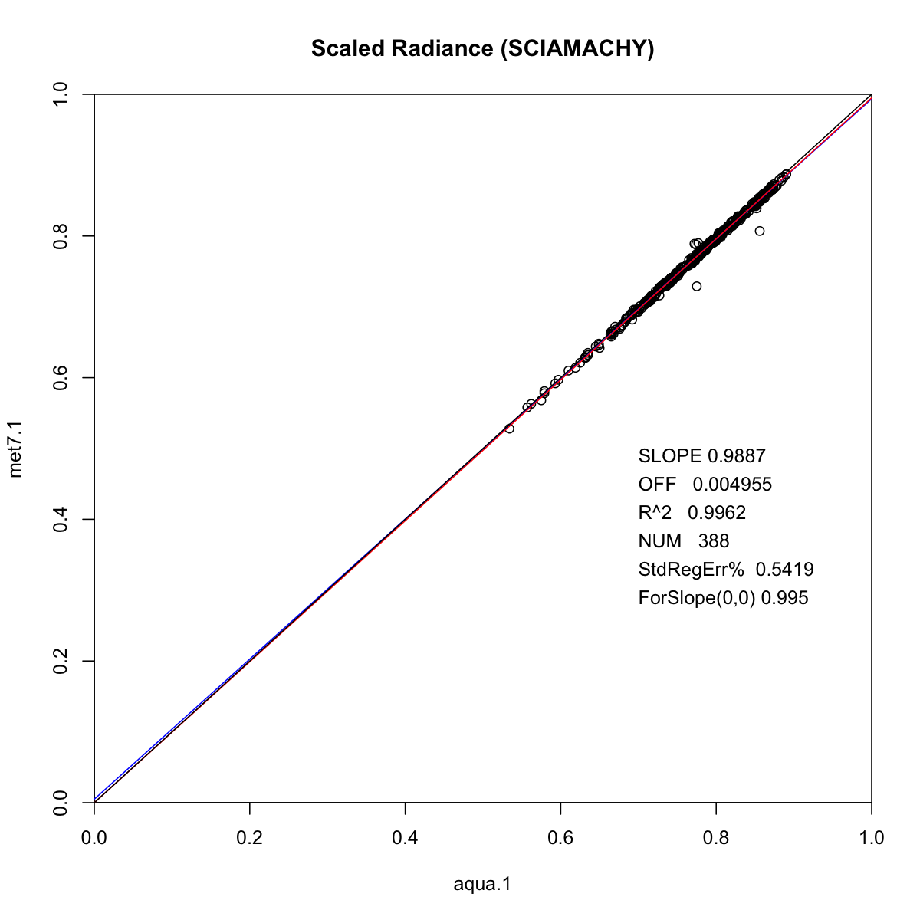
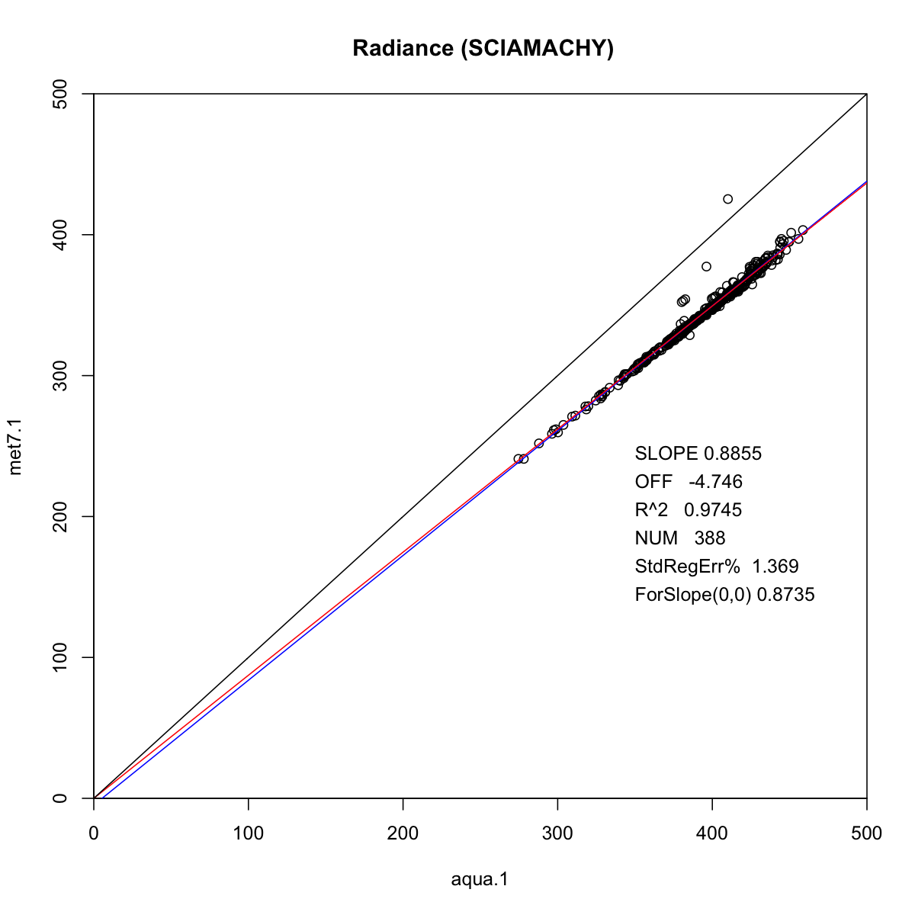
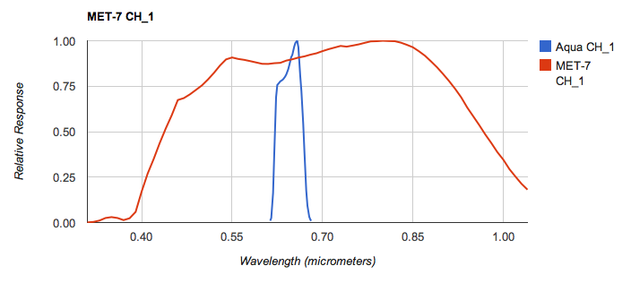
Met-7

Slide 11
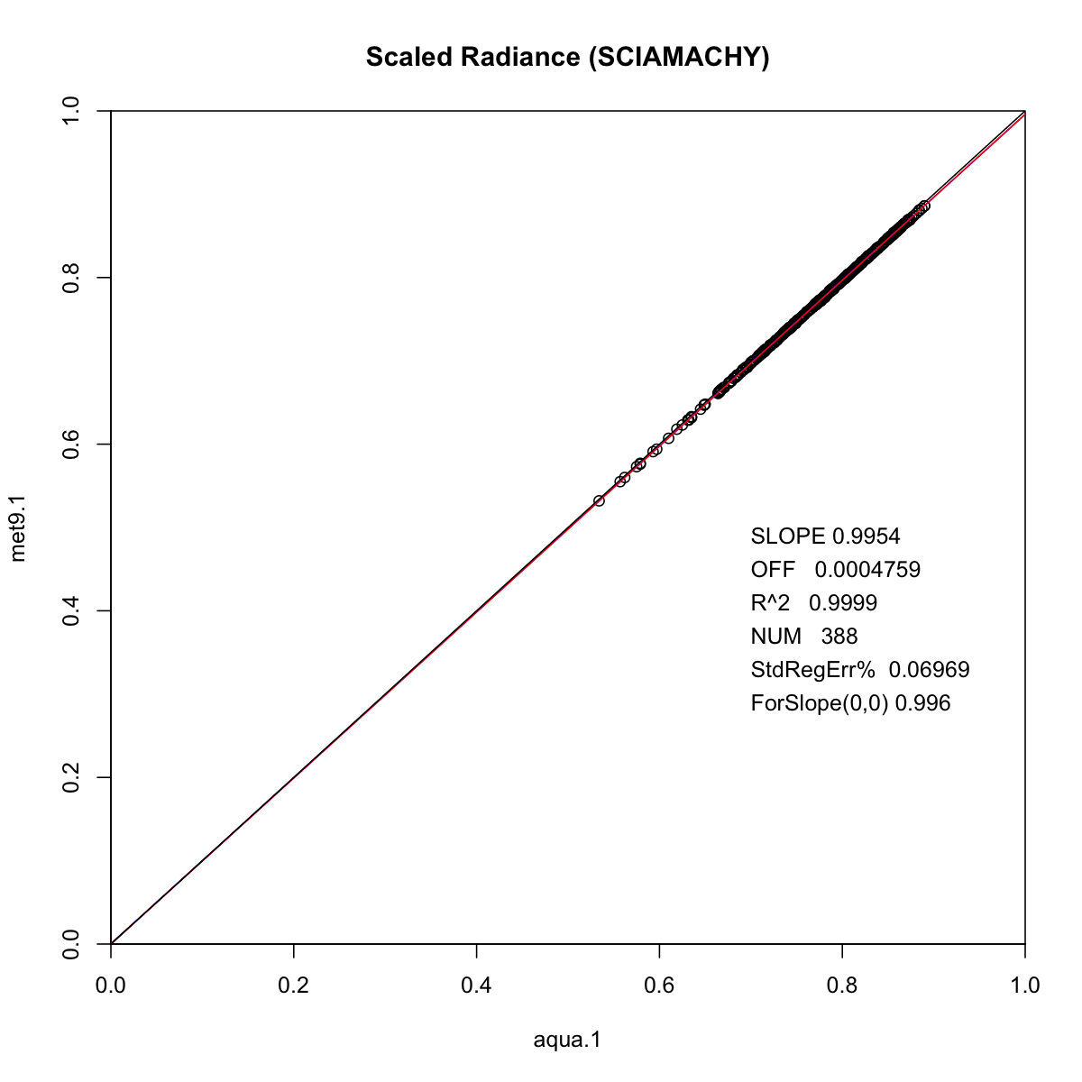
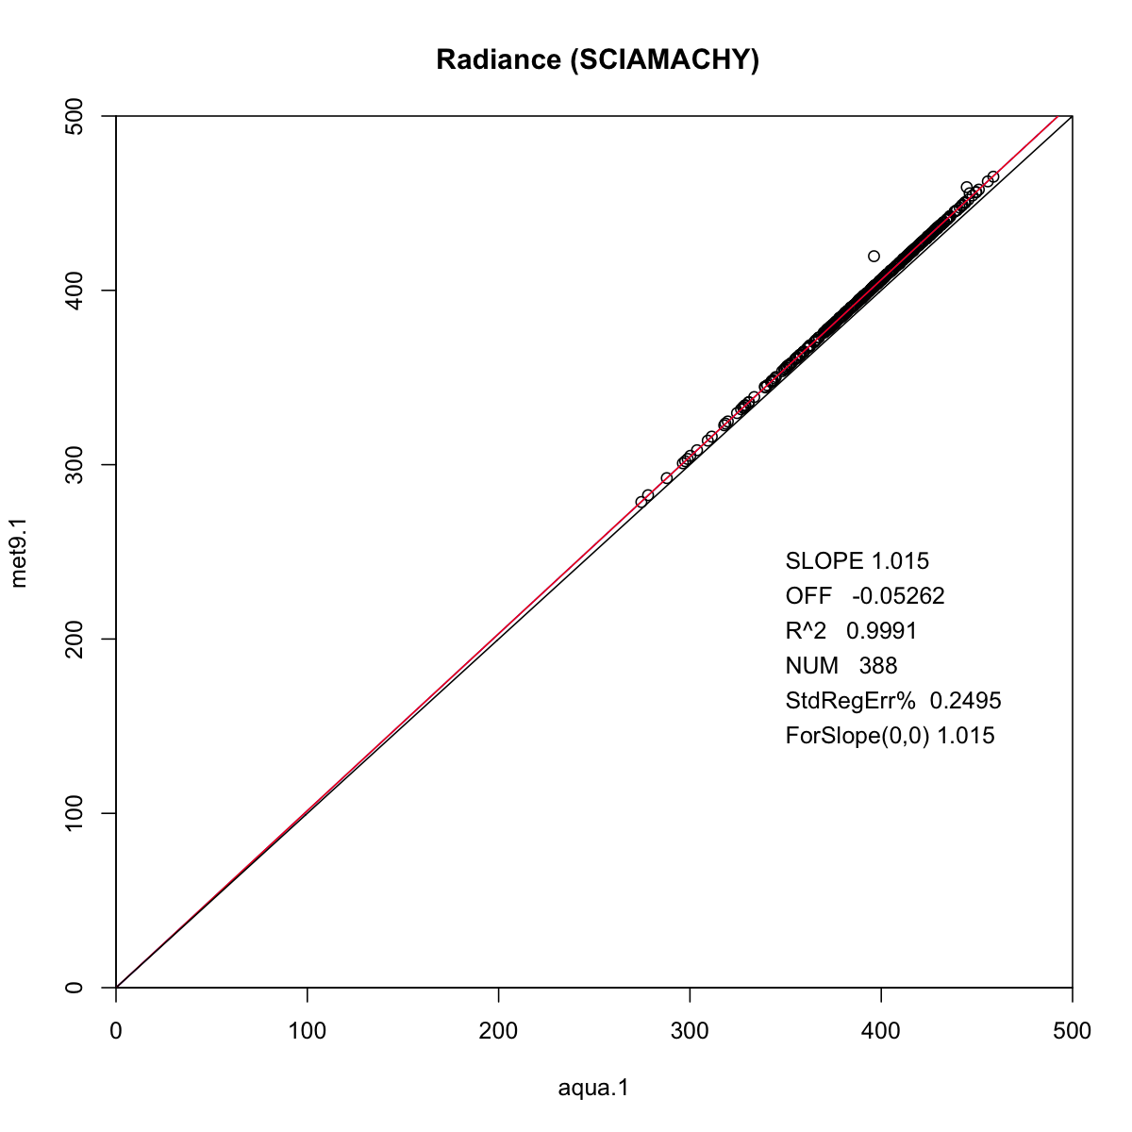
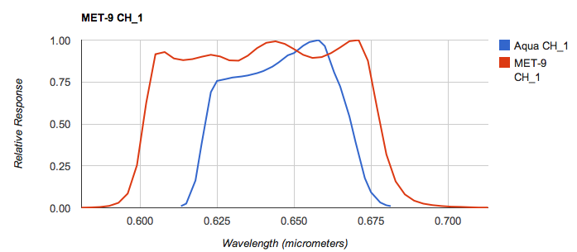
Met-9

Slide 12
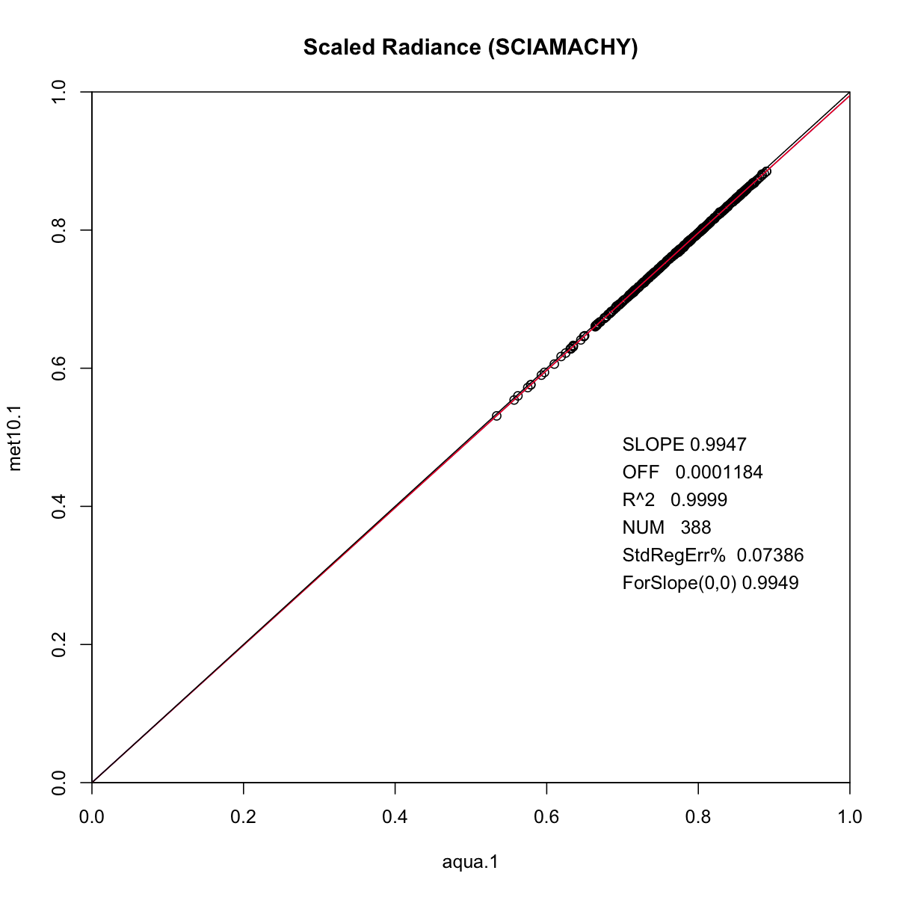
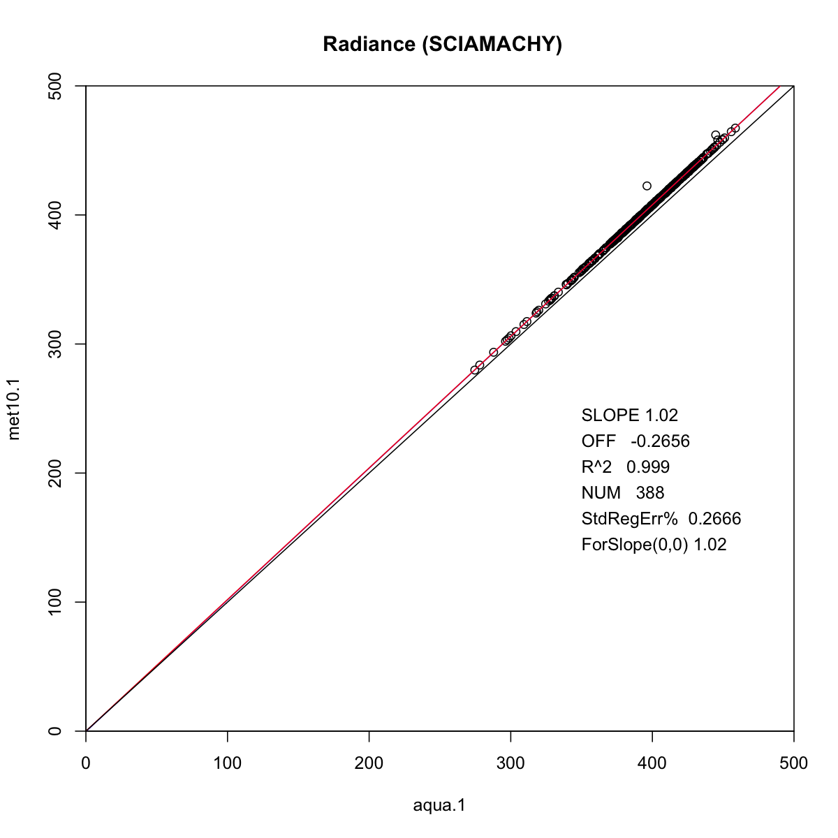
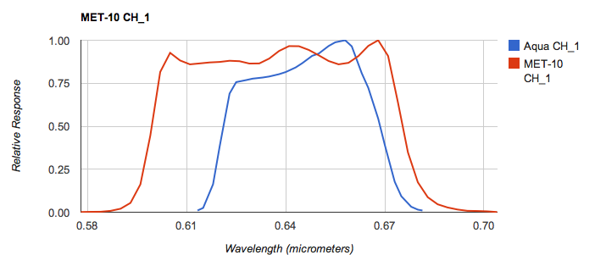
Met-10

Slide 13
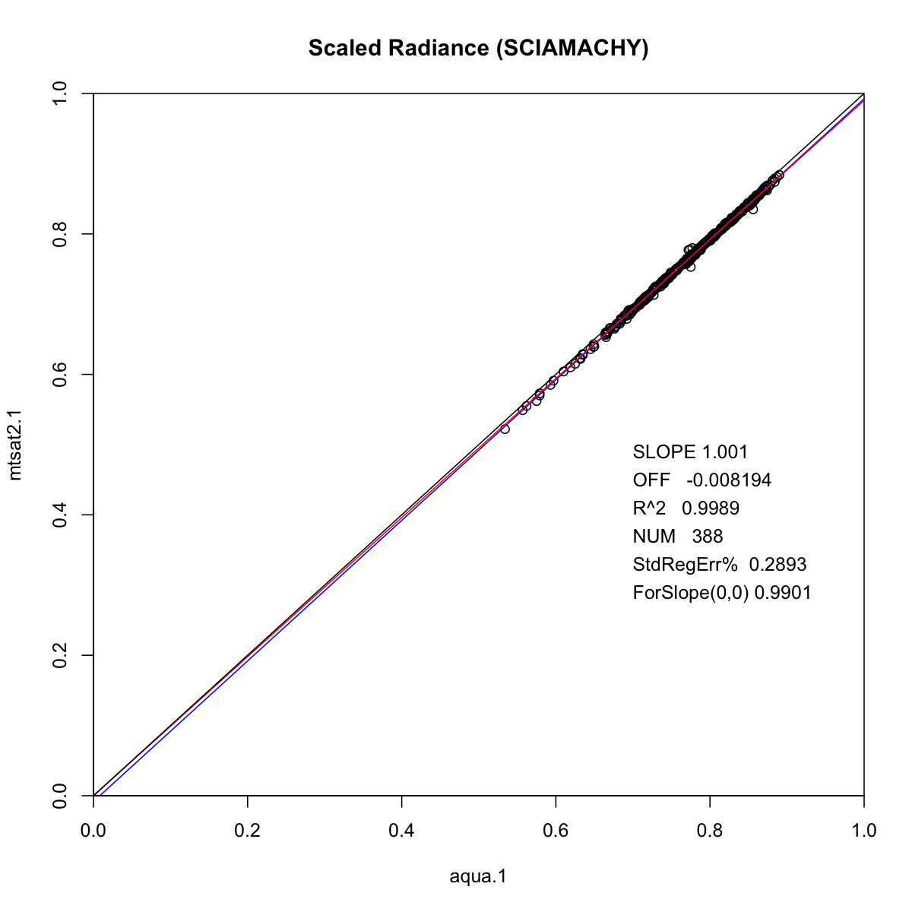
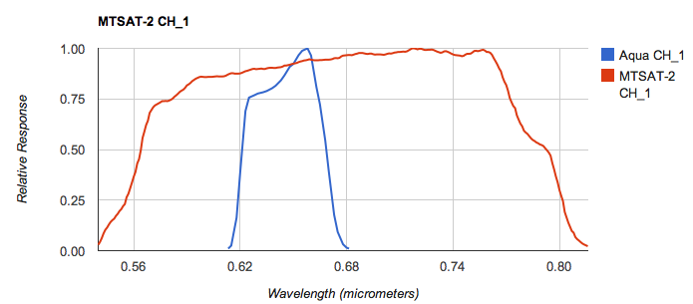
MTSAT-2

