Slide 1
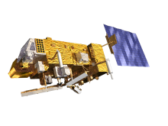
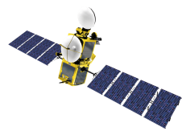
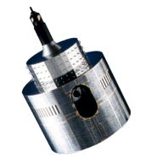
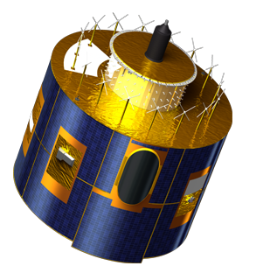
Towards a GSICS DCC product...
Sébastien Wagner (EUMETSAT), Masaya Takahashi (JMA)
Notes:
EUM/STG-SWG/36/14/VWG/15

Slide 2
Short summary of the 2014 GSICS Annual Meeting...
JMA:
Contemporaneous MODIS and MTSAT observations
Sub-sampling of MODIS data due to data volume and transfer speed
Generation of monthly and/or rolling window corrections
Seasonal cycle
NOAA:
Monthly corrections
Raised the question how to derive the reference reflectance? ➔ Long-term mean / monthly reference reflectance
Semi-annual / annual variability
CMA
Monitoring of the DCC reflectance on monthly and/or rolling window basis
LEO/LEO and GEO/LEO

Slide 3
Short summary of the 2014 GSICS Annual Meeting...
KMA
Method based on B.J. Sohn approach (RTM based).
EUMETSAT:
Contemporaneous / long-term mean / monthly reference reflectance (synthetic typical year) for MODIS
Generation of monthly and/or rolling window corrections
Seasonal cycle
A draft of a GSICS DCC product data format was also presented and discussed (together with the Data Working Group)
Among others:
Solar Constant=Variable[chan]
SBAF = Variable[chan]
Space count offset + uncertainty =Variable[chan,date] - for users
PDF=intermediate

Slide 4
Short summary of the 2014 GSICS Annual Meeting...
As a result (minutes of the meeting):
Decision: Meanwhile, demo products will include one global attribute to describe all the configuration of the algorithm needed to provide traceability to ensure the product is reproducible by the creator.
Action: GDWG to investigate methods to structure the order of the global attributes within the netCDF file - e.g. between attributes related to the method and the application ➔ Closed
Action: GDWG to investigate how to include algorithm type in filename.
GEO-LEO-VISNIR?
(see https://gsics.nesdis.noaa.gov/wiki/Development/ProductTaxonomy)
For the methodology, should we include it channel per channel (blend of methods for each and every band)?
Decision: DCC products will follow a similar style as current GEO-LEO IR ones – i.e. multiple NRTC files each containing results for single day, and a single RAC file containing results for the whole time series - preferably in daily time steps, or otherwise monthly.
rolling window (backward = NRTC, centered = RAC). Agreed?

Slide 5
Questions - product
How to derive the reference reflectances/radiances?
Constant value? ➔ does not reflect DCC seasonality
Contemporaneous observations? ➔ problem when MODIS is not available
Synthetic typical year?
Need to process the MODIS archive for each GEO area and derive the reference reflectance/radiance
Derive similarly the reference reflectance/radiance and the target count (rolling window)
Who will prepare the reference?
NASA?
Each and every target satellite operator?
What about the product
Do we want one product per methodology or a blended product (blend can change from a band to another...)?
Any need for a month-to-month product (approach mostly adopted so far)?
If yes, is the central daily product enough? (no need for an extra product...)

Slide 6
Questions - product
NASA + EUMETSAT to look into VIS0.8 + NIR1.6 + HRVIS
Inter-calibration of current Meteosat Second Generation SEVIRI instruments with MODIS
Preparation of future GEO missions (more bands)
In collaboration with JMA in preparation of the launch of Himawari 8
And also other missions coming soon with NOAA, CMA, KMA and EUMETSAT next generations of GEO imagers
What about the SBAF for other existing / past / future instruments ➔ request from SCOPE-CM + operational centers
In the case of future instruments, what is the time interval needed to derive the SBAF?

Slide 7
Questions – plotting tool
What do we want/need to represent?
DCC statistics timeseries
Do we want to work in radiance or in reflectance?
Which functionalities to we need?
Trend analysis methods (linear, quatratic, etc.)?
Time series for each methodology within a product? (1 blended product with several methods)
Or representation of more products at once (several products with single method)
Etc.
➔ See Masaya’s presentation

Slide 8
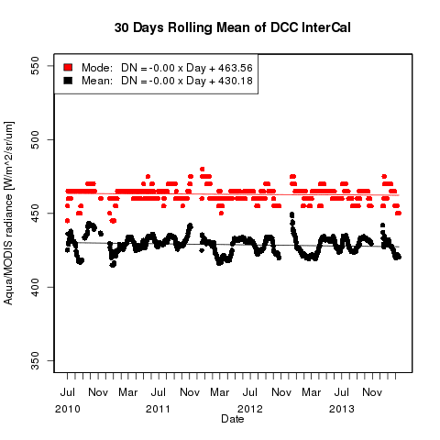
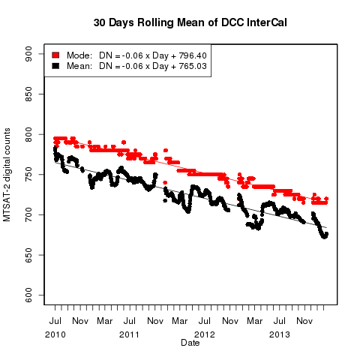
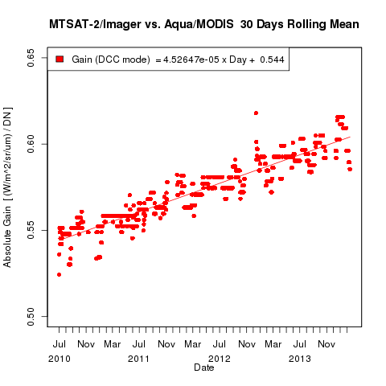
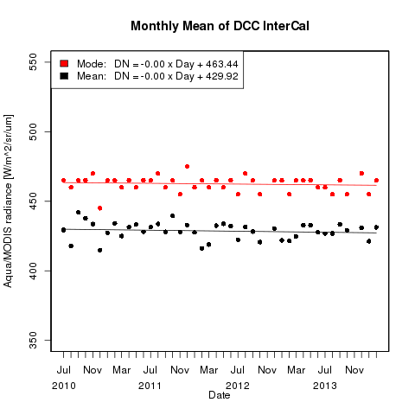
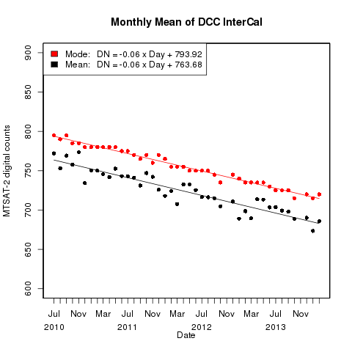
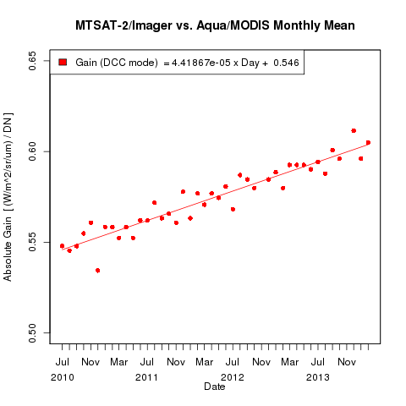
AQUA/MODIS* MTSAT-2/Imager MTSAT-2 Gain vs. MODIS
Daily Rolling Ave.
Monthly Ave.
Courtesy M. Takahashi - JMA
MOD02SSH (5km sub-sampled dataset) collection5 is used

Slide 9
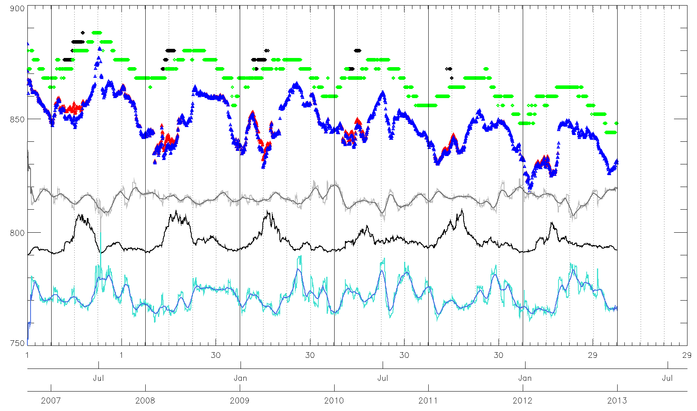
Example of information to display...
MODE
SKEWNESS + smoothed over 30 days
MODE – No saturation
Number of DCCs
MEAN
K-K0
MEAN – No saturation
KURTOSIS + smoothed over 30 days

Slide 10
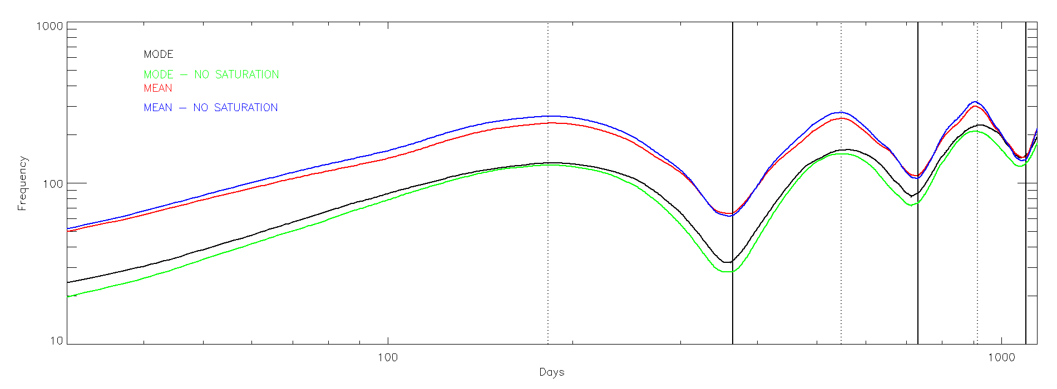
Example of information to display: variograms...

Slide 11
Discussion

