Slide 1
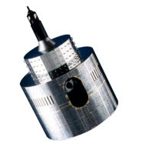
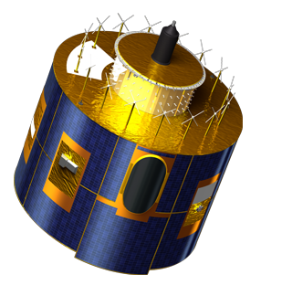
Inter-calibration using DCCs and seasonality
Sébastien Wagner (EUMETSAT)
Notes:
EUM/STG-SWG/36/14/VWG/15

Slide 2
Short summary of the 2014 GSICS Annual Meeting...
Moved from month-to-month analysis to a GEO-LEO IR approach with a rolling window to derive:
Daily Near-Real-Time Corrections
Re-analysis Corrections
Effect of the saturation of MET-09/VIS0.6 over DCCs on the end results
Results without the saturated pixels are smoother (saturation adds a peak at Spring time)
Saturation disappears in time (degradation helps us ☺)
Attempts to change the size of the rolling window for NRTC (30 days or 15 days)
Start looking into seasonality
Variograms

Slide 3
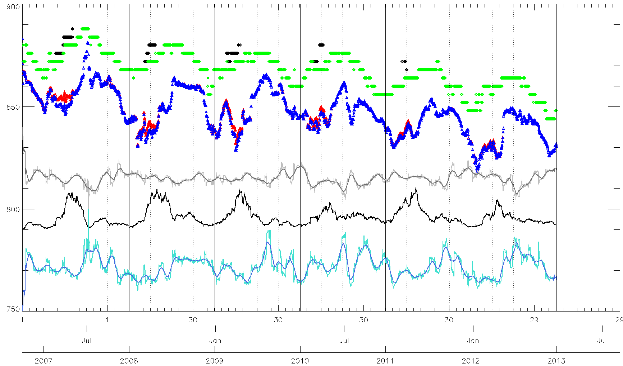
MODE
NRTC – 30 days
SKEWNESS + smoothed over 30 days
MODE – No saturation
Number of DCCs
MEAN
MEAN – No saturation
K-K0
KURTOSIS + smoothed over 30 days

Slide 4
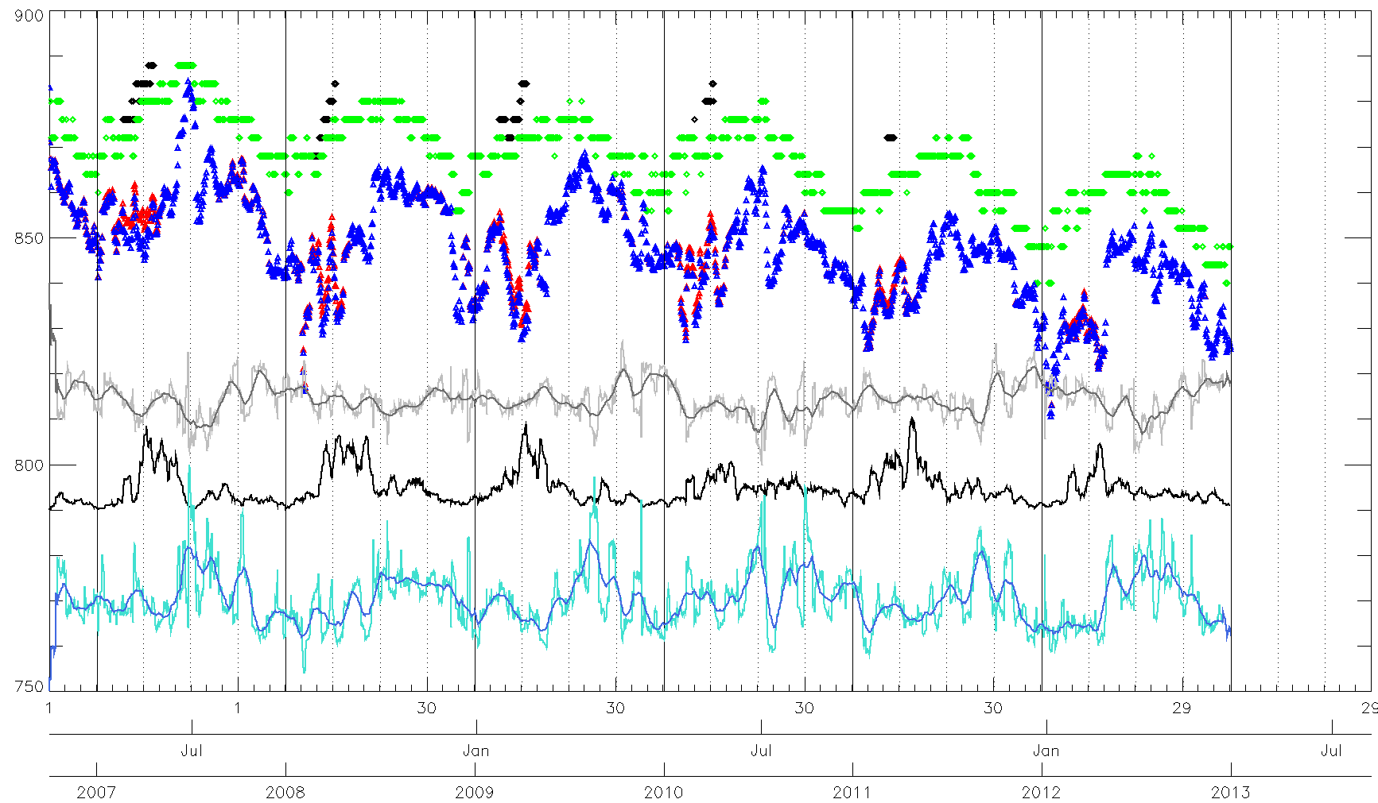
MODE
NRTC – 15 days
SKEWNESS + smoothed over 30 days
MODE – No saturation
Number of DCCs
MEAN
MEAN – No saturation
K-K0
KURTOSIS + smoothed over 30 days

Slide 5
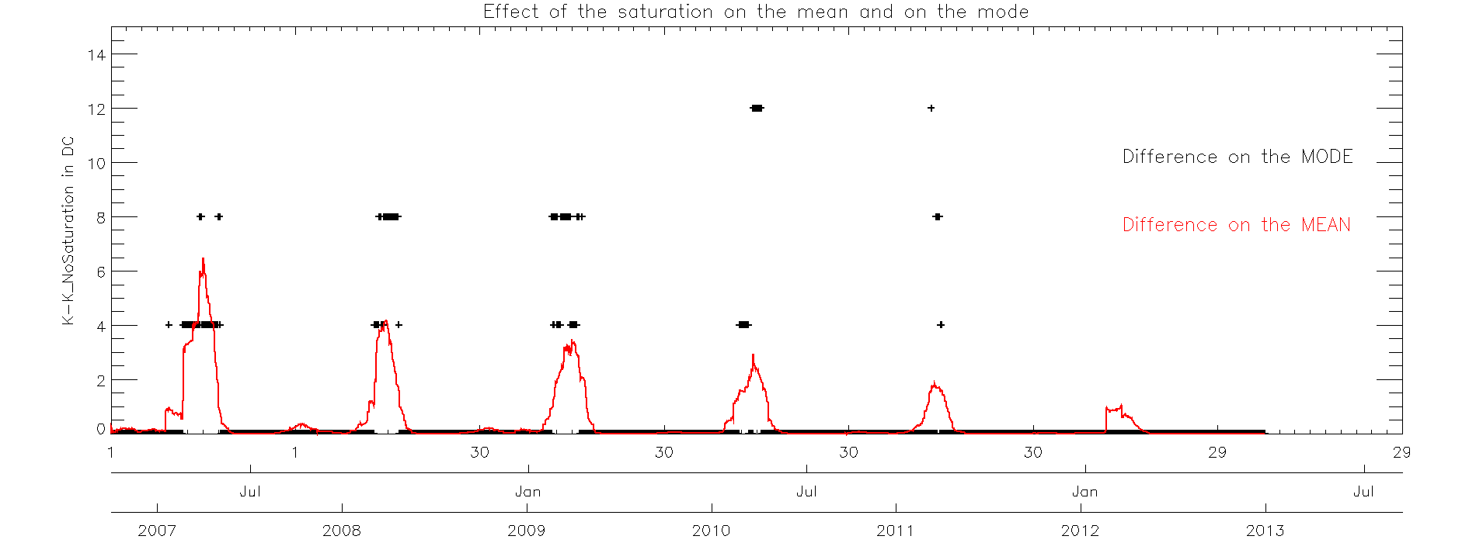
Effect of the saturation MET-9/VIS0.6
Effects of saturation decreases with time ➔ Instrument degradation helps us!

Slide 6
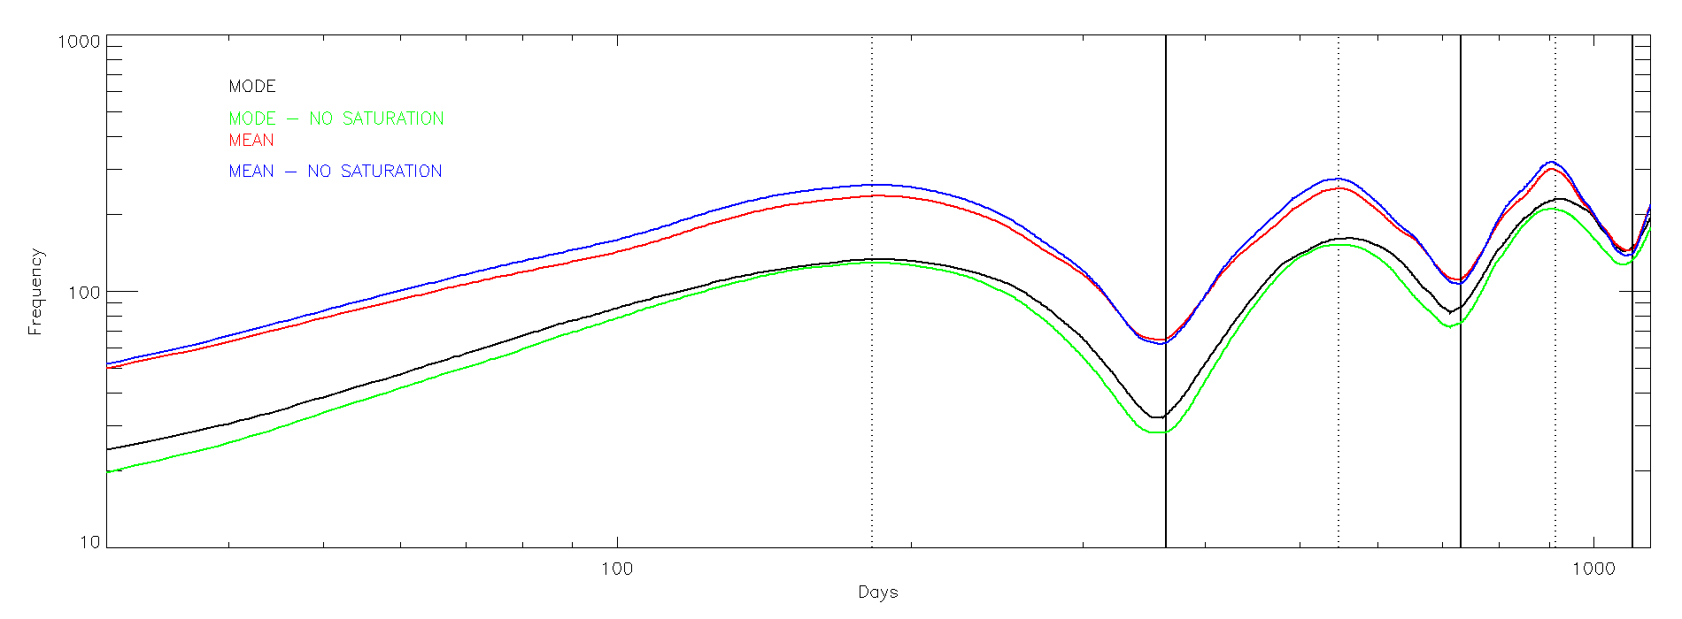
Variogram analysis of the time series
Variogram
30 days (interval used for the NRT product)
 | Mode | Mean | Mode (no saturation) | Mean (no saturation)
Drift Stability | 0.1538 | 0.1110 | 0.1374 | 0.1046

Slide 7
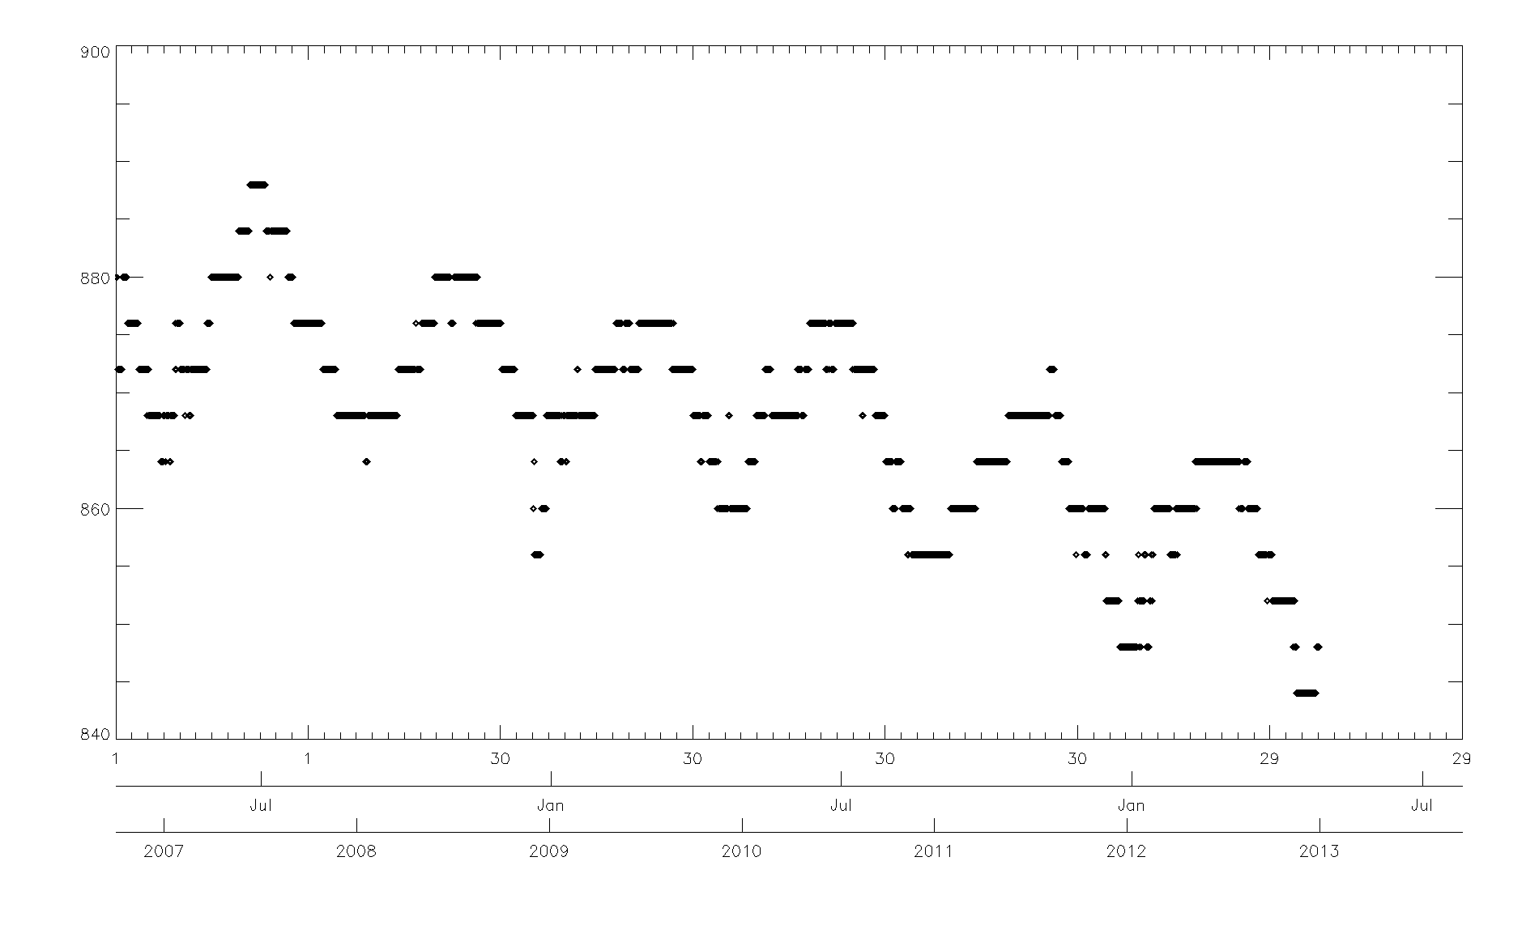
Original time series – NRTC 30 days – Mode – No saturation

Slide 8
Deseasonalizing the time series
Choice of a model ➔ Multiplicative: Seasonalized = Deseasonalized * Seasonal factors
Calculation of a smooth version of the time series:
Each daily point is the centred average over 365 days (see variograms).
Beginning and endings points: various methods to take care of the missing data (replacing the missing points by as many time the last available value as necessary)
Estimation of the seasonal indices:
Ratio between the mode time series and the smoothed data.
Calculating the seasonal indices:
For each day of the year, average all the ratio values (Step A) for that day across the years (for leap years I adjust it to 365 equivalent) ➔ year of seasonal indices. However, average value ≠ 1.
Normalization of the ratios by the mean value over the year è 365 seasonal indices.
Deseasonalization of the time series by dividing each value from the original time series by the seasonal indices
Linear regression of the deseasonalized time series.
Consistency check: multiplying the trend by the seasonal indices and visual check.

Slide 9
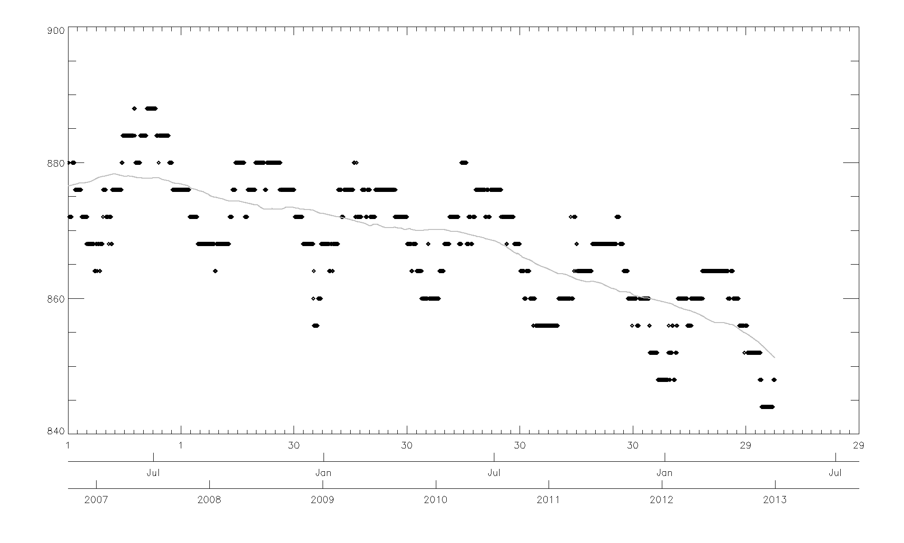
Original time series + yearly-smoothed time series

Slide 10
Deseasonalizing the time series
Choice of a model ➔ Multiplicative: Seasonalized = Deseasonalized * Seasonal factors
Calculation of a smooth version of the time series:
Each daily point is the centred average over 365 days (see variograms).
Beginning and endings points: various methods to take care of the missing data (replacing the missing points by as many time the last available value as necessary)
Estimation of the seasonal indices:
Ratio between the mode time series and the smoothed data.
Calculating the seasonal indices:
For each day of the year, average all the ratio values (Step A) for that day across the years (for leap years I adjust it to 365 equivalent) ➔ year of seasonal indices. However, average value ≠ 1.
Normalization of the ratios by the mean value over the year è 365 seasonal indices.
Deseasonalization of the time series by dividing each value from the original time series by the seasonal indices
Linear regression of the deseasonalized time series.
Consistency check: multiplying the trend by the seasonal indices and visual check.

Slide 11
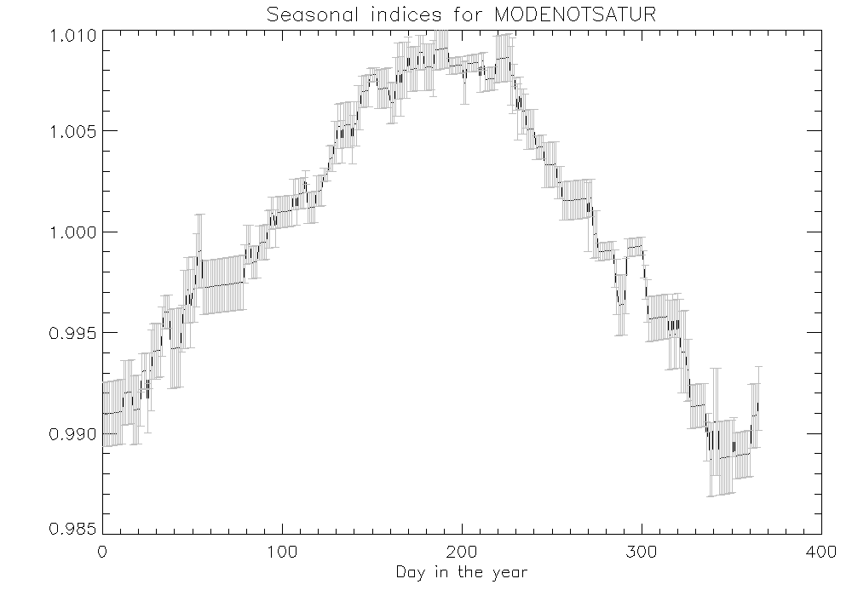
Adjusted seasonal factors

Slide 12
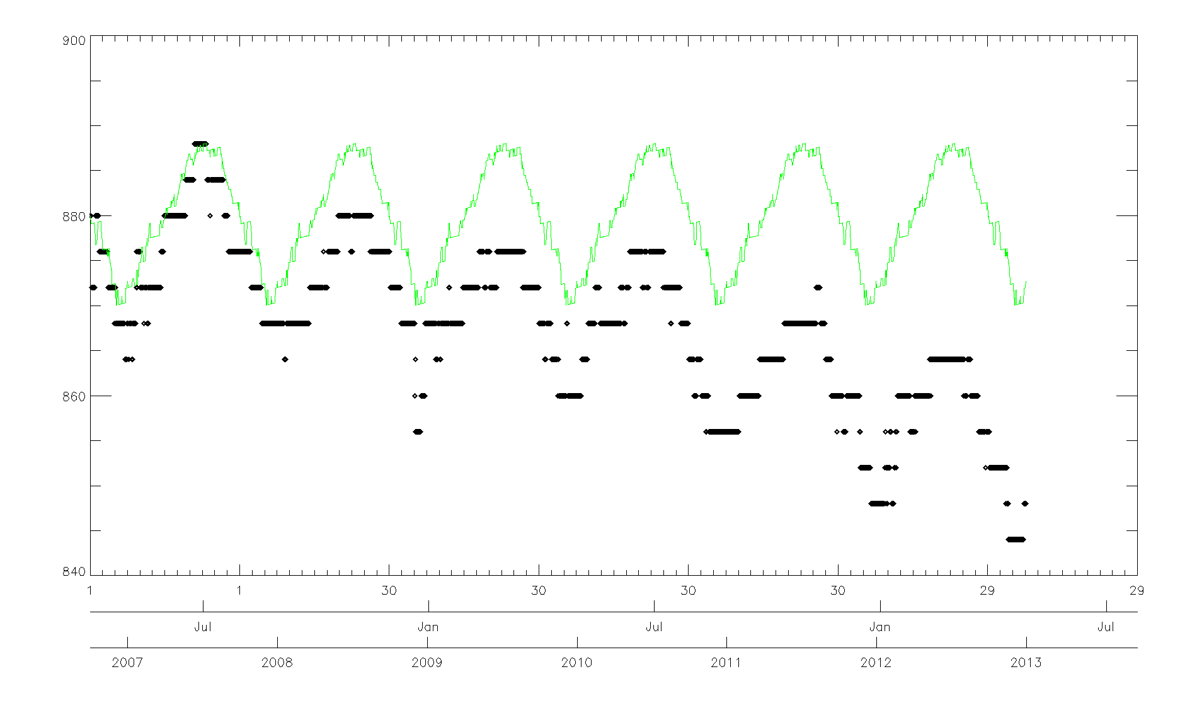
Adjusted seasonal factors

Slide 13
Deseasonalizing the time series
Choice of a model ➔ Multiplicative: Seasonalized = Deseasonalized * Seasonal factors
Calculation of a smooth version of the time series:
Each daily point is the centred average over 365 days (see variograms).
Beginning and endings points: various methods to take care of the missing data (replacing the missing points by as many time the last available value as necessary)
Estimation of the seasonal indices:
Ratio between the mode time series and the smoothed data.
Calculating the seasonal indices:
For each day of the year, average all the ratio values (Step A) for that day across the years (for leap years I adjust it to 365 equivalent) ➔ year of seasonal indices. However, average value ≠ 1.
Normalization of the ratios by the mean value over the year è 365 seasonal indices.
Deseasonalization of the time series by dividing each value from the original time series by the seasonal indices
Linear regression of the deseasonalized time series.
Consistency check: multiplying the trend by the seasonal indices and visual check.

Slide 14
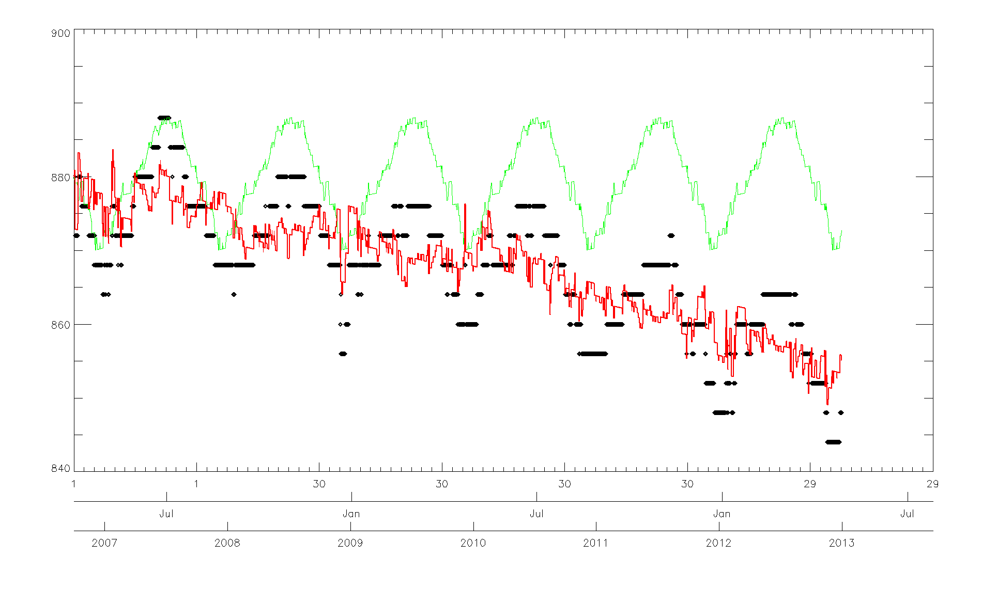
Deseasonalized time series

Slide 15
Deseasonalizing the time series
Choice of a model ➔ Multiplicative: Seasonalized = Deseasonalized * Seasonal factors
Calculation of a smooth version of the time series:
Each daily point is the centred average over 365 days (see variograms).
Beginning and endings points: various methods to take care of the missing data (replacing the missing points by as many time the last available value as necessary)
Estimation of the seasonal indices:
Ratio between the mode time series and the smoothed data.
Calculating the seasonal indices:
For each day of the year, average all the ratio values (Step A) for that day across the years (for leap years I adjust it to 365 equivalent) ➔ year of seasonal indices. However, average value ≠ 1.
Normalization of the ratios by the mean value over the year è 365 seasonal indices.
Deseasonalization of the time series by dividing each value from the original time series by the seasonal indices
Linear regression of the deseasonalized time series.
Consistency check: multiplying the trend by the seasonal indices and visual check.

Slide 16
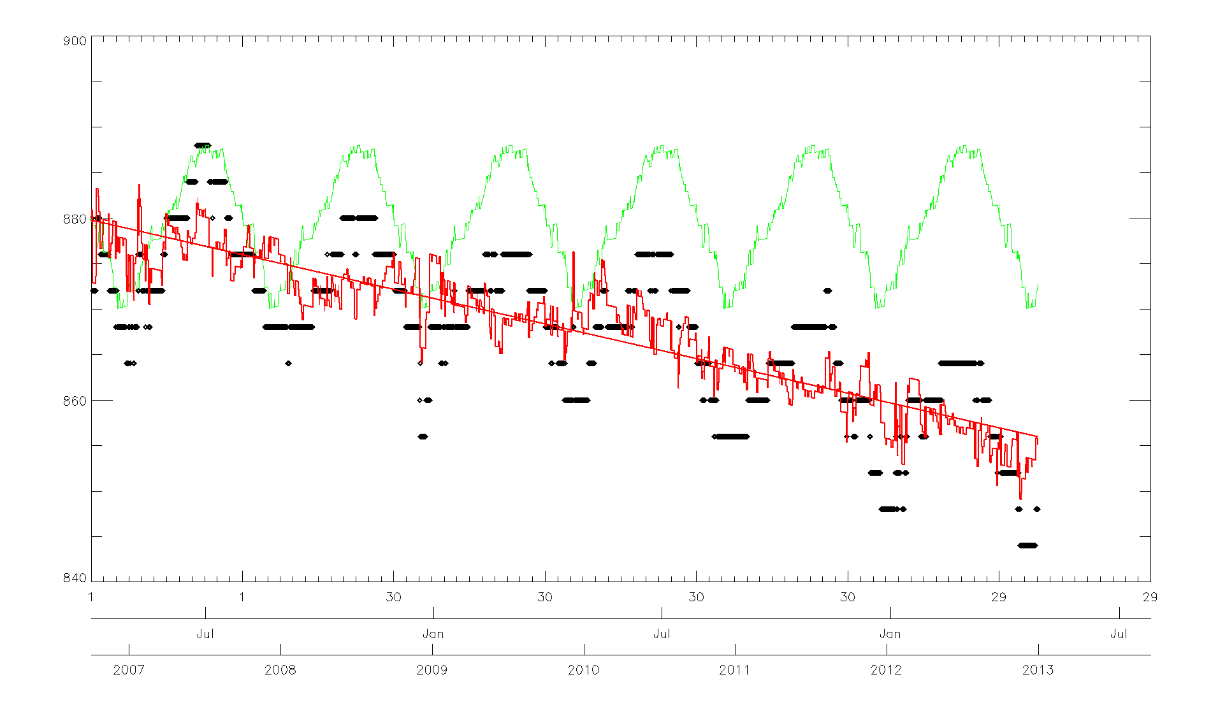
Deseasonalized time series + drift
 | Drift | Offset | Error
Seasonalized | -0.4447% yr⁻¹ | 880.16 | 7.587
Deseasonalized | -0.4325% yr⁻¹ | 879.74 | 7.591

Slide 17
Deseasonalizing the time series
Choice of a model ➔ Multiplicative: Seasonalized = Deseasonalized * Seasonal factors
Calculation of a smooth version of the time series:
Each daily point is the centred average over 365 days (see variograms).
Beginning and endings points: various methods to take care of the missing data (replacing the missing points by as many time the last available value as necessary)
Estimation of the seasonal indices:
Ratio between the mode time series and the smoothed data.
Calculating the seasonal indices:
For each day of the year, average all the ratio values (Step A) for that day across the years (for leap years I adjust it to 365 equivalent) ➔ year of seasonal indices. However, average value ≠ 1.
Normalization of the ratios by the mean value over the year è 365 seasonal indices.
Deseasonalization of the time series by dividing each value from the original time series by the seasonal indices
Linear regression of the deseasonalized time series.
Consistency check: multiplying the trend by the seasonal indices and visual check.

Slide 18
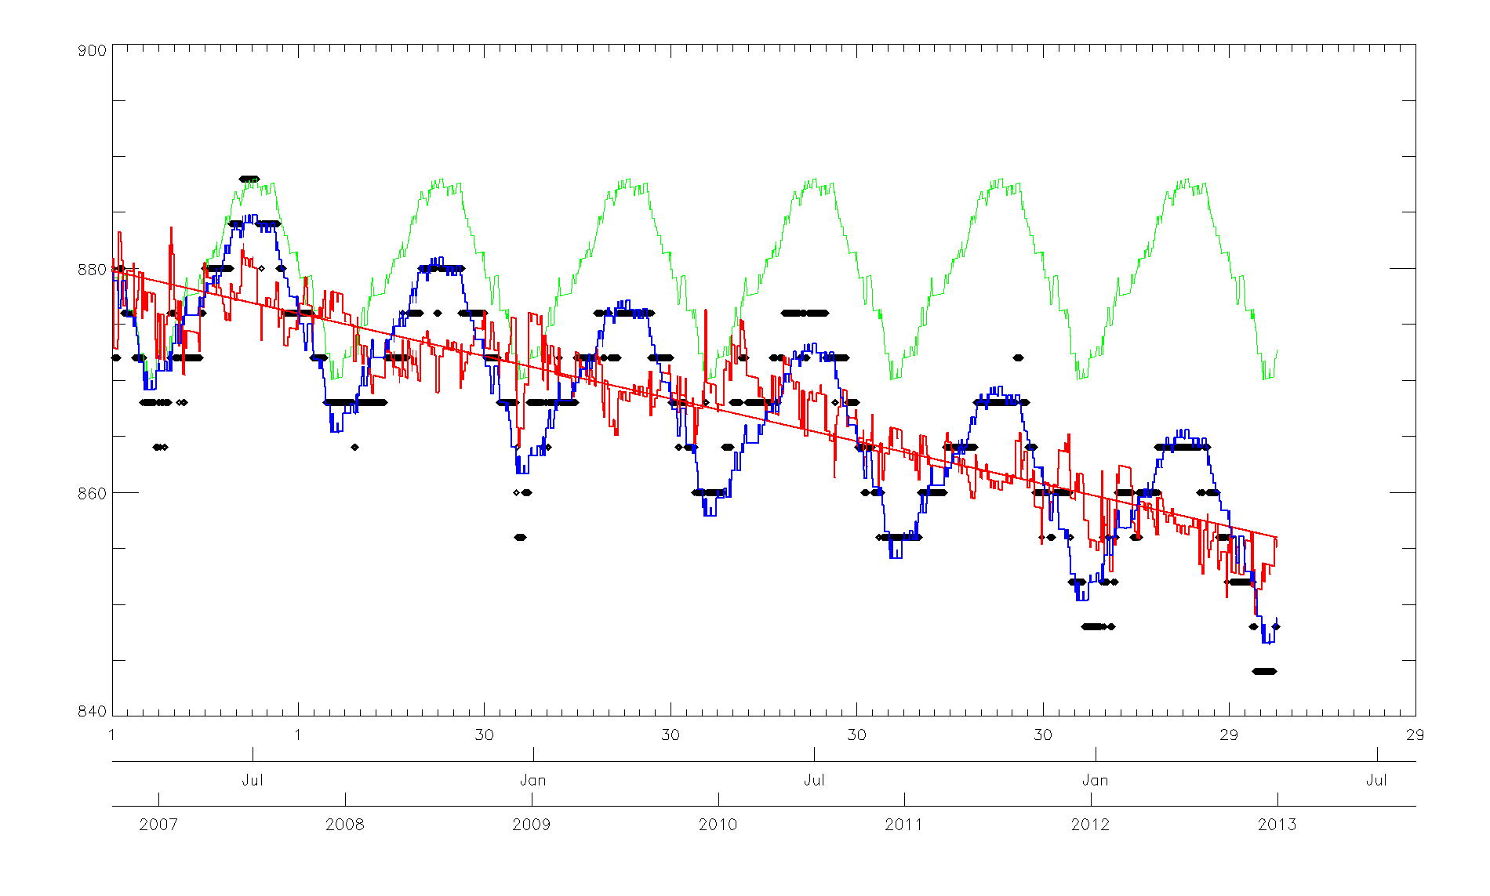
Verification of the seasonal model

Slide 19
Conclusion
Still to be done:
Finish-up the analysis
Define the smoothing parameters to try to reduce the noise
Apply similar analysis to the reference time series for sake of consistency
Apply the current seasonal indices to other SEVIRI instruments
Questions:
Can we think of “Level 3 product” (after NRTC and RAC)?
Any other better way of taking care of the seasonality?
Discussion / suggestion for the next web meeting on DCCs…

Slide 20
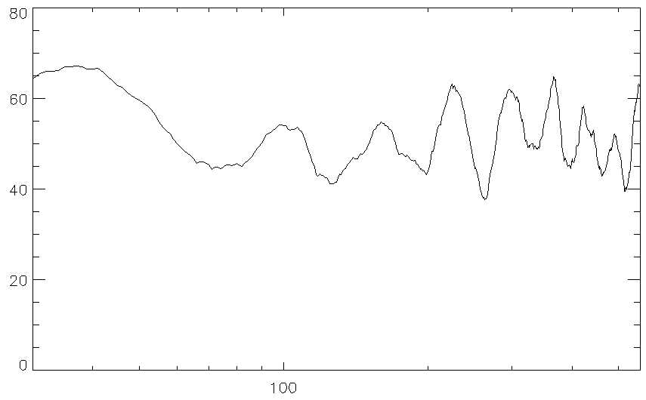
MODIS data as extracted by JMA (data provided by JMA)

