Slide 1
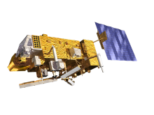
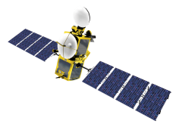
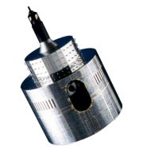
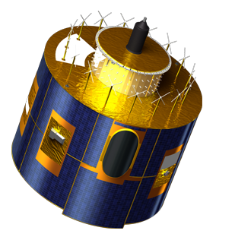
A timeline for the lunar calibration workshop
Sébastien Wagner (EUMETSAT)
In collaboration with
Tom Stone (USGS)
Sophie Lachérade, Bertrand Fougnie (CNES)
Jack Xiong (NASA)
Notes:
EUM/STG-SWG/36/14/VWG/15

Slide 2
Draft time line – still to be confirmed
Time line | Organizers | Participants
24/06/2014 | Kick-off lunar calibration workshop web meeting
July – August | Development / Finalization of the GIRO application Documentation on GSICS / Lunar Calibration Wiki | Participants to prepare input data (extraction / reformatting)
End August / Early September | Provide the GIRO application
 |  | Feedback / Output
September / October | Updates / Support
November | Output screening / Feedback to participants | Re-processing if needed
01/12/2014 - 04/12/2014 | Lunar calibration workshop at EUMETSAT Darmstadt, Germany

Slide 3
Additional milestone
By end of July : potential participants to request invitation letters if needed
Progress meeting in September/October (a Doodle poll will be sent to check suitability/availability)
Web meeting
Check the current situation with the various data sets
Very preliminary feedbacks on the GIRO application
Teams will need to confirm their participation at the progress meeting or shortly after
Discussion on the organization of the workshop (agenda, practicalities, preparation of the presentations by each team, etc.)

Slide 4
In case of delays...
Potential other dates:
08/12/2014 – 12/12/2014
January 2015 at the latest
➔ Gives time to participants to work on their data before the GSICS Research and Data Working Group Annual Meeting
(16/03/2015 – 20/03/2015, hosted by the India Meteorological Department in Delhi - India)
➔ IF ANY SERIOUS ISSUE: date will be discussed at the progress meeting

Slide 5
Conclusions
Target = workshop organized in December.
This supposes organizers and participants to closely work together to prepare the workshop and to make it happen.

