Slide 1
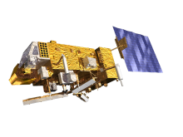
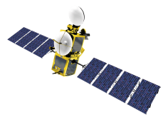
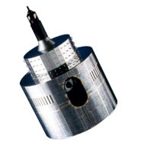
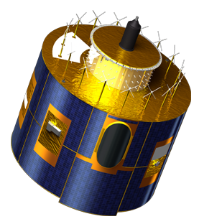
GIRO APPLICATION
Current status and NEXT STEPS
Bartolomeo Viticchiè, Sébastien Wagner,
Jagjeet Nein (EUMETSAT)
& Masaya Takahashi (JMA)

Slide 2
GIRO APPLICATION
This presentation has the aim of presenting:
the code design,
the current status of the implementation, and
the next steps of the implementation.

Slide 3
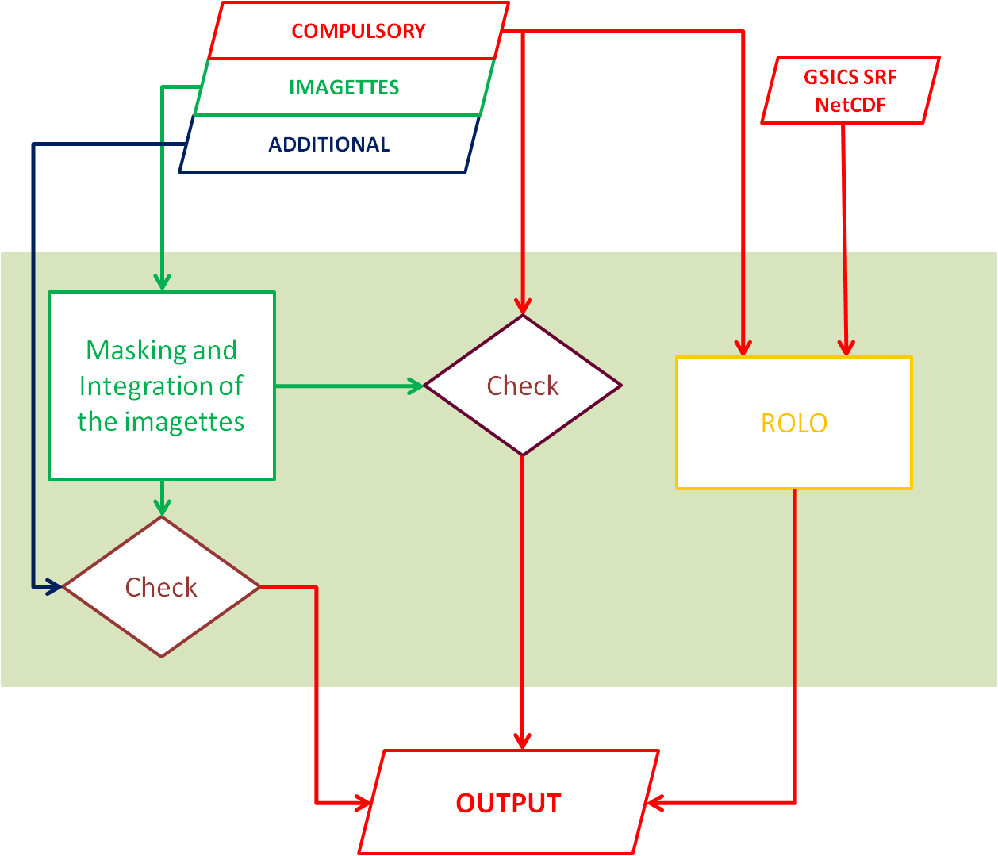
GIRO APPLICATION – Outline
imagette refers to the portion of image-data that has been extracted for calibration purposes; it contains the complete Moon disk and a portion of deep space.

Slide 4
GIRO APPLICATION – Outline
Key features:
Implemented in C
C is a commonly used and portable language.
The executable will run on Linux machines (both 32 and 64 bits).

Slide 5
GIRO APPLICATION – Outline
Key features:
Implemented in C,
Input and output files in NetCDF format:
IN: lunar observation files,
IN: SRF file (GSICS), and
OUT: lunar calibration file.
The tool processes sequences of lunar observation files. The lunar calibration file contains sequences of quantities that can be used to monitor the instrument performances.
Presentation of Masaya Takahashi

Slide 6
GIRO APPLICATION – Outline
Key features:
Implemented in C,
Input and output files in NetCDF format,
Two main processing blocks:
OPTIONAL Masking and Integration of the imagettes.
Computation of the ROLO reference irradiance.

Slide 7
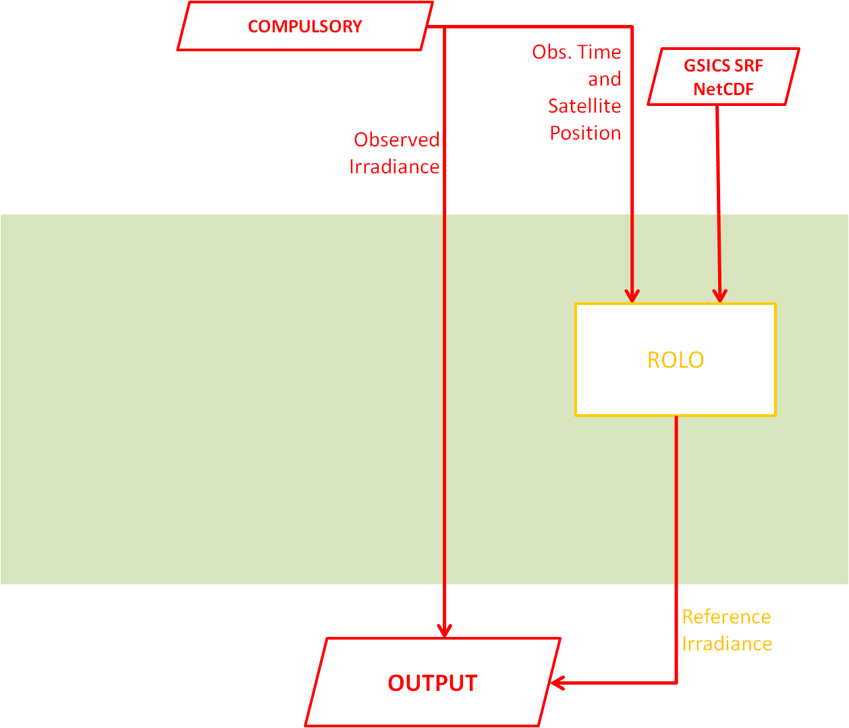
GIRO APPLICATION – Basic Functionalities

Slide 8
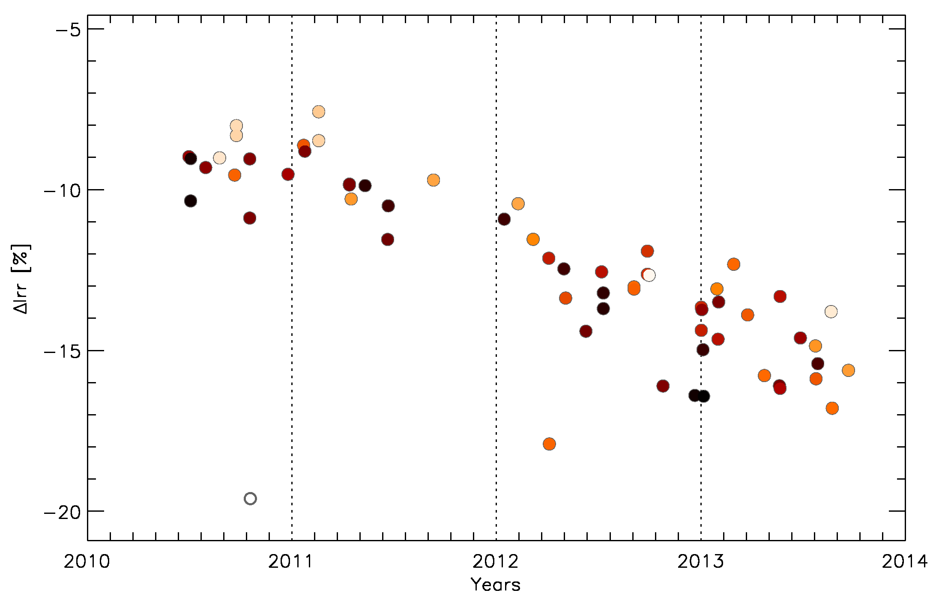
GIRO APPLICATION – Output
[%]
The observed irradiance is used together with the ROLO reference irradiance produced by the orange block to derive the following quantity:
Observed irradiance-reference irradiance bias [%]:
MTSAT2 calibration

Slide 9
GIRO APPLICATION – Basic Functionalities

Slide 10
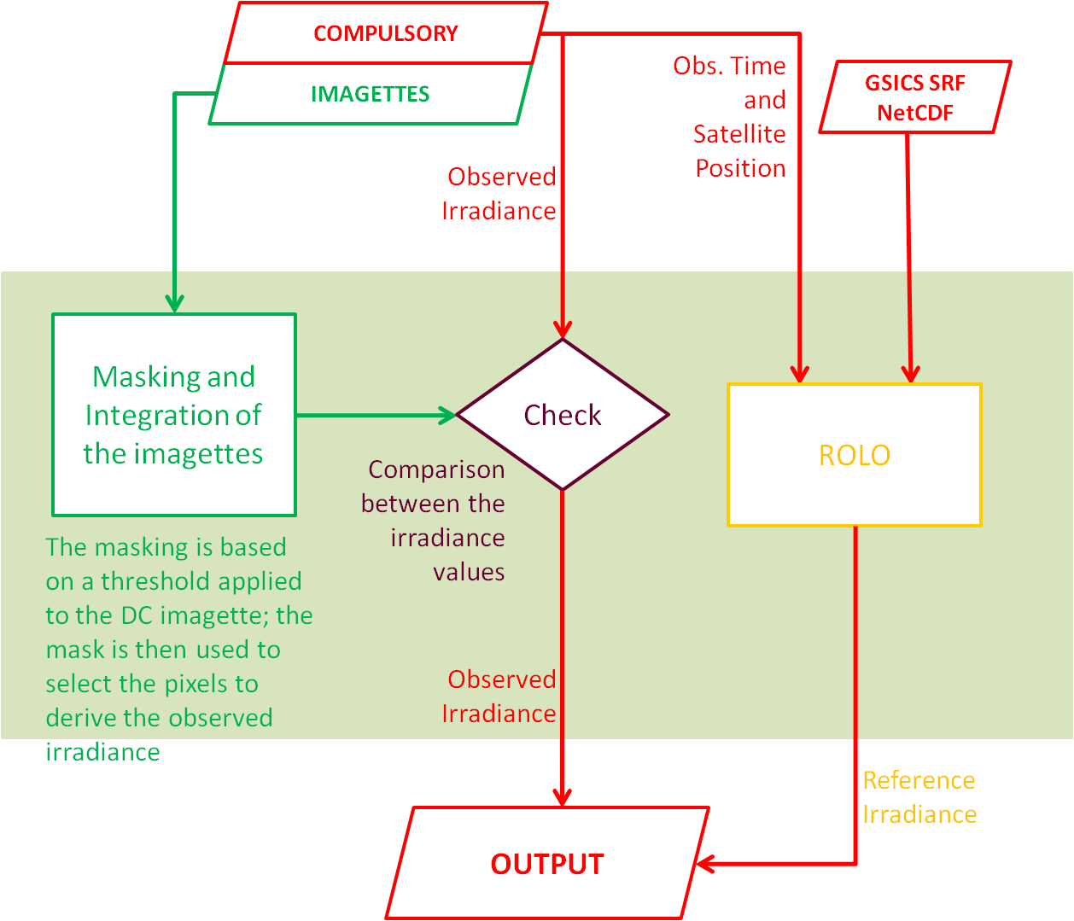
GIRO APPLICATION – Use of the imagettes
Notes:
The masking can be tricky and has an important impact on the final results; that’s why we propose a way to perform this step

Slide 11
GIRO APPLICATION – Further Analysis
Notes:
The masking can be tricky and has an important impact on the final results; that’s why we propose a way to perform this step

Slide 12
GIRO APPLICATION – Further Analysis
https://gsics.nesdis.noaa.gov/wiki/Development/20140624
Notes:
The masking can be tricky and has an important impact on the final results; that’s why we propose a way to perform this step

Slide 13
GIRO APPLICATION – Current Status
Reading of the lunar observation NetCDF files (using MTSAT2 dataset as benchmark);
Reading of the GSICS SRF NetCDF files;
Masking and Integration procedure.

Slide 14
GIRO APPLICATION – Next Step
Implementation of the writing of the Output NetCDF file.
Proposal for a first test:
Reading of the input NetCDF files (observation + SRF),
Computation of the observables,
Writing of a “dummy” lunar calibration file.
The test has the aim of performing a check of part of the function of the software.
In EUMETSAT we will employ three datasets for testing:
MTSAT2
MET8, MET9, MET10 (MSGs)
MET7

Slide 15
Thanks for your attention

