Slide 1
Defining Primary GSICS References - an Evolving Concept for Inter-Calibration Products
Special Issue of the IEEE TGRS on “Inter-Calibration of Satellite Instruments”:
Special Issue of the IEEE TGRS on “Inter-Calibration of Satellite Instruments”:
Tim Hewison
(EUMETSAT) (GRWG Chair)

Slide 2
Background Motivation
and
Overall Proposal

Slide 3
Current Situation
GSICS Inter-Calibration Products
Defined by (Monitoring – Reference) Instruments
GEO-LEO IR Products based on MetopA/IASI
Based on SNO method
Now in Pre-Operational mode
+ Aqua/AIRS as transfer to characterise diurnal variations
Developing Delta Corrections for MetopB/IASI
GEO-LEO VIS Products based on Aqua/MODIS
Based on DCC method
Soon to be in Demonstration mode

Slide 4
Motivation to Change
New reference instruments becoming available
MetopB/IASI, SNPP/CrIS, ...
VIIRS, ...
Need to define Archive Recalibration Corrections
To support generation of FCDRs
Aim to blend multiple references
After bias adjustment
Define a Primary GSICS Reference by consensus
More methods becoming available
DCC, Lunar, Rayleigh, ...
Ultimately aim to combine multiple methods

Slide 5
Requirements
Long-term continuity of GSICS Products
Without calibration jumps between references
Although their uncertainty will change...
Ensuring Traceability
back to single Primary Reference
For each Spectral Band
Radiometric Consistency
Cover a broad range of applicability

Slide 6
Proposed Solution – Define Primary GSICS Reference
Define one Primary GSICS Reference instrument
for each Spectral Band (VIS/NIR/TIR/UV/...)
and application area (NRTC/RAC/ARC/...) ?
by consensus agreement
based on a set of criteria (TBD)
supported by a Traceability Statement

Slide 7
Proposed Solution – Blend all Corrections to Provide Correction to Primary GSICS Reference
Define one Primary GSICS Reference
Regard others as Transfer References
Generate Delta Corrections* to convert to Primary
Apply Delta Corrections to transfer references corrections
BLEND Corrections from all available references
*Delta Corrections
Normally based on double differences
In channel-space of monitored instruments
Over extended overlap period between references

Slide 8
How?
Generate RAC/NRTC/Daily Products
Using both Primary and Transfer References
During whole overlap period
Define Delta Correction
As double difference
Define Delta Correction Period
Check for Jumps, Trends - Define break points if necessary
Define Weights to blend references after Delta Correction
Evaluate Delta Correction Uncertainty
Apply Delta Corrections
Blend Corrected Corrections into Primary GSICS Correction
May include results from transfer refs for optional use

Slide 9
Correcting the Corrections and Blending References
Reference-1 (Primary)
Monitored Instrument
Reference-2
(Transfer)
GSICS Correction, g₁ Mon➔1
GSICS Correction, g₂ Mon➔2
-
Derived by GSICS
Delta
Correction, g_{1/2}
2➔1
+
Corrected
Correction, g_{2,1/2}
Mon ➔2➔1
g̅
Primary GSICS Correction, g₀ Mon➔1
Applied
by User
Mon➔1

Slide 10
Aside: Proposed Solution to Combine Methods
Define one Primary Method?
Or do weighted average of Methods

Slide 11
Proposed Solution - Versions
If we change the Primary GSICS Reference:
e.g. If a better reference becomes available in future
or different applications (e.g. Archive Re-Calibration)
by consensus agreement – or following selection proc.
Would potentially introduce a calibration jump
Generate new Version of each GSICS Product:
Submit through a streamlined review process (GPPA)
Revise uncertainty evaluation
Revise traceability statement

Slide 12
What does this mean for the User?
Users only have to select:
Monitored Instrument
Spectral Band
Time Period
Product Version (usually most recent)
(Optionally) Override default Primary GSICS Reference
To select a Transfer Reference
Benefits:
Less to implement
Less choice => Less scope for error

Slide 13
What next?
Agree within GRWG general approach to :
Primary GSICS Reference
Define Process to select
Define Process to redefine Primary Reference
Define Delta Correction
& Uncertainty
Define ATBD to
Define Delta Correction & Uncertainty
Apply Delta Correction to Corrections from Transfer References
Blend Corrections from all References to generate Primary GSICS Corrections

Slide 14
Defining the Primary GSICS Reference

Slide 15
Proposed Solution – Define Primary GSICS Reference
Define one Primary GSICS Reference instrument
for each Spectral Band (VIS/NIR/TIR/UV/...)
and application area (NRTC/RAC/ARC/...) ?
by consensus agreement
based on a set of criteria (TBD)
supported by a Traceability Statement

Slide 16
Correcting the Corrections
- Defining the Delta Correction

Slide 17
Outline Delta Correction ATBD
Specific Example: GEO-LEO IR
Three options to generate Delta Corrections:
#1. Derive from RAC-like files
#2. Derive from Daily Correction files
#3. Derive from Collocations
First need to define Primary GSICS Reference
In practice, this will depend on the above results

Slide 18
Outline ATBD for Option #1: GEO-LEO IR - RAC
Generate intermediate RAC-like products for (Mon-Ref1) and (Mon-Ref2)
Check periods over which each reference is available
Define/Refine date range over which to evaluate Delta Correction
Default: Whole overlap period
Read coefficients from RAC (Mon-Ref1) and (Mon-Ref2)
Calc Double Difference of RAC coefficients from time series of RAC(Mon-Ref2)-RAC(Mon-Ref1)
Apply DD coefficients to evaluate DD bias time series for standard radiance scenes
Identify any step changes in the DD bias time series – if significant:
split overlap period and treat as separate reference & Go to 3
Identify any periodicity in the DD bias time series – if significant:
limit date range to n periods, define uncertainty growth & Go to 3
Identify any drifts in the DD bias time series – if significant:
limit date range to create period with insignificant changes, define uncertainty growth & Go to 3
If no significant changes:
Define Delta Correction as mean of Double Difference of RAC coefficients and covariance
Correcting covariance for oversampling in RAC time series
Apply Delta Correction to (Mon-Ref2) to (Mon-Ref1/2)

Slide 19
Outline ATBD for Option #2: GEO-LEO IR - Daily
Generate intermediate Daily Correction products for (Mon-Ref1) and (Mon-Ref2)
Check periods over which each reference is available
Define/Refine date range over which to evaluate Delta Correction
Default: Whole overlap period
Read coefficients from Daily(Mon-Ref1) and (Mon-Ref2)
Calc Double Difference of Daily coefficients from time series of Daily(Mon-Ref2)-Daily(Mon-Ref1)
Apply DD coefficients to evaluate DD bias time series for standard radiance scenes
Filter time series of DD bias time series to reject outliers
Identify any step changes in the DD bias time series – if significant:
split overlap period and treat as separate reference & Go to 3
Identify any periodicity in the DD bias time series – if significant:
limit date range to n periods, define uncertainty growth & Go to 3
Identify any drifts in the DD bias time series – if significant:
limit date range to create period with insignificant changes, define uncertainty growth & Go to 3
If no significant changes:
Define Delta Correction as mean of Double Difference coefficients and covariance
Apply Delta Correction to (Mon-Ref2) to generate RAC for dates when Ref1 not available

Slide 20
Outline ATBD for Option #3: GEO-LEO IR - Collocations
Generate intermediate Collocation products for (Mon-Ref1) and (Mon-Ref2)
Check periods over which each reference is available
Define/Refine date range over which to evaluate Delta Correction
Default: Whole overlap period
Recalculate RAC-like products from collocations of (Mon-Ref1) and (Mon-Ref2)
Calc Double Difference of RAC coefficients from time series of RAC(Mon-Ref2)-RAC(Mon-Ref1)
Apply DD coefficients to evaluate DD bias time series for standard radiance scenes
Identify any step changes in the DD bias time series – if significant:
split overlap period and treat as separate reference & Go to 3
Identify any periodicity in the DD bias time series – if significant:
limit date range to n periods, define uncertainty growth & Go to 3
Identify any drifts in the DD bias time series – if significant:
limit date range to create period with insignificant changes, define uncertainty growth & Go to 3
If no significant changes:
Define Delta Correction as weighted regression from all remaining collocations
coefficients and covariances
Apply Delta Correction to (Mon-Ref2) to generate RAC for dates when Ref1 not available

Slide 21
Conclusions of Previous Discussion
Need to generate double differences for all overlap period
Analyse these to characterise reference differences
Should probably not extrapolate trends
But could reconstruct them from multiple references
May not need Delta Corrections until current reference instrument dies
But then Delta Corrections will be needed instantly
For continuity of RACs, NRTCs
To trace them back to previous references
So need to start generating double differences asap
And define Delta Corrections to be ready when needed

Slide 22
Questions
Should we extrapolate periodic cycles?
If we can model/understand them & they are significant
Or use last n whole years
Is it OK to extrapolate uncertainty like this for NRTC/RAC?
For Delta Correction, keeping constant DD bias after Ref1 is dead
Is there any point in generating Delta corrections for current RAC/NRTC using the same smoothing period?
Or should we calc DD over whole overlap period? (or n years?)
Is this concept applicable to other GSICS Products?
DCC, Lunar, ...
Can we make blended reference for Archive Re-Cal/RACs?
With or without bias adjustment?

Slide 23
Urgent Questions
How to characterise diurnal calibration variability?
Do we need to include this in RAC/NRTC netCDF or document it?
How to define Delta Corrections for IASI-B->A?
Just from double difference of RAC & NRTC – same periods (As agreed in 2014 GRWG Meeting) - No added value
Average of all RACs/NRTCs over overlap period? (Correlated)
Average of selected RACs/NRTCs every 29/14d? (Uncorrelated)
Calculate Variograms from RACs/NRTCs over 30d-Nyquist
Recalculate regression from all collocations in overlap period?
Need more data – Any advantages?
As 2, 3 or 4, but for only the most recent n years (avoids aliasing seasonality e.g. from n.5 years)

Slide 24
Recap ATBD for Option #1: GEO-LEO IR - RAC
Generate intermediate RAC-like products for (Mon-Ref1) and (Mon-Ref2)
Check periods over which each reference is available
Define/Refine date range over which to evaluate Delta Correction
Default: Whole overlap period
Read coefficients from RAC (Mon-Ref1) and (Mon-Ref2)
Calc Double Difference of RAC coefficients from time series of RAC(Mon-Ref2)-RAC(Mon-Ref1)
Apply DD coefficients to evaluate DD bias time series for standard radiance scenes
Identify any step changes in the DD bias time series – if significant:
split overlap period and treat as separate reference & Go to 3
Identify any periodicity in the DD bias time series – if significant:
limit date range to n periods, define uncertainty growth & Go to 3
Identify any drifts in the DD bias time series – if significant:
limit date range to create period with insignificant changes, define uncertainty growth & Go to 3
If no significant changes:
Define Delta Correction as mean of Double Difference of RAC coefficients and covariance
Correcting covariance for oversampling in RAC time series
Apply Delta Correction to (Mon-Ref2) to generate RAC for dates when Ref1 not available

Slide 25
ATBD for Delta Corrections
Define Delta Correction as mean of Double Difference coefficients and covariance
Correcting covariance for oversampling in RAC time series
Filter outliers
2- or 3-sigma filter of time series of DD std Tb biases
not necessary for RAC
Calculate mean and covariance of DD coefficients
Scale covariance by oversampling factor
where
{x}_{t} = Time Series of x <x> = Mean of Time Series of x
P = Smoothing Period
n = number of samples
Δt= Overlap Period

Slide 26
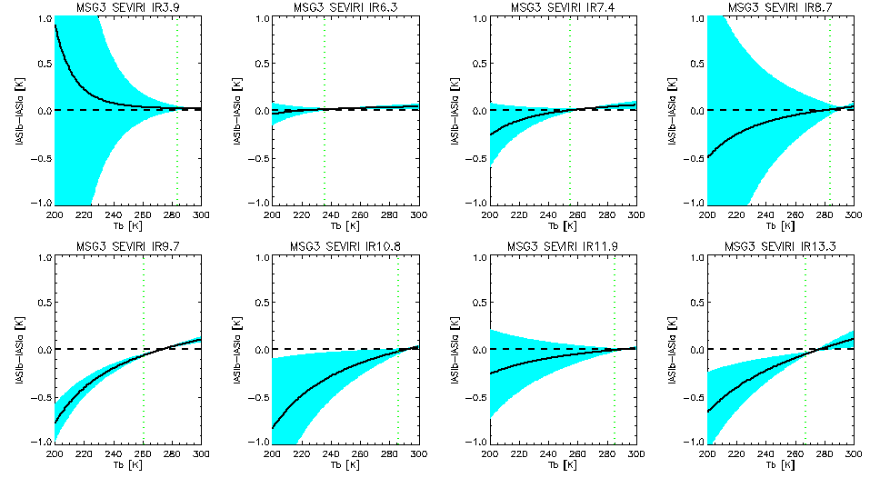
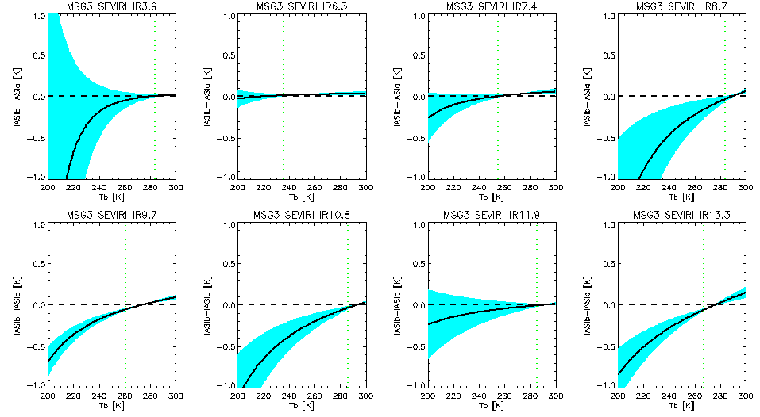
Option #2: Daily Correction (MSG3-IASIB)-(MSG3-IASIA)

Slide 27
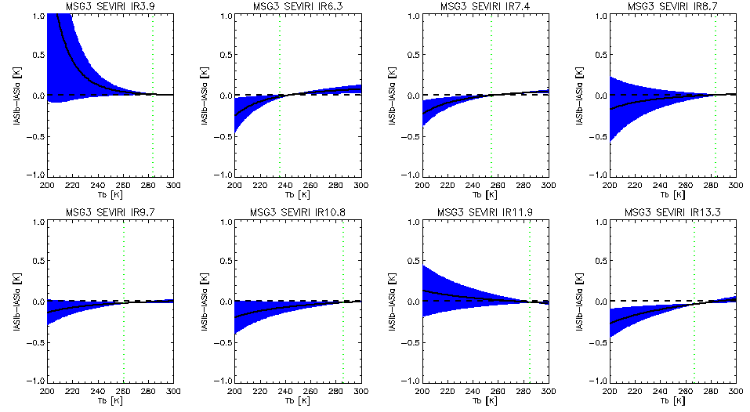
Option #1: Demo RAC (MSG3-IASIB)-(MSG3-IASIA)
=> Mean differences statistically consistent with Daily Results => Correction for over-sampling produces comparable uncertainties

Slide 28
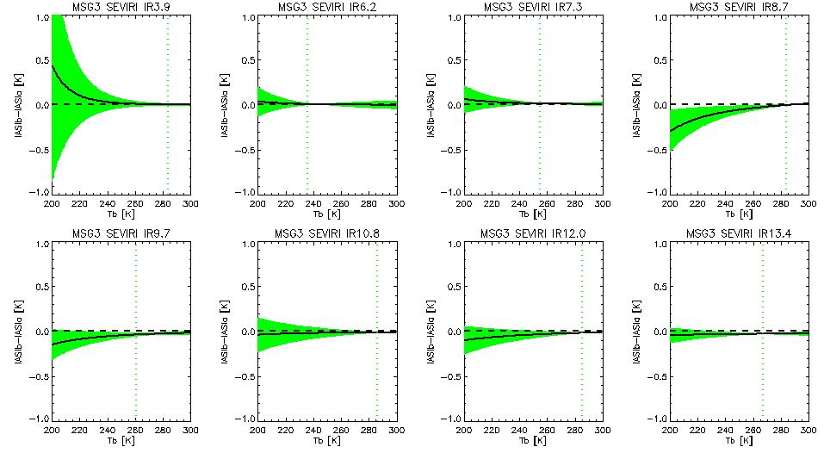
Option #1: PreOp RAC (MSG3-IASIB)-(MSG3-IASIA)
More Metop overpasses => More collocations => Lower uncertainties, but consistent mean

Slide 29
Specific Example #3: GEO-LEO IR –Collocations
Generate intermediate Collocation products for (Mon-Ref1) and (Mon-Ref2)
Individual collocations from each pair of instruments cannot be directly compared because they do not have the same location & time.
Only their distributions can be compared statistically!
E.g. Using by comparing RACs... (Option 1/2)
OR Perform regression of whole overlap dataset...
L_{REF1}
L_{MON}
L_{REF2}
L_{MON}

Slide 30
Option #3: From Collocations
Cannot find uncertainty from time series
Need to propagate from regressions
Need to make assumptions about cross-covariance terms in Σ uncertainty
Finding: Need to only compare matched days
Otherwise, calibration trends introduce biases
Reduces number of cases in my test dataset

Slide 31
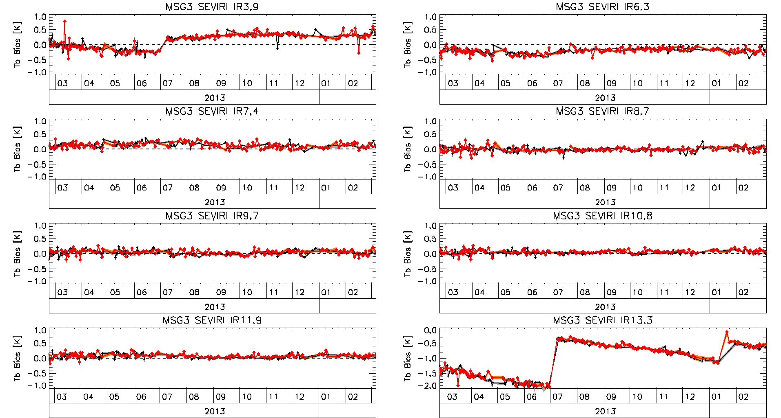
Time Series of Standard Biases – Updated! Full year (Met10/SEVIRI-MetopB/IASI) & (Met10/SEVIRI-MetopA/IASI)
Unsmoothed Daily Results 3-sigma filter
– not necessarily same days!

Slide 32
Recap: Option #1: Demo RAC (MSG3-IASIB)-(MSG3-IASIA)

Slide 33
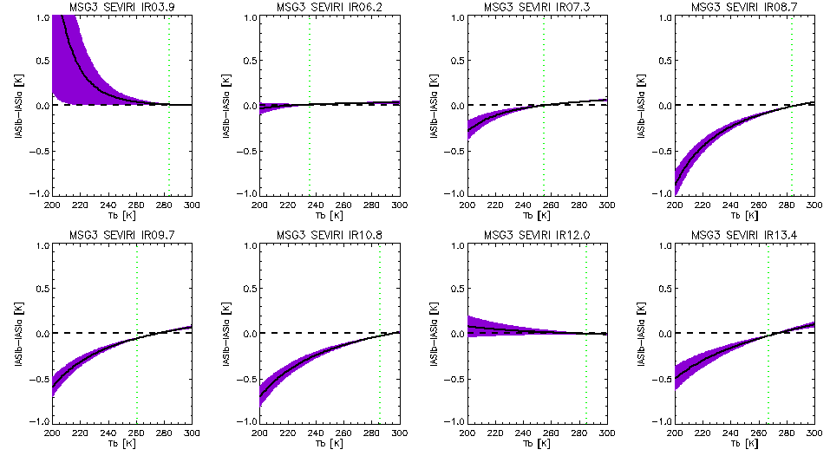
Option #2: Daily Correction (MSG3-IASIB)-(MSG3-IASIA)
Option 3: Matched Collocations (MSG3-IASIB)-(MSG3-IASIA)
Consistent mean biases with Option 2
But had to increase uncertainty from regression by a factor of ~3

Slide 34
Option 3: Matched Collocations (MSG3-IASIB)-(MSG3-IASIA)
Option #1: Demo RAC (MSG3-IASIB)-(MSG3-IASIA)
Option 3: Matched Collocations (MSG3-IASIB)-(MSG3-IASIA)
Mean Biases from RAC Corrections (Option 1) closer to zero
But broadly consistent with Collocations from matching days (Option 3)

Slide 35
Option #3: From Collocations - Findings
Finding: Need to only compare matched days
Otherwise, calibration trends introduce biases
Reduces number of cases in my test dataset
Consistent results – but larger uncertainties
Needs more data to be kept (all collocations)
Need to make assumptions about cross-covariance terms in Σ uncertainty
(Unweighted regression gives large uncertainties in shorter wavelength channels)
Weighted regression: weights need increasing by a factor of ~3 to give uncertainties consistent with time series of Daily Corrections
Results not robust to sub-sampling time series

Slide 36
Conclusions re: Defining Delta Corrections
Proposal (based on this analysis):
Delta Corrections are calculated as:
mean Double Difference of Re-Analysis Corrections Coefficients
Evaluated over the whole overlap period (Option #1)
Updated daily for NRTC & RAC products
Delta Correction Uncertainty is calculated from:
Covariance of times series of Delta Corrections
Evaluated over the whole overlap period*
Scaled to account for over-sampling factor (RACs are smoothed)
Apply Delta Correction to all secondary references
Generate GSICS Corrections to Primary Reference

Slide 37
Delta Correction Stationarity Tests
* Delta Corrections only use whole overlap period if:
Test¹ shows no significant² jumps during period
¹ Suitable tests to be defined
² Significant wrt uncertainty on GSICS Correction and/or user requirements
Test¹ shows no significant² cycles during period
Or define for an integral number of cycles?
Test¹ shows no significant² trend during period
Or ... we’re in trouble...?

Slide 38
Blending Corrections from different References

Slide 39
Primary GSICS Reference Transfer Strategies
Strategy | Definition | Pros | Cons | NRTC? | RAC? | ARC?
Single Transferable Reference | Pecking Order: IASI-A, -B, -C, CrIS, AIRS,... Transition Condition | V. Simple | Doesn’t use all data | Y | Y | Y
Simple Blend | Equal Weightings of each reference | V. Simple Uses all data | Short periods add noise | N? | Y? | Y
Delayed Blend | Equal Weightings + Delay | F. Simple Uses most data | None? (Delay) | Y | Y | N/R
Tapered Transition | Tapered Weightings | Uses most data Smoothes steps | Can’t see future! | N | N | Y
Weighted Blend | Weightings by Uncertainty | Q. Simple Uses all data | None? | Y | Y | Y
Others?

Slide 40
Define Weights in Blended Reference
What matters:
How good is Delta Correction relative to GSICS Correction?
Evaluate Uncertainty!
Uncertainty of Mean Double Difference of Overlap T/S
Relative to Uncertainty of Single Difference T/S
If only one reference available
it gets 100% weight!
If multiple references available
Weight each by their total uncertainty (incl. Delta Corr.)

Slide 41
Simple Example Blended Reference
Simplest Blend:
Equal Weight for each available Reference
More Advanced:
Tapered transition e.g. 1 year
Weight based on Relative Uncertainty of Single and Double Differences

Slide 42
Example Tapered Blended Reference for ARC

Slide 43
Recap ATBD for Option #1: GEO-LEO IR - RAC
Generate intermediate RAC-like products for (Mon-Ref1) and (Mon-Ref2)
Check periods over which each reference is available
Define/Refine date range over which to evaluate Delta Correction
Default: Whole overlap period
Read coefficients from RAC (Mon-Ref1) and (Mon-Ref2)
Calc Double Difference of RAC coefficients from time series of RAC(Mon-Ref2)-RAC(Mon-Ref1)
Apply DD coefficients to evaluate DD bias time series for standard radiance scenes
Identify any step changes in the DD bias time series – if significant:
split overlap period and treat as separate reference & Go to 3
Identify any periodicity in the DD bias time series – if significant:
limit date range to n periods, define uncertainty growth & Go to 3
Identify any drifts in the DD bias time series – if significant:
limit date range to create period with insignificant changes, define uncertainty growth & Go to 3
If no significant changes:
Define Delta Correction as mean of Double Difference of RAC coefficients and covariance
Correcting covariance for oversampling in RAC time series
Apply Delta Correction to (Mon-Ref2) to generate RAC for dates when Ref1 not available
How? See Next Slide...

Slide 44
How to make NRTC to Primary GSICS Reference using Delta Corrections
Check whether there is an existing Primary Reference product?
If not create one
For given date, check which References’ Delta Corrections and NRTCs are available for
Apply Delta Correction for each available reference to each NRTC and evaluate uncertainty
Combine Corrected Corrections (NRTC+Delta) for each Reference
Weighted by uncertainty
Write this out to Primary Reference NRTC Product

Slide 45
How to make RAC to Primary GSICS Reference using Delta Corrections
Check whether there is an existing Primary Reference product?
If not create one
For given date, check which References’ Delta Corrections and RACs are available for
Apply Delta Correction for each available reference to each RAC and evaluate uncertainty
Combine Corrected Corrections (RAC+Delta) for each Reference
Weighted by uncertainty
Write this out to Primary Reference RAC Product
All products use common Delta Correction - mean RAC DD over whole* overlap period
Advantages:
Enforces a delay of 14 days before it is applied
More robust than daily/NRTC Delta Corrections
Simpler to implement
The double differences are going to be averaged anyway!
(*Or subset thereof, if jumps detected...)

Slide 46
How to make ARC to Primary GSICS Reference using Delta Corrections
Check whether there is an existing Primary Reference product?
If not create one
For given date, check which References’ Delta Corrections and ARCs are available for
Apply Delta Correction for each available reference to each ARC and evaluate uncertainty
Combine Corrected Corrections (ARC+Delta) for each Reference
Weighted by uncertainty
Write this out to Primary Reference ARC Product

Slide 47
Applying Delta Correction to Secondary Corrections

Slide 48
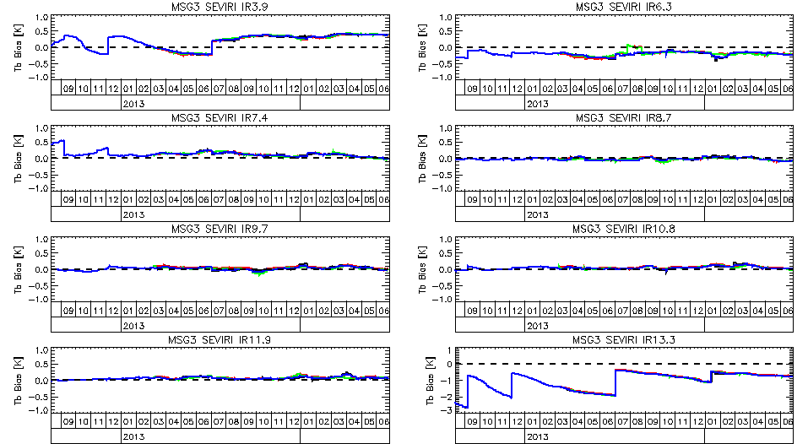
Standard Bias MSG3-IASA/IASIB/IASIB+Delta/ Primary = Avg(MSG3-IASIA,IASIB+Delta)

Slide 49
Uncertainty on blended Inter-Calibrations to Primary GSICS Reference

Slide 50
Define Primary GSICS Correction

Slide 51
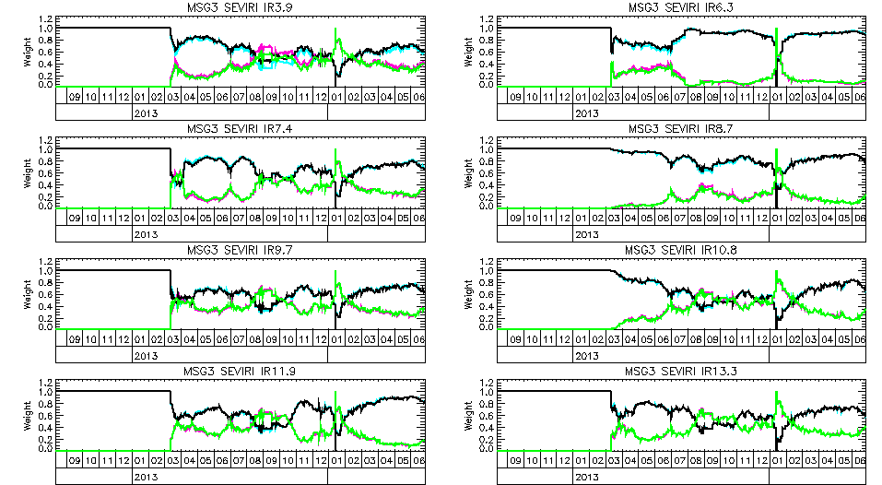
Weights MSG3-IASA/IASIB+Delta

Slide 52
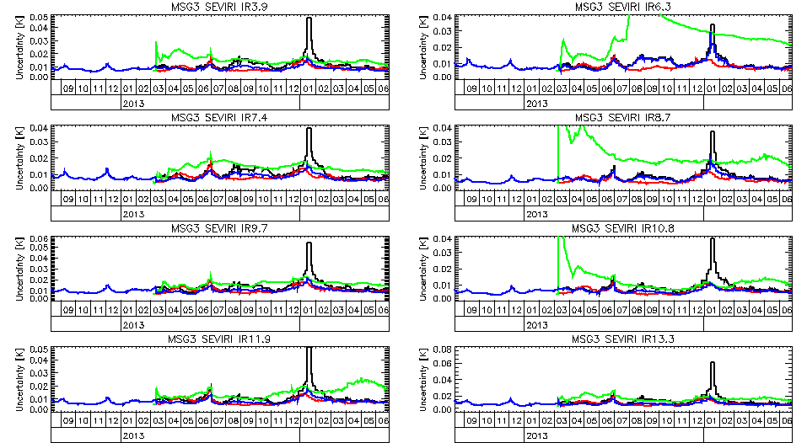
Uncertainty MSG3-IASA/IASIB/IASIB+Delta/ Primary = Avg(MSG3-IASIA,IASIB+Delta)
Red is usually similar to black IASIA~IASIB
Blue is better than black! (More data!)
Sparse data periods are filled (Jan 2014)
Delta Correction improves after first months

Slide 53
Summary
&
Way Forward

Slide 54
Summary of Proposal
Generate Delta Corrections
to convert Corrections from different references
based on mean of double difference of GSICS Correction in overlap period
Define one Primary GSICS Reference for each spectral band
and processes to select and change
Make new inter-calibration products
to the Primary GSICS Reference
Known as Prime GSICS Corrections
blending corrections from multiple references according to uncertainties
include all composite parts in single netCDF file
Draft Outline ATBD & prototype products available for review

Slide 55
What Next for Delta Corrections?
Agree Delta Correction formula proposed here
Define stationarity tests to characterise overlap period:
Step Changes
Periodic Variations – including diurnal & seasonal
Long-term trends
Agree how to handle these, if significant
Hopefully not for IASI-A/B
Final agreement on use of Primary References
E.g. to Blend or Not to Blend

Slide 56
What next for Primary References?
Define process to select & migrate Primary GSICS References
for each spectral band
Please review draft ATBD & Prototype Products!
Prepare Traceability Statement for Primary GSICS Reference, incl:
Description of transfer process
Comparisons with secondary references
Pre-launch Characterisation
Who wants to lead this?

Slide 57
What next for Blended Corrections?
Seek users’ feedback on this proposal
Define netCDF format & content of GSICS Products
Revise
User Guides,
Traceability Statement,
Uncertainty Analysis
Refine GSICS Procedure for Product Acceptance (GPPA)
Define new structure on GSICS Data Servers
Start generating products
in parallel with current products
Modify GSICS plotting tool
to work with new products

Slide 58
Thank you
Any Questions?

Slide 59
Additional Thoughts

Slide 60
Aside: How to Handle Periodic Variations
Blank out anomalous periods
e.g. Midnight BB Cal
Add a predictor
e.g. Time of Day, Time of Year
Use full number of periods to define Delta Correction
To cancel out impact of variations,
But uncertainties will be correspondingly larger
Estimate spread empirically
and inflate uncertainties to cover these

Slide 61
Aside: To Correct or Not to Correct?
Delta Corrections may not be significant
i.e. Statistically or physically different from zero (no correction)
E.g. For IASI-A/B in most SEVIRI channels
Need to decide whether to apply insignificant Corrections
Doing so can introduce unphysical variability
Not doing so risks introducing jumps in time series
If Correction changes to become significant
Can we leave this as a decision for the users?
Are you more interested in noise or long-term stability?
Need to provide clear guidance

Slide 62
Aside: Combining GSICS Products
Merge Multiple Spectral Bands into one file?
Treat all algorithm changes as new versions?
Start with corrections only for TIR channels?
Add VIS channels next, based on DCC products?
Good idea for Users
Difficult to implement for Developers
E.g. Lots of different variables in netCDF files
Could provide users with a combination of netCDFs
E.g. Zip archive of pointers, ...?

