Slide 1
GPM Microwave Radiometer Vicarious Cold Calibration
Rachael Kroodsma
UMD ESSIC / NASA GSFC
rachael.a.kroodsma@nasa.gov

Slide 2
Outline
Motivation
  GPM inter-calibration
Dissertation Work
  Inter-calibration algorithm development
    Vicarious cold calibration
Current Work
  GMI calibration analysis
  Inter-calibration uncertainty analysis

Slide 3
Global Precipitation Measurement (GPM)
Use multiple radiometers on individual platforms to measure global precipitation
  Goal: global measurements every 3 hours
GPM X-Cal group is responsible for developing inter-calibration algorithms
  Original focus on microwave imagers
  More recent focus on microwave sounders
Core observatory launched!
  February 28, 2014 3:37 JST

Slide 4
GPM Microwave Imager (GMI)
GMI turned on March 4
Public data release June 16
  Over 2 months ahead of requirement (6 months after launch)
Next reprocessing on September 2
  Clean up many of the anomalies seen in the current GMI data
GMI calibration is looking very good

Slide 5
Microwave Imagers for GPM constellation
Radiometer | Frequency (GHz) |  |  |  |  | Nominal EIA (degrees) | Orbital Inclination (degrees) | Local Crossing Time (asc)
WindSat | 10.7V 10.7H | 18.7V 18.7H | 23.8V 23.8H | 37.0V 37.0H |  | 49.9-55.3 | 98.7 | 6:00pm
AMSR-E | 10.65V 10.65H | 18.7V 18.7H | 23.8V 23.8H | 36.5V 36.5H | 89.0V 89.0H | 55 | 98 | 1:30pm
SSM/I |  | 19.35V 19.35H | 22.235V | 37.0V 37.0H | 85.5V 85.5H | 53.1 | 98.8 | 6:00pm – 9:00pm
TMI | 10.65V 10.65H | 19.35V 19.35H | 21.3V | 37.0V 37.0H | 85.5V 85.5H | 53.3 (post-boost) | 35 | --
SSMIS |  | 19.35V 19.35H | 22.235V | 37.0V 37.0H | 91.655V 91.655H | 53.1 | 98.9 | 6:00pm – 8:00pm
AMSR2 | 10.65V 10.65H | 18.7V 18.7H | 23.8V 23.8H | 36.5V 36.5H | 89.0V 89.0H | 55 | 98 | 1:30pm
MADRAS |  | 18.7V 18.7H | 23.8V | 36.5V 36.5H | 89.0V 89.0H | 53.5 | 20 | --
GMI | 10.65V 10.65H | 18.7V 18.7H | 23.8V 23.8H | 36.64V 36.64H | 89.0V 89.0H | 52.8 | 65 | --

Slide 6
GPM X-Cal Algorithm
X-Cal inter-calibration algorithm:
Each team calculates a double difference (DD) between the target and reference radiometers
Combine teams’ results into one value at the cold end and one at the warm end
Assume linear dependent calibration between cold and warm TBs
Algorithm ~1 year after launch
Current GPM Inter-Calibration Algorithm
GMI
TMI
SSMIS F16
GMI
TMI
TMI
AMSR2
SSMIS F17
SSMIS F18
SSMIS F19

Slide 7
University of Michigan’s Contribution:
Vicarious Cold Calibration

Slide 8
Vicarious Cold Inter-Calibration Algorithm*
GDAS inputs
Freq/pol, EIA
Radiative transfer model
Radiometer ‘A’ TB data
Simulated TB data for ‘A’
Vicarious cold calibration algorithm
Observed cold cal TB
Simulated cold cal TB
Obs cold cal TB – Sims cold cal TB
Repeat for radiometer ‘B’
‘A’ Single difference
‘B’ Single difference
‘A’ single diff – ‘B’ single diff
Double difference for ‘A’ and ‘B’
*R. A. Kroodsma, D. S. McKague, and C. S. Ruf, “Inter-calibration of microwave radiometers using the vicarious cold calibration double difference method,” J. Selected Topics Remote Sensing, vol. 5, no. 3, pp. 1006-1013, 2012.

Slide 9
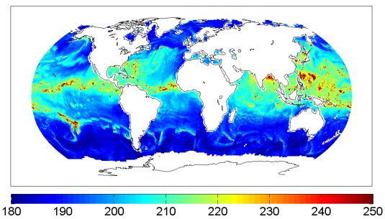
Calculate Cold Cal TB from Histograms
One month of over-ocean TB observations
Each channel: Freq/pol
………..
19H
21V
37V
………..
Hemispheres
NH
SH
Orbits
asc
des
Scan Position
………..
70
71
72
………..
Notes:
Channel and scan positions are radiometer-specific.

Slide 10
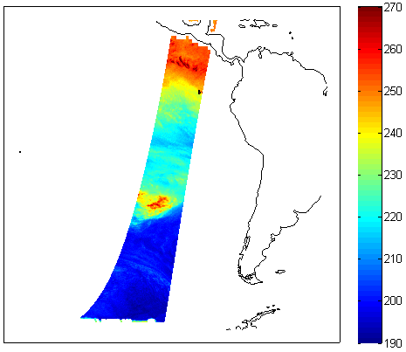

Simulate Radiometer TBs and Calculate Cold Cal TB
AMSR-E Observed 23.8V TBs
Simulated 23.8V TBs
GDAS
Lat/Lon, scan time
SST, wind, water vapor, cloud liquid water and temp profiles
TB (K)
EIA, freq
RTM
TOA TB
Difference from match-up inter-calibration method: we simulate all over-ocean TBs for vicarious cold calibration, not just those in the match-up regions.

Slide 11
Observed (obs) and Simulated (sims) Cold Cal TB Comparison
TB Histograms
23.8V NH monthly cold cal TB
Sims cold cal TB matches obs seasonal cycle
Warm tail in obs due to rain
10.65V SH des cold cal TB
Cold end shape of histograms look similar
Sims cold cal TB matches obs scan position variation

Slide 12
Single Difference (SD)
[Obs – Sims] Cold Cal TB
23.8V NH monthly SD
10.65V SH des SD
SD accounts for frequency, EIA, and geophysical variability
*Considered a relative calibration*

Slide 13
Double Difference (DD)
AMSR-E – TMI DD
Average 1 year of DDs to derive the inter-calibration values

Slide 14
Contribution to GPM X-Cal: AMSR2 – TMI
UM results show good agreement

Slide 15
Current Work:
GMI Calibration Analysis

Slide 16
GMI Calibration Analysis
Use the vicarious cold calibration single difference (SD) to analyze GMI calibration
  [Obs – Sims] cold cal TB
Relative calibration
Time dependent SD
  Calibration stability over time
Scan dependent SD
  Identify scan biases

Slide 17
GMI Time Dependent SD
All channels show a relatively stable calibration w.r.t. time
Notes:
Cold cal TB calculated using 7 days of data. Only scan positions 50-150.

Slide 18
GMI Time Dependent SD: Asc/Des splits
Splitting into asc/des orbits shows a very apparent yaw dependent calibration at some channels (10.65V/H and 36.5V)

Slide 19
GMI Asc SD – Des SD by Yaw
Nonzero value indicates an asc/des calibration dependency.
10.65V/H and 36.5V show the largest deviations from zero. Note that 10.65H is opposite from 10.65V and 36.5V.

Slide 20
GMI Scan Dependent SD by Yaw
10.65 and 36.5 channels show some yaw dependent scan biases.
Significant scan dependent biases in 10.65H.

Slide 21
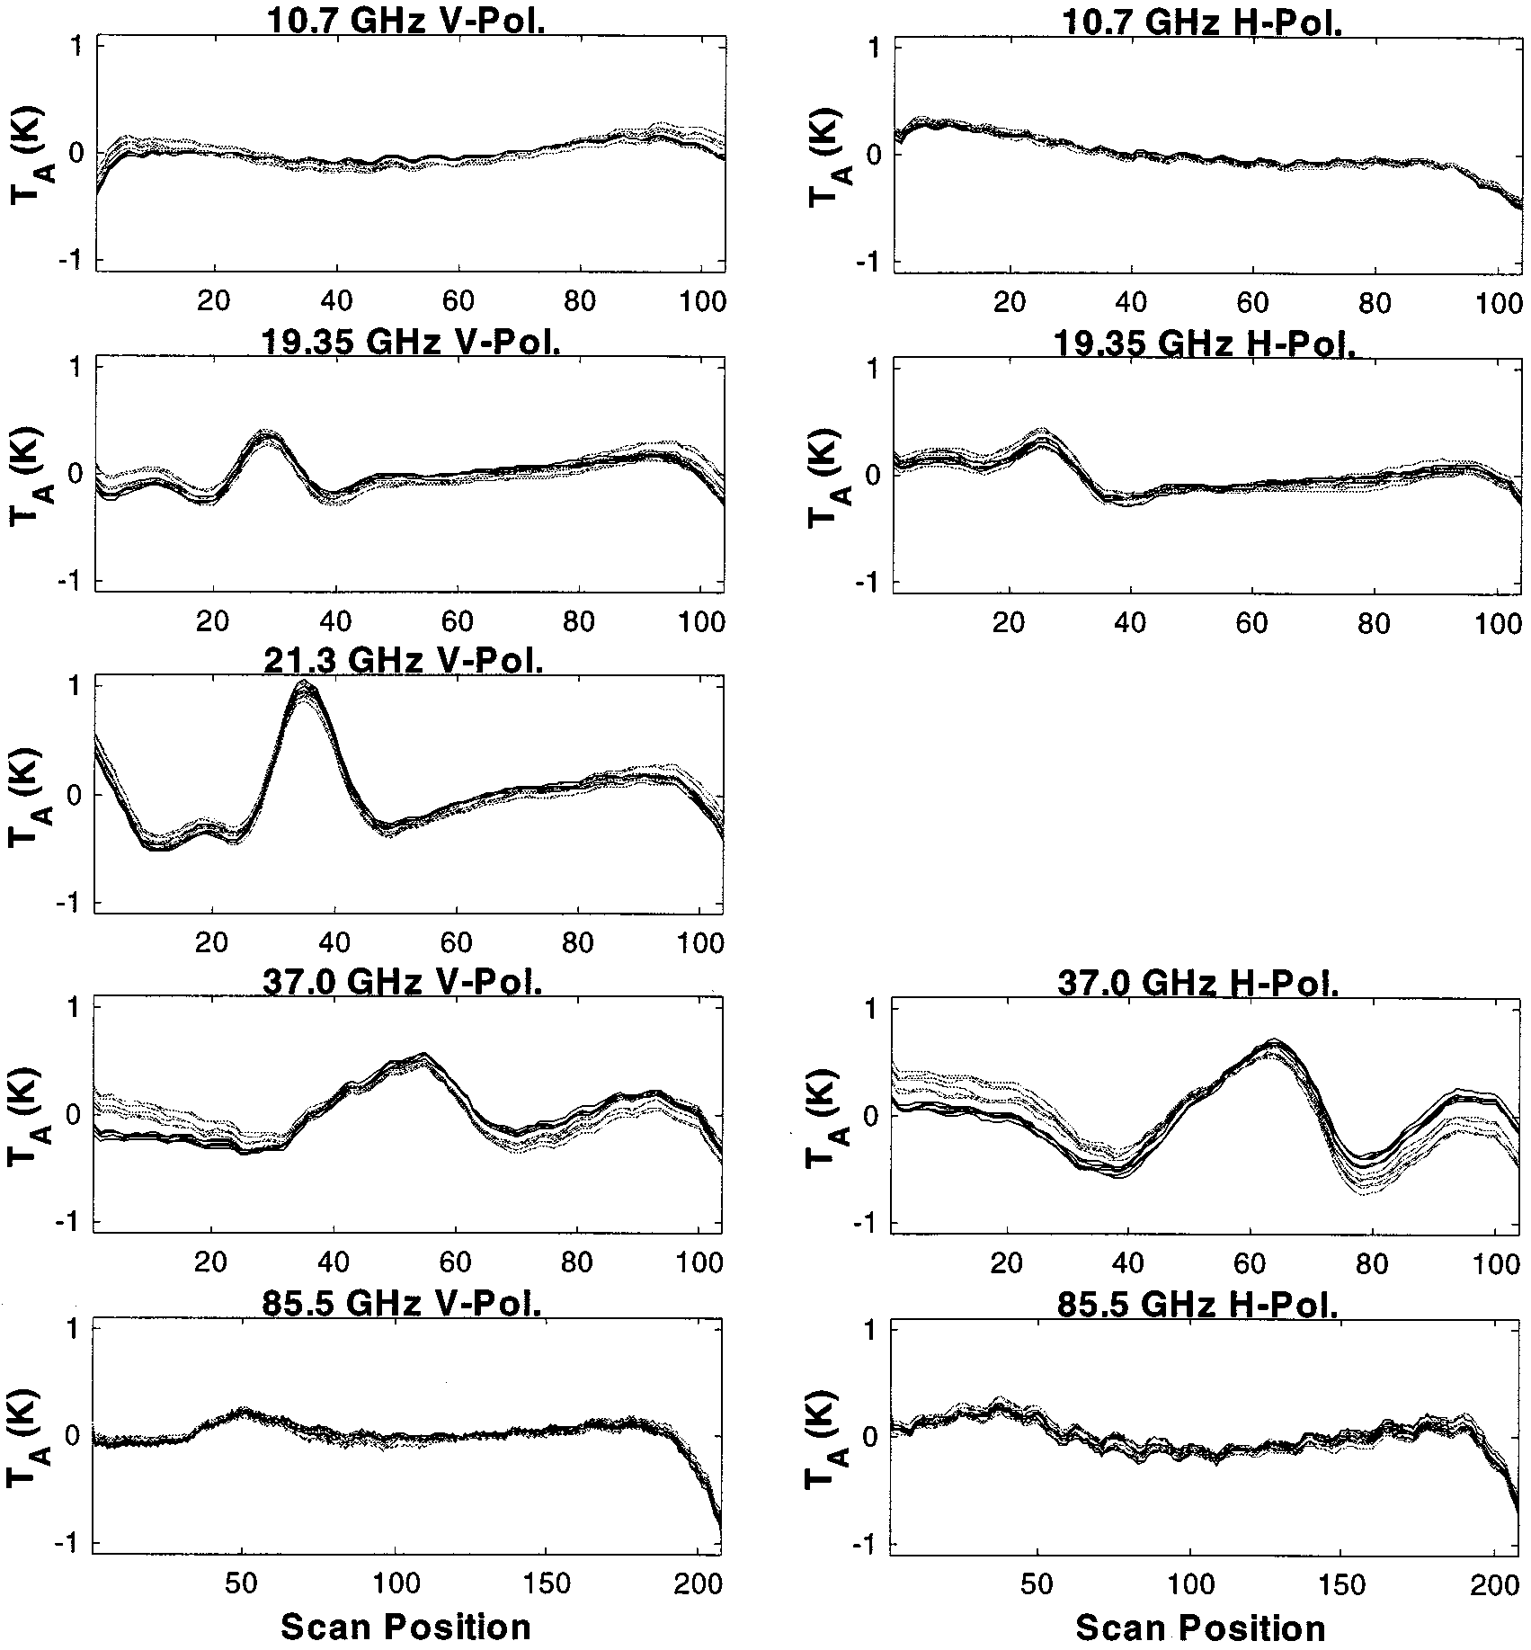
Wentz et al. 2001: TMI scan biases
Initial TMI calibration showed some significant scan biases. Except for the 10.65H channel, GMI scan biases look very good by comparison. Plus, we have been able to identify the source of many of the scan anomalies seen in GMI data and can remove them.

Slide 22
X-Cal Consensus Inter-Cal: GMI – TMI
 | 10v | 10h | 18v | 18h | 23v | 36v | 36h | 89v | 89h
Cold DD | 3.9 | 3.0 | 2.8 | 2.2 | 1.1 | 2.0 | 1.1 | 0.8 | 0.9
@Temp | 160 | 85 | 180 | 100 | 190 | 200 | 130 | 250 | 250
Warm DD | 5.2 | 5.0 | 5.0 | 4.1 | 2.6 | 1.5 | 1.3 | -- | --
@Temp | 285 | 283 | 288 | 286 | 286 | 282 | 281 | -- | --
Notes:
Using GMI 1C V03A and TMI 1B11 v7
89 GHz channel is a constant offset at all temperatures
These numbers may change with the next reprocessing (GMI V03B)

Slide 23
Current Work:
Inter-Calibration Uncertainty

Slide 24
Vicarious Cold Inter-Calibration Algorithm*
GDAS inputs
Freq/pol, EIA
Sources of Error
Radiative transfer model
Radiometer ‘A’ TB data
Simulated TB data for ‘A’
Vicarious cold calibration algorithm
Observed cold cal TB
Simulated cold cal TB
Obs cold cal TB – Sims cold cal TB
Repeat for radiometer ‘B’
‘A’ Single difference
‘B’ Single difference
‘A’ single diff – ‘B’ single diff
Double difference for ‘A’ and ‘B’
*R. A. Kroodsma, D. S. McKague, and C. S. Ruf, “Inter-calibration of microwave radiometers using the vicarious cold calibration double difference method,” J. Selected Topics Remote Sensing, vol. 5, no. 3, pp. 1006-1013, 2012.

Slide 25
Double Difference Sensitivity to RTM
Surface emissivity models: Elsaessar (current) and RSS
Atmospheric absorption: Rosenkranz (current) and MonoRTM
Ancillary data: GDAS (current) and ERA-I
DDs are found for the following 5 cases using 2013 data for SSMIS F17 and AMSR2 compared with TMI.
Case 1: GDAS inputs, Elsaessar surface model, Rosenkranz atmosphere
Case 2: GDAS inputs, RSS surface model, Rosenkranz atmosphere
Case 3: GDAS inputs, Elsaessar surface model, MonoRTM atmosphere
Case 4: ERA-I inputs, Elsaessar surface model, Rosenkranz atmosphere
Case 5: ERA-I inputs, Elsaessar surface model, MonoRTM atmosphere

Slide 26
Double Differences for 5 Cases
DD spread (K) of 5 cases
Channel | A2-TMI | F17-TMI
10v | 0.08 | --
10h | 0.04 | --
19v | 0.11 | 0.10
19h | 0.12 | 0.08
21v | 0.69 | 0.57
37v | 0.16 | 0.07
37h | 0.16 | 0.06
85v | 0.34 | 0.32
85h | 0.70 | 0.67

Slide 27
Summary
Initial check-out of GMI looks good
  Vicarious cold calibration shown to be a useful tool for analyzing calibration
GMI will be ready to be used as the reference radiometer for GPM
  1 year of data is desired before adding it to the constellation
X-Cal has recently started to focus on calculating uncertainties for inter-calibration
  Preliminary analysis has shown sensitivity of water vapor and high frequency channels to water vapor profile assumptions and atmospheric absorption models

