Slide 1
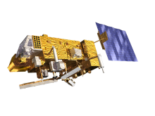
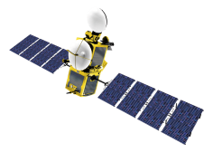
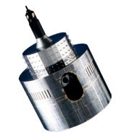
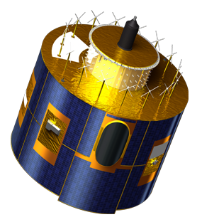
PREPARATION OF THE GiRO executable
Current status
Bartolomeo Viticchiè, Tom Stone, Sebastien Wagner, Masaya Takahashi & Tim Hewison

Slide 2
GIRO first release: feedbacks from users
Functionalities:
reading of the input NetCDF files (observation + spectral response function),
computation of the observables, and
writing of a “dummy” lunar calibration file in which only the observables will be stored while the rest of the information is left at _FillValue (for the definition of observables please refer to [HLD_GIRO_IO]).
First Release | 25th July 2014
Compilation Environment | Linux 32 bits: gcc 4.6.2 Linux 64 bits: gcc 4.3.2 Zlib 1.2.8HDF 5-1.8.13NetCDF-4.3.2
Tested on | Ubuntu 14.04 LTS 32 bits, openSUSE 11.1 64 bits, openSUSE 12.1 32 bits, and Red Hat Enterprise Linux Server 6.2 32/64 bits (JMA test), 32 bit CentOS (USGS test); tested also by NOAA, KMA, ISRO,
1 bug reported
Fangfang Yu (NOAA): on the handling of rectangular Moon imagettes
NOW FIXED

Slide 3
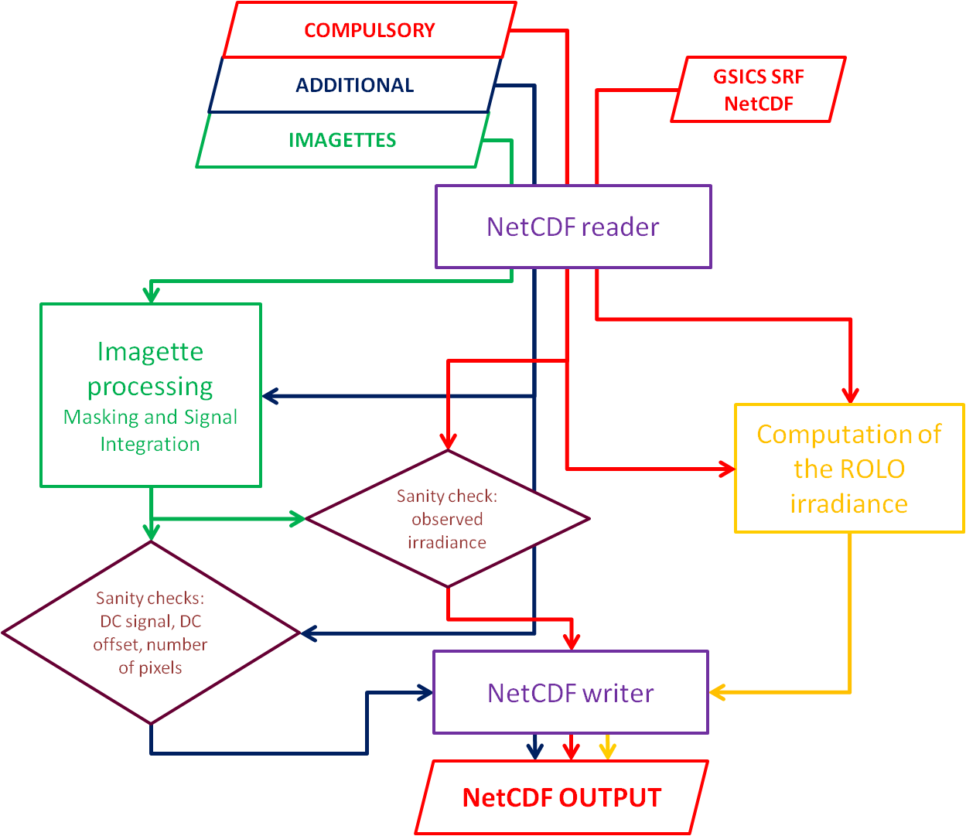
GIRO second release
Functionalities:
reading of the input NetCDF files (observation + spectral response function),
computation of the observables
writing of the sanity check files
computation of the ROLO reference irradiance
writing of a complete lunar calibration output file
Figure 1 of https://gsics.nesdis.noaa.gov/pub/Development/20140624/GSICS_ROLO_HighLevDescript_IODefinition_wiki.pdf

Slide 4
GIRO second release
Functionalities:
reading of the input NetCDF files (observation + spectral response function),
computation of the observables
writing of the sanity check files
computation of the ROLO reference irradiance
writing of a complete lunar calibration output file
Figure 1 of https://gsics.nesdis.noaa.gov/pub/Development/20140624/GSICS_ROLO_HighLevDescript_IODefinition_wiki.pdf

Slide 5
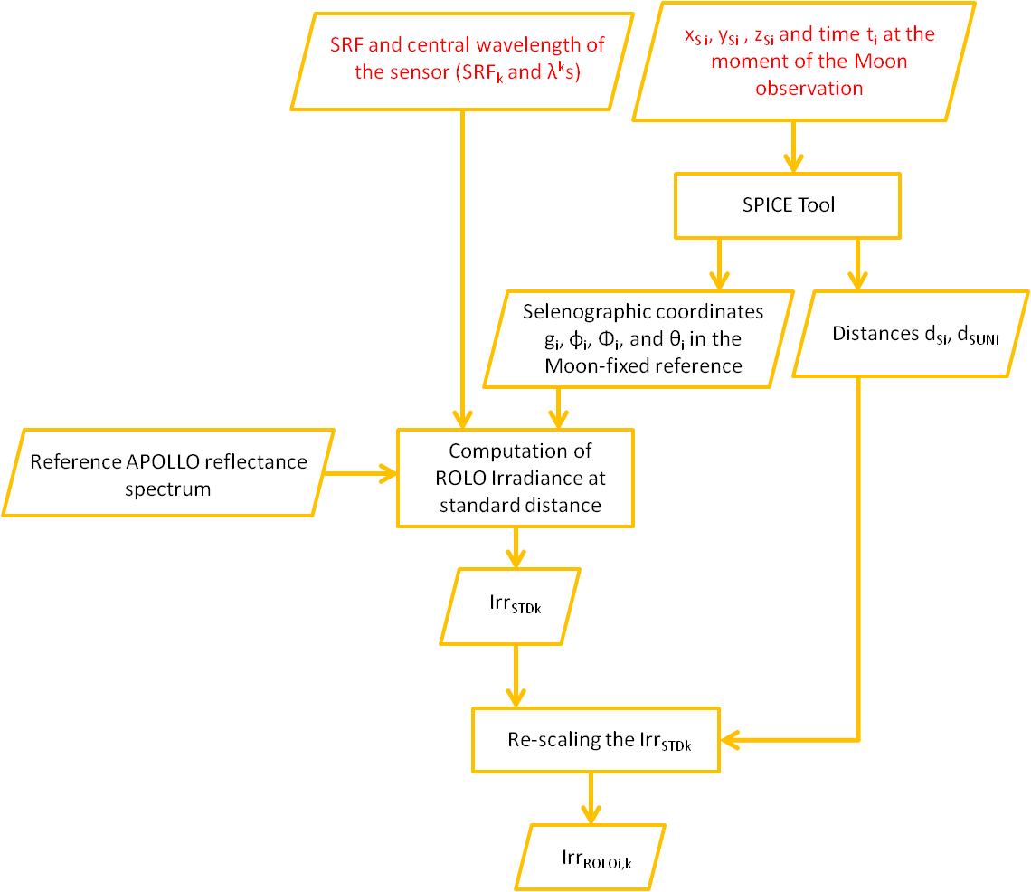
Computation of the ROLO reference irradiance: testing vs. ROLO
Computation of the observation geometry
Sun – Moon – Satellite
Figure 5 of https://gsics.nesdis.noaa.gov/pub/Development/20140624/GSICS_ROLO_HighLevDescript_IODefinition_wiki.pdf

Slide 6
Computation of the ROLO reference irradiance: testing vs. ROLO
Check on the consistency
of the Apollo reference spectrum
Figure 5 of https://gsics.nesdis.noaa.gov/pub/Development/20140624/GSICS_ROLO_HighLevDescript_IODefinition_wiki.pdf

Slide 7
Computation of the ROLO reference irradiance: testing vs. ROLO
Detailed check of the computation steps:
computation of the Moon reflectance the ROLO wavelengths;
smoothing of this reflectance spectrum using the Apollo one.
Figure 5 of https://gsics.nesdis.noaa.gov/pub/Development/20140624/GSICS_ROLO_HighLevDescript_IODefinition_wiki.pdf

Slide 8
Computation of the ROLO reference irradiance: testing vs. ROLO
Check on the reference irradiance
Figure 5 of https://gsics.nesdis.noaa.gov/pub/Development/20140624/GSICS_ROLO_HighLevDescript_IODefinition_wiki.pdf

Slide 9
Computation of the ROLO reference irradiance: testing vs. ROLO
Goal: to verify that the reference lunar irradiances generated by the GIRO match ROLO results with acceptable accuracy.
Run the GIRO for a test dataset — MSG1
Extract the observational parameters for input to ROLO:
times of the Moon observations
spacecraft location @ observation times
Process the observations through the ROLO system at USGS
Compare quantities at various stages in the processing:
fundamental inputs to the ROLO lunar model (obs. geometry)
fundamental model outputs (lunar disk reflectance spectrum)
corrections for instrument spectral response functions (SRFs)
irradiance distance corrections (Sun–Moon and Moon–sensor)
model-generated lunar irradiances
courtesy of Tom Stone

Slide 10
Computation of the ROLO reference irradiance: testing vs. ROLO
The ROLO lunar model kernel — disk-equivalent lunar reflectance (A) at the 32 ROLO band wavelengths (k):
GIRO validation included comparisons of computations of:
geometry inputs:
phase angle g
sub-solar selenographic longitude Φ
sub-observer selenographic longitude φ and latitude θ
lunar disk reflectances A_{k}
spectral interpolation and convolution with instrument SRFs
courtesy of Tom Stone

Slide 11
Computation of the ROLO reference irradiance: testing vs. ROLO
0.1 %
377 Moon Observations
- 0.1 %
courtesy of Tom Stone

Slide 12
Conclusions
GIRO second release is ready to be shared
It has been tested using the MSG1 dataset against the ROLO (test performed in collaboration with Tom Stone)
It will be important to have the feedbacks from the users to spot possible bugs in the current version of the code
In the next few months, in preparation for the Lunar Calibration Workshop the code will be modified in some parts; in detail, with the aim of improving the user-oriented features (messaging, error check, ... etc)

