Slide 1
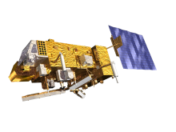
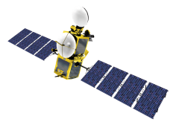
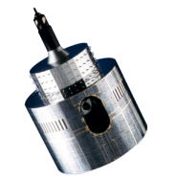
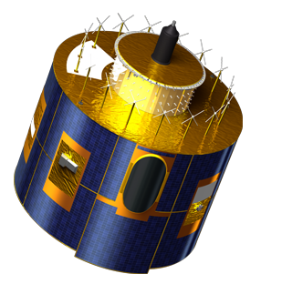
Lunar Calibration Workshop
Status of the preparation
Sébastien Wagner (EUMETSAT)
In collaboration with
Tom Stone (USGS)
Sophie Lachérade, Bertrand Fougnie (CNES)
Jack Xiong (NASA)
Notes:
EUM/STG-SWG/36/14/VWG/15

Slide 2
CMA (Scott Hu and CMA FY-3C/FY-2D 2E teams)

Slide 3
CNES (Sophie Lachérade, Bertrand Fougnie, Ouahid Aznay)

Slide 4
EUMETSAT (Bartolomeo Viticchiè, Sébastien Wagner, Tim Hewison)

Slide 5
JMA (Masaya Takahashi, Arata Okuyama)

Slide 6
KMA (Tae-Hyeong Oh)

Slide 7
NASA MCST (Ben Wang and the MODIS team)

Slide 8
NASA OBPG (Gene Eplee, Gerhard Meister, Fred Patt)

Slide 9
NASA (Jon Fulbright and the NASA VIIRS team)

Slide 10
NOAA STAR (Jason Choi, Changyong Cao, Xi Shao)

Slide 11
NOAA (Fangfang Yu, Fred Wu)

Slide 12
VITO (Stefan Adriaensen)

Slide 13
VITO (Stefan Adriaensen)

Slide 14
KIOST (Seongick Cho)

