Slide 1
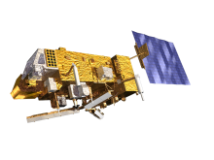
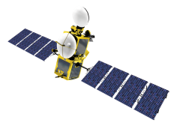
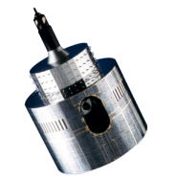
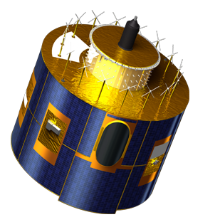
Lunar Calibration Workshop
General discussion
Sébastien Wagner (EUMETSAT)
In collaboration with
Tom Stone (USGS)
Sophie Lachérade, Bertrand Fougnie (CNES)
Jack Xiong (NASA)
Notes:
EUM/STG-SWG/36/14/VWG/15

Slide 2
To be discussed
General discussion on the feasibility of holding the targeted date for the workshop
Process for distributing the GIRO application
Attendance and invitation letters
Practical work during the workshop
Any other business

Slide 3
Date of the workshop
Team | Status
CMA | To be converted
CNES | To be converted +
EUMETSAT | Ready
ISRO | OCM-2? INSAT-3D?
JAXA | ?
JMA | Ready (MTSAT-2) / To be converted + (GMS5)
KMA | To be converted
NASA – MODIS | To be converted
NASA - SeaWiFS | To be converted +
NASA – VIIRS | To be converted +
NOAA – VIIRS | To be converted
NOAA – GEOs | Ready (?) +
USGS | OLI?
VITO | To be converted

Slide 4
Date of the workshop
Can a few weeks more help (WS in January), keeping in mind Xmas is in between?
How can we help the various groups in their preparation?
➔ Please contact us (EUMETSAT) when you are experiencing problems so that we can help!
Can some sample IDL code as we use at EUMETSAT help?
What else?

Slide 5
Distributing the GIRO
For the exercise and the workshop , only an executable
For the workshop and the till the outcome are not finalized ➔ limited distribution
Downloadable from the GSICS wiki (https://gsics.nesdis.noaa.gov/wiki/Development/LunarWorkArea)
Password protected
Password communicated to the participants
Will be available this week (hopefully)

Slide 6
Attendance and invitation letters
Attendance: we need a list of official attendees as we have a limited number of places (20-30 people)
The question was raised regarding future instruments (so, no data available yet). According to the level of participation guests could join the workshop to follow the activity and learn from other groups experience.
Please let us know if you need an invitation letter

Slide 7
Practical work during the workshop
We have access to an IT room with PC where we can run the GIRO (limited to 15 PCs...)
Can people be equipped with Linux laptops for the workshop?

Slide 8
Any other business?
Feel free to comment, suggest, ask ☺

