Slide 1
Synergy How to merge results from various methods ? Is it possible to derive a unique approach ? Bertrand Fougnie, CNES

Slide 2
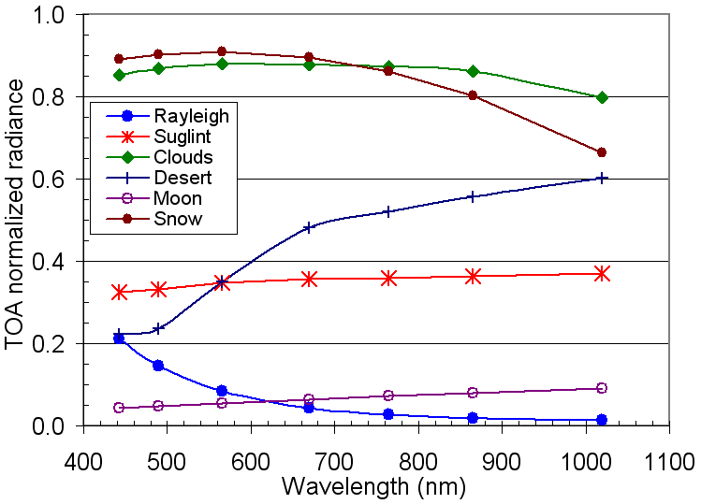
Introduction
Several calibration methods could be available
Desert, Rayleigh, Sunglint, Cloud-DCC, Antarctica, Moon…
Each target has its own behavior :
Magnitude: from very dark to very bright
Spectral shape : from white to very pronounced
Angular signature : from nearly uniform to large BRDF
Polarized properties : from non-polarized to nearly fully polarized
Short-term stability : from variable to fully stable
Long-term stability : from seasonal variable to fully stable
So efficiency range …
Indicative behavior of targets
May sensitively vary with various parameters

Slide 3
Introduction
Several calibration methods could be available
Desert, Rayleigh, Sunglint, Cloud-DCC, Antarctica, Moon…
Implement several methods will provide
various results which will differ (in general) : sometimes consistant, sometimes not at all
GSICS has to face the way to provide to users not only a list of various calibration sets, but also a way to use it :
propose a combined mean calibration set, if possible and relevant
recommande the use one set instead of others depending on the user needs

Slide 4
The One-method matrix
Sensor to calibrate
To be evaluated for each band
Uncertainty from implemented method
(depending on data sampling)
Uncertainty from sensor
Characterization
to be addressed
Spectral response knowledge
Straylight
Linearity
Polarization
Radiometric noise
…
Trending
Absolute
Interband
Cross-calibration
…
DCC

Slide 5
The Synergy matrix
Sensor to calibrate
To be evaluated for each band
Uncertainty from implemented method
(depending on data sampling)
Uncertainty from sensor
Characterization
to be addressed
Moon
DCC
PICS-desert
PICS-snow
SNO
Rayleigh
Sunglint
Spectral response knowledge
Straylight
Linearity
Polarization
Radiometric noise
…
Trending
Absolute
Interband
Cross-calibration
…

Slide 6
The Synergy matrix
Example : combination of Desert, DCC and Rayleigh
for MERIS and PARASOL
Sensor to calibrate
To be evaluated for each band
Uncertainty from implemented method
(depending on data sampling)
Uncertainty from sensor
Characterization
to be addressed
Moon
DCC
PICS-desert
PICS-snow
SNO
Rayleigh
Sunglint
Spectral response knowledge
Straylight
Linearity
Polarization
Radiometric noise
…
Trending
Absolute
Interband
Cross-calibration
…

Slide 7
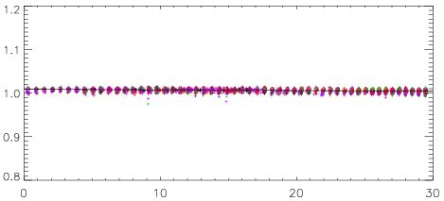
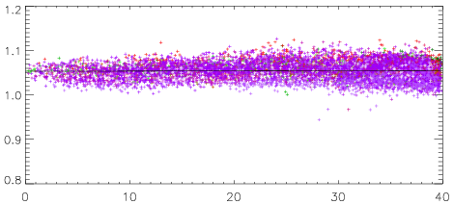
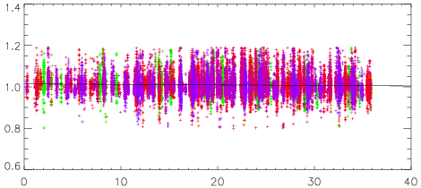
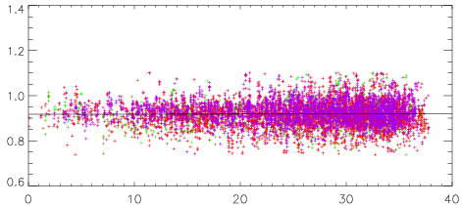
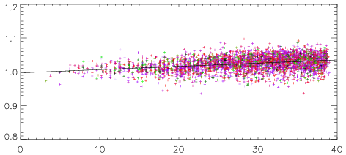
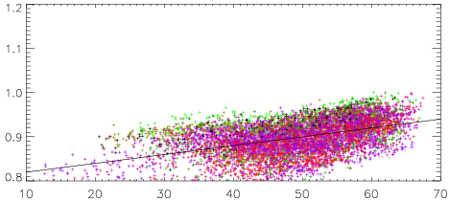
443nm band
as a function of VZA
MERIS
PARASOL
DCC
Desert
Rayleigh

Slide 8
Example
Generale baseline
Application to PARASOL

Slide 9
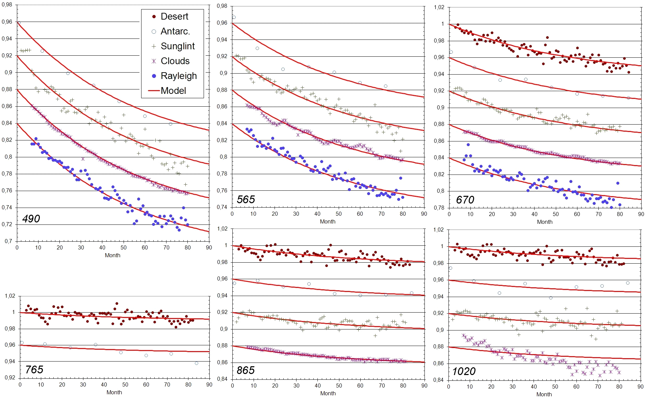
Ex: PARASOL - Monitoring
Best compromise
B490 = 0.16
D=0.018
B670 = 0.062
Synergy : calibration of the temporal monitoring
Calibration versus month
B565 = 0.11
B865 = 0.024
B1020 = 0.018
B765 = 0.01

Slide 10
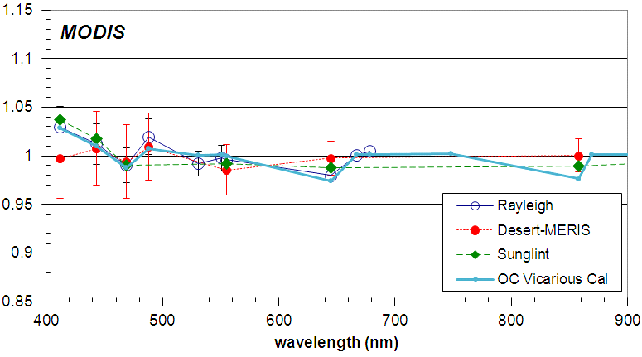
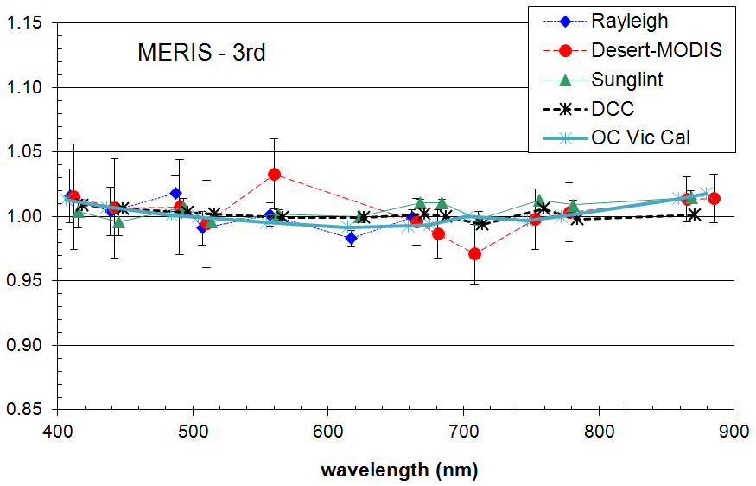
Ex: MODIS&MERIS – Absolute/Interband
Deviations are
Know limitation of methods
If not : are they significant
But often close to the accuracy of each individual method
for 1 method : very difficult to conclude
Becomes (very) significant when observed by several methods
not so easy to define an automized synergetic mean

Slide 11
Strategy – step 1
Derive the theoretical budget for each Method
This Method budget depends on the considered sensor :
Geometrical sampling
Geophysical range
Available spectral bands
Method budget(RadAspect) depends on the considered aspect :
temporal, cross-cal, absolute, interband, field-of-view…
Evaluate how the sensor impacts the result for each method
This Sensor(Method) budget depends on :
Radiometric performances : straylight, noise, non-linearity, polarization, rejection…
Sensor(Method, RadAspect) budget depends on the considered aspect :
Ex: straylight/linearity may be not so crucial for temporal
Pay attention to distinguish noise (type-A) and bias (type-B)
Only Bias is targeted
= Construction of the Synergy Matrix (not obvious)

Slide 12
The Synergy matrix
Sensor to calibrate
To be evaluated for each band
Uncertainty from implemented method
(depending on data sampling)
Uncertainty from sensor
Characterization
to be addressed
Moon
DCC
PICS-desert
PICS-snow
SNO
Rayleigh
Sunglint
Spectral response knowledge
Straylight
Linearity
Polarization
Radiometric noise
…
Trending
Absolute
Interband
Cross-calibration
…
Radiometric Aspect
Method/Sensor
Band/Sensor

Slide 13
Strategy – step 2
For every Band, every Sensor, every Aspect :
if methods agree : propose a merge
A select the best « pilot » : be able to define objective criteria // or arbitrarily
Ex : more or less CNES’s approach for the estimation of PARASOL temporal drift within the field-of-view
Consider a weighted mean based on Method + Sensor(Method) budgets
Ex : NOAA’s approach for the estimation of GOES temporal drift
Ex : more or less CNES’s approach for the estimation of PARASOL mean temporal drift (best compromise)
if methods disagree :
Was it expected from budgets : reject some method (i.e. weigth = 0)
If not, this is the sign of a radiometric default or another anomaly
→ Understand what happens or be aware of possible bias
→ select a method or consider weighted mean
Alternative : do we want to
Identify the best method for each sensor & band & characterization
Other methods are used as validation
Combine as much as possible
Weighted mean or Best compromise
The ultimate goal : be able to go down the accuracy of each individual method

Slide 14
No universal approach defined in advance !!!
This is a case by case analysis
GSICS has to face the way to provide to users not only a list of various calibration sets, but also a way to use it :
propose a combined mean calibration set, if possible and relevant
recommande the use one set instead of others depending on the user needs

