Slide 1
An Integrated Calibration Method to Improve the GOES Visible Calibration Accuracy
Fangfang Yu and Xiangqian Wu
GSICS VNIR Subgroup Webmeeting
10/22/2014

Slide 2
Background
Multiple vicarious methods are usually available for the VNIR channels
Different stable reference used for each method
Independently evaluate the sensor performance & cross verifications
GSICS VNIR inter-calibrations
Two common references: DCC & Moon
Other options: Desert, Rayleigh scattering, Ray-matching, star, sun-glint …
Absolute calibration vs. Relative calibration: no method can excel to the others
How to combine the multiple vicarious calibration methods?
Can we improve the calibration accuracy from the combined results?
Improved absolute calibration accuracy: long-term climate change studies
Improved relative calibration accuracy: early change (trending) detection
Applications:
GSICS VNIR products
Verification of AHI/ABI on-orbit calibration accuracy & early warning of on-orbit calibration anomaly

Slide 3
Objectives
Evaluate the individual vicarious calibration method implemented in-house for GOES Imager visible channel at NOAA/NESDIS
Integrate the different vicarious calibration methods to improve the calibration accuracy
Improve the relative calibration accuracy
Evaluate the difference between different absolute calibration results
Manuscript on the research method was submitted to Remote Sensing of Environment for peer-review purpose on July 22, 2014. Received positive feedbacks from two anonymous reviewers with many constructive comments on Oct. 13, 2014.

Slide 4
GOES Imager Visible Vicarious Calibration Methods
Reference targets:
Stars – relative cal.
Ray-matching – relative cal.
Sonoran desert – absolute cal.
Deep Convective Cloud (DCC) – absolute cal.
Moon – to be implemented with GSICS Implemented ROLO (GIRO) model
Absolute calibration accuracy was achieved by calibrating the GOES Imager visible data traceable to Aqua MODIS Band 1 C6 standard
Recommended by the GSICS VNIR sub-group
GOES-15 (GOES-West, 135W) and GOES-12 (GOES-East, 75W) as examples
In-house implemented algorithms

Slide 5
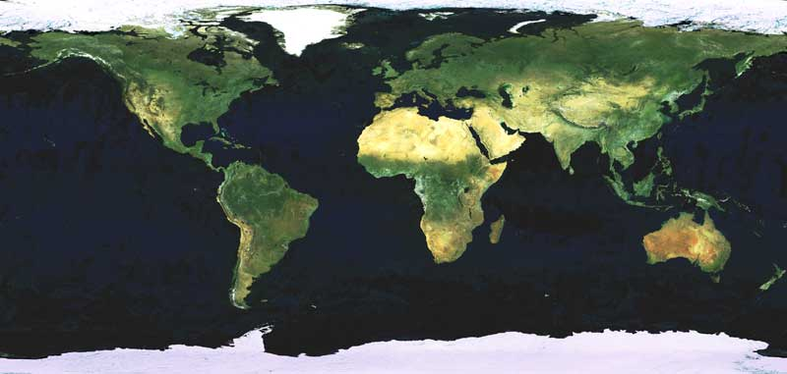
Spectral Response Functions & Desert/Clouds/Vegetation/Water Spectra
GOES-W
GOES-E

Slide 6
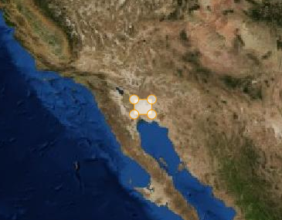
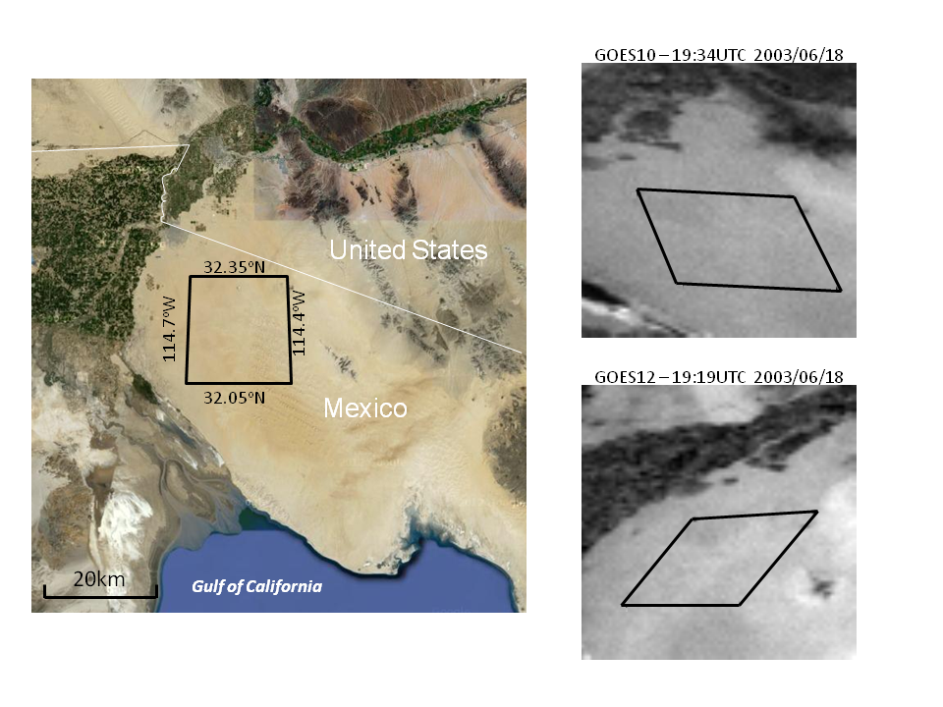
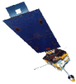
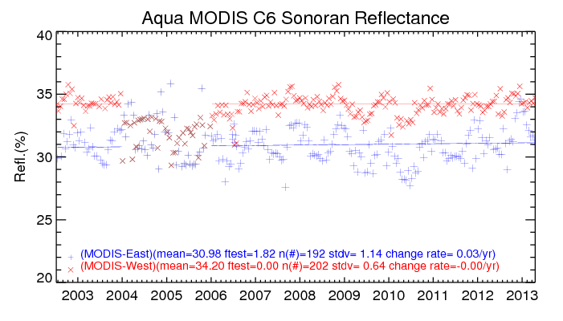
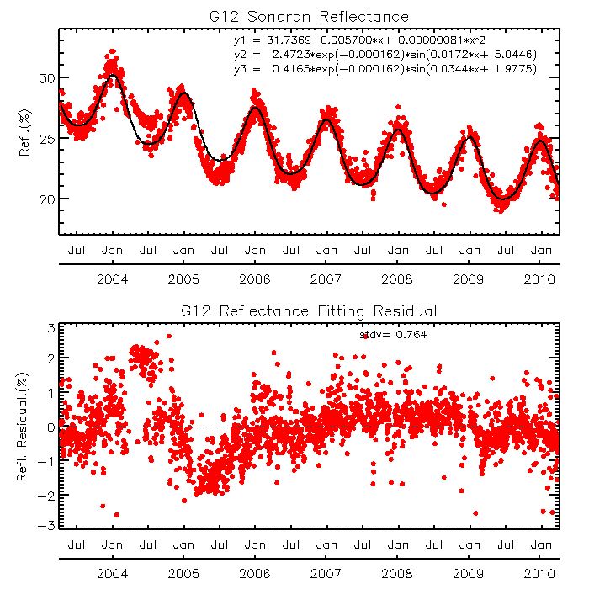
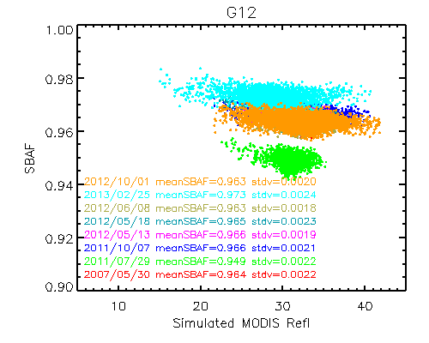
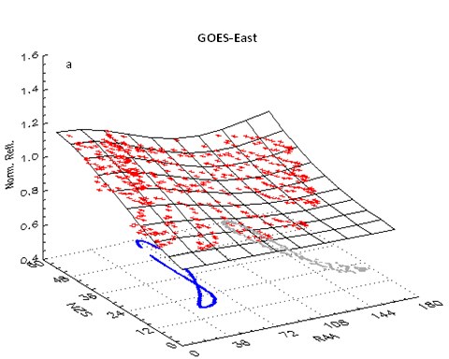
Sonoran Desert
[32.05N-32.25N, 114.7W-114.4W]
GOES-West
GOES-East
Target is long-term radiometrically, spatially and spectrally stable at GOES viewing geometries.
Challenges:
Impact of seasonal variation of solar zenith angle
Impacts of daily dynamic atmospheric components and periodic climatic variations e.g. ENSO events
Different SRFs
No strict GEO-LEO ray-matching pixels for absolute cal.
Absolute Calibration:
Quadratic fitting for sensor degradation + two sine functions for the impacts of seasonal changes of solar zenith angle and atmospheric components.
Hyperion data for the spectral correction
One year of satellite measurements to develop the BRDF model to transfer the Aqua MODIS data to GOES viewing geometries
Yu, F. et al. (2014) JGR doi:10.1002/2013JD020702

Slide 7
Reference reflectance of Sonoran Desert
Desert Reference Reflectance, traceable to Aqua MODIS
 | GOES-12 (East) | GOES-15 (West)
Desert MODIS long-term reflectance (%) | 32.59 | 34.29
SBAF (GOES/MODIS, Hyperion data derived) | 0.949 | 0.929
Daily median MODIS reflectance
Removal of contaminated pixels
Average the daily clear-sky pixel reflectance at monthly interval
Trend fitting
Yu, F. et al. (2014) JGR doi:10.1002/2013JD020702

Slide 8
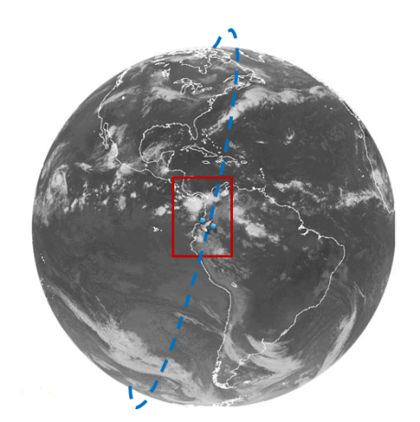
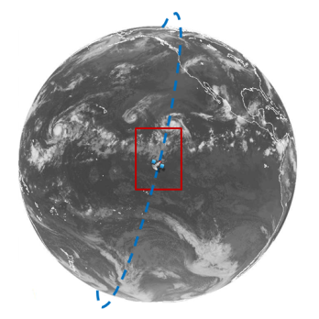
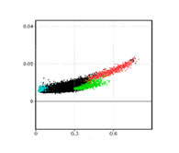
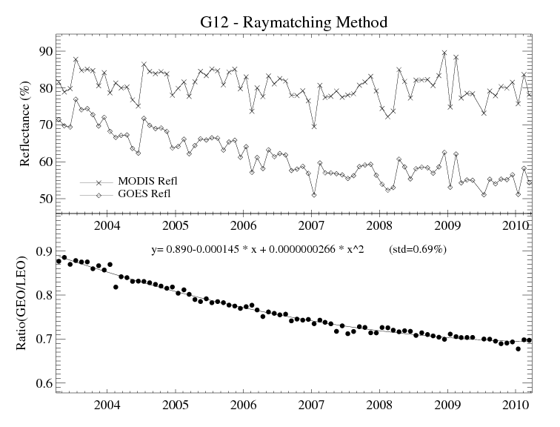
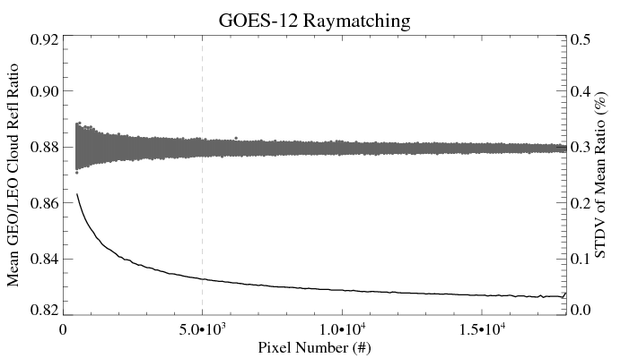
Ray-matching
GOES-East
GOES-West
Direct satellite-to-satellite inter-comparison to minimize the impacts of BRDF and different atmospheric components
Doelling, D. et al. (2004)
Challenges
Lack of coincident hyper-spectral radiometric measurements in result in large uncertainty in spectral correction
Few collocations with same relative azimuth angles - BRDF
Relative Calibration
Collocations at sub-satellite regions within ±10º lat/lon
Viewing angle difference < 1%
High reflectance cloud collocations: MODIS reflectance > 50%
Reflectance ratio for sensor trending purpose
Statistically stable ratio with sufficient high reflectance cloud pixel #
GOME-2 Simulated G14 and MODIS Refl.
GOES-MODIS Refl.
MODIS reflectance
Wu, X. et al. (2011)IGARSS
Yu, F. and X. Wu (2014) Remote Sensing of Environment, Submitted

Slide 9
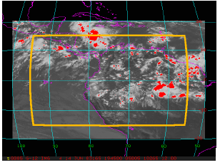
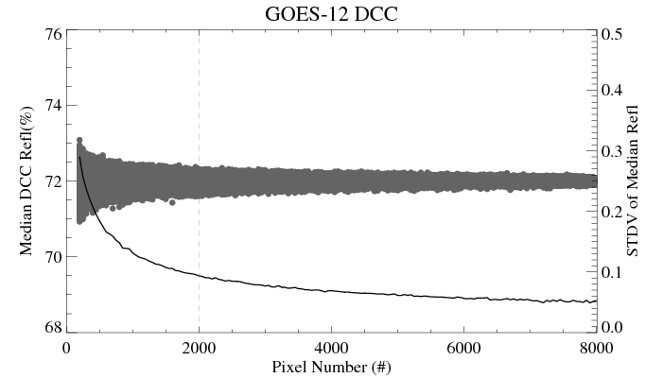
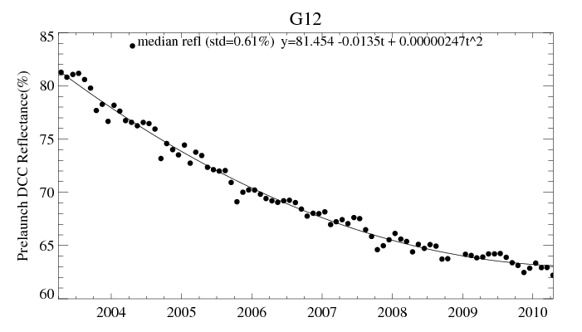
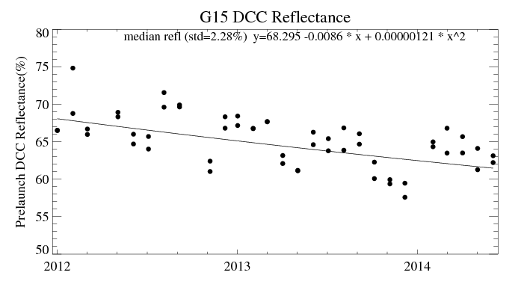
Deep Convective Cloud (DCC)
Stable, spectrally flat, high reflectance and common to all the satellites
Doelling, D. et al. (2004)
Reflectance is represented with monthly identified DCC pixels
Challenges
Slight variation in reflectance
Occasional insufficient DCC pixels may lead to relatively large reflectance deviation for GOES-West Satellites
Absolute Calibration
Use mode or median reflectance of the monthly DCC pixels to represent the DCC reflectance
At least 2,000 DCC pixels are needed to generate a statistically reliable monthly DCC reflectance value
Use Ray-matching collocated DCC pixels to determine the reference reflectance
Courtesy of D. Doelling
Yu, F. and X. Wu (2014) Remote Sensing of Environment, Submitted

Slide 10
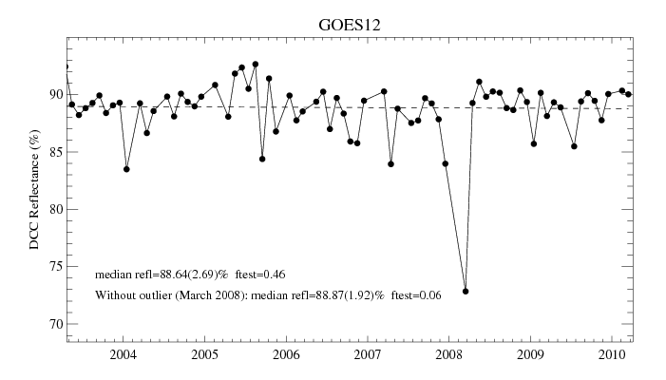
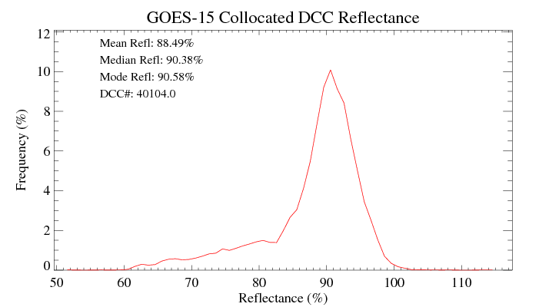
Reference Reflectance of DCC
DCC Reference Reflectance, traceable to Aqua MODIS
 | GOES-12 (East) | GOES-15 (West)
DCC MODIS long-term reflectance (%) | 88.87 | 90.38
SBAF (GOES/MODIS) | 0.991¹ | 0.994²
1: SCIAMACHY data derived provided by D. Doelling, 2: GOME-2 data derived
DCC Reference Reflectance Derived from Ray-matching Collocated MODIS DCC Pixels
Time-series of monthly MODIS DCC reflectance for GOES-12
Histogram of MODIS DCC Reflectance for GOES-15 (Dec 2011 – March 2014)
Yu, F. and X. Wu (2014) Remote Sensing of Environment, in review

Slide 11
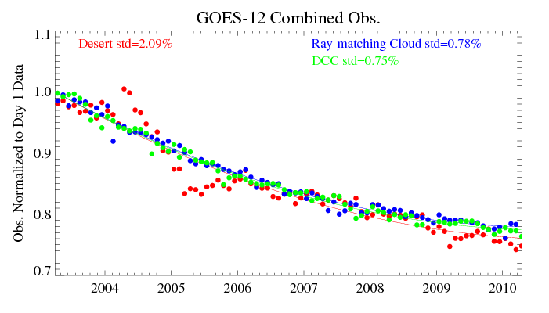
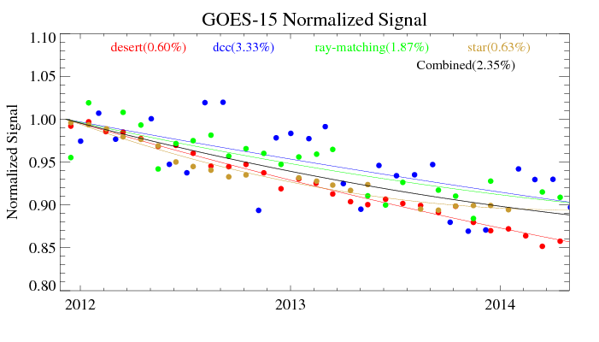
Combination of the Different Vicarious Calibration Results
Monthly average reflectance
Trending fitting
Normalized to the estimated Day1 reflectance
Combine the Normalized Data

Slide 12
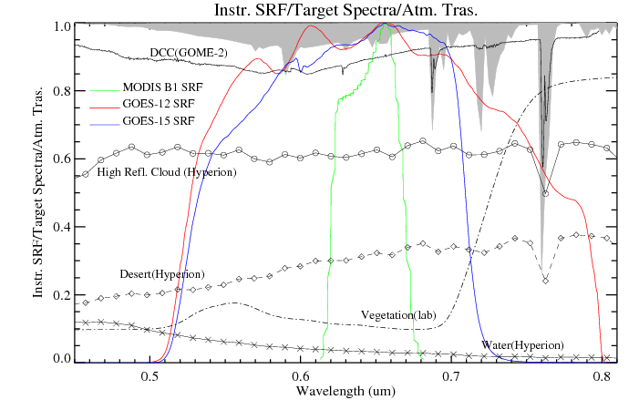
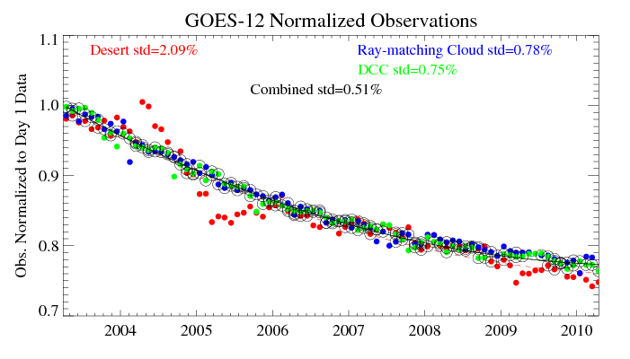
Integrated Vicarious Calibration
Similar degradation patterns over different reference targets may indicate that the spectral response function degradation, if any, is very small and negligible
Where is the truth of sensor degradation?
The truth should exist where most observations converge
Recursive filtering to remove the observations away from the “truth” - the fitting curve
*Relative calibration accuracy improved to 0.41% when only ray-matching and DCC methods are combined
ENSO effects?

Slide 13
“Recursive Fitting” Residual Distribution

Slide 14
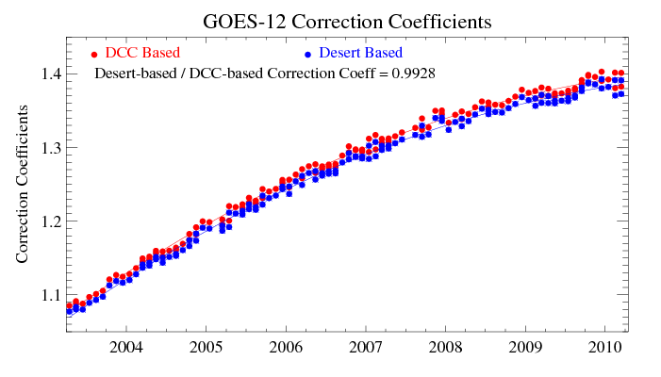
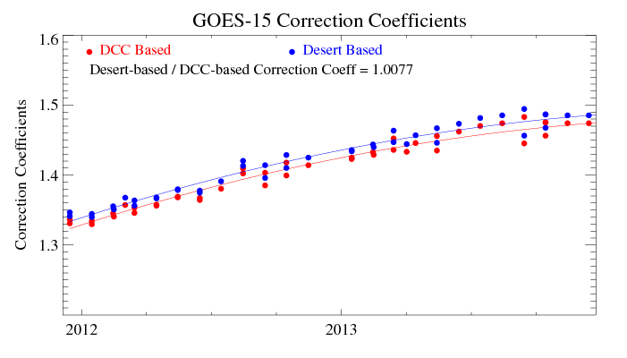
Absolute Calibration Correction Comparisons
where,
Sonoran Desert:
DCC :
Co-occurrence of the monitored and reference data period to determine the reference reflectance!
Yu, F. and X. Wu (2014) Remote Sensing of Environment, in review

Slide 15
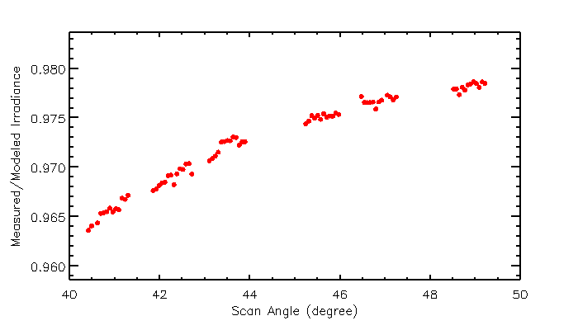
Possible Causes to the Bias
Reference reflectance, especially at Day1 ,is critical to determine the absolute calibration correction coefficients
Need long-term desert observation to ensure the accurate desert Day1 reflectance value
Co-occurrence of the monitored and reference data period to determine the reference reflectance
Possible reflectance difference between overall DCC pixels (±20ºfrom sub-satellite point) and subset DCC pixels (±10ºfrom sub-satellite)
Slight Land/ocean DCC difference?
Slight difference at different viewing angle, residual of DCC ADM correction?
Impact of GOES scan mirror reflectivity between nadir (DCC) and off-nadir (Sonoran desert) observations.
GOES-West
X
GOES-East
X
nadir
Yu et al. (2013), GSICS QL

Slide 16
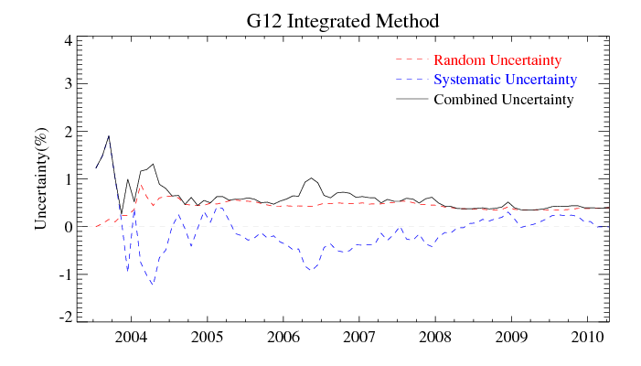
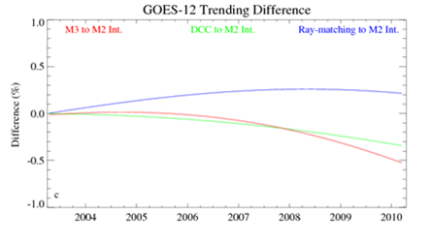
Time-Series of G12 Error Budget
Integrated method uncertainty
Integration of DCC and Ray-matching results as the “truth”
Yu, F. and X. Wu (2014) Remote Sensing of Environment, in review

Slide 17
Discussions - 1
Anchoring date
Day 1
Pros: consistent, valuable to detect the potential SRF shift and/or reference target change/variation
Cons: relatively larger uncertainty
Median date over the period
Pro: possible reduced uncertainty
Cons: dynamic median dates at different time (days after operation).
Suggestion
Re-analysis: median date as the anchors. Trendings anchored at Day1 used to evaluate the potential SRF shift and/or reference target
Near real-time: anchored at day 1
Sensitivity of DCC/Ray-matching minimum pixels for reliable monthly data
Current values randomly selected
Should not be critical

Slide 18
Discussions - 2
Can it be used for on-board calibration verification like ABI and MODIS
yes
Relative calibration: how to handle with rapid change like VIIRS early in orbit period
Rapid change relies on the on-board calibration
Improved relative calibration to reduced latency time for the warning
Degradation fitting function
Accurate degradation function is another key to the success!
Suggestion using different fitting function once the rapid change occurs, or when necessary
Absolute calibration vs. relative calibration accuracy
This method can improve the relative calibration accuracy, not the absolute calibration accuracy
Therefore useful to provide early warning for the on-board calibration anomaly
Provide more robust result to distinguish the abs. calibration difference

Slide 19
Conclusions
The integrated method can improve the relative calibration accuracy for the GOES Imager visible channels (GOES-East)
Maximum overall uncertainty is about 2% in the first one year with long-term stability <0.5%
After about 2 years, calibration accuracy is generally stable at <1%
Similar error budget assessment is needed for the GOES-West satellites
For the GOES-West satellites, the stellar calibration is expected to play a critical role to improve the relative calibration accuracy
Especially in the early stage of the satellite mission life
For the GOES-East satellites, the ray-matching and DCC results play almost equally important roles in the integrated method
The stellar observations are expected to further improve the relative calibration accuracy
The difference between desert- and DCC- based absolute calibration accuracy is less than 1%
Bias may be reduced with the correction of scan angle dependent reflectivity
Tools and knowledge/experience will continue evolving and will be applied to verify radiometric calibration accuracy of GOES-R ABI solar reflectance channels.

