Slide 1
Himawari-8 Launch and its calibration approaches
JMA / MSC

Slide 2
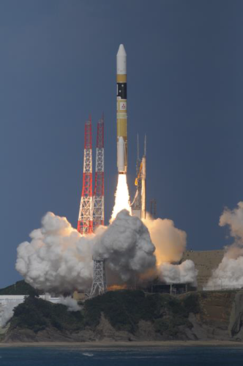
Himawari-8 launched successfully
7 Oct.
Himawari-8 was successfully launched using H-IIA Launch Vehicle No. 25 from the Tanegashima Space Center, Japan.
16 Oct.
It entered geostationary orbit on 140.7 degrees East.
End of Nov. 2014
Imager function test will start
Dec. 2014
First image will be published
Summer 2015
Operational observation switch over to the Himawari-8
MHI / JAXA

Slide 3
AHI on-board calibration
Infrared
Calibration equation for L1A
Blackbody calibration is performed once a 10 minutes.
“m” is adjustable based on imager temperature similar to the MBCC function.
“b” is corrected based on spacelook at beginning or end of each scan.
VIS/NIR
Calibration equation for L1A
Solar diffuser + spacelook
Angular dependency of scan mirror reflectivity is corrected by ρ_{ns} and ρ_{ew}.
Calibration coefficients can be updated on real time basis or on manual (but not active, for now)
For Himawari-8 L1B
The L1B contains digital numbers and linear coefficients to convert the DN to radiances, similar to the MODIS L1B.
$$R=\frac{qC^{2}+mC+b}{ρ_{ns}ρ_{ew}}$$

Slide 4
Planned radiometric calibration/comparison for AHI
Solar Diffuser | Black Body
Y
Y
Y
Y
Y
Y
 | Y
 | Y
 | Y
 | Y
 | Y
 | Y
 | Y
 | Y
 | Y
 | Y
Band | Central Wavelength [µm] | Solar Diffuser | Black Body | GSICS (IR) | GSICS (DCC) | GSICS (Moon) | Vicarious method (RTM) | Ray matching | GEO-GEO
1 | 0.47 | Y |  |  | Y | Y | Y | Y | Y
2 | 0.51 | Y |  |  | Y | Y | Y | Y | Y
3 | 0.64 | Y |  |  | Y | Y | Y | Y | Y
4 | 0.86 | Y |  |  | Y | Y | Y | Y | Y
5 | 1.6 | Y |  |  | Y? | Y | Y | Y | Y
6 | 2.3 | Y |  |  | Y? | Y? | Y | Y | Y
7 | 3.9 |  | Y | Y |  |  |  |  | Y
8 | 6.2 |  | Y | Y |  |  |  |  | Y
9 | 6.9 |  | Y | Y |  |  |  |  | Y
10 | 7.3 |  | Y | Y |  |  |  |  | Y
11 | 8.6 |  | Y | Y |  |  |  |  | Y
12 | 9.6 |  | Y | Y |  |  |  |  | Y
13 | 10.4 |  | Y | Y |  |  |  |  | Y
14 | 11.2 |  | Y | Y |  |  |  |  | Y
15 | 12.4 |  | Y | Y |  |  |  |  | Y
16 | 13.3 |  | Y | Y |  |  |  |  | Y
(Y): applicable, but not planned yet

Slide 5
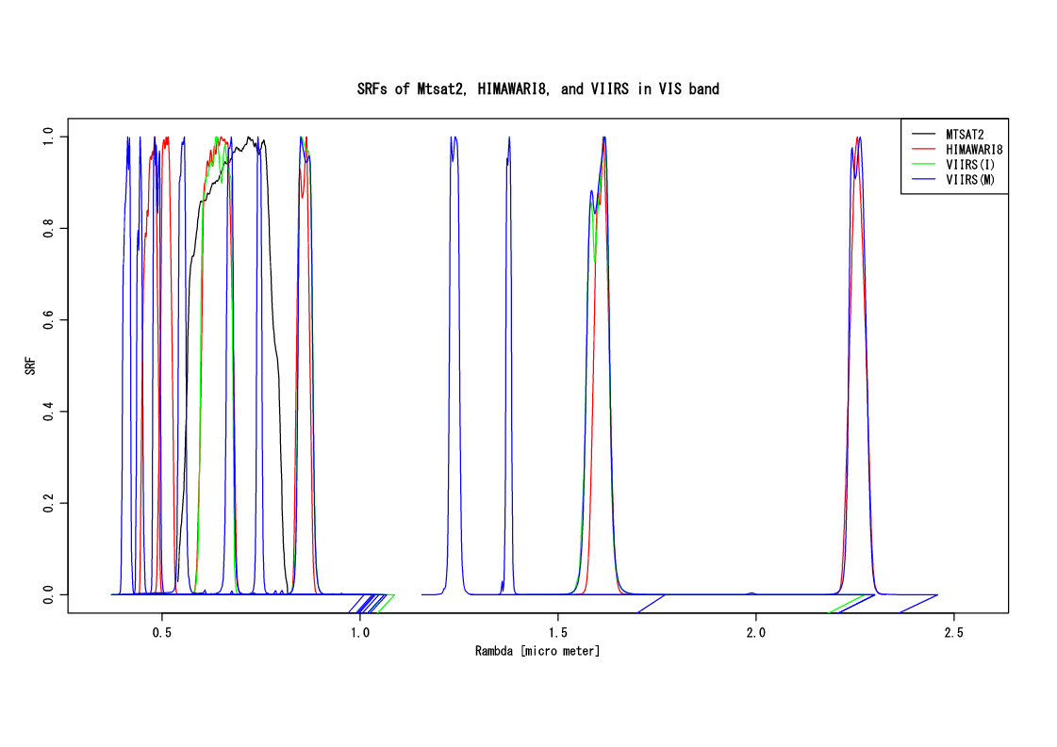
MTSAT-2 vs VIIRS ray-matching
HIMAWARI8/AHI has 6 Visible/Near-infrared bands.
SRFs of AHI are close to that of NPP/VIIRS.
To check feasibility of this approach, we performed a comparison between VIIRS/M05 and MT-2/VIS as a proxy of the AHI data.
M05
Corresponding bands
M03
I01
AHI | VIIRS | MT-2
Band01 | M03
02 | M03
03 | I01
 | M05, M06, I01 | VIS
04 | M07, I02
05 | M10, I03
06 | M11
M07
M10
M11
Band 04
Band 05
Band 06
03
VIS

Slide 6
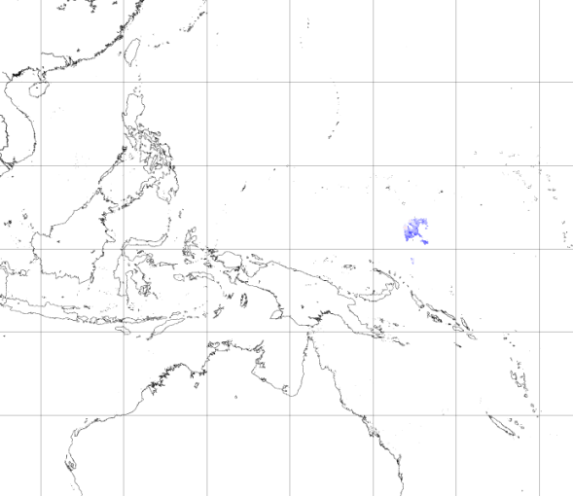
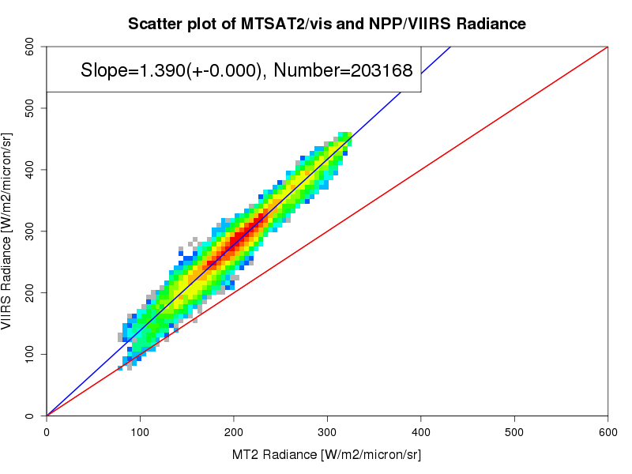
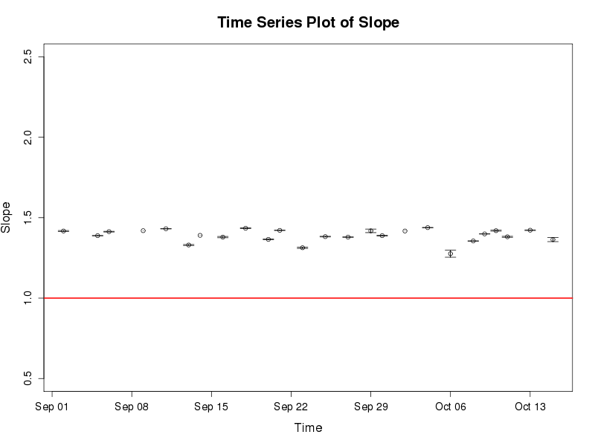
MTSAT-2 vs VIIRS ray-matching (contd.)
A sample of selected area
Time series of Slope
VIIRS Radiance
Slope
seems to be on a regression line.
MT2 Radiance
Date
MT2 radiance is smaller than that of VIIRS, probably due to the sensor degradation and difference of SRFs.
Time series plot is almost stable.
The ray-matching approach using VIIRS data is useful.
<MT-2 radiance>
Observation and simulation comparison
From MSCWEB monitoring page (2014/07)

Slide 7
Current issues
DCC based approach developed by GSICS
SBAF between MODIS and AHI will be a great help
Ray-matching approach using VIIRS L1B
Some of AHI bands are close to the ones of VIIRS, though, SBAF will be of help if possible.
File size of VIIRS L1B data is too large to handle.
Himawari standard data can contain GSICS correction parameters.
How to integrate the calibration coefficients based on the multiple calibration approaches?
Are these multiple result consistent?
Weighted mean by uncertainty?
At least, we will publish a result by the DCC method on our Web site, because it will be a GSICS Correction.

