Slide 1
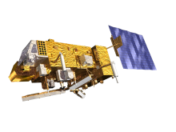
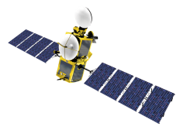
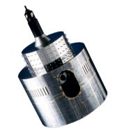
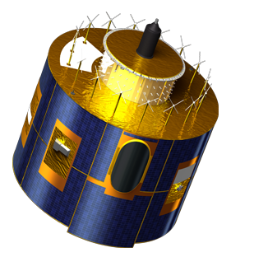
PREPARATION OF THE GiRO executable
Current status
Bartolomeo Viticchiè, Tom Stone, Sebastien Wagner, Masaya Takahashi & Tim Hewison

Slide 2
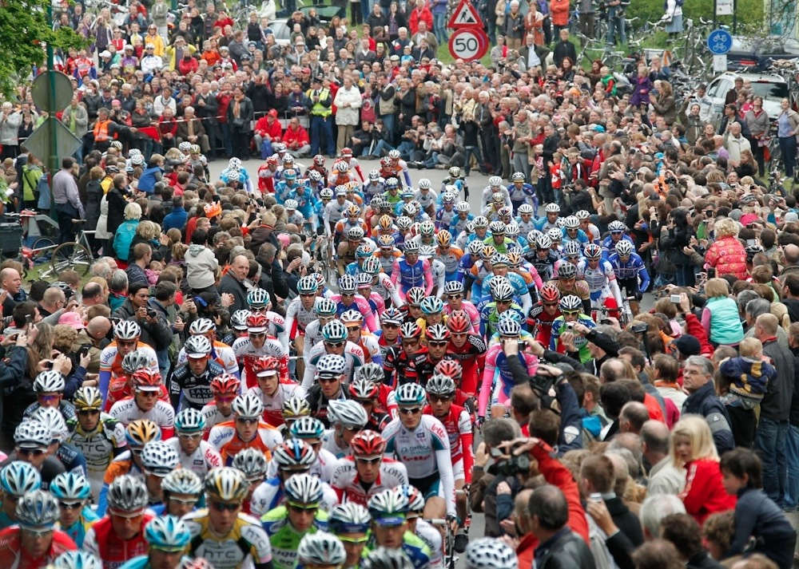
GIRO second release
Many users running the GIRO!

Slide 3
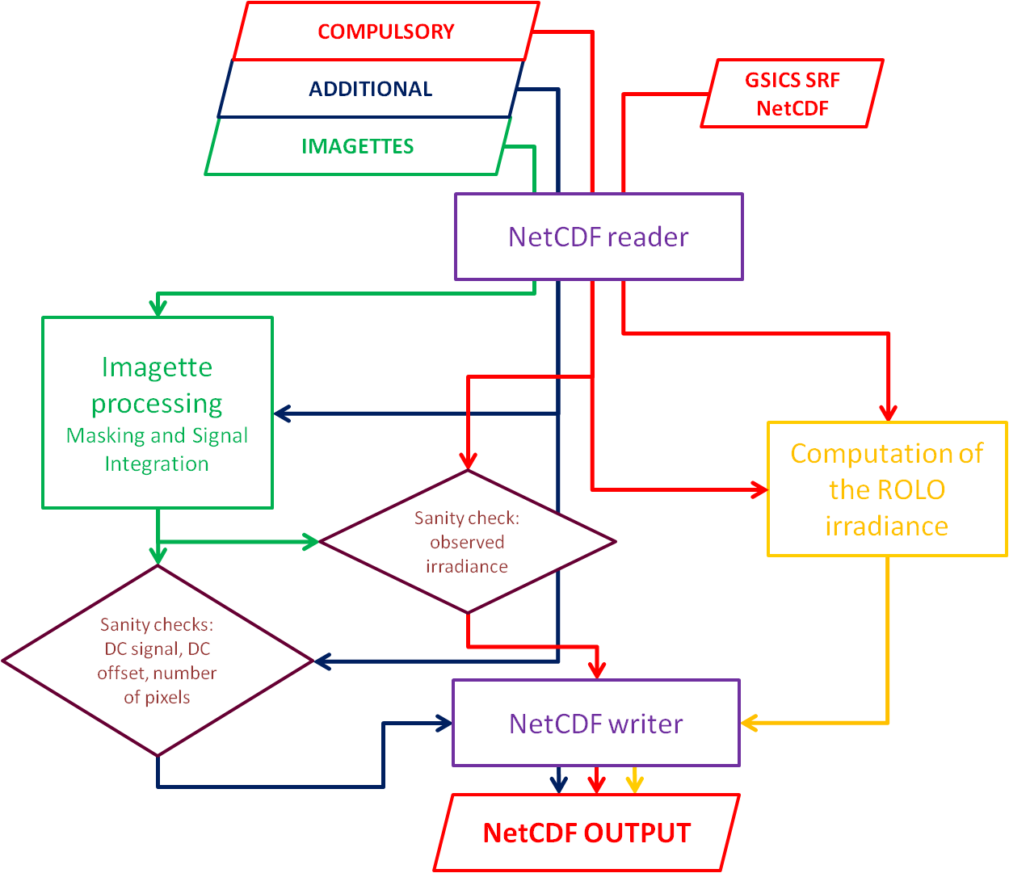
GIRO second release
Functionalities:
reading of the input NetCDF files (observation + spectral response function),
computation of the observables,
writing of the sanity check files,
computation of the ROLO reference irradiance,
writing of a complete lunar calibration output file.
Figure 1 of https://gsics.nesdis.noaa.gov/pub/Development/20140624/GSICS_ROLO_HighLevDescript_IODefinition_wiki.pdf

Slide 4
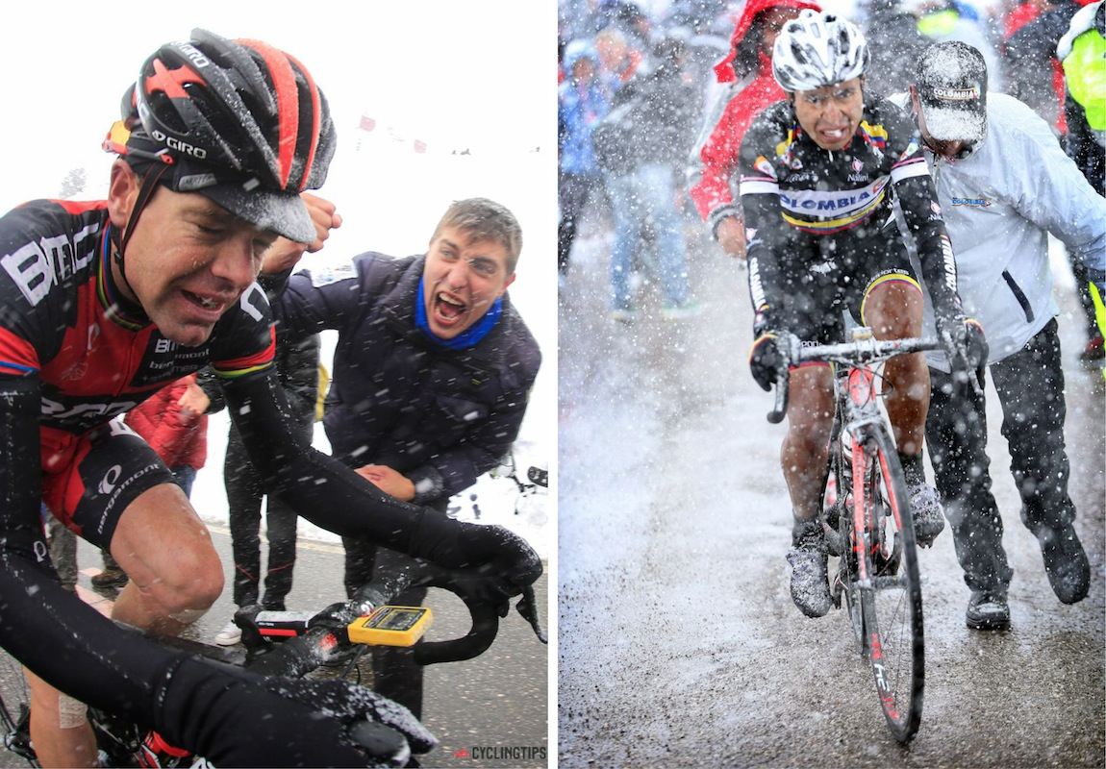
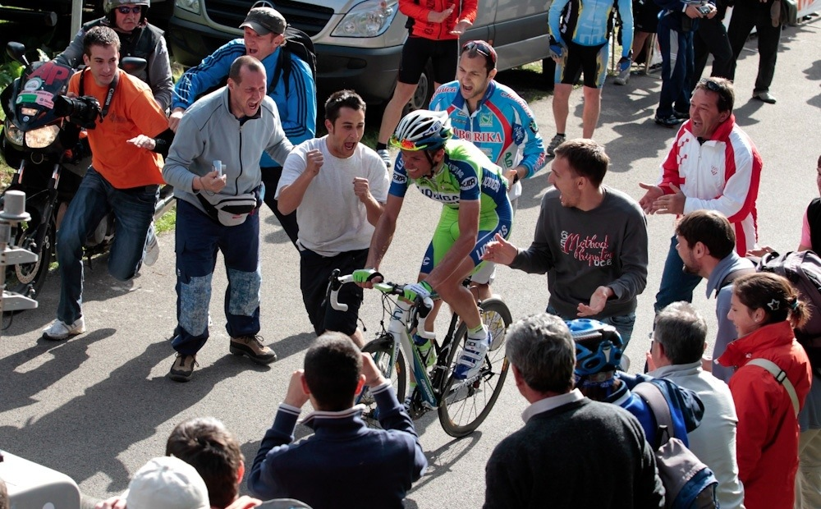
GIRO second release: feedbacks from users

Slide 5
GIRO second release: feedbacks from users
Bugs fixed:
Problems in the reading of rectangular imagettes (reported by Fangfang Yu, NOAA, by analysing GOES data),
Problem in the evaluation of the Moon imagette dimension (problem found by analysing MODIS and VIIRS data)
BOTH POINTS 1 AND 2 HAVE BEEN SPOTTED BY CHECKING THE CONTENT OF THE SANITY CHECK FILES. IN DETAIL, BY COMPARING THE VALUES OF THE DC OFFSET AS PROVIDED BY THE USER AND AS DERIVED BY THE IMAGETTE PROCESSING WITHIN GIRO. IF THE IMAGETTES ARE NOT READ PROPERLY THE OFFSET FROM THE IMAGETTE PROCESSING IS (USUALLY) IN STRONG DISAGREEMENT WITH THE ONE PROVIDED BY THE USER.
Wrong values of the Solar Irradiance in the NIR spectral range.
4. Problems in the smoothing/interpolation of the Solar Spectrum on the SRF wavelengths in the NIR spectral range (reported by Zhipeng Wang, NASA GSFC, by analysing VIIRS data).
POINT 4. HAS BEEN SPOTTED BY Zhipeng Whang BY ANALYSING VIIRS AND TERRA/AQUA MODIS DATA. IN DETAIL, IN SOME OF THE CHANNELS NaN VALUES WERE FOUND FOR THE ROLO IRRADIANCE. THIS WAS DUE TO A WRONG INTERPOLATION OF THE SOLAR IRRADIANCE SPECTRUM ON THE SRF WAVELENGTHS OF THOSE CHANNELS.

Slide 6
GIRO second release: feedbacks from users
Bugs fixed:
Problems in the reading of rectangular imagettes (reported by Fangfang Yu, NOAA, by analysing GOES data),
Problem in the evaluation of the Moon imagette dimension (problem found by analysing MODIS and VIIRS data)
BOTH POINTS 1 AND 2 HAVE BEEN SPOTTED BY CHECKING THE CONTENT OF THE SANITY CHECK FILES. IN DETAIL, BY COMPARING THE VALUES OF THE DC OFFSET AS PROVIDED BY THE USER AND AS DERIVED BY THE IMAGETTE PROCESSING WITHIN GIRO. IF THE IMAGETTES ARE NOT READ PROPERLY THE OFFSET FROM THE IMAGETTE PROCESSING IS (USUALLY) IN STRONG DISAGREEMENT WITH THE ONE PROVIDED BY THE USER.
Wrong values of the Solar Irradiance in the NIR spectral range.
4. Problems in the smoothing/interpolation of the Solar Spectrum on the SRF wavelengths in the NIR spectral range (reported by Zhipeng Wang, NASA GSFC, by analysing VIIRS data).
POINT 4. HAS BEEN SPOTTED BY Zhipeng Whang BY ANALYSING VIIRS AND TERRA/AQUA MODIS DATA. IN DETAIL, IN SOME OF THE CHANNELS NaN VALUES WERE FOUND FOR THE ROLO IRRADIANCE. THIS WAS DUE TO A WRONG INTERPOLATION OF THE SOLAR IRRADIANCE SPECTRUM ON THE SRF WAVELENGTHS OF THOSE CHANNELS.
THE MODIFICATIONS RELATED TO POINTS 3. AND 4. HAVE A DIRECT IMPACT ON THE COMPUTATION OF THE ROLO REFERENCE IRRADIANCE!
A COMPARISON BETWEEN THE GIRO AND THE USGS ROLO IRRADIANCES HAS BEEN REPEATED AND THE PREVIOUS SMALL DIFFERENCES HAVE BEEN FURTHER REDUCED

Slide 7
GIRO second release: feedbacks from users
Issue raised by Zhipeng Whang:
“...in some cases, raw DC read from MODIS (dc_raw) is converted to dc_obc to compensate the temperature effect... while dc_raw are all integer, dc_obc are float. Unless GIRO provides the ability of various adjustment on top of the background subtraction, defining dc_obc as float can provide more flexibility for our users... ”
Major changes:
The GIRO application handles now the information derived from the DC imagette in floating point (before as integers). IMPORTANT! The information are still stored as integers, but are converted to floating point in the processing by employing variable’s attributes: scale_factor and add_offset (see section 7.3.1 of [HLD_GIRO_IO]).

Slide 8
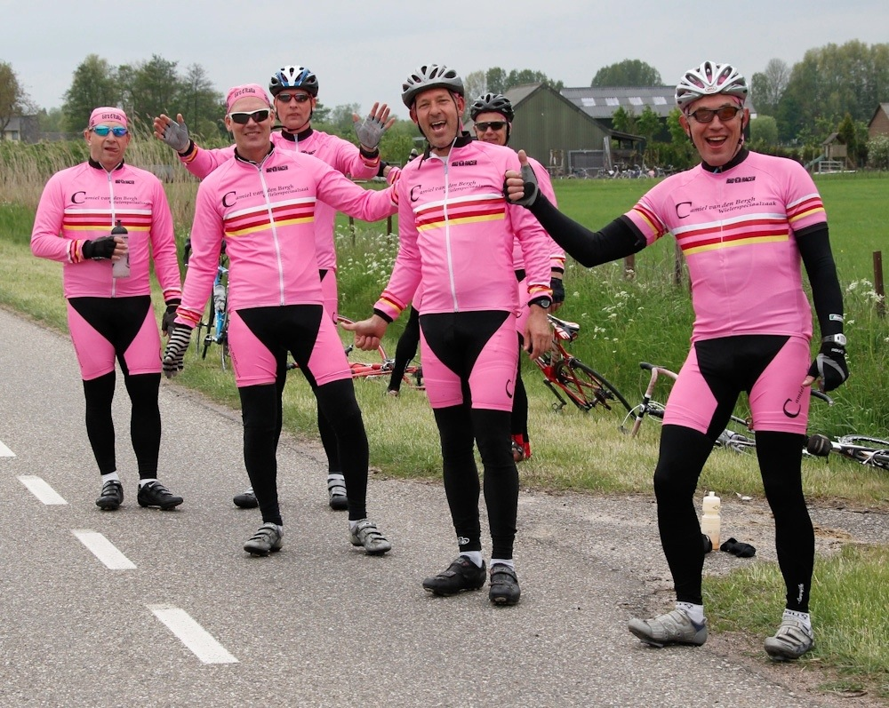
GIRO third release: users that derived calibration results
Fangfang Yu (NOAA) : results from GOES15
Sophie Lacherade and Bertrand Fougnie (CNES) : results from Pleiades1B
Tae-Hyeong Oh (KMA) : results from COMS1
Zhipeng Wang (NASA GSFC) : results from VIIRS and MODIS
Thank you very much for the feedbacks and support!

Slide 9
Conclusions
The GIRO third release is the executable that will used at the workshop in combination with the GIRO PERTurbation tool for the sensitivity analysis.
Few bugs have been found and fixed thanks to the feedbacks of the users. If you find any malfunctioning of the GIRO third release please contact us! Do not wait the workshop to communicate with the developers!
THE GIRO WORKING GROUP LOOK FORWARD TO SEE YOU AT THE WORKSHOP!

