Slide 1
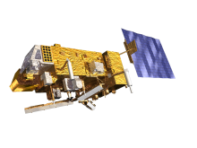
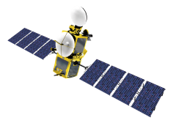
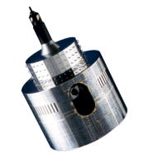
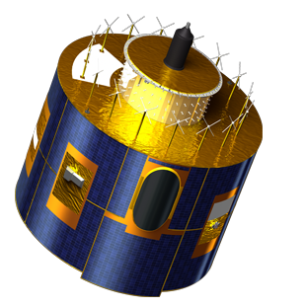
Lunar Calibration Workshop
Preparation
Sébastien Wagner (EUMETSAT)
In collaboration with
Tom Stone (USGS)
Sophie Lachérade, Bertrand Fougnie (CNES)
Jack Xiong (NASA)
Notes:
EUM/STG-SWG/36/14/VWG/15

Slide 2
Workshop preparation
Another 2 weeks to go!
Version 3.0 of the GIRO application was delivered (see Bart’s presentation) + update of the input/output documentation
Development of a sensitivity analysis tool (see Seb’s presentation)
Agenda in advanced draft shape!
Available on https://gsics.nesdis.noaa.gov/wiki/Development/LunarCalibrationWorkshop
Registered participants so far = 19 (of which a few “observers” ☺). A couple of registrations still missing...

Slide 3
Time line
Time line | Organizers | Participants
24/06/2014 | Kick-off lunar calibration workshop web meeting
July – August | Development / Finalization of the GIRO application Documentation on GSICS / Lunar Calibration Wiki | Participants to prepare input data (extraction / reformatting)
End August / Early September | Provide the GIRO application
 |  | Feedback / Output
September / October | Updates / Support
November | Output screening / Feedback to participants | Re-processing if needed
01/12/2014 - 04/12/2014 | Lunar calibration workshop at EUMETSAT Darmstadt, Germany

Slide 4
Time line
Time line | Organizers | Participants
24/06/2014 | Kick-off lunar calibration workshop web meeting
July – August | Development / Finalization of the GIRO application Documentation on GSICS / Lunar Calibration Wiki | Participants to prepare input data (extraction / reformatting)
End August / Early September | Provide the GIRO application
 |  | Feedback / Output
September / October | Updates / Support
November | Output screening / Feedback to participants | Re-processing if needed
01/12/2014 - 04/12/2014 | Lunar calibration workshop at EUMETSAT Darmstadt, Germany
WE ARE HERE NOW

Slide 5
Agenda
Meeting starts at 08:30 on Monday and ends by 16:00/17:00 on Thursday
Topics/activities (detailed agenda discussed later)
Monday : General presentations + participant reports and discussion on the GEO instruments
Tuesday : Participant reports and discussion on the LEO instruments
Wednesday : Sensitivity analysis
Thursday : Reporting outcomes & discussing the way forward
Preparation of the meeting:
Each group/participant will present its/his/her data set (preparation + results)
Guidelines on presentations
(please check https://gsics.nesdis.noaa.gov/wiki/Development/LunarCalibrationWorkshop)
Lot of slots for discussion and interactions

Slide 6
Agenda – Guidelines for presentations
Guidelines for presentations on the lunar observation data set preparation:
- General description of the sensor (spectral bands, orbit, resolution, etc.)
- Description of the Moon acquisition (maneuver)
- Example of an image: how does the Moon look like?
- Dark signal correction
- Absolute calibration (calibration methods)
- Integration step
- Oversampling consideration
- Satellite position
- Operation of the GIRO: status and calibration results
- Feedback for discussions

Slide 7
Agenda
Two social events:
Tuesday (around 19:30) : Dinner in a local brewery in Darmstadt (place TBC)
Wednesday (after working day): Christmas Market experience. Be ready for standing outside in the cold, each curry Wurst and drinking Gluhwein! (http://en.wikipedia.org/wiki/Mulled_wine ☺)
➔ Warm clothes, shoes, gloves, hats strongly advised ☺

Slide 8
Detailed agenda
https://gsics.nesdis.noaa.gov/wiki/Development/LunarCalibrationWorkshop

Slide 9
Sensitivity analysis - practicalities
Idea = run some sensitivity analysis on the spot and to exchange on the very first results.
Need to run a perturbation tool + GIRO + some analysis/plotting tools
EUMETSAT has developed a perturbation tool in C and some IDL routines to make the analysis.
We have some infrastructure issues for having all participants running the analysis on our systems ➔ Solutions:
1/ who is able to run the GIRO application (+ dataset storage) on the laptop he/she may bring to the meeting?
2/ who is able to access remotely (through an normal internet connection) their home system to run the GIRO and retrieve results on the spot?

Slide 10
DATA PREPARATION

Slide 11
Data preparation: who is on track? Status from last web meeting in September
Team | Status
AIST | ASTER data (newly joining). To be converted
CMA | To be converted
CNES | Ready (Pleiades 1A + 1B)
EUMETSAT | Ready (MET-7,-8,-9 and -10)
ISRO | OCM-2: to be converted. INSAT-3D: to be converted
JAXA | ?
JMA | Ready (MTSAT-2+ GMS5)
KMA | Ready (COMS)
NASA – MODIS | Ready
NASA – OCO-2 | To be converted
NASA - SeaWiFS | To be converted +
NASA – VIIRS | Ready
NOAA – VIIRS | Ready
NOAA – GEOs | Ready
USGS/NASA | OLI: to be converted
VITO | PROBA-V: to be converted

Slide 12
Data transfer for Lunar Calibration Dataset
From the very first web meeting in June 2014, objectives of the workshop:
Work across agencies / operators with a common and validated implementation of the USGS ROLO model ➔ one of GSICS’ goal = instruments inter-calibration
To share knowledge and expertise on lunar calibration.
First step to provide the international community with validated and traceable version of the USGS ROLO model ➔ version based on publically available literature.
Generate for the first time a reference dataset that could be used for validation / comparisons later on.

Slide 13
Data transfer for Lunar Calibration Dataset
We ask participants to start sending the data they are planning to share.
Use of a drop box:
➔ Use the Filedrop URL Lunar-Calibration : https://filedrop.eumetsat.int/filedrop/Lunar-Calibration
You can bookmark this page if needed.
Click to the URL + specify your email address and a subject (a message text is also ok)
Add your data files (zipped archives strongly recommanded!) and upload them by clicking the ‘Send’ button.
I will receive a notification email, which contains the download link of your uploaded data ☺ ☺ ☺ ☺

Slide 14
Data transfer for Lunar Calibration Dataset
WARNINGS
Browser Support: Internet Explorer, Chrome, Firefox, Safari
Constraints:
• Blocked file extensions: vbs, pif, scr, bat, cmd, com, cpl
• Quota: 10000 MB (maximum combined storage that can be used at any given time)
• Attachment expiration: 14 days (uploaded attachments automatically deleted by the system after 14 days at the latest)

