Slide 1
GSICS UV sub-group: GOME-2 hyper-spectral radiances for calibration of imager data
Rűdiger Lang, Rose Munro, Gabriele Poli, Antoine Lacan, Christian Retscher, Michael Grzegorski, Alexander Kokhanovsky, Rasmus Lindstrot, Richard Dyer and Ed Trollope

Slide 2
GOME-2 hyper-spectral radiances for calibration of imager data
Outline
GOME-2 calibration of AVHRR channel 1 radiances
GOME-2 calibration of Seviri channel 1 radiances
PMAp – multi-sensor aerosol product: Towards continuous calibration of AVHRR vis (and IR) channels
AVHRR calibration of GOME-2 pointing and FOV

Slide 3
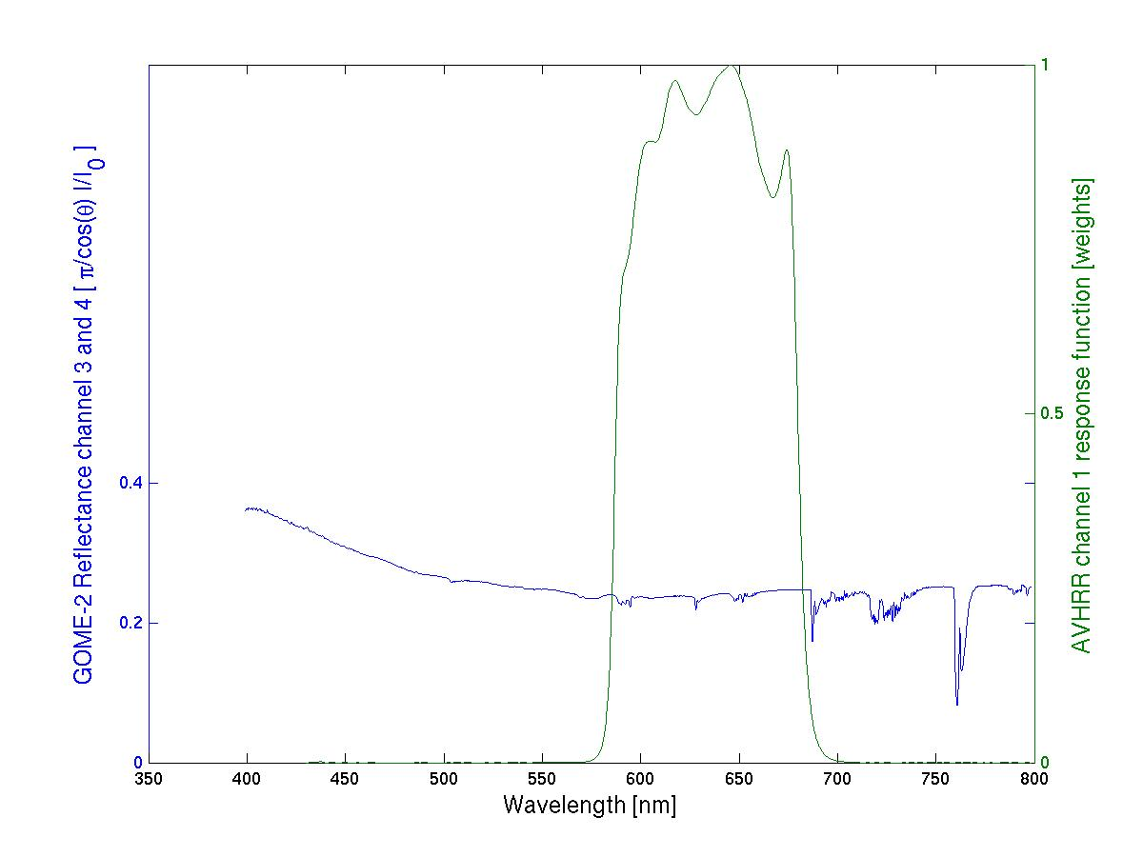
GOME-2/AVHRR reflectivity inter-calibration
AVHRR ch 1/ Metop-A
GOME-2 FM3 Metop-A
AVHRR ch1
response function
GOME-2 Ch:4 (Band 6)
1024 measurements
GOME-2 Ch:3 (Band 5)
1024 measurements

Slide 4
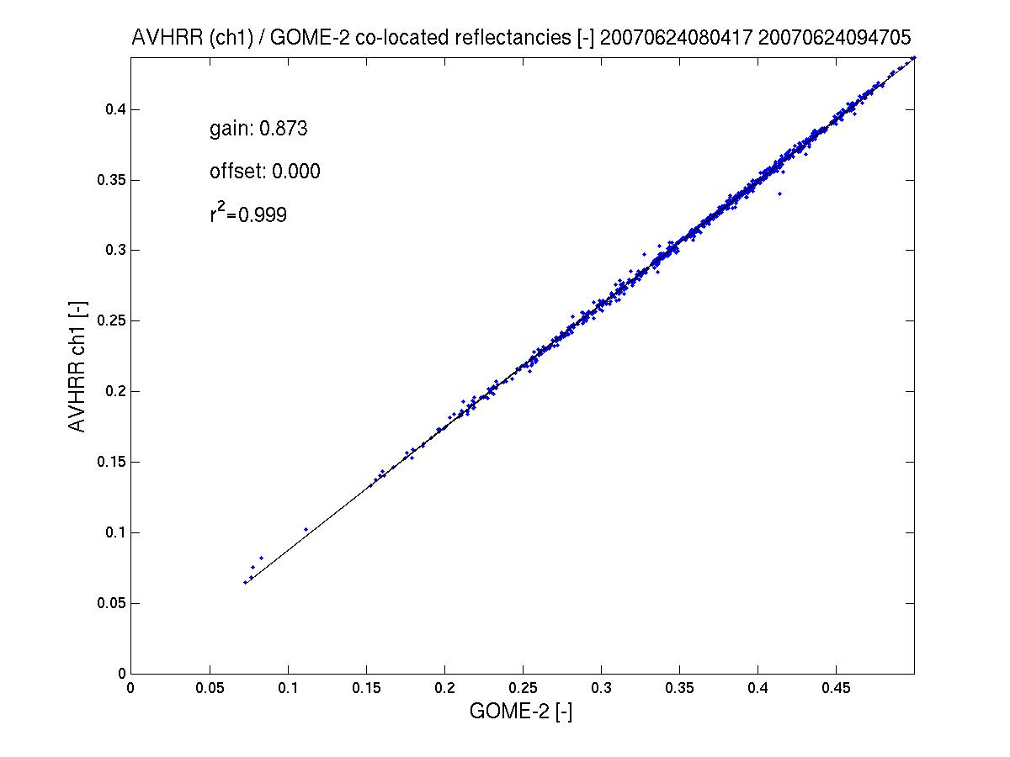
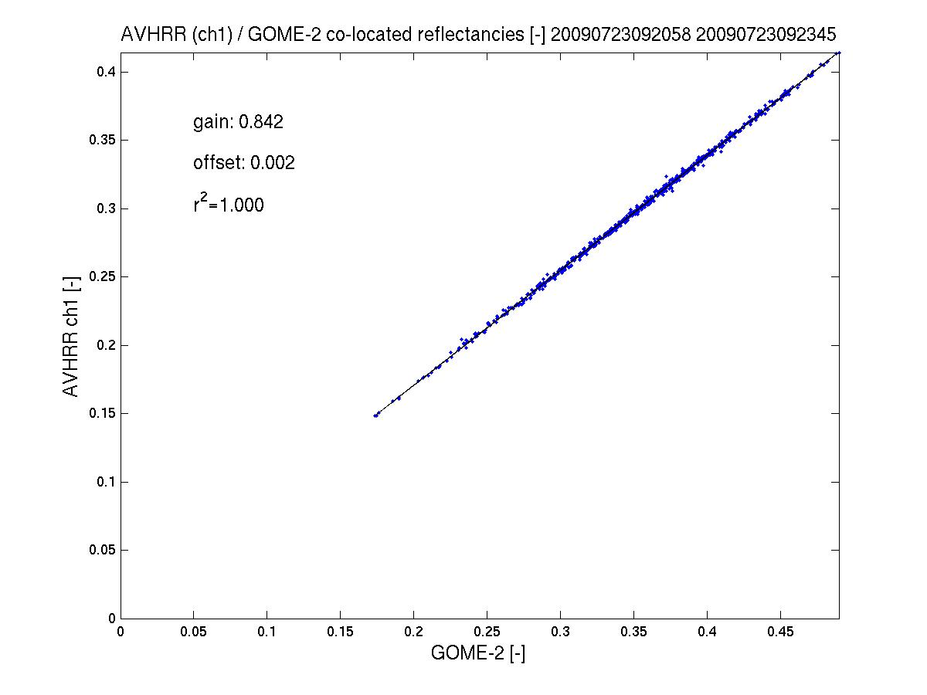
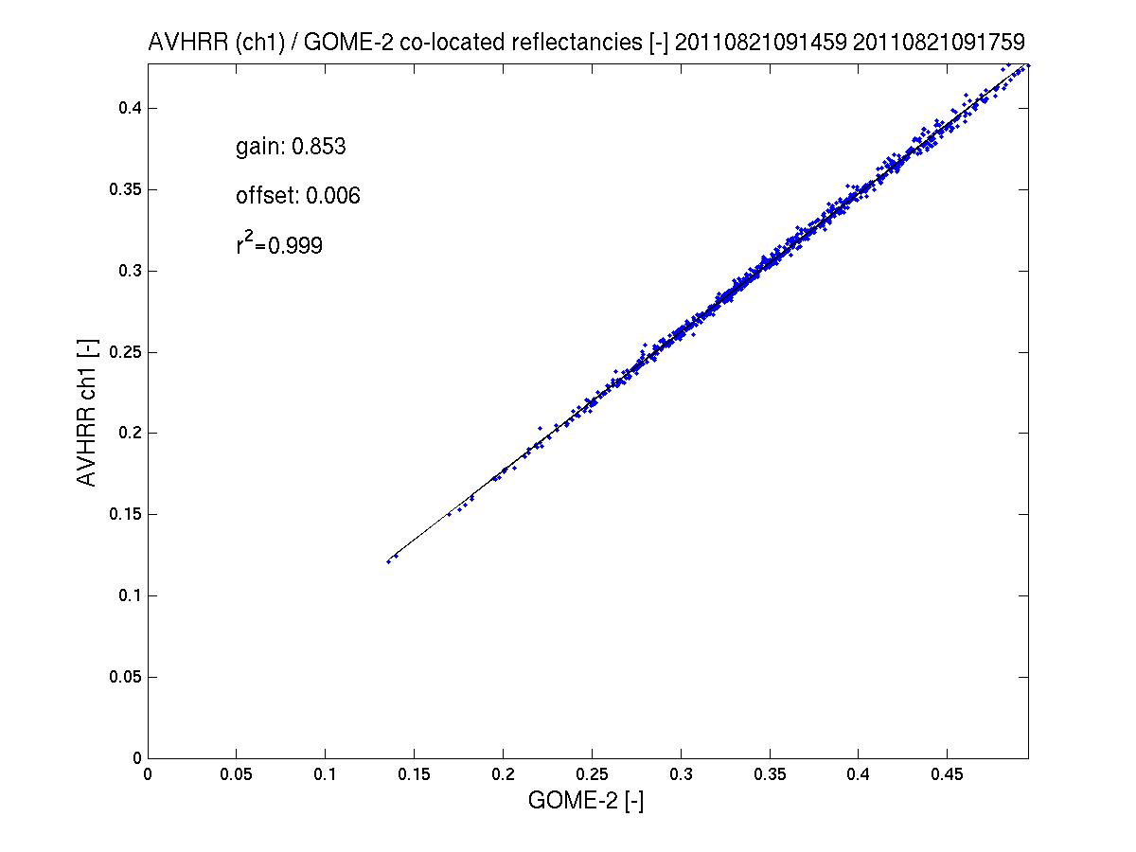
GOME-2 / AVHRR reflectivity inter-calibration
AVHRR ch 1/ Metop-A
GOME-2 FM3 Metop-A
AVHRR channel 1 to GOME-2/Metop-A gain in reflectivity ~10%
(AVHRR < GOME-2)
Results indicate that the gain has been quite stable from 2007 to 2011.
see GSICS Quarterly Newsletters, vol 5, number 3, Latter et al.
2011
2007
2009
spatial aliasing accounted for

Slide 5
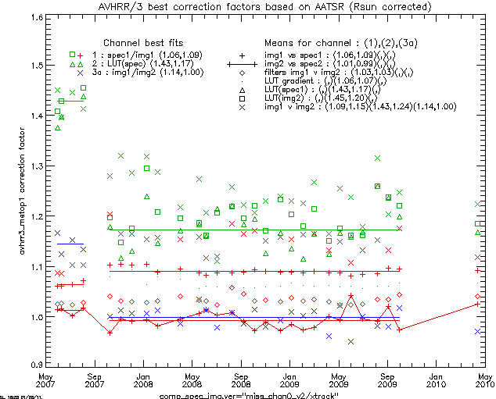
GOME-2 / AVHRR reflectivity inter-calibration
AVHRR ch1-3a / Metop-A and AATSR / Envisat
GOME-2 FM3 Metop-A
AVHRR channel 1-3a offsets in reflectivity
from
GOME-2 /Metop-A
AATSR /Envisat
Results indicate that the offset has been quite stable from 2007 to 2011.
see GSICS Quarterly Newsletters, vol 5, number 3, Latter et al.
AVHRR
Ch2
Ch1
Ch3a
Courtesy Latter et al.
Notes:
Fits shown as (pre-01Oct2007,post-01Oct 2007) as apparent change in processing (thought to be AVHRR/3). Colours indicate AVHRR/3 channel.
Corrected AVHRR/3 = scale factor * AVHRR/3(Calibrated & Rsun_corrected)
Best fit methods taken as:
CH1=scale factors(1.06,1.09) from: img1 vs spec1 (direct comparison with GOME-2 using spatial/spectral averaging)
CH2=scale factors(1.43,1.17) from: LUT(spec1) (Ice cloud properties predicted ch1/ch2 ratio, with CH1 correction applied)
CH3=scale factors(1.14,1.00) from: img1 v img2 (Comparison of AATSR vs AVHRR/3 1.6micron channel, spatially average over GOME-2 scenes)
Note 1: Due to time differences with AATSR, some scatter is expected due to scene variation, but assumed to average out over an orbit. (As the time difference is always in same sense, developing convection or burn-off of sea mist etc. may actually cause a small bias, but neglected here.)
Note 2: For CH2, the CH1 correction applied is that calculated for the same orbit, hence the increased scatter as scene changes effective impact twice (but again should average out over the orbit)
Note 3: AVHRR/3 irradiance corrected for sun-earth distance variation (not included in AVHRR/3 standard calibration)
Comments:
Diamonds (filters img1 v img2) show a bias of ~3% is expected between AVHRR/3 and AATSR if both calibrated correctly. Above (post 01Oct2007) shows AATSR 1% higher than GOME-2, AVHRR/3 9% higher than GOME-2, (i.e. 10% diff), but direct comparison suggest 15% (of which 3% attributable to filter difference (AVHRR/3 lower))
CH2 (x) img1 v img2 shows large scatter, but bands very different and strongly affected by water vapour, so not surprising.

Slide 6
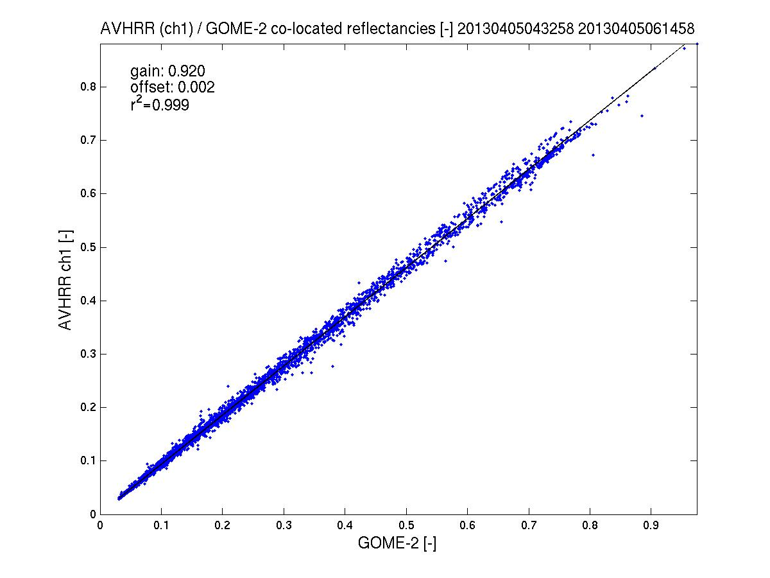
GOME-2 / AVHRR reflectivity inter-calibration
AVHRR ch 1/ Metop-A
GOME-2 FM3 Metop-A
AVHRR channel 1 to GOME-2/Metop-A gain in reflectivity <8%
(AVHRR < GOME-2)
2011 - 2013
see GSICS Quarterly Newsletters, vol 5, number 3, Latter et al.
2013
spatial aliasing accounted for

Slide 7
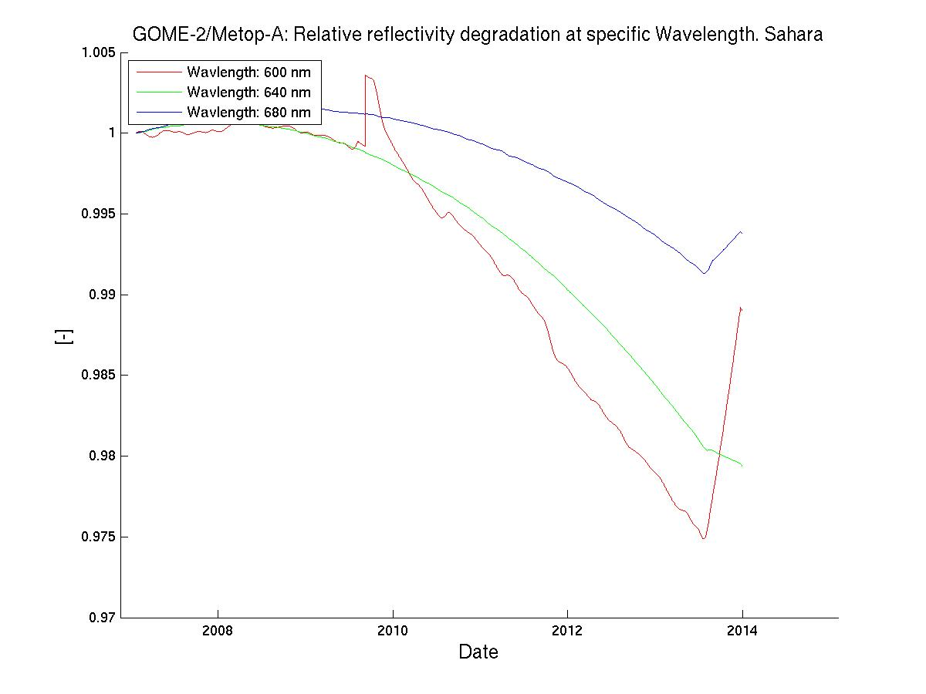
GOME-2 Metop-A degradation component modelling
Sahara – Reflectivity Degradation / AVHRR ch1-domain
GOME-2 FM3 Metop-A
R2 campaign
Jan 2007– Jan 2012
OPS phase (same PPF 5.3)
Jan 2012 – Oct 2013
Reflectivtiy
Degradation
600 nm
640 nm
680 nm
Average over all
GOME-2 viewing angles

Slide 8
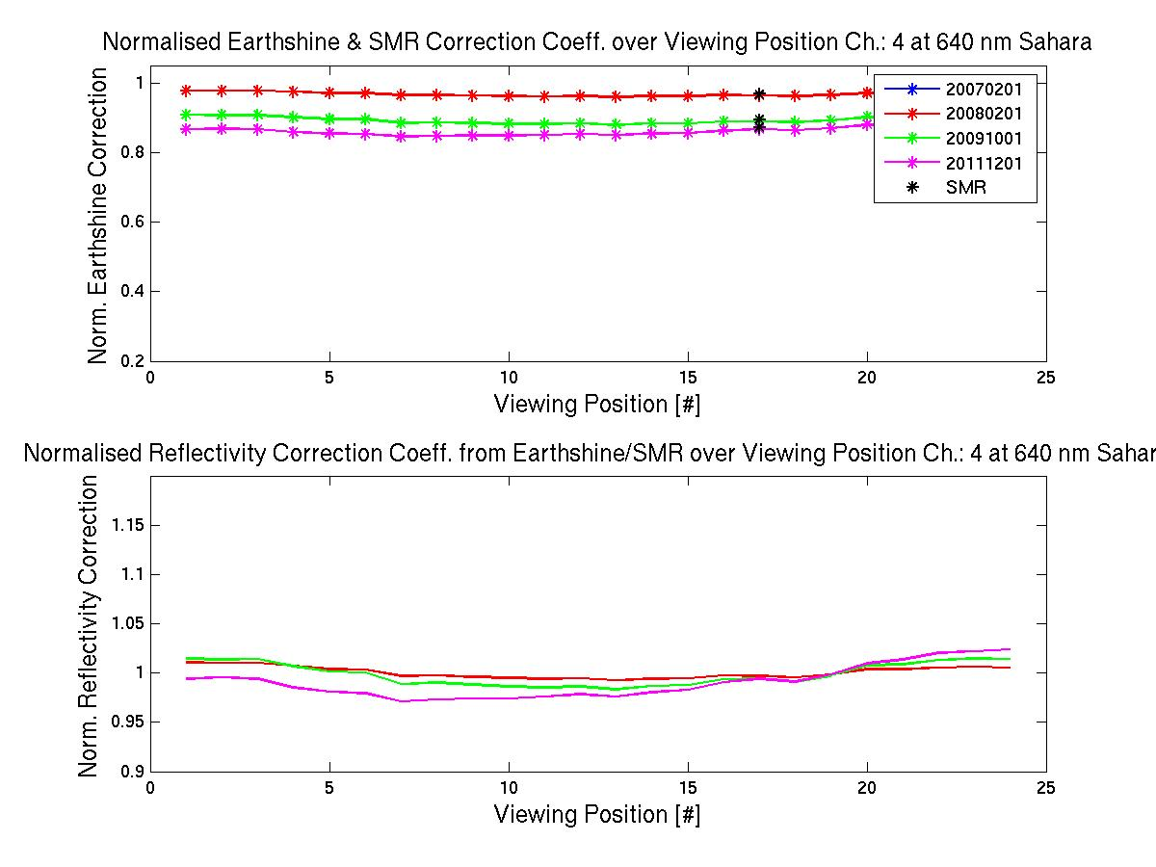
GOME-2 Metop-A degradation component modelling
Sahara – Reflectivity Degradation / AVHRR ch1-domain
GOME-2 FM3 Metop-A
R2 campaign
Jan 2007– Jan 2012
OPS phase (same PPF 5.3)
Jan 2012 – Oct 2013
Reflectivtiy
Degradation
640 nm
Over all
GOME-2 viewing angles
at
2008/02/01
2009/10/01
2011/12/01

Slide 9
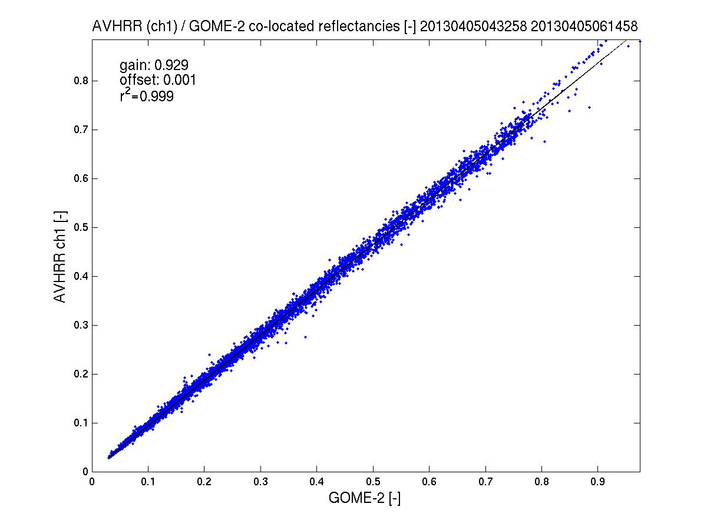
GOME-2/AVHRR reflectivity inter-calibration
AVHRR ch 1/ Metop-A
GOME-2 FM3 Metop-A
AVHRR channel 1 to GOME-2/Metop-A gain in reflectivity <8%
(AVHRR < GOME-2)
2013
Corrected /
Un-corrected
see GSICS Quarterly Newsletters, vol 5, number 3, Latter et al.
2013
spatial aliasing accounted for

Slide 10
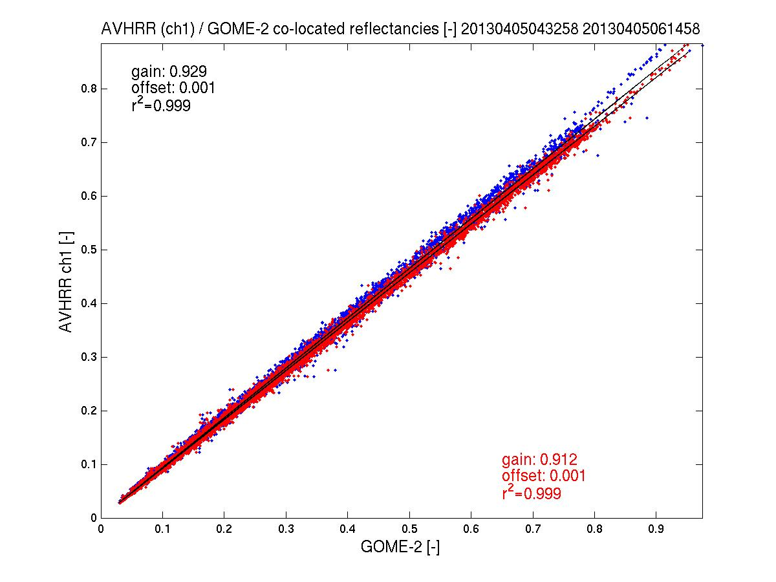
GOME-2/AVHRR reflectivity inter-calibration
AVHRR ch 1/ Metop-A
GOME-2 FM3 Metop-A
AVHRR channel 1 to GOME-2/Metop-A gain in reflectivity <8%
(AVHRR < GOME-2)
2013
Corrected /
Un-corrected
see GSICS Quarterly Newsletters, vol 5, number 3, Latter et al.
2013
spatial aliasing accounted for

Slide 11
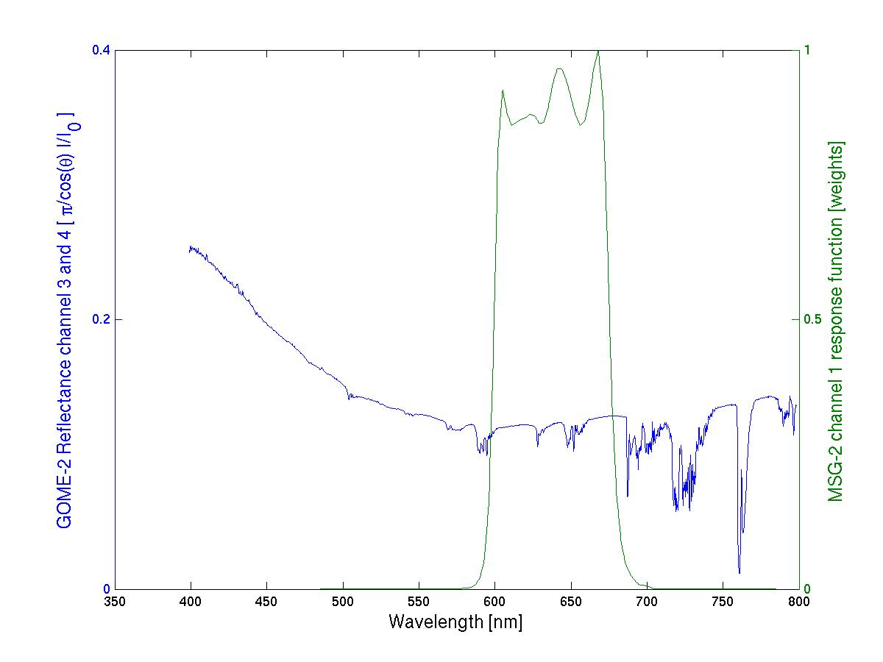
GOME-2 FM3 Metop-A
GOME-2 / Seviri reflectivity inter-calibration
SEVIRI ch1/ MSG-2 – preliminary results
Seviri ch1
response function
GOME-2 Ch:4 (Band 6)
1024 measurements
GOME-2 Ch:3 (Band 5)
1024 measurements

Slide 12
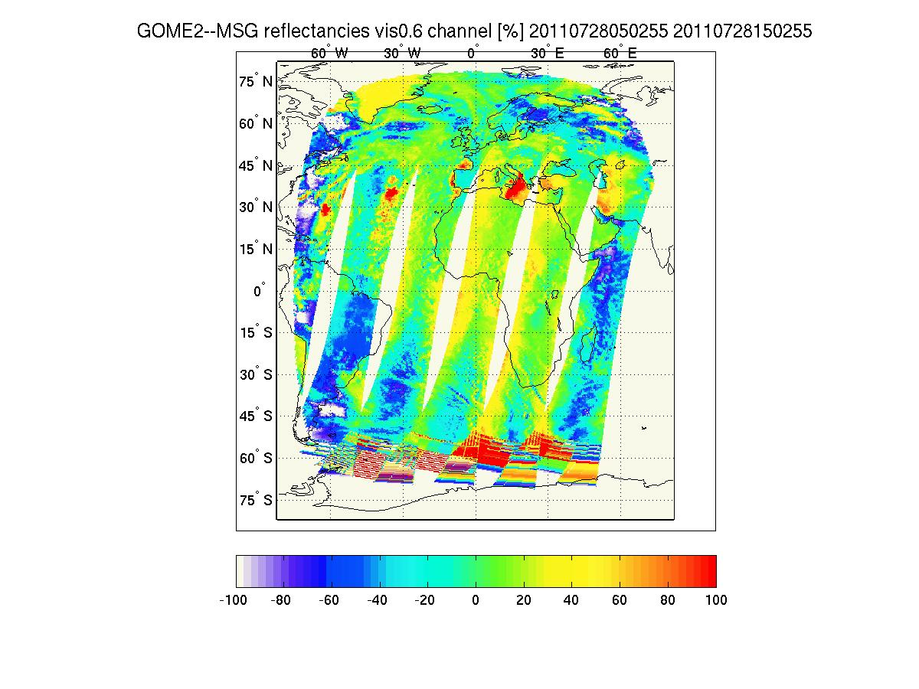
GOME-2 / Seviri reflectivity inter-calibration
SEVIRI ch1/ MSG-2 – preliminary results
GOME-2 FM3 Metop-A
Co-location of GOME-2 Metop-A with Seviri / MSG data.
Spatial collocation: Average of all Seviri measurements (~4km) in one GOME-2 ground pixel (40 by 80 km)
Temporal collocation: Within +- 15 min of sensing time.
No spatial aliasing correction

Slide 13
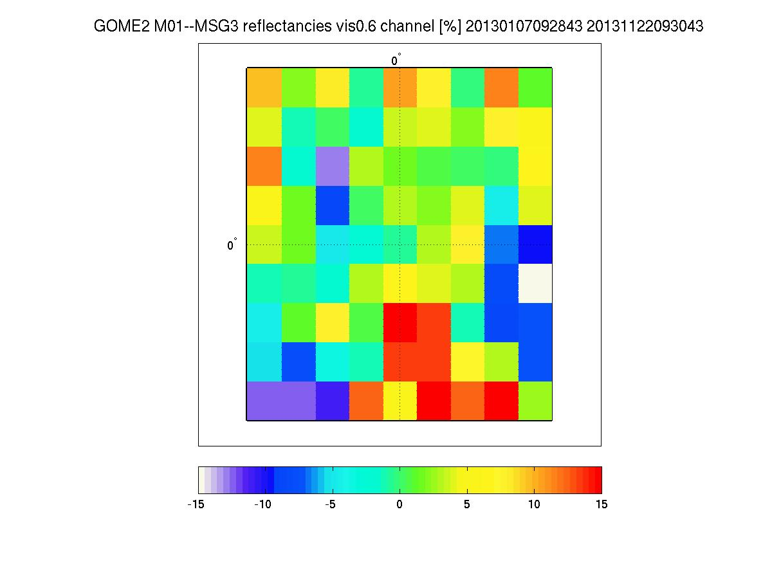
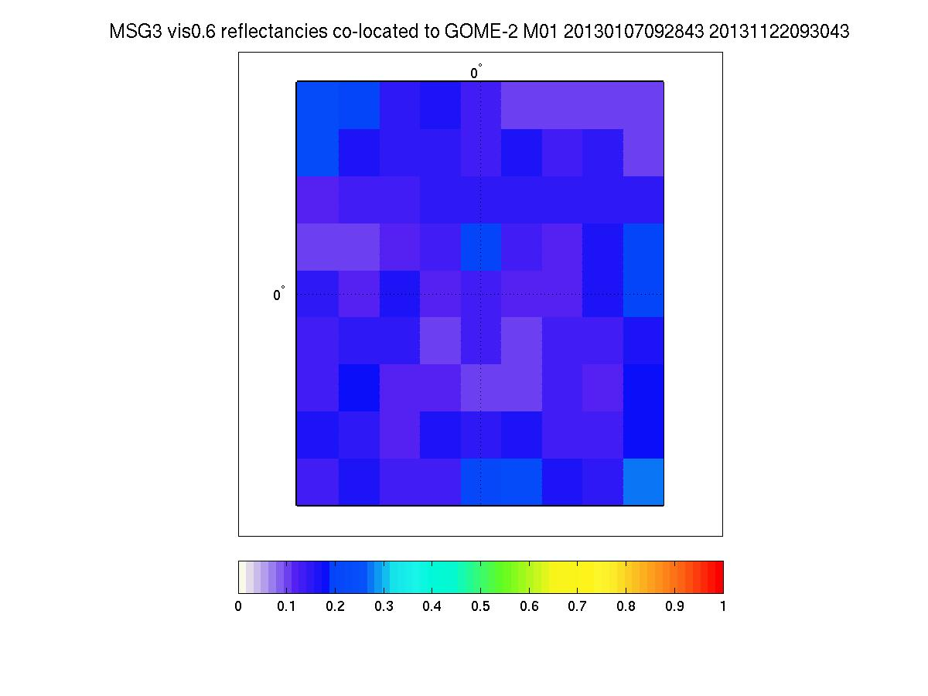
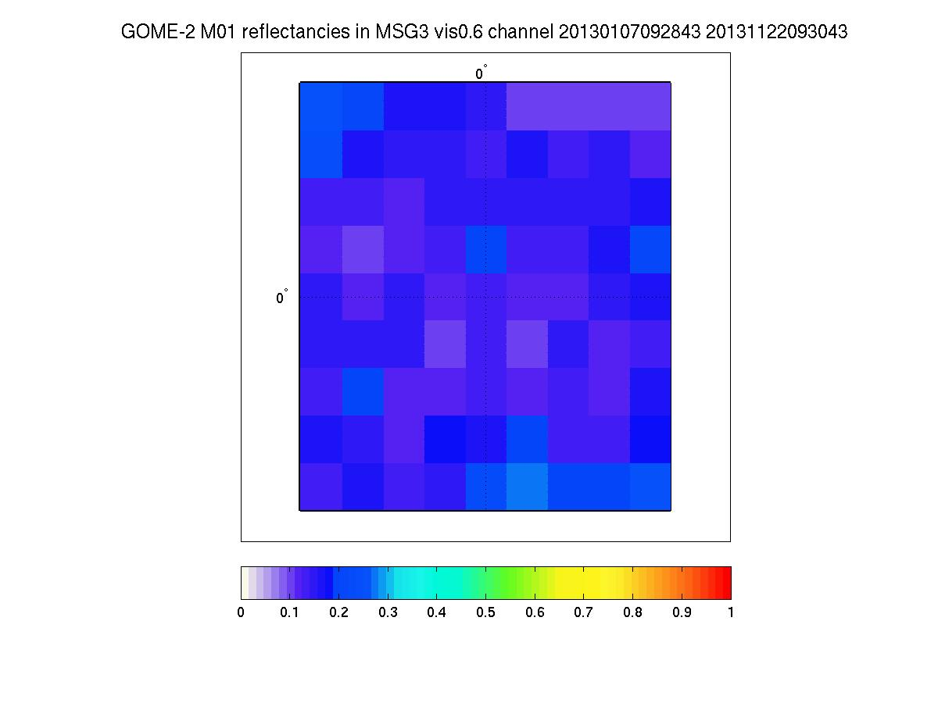
GOME-2/Metop-B reflectivity inter-calibration
SEVIRI ch1/ MSG-3 – preliminary results
GOME-2 FM2 Metop-B
Reflectance MSG3 / Seviri Ch 1
1.5/1.5 degrees box at 0/0º
Reflectance GOME-2 / Metop-B
1.5/1.5 degrees box at 0/0º
Residual MSG-3 /Seviri vs GOME-2 / Metop-B [%]
1.5/1.5 degrees box at 0/0º

Slide 14
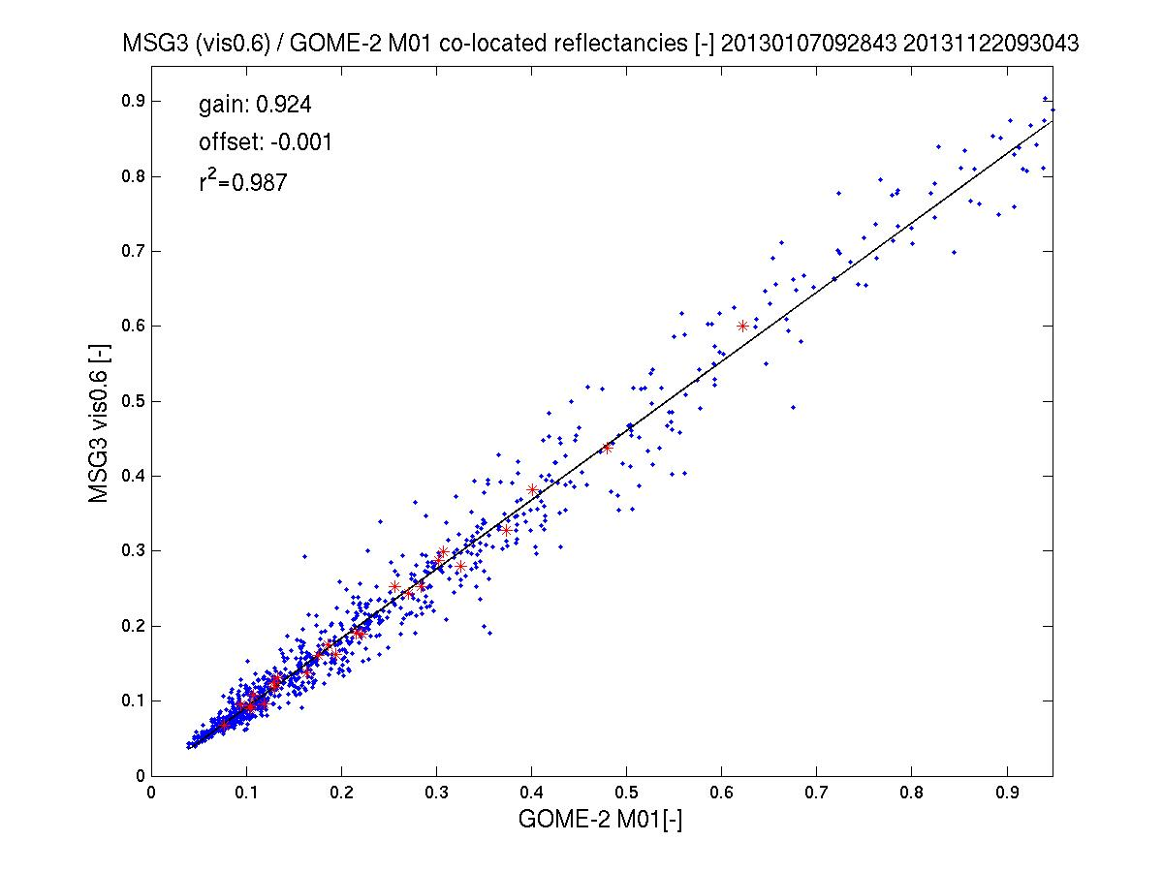
GOME-2/Seviri reflectivity inter-calibration
SEVIRI ch1/ MSG-3 vs GOME-2/Metop-B – preliminary results
GOME-2 FM2 Metop-B
MSG-3 / Seviri ch 1 to GOME-2/Metop-B gain in reflectivity ~8%
(Seviri < GOME-2)
1st Jan to 22nd Nov 2013
* bi-weekly average

Slide 15
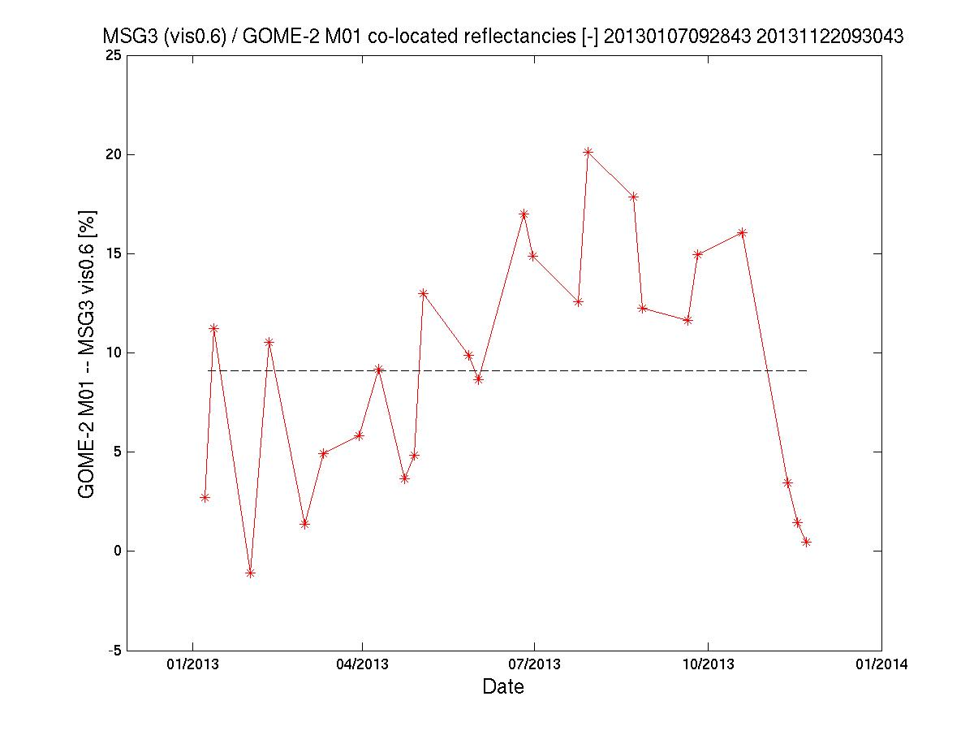
GOME-2/Metop-B reflectivity inter-calibration
SEVIRI ch1/ MSG-3 – preliminary results
GOME-2 FM2 Metop-B
MSG-3 / Seviri ch 1 to GOME-2/Metop-B gain in reflectivity ~8.5%
(Seviri < GOME-2)
1st Jan to 22nd Nov 2013
No spatial aliasing correction yet
No correlation with SZA found

Slide 16
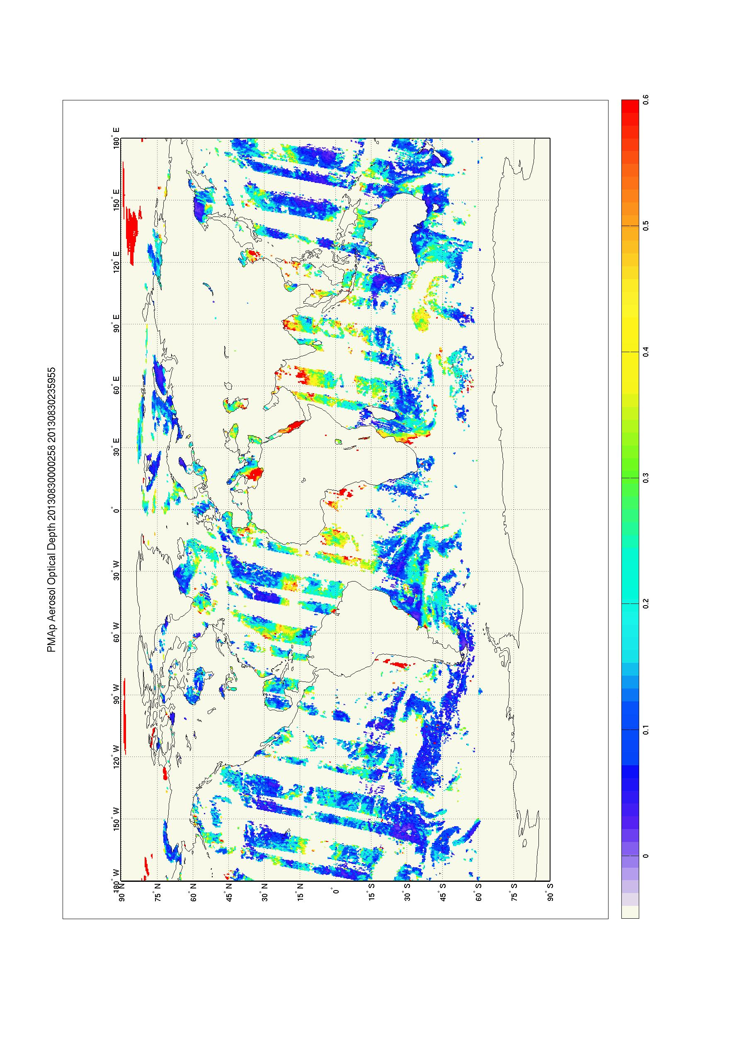
PMAp: Aerosol Optical Depth and volcanic ash from GOME-2 (Polarisation Measurements) / IASI and AVHRR
AOD / volcanic ash retrieval from two Metops – PMAp
Multi-sensor aerosol properties retrieval using GOME-2 stokes fractions from PMDs
GOME-2 FM3 Metop-A
GOME-2 FM2 Metop-B
GOME-2 PMD -
ground pixel sizes
Metop-B: 10 by 40 km
Metop-A: 5 by 40 km
GOME-2 PMD
AVHRR
GOME-2 PMD
IASI

Slide 17
PMAp – Multi-sensor co-location for aerosol optical depth retrievals
GOME-2 FM3 Metop-A
GOME-2 FM2 Metop-B
Instrument |  | Spatial resolution | Spectral range | comments
GOME | Main science channel | 80 x 40 km | 240nm -800nm, res. 0.25-0.5nm | AAI, low spatial resolution, not used
 | Polarization Monitoring Device | 10 x 40 km Metop-B 5 x 40 km Metop-A | 311nm-803nm, 15 bands | AOD, aerosol type, AAI
AVHRR | - | 1.08 x 1.08 km | 580nm-12500nm, 5 bands | Clouds, scene heterogeneity, dust/ash
IASI | - | 12km (circular) | 3700–15500nm, resolution 0.5 cm⁻¹ | desert dust, volcanic ash aerosol heights
Auxiliary data | ECMWF wind speed (forecasting) | Temporal interpolation necessary | - | Required for retrievals over ocean
 | surface albedo, Surface elevation | - | - | Required for retrievals over land
Target spatial resolution

Slide 18
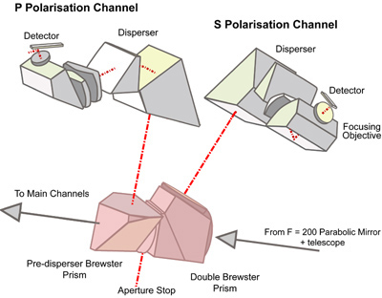
PMAp – Multi-sensor co-location for aerosol optical depth retrievals The GOME-2 Polarisation Measurement Devices
GOME-2 FM3 Metop-A
GOME-2 FM2 Metop-B
Band-S
No. | pix1 | pixw. | wav1 | wav2
1 | 22 | 5 | 311.709 | 314.207
2 | 30 | 4 | 316.762 | 318.720
3 | 37 | 12 | 321.389 | 329.139
4 | 50 | 6 | 330.622 | 334.443
5 | 57 | 6 | 336.037 | 340.161
6 | 84 | 17 | 360.703 | 377.873
7 | 102 | 4 | 380.186 | 383.753
8 | 117 | 19 | 399.581 | 428.585
9 | 138 | 27 | 434.083 | 492.066
10 | 165 | 18 | 494.780 | 548.756
11 | 183 | 2 | 552.474 | 556.262
12 | 187 | 11 | 568.070 | 612.869
13 | 198 | 9 | 617.867 | 661.893
14 | 218 | 4 | 744.112 | 768.269
15 | 224 | 2 | 794.080 | 803.072
Radiances & stokes fraction
better spatial resolution
stokes fraction s = Q/I

Slide 19
PMAp – Multi-sensor co-location for aerosol optical depth retrievals The GOME-2 PMD / AVHRR / IASI co-location
GOME-2 FM3 Metop-A
GOME-2 FM2 Metop-B
AVHRR collocation: an AVHRR pixel is collocated to a GOME-2 PMD pixel if it is inside the GOME-2 pixel
Spatial aliasing due to read-out timing of detectors is taken into account!
IASI collocation: a IASI pixel may span up to 6 GOME-2 PMD pixels. Which GOME-2 pixel should it be collocated to?

Slide 20
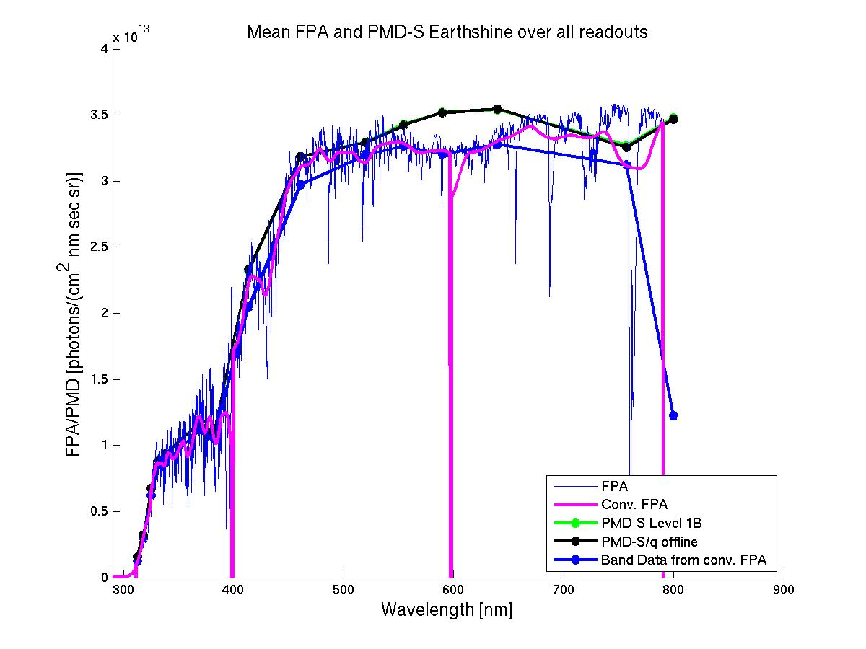
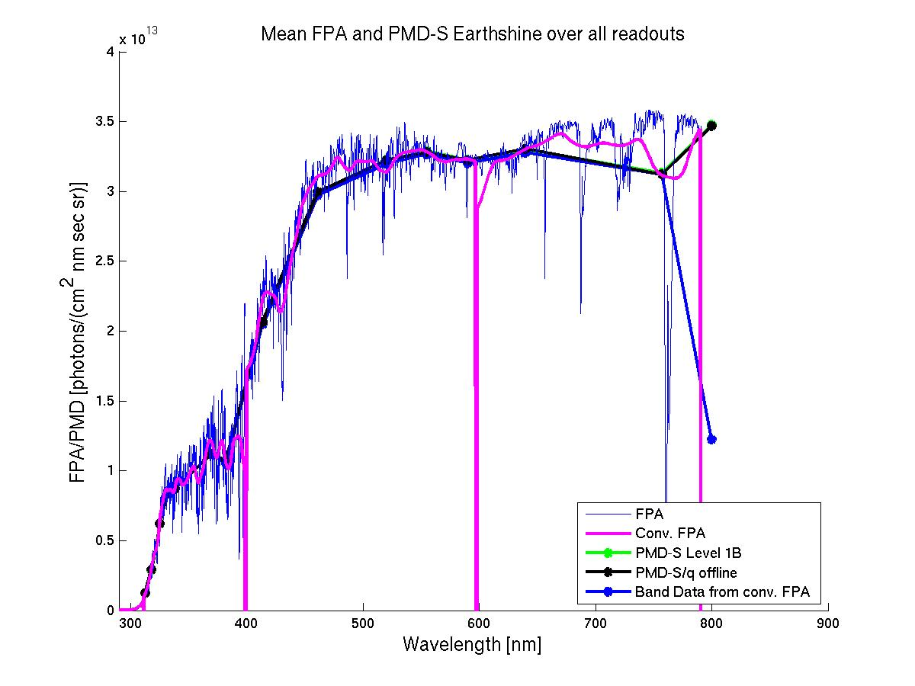
PMAp – Multi-sensor co-location for aerosol optical depth retrievals Towards continuous calibration of AVHRR channels
GOME-2 FM3 Metop-A
GOME-2 FM2 Metop-B
For PMAp a consistent and continuous AVHRR – GOME-2/IASI radiometric
inter-calibration is needed!
1)
AVHRR vs GOME-2:
Use GOME-2
Main channels to calibrate AVHRR
ch 1 and 2
AVHRR channels
Channel | Central wave-length[μm] | Wavelength range [μm]
1 | 0.630 | 0.580 - 0.680
2 | 0.865 | 0.725 - 1.000
3A | 1.610 | 1.580 - 1.640
3B | 3.740 | 3.550 - 3.930
4 | 10.800 | 10.300- 11.300
5 | 12.000 | 11.500- 12.500
2)
Correct PMDs using MSC
GOME-2
PMD vs Main channels (MSC):
Make PMDs consistent
with main science
channel radiances
3)
AVHRR vs IASI:
Use IASI to calibrate AVHRR ch 3 to 5

Slide 21
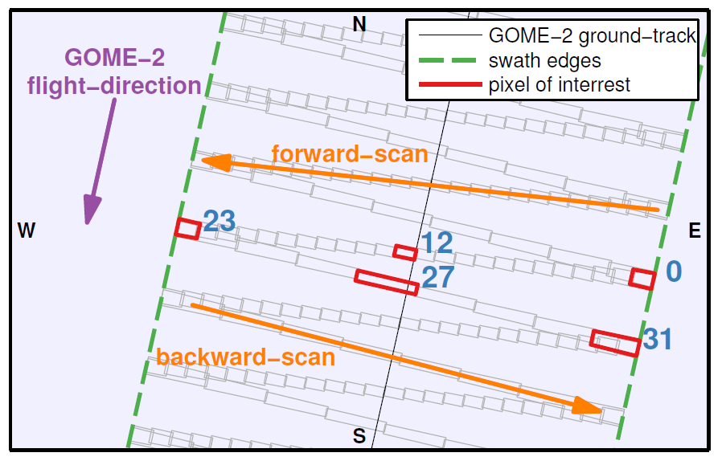
GOME-2 pointing and Geo-referencing
Forward and Back-scan – spatial aliasing
GOME-2 FM3 Metop-A
GOME-2 FM2 Metop-B
GOME-2 scanning: 4 seconds forward direction (24 pixel)
2 seconds backward direction (8 pixels)
Courtesy: H. Sihler, MPIC, Mainz

Slide 22
GOME-2 pointing and Geo-referencing
Forward and Back-scan – spatial aliasing / preliminary results!
GOME-2 FM3 Metop-A
GOME-2 FM2 Metop-B
GOME-2 scanning: forward scan nadir viewing pixel
Using accumulated AVHRR channel 1 radiances,
convolved with spectral response function within reported geo-location of one GOME-2 ground pixel
Plot shows:
Area of highest correlation (colored)
Geo-reference footprint of one pixel as reported in GOME-2 level-1 product (black square)
Courtesy: H. Sihler, MPIC, Mainz

Slide 23
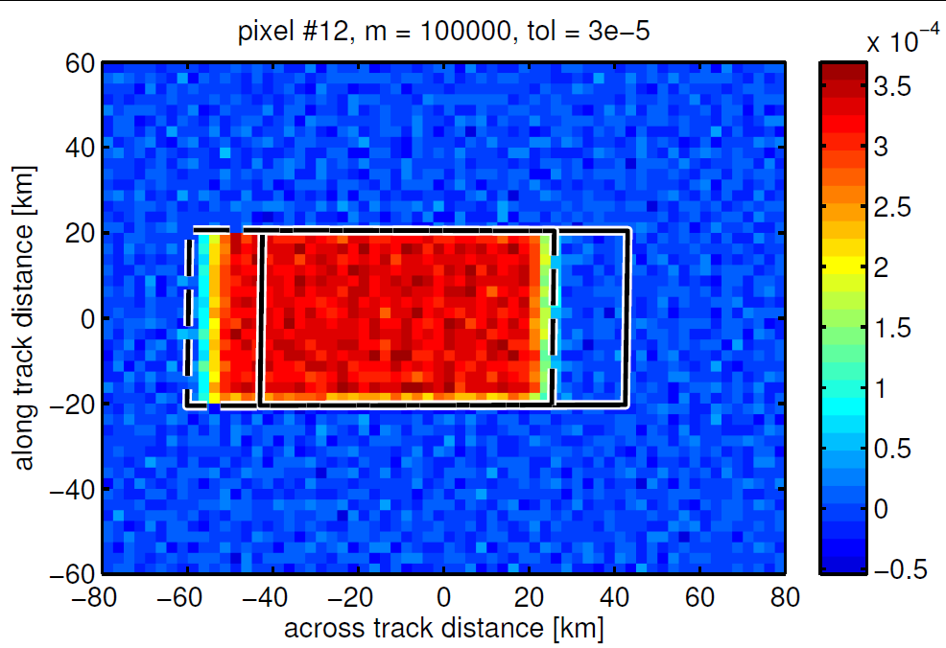
GOME-2 pointing and Geo-referencing
Forward and Back-scan – spatial aliasing / preliminary results!
GOME-2 FM3 Metop-A
GOME-2 FM2 Metop-B
GOME-2 scanning: forward scan nadir viewing pixel
Using accumulated AVHRR channel 1 radiances,
convolved with spectral response function within reported geo-location of one GOME-2 ground pixel
Plot shows:
Area of highest correlation (colored)
Geo-reference footprint of one pixel as reported in GOME-2 level-1 product (black square)
Corrected according to detector read-out timing: spatial aliasing
Courtesy: H. Sihler, MPIC, Mainz

Slide 24
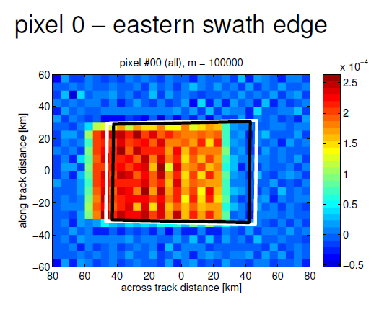
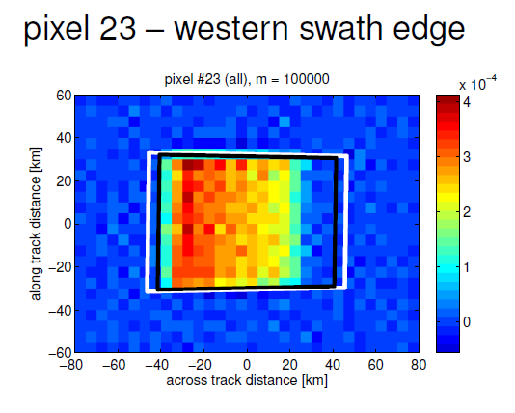
GOME-2 pointing and Geo-referencing
Forward and Back-scan – spatial aliasing / preliminary results!
GOME-2 FM3 Metop-A
GOME-2 FM2 Metop-B
Using accumulated AVHRR channel 1 radiances,
convolved with spectral response function within reported geo-location of one GOME-2 ground pixel
Plot shows:
Area of highest correlation (colored)
Geo-reference footprint of one pixel as reported in GOME-2 level-1 product (black square)
Distorted (squeezed) Western pixel because of scan mirror turn during detector read-out
Courtesy: H. Sihler, MPIC, Mainz

Slide 25
GOME-2 pointing and Geo-referencing
Forward and Back-scan – spatial aliasing
GOME-2 FM3 Metop-A
GOME-2 FM2 Metop-B
GOME-2 scanning: 4 seconds forward direction (24 pixel)
2 seconds backward direction (8 pixels)
Courtesy: H. Sihler, MPIC, Mainz

Slide 26
Summary
GOME-2 inter-calibration (AVHRR/Seviri/PMAp)
GOME-2 / Metop-A channel 3/4 vs AVHRR / Metop-A channel 1
Scale factor of 0.89
(2007 to 2011, 2011 to 2013 after correction of GOME-2 data, spatial aliasing accounted for by empirical correlation optimisation)
GOME-2 / Metop-B channel 3/4 vs Seviri / MSG-3 channel 1
Scale factor of ~0.92
(2013, no correction of GOME-2 data, no spatial aliasing)
PMAp: GOME-2/(IASI) AVHRR inter-calibration
Towards continuous (operational) calibration for consistency with GOME-2 main science channels
AVHRR inter-calibration of GOME-2 geo-reference data
Calibrating aspects of spatial aliasing and its radiometric effect in GOME-2 radiances by using AVHRR co-relation statistics

