Slide 1
Introduction of the SCIAMACHY SBAF web tool
Dec 16, 2014
D. Doelling, B. Scarino

Slide 2
Introduction
Similar to the IR, which is referenced to IASI, the GSICS visible calibration will be referenced to a well-calibrated and traceable hyper-spectral visible sensor
Such as the future CLARREO instrument
Or other sequential overlapping hyper-spectral sensors for traceability
Will eventually characterize calibration sites, spectrally, in order to transfer the reference calibration
Current GSICS approach is to use sequential overlapping MODIS and VIIRS sensors
Traceable to a future absolute calibration source
MODIS and VIIRS are broadband sensors, as are the target sensors, therefore spectral band adjustment factors (SBAF) are required to transfer the reference calibration

Slide 3
SBAF approaches and considerations
Desert targets are spectrally pre-characterized and radiative transfer models predict the instantaneous target sensor radiance.
Bright high clouds have been known to be spectrally flat, mitigating the need for an SBAF
Use coincident MODIS cloud properties to predict the target radiance
Use SCIAMACHY hyper-spectral radiances convolved with the reference and target spectral response functions over the calibration site
Because it is nearly impossible to have coincident reference, target, and hyper-spectral sensors, can these hyper-spectral SBAFs be predetermined over a site?
SCIAMACHY pseudo and Aqua-MODIS 0.65-µm monthly relative radiance ratios were found within 0.45% and the relative trend was -0.2%/decade (shown in next presentation)

Slide 4
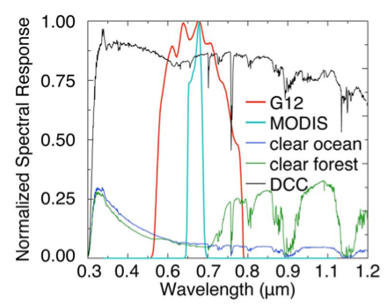
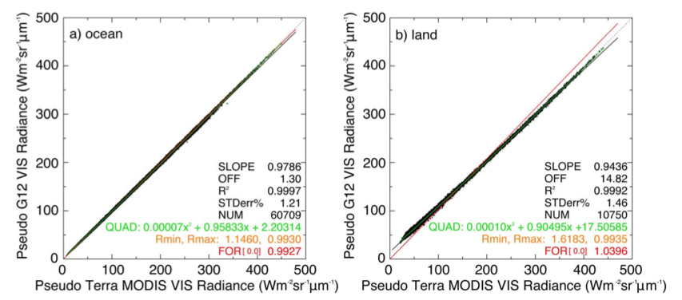
GOES-12/MODIS SCIAMACHY SBAF
SCIAMACHY (10:00 AM sun-synchronous orbit) Level-1b, Version-7.03 hyper-spectral footprint measurements, from August 2002 through December 2010, were collected over the GOES-EAST ocean and land domains
SCIAMACHY-based GOES-12 and MODIS pseudo radiances are then regressed to derive the SBAF
Doelling et al. 2012, GRSL

Slide 5
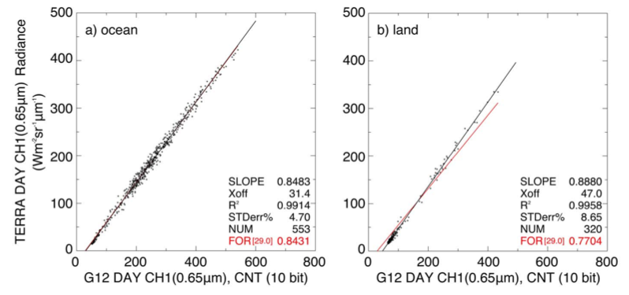
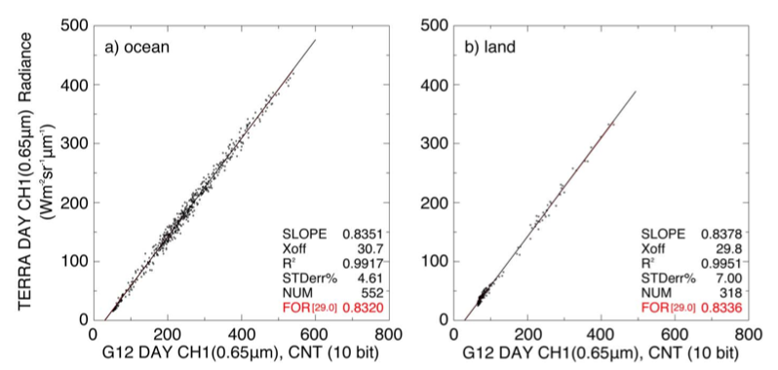
Apply SBAF to Terra-MODIS and compare with GOES-12
Before SBAF
September 2009, ray-matched Terra-MODIS radiances and GOES-12 visible counts. The GOES-12 space offset is 29 counts
Before SBAF:
• Ocean and land slopes differ by 9.4%
• Count Offset for land radiance pairs is 47
After SBAF
After SBAF:
• Ocean and land slopes differ by 0.2%
• Ocean and land count offsets are close to 29
Doelling et al. 2012, GRSL

Slide 6
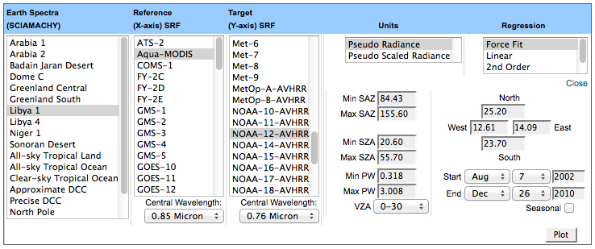
SCIAMACHY web based SBAF tool
SBAF tool: http://angler.larc.nasa.gov/SBAF/
SRF tool: http://angler.larc.nasa.gov/SPECTRAL-RESPONSE
• Nadir-view SCIAMACHY footprint (30x240 km) hyper-spectral radiance, date,
location, angle, and collocated GEOS-4/5 PW information were saved in a database
• Request for more earth spectra, SRFs, regression types can be made
• All auxiliary data is welcome, will provide footprint center location and time
Scarino et al. 2014, submitted TGRS

Slide 7
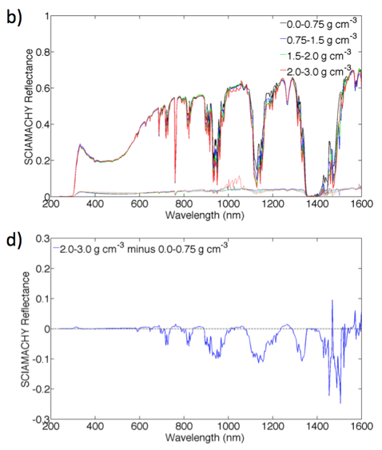
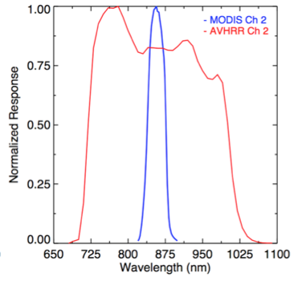
SCIAMACHY hyper-spectral radiance over Libya-1
Scarino et al. 2014, submitted TGRS

Slide 8
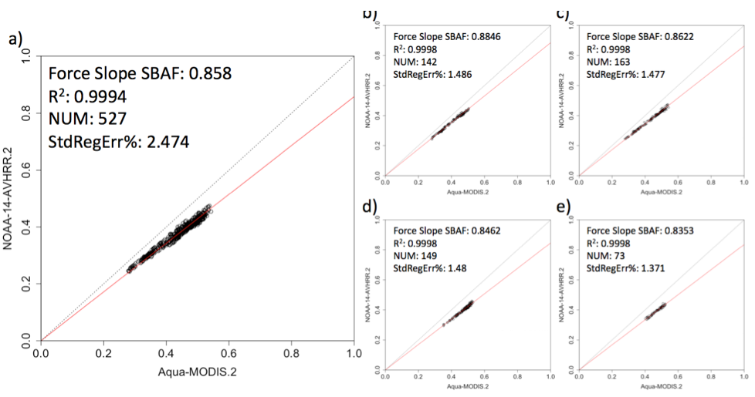
AVHRR/MODIS 0.86-µm SBAF by PW over Libya-1
PW 0.0-0.75 g cm⁻³
PW 0.75-1.5 g cm⁻³
PW 0.0-3.0 g cm⁻³
PW 1.5-2.0 g cm⁻³
PW 2.0-3.0 g cm⁻³
• As the PW increases the slope decreases, indicating that the broader-band AVHRR is getting darker
Scarino et al. 2014, submitted TGRS

Slide 9
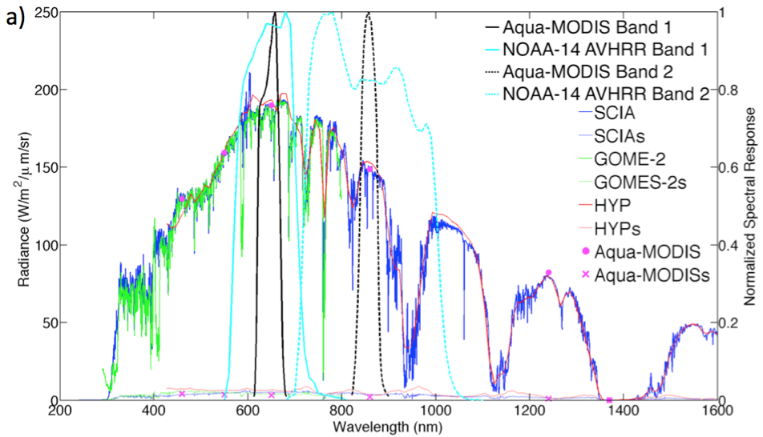
SCIAMACHY SBAF validation
August 2007, Libya-4, 17 SCIAMACHY FOVs, 17 GOME-2 FOVs, 5 Hyperion swaths
SBAF
For band 1 (0.65-µm) the SBAFs were within 0.3%
For band 2 (0.86-µm) the SBAFs were within 0.1%
Scarino et al. 2014, submitted TGRS

Slide 10
Conclusions
SCIAMACHY-based SBAF web tool introduced as a way of mitigating spectral band differences between target and reference sensor, thereby enabling MODIS and VIIRS to be used as traceable references
The apriori land and ocean SBAFs provided similar GOES-12/Terra-MODIS land and ocean gains
The SBAF web tool can be optimized for users’ applications. In order to reduce the overall SBAF uncertainty, SBAFs as a function of PW (and other variables) can be used
The SCIAMACHY SBAF was validated against GOME-2, and Hyperion over Libya-4 during August 2007

