Slide 1
Inter-calibration of GEO (Met-9) and LEO (MODIS) relative to SCIAMACHY
GRWG UV Sub-Group Web Meeting
Hyper-spectral SNO comparisons of VIS channels
Dec 16, 2014
D. Doelling, B. Scarino

Slide 2
Introduction
The SCIAMACHY hyper-spectral sensor can be used as a transfer medium to tie GEO imagers with the GSICS visible reference, Aqua-MODIS, radiances
Removes the need for SBAFs
First inter-calibrate SCIAMACHY and Aqua-MODIS over the North Pole
Determine if SCIAMACHY is stable with respect to MODIS
Determine relative calibration difference
Then inter-calibrate SCIAMACHY and Met-9 over the equatorial domain
Compare calibration gains with other methods

Slide 3
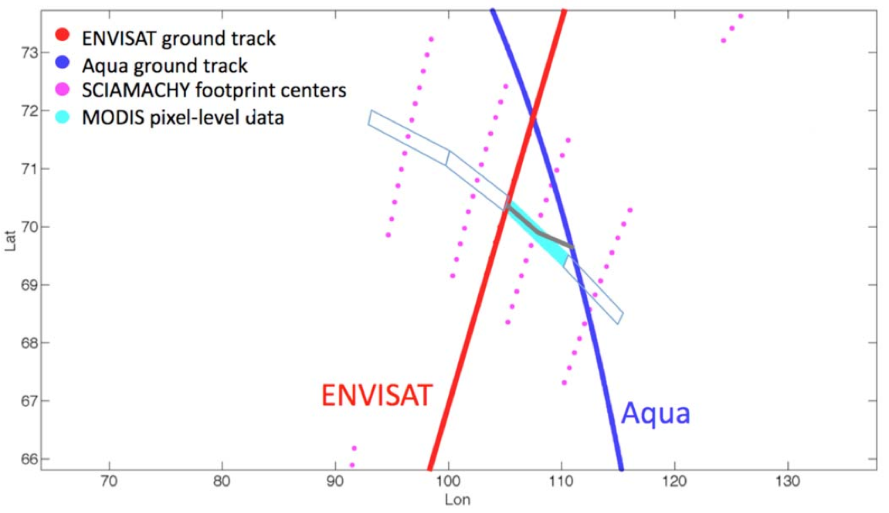
SCIAMACHY/Aqua-MODIS NSNO
• SCIAMACHY and Aqua-MODIS SNO are not possible because SCIAMACHY does not have nadir footprint. Use above geometric configuration to derive nearly SNO (NSNO).
• NSNO occurs at 11:45 AM (local time), assuring azimuthal angle match
• Envisat and Aqua ground intersect occur 14 times daily at 71°N
• Perform monthly regressions of SCIAMACHY footprint pseudo and MODIS radiance pairs between April and September in order to ensure a sufficient SZA
Doelling et al. 2013, TGRS

Slide 4
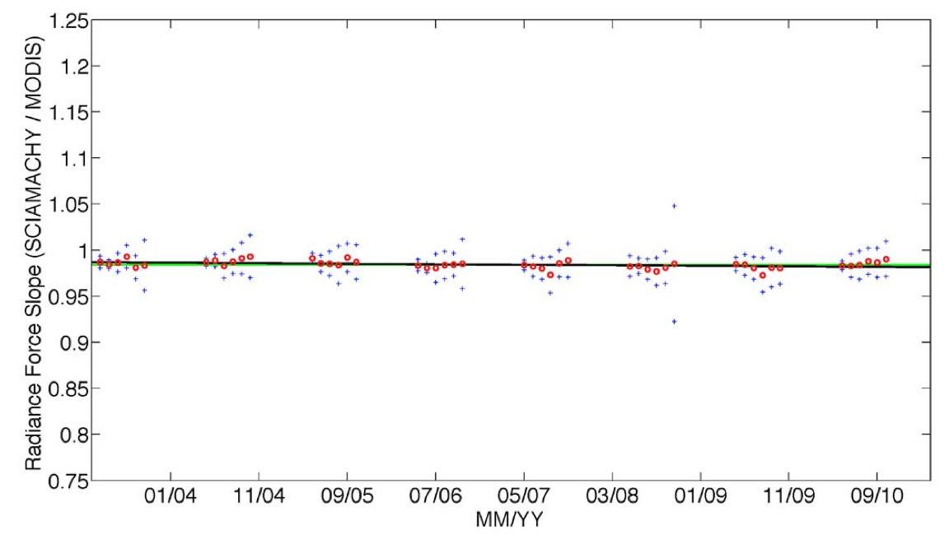
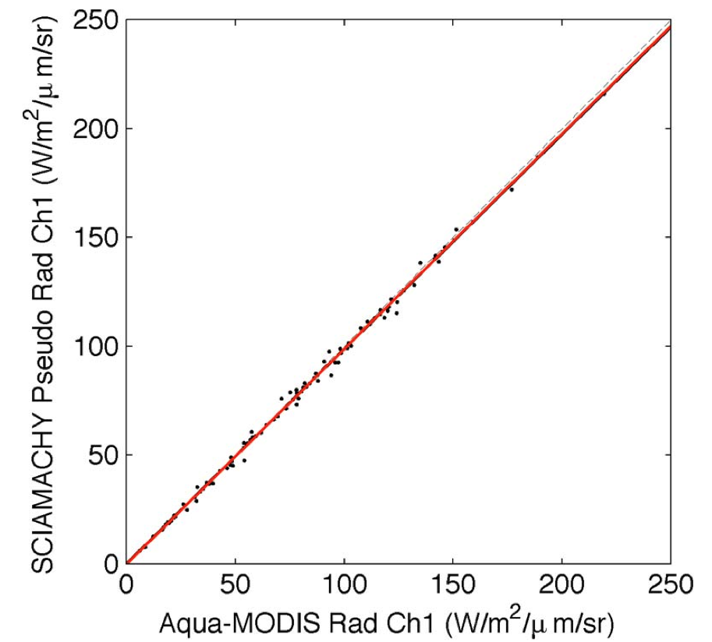
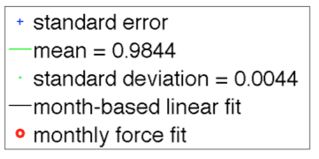
SCIAMACHY/Aqua-MODIS NSNO
July 2010
N 95
Slope 0.988
Stderr 2.8%
• Relative temporal trend of -0.2% per decade, based on 7-years of data
• Monthly standard deviation about the SCIA/MODIS ratio of 0.9844 is 0.45%
• SCIAMACHY Level-1b, Version-7.03 is as stable as Aqua-MODIS Collection 5
• both use solar diffusers for on-orbit calibration
• both are within their uncertainty of 2% at 0.65 µm
Doelling et al. 2013, TGRS

Slide 5
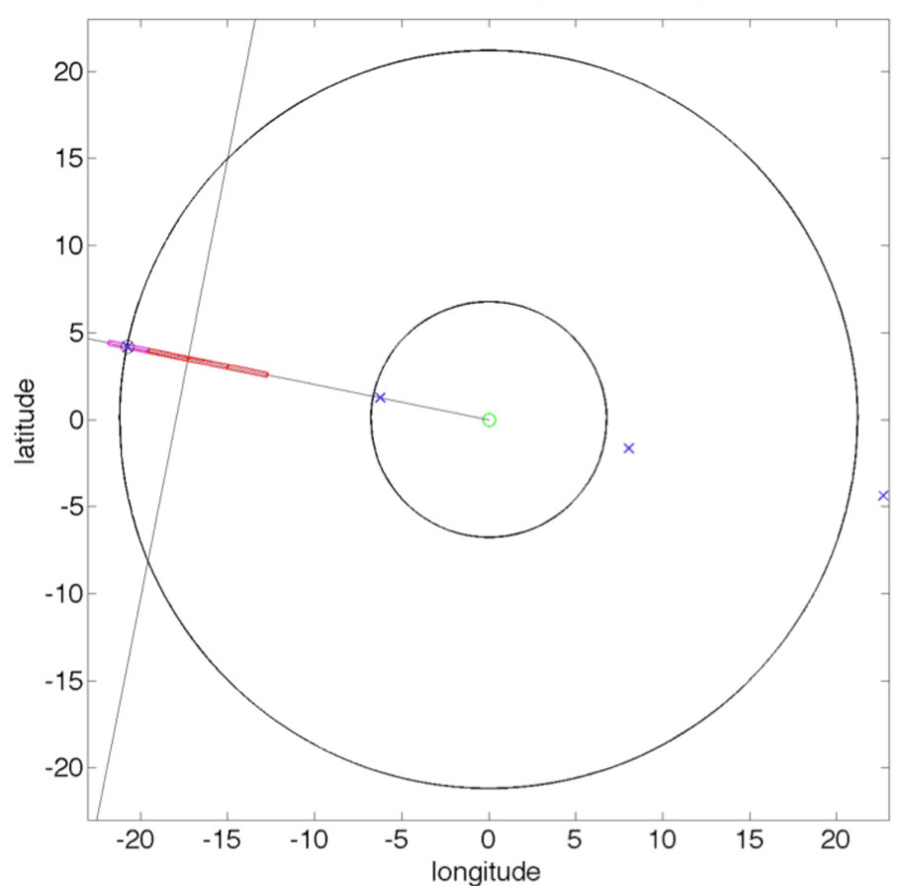
SCIAMACHY/GEO ray-match
• Envisat has a 35-day repeat cycle providing ~40 SCIA/GEO matches (42=4*(365/35)
• The GEO/SCIA matches are fixed spatially
Envisat ground track
pink SCIA 240-by-30-km FOV is ray-matched
GEO sub-satellite point
• Expand radii to increase sampling. Will off-nadir ray-matching introduce biases?
Use if SCIA footprint falls inside blue 40-km circle
Other SCIA/GEO ray-match locations
• SCIAMACHY also contains 30x60-km “cluster” FOVs with limited spectral range. Should provide 16 X the matches
22.5° GEO VZA

Slide 6
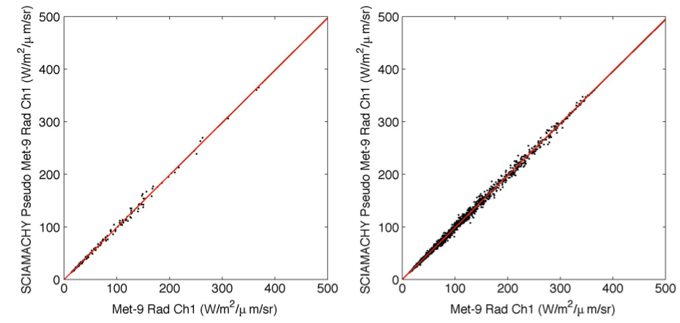
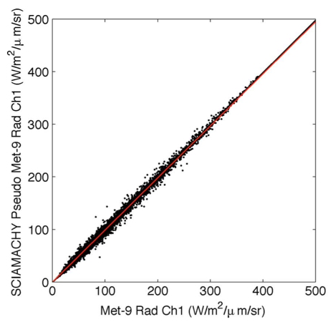
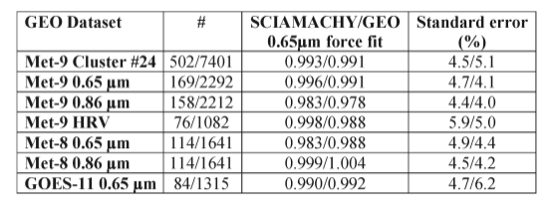
SCIAMACHY/Met-9 0.65µm ray-match April 2007 to December 2010
40-km
160-km
30x60-km
Cluster #24
Slope 0.996
N 169
Stderr 4.7%
Slope 0.991
N 2292
Stderr 4.1%
Force fit 0.991
N 7401
Stderr 5.1%
40/160-km
• 40-km and 160-km slopes are within 0.5%, well within the regression standard error, except for Met-9 HRV
• All GEOs have been ray-matched against Aqua-MODIS to remove calibration drift between April 2007 and December 2010
Doelling et al. 2013, TGRS

Slide 7
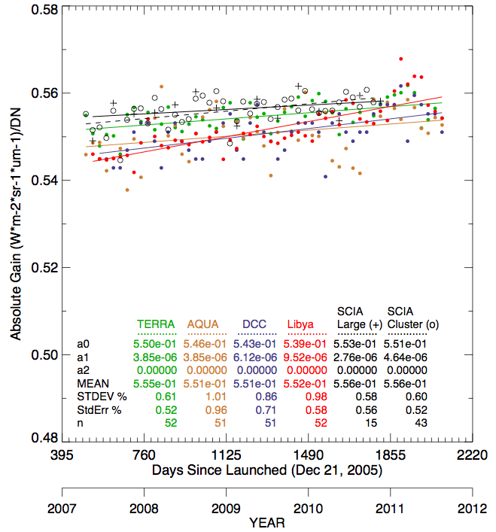
Meteosat-9 0.65µm calibration gain comparison
• SCIAMACHY/Meteosat-9 0.65-µm calibration is within 1% of all other calibration coefficients
• Has one of the lowest monthly uncertainty levels at ~0.55%
• SCIAMACHY based GEO calibration as good as other methods and has the advantage of not needing any spectral corrections
• The calibration can be used to verify spectral corrections of other methods
Seasonal gains

Slide 8
Conclusions
SCIAMACHY is as stable as Aqua-MODIS based on 7 years of polar SCIA/MODIS NSNOs
Monthly uncertainty of 0.45% about the SCIA/MODIS ratio
A relative trend of -0.2% per decade
SCIAMACHY/GEO ray-matching is possible, but sampling is extremely sparse (~40 matches/year)
Only 4 30x240-km footprints per scan and only half of all SCIA scans are nadir
Increasing the ray-match radii tolerance or using the smaller clusters increases the sampling
Has the lowest monthly gain uncertainties of all methods because it accounts for spectral response difference directly

