Slide 1
GPM Inter-Calibration Update
Rachael Kroodsma
UMD ESSIC / NASA GSFC
rachael.a.kroodsma@nasa.gov

Slide 2
Updates on GPM mission instruments
SSMIS F19 data have been acquired by PPS
End of November to present
X-Cal has just begun to look at data
TRMM is in descent
Currently around 365 km altitude
Plan to do another deep space calibration (DSC) in February
GMI continues to operate well
Recent DSC in December

Slide 3
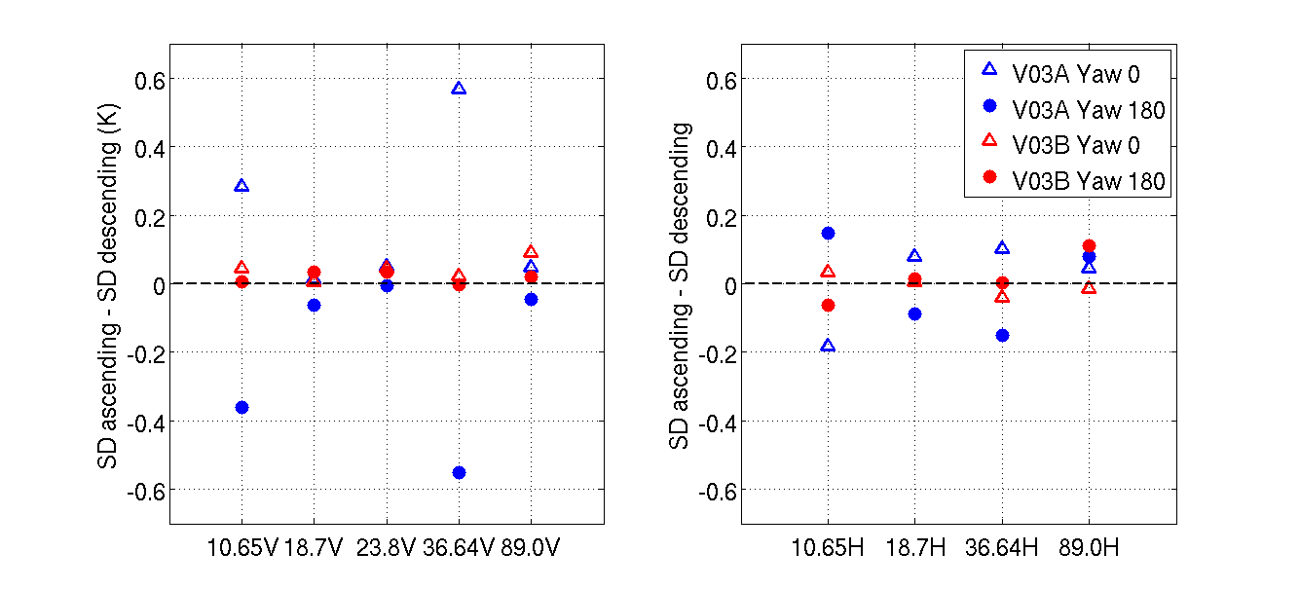
Recent Improvements to GMI Calibration
GMI V03B (red) removes the discrepancy seen in the previous version V03A (blue) with asc/des orbits and yaw orientation. This discrepancy was caused by a magnetic anomaly.

Slide 4
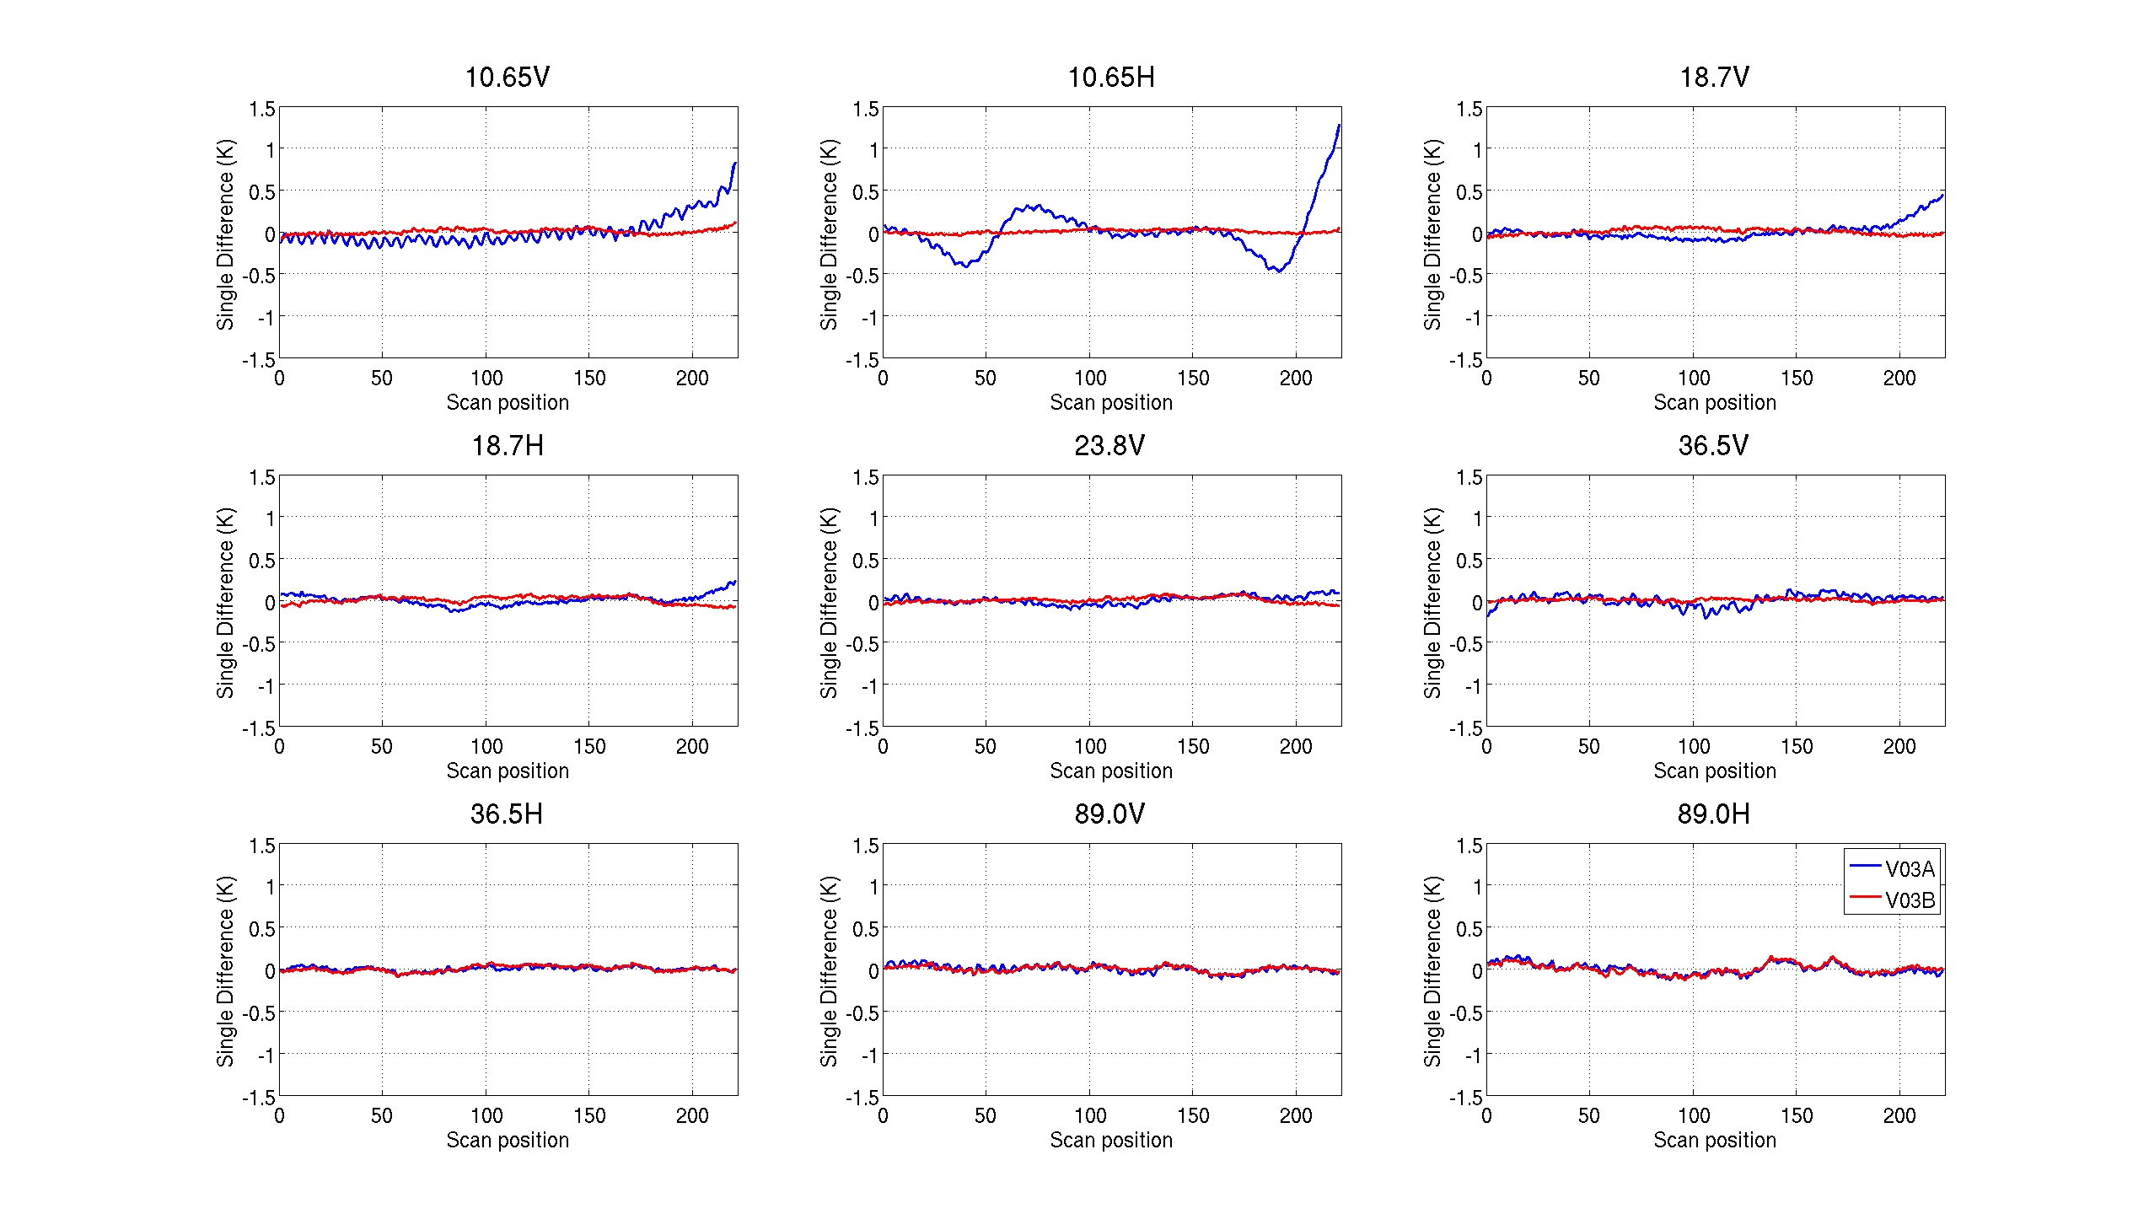
Recent Improvements to GMI Calibration
Along-scan correction for V03B (red) improves scan biases.

Slide 5
GMI – TMI inter-cal: V03A vs. V03B (cold end)
 | 10v | 10h | 18v | 18h | 23v | 36v | 36h | 89v | 89h
V03A DD | 4.2 | 3.2 | 3.3 | 2.9 | 1.9 | 2.3 | 1.1 | 1.2 | 1.1
V03B DD | 4.4 | 3.2 | 3.3 | 3.0 | 1.9 | 2.1 | 0.8 | 1.2 | 1.0
Diff | -0.2 | 0.0 | 0.0 | -0.1 | 0.0 | 0.2 | 0.3 | 0.0 | 0.1
V03B has a fairly small impact on the inter-calibration, since the double difference is an average of the asc/des orbits and yaw orientations.

Slide 6
Future Plans
X-Cal meeting in Orlando, FL, Jan. 28-29
Discuss GMI relative calibration
Sensitivity of inter-calibration to model errors
Continue to monitor and improve GMI calibration
DSC results
Antenna pattern correction
RFI

