Slide 1
The GSICS Procedure for Product Acceptance ( GPPA )- Timeliness
Manik Bali
NCWCP, College Park.
January 20, 2014

Slide 2
Action: GCC to take a lead in discussing the GPPA with GSICS members to reduce the amount of time needed to move through the phases

Slide 3
Challenges
Timeliness [ Manik Bali ]
Submission [ Peter Miu ]

Slide 4
Outline
GPPA Introduction
GPPA and Timeliness
GPPA Time Profile [ In theory ]
GPPA Time Profile [ In reality ]
Proposed solution
Submission Phase
Demo Phase
Pre-Op Phase
Conclusion

Slide 5
GPPA Introduction
GPPA was originally developed by Dr. Bob Iacovazzi@NOAA, following the QA4EO guidelines
The GPPA is the GSICS:
Product developers pathway to obtain a “Stamp of Approval” for a potential product
Data users window to GSICS product quality and “fitness for purpose”
Governing body reference for judging GSICS product fitness
The GPPA defines and documents:
Scope of product within the GSICS product portfolio – correction of level1b data
Theoretical basis, traceability, and implementation and distribution strategy
Product quality (uncertainty, quality indicators, data user’s guide, etc)
The GSICS Product Acceptance Form (GPAF) is available at GSICS wiki
https://gsics.nesdis.noaa.gov/wiki/Development/GppaWorkflow
Credit: F. Yu, R. Iacovazzi

Slide 6
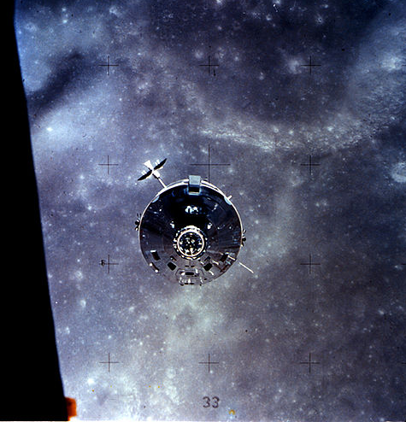
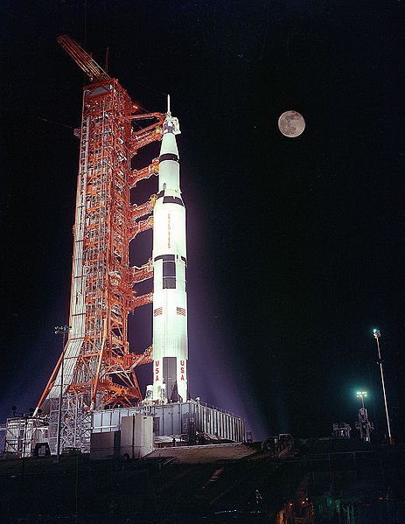
GPPA Introduction
Operational
Phase
Product is fully accepted by GSICS Executive Panel (EP) and maintained within GSICS and
distributed to the public.
Product Logs, Data Usage
Preoperational
Phase
Product version Control Data released with disclaimer
C Operations and distribution plan Data user’s guide T=180 days
Demonstration Phase
Founding concepts Supporting models Data Archived and Free Access
ATBD Peer-Publications Product quality indicator description
Traceability document T=365 days
Submission Phase
Fill out GSICS Product Acceptance Form ( GPAF )

Slide 7
Timeliness- Submission Phase
Goal of this phase
To examine if the product falls within GSICS Scope.
No maturity is assigned.
Fill out Sections I, II, III.1.A.1, and III.1.A.2 of the GSICS Product Acceptance Form (GPAF). Also, fill out Section III.1.B (ATBD) of the GPAF, but during the Submission Phase the ATBD needs only to be a preliminary version. The ATBD could be a journal article, technical memorandum or other documentation of the method used to make the product.
Who: Product provider
Submit the GPAF and preliminary ATBD for review to the GSICS Product Acceptance Team (GPAT) via the GSICS Coordination Center (GCC) Deputy.
Who: Product provider

Slide 8
Timeliness- Submission Phase
Determine if the GPAF is filled out correctly and decide if the product theoretical basis is adequate and the product scope is within the GSICS domain.
Who: GPAT
Due: 6 weeks after the GPAF submission
GPAT feedback given to the Product provider.
Who: GCC Director
Due: 7 weeks from GPAF submission
Upload a sample file to a GSICS data server if GPAT feedback is affirmative.
Who: Product provider, GDWG Chairman
Due: One week after GPAT feedback regarding GPAF form submission
14 W

Slide 9
Timeliness- Submission Phase
Determine if the sample file follows the GSICS netCDF and file naming conventions.
Who: GDWG Chairman
Due: 2 weeks after successful product sample file upload
Remediate any GPAF issues according to the GPAT feedback.
Who: Product provider, GCC Director
Due: Within 20 days after sending GPAT feedback to the Product provider
Once all issues are resolved, the product enters the Demonstration Phase.
Who: GCC Director in consultation with the GPAT
Due: Within 90 days of the GPAF submission
32 W

Slide 10
Timeliness- Demonstration Phase
Goal
Aim is to increase acceptability of the product by implementing feedbacks from users , reviews from reviewers ( GPAT or External ) and adding a measure of product quality to the product.
Notify the Executive Panel about the Product entering Demonstration Phase.
Who: GCC Director
Due: Two weeks after the Product enters Demonstration Phase.
Arrange for routine upload of the Product to a GSICS data server and agree on file retention policy.
Who: GDWG Chair, GRWG Chair, and Product provider
Due: One month after entering the Demonstration phase
Notify GSICS users and invite feedback from them.
Who: GCC Director
Due: As soon as routine upload is completed and the file retention policy is resolved.
38 W
38 W

Slide 11
Complete documents associated with GPAF Sections III.1.B (ATBD) and III.1.C (product traceability to standards) and submit them to the GCC Director.
Who: Product provider
Due: Three months after entering the Demonstration phase
Examine the submitted documents (ATBD and product traceability to standards).
Who: GPAT and product users
Due: One month after GCC received the documents
Remediate any document issues according to the GPAT and user feedback.
Who: Product provider, GCC Director
Due: One month after receiving GPAT feedback
58 W

Slide 12
Complete documents associated with GPAF Sections III.2.A (radiative transfer models) and III.2.B (cal/val supporting measurements).
Who: Product provider
Due: Six months after entering the Demonstration phase
Collect and disseminate user feedback regarding product's data usability and format
Who: Product users, GCC Director
Due: Six months after entering the Demonstration phase
Examine the submitted documents (radiative transfer models and cal/val supporting measurements).
Who: GPAT
Due: One month after GCC received the documents
114 W

Slide 13
Make a consensus decision whether or not to continue the Product acceptance process.
Who: GPAT
Due: Two weeks after the remediation process ends for the documents regarding the radiative transfer models and cal/val supporting measurements
Notify the Executive Panel on the status of the Product's acceptance process.
Who: GCC Director
Due: Two weeks following the GPAT decision on the Product's acceptance process.
118 W
118 W

Slide 14
Complete and submit Section III.3.A (Product quality) of the GPAF.
Who: Product provider
Due: Ten months after entering the Demonstration phase
Examine the submitted Product quality document.
Who: GPAT
Due: One month after GCC receives the document
Remediate any document issues according to the GPAT feedback.
Who: Product provider, GCC Director
Due: One month after receiving GPAT feedback
Once all issues are resolved, the Product enters the Pre-operational Phase.
Who: GCC Director in consultation with the GPAT
Due: Within one year of the product entering the Demonstration Phase
170W

Slide 15
Timeliness- Pre-Operational
Send notification and GPAT Product recommendations to the Executive Panel regarding the Product.
Who: GCC Director
Due: Two weeks after the Product enters the Pre-operational Phase.
Executive Panel review of the GPAT recommendations. Executive Panel feedback regarding the product sent to the GCC Director.
Who: GSICS Executive Panel
Due: Six weeks after being notified
GCC Director notifies the Product provider about the Executive Panel feedback.
Who: GCC Director
Due: Two weeks after receiving feedback from the Executive Panel
180W

Slide 16
Complete documents associated with GPAF Sections III.2.C (Analysis software documentation), III.2.D (Product version control plan), III.3.B (operations and distribution plan), and III.3.C (data user's guide) and submit the documents to the GCC.
Who: Product provider
Due: Three months after entering the Pre-operational phase
Examine the submitted documents (product version control plan, operations and distribution plan, and data user's guide).
Who: GPAT
Due: One month after GCC received the documents
186W

Slide 17
Remediate any documentation and overall product issues following the Executive Panel and GPAT feedback.
Who: Product provider, GCC Director
Due: One month after receiving feedback
GPAT reviews the remediation material and decides if the requirements are now satisfied. Sends final recommendation to the GCC Director.
Who: GPAT and GCC Director
Due: Thee weeks following conclusion of the document remediation period.
GCC Director notifies the Executive Panel that the product has satisfied all the requirements for entering the Operational Phase.
Who: GCC Director
Due: One week following the GPAT review
194W

Slide 18
GPPA Time Profile
Submission Phase 32 W
Demo Phase 138 W
Pre-Op Phase 24 W
Time taken by Individual Tasks
Feedback from GPAT [T=~ 26 W], Reason cited ..review too demanding, not aligned with local work member needs to spend extra hours.
Go ahead from EP members [Not all EP members reply T= Indeterminate]
Time accumulated at the end of the author of the product to make suggested changes ( eg. product quality stage ~10 months, Uncertainty, hosting data* ) .
Prior to submission ( ~ 1- 2 Yrs )

Slide 19
Total Time
If all works perfectly
Total Time = 194 Weeks ~ 3.7 Yrs for the product to transition to Op state.
Add 1.5 yrs , time spent prior to submission , get papers published
Total Time ~ 3.7+1.5 = 5.2 Yrs
It is envisaged that by the time product attains full maturity significant life of reference instrument is spent.

Slide 20
Exempt Clause-Alternative to GPAT
This clause attempts to save time in case of a delayed response from GPAT
1. If insufficient feedback is received from the beta-testers( reviewers) outside the GSICS algorithm development community during one year test period, GCC will make the suggestion to the EP based on the GPAT's review comments. The product provider(s) should systematically seek external feedback.
2. In case of incomplete documentation that are not considered to jeopardize product quality, GCC will make the suggestion to the EP based on the GPAT and users‘ feedback. However, all the required documentations shall be completed and submitted for review purpose in the pre-operational phase.
But feedback from users (external) difficult to get.

Slide 21
Proposed solutions
Any alternate pathways need to
Preserve the inheritance from the QA4EO
Align with maturity index of member agency ( ensures minimal extra work to satisfy GPPA)
Parallelize and Optimize the processes in GPPA

Slide 22
Submission Phase
Overlap (Parallelize )- publication with NRT monitoring and pursue long term quality monitoring. Include this as part of submission.
Product falls within the scope of GSICS.
Product is distributed freely.
Product is monitored in RAC/NRT via a website/tool and a clear plan to monitor the bias in a long term. [Expected time is 3-6 Mo]
An article which clearly explains the product concept, usage is accepted in the GSICS Quarterly.
A preliminary version of the user guide and ATBD is distributed.
A clear plan of usage of the product at least by the producer is stated.
A clear plan of maturity to be applied at the end of the producer is stated .
Producer is encouraged to follow CF-1.5 or higher meta data conventions and GSICS file naming conventions[ not a denying criterion] .
Evidences are provided to GRWG, GDWG Chair and Subgroup Chair via the GCC.
Upon their recommendation, Product is accepted in GSICS and assigned Demo maturity . GSICS product catalog provides link to data and documents related to the product .
Encourages worldwide usage of the Product.
Product is accepted by GSICS [ No maturity assinged Rename as Acceptance Phase*** ]
Envisaged time save < 1 Yr

Slide 23
Demo Phase
Author wishes to attain GSICS maturity and follow GSICS stated ( Metadata, Filenaming conventions etc) .
Complete documents associated with GPAF Sections III.2.A (radiative transfer models) and III.2.B (cal/val supporting measurements).
Who: Product provider
Due: Six months after entering the Demonstration phase
Examine the submitted Product quality document. ***
Who: GPAT
Due: One month after GCC receives the document
Collect and disseminate user feedback regarding product's data usability and format
Who: Product users, GCC Director
Due: Six months after entering the Demonstration phase
Can run parallel with previous submission phase since Product already on display and publicly available.
** Apply Except Clause in case of delay.
Complete and submit Section III.3.A (Product quality) of the GPAF.
Who: Product provider
Due: Ten months after entering the Demonstration phase
Expected Time saved ~ 10 Mo

Slide 24
Pre-operational ( T~ 24 W)
Optimize
Apply the except clause during the review process.
Expected Time saved ~ 4-8 W

Slide 25
Conclusion
Timeliness of the GPPA has been evaluated.
A strategy of Parallelization and Optimization has been presented to speed up the acceptance and maturity of products in the GPPA.
It is envisaged that the new strategy would save 30% of the time.
This would allow the products to remain aligned to the goals of their respective agencies and at the same time included into GSICS.

Slide 26
THANK YOU

Slide 27
GPRC Centers
GSICS Members
WMO
ROSHYDRO
EUMETSAT
CNES
KMAA
USGS/NOAA
NASA/NIST
KMA
CMA
JMA/JAXA
IMD/ISRO
Obs. ESA + CEOS
ASSO. GPX
14 Members Worldwide

Slide 28
THANK YOU

Slide 29
Backup slides

Slide 30
NOAA NCDC Maturity Matrix
Maturity | Software Readiness | Metadata | Documentation | Product Validation | Public Access | Utility
1 | Conceptual development | Little or none | Draft Climate Algorithm Theoretical Basis Document (C-ATBD); paper on algorithm submitted | Little or None | Restricted to a select few | Little or none
2 | Significant code changes expected | Research grade | C-ATBD Version 1+ ; paper on algorithm reviewed | Minimal | Limited data availability to develop familiarity | Limited or ongoing
3 | Moderate code changes expected | Research grade; Meets int'l standards: ISO or FGDC for collection; netCDF for file | Public C-ATBD; Peer-reviewed publication on algorithm | Uncertainty estimated for select locations/times | Data and source code archived and available; caveats required for use. | Assessments have demonstrated positive value.
4 | Some code changes expected | Exists at file and collection level. Stable. Allows provenance tracking and reproducibility of dataset. Meets international standards for dataset | Public C-ATBD; Draft Operational Algorithm Description (OAD); Peer-reviewed publication on algorithm; paper on product submitted | Uncertainty estimated over widely distributed times/location by multiple investigators; Differences understood. | Data and source code archived and publicly available; uncertainty estimates provided; Known issues public | May be used in applications; assessments demonstrating positive value.
5 | Minimal code changes expected; Stable, portable and reproducible | Complete at file and collection level. Stable. Allows provenance tracking and reproducibility of dataset. Meets international standards for dataset | Public C-ATBD, Review version of OAD, Peer-reviewed publications on algorithm and product | Consistent uncertainties estimated over most environmental conditions by multiple investigators | Record is archived and publicly available with associated uncertainty estimate; Known issues public. Periodically updated | May be used in applications by other investigators; assessments demonstrating positive value
6 | No code changes expected; Stable and reproducible; portable and operationally efficient | Updated and complete at file and collection level. Stable. Allows provenance tracking and reproducibility of dataset. Meets current international standards for dataset | Public C-ATBD and OAD; Multiple peer-reviewed publications on algortihm and product | Observation strategy designed to reveal systematic errors through independent cross-checks, open inspection, and continuous interrogation; quantified errors | Record is publicly available from Long-Term archive; Regularly updated | Used in published applications; may be used by industry; assessments demonstrating positive value
Salient Features
Stability in source code that meets certain coding standards.
Metadata that meets NOAA-recommended standards for collection-level and NCDC CDRP-recommended NetCDF Climate and Forecast (CF)-compliant attributes for file-level metadata
Availability of documentation including a Climate Algorithm Theoretical Basic Document (CATBD) that describes the algorithm and process steps in detail, Publically available data and source code for transparency and traceability of the algorithm and processing.
Another integral part of CDR readiness is examining the maturity of the algorithms and application of the product in peer-reviewed publications.
Peng, G., W. Meier, D. Scott, and M. Savoie. 2013. A long-term and reproducible passive microwave sea ice concentration data record for climate studies and monitoring. Earth Syst. Sci. Data 5: 311-318. http://dx.doi.org/10.5194/essd-5-311-2013.
1 & 2 | Research
3 & 4 | IOC
5 & 6 | FOC
Aims to assign maturity when climate products transitioned from Research to Operations
Bates, J. J. and J. L.Privette, (2012), A maturity model for assessing the completeness of climate data records, Eos Trans. AGU, 93(44), 441

Slide 32
GSICS Introduction
GSICS Members
WMO
ROSHYDRO
EUMETSAT
CNES
KMAA
USGS/NOAA
NASA/NIST
KMA
CMA
JMA/JAXA
IMD/ISRO
Obs. ESA + CEOS
ASSO. GPX
14 Members Worldwide

Slide 33
GSICS Coordination Center, NOAA
GSICS Product Promotion
GCC established a broad based panel of reviewers.
GCC ensures that each product follows the GSICS Procedure for Product Acceptance (GPPA)
Reviewers of GSICS product and Newsletter articles receive letter of appreciation from WMO.

Slide 34
Conclusions
GSICS distributes 37 Cross Calibration products in VIS and IR bands online, via product catalog
Application of products have a positive impact on measured TOA radiances and downstream products ( eg. Level 1 ,SST).
GCC publishes Newsletter brand new format , with a doi number
GCC awards certificate of appreciation backed by WMO.
GSICS Users Workshop to be held in Shanghai Nov 19-21 ,2014

Slide 35
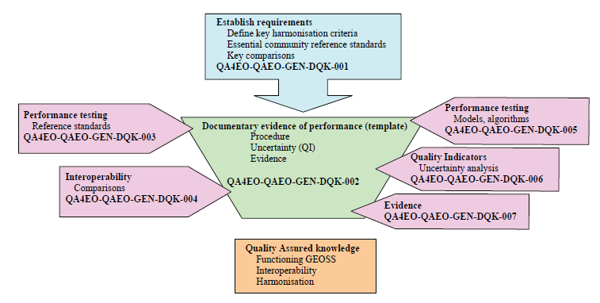
QA4EO - Guidelines
The GSICS Procedure for Product Acceptance (GPPA)
“
The Quality Assurance Framework for Earth Observation consist of ten distinct guidelines linked in the Guidelines Framework
“
Guidelines address
Quality Indicators
Traceability
Reference (measurement)Standard
Uncertainty
Ref: QA4EO The Guide

Slide 36
The GSICS Procedure for Product Acceptance (GPPA)
QA4EO – GPPA Connection

Slide 37
Four Product Phases
GPPA Description
Data Producer
(GPAF)
Data
Reviewer
(GPERF)
Data User
( GPERF)
GSICS Executive Panel
Submission Phase
Demonstration Phase
Pre-operational Phase
Operational Phase
GPPA
Guiding Principal
Credit: F. Yu, R. Iacovazzi

Slide 38
GPPA: Submission Phase
GPPA Description
Data provider is requested to fill out a GSICS Product Acceptance Form ( GPAF ) and provide supporting documents
This form requires…
Information about the provider and nature of the distribution.
Contains a checklist of required supporting docs


Slide 39
GPPA Maturity –Submission Phase
GPPA Description
Documents provided to GPRC Rep, GRWG and GDWG Chairs, GCC Dir and Product Users and reviewers
GPERF given to GPAT members
Submission Phase
Fill out GSICS Product Acceptance Form ( GPAF )

Slide 40
GPPA Maturity-Demonstration Phase
GPPA Description
Demonstration Phase
Founding concepts Supporting models Data Archived and Free Access
ATBD Peer-Publications Product quality indicator description
Traceability document T=365 days
Submission Phase
Fill out GSICS Product Acceptance Form ( GPAF )
Documents provided to GPRC Rep, GRWG and GDWG Chairs, GCC Dir and Product Users reviewers

Slide 41
GPPA Maturity-Preoperational Phase
GPPA Description
Preoperational
Phase
Product version Control Data released with disclaimer
C Operations and distribution plan Data user’s guide T=180 days
Demonstration Phase
Founding concepts Supporting models Data Archived and Free Access
ATBD Peer-Publications Product quality indicator description
Traceability document T=365 days
Submission Phase
Fill out GSICS Product Acceptance Form ( GPAF )
Documents provided to GPRC Rep, GRWG and GDWG Chairs, GCC Dir and Product Users and reviewers

Slide 42
GPPA - Adaptability
GPPA Description
GPPA Exempt Clauses from Demo to Pre-Operational Phase
If insufficient feedback is received from the beta-testers outside the GSICS algorithm development community during one year test period, GCC will make the suggestion to the EP based on the GPAT's review comments. The product provider(s) should systematically seek external feedback.
In case of incomplete documentation that are not considered to jeopardize product quality, GCC will make the suggestion to the EP based on the GPAT and users‘ feedback. However, all the required documentations shall be completed and submitted for review purpose in the pre-operational phase.
Potential to save review time.

Slide 43
NCDC Maturity Index
6
No Code Changes expected Data Archived, long term and Free Access
C ATBD Peer-Publications Metadata with data file. reproducibility
Strategy designed to reveal systematic errors, Data may be used
Salient Features
Stability in source code that meets certain coding standards.
Metadata that meets NOAA-recommended standards for collection-level and NCDC CDRP-recommended NetCDF Climate and Forecast (CF)-compliant attributes for file-level metadata
Availability of documentation including a Climate Algorithm Theoretical Basic Document (CATBD) that describes the algorithm and process steps in detail, Publically available data and source code for transparency and traceability of the algorithm and processing.
Another integral part of CDR readiness is examining the maturity of the algorithms and application of the product in peer-reviewed publications.
Peng, G., W. Meier, D. Scott, and M. Savoie. 2013. A long-term and reproducible passive microwave sea ice concentration data record for climate studies and monitoring. Earth Syst. Sci. Data 5: 311-318. http://dx.doi.org/10.5194/essd-5-311-2013.
5
Minimal Code Changes expected Data Archived and Free Access
C ATBD Peer-Publications Metadata with data file. reproducibility
Wide Uncertainty Analysis (investigators. Space & Time), Data may be used
4
Some Code Changes expected Data Archived and Free Access
ATBD Peer-Publications Metadata with data file. reproducibility
Wide Uncertainty Analysis ( Space & Time) Data may be used
3
Moderate Code Changes expected Free Access
C ATBD Peer-Publications Meets Intl. Standards
Limited Uncertainty Analysis and Use of data
2
Code Changes expected Restricted Access
C ATBD rev-Publications Research Grade S
Simple Validation
1
Conceptualization Restricted Access
Draft ATBD sub- Publications Little Meta Data
Un validated Product

Slide 44
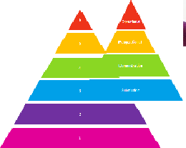
GPPA Vs NCDC Maturity Matrix
NCDC Maturity Matrix | GPPA
Climate Product Specific ( Six maturity Levels) | Calibration Specific (Three steps: Demo Pre-Op, Op)
Stability in Coding Standards. | Not very stringent. Focuses on the results calculated by the code.
Needs a comprehensive ATBD. | Needs ATBD ( with publication list), User Guide, Uncertainty Analysis etc.
More stress on ensuring accuracy and stability of product ( would clarify further) | Rigorous product review process includes User feedback and review from international partners ( i.e GPATs)
Product generally take 12 months for each stage ~ 6 Yrs | Product can attain max maturity in 18 Months in theory – longer in practice

Slide 45
Conclusion
A Comprehensive GSICS Procedure for Product Acceptance has been derived from QA4EO and applied to 37 GSICS products.
GPPA has helped in creation of high level quality management system and…
Encourages Collaborative ATBD with minimal requirement of additional resources.
Adoption of file format, file naming, parameter naming convention.
Helps in formation of Cal/Val plans and pre-launch test best practice guidelines .
The NCDC Maturity Matrix is extremely comprehensive and tuned for CDR’s and TCDR’s while GPPA is applicable to calibration corrections as input for such CDRs

