Slide 1
Introduction to Mini Conference & GSICS
Special Issue of the IEEE TGRS on “Inter-Calibration of Satellite Instruments”:
Special Issue of the IEEE TGRS on “Inter-Calibration of Satellite Instruments”:
Tim Hewison
(EUMETSAT) (GRWG Chair)

Slide 2
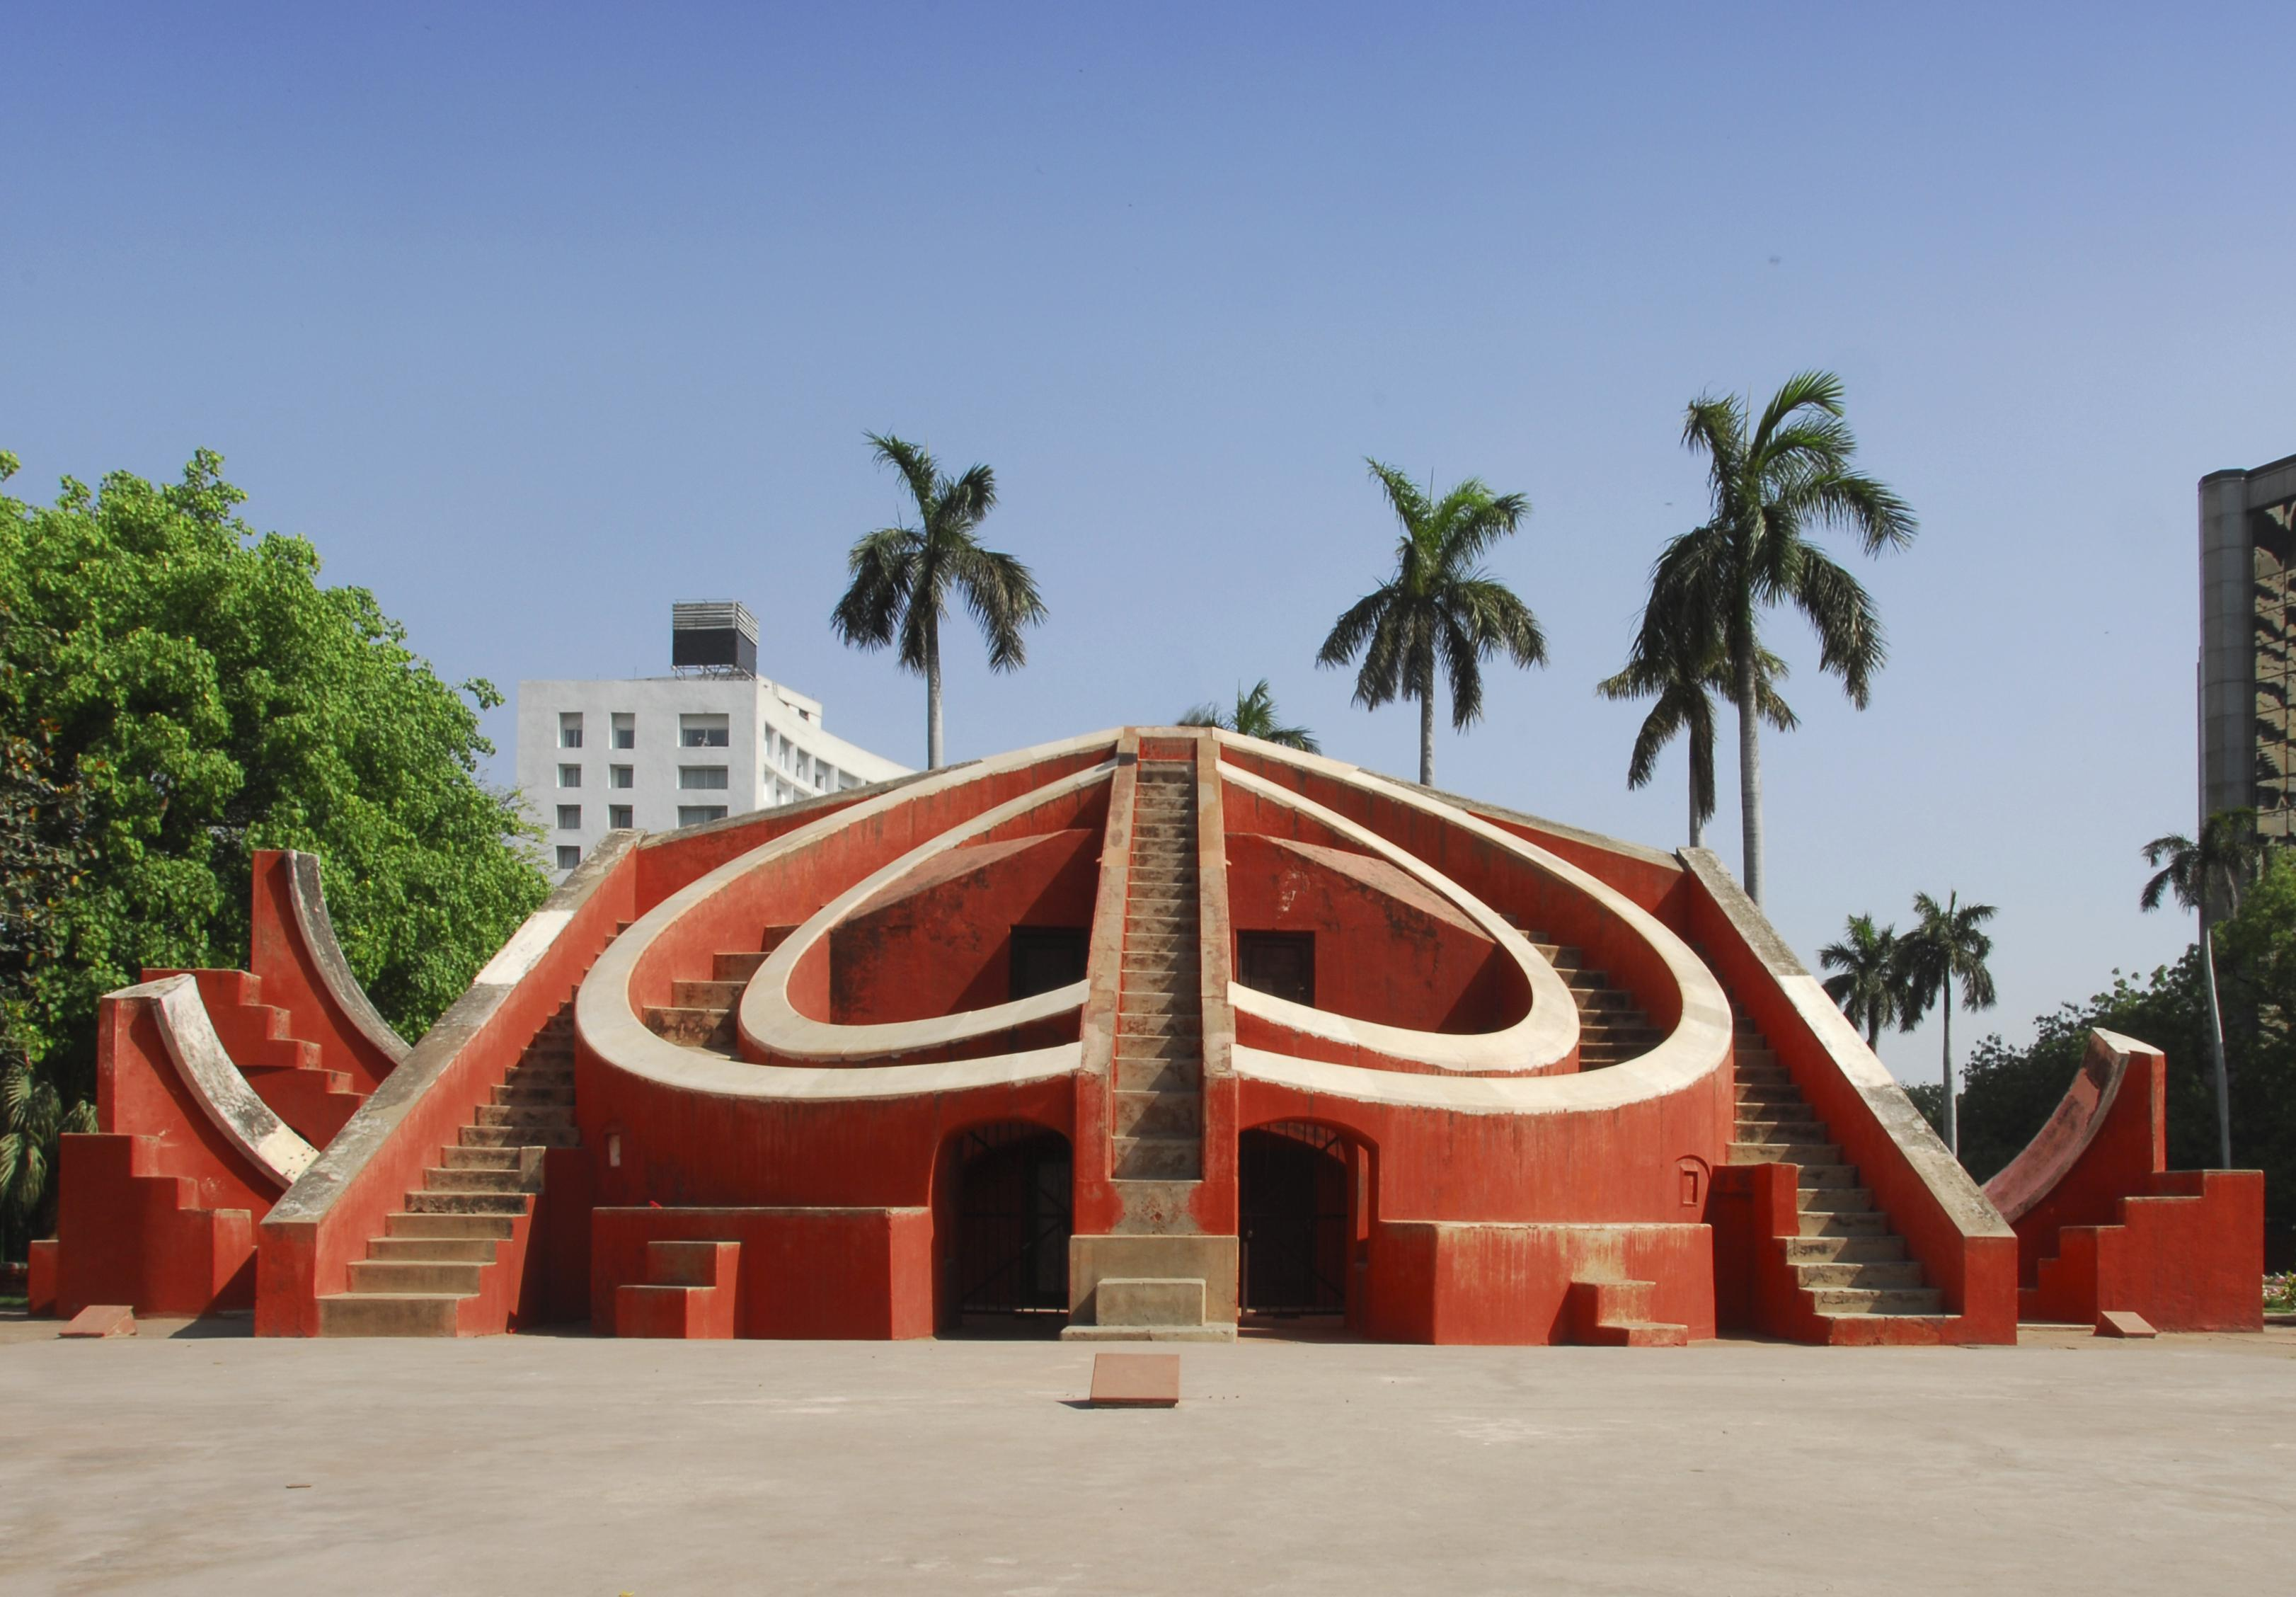
300 years of Observations to help forecasting

Slide 3
Global Space-based Inter-Calibration System
What is GSICS?
Global Space-based Inter-Calibration System
Initiative of CGMS and WMO
Effort to produce consistent, well-calibrated data from the international constellation of Earth Observing satellites
What are the basic strategies of GSICS?
Improve on-orbit calibration by developing an integrated inter-comparison system
Initially for GEO-LEO Inter-satellite calibration
Being extended to LEO-LEO
Using external references as necessary
Best practices for calibration & characterisation
This will allow us to:
Improve consistency between instruments
Reduce bias in Level 1 and 2 products
Provide traceability of measurements
Retrospectively re-calibrate archive data
Better specify future instruments
EUMETSAT | CNES | JMA
NOAA | CMA | KMA
ISRO | NASA | WMO
USGS | NIST | JAXA
ROSHYDROMET | IMD | ESA
Notes:
3
Well, what is GSICS?
The Global Space-based Inter-Calibration System (GSICS) is an initiative of CGMS and WMO, which aims to ensure consistent calibration and inter-calibration of operational meteorological satellite instruments.
One of the basic strategies of GSICS is to develop an integrated on-orbit cal/val system - initially by LEO-GEO Inter-satellite/inter-sensor calibration.
This will then allow us to provide corrections to improve the consistency between instruments, produce less biased level 1, and therefore, level 2 data, and ultimately, retrospectively re-calibrate archive data, which is of great interest in the climate monitoring community

Slide 4
GSICS Principles
Systematic generation of inter-calibration products
for Level 1 data from satellite sensors
to compare, monitor and correct the calibration of monitored instruments to community references
by generating calibration corrections on a routine operational basis
with specified uncertainties
through well-documented, peer-reviewed procedures
based on various techniques to ensure consistent and robust results
Delivery to users
Free and open access
Adopting community standards
To promote
Greater understanding of instruments’ absolute calibration, by analysing the root causes of biases
More accurate and more globally consistent retrieved L2 products
Inter-operability for more accurate environmental, climate and weather forecasting products
TRACEABILITY / UNBROKEN CHAINS OF COMPARISONS

Slide 5
GSICS Organisation
CGMS
WMO
GSICS Exec Panel
GSICS Coordination Center
GSICS Research Working Group
GSICS Data Working Group
VIS/NIR Sub-Group
Microwave Sub-Group
UV Sub-Group
IR Sub-Group
WGCV MWSG
GPM X-CAL
WGCV ACSG
CEOS ACC
WGCV IVOS

Slide 6
GSICS User Community
Satellite Operators
To improve the calibration of Earth-observing satellite instruments
Prelaunch instrument characterization guidelines
Cal/Val Plans
Best practices for instrument monitoring and improved calibration
Satellite Application Community
CDR generation for climate monitoring “SCOPE-CM” framework, national/international programs
Reanalysis community for climate modelling (ECMWF reanalysis – 2012/15)
Operational NWP: direct radiance assimilation
Other users interested in accurate/consistent calibration to generate stable (composite) L2 quantitative products or imagery

Slide 7
GSICS Product Types
GSICS Bias Monitoring
Routine comparisons of satellite radiances against reference
GSICS Correction
Function to correct issued radiances for consistent calibration with reference
GSICS Calibration
Alternative Calibration Coefficients = operational calibration + inter-calibration corrections
GSICS Reports & Guidelines
Recommendations to modify processing/practices
Design and Operation of future satellite instruments
For Operational Environmental Satellites
✓ Infra-red recalibration (GEO and LEO) ✓ Pre-Operational & Demo status
(current operational satellites) ✓ Near real-time and re-analysis
✓ Visible and near-infrared recalibration (GEO and LEO) ✓ In development within GSICS
✓ Microwave – Conical & Cross-track Scanners (LEO) ✓ In development with GPM XCAL
✓ Historic Instruments ✓ In development for SCOPE-CM

Slide 8
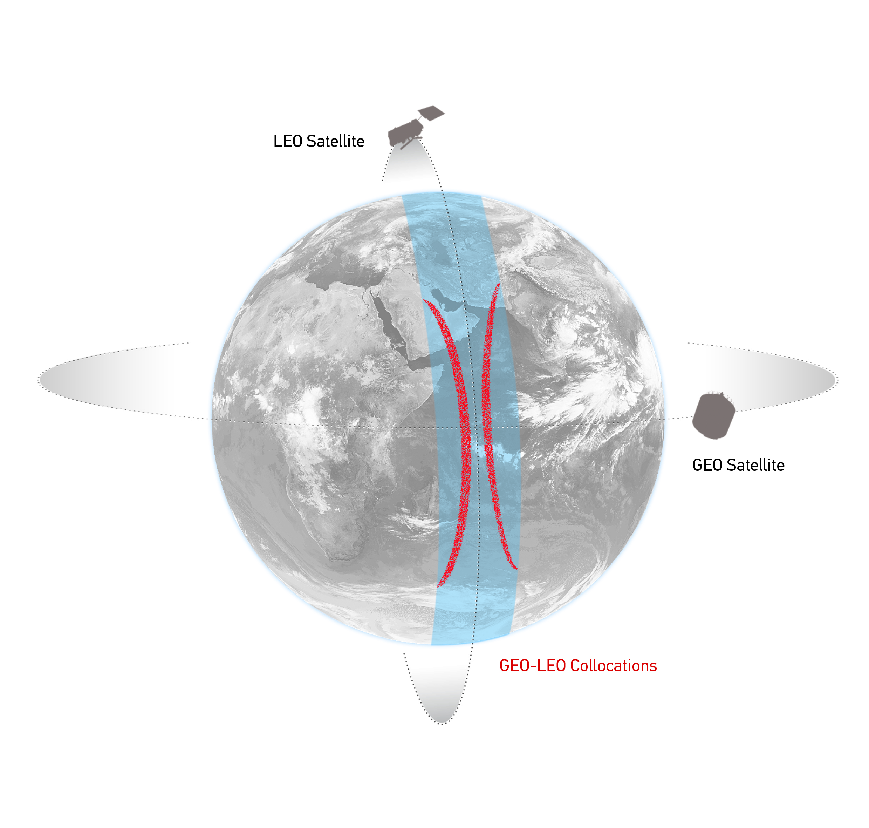
GEO-LEO IR - Hyperspectral SNO
Simultaneous near-Nadir Overpasses
of GEO imager and LEO sounder
Select Collocations
Spatial, temporal and geometric thresholds
Schematic illustration of the geostationary orbit (GEO) and polar low Earth orbit (LEO) satellites and distribution of their collocated observations.

Slide 9
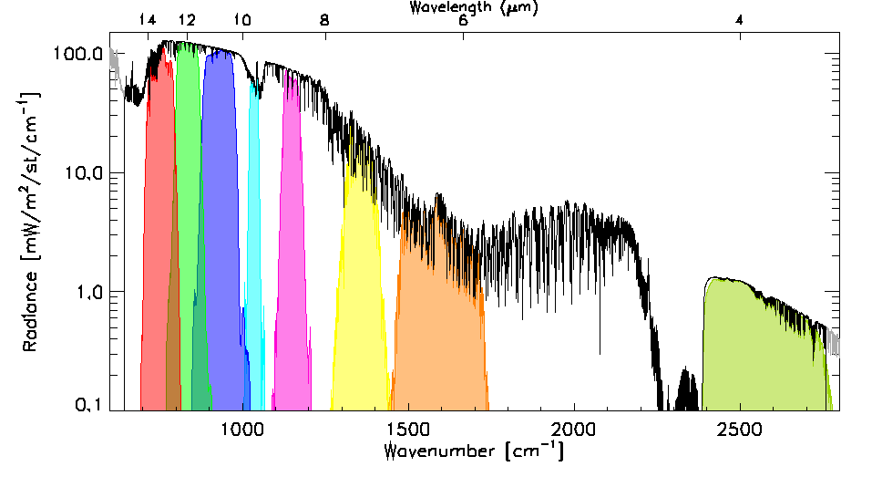
GEO-LEO IR - Hyperspectral SNO
Simultaneous near-Nadir Overpasses
of GEO imager and LEO sounder
Select Collocations
Spatial, temporal and geometric thresholds
Spectral Convolution:
Convolve LEO Radiance Spectra with GEO Spectral Response Functions
to synthesise radiance in GEO channels
Example radiance spectra measured by IASI (black), convolved with the Spectral Response Functions of SEVIRI channels 3-11 from right to left (colored shaded areas).

Slide 10
GEO-LEO IR - Hyperspectral SNO
Simultaneous near-Nadir Overpasses
of GEO imager and LEO sounder
Select Collocations
Spatial, temporal and geometric thresholds
Spectral Convolution:
Convolve LEO Radiance Spectra with GEO Spectral Response Functions
to synthesise radiance in GEO channels
Spatial Averaging
Average GEO pixels in each LEO FoV
Standard Deviation of GEO pixels as weight
LEO FoV~10km
~ 3x3 GEO pixels
Illustration of spatial transformation. Small circles represent the GEO FoVs and the two large circles represent the LEO FoV for the extreme cases of FY2-IASI, where nxm=3x3 and SEVIRI-IASI, where nxm=5x5.

Slide 11
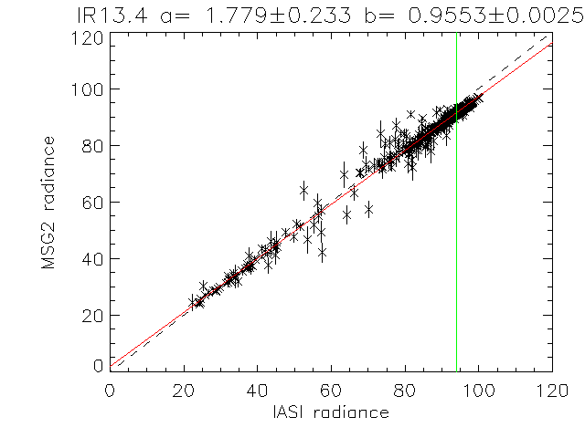
GEO-LEO IR - Hyperspectral SNO
Simultaneous near-Nadir Overpasses
of GEO imager and LEO sounder
Select Collocations
Spatial, temporal and geometric thresholds
Spectral Convolution:
Convolve LEO Radiance Spectra with GEO Spectral Response Functions
to synthesise radiance in GEO channels
Spatial Averaging
Average GEO pixels in each LEO FoV
Standard Deviation of GEO pixels as weight
Weighted Regression of LEO v GEO rads
Evaluate Bias for Standard Radiance Scene
Weighted linear regression of L_{GEO|REF} and <L_{GEO}> for Meteosat-9 13.4μm channel based on single overpass of IASI

Slide 12
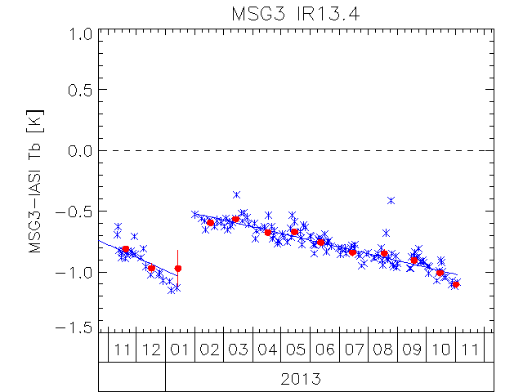
GEO-LEO IR - Hyperspectral SNO
Simultaneous near-Nadir Overpasses
of GEO imager and LEO sounder
Select Collocations
Spatial, temporal and geometric thresholds
Spectral Convolution:
Convolve LEO Radiance Spectra with GEO Spectral Response Functions
to synthesise radiance in GEO channels
Spatial Averaging
Average GEO pixels in each LEO FoV
Standard Deviation of GEO pixels as weight
Weighted Regression of LEO v GEO rads
Evaluate Bias for Standard Radiance Scene
Plot time series of Bias
Time Series of Bias from inter-calibration of 13.4μm channel of Meteosat-10/SEVIRI with Metop-A/IASI
expressed in Brightness Temperature Bias for Standard Scene Radiance
Blue x = Daily Result, Blue Line=trend
Red dot = Monthly Average

Slide 13
GSICS GEO-LEO IR Product Status 2015-03
GPRC | Monitored Instrument | Reference Instrument | GSICS NRT Correction | GSICS Re-Analysis Correction | GSICS Bias Monitoring
EUMETSAT | Meteosat-8 – 10 } Meteosat-7 | Metop-A/IASI | Demo/Pre-operational | Demo/Pre-operational | Plots RAC
JMA | MTSAT-1R } MTSAT-2 } | IASI (+ AIRS) | Demonstration | Demo | Plots RAC?
NOAA | GOES-13 & -15 Imager GOES-11 & -12 Imager | IASI (+ AIRS) | Pre-op | Pre-op Demo | Prototype
 | GOES Sounder | IASI (+ AIRS) | Development | Development | In development
CMA | FY2C – E | IASI (+ AIRS) | Development | Development | Prototype
KMA | COMS-1 | IASI | Prototype | Prototype
ISRO | INSAT-3D | IASI | Prototype | Prototype
Full GSICS Product Catalog available at http://www.star.nesdis.noaa.gov/smcd/GCC/ProductCatalog.php

Slide 14
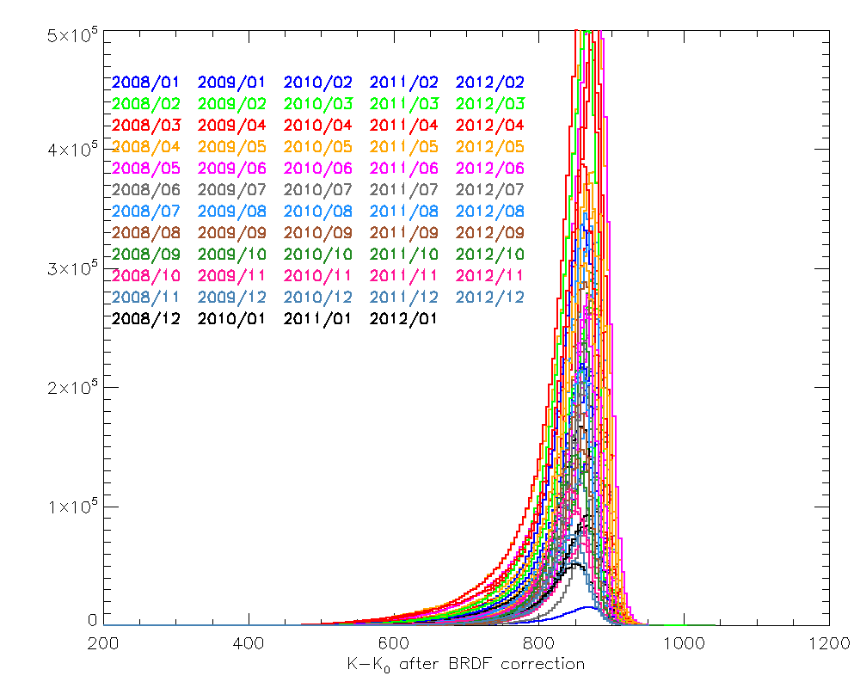
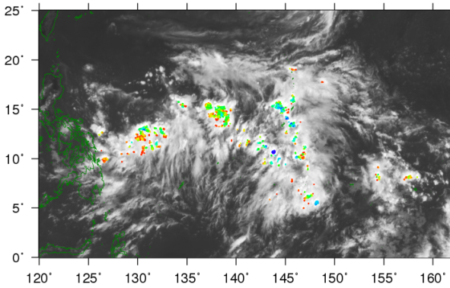
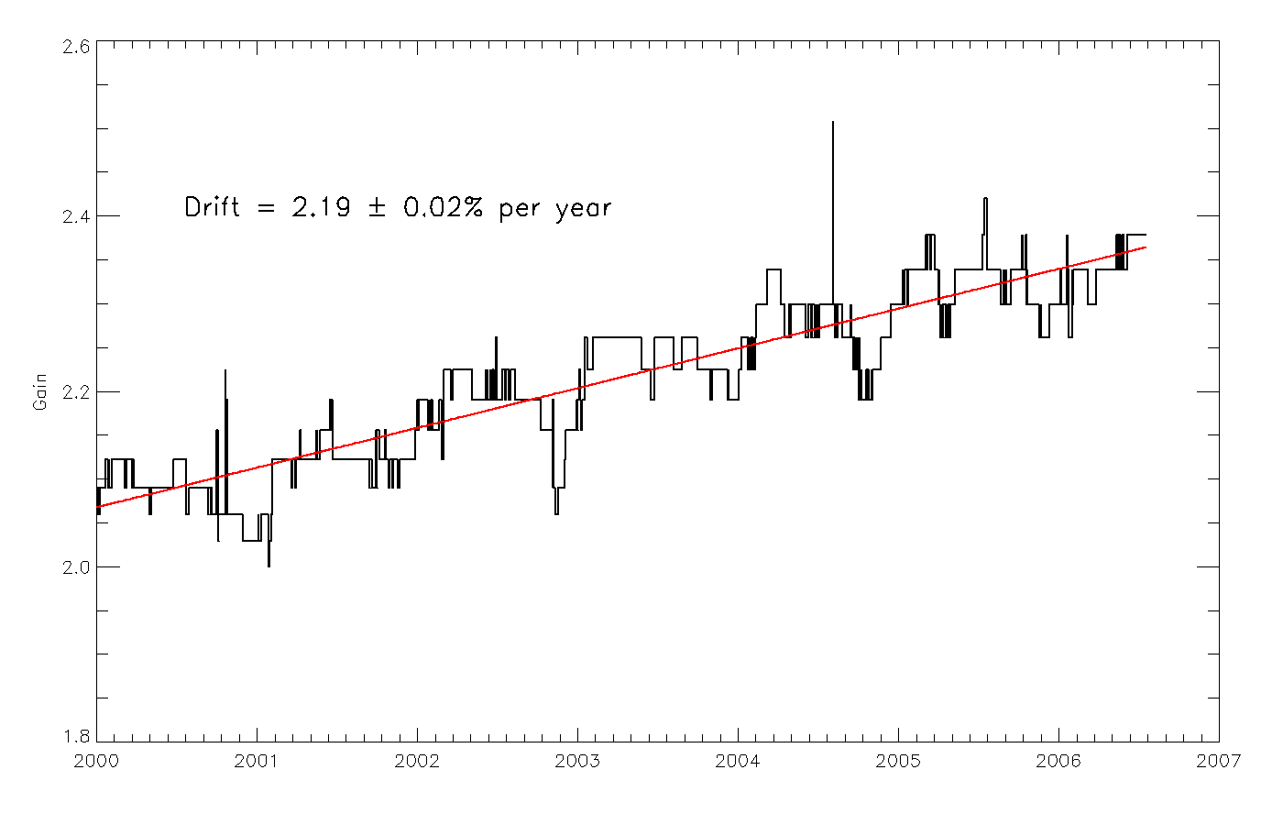
GEO-LEO VIS - Deep Convective Clouds (DCCs)
Bright, natural solar diffusers
Near Top Of Atmosphere
Little water vapour, aerosol
Globally available
In Equatorial Band
Use as Pseudo Invariant Targets
to transfer calibration MODIS->GEO
Select coldest, brightest pixels
Identify using T_{IR} threshold
Homogeneity Tests
Limit viewing and solar geometry & Normalise
Build up monthly PDF statistics
Compare mode/mean with ref obs
Derive Calibration Coefficients
Seasonal and Land/Sea Variations
MTSAT-2 DCC detection 2012-07-01T04
10.8μm TB [K]
Gains for Meteosat-7/VIS using Aqua/MODIS Reference via DCCs

Slide 15
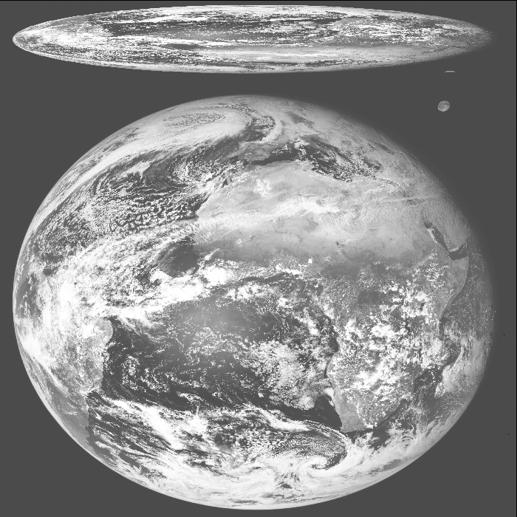
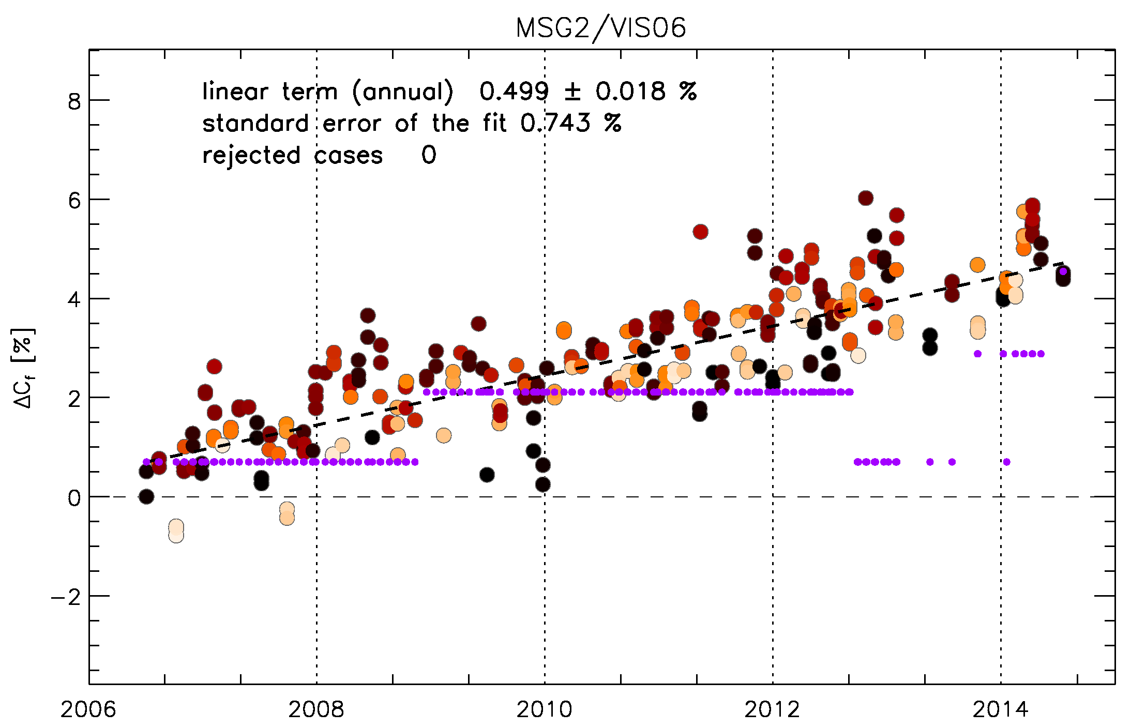
GEO-LEO VIS/NIR - The Moon
Dark, natural solar diffuser
No kind of atmosphere
Extremely stable
Can apply retrospectively to generate FCDRs
Globally available
Select pixels of Moon
Applying threshold to IR image
Calculate integrated irradiance
Compare with model
ROLO developed by USGS
<1% relative uncertainty
Applicable to full Reflected Solar Band
Use as Pseudo Invariant Targets
to transfer calibration MODIS->GEO
Lunar Calibration Workshop
at EUMETSAT, 1-4 December 2014
SEVIRI L1.0 image
Meteosat-9/VIS06 Bias Change
wrt ROLO Model Lunar Irradiance
(after phase angle correction)

Slide 16
GSICS Procedure for Product Acceptance
Based on QA4EO
Products progress from
Demonstration Mode
Through
Pre-Operational Mode
To
Operational Mode
By a series of reviews
Over period of ~1.5yr
Subject to meeting acceptance criteria

Slide 17
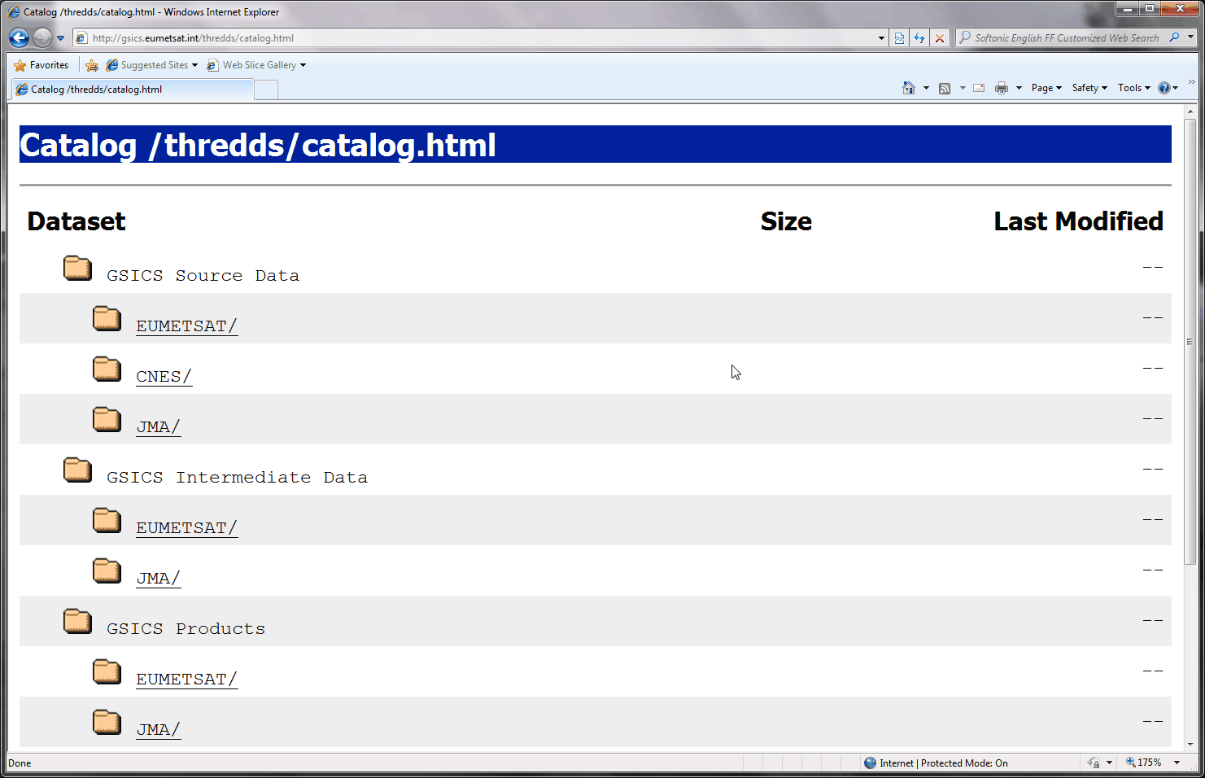
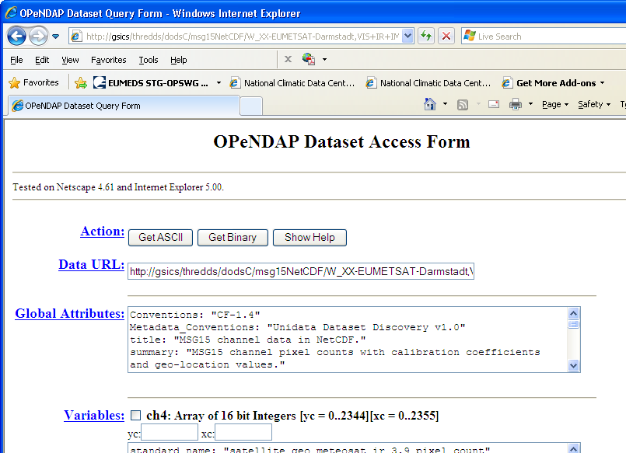
Where to get the data?
GSICS Bias Monitoring
Hosted on websites of GSICS Processing & Research Centres (GPRCs)
http://gsics.tools.eumetsat.int/plotter/
GSICS Corrections
− GSICS Data & Products Servers
− THREDDS-based system
− NetCDF format
− WMO GTS standard file names
− Unidata & CF conventions
See gsics.wmo.int for links
GTS = Global Telecommunication System
CF = Climate and Forecast

Slide 18
Conclusions
GSICS is maturing into a system for generating inter-calibration products
suitable for integrating into operational processing
First products soon to be declared operational
Continuing to develop new inter-calibration products
While cooperating with related activities
To integrate GSICS into WIGOS
To support Architecture for Climate Monitoring from Space
Today: Examples of potential future activities & interactions
Rest of the Week: Focusing on the development of GSICS products

Slide 19
Thank You
Notes:
19

Slide 20
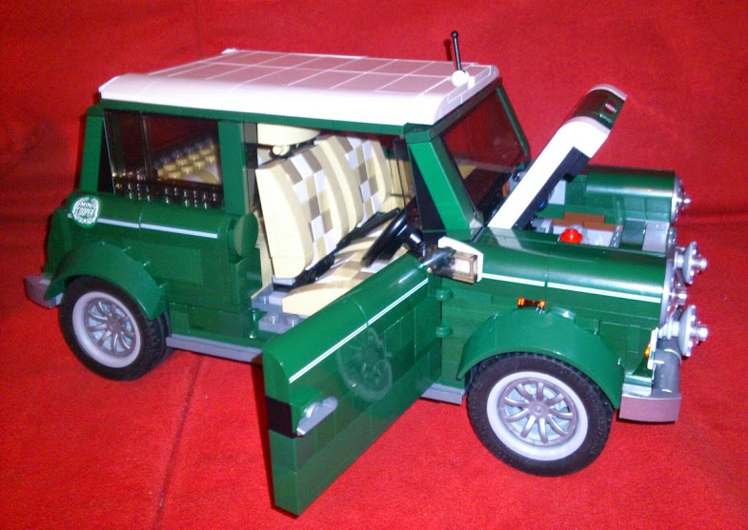
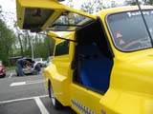
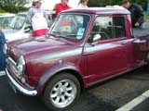
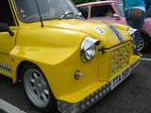
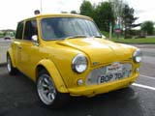
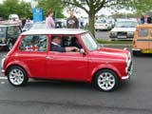
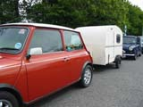
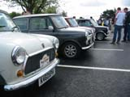
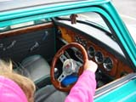
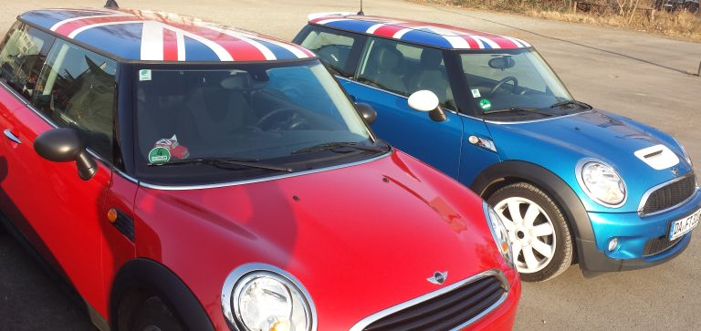
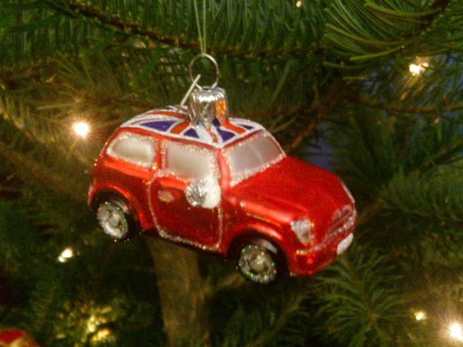
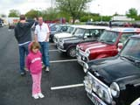
Not that sort of Mini Conference ☹

Slide 21
Agenda for GSICS Mini Conference
11:20 | Tim Hewison | EUMETSAT | Introduction to Mini Conference & GSICS | 1a | 0:20
11:40 | Jerome Lafeuille | WMO | WMO's commitment to GSICS | 1b | 0:20
12:00 | B.Wielicki/D.Doelling | NASA | CLARREO update | 1c | 0:20
12:20 | Xiuqing ("Scott") Hu | CMA | SI-traceable demo instrument for FY-3 | 1d | 0:20
12:40 | Rob Roebeling | EUMETSAT | Inter-calibrating Meteosats-HIRS/AIRS/IASI | 1e | 0:20
13:00 | Lunch Break |  |  |  | 1:00
14:00 | Hidehiko Murata | JMA | Himawari-8 Update | 1f | 0:20
14:20 | Fred Wu | NOAA | JMA-NESDIS collaboration on Himawari | 1g | 0:20
14:40 | Denis Jouglet | CNES | Comparison of Hyperspectral TIR sensors | 1h | 0:20
15:00 | Manik Bali | NOAA | SRF retrieval using AIRS/IASI/CrIS radiances | 1i | 0:20
15:20 | Pradeep Thapliyal | ISRO | Diurnal calibration of INSAT-3D Sounder/Imager using AIRS/IASI | 1j | 0:20
15:50 | Coffee Break |  |  |  | 0:30
16:20 | A.K.Mitra | IMD | INSAT-3D calibration campaign in Jaisalmer | 1m | 0:20
16:40 | Yong Zhang | CMA | Reference site Ground-based Automatic Measurement system for CAL/VAL | 1n | 0:20
17:00 | Kusuma Rao | ISRO |  | 1o | 0:20
17:20 | Constantine Lukashin / Dave Doelling | NASA | ARCSTONE Lunar Spectral Calibraiton Mission | 1p | 0:20
17:40 | All |  | Discussion | 1q | 0:20
18:00 | END

Slide 22
Notes to speakers
Please follow file naming convention: 1a_Hewison_Introduction.pptx/pdf/ppt
Presentations will be uploaded to the GSICS Wiki
Unless you tell me not to
All slots are strictly 20min
Please leave at least 5min for questions
I will give a warning after 13min
Thank you!

