Slide 1
A WMO perspective on GSICS Joint Meeting of the Working Groups on Research and on Data Management
Jérôme Lafeuille
(WMO Space Programme)

Slide 2
A WMO perspective of GSICS
GSICS Executive Panel guidance to move to operational status
What can we do more/better to make GSICS fully operational?
Recognizing GSICS as part of WIGOS
GSICS in the Architecture for Climate Monitoring from Space
Renaming GSICS ?

Slide 3
1. GSICS Executive Panel guidance
Established GRWG, GDWG, GCC with ToRs
Nominated WG Chairs
Defines aims and scope of GSICS: Vision of GSICS
Approves procedures (GPPA)
Approves new products compliant with scope and procedure
Endorses work plans including user outreach activities (Quarterly, workshop, publication)
Stressed the need to bring GSICS products to operational status

Slide 4
In the Vision…
The aim of GSICS is to organize the production of satellite inter-calibration information to enable improved and consistent accuracy among space-based observations worldwide for climate monitoring, weather forecasting, and environmental applications.
satellite operators and science teams collaborate to define, implement and share community-agreed best practices, standards, procedures and tools
users can monitor, improve and harmonize the calibration of instruments aboard operational GOS satellites
Focus on the systematic generation of on-orbit inter-calibration information to correct the individual calibration of Level 1 satellite data
As part of a comprehensive calibration strategy with relevant partners

Slide 5
Becoming fully operational
Routine near-real time production of validated inter-calibration corrections
User take up:
Catalogue
Outreach activities
GSICS mentioned in the Manual in WIGOS (WMO Integrated Global Observing Systems)

Slide 6
Calibration in the Manual on WIGOS
4.3.1 Calibration and Traceability
4.3.1.1 Satellite operators shall perform a detailed instrument characterization before launch.
Note: Members must strive to follow the pre-launch instrument characterization guidelines recommended by the Global Space-based Inter-calibration System.
4.3.1.2 After launch, satellite operators shall calibrate all instruments on a routine basis against reference instruments or calibration targets.
Note 1: Advantage should be taken of satellite collocation to perform on-orbit instrument intercomparison and calibration.
Note 2: Calibration must be done in accordance with established and documented methodologies by the Global Space-based Inter-calibration System and the CEOS Working Group on Calibration and Validation.
4.3.1.3 Satellite operators shall ensure traceability to SI according to international approved standards.
Note: The Implementation Plan for the Global Climate Observing System (WMO/TD-No. 1253) calls for sustained measurement of key variables from space traceable to reference standards, and recommends implementing and evaluating a satellite climate calibration mission.
4.3.1.4 To ensure traceability to SI, satellite operators shall define a range of ground-based reference targets for calibration purposes.

Slide 7
2. What can we do to make GSICS fully operational?
Systematic availability of GSICS-corrected calibration information with the Level 1 data
GSICS as an element of WIGOS
GSICS as an element of Architecture for Climate Monitoring

Slide 8
3. Can GSICS be recognized as element of WIGOS ?
GSICS in the future WIGOS Architecture
should describe GSICS functions besides other key WIGOS functions such as: maintaining requirements, observation monitoring, populating OSCAR.
GSICS to be addressed by a Chapter in future Guide to WIGOS
Need up-to-date description of scope, structure, main processes to be included in WIGOS documentation
Rewriting to be based on the GCOS Vision, existing ToRs, GPPA
Role of user interaction: GSICS responds to users’ needs
Would be submitted to endorsement by WMO Members at CBS
Reference measurement standards (in orbit) in the Vision of the future space-based component of WIGOS
Specify realistic needs for 2040

Slide 9
4. GSICS and the Architecture for Climate Monitoring from Space
What will the Climate Architecture be ?
Not a physically separated «climate monitoring constellation»
A virtual constellation integrated into the WIGOS Space component
The Climate Architecture would be composed of elements of the WIGOS space component (climate relevant missions) and processes ensuring their usability for climate monitoring
GSICS should document its key processes as a contribution to the Calibration function of the Climate Architecture
Scope for collaboration with CEOS WGCV
Inform the Joint CEOS-CGMS WG Climate Geneva on 24-26 March

Slide 10
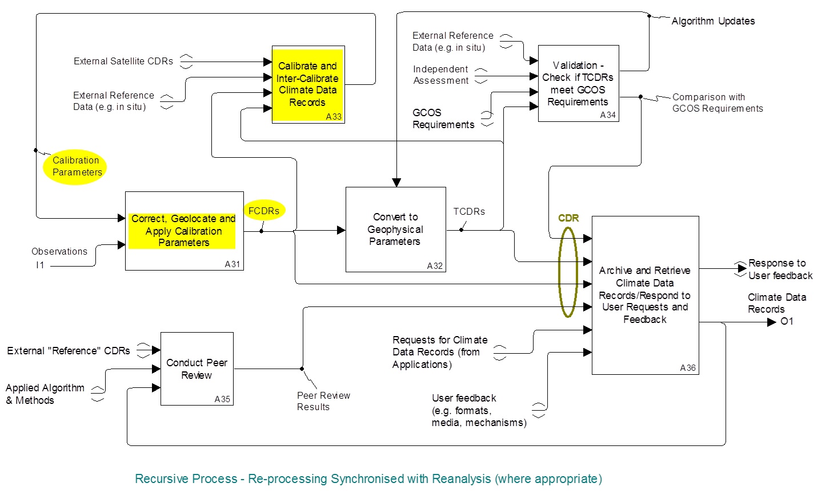
Strategy towards an Architecture for Climate Monitoring from Space Decomposition of "Create and Maintain Long-term Climate Data Records

Slide 11
5. Renaming GSICS ?
The term Inter-calibration (or Cross-calibration) is regularly questioned since it is not used in the VIM
Involves 2 steps:
Comparison with a measurement reference instrument
Calibration adjustment taking into account this comparison
Could be simply named «Calibration»: the operation that (i) establishes a relation between a quantity value and an indication and (ii) uses this relation to determine a measurement result from an indication
Without changing the acronym, could GSICS be renamed: «Global Space-based Inter-comparison and Calibration System»? Or «Global Satellite Instrument Calibration System» ? Or «Global Inter-Satellite Instrument Calibration System» ?

Slide 12
Conclusions: proposed actions
To disseminate of GSICS-corrected calibration with Level 1 data
To describe GSICS in the future WIGOS Architecture Document
To describe the use of GSICS in a chapter of future Guide to WIGOS
To define realistic requirements for in-orbit measurement reference standards for the Vision of WIGOS/space in 2040 (CLARREO-type)
To document key processes within the Calibration function of the Climate Architecture
To rename GSICS «Global Space-based Inter-comparison and Calibration System» or «Global Satellite Instrument Calibration System»

Slide 13
Thank you for your attention! Please visit: www.wmo.int/oscar Your feedback is welcome jlafeuille@wmo.int
www.wmo.int

Slide 14
VIM definitions
CALIBRATION: Operation that, under specified conditions, in a first step, establishes a relation between the quantity values with measurement uncertainties provided by measurement standards and corresponding indications with associated measurement uncertainties and, in a second step, uses this information to establish a relation for obtaining a measurement result from an indication.
NOTE 2 Calibration should not be confused with adjustment of a measuring system, often mistakenly called “self-calibration”, nor with verification of calibration.
adjustment of a measuring system : adjustment set of operations carried out on a measuring system so that it provides prescribed indications corresponding to given values of a quantity to be measured
NOTE 1 Types of adjustment of a measuring system include zero adjustment of a measuring system, offset adjustment, and span adjustment (sometimes called gain adjustment).
NOTE 2 Adjustment of a measuring system should not be confused with calibration, which is a prerequisite for adjustment.

