Slide 1
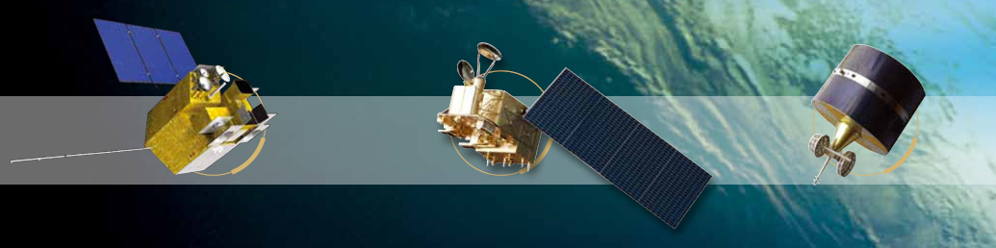

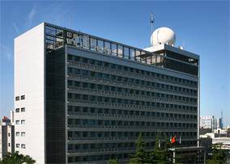
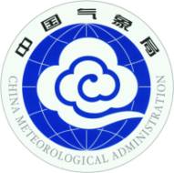

SI-traceable demo instrument for FY-3
Lunar and Earth Spectral Imager Radiometry Benchmark (LeSIRB)
2015 GSICS Annual Meeting , Deli India
March 16~20, 2015
Xiuqing Hu
National Satellite Meteorological Center, CMA
Yupeng Wang, Wei Fang
Changchun Institute of Optics, Fine Mechanics and Physics (CIOMP), Chinese Academy of Sciences (CAS)

Slide 2
outline
Background
LeSIRB and Key elements
Radiometric transfer chain
Accuracy budget
Summary

Slide 3
Background and Requirement
A high absolute accuracy ‘SI traceable’ measurement of the state of the climate : A trustable snapshot against which to unequivocally monitor future change Not just instrument characteristics but also sampling – space & time. (From Nigel Fox)
Improving the in-flight solar band calibration accuracy is the most important problem which is being faced by Chinese earth observation satellites which are lack of high accurate onboard calibration.
The similar concept of TRUTH and CLARREO is accepted by Chinese satellite programmer and remote sensing scientist. But the technique of the sensor development has a big challenge and the demo instrument design is being planned in China recently.
GRWG_14.39: CMA to investigate hosting a joint GSICS/CEOS-IVOS workshop to promote SI traceable measurements in orbit.

Slide 4
Current and Future FY-3 Series
Designing lifetime: 3 yrs 5 yrs 8 yrs
FY-3(3rd batch)
FY-3G
FY-3R
FY-3F
FY-3(2nd batch)
FY-3E
FY-3D
FY-3(1st batch)
FY-3C
FY-3B
FY-3A
2008 2010 2012 2014 2016 2018 2020 2022 2024
FY-1C/1D
AM
PM
EM
Rainfall
CMA hopes to develop a SI-traceable demo instrument for FY-3 in the 3rd batch. The possibility of this plan is being discussed between us and satellite manufacture

Slide 5
LeSIRB-Lunar and Earth Spectral Imager Radiometry Benchmark
Establish space-borne SI-traceable radiance benchmark and its transfer system to spectral imager for measurement of terrestrial
High accuracy inter-calibration based on the traceable terrestrial and lunar imaging spectral measurement
Spectral range | 350-1000 nm
Spectral resolution | 2 nm
Wavelength calibration accuracy | 0.5 nm
Swath width | 50 km
Ground spatial resolution | 100 m (nadir)
Radiometric calibration accuracy | 1~2%
stability | 0.1%/year
SNR | >600

Slide 6
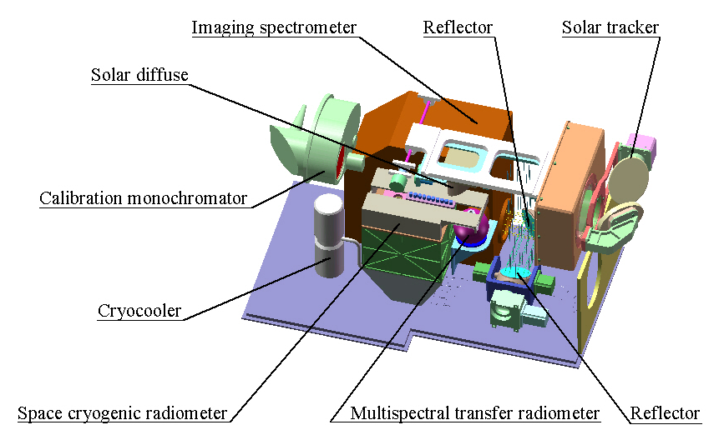
Key elements
Dimension: 890mm×500mm×585mm；
Mass：78kg
Peak power：135W

Slide 7
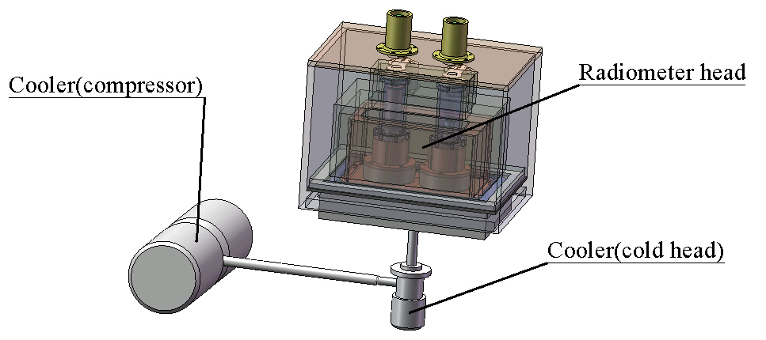
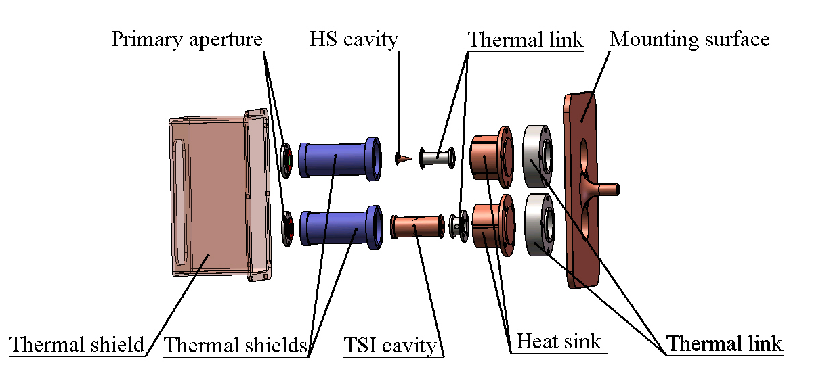
Space Cryogenic Radiometer
SCR：radiometric benchmark
SCR is an electrical substitution radiometer operating at ~80K
1-TSI cavity
1-High sensitivity cavity

Slide 8
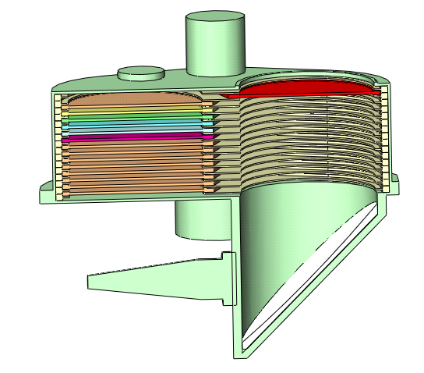
Calibrate Monochrometer
CM is a narrow bandpass filter monochrometer with optical fiber output
channels | 10
Blocking Range | 0.01%
Spectral Range (nm) | 350-1000
Spectral resolution (nm) | 3
Center wavelength (nm) | 350, 390,430,460,480,520,600,700,850,1000

Slide 9
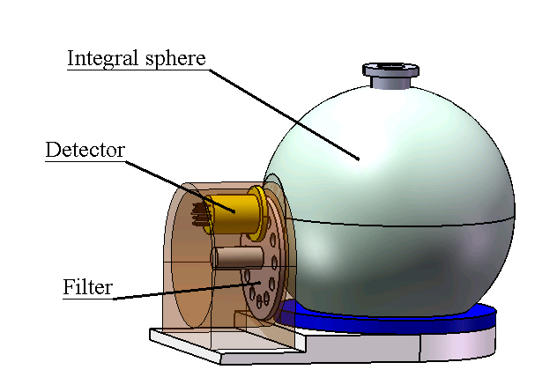

MultiSpectral Transfer Radiometer
MSTR is a transfer detector composed by a integral sphere and a filter radiometer
Measure the radiance and irradiance for radiance calibration
Limiting Aperture
Integral Sphere
Filter radiometer

Slide 10
Spectral Imager
SI consists a telescope and a grating spectrograph
Terrestrial and lunar observation
Traceabled to the SCR benchmark
Primary Mirror
Third Mirror
Secondary Mirror
Orbital Altitude | 800 km
Breadth | 50 km
Ground resolution | 100 m at nadir
Spectral range | 350-1000 nm
Spectral resolution | 2 nm
SNR | ≥ 600
Slit
Collimator
Grating
Imaging Mirror
Detector

Slide 11

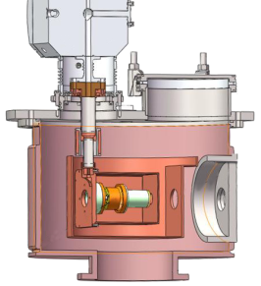
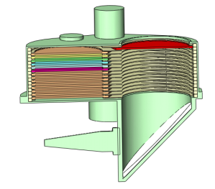
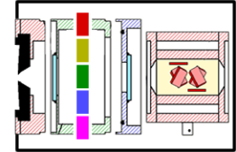


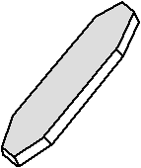
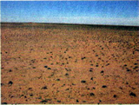
Radiometric transfer Chain
Space Cryogenic Radiometer）
SUN
Traceability
SI
Calibration Monochrometer
monochromatic light
MultiSpectral Transfer Radiometer
Other remote sensor
Spectral imager
Solar Diffusor
Terrestrial and lunar target

Slide 12
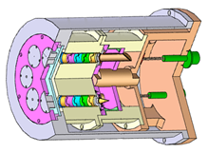
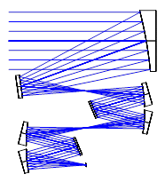
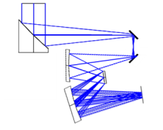

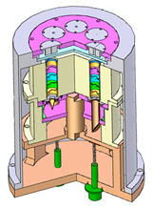

Calibration Steps
Solar tracker mirror 1
Solar tracker mirror 2
Solar diffuser
Step 1: Calibrate the monochromatic light by Cryogenic Radiometer
Step 2：Calibrate the MultiSpectral Transfer Radiometer using the calibrated monochromatic light
fabric
MSTR
Spectral imager
Cryogenic
monochrometer
Solar tracker mirror 1
Solar tracker mirror 2
moving
Solar diffuser
Fabric
MSTR
Spectral imager
monochrometer

Slide 13

Calibration Steps
Solar tracker mirror 1
Solar tracker mirror 2
Reflector
moving
Solar diffuser
Step 3：Calibrate Solar diffuser using MultiSpectral Transfer Radiometer
Step 4：Calibrate the spectral imager using Solar diffuser
MSTR
Spectral imager
Solar tracker mirror 1
Solar tracker mirror 2
Reflector
moving
Solar diffuser
Spectral imager

Slide 14
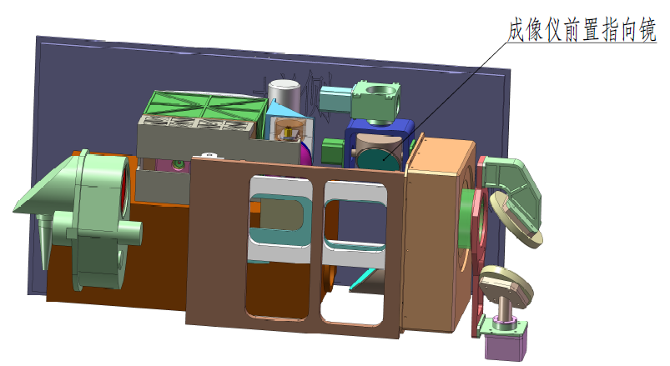
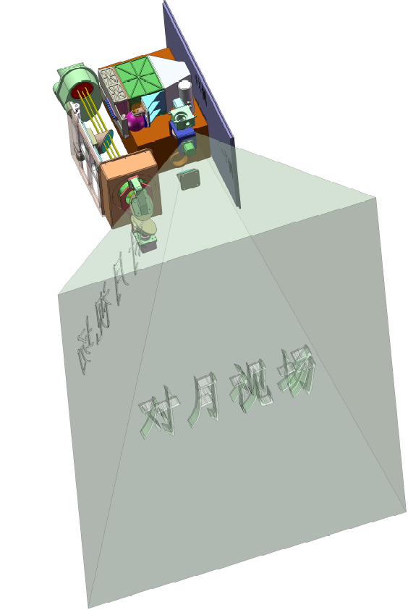
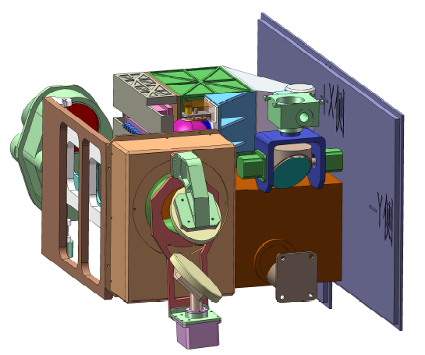
Moon observation
对月观测
Moon observation
Notes:
14

Slide 15
Accuracy Budget

Slide 16
Summary
This LeSIRB is the demon instrument for establishing space-borne radiometric benchmark for FY-3 or other Chinese polar-orbiting satellites.
First step is just for verifying the the concept and possibility of establishing space-borne radiometric benchmark , similar as TRUTH and CLARREO.
This plan is also to test our technique maturity , especially space-borne Cryogenic Radiometer and its radiometric standard transfer chain.

