Slide 1
CALIBRATION APPRACH FOR INSAT-3D SATELLTIE
: FIRST JOINT CAMPAIGN IN JAISALMER, RAJASTHAN
A. K Mitra, A.K Sharma and Shailesh Parihar
Ministry of Earth Sciences
India Meteorological Department
New Delhi-INDIA
16-20 March 2015

Slide 2
Overview
Vicarious calibration methods are one approach that has been used successfully for the absolute radiometric calibration.
One of these vicarious calibration methods is the reflectance-based approach that is applied here for radiometric calibration of sensors onboard for geostationary satellite INSAT-3D.
A joint campaign for radiometric calibration of optical sensor of INSAT-3D in the year 2013 has been made for a suitable site of atleast 5 km x 5 km area of time invariant and uniform reflectance over Thar Desert (desert sand), Jaisalmer in the state of Rajasthan.
The initial field campaigns were made at the site and in-situ measurements were carried out to check the suitability of selected Calibration/Validation (Cal/Val) site.

Slide 3
Test carried out with hyper-spectral Spectroradiometer covering spectral range of 350nm-2500nm and Sun photometer / Ozonometer for measuring the atmospheric parameters in the region for radiometric characterization of site.
The spectral signature and top of the atmosphere (TOA) radiance were computed using radiative transfer model 6S (Second Simulation of the Satellite Signal in the Solar Spectrum). The computed 6S TOA radiances then compared with the INSAT-3D measured radiances.

Slide 4
Major Tasks to performed…
Radiometric calibration quality of INSAT-3D Imager data
Sensor Performance, Ground Processing and Calibration
Radiometric Accuracy & Consistency
Data Products used for weather and climate applications

Slide 5
Payloads
INSAT-3D has the following payloads on board the spacecraft:
Six channel imager
Nineteen channel sounder
Data Relay Transponder(DRT)
Satellite Aided Search and Rescue (SAS & R) System
Visible (1 Km resolution) & Infra-red telescopes are the principle instruments on board the remote sensing satellites.
These instruments need to be calibrated frequently, so that physically meaningful results can be obtained.

Slide 6
The Purpose of the Presentation
Effort to produce consistent, well-calibrated data from the calibration of INSAT-3D
Emphasis on systematic calibration/Validation on INSAT-3D Imager products
Improve the vicarious calibration method through Radiative Transfer Model
Establish best suited ground site for vicarious calibration method

Slide 7
Justification for having a CAL/VAL site
Post-launch calibration and characterization of meteorological satellite sensors is a keenly felt need in most applications of satellite data for climate research which requires very high accuracies which can only be assured if the calibration of the instruments on board different satellites is accurately known and maintained.
Since the visible sensor on INSAT-3D has no onboard calibration device, it is necessary to develop post-launch calibration coefficients (or slopes) which take into account the in-orbit degradation of the sensor so that the derived products are rendered accurate. A Cal/Val site therefore needs to be established and maintained

Slide 8
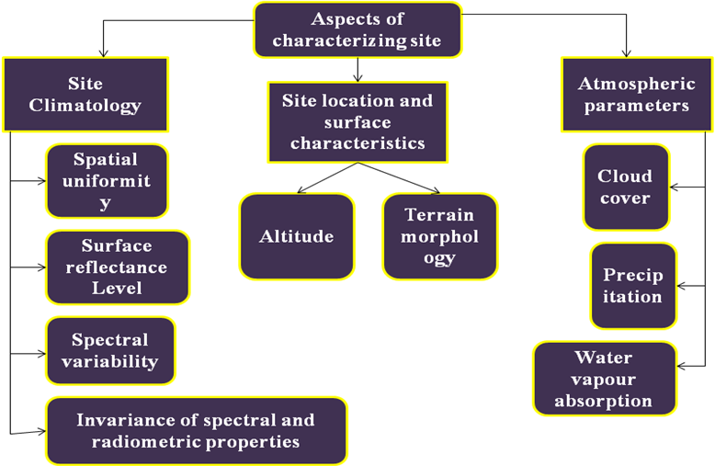
Site selection criteria
In order to calibrate and validate low and mid resolution optical sensors using vicarious calibration first is the need of finding a suitable test site where regular ground campaigns can be made. So, for this purpose we proposed to establish a land based Cal/Val site for INSAT-3D satellite for Visible and SWIR channel over Jaisalmer, Rajasthan, India

Slide 9
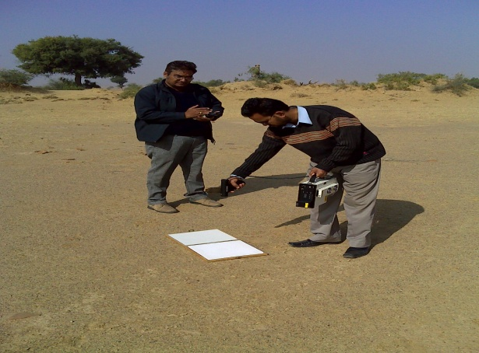
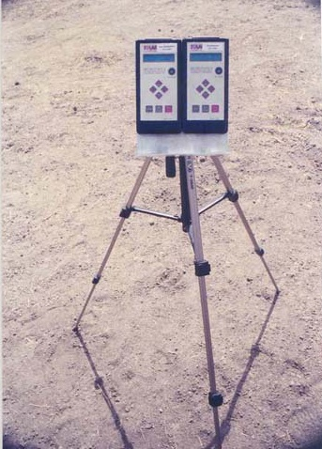
Reflectance Based Approach

Slide 10
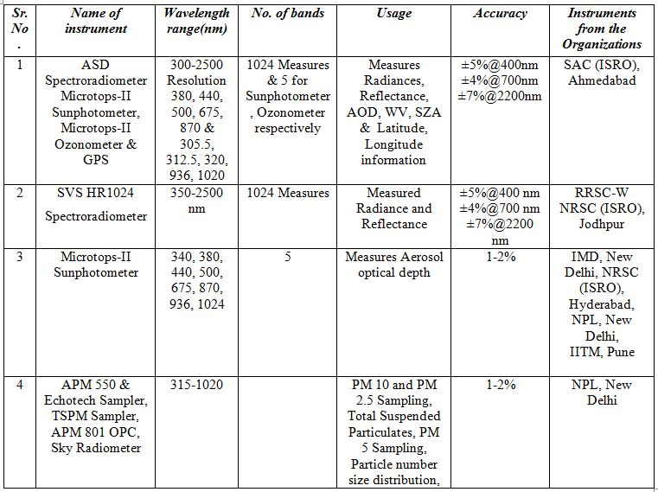
Field Campagin

Slide 11
Second Simulation of the Satellite Signal in the Solar Spectrum (6S)
6S model which can accurately simulate the problems introduced by the presence of the atmosphere along the path from Sun to Target (surface) to Senor.
It can be said with the different comparison and validation exercises that 6S complies well with the standard RT model accuracy requirement of calculations within 1% [Vermote & Kotchenova, 2008].

Slide 12
Ground Measure Data
In-situ data collected and analysis
Wavelength range of Spectroradiometer
Meteorological Parameters (AOT, OZONE, WV)
Wind Direction
Ground reflectance data with INSAT-3D albedo comparison
Combined plot of ground reflectance and removed wild points from 17-21, Dec 2013
Ground measured reflectance averaged over pixel area (Five Pixels are considered)
Sensor Measured (INSAT-3D) and TOA Radiance along with dates
Combined plot of TOA radiance for SAC, Ahmedabad and RRSC-W NRSC (ISRO), Jodhpur and INSAT-3D radiance
6S TOA Radiance and INSAT-3D Radiance

Slide 13
Measurements'

Slide 15
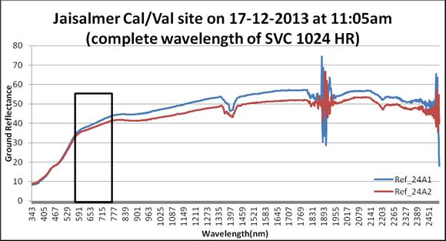
Wavelength range of Spectroradiometer

Slide 16
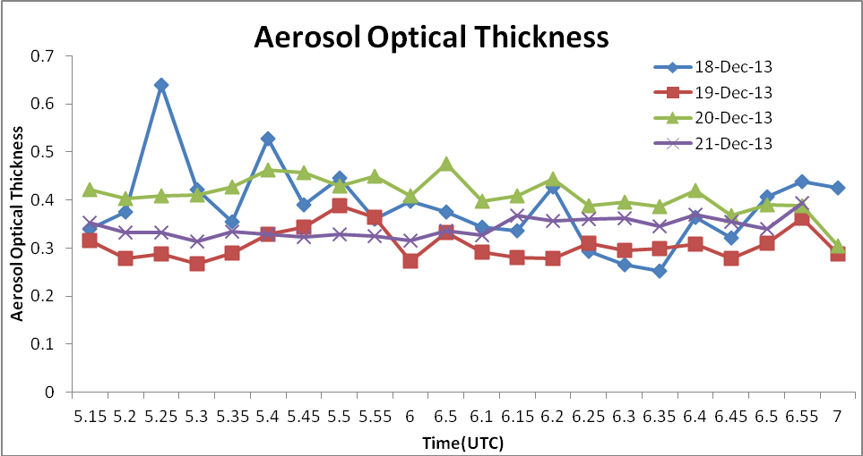
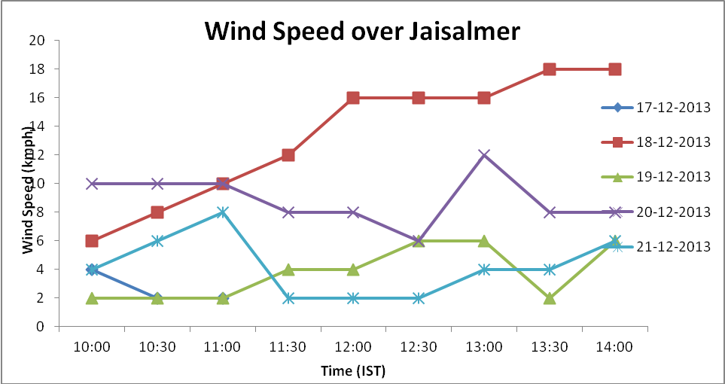
Meteorological Parameters

Slide 17
In-situ ground reflectance

Slide 18
Sensor Measured (INSAT-3D) and 6S Computed TOA Radiance
Negative correlation has been observed between 6s simulated radiance and INSAT-3D measured radiance

Slide 19
Conclusion
High variation in reflectance and less statistical correlation agreement do not satisfy the condition of “Radiometrically uniform calibration site” in its present condition.
It was jointly suggested by the Cal/Val team to search some other suitable site for INSAT-3D Cal/Val.

Slide 20
Proposals
Pros:
The on-board calibration provided us accuracy of data products. It is beneficial for climate studies and re-analysis of NWP models.
Cons:
The magnitude and impact of climate change are not, at present, clearly defined. We do not presently observe Earth’s climate system with sufficient accuracy to establish a climate record that is tested and trusted, nor are climate observations in place that can adequately constrain climate model predictions.
Poor understanding of the optical properties and spatial distribution of atmospheric aerosols and other variable components necessary for tying ground-based measurements to satellite measurements.
For in-situ Cal/Val, need for standardized ways of procedures and combining data from different sources to ensure interoperability and promotes the international exchange of technical information and documentation, joint experiments, and the sharing of facilities, expertise, and resources..

Slide 21
Collaborative activities between the world’s major space agencies in the area of climate monitoring with the overarching goal to improve the systematic availability of Climate Data Records through the coordinated implementation and further development of a global architecture for climate monitoring from space.
Identify test sites and encourage continuing observations and intercomparison of data from these sites.
REFERENCE
CALIBRATION/VALIDATION OF INSAT-3D SATELLITE: FIRST JOINT CAMPAIGN IN JAISALMER DURING 14-23, DECEMBER 2013
Meteorological Monograph No. ESSO/IMD/SATMET/01/2014/07 (2014)

Slide 22
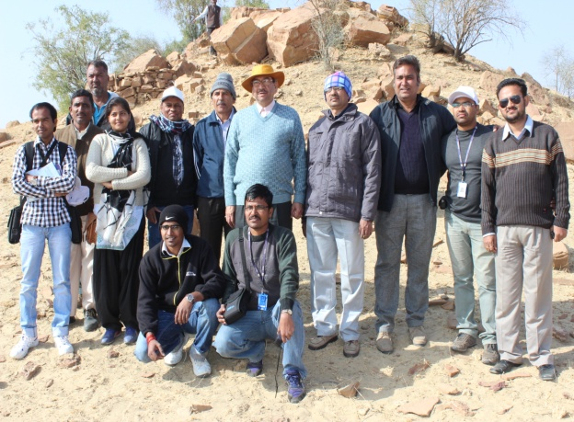
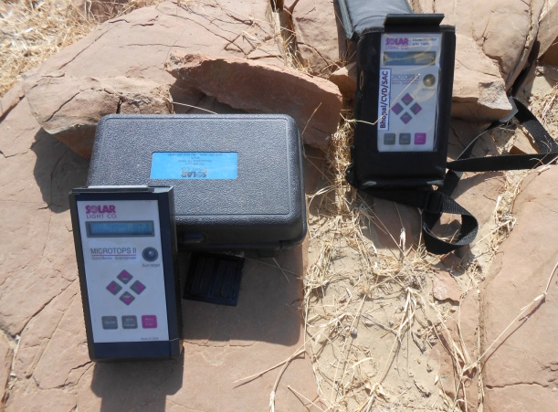
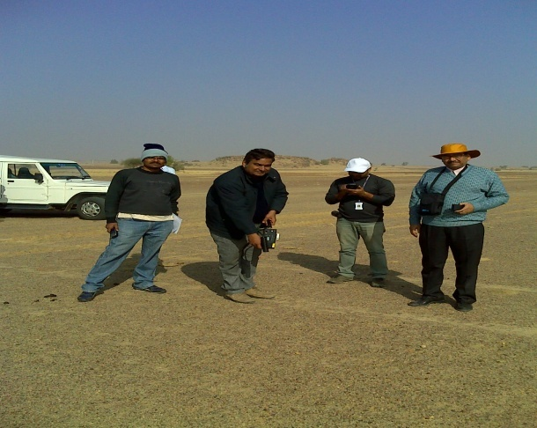
Thank You

