Slide 1
ARCSTONE Mission:
Accurate Lunar Spectral Irradiance Calibration
Concept Lead: Constantine Lukashin (NASA LaRC)
Concept Team:
NASA LaRC: R. Baize, J. Leckey, N. Miller, M. Vanek
NASA STMD: S. Horan
NASA GSFC: K. Thome and J. McCorkel
NIST: K. Lykke, S. Brown, J. Woodward
USGS: T. Stone
Notes:
J. Leckey is PM of the concept; N. Miller (lead of engineering Lab77, LaRC small sat lab); M. Vanek is instrument expert; Steve Horan is one of the PI’s at Space Tech Mission Directorate; all NIST group are instrument calibration, and NIST Lunar Cal lab at the Mauna Loa, Hawaii
(they will do start measurements in 2015).

Slide 2
ARCSTONE – Accurate Lunar Irradiance:
Need and Importance
Problem Statement:
Science missions in LEO and GEO need reliable calibration methods that can be used
across Earth Observing System to provide traceability to absolute standards and inter-mission
calibration with high accuracy.
Ohring et al., 2005: “Satellite Instrument Calibration for Measuring Global Climate
Change,” BAMS, pp. 1303 – 1313. This Workshop provided guidance for accuracy for
All key weather and climate parameters (most of them are not currenty met) .
NRC Decadal Survey 2007 followed with multiple recommendations for NASA and NOAA:
High accuracy observation from TSIS, CERES/RBI, and CLARREO.
Enable long-term stable data records for key variable (minimize gap risk).
Accuracy is the foundation stone for measurement usefulness (information content) !
Solutions:
Establish an accurate calibration source available on LEO and GEO missions –
the high accuracy Lunar Irradiance/Reflectance (constant in time).
Demonstrate the high accuracy Lunar Irradiance calibration in on-orbit
environment using a Small Satellite mission implementation.
Impact: This becomes an enabling technology for the past, current and future
Earth Science missions in LEO and GEO (processes, weather and climate).

Slide 3
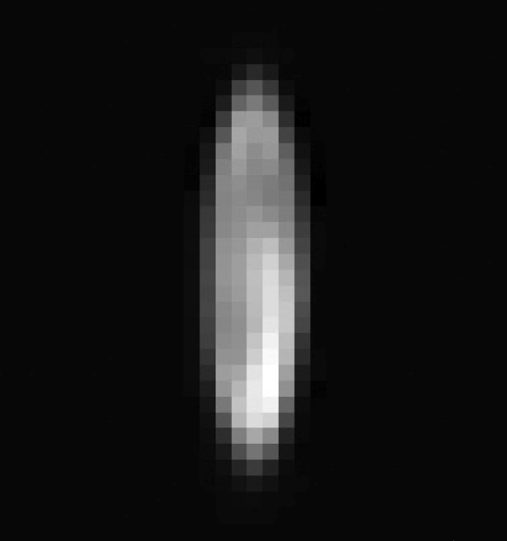
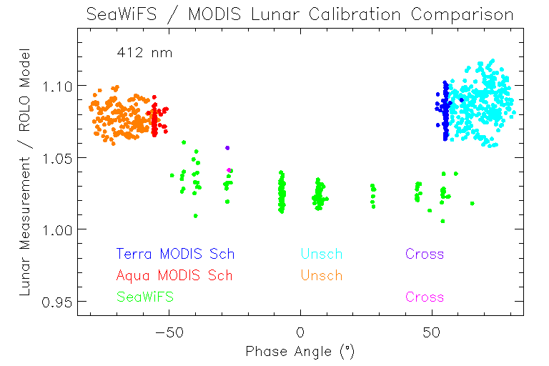
Lunar Calibration On-Orbit:
State of the Art - SeaWIFS Example 1
SeaWiFS gain stability 0.13% (k=1) achieved with Lunar calibration monthly !
Absolute biases up to 3% (k=1)
SeaWIFS and MODIS lunar calibration comparison, at 412 nm wavelength:
Lunar image by SeaWIFS
SeaWIFS scatter due to oversampling corrections.
MODIS scatter due to lower lunar signal at higher lunar phase angle.
Needed: Absolutely accurate irradiance for all lunar phase and libration states !
Notes:
ROLO model is darker then SeaWifs by 3%
ROLO model is darker than MODIS by 8%

Slide 4
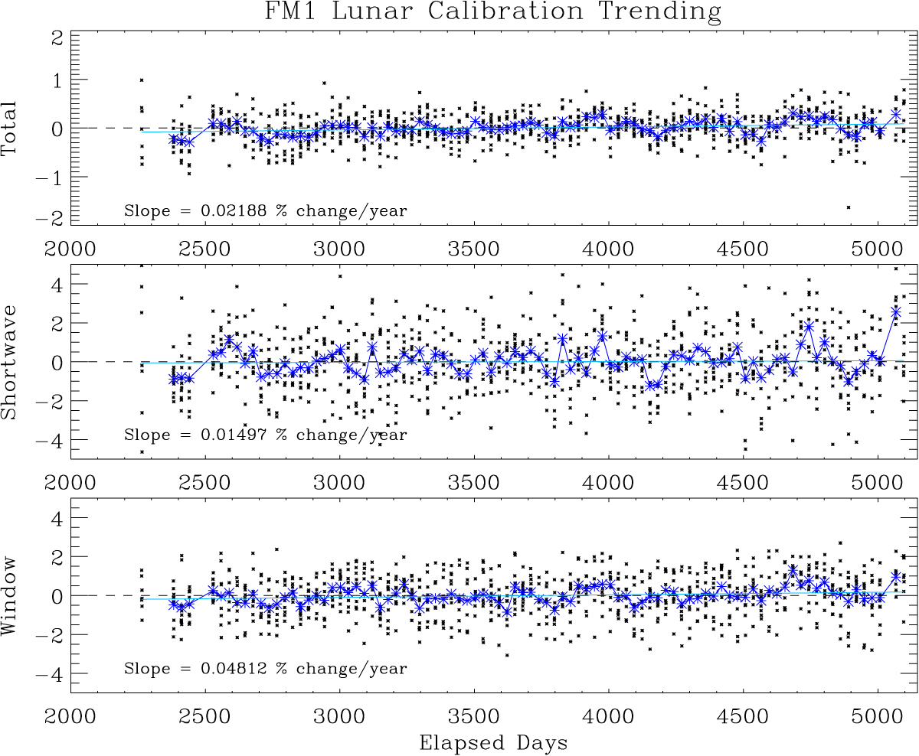
Lunar Calibration On-Orbit:
State of the Art: CERES Example 2
CERES gain stability from Lunar Observations,
Broadband [Daniels et al., 2014]:
 | Total | Shortwave | Window
FM1 | 0.219% / decade | 0.150% / decade | 0.481% / decade
CERES SW channel gain stability 0.15% per decade demonstrated with Lunar calibration monthly !
Potential impact on future CERES operations and calibration approach !
Needed: Absolutely accurate irradiance for all lunar phase and libration states !
Notes:
This is not part of CERES ATBD, this is just a check for the primary approach, validation;

Slide 5
Lunar Calibration On-Orbit:
Effect of Libration
From Lorentz et al., LUSI Concept, 2009
Effect of Libration on Lunar Irradiance: 2% variation in amplitude
Threshold requirement for covering lunar libration space:
measurements over approximately 3 years time period of daily sampling !
Notes:
3 years is half a cycle 1000 days

Slide 6
ARCSTONE Mission: Concept
Concept of Operations and Data Products:
Data to collect: Lunar and Solar spectral irradiance (every 24 hours at least).
Collection within 10 min each day to achieve combined accuracy < 1% (k=2).
Spectrometer with single field-of-view about 1º (no scanning !).
Preferred orbit – 90º inclination polar (best sampling).
Spectral range from 800 nm (350 nm trade space?) to 2300 nm, spectral sampling 4 nm.
Note: NIST plans to do VIS measurements from Mauna Loa starting in 2015.
Data Products:
After 1 year: Improvement of current Lunar Calibration Model (factor > 2);
After 3 years: New Lunar Irradiance Model, improved accuracy level (factor > 6).
Longer time: More Lunar geometries covered – better model reliability.
Key Technologies to Enable the Concept:
Approach to orbital calibration via referencing Sun using precision aperture (pin hole):
Demonstration of lunar and solar measurements with the same detector and without
filters or specific optics that can degrade on orbit.
Pointing ability (precision & accuracy) of small spacecraft now permits obtaining
required measurements.
A standard small satellite bus can now accommodate mission needs.
Notes:
Full spectra can be too costly from Small Sat mission;
Mona Loa telescope to measure the shorter wavelengths
Aperture method does not degrade over time as the solar diffuser would;
Pointing about 0.1 deg in accuracy + precision (combined) is ok for current small sats;

Slide 7
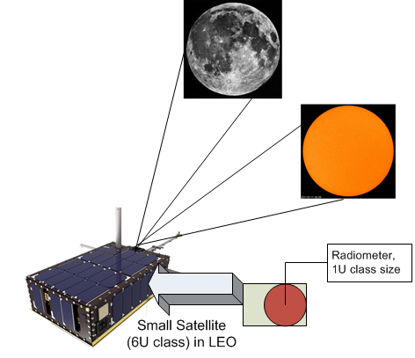
ARCSTONE Mission: Calibration of Lunar Irradiance
Lunar
Observations
Solar
Observations
Concept of Operations:
Spectrometer w/ single FOV on small satellite;
Preferred orbit: polar 90º inclination;
Lunar observations daily, < 10 min;
Solar observation daily, < 10 min;
Duty cycle is very low (power efficiency);
Rigorous approach to sensor ground calibration;
New approach to sensor calibration on-orbit;
Pointing operations by small satellite bus.
Concept of ARCSTONE Implementation
Proposed Technical Approach:
Enable accurate LEO and GEO sensor calibration;
Lunar spectral irradiance measurements;
Solar spectral irradiance measurements;
Combined accuracy in reflectance < 1% (k=2);
Spectral range from 800 (350 nm ?) nm to 2300 nm;
Spectral sampling 4 nm;
New high accuracy Lunar Irradiance/Reflectance
Model.
ROM Cost and Schedule:
ROM Cost < $15M;
3 years of preparation (2 ?), and from 1 to 3 years in-orbit.
Deliverables:
- Accurate Lunar Irradiance/Reflectance Calibration Model.
Proposal Team:
NASA LaRC (Project, Sensor/Bus Integration, Operations);
Instrument (spectrometer): TBD, RFI is online.
NASA GSFC (instrument ground/orbit calibration);
NIST (instrument ground calibration);
USGS (building new Lunar Irradiance Model).
Impacts:
SM&P: potential cost saving for NASA missions;
Improve quality of data products (weather, climate);
Enable Earth climate climate change observations;
Notes:
SM&P: size, mass, and power – small and more efficient calibration system/ less hardware;
RFI – Request For Information

Slide 8
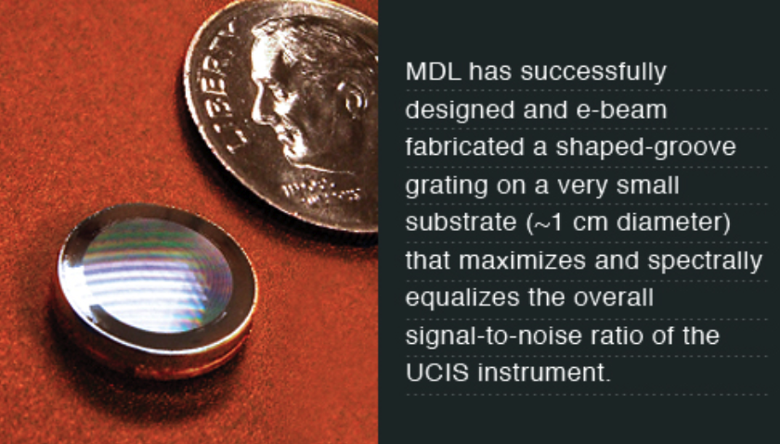
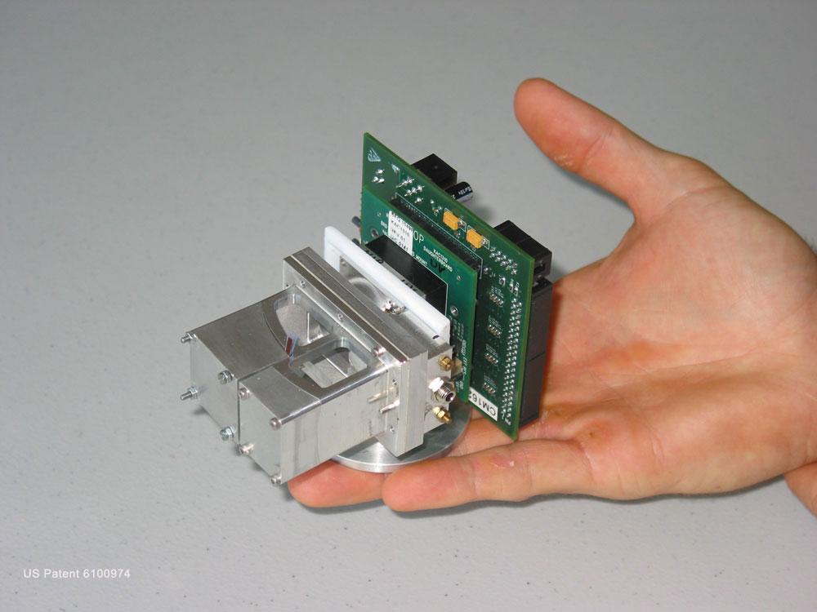
ARCSTONE Mission:
Examples of Compact Imaging Spectrometers
The success of JPL’s Moon Mineralogy Mapper (M3) imaging spectrometer for deriving solar-illuminated mineralogical properties has driven interest in miniaturizing such a system for in situ use on other solar system bodies. JPL’s Ultra-Compact Imaging Spectrometer (UCIS) is a highly miniaturized M3-like Offner pushbroom spectrometer suitable for a Mars-like rover where it could be mounted on the rover mast for determining the mineralogy of the surrounding terrain and guiding the rover towards closer examination of scientifically important targets. MDL has successfully designed and e-beam fabricated a shaped-groove grating on a very small substrate (~1 cm diameter) that maximizes and spectrally equalizes the overall signal-to-noise ratio of the UCIS instrument. Ultimately, UCIS will achieve a mast-mounted total mass of 1.5 kg, with some additional electronics potentially located on the rover body, enabling high-resolution imaging spectroscopy from a rover platform.
SPILAB manufactured a palm sized Offner imaging spectrometer.
The convex diffraction grating was manufactured by QUDOS Tech
using electron beam milling.
ARCSTOME mission concept requires even simpler instrument:
A spectrometer with single field-of-view !

Slide 9
ARCSTONE Mission:
Instrument Calibration & Characterization
Leverage CLARREO RS calibration approach:
SOLARIS Calibration Demonstration System (GSFC)
CLARREO RS Calibration Approach:
From CLARREO SDT Report, October 2014.
A. Component-level testing using NIST Standards.
Instrument level calibration and characterization
will validate the uncertainty goals.
Other Important Characterizations Scatter within
instrument:
- Size-of-source effect;
- Spectrometer out-of-band signal;
- Linearity of response and Spatial uniformity;
- Sensitivity to polarization of incoming light.
SIRCUS facility at NIST provides a tunable laser
source from 300 nm to 2500 nm.
The basis of SIRCUS is a well-understood tunable laser source that can be coupled to a fiber optic system providing
both radiance and irradiance sources. The output of the source is determined via detector standards characterized
against the Primary Optical Watt Radiometer (POWR). The accuracy of such a radiance-based calibration has been
demonstrated in NIST facilities to an expected accuracy of 0.2% for k=3.

Slide 10
ARCSTONE Mission:
Instrument Calibration on-Orbit
Leverage CLARREO RS calibration approach:
SOLARIS Calibration Demonstration System (GSFC)
CLARREO RS Calibration Approach:
From CLARREO SDT Report, October 2014.
Ensuring SI-traceability and adequate accuracy
requires evaluation of sensor performance on-orbit
and a traceable error budget. The basis of the sensor
traceability is via a high- fidelity sensor model
developed from prelaunch characterization data
coupled with on-orbit absolute solar irradiance
measurements to show the sensor did not change
going to orbit.
Disagreement between reported solar irradiance and predicted values mean that the sensor model requires modification. Stellar views provide information regarding the optical quality of the sensor. Temporal changes in the sensor are evaluated using these techniques as well. The sensor model can
be thought of as the numerical abstraction of the physical instrument, encapsulating knowledge of
both optical physics and empirical results gained from laboratory analysis. Disparities between laboratory results and model predictions guide model improvements.

Slide 11
ARCSTONE Mission:
Project Success Criteria
Key Performance Parameters (KPP) | State of the Art (SOA) | Threshold Value | Goal Value
Accuracy | 3% (k=1) | 1.5% (k=1) | 0.5% (k=1)
Stability | 0.13% (k=1) per decade | 0.1% (k=1) per decade | 0.1% (k=1) per decade
Orbit | Surface | ISS / Sun-synch orbit | 90º inclination polar
Time on-Orbit | None | 1 year | 3 years
Instrument pointing | None | 0.2º combined | 0.1º combined
Spectral Range |  | 800 nm – 2200 nm | 350 nm – 2300 nm
Spectral Sampling | Multi-Spectral | 8 nm | 4 nm
* To be expanded to all key mission parameters.

Slide 12
ARCSTONE Mission:
Summary
  (1) What is needed from the mission ?
  Accurate SI-traceable calibration source on-orbit for past, current and future
  Earth Science missions in LEO and GEO.
  (2) What can we do ?
  ARCSTONE mission shall obtain the accurate Lunar spectral irradiance to enable
  reference calibration of weather and climate operational sensors in the reflected
  solar wavelength range. NASA RFI for a compact instrument is online:
  https://prod.nais.nasa.gov/cgibin/eps/synopsis.cgi?acqid=164358
  (3) Who will care ?
  - NASA Missions: SeaWIFS, MODIS, CERES, RBI, CLARREO, PACE, ACE;
  - NOAA Missions: VIIRS, GOES-R ABI;
  - International Space Agencies: ESA, EUMETSAT, etc., LEO and GEO imagers;
  - GSICS Lunar Calibration community.
  (4) What we need from the GSICS ?
  We need formal support from GSICS and from GSICS Lunar Calibration community.
Notes:
Get Jerome to write an official letter, when submitting proposal

